Slide 1
The U.S. ATLAS Facility and Agile Infrastructure
Michael Ernst, BNL
US ATLAS Distributed Facilities Meeting, University of Arizona
December 11, 2013

Slide 2
LHC Long Shutdown 1 (LS1)
We’re about halfway through LS1…
2013
2014
2015
F
M
A
M
J
J
A
S
O
N
D
J
F
M
A
M
J
J
A
S
O
N
D
J
F
M
A
LHC
SPS
PS
PS Booster
beam to beam
available for works
Physics
Beam commissioning
Shutdown
Powering tests
… beam still foreseen for January 2015 (physics in ~April)

Slide 3
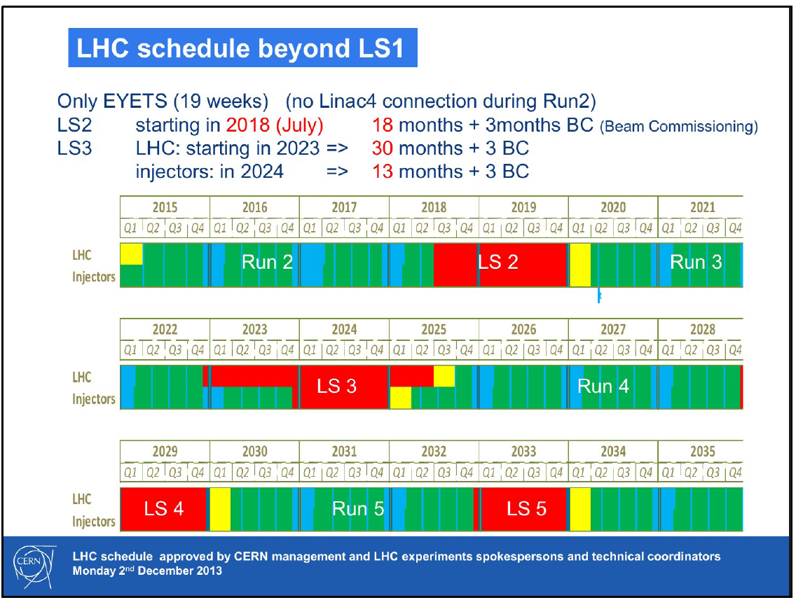

Slide 4
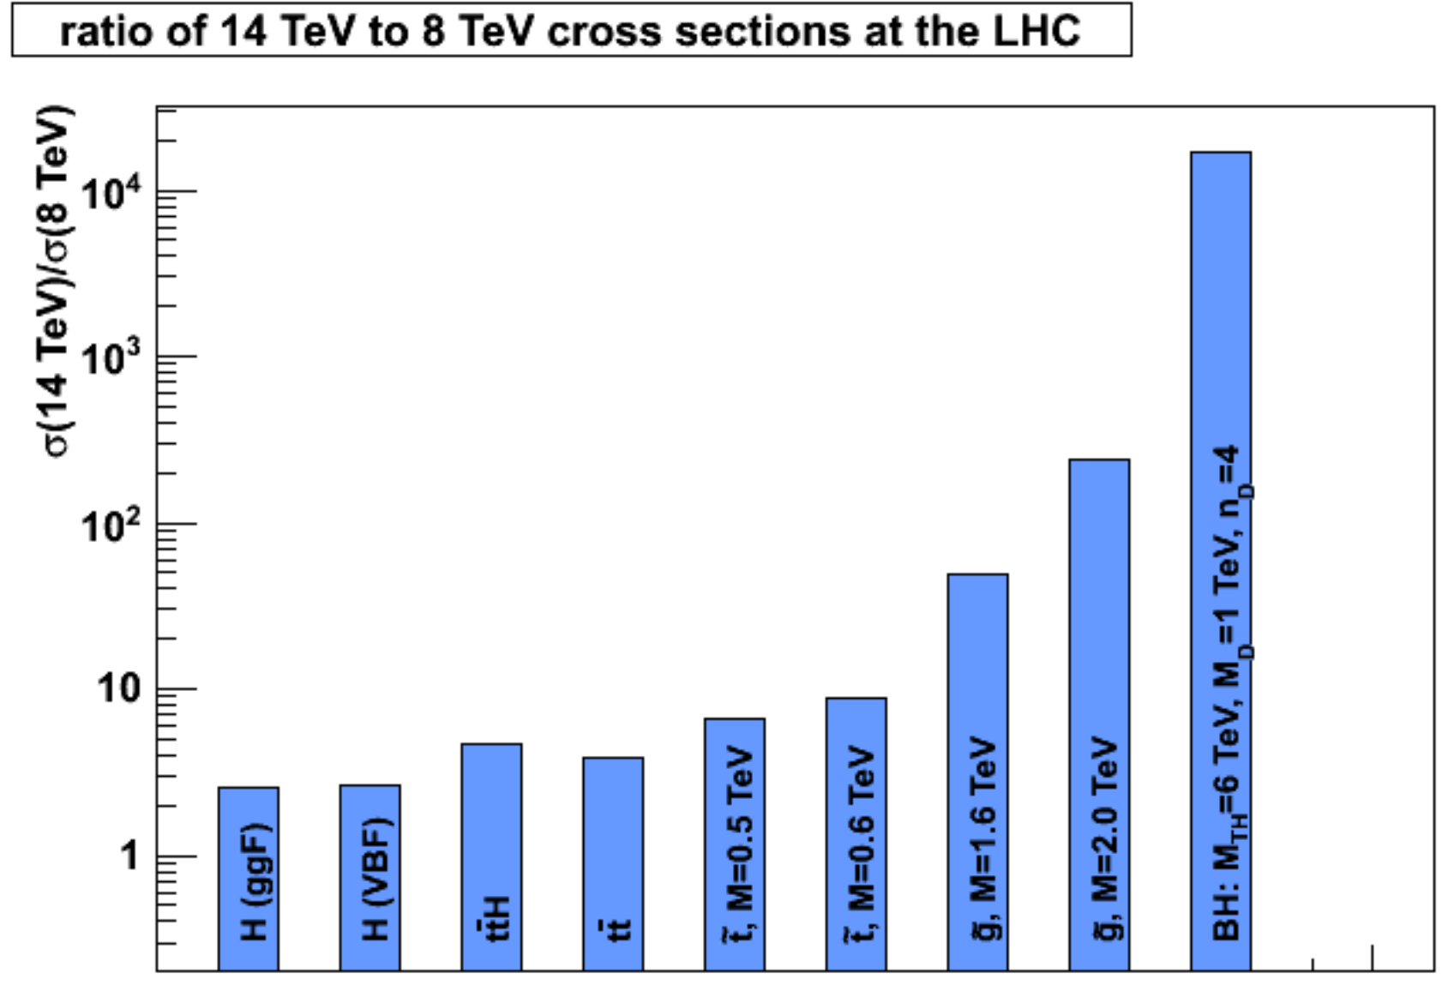
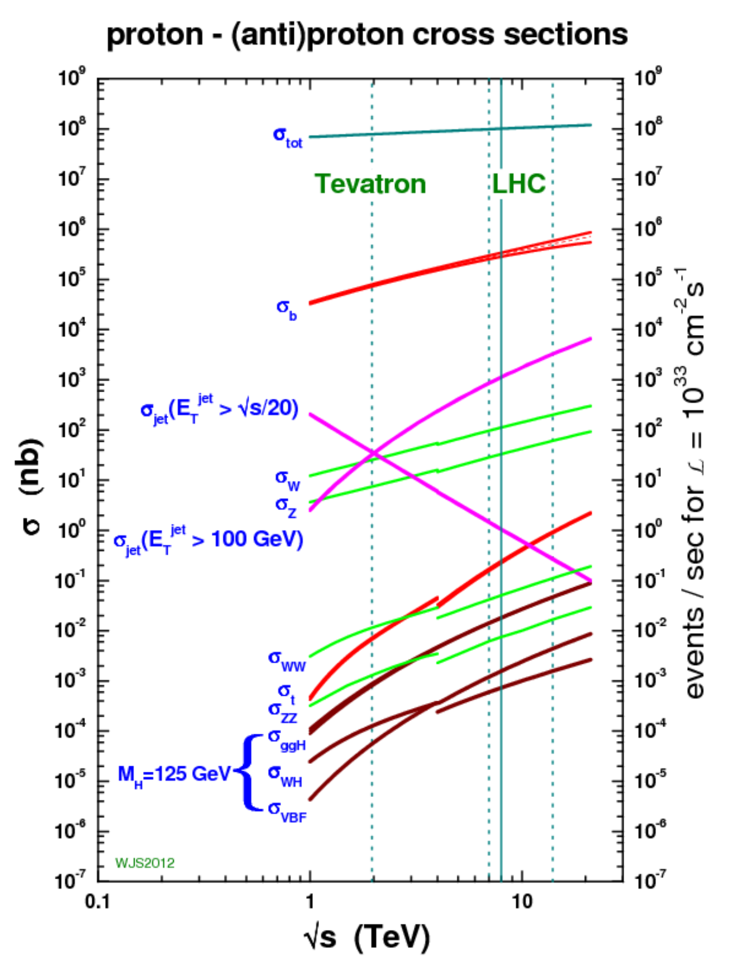
LHC Run 2
2015 is a whole new energy domain
  Every measurement is new
  Every search has a new chance
Early Run-2 data has discovery potential
  With a few fb⁻¹ many searches reach or surpass current sensitivity
  Discovery of TeV scale particles possible
Center of mass energy ~2x
Event rate to storage ~2x, pile-up above 30, 25 ns bunch spacing
Foreseen computing capacity increment much less than extrapolation from 2013 practice would suggest

Slide 5
LS1 S&C Upgrades
ATLAS S&C following an evolutionary plan towards Run-2
A sizable, complex and challenging task
  Tight budgets – maximize event throughput per unit cost
  Computing requirements grow substantially
  Computing model evolution leveraging powerful networks will continue, putting new demands on facilities and fabric, e.g.
    Federated Data Stores w/ direct access across the WAN
    Potential to (transparently) integrate user analysis stations with resources & capabilities at Tier2s and the Tier-1 (e.g. ATLAS Connect)
  Technology evolution presents opportunities but also challenges
    New processors => Sequential to Parallel processing
  We learned much in Run-1 all along the processing & analysis chain, we want to incorporate the lessons
  Facilities delivered stable ops and high availability in Run-1, LS1 is an opportunity for major upgrades
Hence a broad range of upgrades planned and now well underway
  While sustaining full scale steady state operations

Slide 6
Multi-Core
GEANT 4.10 has the capability for event level parallelism to run on multiple cores
  Saving memory by sharing common elements like geometry
  Allows to utilize highly parallel machines efficiently
ATLAS is looking into threaded frameworks
  Event level parallelism as a start with multi-threaded reconstruction to follow
I think a good transition system would be through the pilot systems
  A pilot job would be assigned multiple cores and assign a mix of single and multiple core workflows
  Production applications will move to multi-core first
    Analysis may be single core for quite some time
6

Slide 7
Transition
My guess is that we will move to new hardware platforms when they make a significant enough impact that they can replace a workflow nearly completely
  For example if suddenly a year’s worth of Gen-Sim could be done on a co-processor enabled farm in a month
    This is an example of the kind of resource we might be willing to get an allocation and free up dedicated computing for analysis
  If reprocessing could be done 10 times faster on a GPU farm, we could imagine getting one farm and freeing the remaining Tier-1 computing for other tasks
Dedicated hardware will most likely be applied to dedicated tasks
– Freeing up other computing resources
Ian Fisk FNAL/CD
7

Slide 8
Run-2 Readiness
The LS1 S&C upgrade program is progressing on many fronts
ATLAS needs to get Run-2 physics out quickly
  As in Run-1 have to avoid limitations from computing
How do we ensure S&C is ready?
  Facility deliverables completed according to the plan
  Components integrated as a functioning system
    Important for the Facilities in view of many changes
  Computing Fabric operational at scale
    Storage & Network performance is the primary concern
Data Challenge (DC14) to assess S&C Readiness
  Will run from early July until September 2014

Slide 9
Goals for Data Challenge 2014 (DC14)
Prepare for Run-2 physics analyses
Test the Run-2 analysis model
  xAOD, reduction framework, common analysis tools
Gain experience with Run-2 analysis model
  Possibly adjust model based on that experience
Commission the Integrated Simulation Framework (ISF) in context of physics analysis
Test updated reconstruction algorithms (Rel19)
Provide large scale test of upgraded distributed computing environment

Slide 10
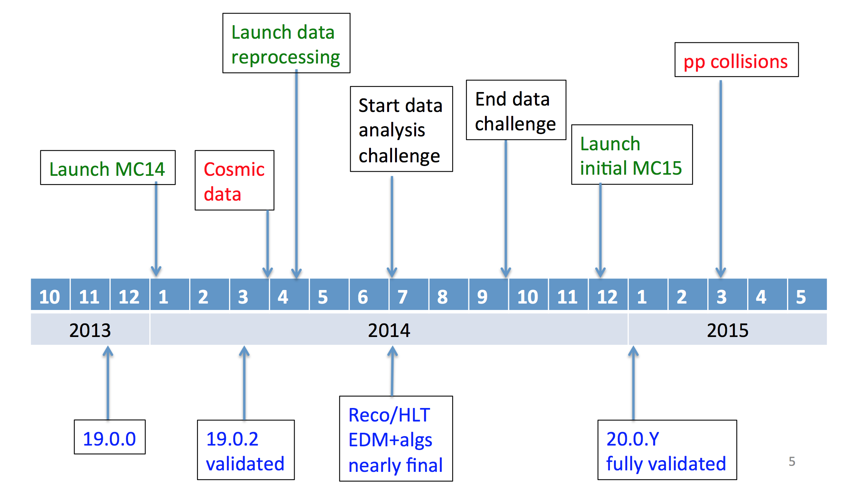
S&C Timeline for LS1
Details of this schedule are evolving…
DC14
We’re here!

Slide 11
The value of DC14 (1/2)
DC14 provides a milestone with inter-dependent deliverables coming together
  Likelihood that lessons from DC14 will drive a round of adjustment/development, so there’s a premium – or necessity – to being ready for DC14 and making the most of it
For example…
  xAOD – including its impact on workflows, data access performance, …
  Federated Storage – its impact on production and analysis efficiency
  ISF – all of DC14 to be based on ISF and G4
  Reduction framework – the new train model
  Massive use of athenaMP – else lose 30-50% of cores due to insufficient memory
  Prodsys2 – particularly DEFT which is green-field new and a dependency for reduction framework. Prodsys1 is not a fallback
  Rucio – will benefit from very nice adiabatic completion/migration plan
  Analysis releases and analysis framework – users should have migrated to analysis release 19 by DC14

Slide 12
The value of DC14 (2/2)
New/increased demands on facilities and networking – are we on track to meet the demand in DC14?
  Readiness of multicore queues for athenaMP bulk production
    Need to move from hard partitioning to something more dynamic for optimal resource utilization for parallel/sequential job env
  Greater role for tape as disk replica counts fall
    Readiness of tape facilities and the workflows that utilize them
  Increased usage of WAN data access
    Supporting, managing, monitoring WAN as well as LAN loads
    Requires special attention to facility/site configuration
      Brian will address those in his talk tomorrow

Slide 13
Flexibility
There is some skepticism because so much effort was invested in getting the data close
Computing intensive tasks like reprocessing can be sustained reading data from remote storage
  Input size is small compared to the time of the application
  ~100kB/s is enough to sustain the ATLAS application per job slot
  Even thousands of cores can be reasonably fed with Gb/s
Analysis as is today can be supported but it would be better to have data formats that allow to read the needed objects only
Intelligent IO and high capacity networks have changed the rules
Ian Fisk FNAL/CD
13

Slide 14
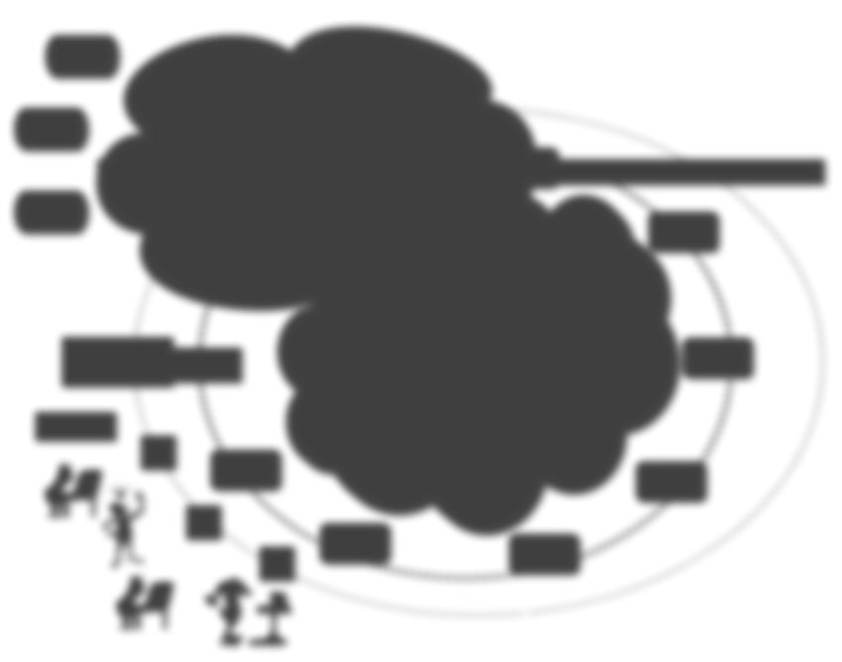




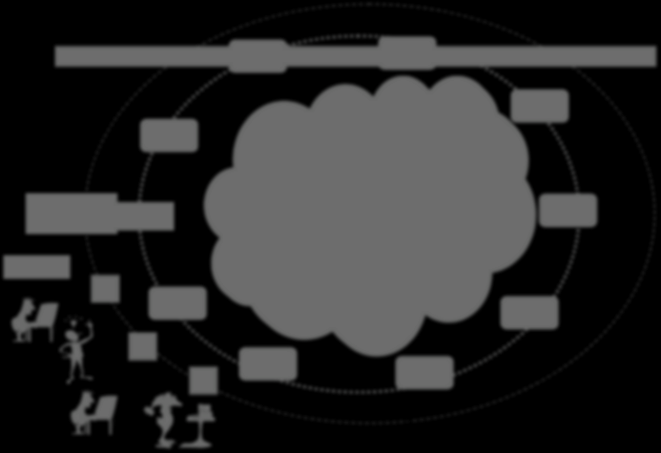


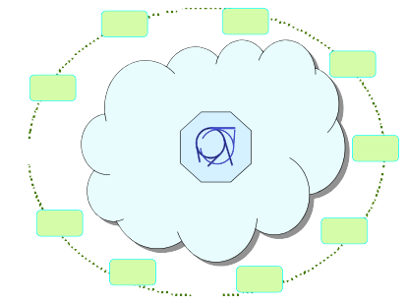
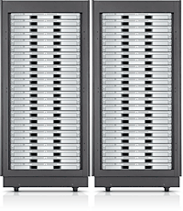



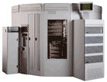

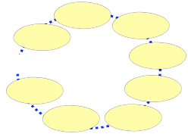





Networks
100Gb/s links are in production for OSG/WLCG
  The number is still growing fast, i.e. site connectivity
  When reaching 100Gb/s WAN network, there is little difference between WAN and LAN for capacity (though re latency)
We have reduced the differences in site functionality
Then reduced the difference in data accessibility
We are in the process of reducing the difference in the perception that two logical sites are separate
We can begin to think of the facility as a big center and not a cluster of centers
Uni x
Tier-2
Tier-2
Uni u
Open
La
b m
Tier-2
ScieUncnei x
Uni z
Grid
USA
Uni a
Tier-2
Lab a
Bro
o
khaven
UK
U
FermiLab
SA
France
Physics
Tier 1
CERN
Uni n
Department ^{Tier2}
Italy
……….
Ian Fisk
Desktop
#
Lab b
NL
Germany
FNAL/CD
∀
Lab c
!
Uni y
Uni b
14

Slide 15
Changing the Services
The OSG/WLCG service architecture has been reasonably stable for over a decade
  This is beginning to change with new Middleware for resource provisioning
A variety of places are opening their resources to “Cloud” type of provisioning
  From a site perspective this is often chosen for cluster management and flexibility reasons
  Everything is virtualized and services are put on top
There is nothing that prevents a site from bringing up exactly the same environment currently deployed for the WLCG, but maybe it’s not needed

Slide 16
Flexibility
Flexibility
We have ways of packaging the local environment and deploying it even in user space (cvmfs local mounts).
We can make virtual machines if we have to. We can take very diverse systems and make them look the same to our application
Sending data over the wide areas means not having to care about data location and combined with controlling the environment it is a transformative change
  Anything you bring to the table can make a contribution
  Local, opportunistic, and temporarily allocated contributions can be a huge increase in capacity

Slide 17

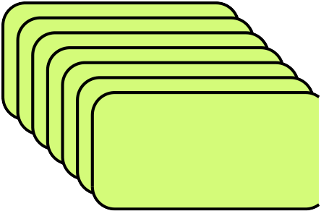
Evolving the Infrastructure
Resource Provisioning
Cloud Interface
VM with
Pilots
Resource Requests
Resource Provisioning
CE
Batch with
Pilots
Batch Queue
Pilots
In the new resource provisioning model the pilot infrastructure communicates with the resource provisioning tools directly
– Requesting groups of machines for periods of time
Ian Fisk FNAL/CD
16

Slide 18


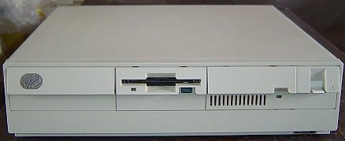

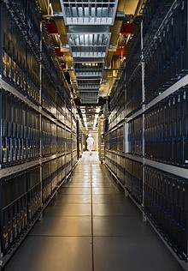
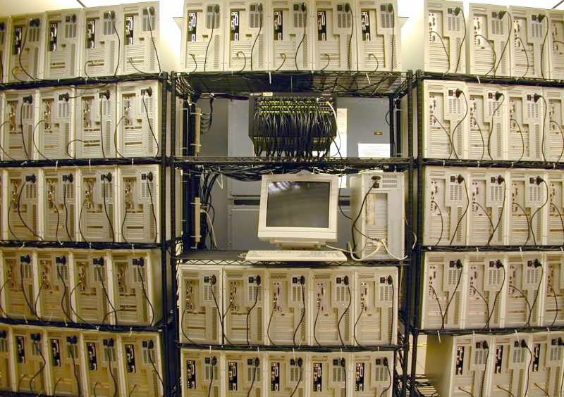
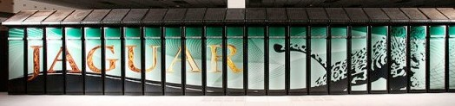
Impact of Resource Provisioning
The resource provisioning layer becomes a potentially common, but complicated interface
  Goal is to get pilots into a diverse set of computers
    Dedicated resources, opportunistic computing, local resources, clouds, super computer allocations, etc.
Queue
Pilots
Resource Provisioning
Ian Fisk FNAL/CD
18

Slide 19
Evolution
After many years of operations our system is evolving
– We are reducing how strictly we define the functionality in each tier
  Lines and capabilities are blurring together
– We have much better access to data
  With it we begin to eliminate the boundaries between sites
– We will have a much more diverse set of resources
  Cloud and opportunistic access will be big areas of growth
– The availability of capability computing is likely to change the landscape
Ian Fisk FNAL/CD
19

Slide 20
Testing Interfaces
At the T1 we are bringing up a new agile infrastructure of services that will be configurable through a cloud interface
– Similar to how we interacts with the HLT
– We should consider using similar resources at more sites.
It is potentially a big change in how we handle prioritization and release of resources
– Needs to be tested, but could be more efficient for us and the experiment
Ian Fisk FNAL/CD
20

Slide 21
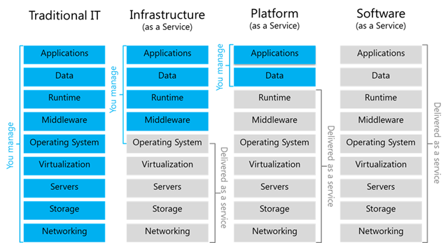
Agile Infrastructure - IaaS
Rationale
  Need to manage a lot of servers
  No increase in staff effort
  …we have to manage the infrastructure efficiently
Infrastructure as a Service (IaaS)
Notes:
21

Slide 22
U.S. ATLAS Facilities as a Cloud Service Provider ?
Following industry reference structure
  Infrastructure, Platform and Applications
Start first with Infrastructure-as-a-Service at scale
  Just provide Amazon functionality
Value increases up the chain so we need a vibrant ecosystem for PaaS and SaaS
 |  |  | Software as a Service
 |  | Platform as a Service
 | Infrastructure as a Service
Facilities

Slide 23
Goals
Objectives
  90% of hardware virtualized
  ~3-5k hypervisors needed over next two years
Following industry reference structure
  Infrastructure, Platform and Applications
Deploy multi-site
  Extend to Tier-2 sites
  Enable remote management
More efficient use of our hardware
Better tracking of usage
Consolidate support to a single device
Support potential new use cases (PaaS)
Notes:
23

Slide 24




Timeline
Grizzly Service
Dec, 2013
' 12
Jan
2013
Feb
Apr
May
…
Oct
Dec
' 13
Folsom
Grizzly
Havana
Today
Sep 27, 2012
Apr 4, 2013
Oct, 2013
Maintain the project linked to upstream releases
Deployment delay:
  Time to understand (challenging learning curve) and for testing
  Checking suitability of new features
We have been delivering a series of pre-production services…
  Adding functionality…
  Scaling out…
  Integrating into infrastructure at the T1 …
Notes:
24

Slide 25
Interfaces
Multiple interfaces available
  Supported OpenStack APIs for python
  REST APIs for many public domain libraries available
  Same API for SIM@P1 cloud
We have demonstrated that PanDA can use cloud resources transparently
Foreman GUI/CLI to create a server with Puppet
  Create me a new (e.g.) analysis server instance with 1 command

Slide 26
Agile Infrastructure - Outlook (I)
Going to production for managed servers
  End of Jan/Feb, 2014
  Based on OpenStack Grizzly release
  ~200 Hypervisors
Notes:
26

Slide 27
Agile Infrastructure - Outlook (II)
Non-managed machines, missing requirements:
  Shared storage for volume service and live-migration
Investigating alternatives for block storage:
  Ceph, others
Special attention to cells
  Exploit cells functionality for scalability
  Multi-site operations (T2s willing to join?)
And more:
  Kiosk to create VMs on demand (user-initiated)
Notes:
27

Slide 28
Planning the Challenges
This meeting is the opportunity to start understanding and defining the goals and timelines for near/mid-term computing aspects
  Understanding and mitigating performance issues
  Agree on areas where R&D is needed
Planning, in collaboration with others (e.g. T3 implementation TF), can then proceed in the weeks & months to come
Integrating services currently under development and participating in new activities
  I.e. making our beyond-pledge resources available to a broad user community in the U.S.
  This is a huge and hugely important topic we will spend a lot of time on at this meeting
Tracking critical path deliverables and taking remedial actions, launching backup plans where needed

Slide 29
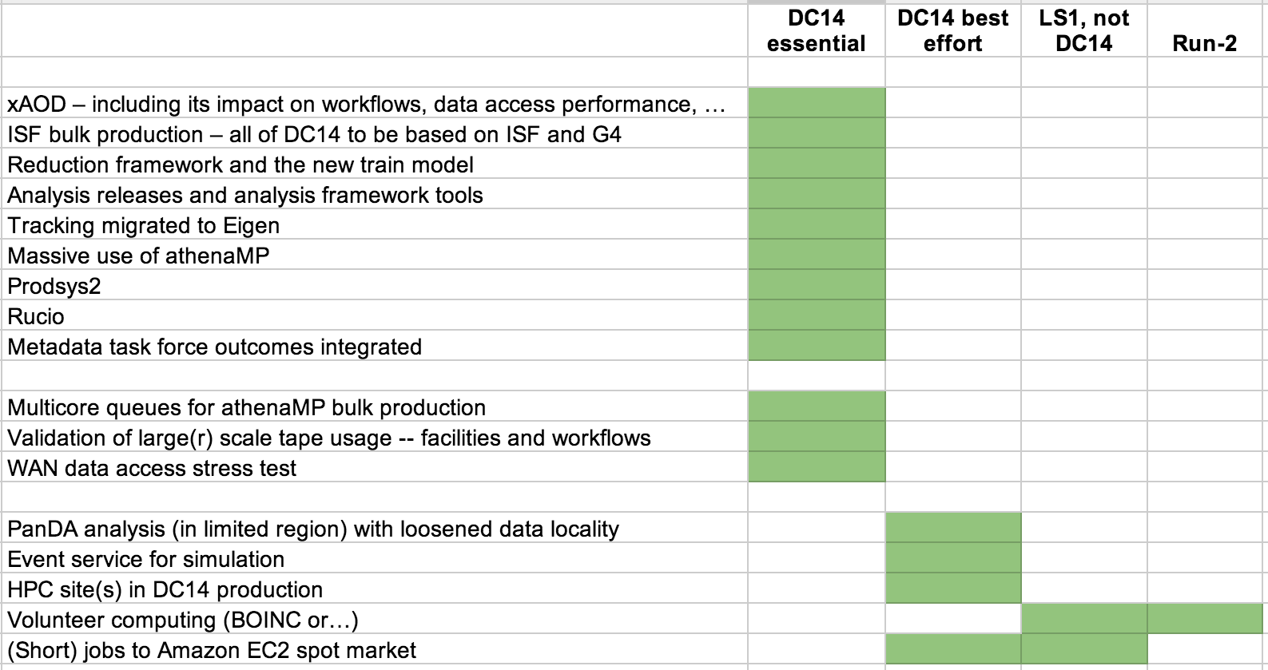
Completing a table like this may be useful for initial DC14 / Late LS1 / Run-2 planning…
Relevant to Facilities
Torre at Oct S&C week

Slide 30
Agenda of First Block
09:00 - 10:30 Introduction, Overview, Goals
Convener: | Michael Ernst
09:00 The US ATLAS Computing Facility and Agile Infrastructure 30'
Speaker: | Michael Ernst
09:30 US ATLAS Facilities Projects: AtlasConnect, FAXbox, T3 Flocking 30'
Speaker: | Robert William Gardner Jr (University of Chicago (US))
10:00 Overview of the Analysis Support group activities in US ATLAS 30'
Speaker: | Erich Ward Varnes (University of Arizona (US))

Slide 31
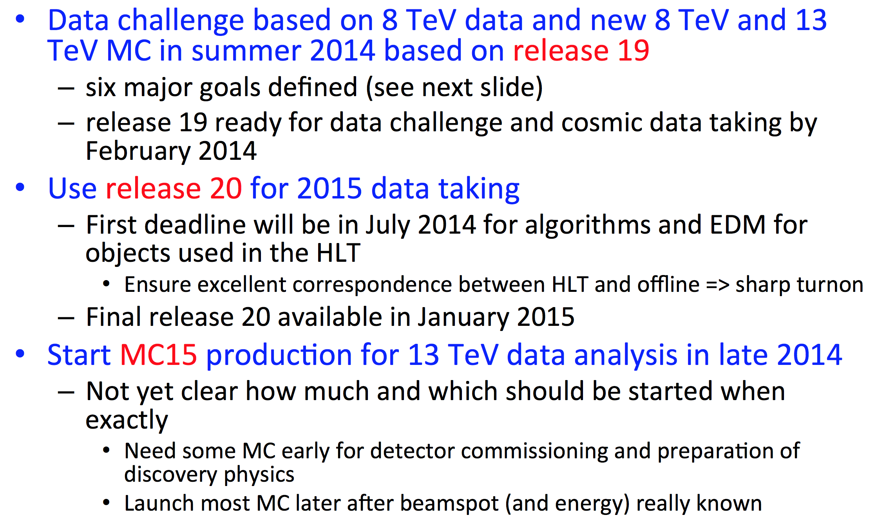
Offline Schedule in LS1
Beate Heinemann, June 2013 ATLAS Week

Slide 32
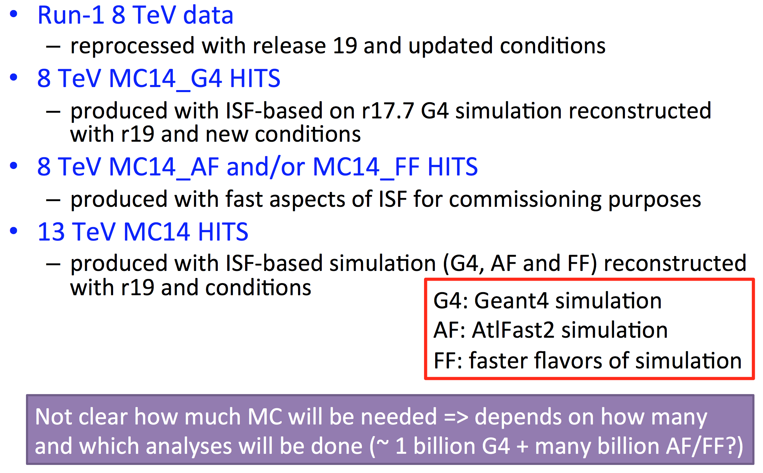
DC14 Processing
Beate Heinemann, June 2013 ATLAS Week

Slide 33
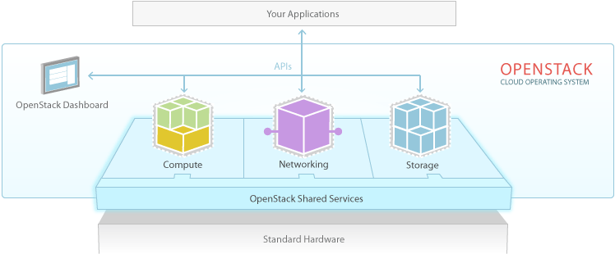
What is OpenStack?
“OpenStack is a cloud operating system that controls large pools of compute, storage, and networking resources throughout a datacenter, all managed through a dashboard that gives administrators control while empowering their users to provision resources through a web interface”
Swift
Nova
Quantum
Notes:
33

