Slide 1
FAXbox Technicals
Lincoln Bryant
Computation & Enrico Fermi Institutes
University of Chicago

Slide 2
About
What is FAXbox?
  A dead-simple XRootD server for analysis job outputs.
  Built on Ceph, a fast, scalable, distributed filesystem.
  Integrated into ATLAS Connect.
Who is it for?
  ATLAS Connect users and Tier 3 users with no dedicated storage

Slide 3
Specs
(2) Dell R510s
  (2) Xeon 5660 CPUs
  128 GB of RAM
  10 Gb NICs
  (4) MD1200 shelfs with 4 TB disks
~420 TB of raw disk, with about ~210 TB usable.
Single XRootD door

Slide 4
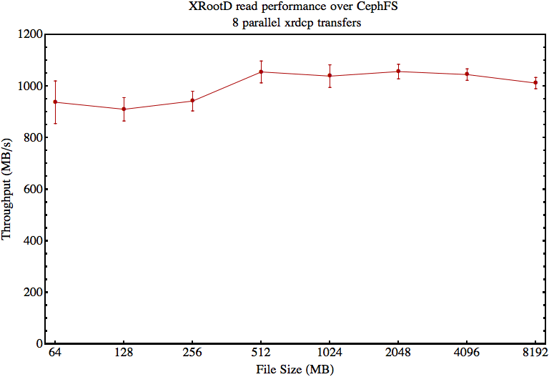
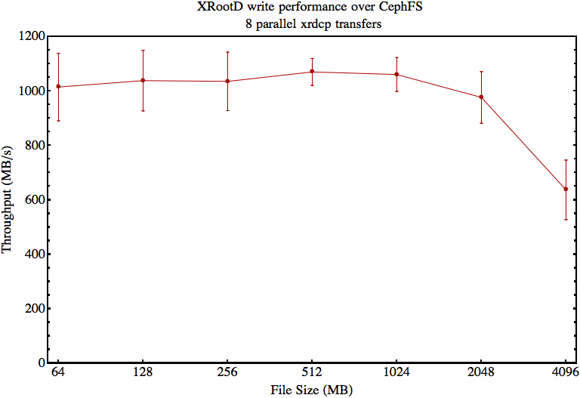
Is it performant?
Performance nearly saturates single 10Gb line
Benchmarks from October.
  We’ve made optimizations since then, expect write performance for large files to have increased

Slide 5
OK, so how do I use it?
Get yourself an ATLAS Connect account
SSH to login.usatlas.org, and setup XRootD from CVMFS
Once that’s done, you’re ready to go!
Basically the same same process for your jobs.
[lincolnb@login ~]$ export ATLAS_LOCAL_ROOT_BASE=/cvmfs/atlas.cern.ch/repo/ATLASLocalRootBase
[lincolnb@login ~]$ source ${ATLAS_LOCAL_ROOT_BASE}/user/atlasLocalSetup.sh
[lincolnb@login ~]$ localSetupXRootD
[lincolnb@login ~]$ xrdcp -fv output.8g root://faxbox.usatlas.org://user/lincolnb/output.8g
[xrootd] Total 8192.00 MB |====================| 100.00 % [116.6 MB/s]

Slide 6
What’s next for FAXbox?
Hardware upgrades! More performance.
  We think we can get more performance out of Ceph with 20Gb bonds on the network.
  Additional servers could boost the performance too.
  More XRootD doors?
Ceph updates! Three big updates we’re looking forward to:
  Filesystem ACLs
  Quotas
  Erasure encoding → More storage bang for the buck!

Slide 7
What’s next for FAXbox?
Automatically authenticated access from ATLAS Connect
  X.509 certificate authority runs on ATLAS Connect
  Jobs submitted from ATLAS Connect have an X.509 proxy injected on user’s behalf.
  XRootD on FAXbox has gridmap file (or GUMS) configured to allow access from ATLAS Connect DNs.
  Designed to be completely transparent to end-users.

Slide 8
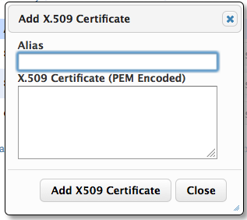
What’s next for FAXbox?
X.509 Authentication (Grid Certs)
  Add your X.509 certificate on the ATLAS Connect website
Group quota management
  PIs or designated managers can manage quotas for working groups.
Web statistics
  See group usage statistics from the web.

Slide 9
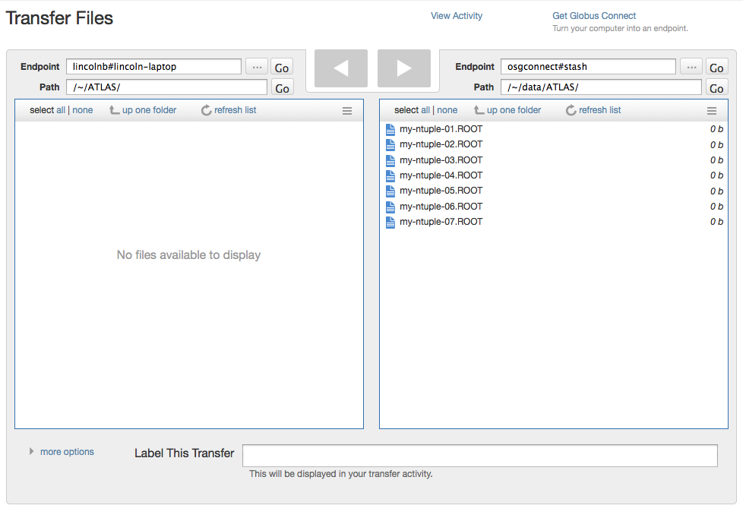
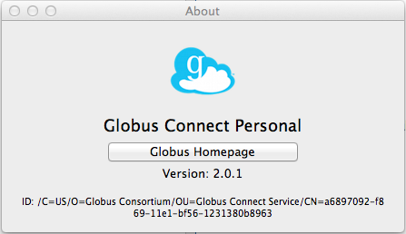
What’s next for FAXbox?
Globus Endpoint
  Access your data from your laptop through the Connect portal.

Slide 10
Questions?

