Slide 1
100% [d]Caching at Illinois
Sarah Williams (Indiana University)
David Lesny (University of Illinois)
USAtlas Distributed Computing Workshop at the University of Arizona 2013-12-11

Slide 2
Caching at a Distributed T2
What do we already cache at a local site level?
  CVMFS (software), pCache (production inputs and analysis non-ROOT inputs), FRONTIER (conditions metadata)
What could still benefit from caching?
  Analysis ROOT files. It is not efficient to put these into pCache on individual worker nodes disks because often only a small portion of the file is used. Reading them off the storage server is better, but because analysis jobs often do many smaller reads they are adversely affected by latency. The magnitude of this effect depends on the job.
  Production inputs and Analysis non-ROOT files could benefit from being cached at the local site, as well as at on the worker node.

Slide 3
Illinois Campus Cluster
Storage Infrastructure
(1) DDN SFA12K40D-56IB Couplet with 5 enclosures
60 3TB 7,200 rpm 2.5 SATA drives expandable to 600 disk drives
(4) Dell PowerEdge R720 GPFS-NDS Nodes each configured with:
  (2) Intel E5-2665 2.4GHz 8 Core Processors, 115W
  256 GB RAM via (16) 16GB 1333MT/s RDIMMs
  Mellanox ConnectX-3 Dual Port FDR IB HCA
  Intel X520 DP 10Gb DA/SFP+ Server Adapter
  (4) 300GB 15K RPM 6Gb/s SAS drives
Network Infrastructure
High Speed InfiniBand Cluster Interconnect
  Mellanox MSX6518-NR FDR InfiniBand (384 port capable)
Management and IPMI Control Networks
  (2) Dell PowerConnect 8064F 48 Port 10GigE switches
  (41) Dell PowerConnect 5548 49 Port 1GigE switches
  (2) Dell PowerConnect 2848 48 Port 1 GigE switches
dCache Local Site Headnode
mwt2-s1 is a Dell R710 with 96GB memory and a dual port mellanox interface.
It has an Infiniband connection to the storage infrastructure, and a 10Gb connection to the worker nodes and to the other MWT2 sites.
Source: https://campuscluster.illinois.edu/
Notes:
hardware, gpfs setup, raw read & write
performance,

Slide 4
Illinois Campus Cluster
Notes:
Network diagram

Slide 5
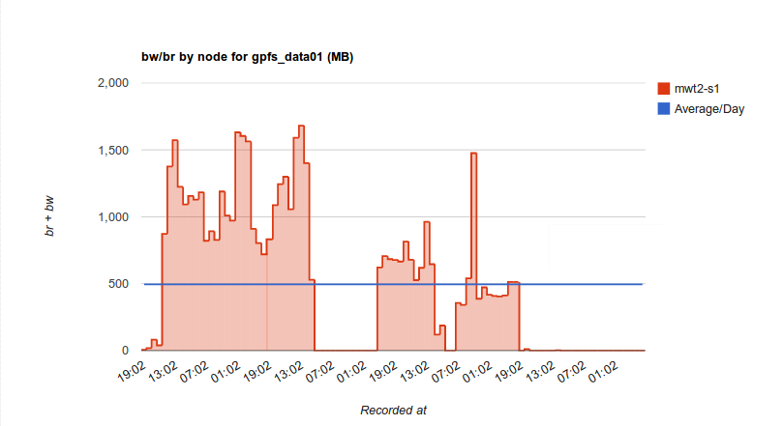
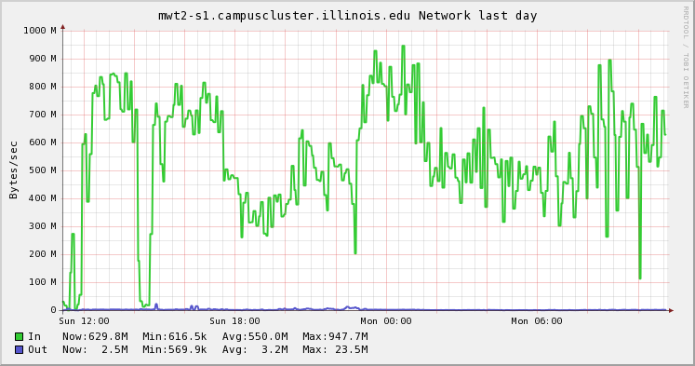
Pre-staging Data
To prep this machine for actual production, we filled it with recently accessed data from the other data servers
Accomplished with dCache ‘permanent migration feature
  migration copy -tmode=cached -target=pgroup -accessed=0..300 -refresh=300 –cpuCost<0.3 –permanent mwt2ICCPools
  Could be a long-term strategy, to stage data to the local site before jobs request it.
Through trial-and-error, found 12 active migration (two per pool) gave best performance, writing at a consistent 6.25Gbps. We saw peaks of almost line speed (10Gbps). Transferring large files was efficient at using the bandwidth than small files.
Bandwidth of reads and writes to GPFS, in MB/s
Network bandwidth to mwt2-s1, in MB/s
Notes:
Add Pat’s updated gpfs data graph

Slide 6
Performance Testing
To model an analysis job, we used readDirect from the FAX End-user tutorial code base:
  https://github.com/ivukotic/Tutorial/
readDirect opens a ROOT file and reads the specified percentage of events from it.
We cannot directly control the bytes read, only number of events read. Instead we ran a series of tests to find the number of events read which would correspond to 10-90% of bytes read.
The test file is NTUP_SMWZ.01120689._000089.root.1, a fairly typical user input file of size 4.6 GB.
The tests read 10%-90% of the file, in 10% increments
Notes:
Description of tests, get from previous slides

Slide 7
Performance Testing
Cache misses are always worse than direct access. Caching in this case only
makes sense if files are re-used.
Notes:
Add latency table
Cache miss tests
Local disk tests, to see if difference between this and aug testing is due to faster machine

Slide 8
Performance Testing

Slide 9
From IU in August: Direct comparison of caching strategies
No caching is the optimum strategy when less than 75% of the file is read. When more than 75% is read, caching becomes optimal.
Notes:
needs page numbers

