Slide 1
ATLAS Connect
Technicals & Usability
David Champion
Computation Institute & Enrico Fermi Institute
University of Chicago

Slide 2
ATLAS Connect Overview
A combined job submission environment and storage platform
Low entry overhead
  simple signup
  easy sponsorship procedure
Ready-to-use tools
Growth — straightforward connectivity to:
  existing tier2 and tier3 facilities
  ready to integrate with future sites

Slide 3
ATLAS Connect Audience
Current tier3 sites with limited resources for cluster management
Tier3 sites with capacity or throughput needs
  can benefit from direct resource sharing with other sites
  can connect short-lived cycle pools
  leverage other sites’ bandwith through computational locality
Future Tier3 working groups
  lower startup cost by leaning upon shared infrastructure

Slide 4



Architectural Overview
PanDA
connect.usatlas.org
Flocked Tier2s
FaxBox
portal
Flocked Tier3s
login
Campus Grids
Courtesy of
Rob Gardner

Slide 5
Components
Web gateway: http://connect.usatlas.org/
Identity/Access portal (via web site)
FAXbox: storage nexus
Login node: ssh://login.usatlas.org

Slide 6
Web Gateway
Provides central access gateway
  ATLAS Connect facilities
  documentation
  user & resource management
  analytics
New user signup → Identity & Access Portal
Hub for future features

Slide 7
Identity and Access Portal
Define identity external to home institutions
  ability to co-locate user activities at one site, regardless of origin
  no dependency on scoped identity@domain names
    (users may change institutions)
  integration with third-party compute and data services (e.g. Globus)

Slide 8
Identity and Access Portal
Access mechanisms that are based on home identity
  InCommon authentication via CILogon
  existing SSH and x.509 identity, depending on context
Role management
  Institution
  ATLAS working groups

Slide 9
FAXbox
Storage nexus integrating multiple access protocols
  Federated ATLAS XRootD (FAX)
  HTTP
  Filesystem
  Parrot/Chirp

Slide 10
Login Server
SSH access
  RSA keys provided in advance via user portal
  or password
Web access through JavaScript vt100 emulation
Direct local or xrdcp access to FAXbox data

Slide 11
Login Server
Job management:
  Condor submission frontend
  Backends
    Condor flocking to MWT2, tier3 clusters, other campus grids
    Remote submission via BOSCO to Condor or other queuing systems
Job metadata insertion to analytics tools
  available via web gateway

Slide 12
High-Level Workflow

Slide 13
Sequence of Steps
User visits ATLAS Connect site
User signs up (see attached workflow screenshots)
User requests institutional group membership
Approver validates group join request
(possibly involving contact with site principals)
User is joined into group
After 3-5 minutes, credentials authorized
User may ssh or web connect to login.usatlas.org

Slide 14
User Management Views

Slide 15
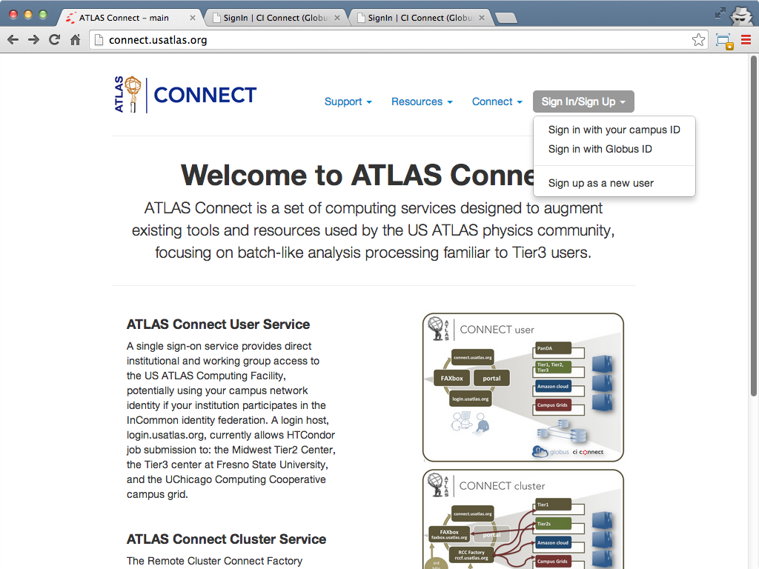
Views: Web Gateway
http://connect.usatlas.org/

Slide 16
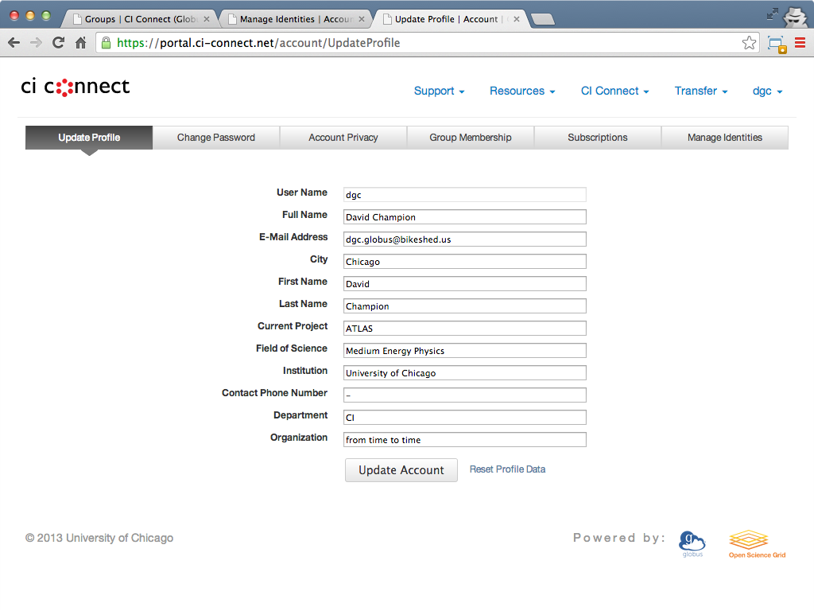
Views: Profile Management
http://connect.usatlas.org/ ▶ Connect ▶ My Profile

Slide 17
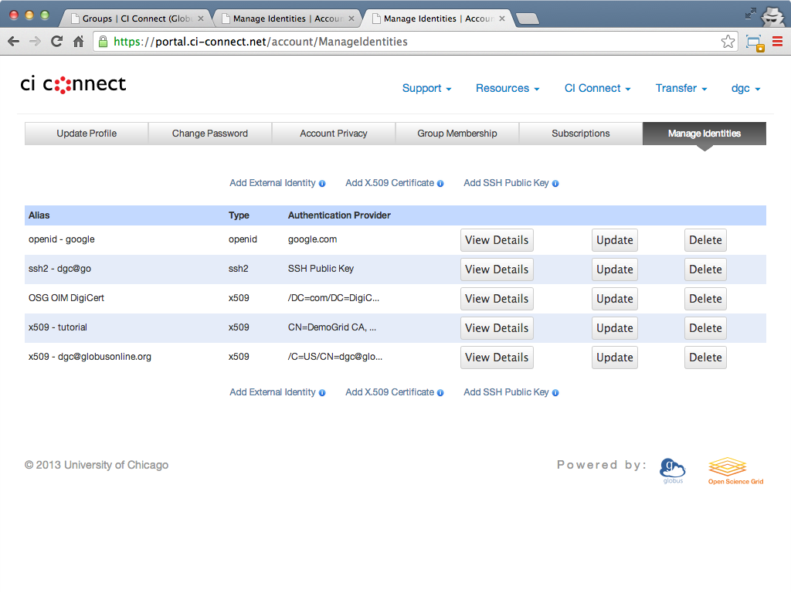
Views: Key Management
http://connect.usatlas.org/ ▶ Connect ▶ My Profile ▶ Manage Identities

Slide 18
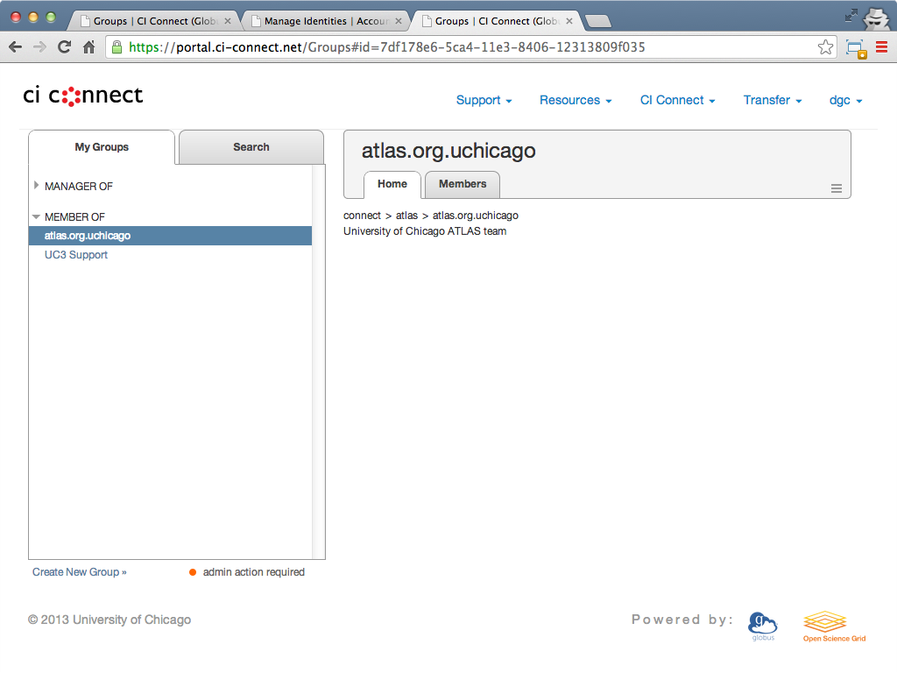
Views: User’s Groups
http://connect.usatlas.org/ ▶ Connect ▶ My Profile ▶ My Groups

Slide 19
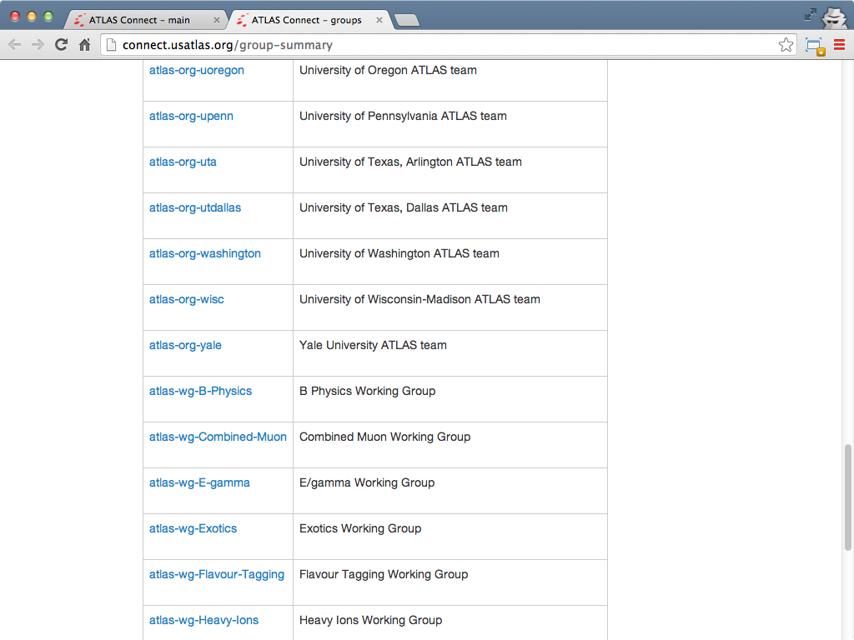
Views: All ATLAS Groups
http://connect.usatlas.org/group-summary

Slide 20
Analytics

Slide 21
Analytics
CycleServer
  Adobe Flash-based utilization metrics & graphing
Accounting Summart (Gratia)
  Job breakdown by project, institution, user

Slide 22
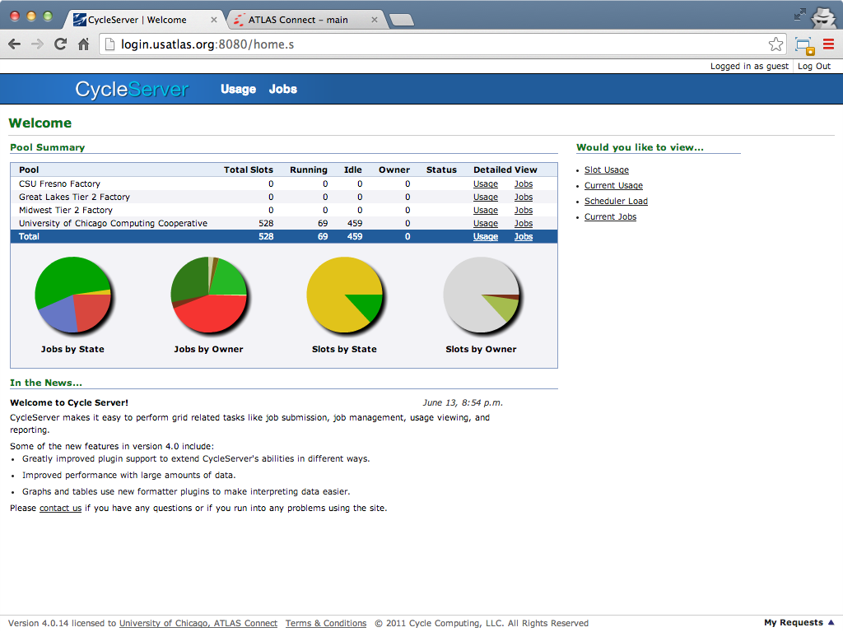
Analytics: CycleServer
http://connect.usatlas.org/ ▶ Resources ▶ ATLAS Connect User

Slide 23
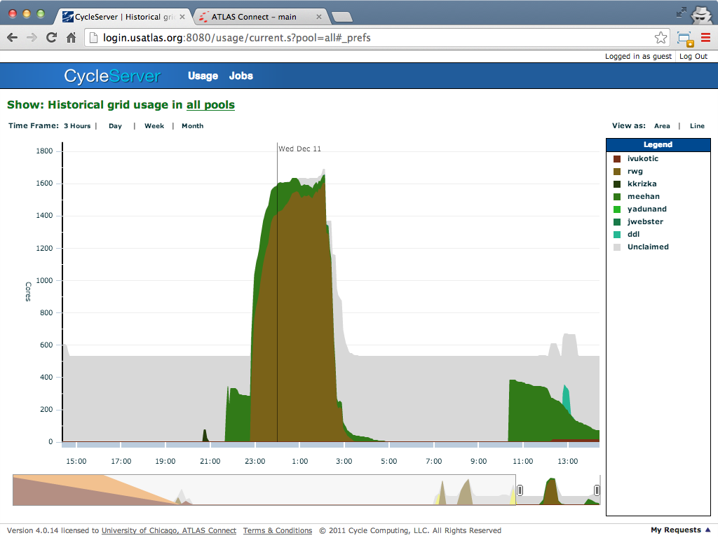
Analytics: CycleServer
http://connect.usatlas.org/ ▶ Resources ▶ ATLAS Connect User

Slide 24
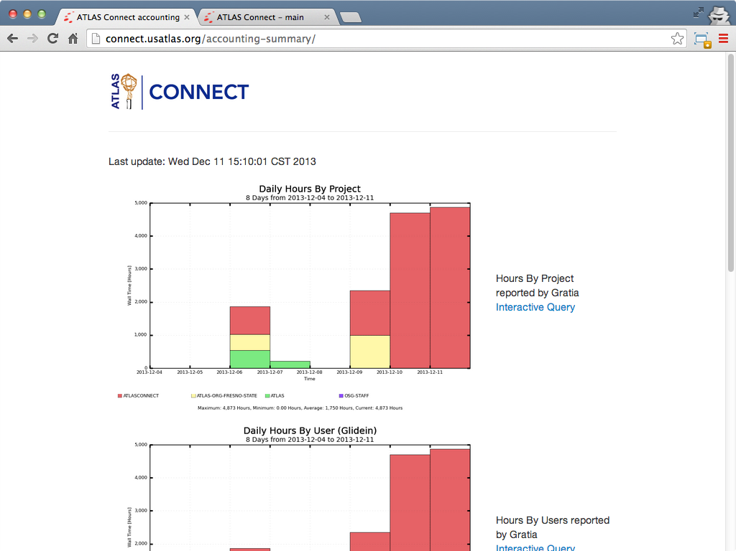
Analytics: Accounting Summary
http://connect.usatlas.org/ ▶ Resources ▶ Accounting Summary

Slide 25
Questions?

Slide 26
Appendix
Signup Workflow

Slide 28
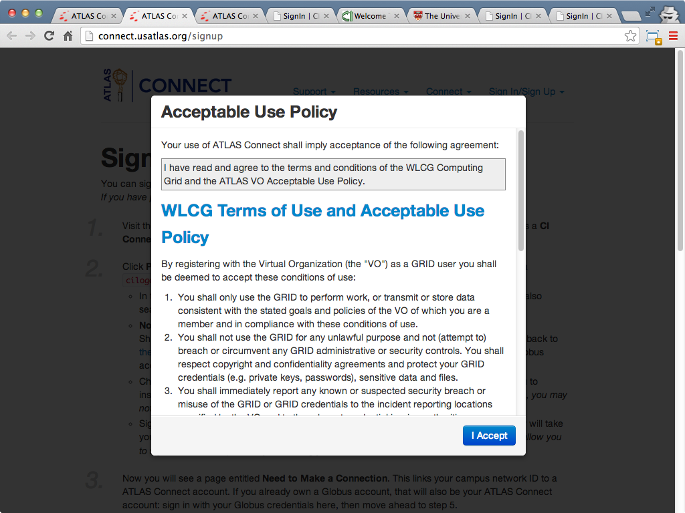

Slide 29
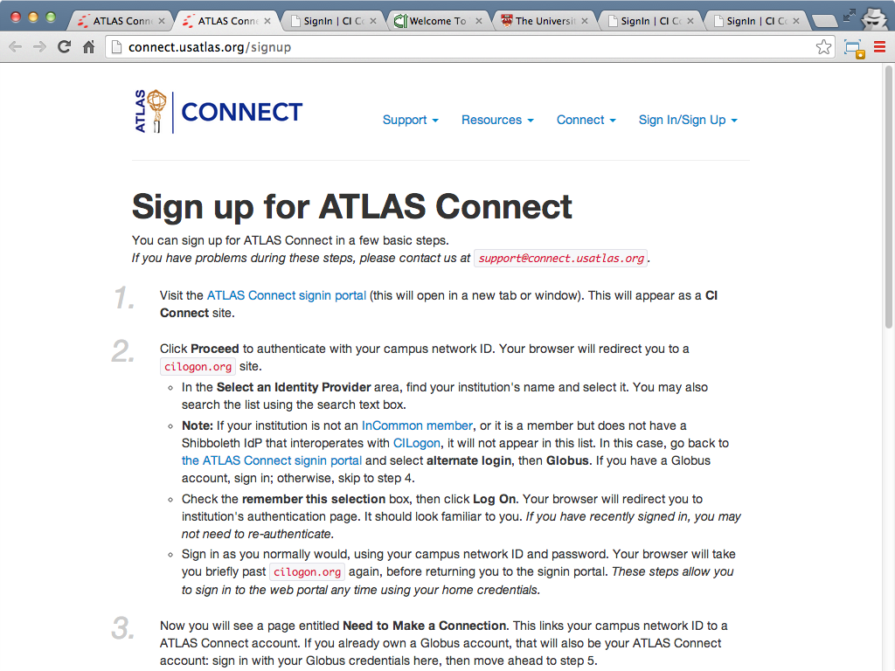

Slide 30
Signup Workflow
InCommon

Slide 31
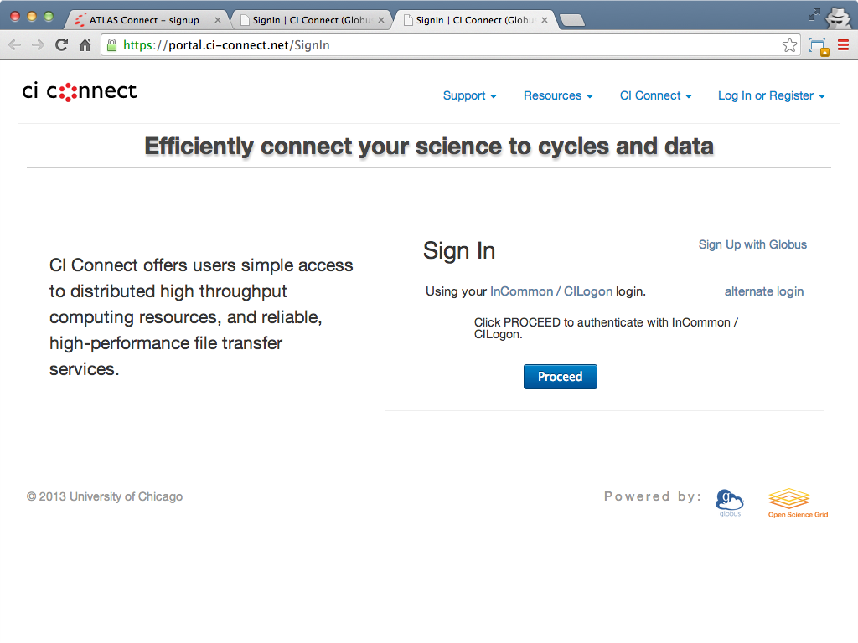

Slide 32
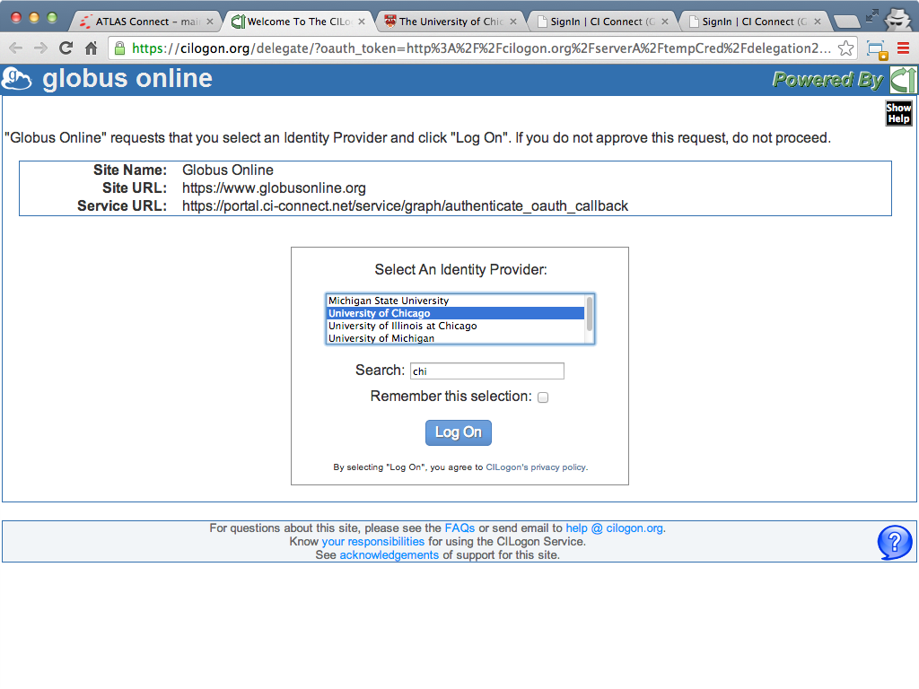

Slide 33
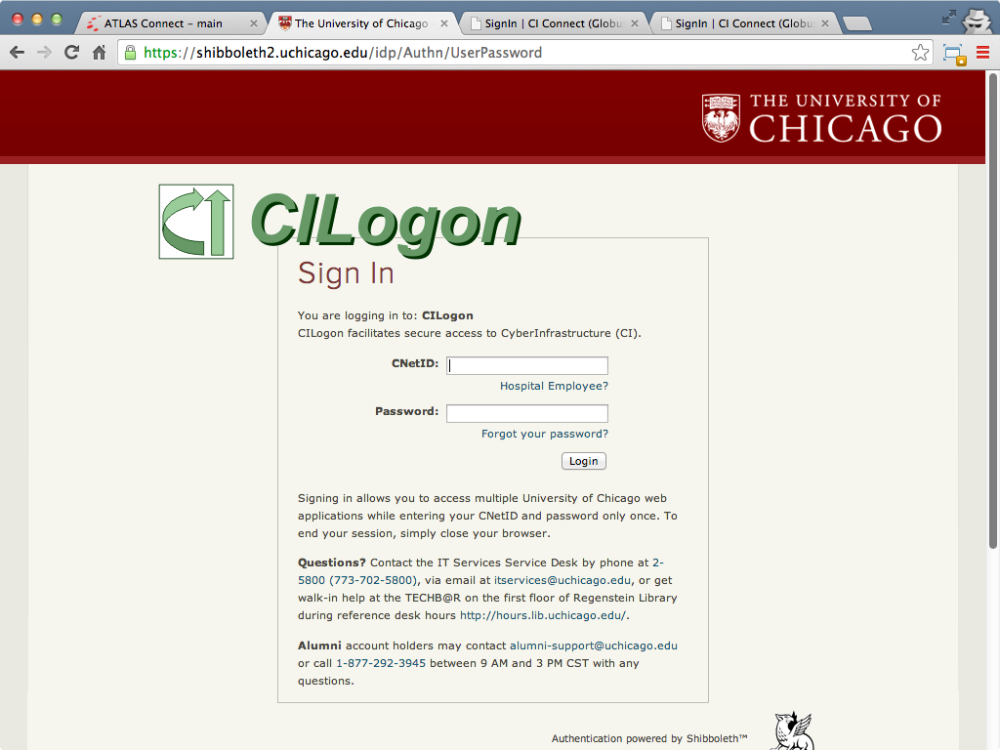

Slide 34
Signup Workflow
InCommon
existing Globus account

Slide 35
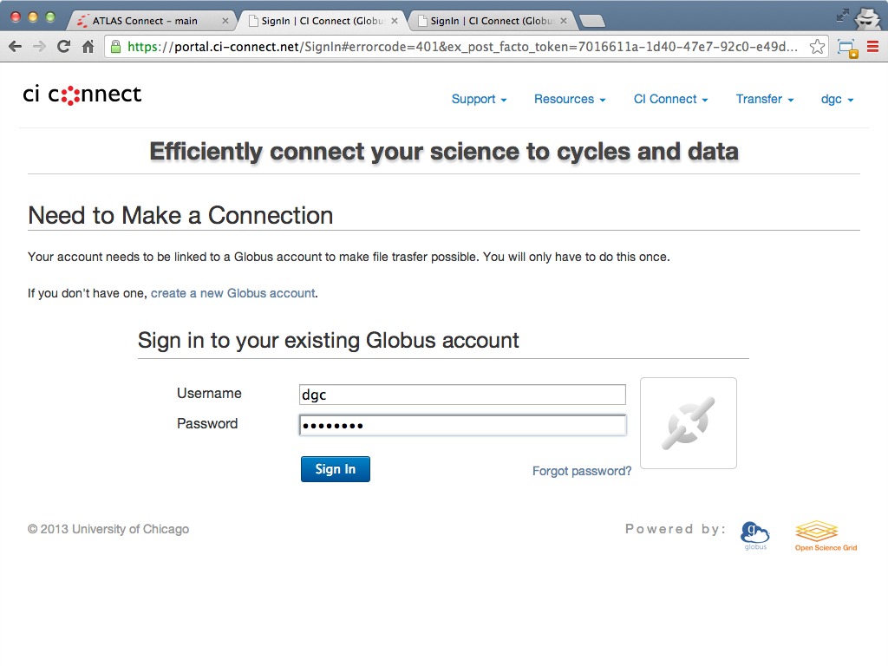

Slide 36
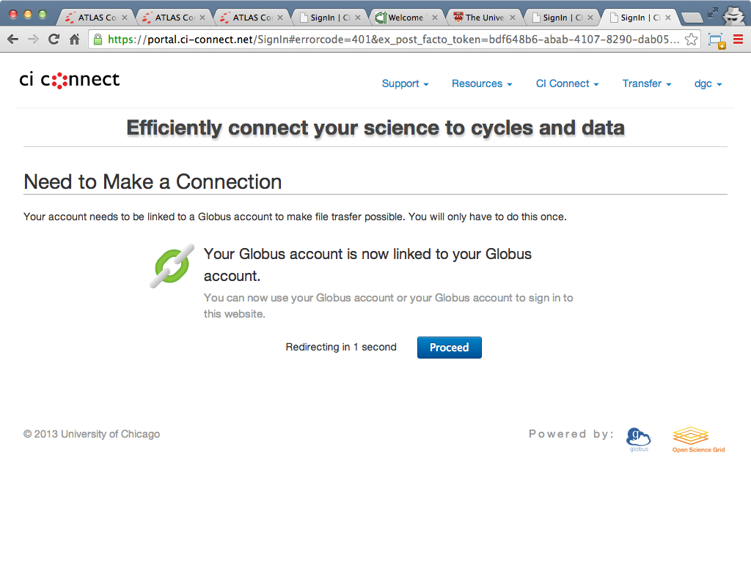

Slide 37
Signup Workflow
InCommon
no Globus account

Slide 38
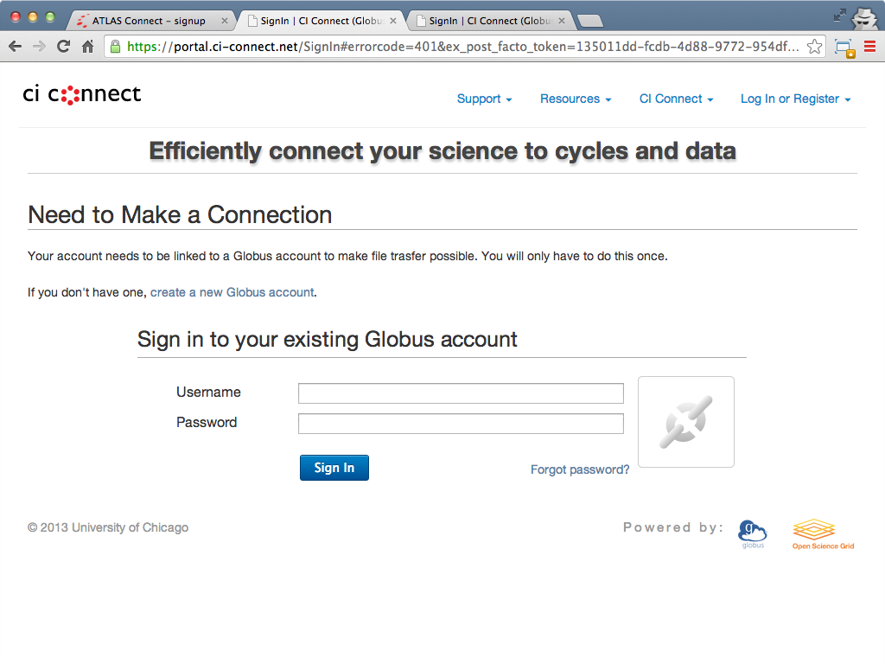

Slide 39
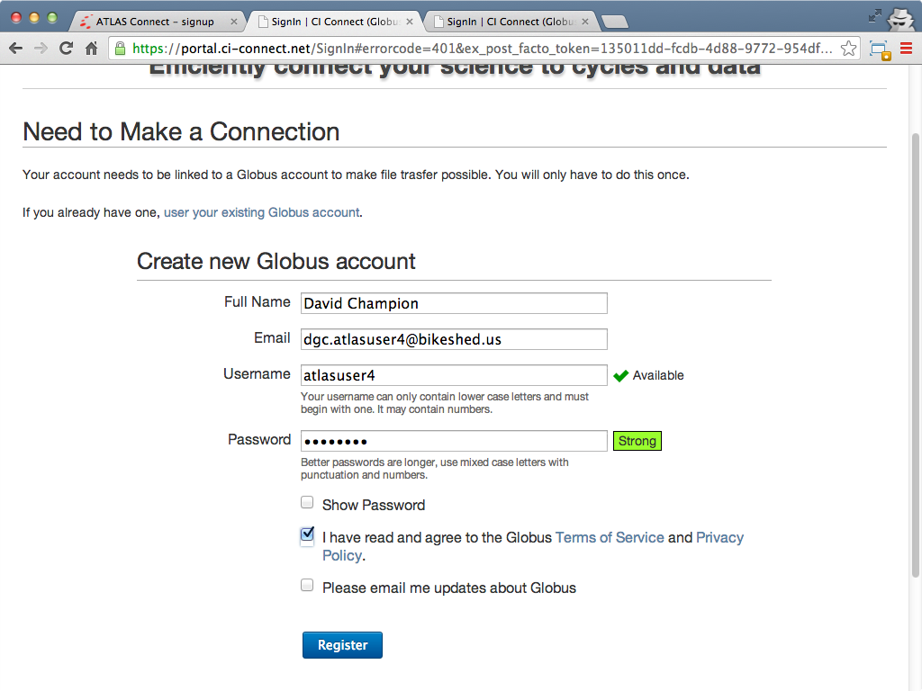

Slide 40
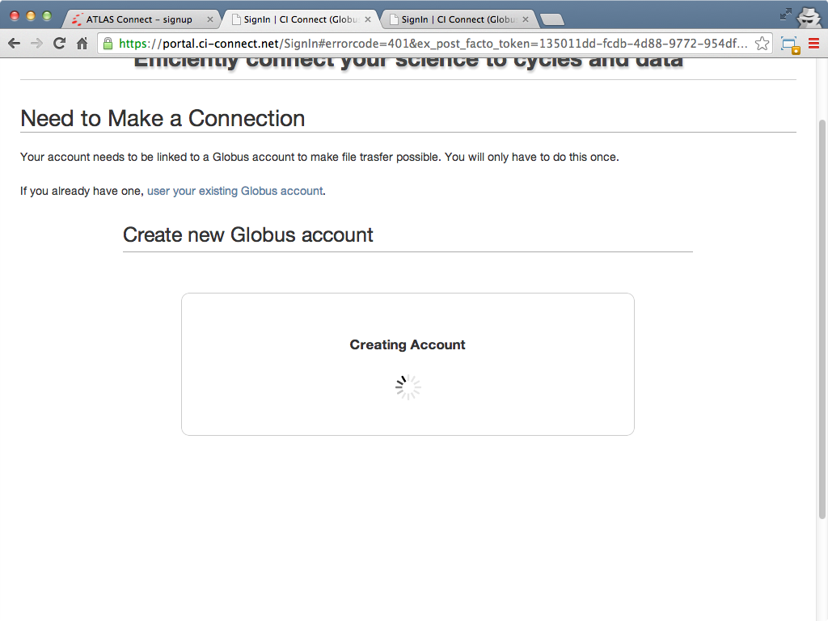

Slide 41
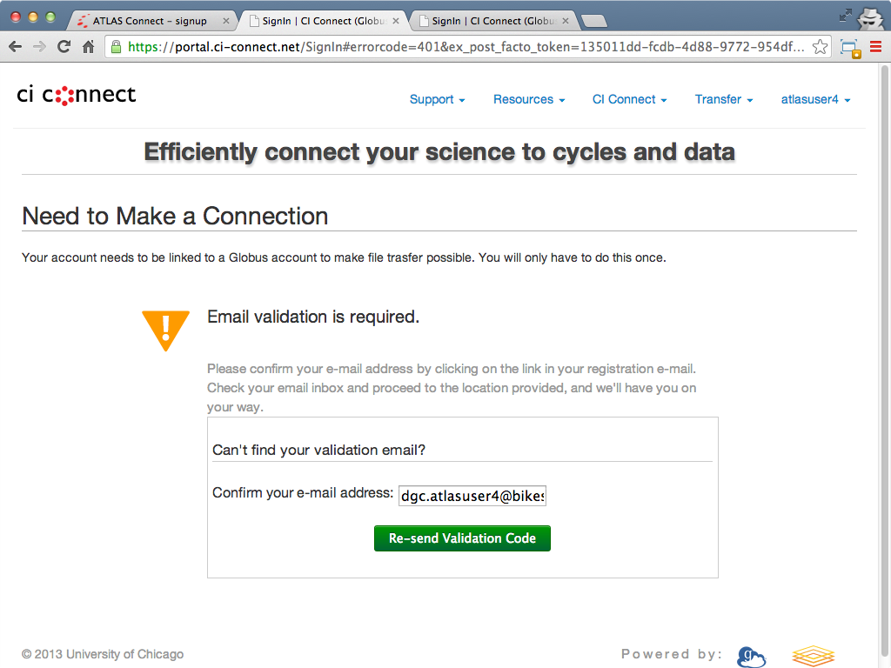

Slide 42
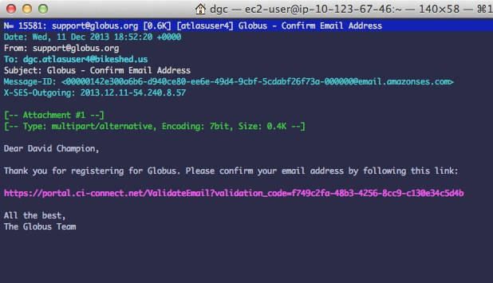

Slide 43
Signup Workflow
No InCommon

Slide 44
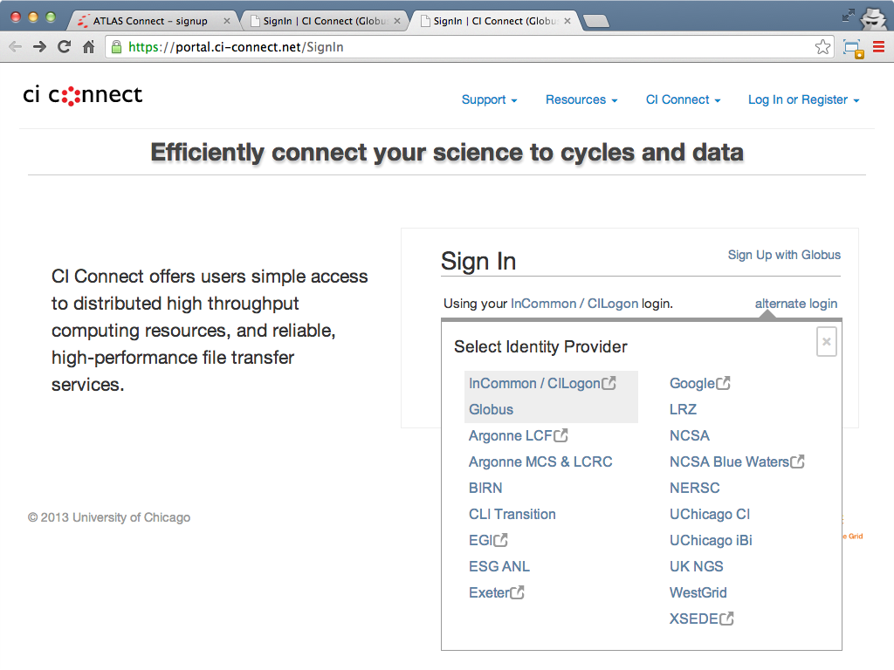

Slide 46
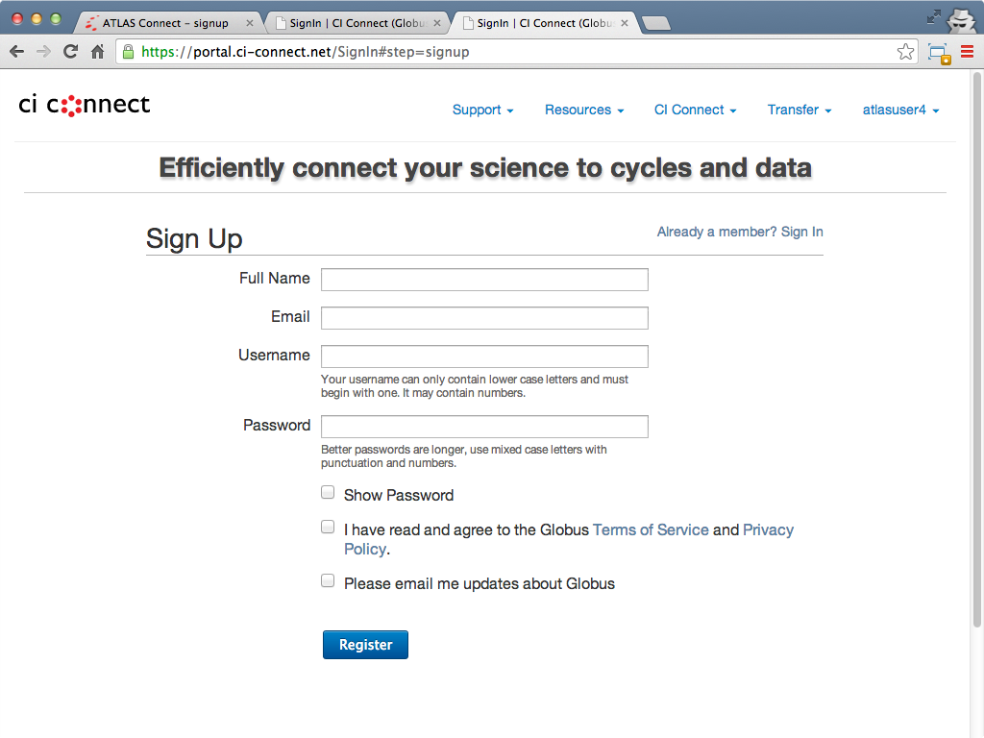

Slide 47
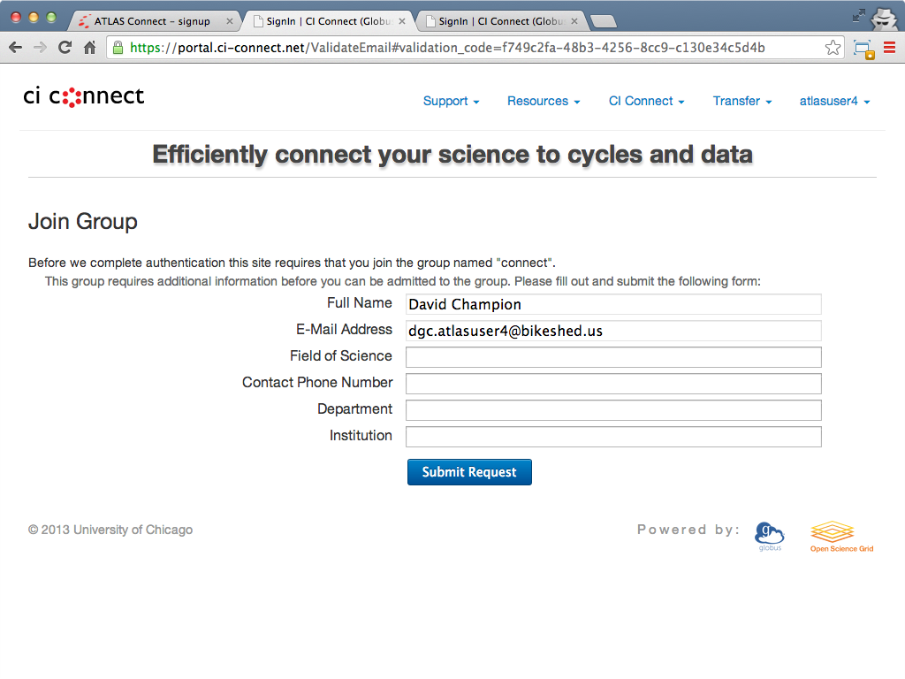

Slide 48
Signup Workflow
Joining ATLAS Connect

Slide 49
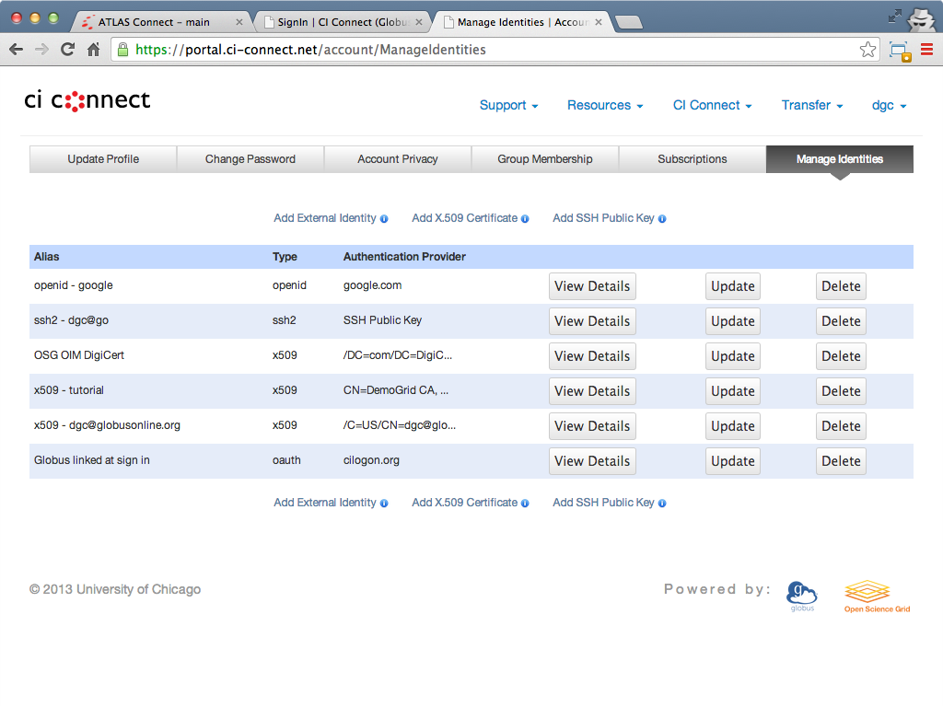

Slide 50
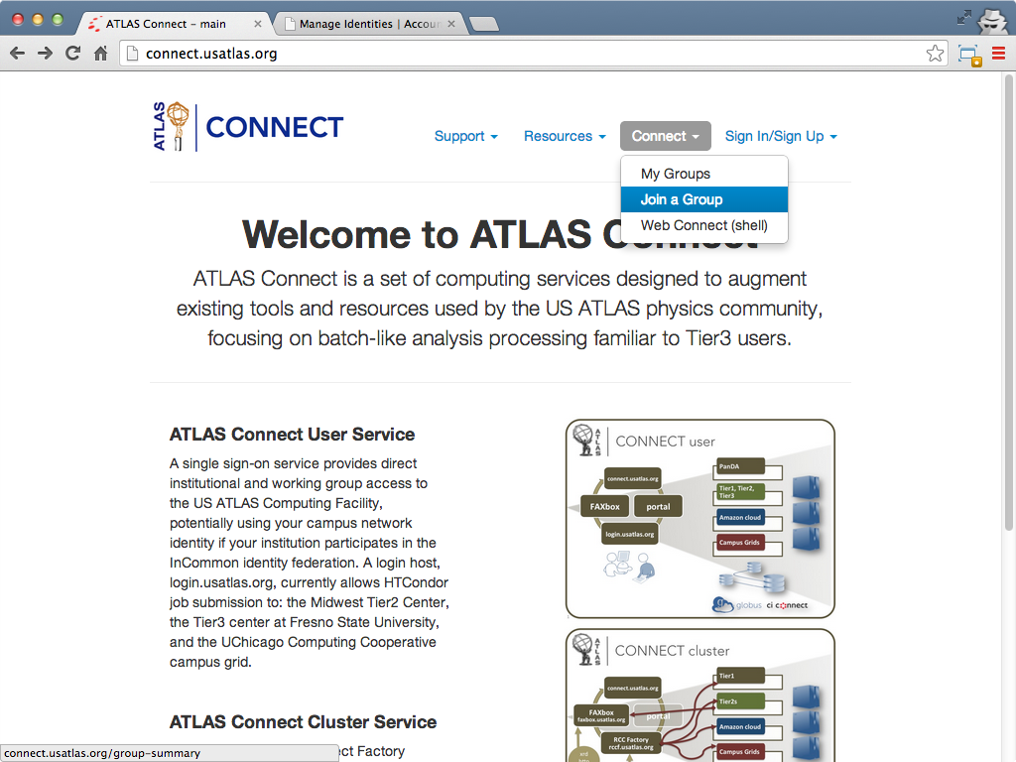

Slide 51
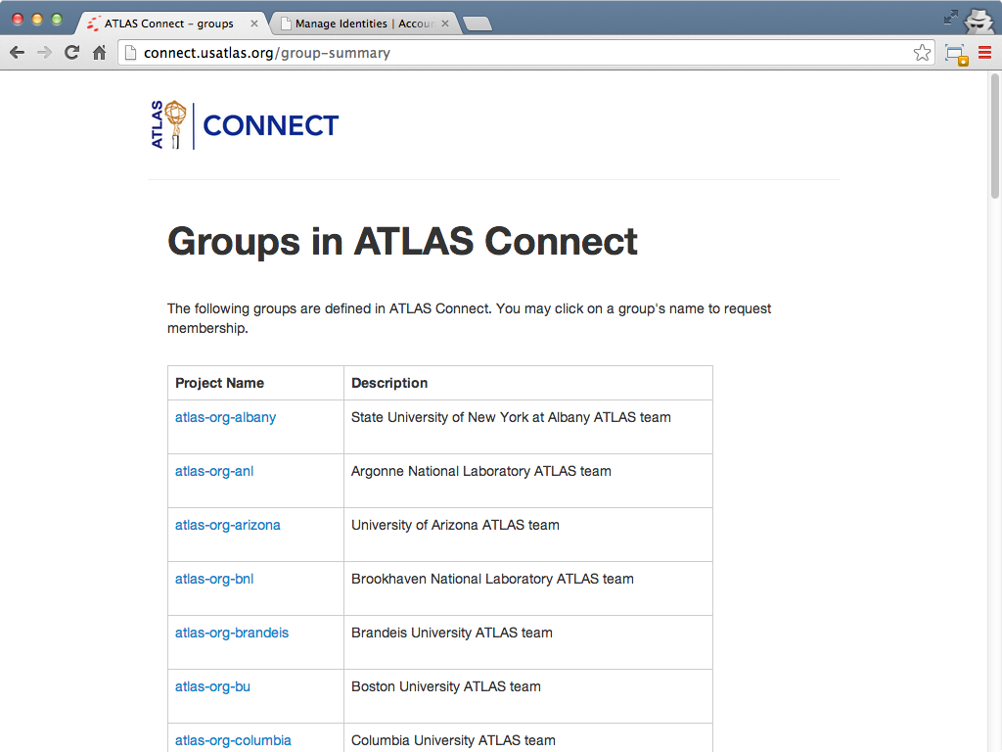

Slide 52
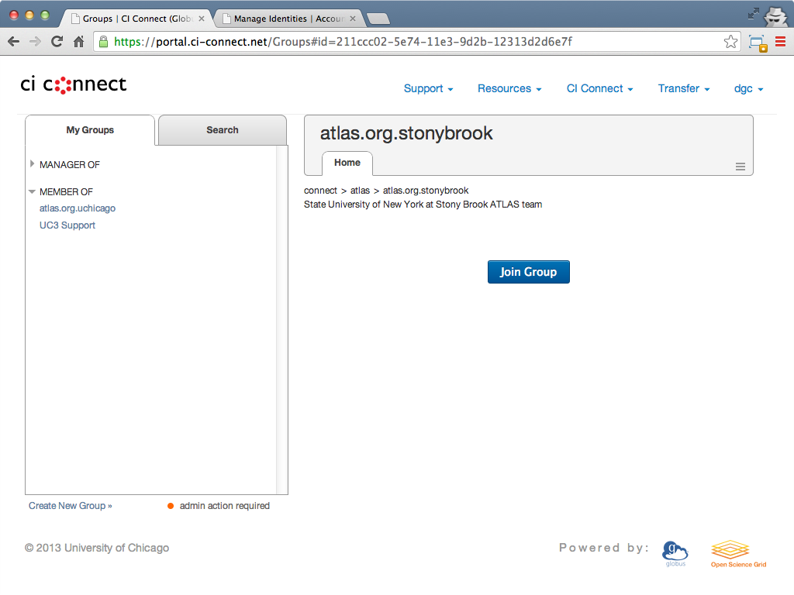

Slide 53
