Slide 1
VeloPix ASIC
7 November 2013
Xavi Llopart, Tuomas Poikela, Massimiliano De Gaspari, Ken Wyllie, Jan Buytaert, Michael Campbell, Vladimir Gromov, Vladimir Zivkovic, MvB
and others

Slide 2
outline
Note that the architecture of the VeloPix ASIC is not part of this review
However, since the VeloPix produces all data that has to be handled
by the DAQ it is presented here in some detail
Introduction
Data rates from physics simulation
VeloPix architecture / features
Data format
Slow / fast control

Slide 3
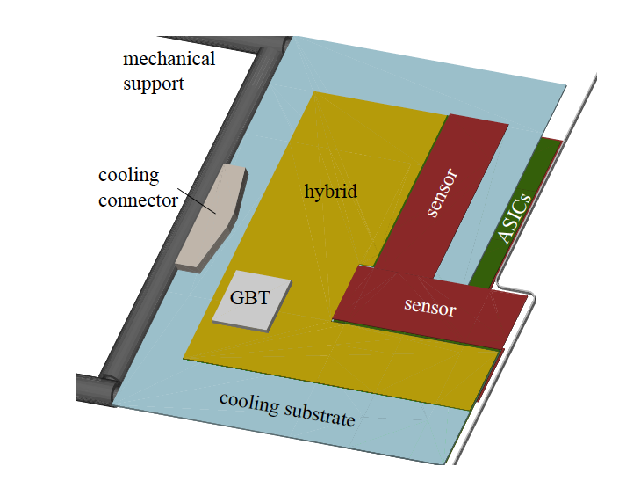
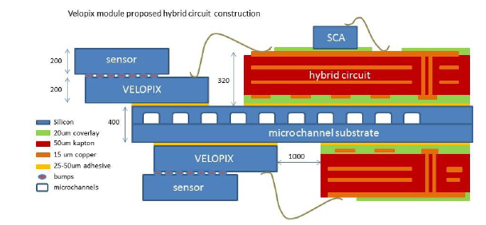
VeloPix module overview
~43mm
ASIC
Sensor tile :
ASIC
~15mm
ASIC
Beam
4 sensors per module
One sensor = 3 ASICs
VeloPix ASIC based on Timepix3
Each ASIC has 256x256 pixels
55 x 55 μm²

Slide 4
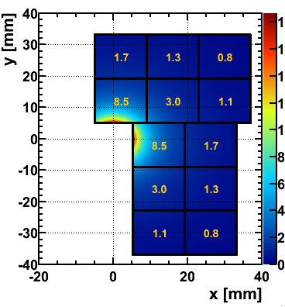
Track rates & radiation
for L = 2x10³³ and R_{min} = 5.1 mm, 2400 bunches, ν = 7.6
Non-uniform occupancy, large variation in
average rate from chip to chip
Average # particles / chip / event
  event = colliding bunch
  average (peak) rate: multiply by 26.8 (40) MHz
Hottest chip 8.5*26.8 (40) = 230 (320) Mtrack/s
=> ~ 600 (890) Mhits/s per chip
Radiation levels:
Order of 400 MRad in 10 year life time
and about 8.10¹⁵ 1 MeV n_{eq}
rad. tolerance demonstrated for this 130 nm technology

Slide 5
VeloPix
VeloPix is based on Timepix3
But has to cope with ~10x higher pixel hit rate
65k pixels, 55x55 um² each
130 nm technology
Chip dimension 14.1 x ~17 mm
Both TPX3 and VeloPix have a data driven readout
VeloPix is a binary pixel chip
  When a hit is registered
  It is combined with other simultaneous hits in the same super-pixel
  A 9-bit timestamp (BCID) is added
  And the packet is sent off-chip immediately
Advantages of binary readout: fixed pixel format, smaller data volume

Slide 6
Super pixel
Typical cluster size of 2 .. 4 pixels
-> beneficial to combine 2x4 pixels in a so-called super-pixel
Removes duplicate address and timestamp information compared to single pixel data packets
Bandwidth gain of 30-40%
Super-pixel (SP) has fixed boundaries
Share logic in centre of SP
  requires less area for routing
super pixel logic
Hit
Processor

Slide 7
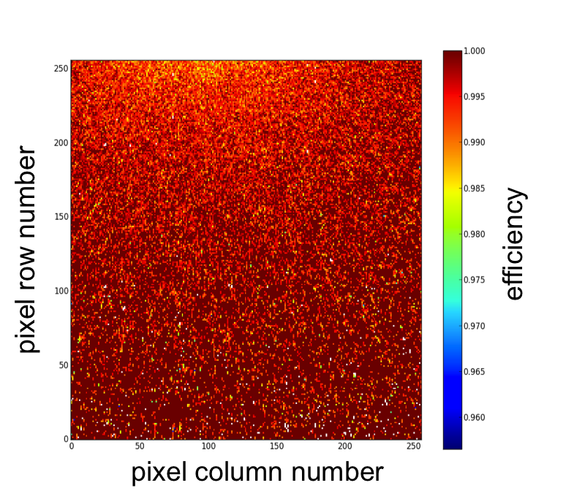
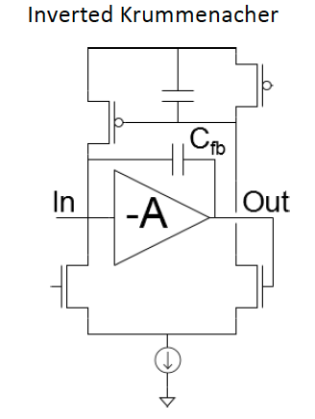
Analog Front-end
Massimiliano de Gaspari
Inverted Krummenacher scheme
  decouples discharge current from leakage current compensation current
Large discharge current reduces dead time and hence pile-up
Considering to add a fast clear for large signals
About 1% loss of hits for an average dead time of 200 ns

Slide 8
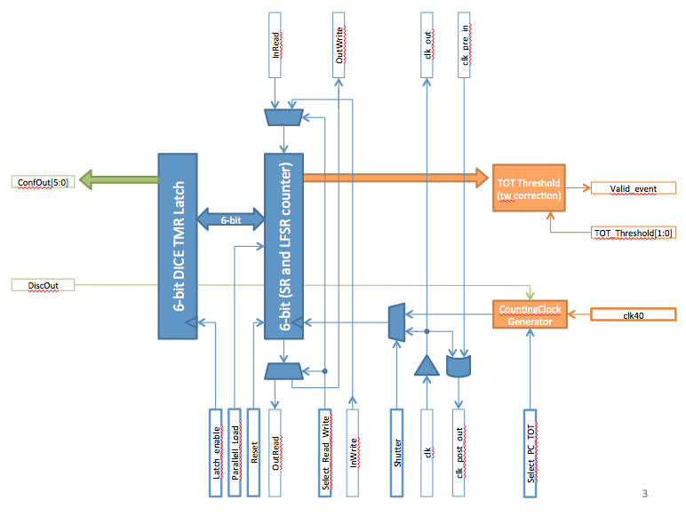
Pixel digital
Xavi Llopart
Normal operation mode: binary
Front-end can do Time-over-Threshold (ToT) measurement
Readout of ToT in special mode, and readout via (slow) ECS interface
Only for monitoring and calibration

Slide 9
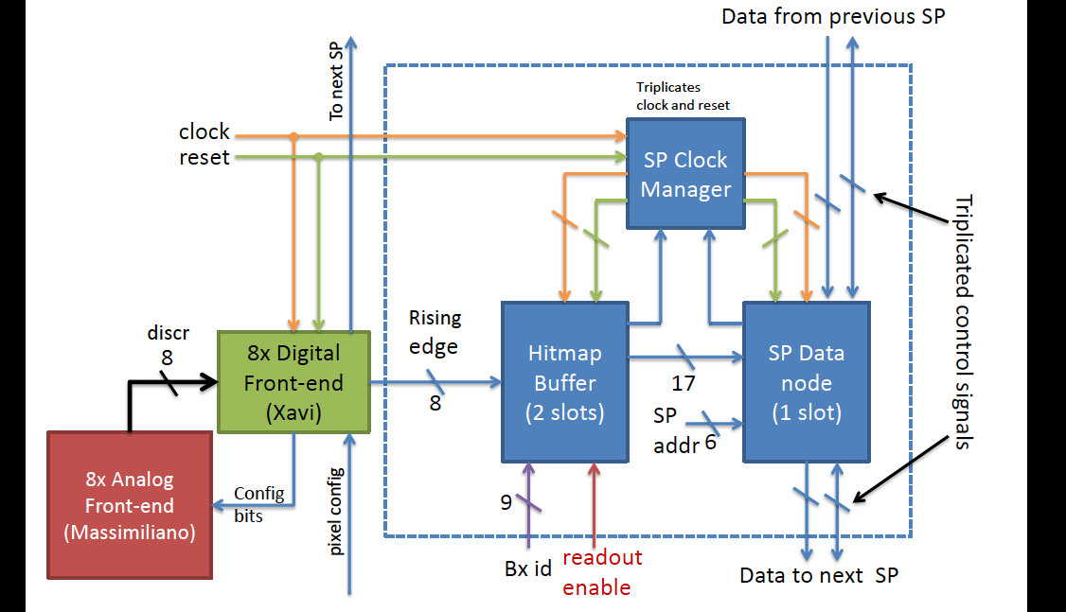
Super pixel
Tuomas Poikela
2 common buffers per super pixel

Slide 10
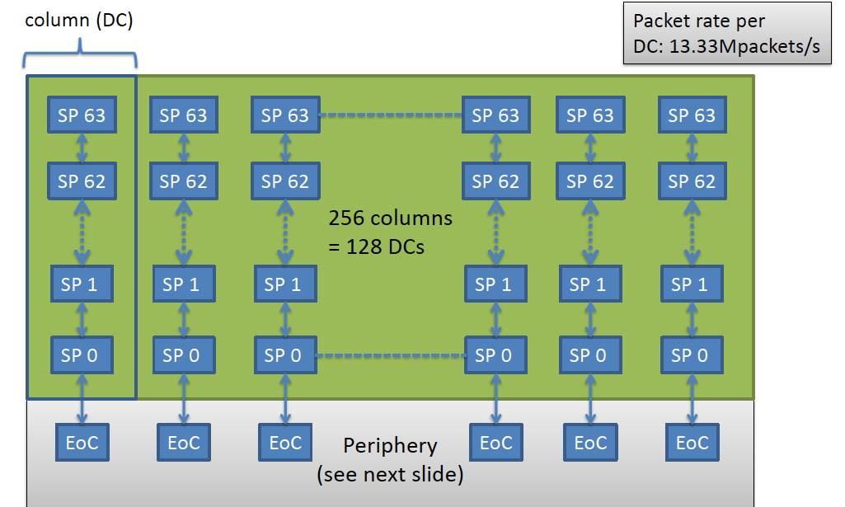
Double column readout
Tuomas Poikela
double
column
Packets ‘trickling’ down
More latency, but also more buffering
23 bits bus, 3 cycles per transfer -> 13.3 Mpacket/s

Slide 11
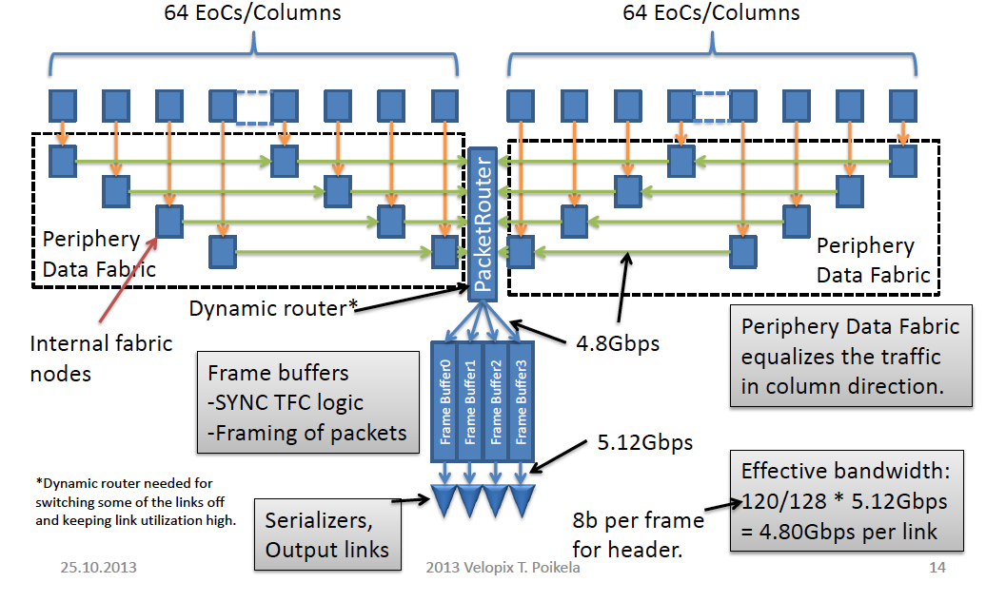
End of Column
Tuomas Poikela

Slide 12
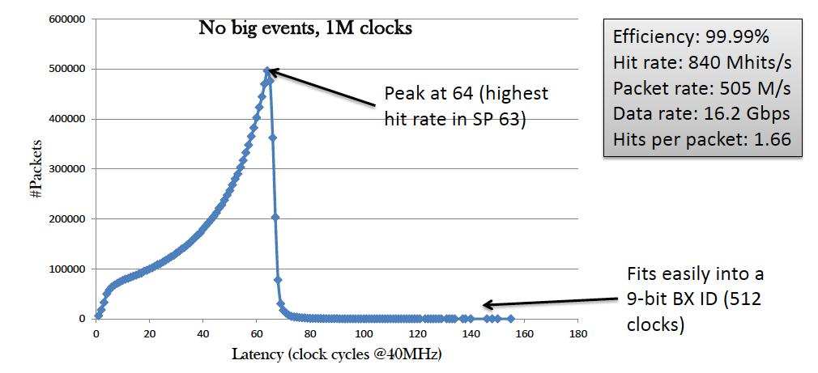
data-packet latency
Packet latency peaks at 64 due to pipelined Double Column readout
Drawback is that data packets are not ordered in time
Reordering required before other processing steps like clustering can be done
Must done by off-detector electronics (TELL40)

Slide 13
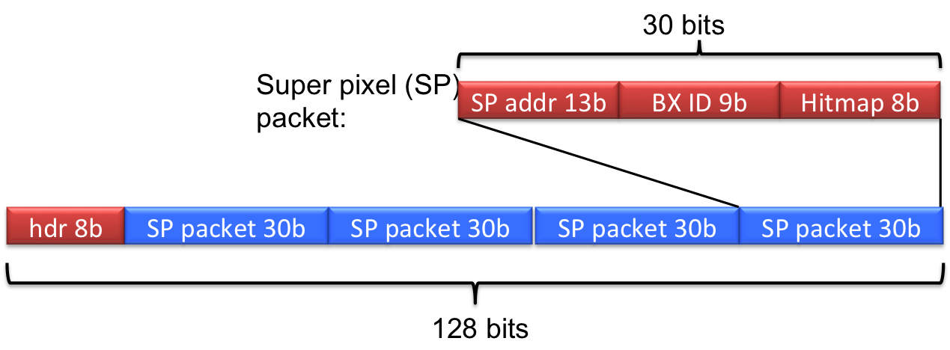
Data format
~900 Mhits/s for hottest ASIC
Packed into super-pixel packets: 2x4 pixels
~520 Mpackets/s, 30 bits each
-> required effective bandwidth ~16 Gbit/s
4 SP packets in 128 bit frame
8 bit header: 4 bit fixed (0x5) and 4 parity bits
SP packets are scrambled to reduce probability of long 0/1 sequences

Slide 14
High speed serialiser
Vladimir Gromov
2 options
GBT-serialiser (back-up)
  120 bits frame of which 112 are available for pixel data
  Input format 120 bits @ 40 MHz
  effective 4.48 Gbps per GBT-serialers
  total bandwidth 17.92 Gbps
  not plug and play from GBT, because of different metal stack (LM vs DM)
GWT: lower power, better matches the VELO data format, line driver with pre-emphasis
  128 bits frame of which 120 are available for pixel data
  Input format 8 bit @ 320 MHz DDR
  effective 4.8 Gbps per GWT-serialiser
  total bandwidth 19.6 Gbps
Technical review of GWT testchip last Monday
  will submit testchip in February 2014

Slide 15
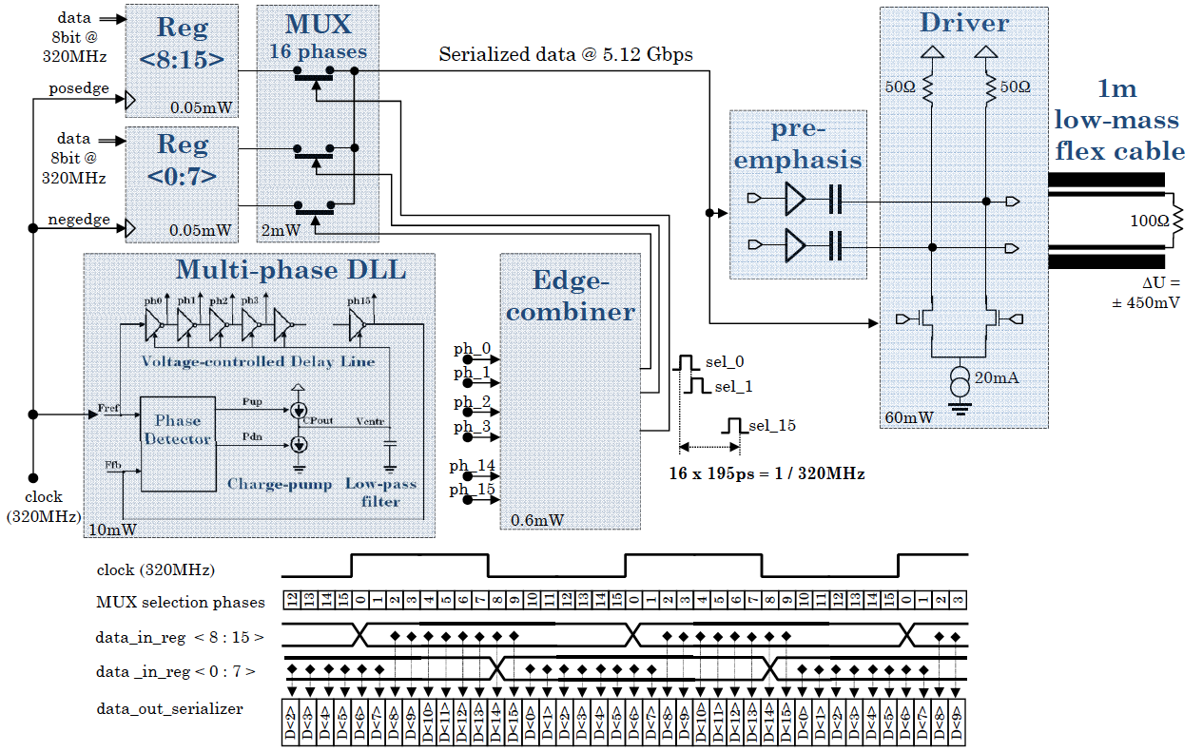
Gigabit Wireline Transmitter (GWT)
Vladimir Gromov

Slide 16
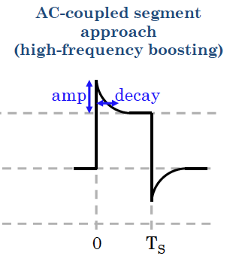
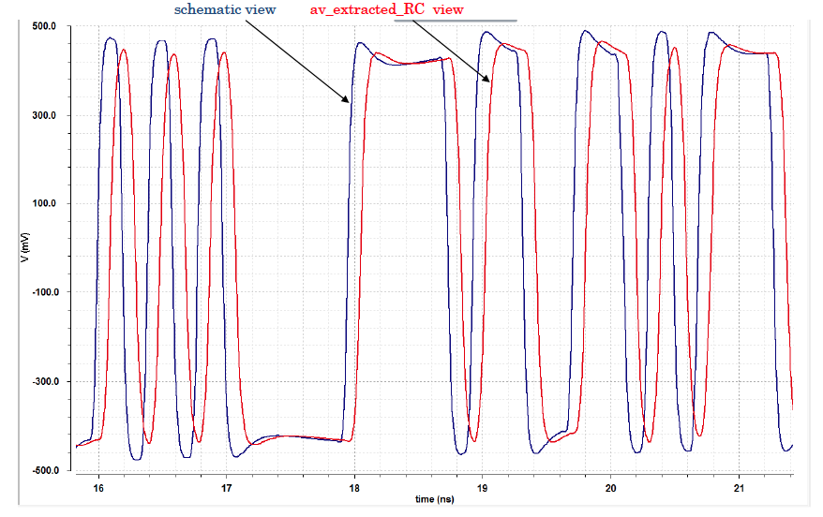
Pre-emphasis GWT line driver
Vladimir Gromov
Pre-emphasis via AC coupling
Simulation of extracted circuit
Includes (tuned) model of proto-type flex cable

Slide 17
Fast control
Vladimir Zivkovic
5 TFC signals will be provided via the GBTx on the hybrid
Decision on point-to-point or multi-drop bus to be taken
  either single PtP line at 320 Mbps
  or 5 parallel lines (multi-drop) at 40 Mbps
The VeloPix will respond to the following TFC signals
Front-end reset
  Clears all data from all buffers, but will not reset the configuration settings.
  Requires up to 64 clock cycles
Bunch count reset
  Checks and preload its internal 12-bit BCID counter with a configurable offset value.
  Reset should arrive at expected count, if not latch current value and increment error count
Sync
  Sends a predefined (configurable) pattern on its serialisers.
Snapshot
  The ASIC instantaneously captures the values of all internal counters. Readout via ECS
Calibration (testpulse)
  Timing signal for testpulse
The VeloPix can not provide non zero-suppressed data
Nor can it respond to the BxVeto

Slide 18

Slow control
Vladimir Zivkovic
Slow control data is set/read via GBT e-ports
Point to point connection between VeloPix and GBTx
Data rate 80 Mbps
All registers can be read back (non-destructive read)
To be decided whether we use an SPI like protocol using SSEL
Or whether we use a single e-port and a sync-header
SSEL
SCLK
W
MOSI
Chip Addr
Reg Addr
Data Payload
R
MISO
Chip Addr
Reg Addr
Data Payload

Slide 19
Backup slides

Slide 20
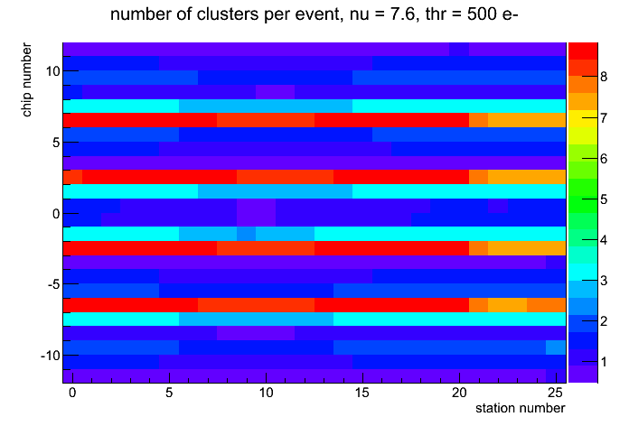
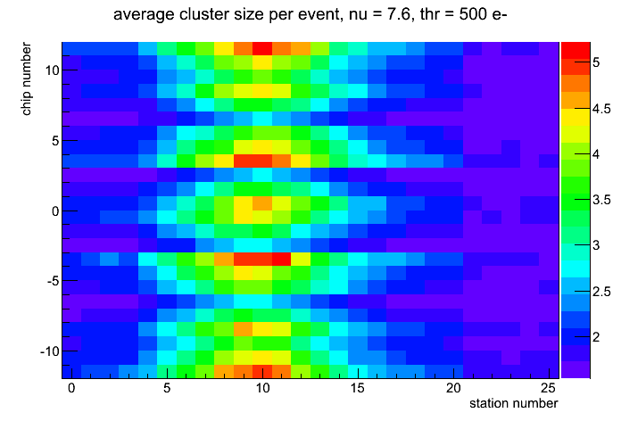
Cluster rate/size versus position
9
10
11
peak value of 8.83 clusters/event for hottest chip
Average clustersize is ~2.2
Regions with a high track density have an
(almost) average clustersize
Large clusters in low occupancy region
6
7
8
2
5
1
4
0
3
left side
right side

Slide 21
SPP rate versus position
9
10
11
average value of 12.6 clusters/event for hottest chip
  -> ~520 Mpackets/s without large events
Average # pixel hits in SPP = 1.6
Regions with a high track density have an
(almost) average clustersize
Large clusters in low occupancy region
6
7
8
2
5
1
4
0
3
left side
right side

Slide 22
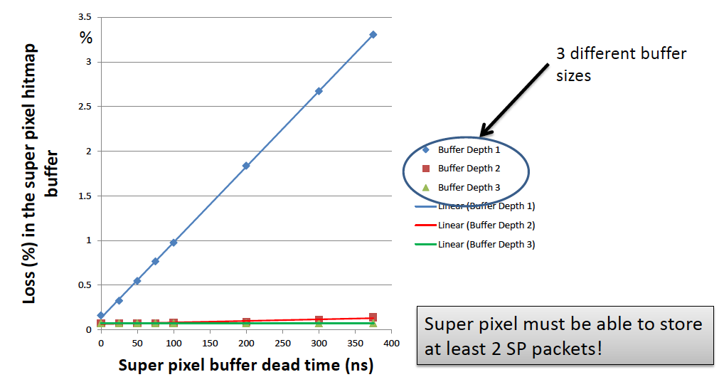
Buffer depth
Tuomas Poikela

Slide 23
VeloPix specifications
VeloPix Features (L=2x10³³ cm⁻²s⁻¹)
Pixel size | 55 μm x 55 μm
Pixel matrix array | 256 x 256
Super pixel size | 2 x 4 pixels
Dynamic range | 50 ke⁻
Timewalk | < 25 ns (@ 1ke⁻)
Time stamp (Bunch ID) | 40 MHz (25 ns resolution)
Operation modes of pixel | Binary, ToT via ECS only
Timestamp | 9 bit
Readout mode | data driven (data push), superpixel packets
Sustainable hit rate | average 600 MHits/s, peak 900 MHits/s
Power consumption | < 3 Watts per chip @ 1.5V (1.5 W/cm²)
Output bandwidth | ~ 16 Gbit/s peak
Radiation tolerance | > 400 MRad

