Slide 1
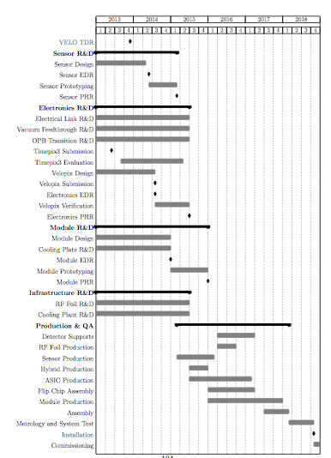
VELO Upgrade Timeline
VELO Upgrade schedule almost finalised for TDR
Today we discuss suggested timelines for the electronics part
Many thanks for input to Martin, Eddy, Jan, Lars, Karol, Tony +++

Slide 2
Module Construction & Assembly
2013
2014
2015
2016
2017
2018
Installation
commissioning
-> mid 2019
Module construction begins
Module construction
ends
Assembly onto bases begins

Slide 3
Velopix Schedule
2013
2014
2015
2016
2017
2018
Module Construction
Assembly
Velopix0 submission
received Q3 2014
Velopix0
verification
Velopix1
test
Velopix1
mass production
reception Q1 2016
Velopix1 “final”
submission
(first 6 wafers can
be used for production)

Slide 4
Tile Production Schedule
p&p = production & prototyping
2013
2014
2015
2016
2017
2018
Module Construction
Assembly
Velopix Design
Velopix p&p
UBM processes
Dicing & thinning
flip chipping

Slide 5
Hybrid Schedule
p&p = production & prototyping
2013
2014
2015
2016
2017
2018
Module Construction
Assembly
Velopix Design
Velopix p&p
Tile production
Hybrid design using
Timepix3 for test
Hybrid production starts
Hybrid prototyping (high speed)
with Velopix0

Slide 6
Link, OPB, Feedthroughs
p&p = production & prototyping
2013
2014
2015
2016
2017
2018
Module Construction
Assembly
Velopix Design
Velopix p&p
Hybrid Design
Hybrid Prototyping
Tile production
Electrical Link R&D
OPB R&D
Production
Vacuum Feedthrough R&D

Slide 7
Firmware and ECS Development
p&p = production & prototyping
2013
2014
2015
2016
2017
2018
Module Construction
Assembly
Velopix Design
Velopix p&p
Hybrid Design
Hybrid Prototyping
Tile production
Electrical Link R&D
OPB R&D
Production
Vacuum Feedthrough R&D
First stage slice + selftest
Second stage slice
Commissioning

Slide 8
Proposed Dates for EDR and PRR
p&p = production & prototyping
2013
2014
2015
2016
2017
2018
Module Construction
Assembly
Velopix Design
Velopix p&p
Electronics EDR
Hybrid Design
Hybrid Prototyping
Tile production
Electrical Link R&D
Electronics PRR
OPB R&D
Production
Vacuum Feedthrough R&D
First stage slice + selftest
Second stage slice
Commissioning

Slide 9
Resources
Production stage | Host Country
Electrical Link | UK, Spain
Vacuum Feedthrough | UK, Russia
OPB | UK
HV + LV | UK
General Electronics | UK, Brazil
Hybrid | UK, Spain
DAQ Integration + ECS | UK, Brazil
FE ASIC | The Netherlands, Switzerland
R&D, Design, Optimisation, QA, Testbeam | UK, The Netherlands, Spain, Brazil, China, Russia, Switzerland
Official production tables leave many tasks open.
e.g. ASIC wafer testing, bench and testbeam activities, production database etc.
may be led by an institute but contributions are possible

