Slide 1
Cloud Computing
Special Interest Group
Cloud Computing for the UK Research Community Workshop
28-29 December 2013
Philip Kershaw, STFC Rutherford Appleton Laboratory

Slide 2
Overview
Who is the Cloud SIG?
Why and why now?
Workshop structure
Desired outcomes

Slide 3
Cloud SIG Committee Members
David Blundell, 100 Percent IT
John Chapman, JANET
Neil Chue-Hong, Software Sustainability Institute
David Colling, Imperial College
David Fergusson, Crick Institute
Roger Jones, CERN
Philip Kershaw, STFC Rutherford Appleton Laboratory (chair)
David Wallom, Oxford e-Research Centre
Jeremy Yates, UCL

Slide 4
Origins
Formed as a follow up from e-Infrastructure Project Directors Group meeting, July this year
  Identified key areas where it was felt there could be benefit from greater co-ordination
  e.g. cloud computing, identity management and access control . . .
The SIG is an independent group
A second incarnation
  Original SIG co-ordinated by Neil Chue Hong (SSI) and Jeremy Cohen (Imperial College)

Slide 5
Why?
Too many SIGs already?
The effectiveness of a SIG:
  the need to actively create, co-ordinate and enable
We seek to have a direct link with and support projects which are already underway in this space
There is much existing work in this area already
  Reports: Magellan (DoE 2011), Cloud Computing for Research (JISC, 2010), …
But it is a fast moving area with new challenges

Slide 6
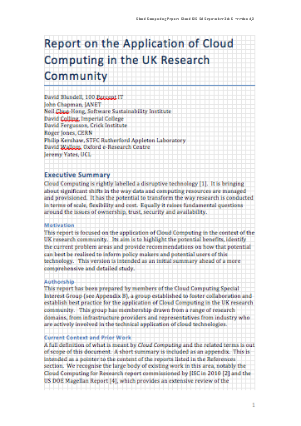
Challenges and Opportunities
The challenges of Big Data are impacting on a wider set of communities within the research domain.
  Cloud computing provides one solution to tackle these challenges the ability to
    to scale out compute and storage
    to bring users to data through the provision of hosted processing and analysis environments at data centres
Opportunities provided through recent investment from UK government in e-Infrastructure
Increased maturity of software for private cloud provision (e.g. OpenStack and vCloud)
Increased availability of pre-packaged Virtual Appliances for scientific computing (e.g. Galaxy CloudMan)
Cloud SIG Executive Summary

Slide 7
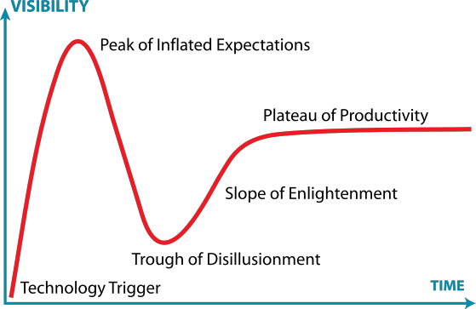
Issues to Address
Standardisation of interfaces
  multiple competing standards, a lack of standards, incomplete standards or existing standards with insufficient uptake
SLAs and charging models
  need for greater understanding, education for users
  Difference between commercial and research funding models
  Can public providers make custom SLA arrangements for research sector?
Danger of fragmentation within research community
  Bespoke solutions developed for generic problems
…
Gartner Hype Cycle

Slide 8
Terms of Reference
The SIG has a number of goals as follows:
To establish best practice for the application of cloud computing in the UK research community
Share this best practice and provide recommendations where needed
Execute these recommendations
Focus work around existing projects in the research community to ensure a direct connection to practical application of cloud technologies.
Co-ordinate efforts and foster collaboration across research communities seeking to avoid domain-specific solutions

Slide 9
Workshop Structure
Structured around three themes
  Public cloud
    How can research users best exploit public cloud resources?
    Give provider and consumer perspectives
  Private cloud
    A number of organisations from the research sector are considering or in the process of rolling out a private cloud
    How can a cloud best integrate with existing infrastructure and functions? - data centre, HPC, hosted processing and analysis environments
  Cloud federation and brokering
    What are the opportunities that are offered from procuring resources from multiple providers?
    What are the technical and policy-related challenges?
    Can brokers support the user community to get the best service?

Slide 10
Outcomes from Workshop
Identify a set of themes, common problem areas
Select priority areas
Use pilot projects as practical vehicles to
  explore these and find solutions or
  provide momentum for solutions
These should be existing projects already running or planned in the research community
  Provide a single voice to lobby for change
(to explore further in final session tomorrow)

Slide 11
Summary
Public cloud
  Ability to massively scale-out
  Immediate availability
  Trust
  WAN b/w – data in / data out
  Service models and SLA that fits the research community’s needs
Federation and brokering
  Technical:
    opportunity to select from a range of providers with a common interface
    technical challenges, evolving capability
  Policy: possibility of collective bargaining
Private cloud
  Capex vs. opex with open source vs. proprietary
  Complexity in deployment, available features, stability
  Licensing
  Trajectory of s/w vendor be it open source or proprietary

Slide 12
Next Steps
SMART objectives
  Specific, Measurable, achievable, realistic, time-bound
What common themes do we have across the community?
  Private cloud expertise
  Hybrid and federation: APIs, virtual appliance portability
  Charging models, SLAs
Training
  Help users - Making cloud friendly tools
Policy-based?
Technical?
  Document tech best practice to eliminate misunderstanding about what cloud can and can’t do
What assets do we have as SIG?
  collective input and co-ordination
  Exchange of expertise and best practice
Know who your users are
  IaaS and PaaS, SaaS are different users: admins, developers/researchers, end users
SIG put proposals BUFDG (British Universities Finance Directors Group)
  Best practice about financing cloud computing for research

