Slide 1

Janet and Cloud
Services

Slide 2
Not just about research
Respond to expressed needs
No solutions in search of a problem
Look first at value then cost
Try to get at REAL costs
Consider risk (many young start-ups)
Leverage Janet network and resources
Co-operate internationally where we can
Help potential service providers
  (whether commercial or sector based)

Slide 3

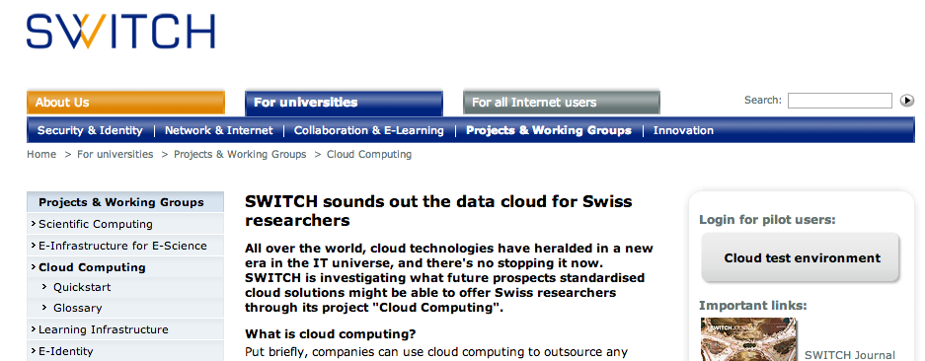
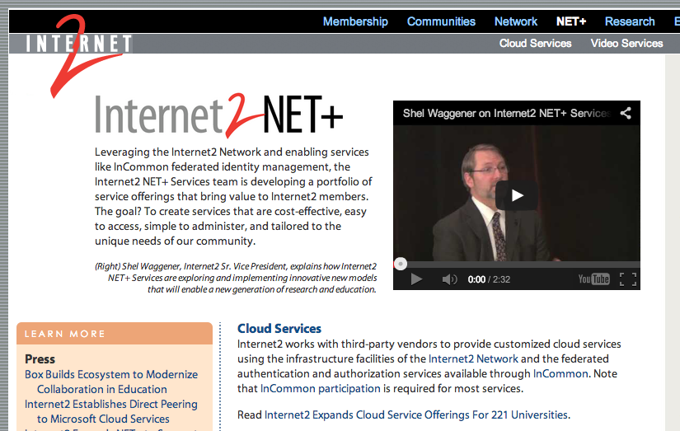
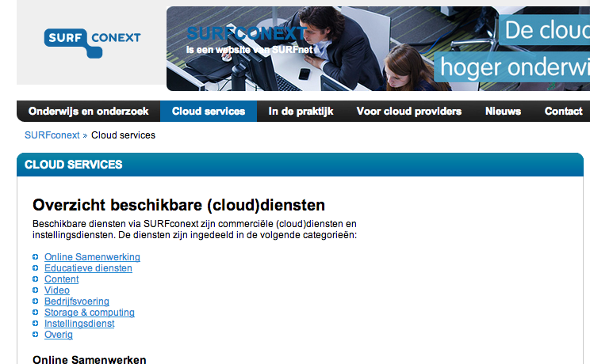
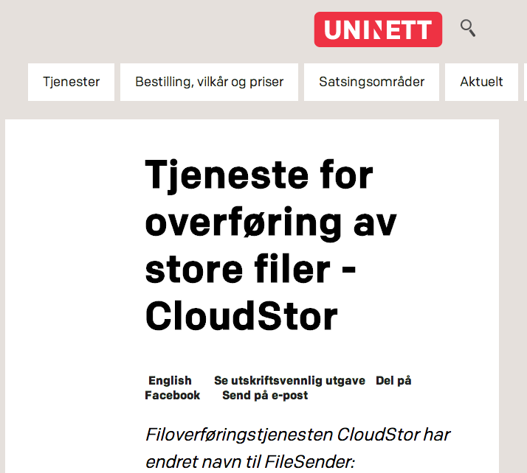
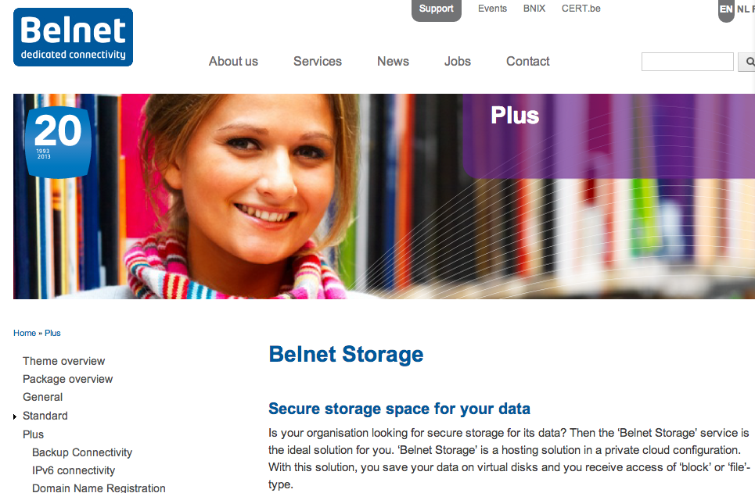
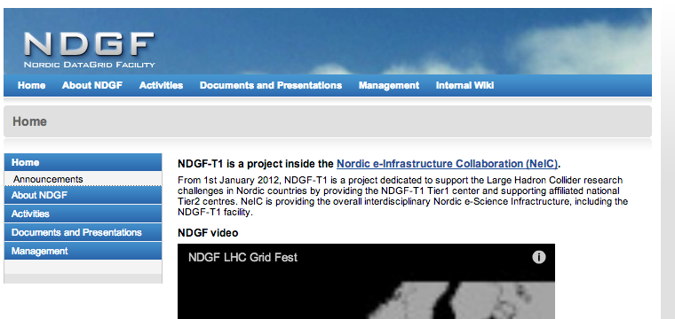
Everybody is doing (talking about) it!

Slide 4
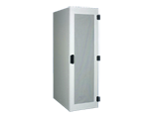
Janet Cloud Context
Cloud Services?
Cloud Services?
Internet
Janet Network
Core Asset
Layers:
Network Infrastructure
Identity Management
Cyber Security
Institution Network
Local resources

Slide 5
Janet Cloud Future
Shared DCs
Amazon
AWS & Glacier
Google
Apps &…
Research Data Archiving
HPC & ???
Microsoft O365 & Azure
Internet
Janet Network
Critical Asset
Layers:
Network Infrastructure
Identity Management
Cyber Security
Other cloud providers
Institution Network
Other DC providers
Research Data Stores in Hybrid solutions
Local resources

Slide 6
Streams
Currently we are working on:
MS Office365 – including with Research Councils and government
MS Azure
Google Apps
GCloud
Data Centre Framework
Dropbox/Box and DPS File sync and share
Boxcryptor, nCrypted-cloud
Amazon Web Services
Research Data Archiving (to tape initially)
Costing IT Services - Financial X-Ray
Hybrid cloud IT infrastructure projects at L’boro STFC and Newcastle
HEFCE cost benefit study

Slide 7
Non - Streams
Things we’d like to be doing too:
Community technical projects e.g. Terena Trusted Cloud, Slipstream (EU Grid);
International agreements e.g. Box, Canvas, Crashplan;
Sector initiatives e.g. UniVault;
UMF initiatives e.g. Brisskit;
Speculative initiatives e.g. Figshare (originally from Imperial);
HPC initiatives e.g. N8, GreenQloud;
Research Data Management initiatives;
Profile raising activities;

Slide 8
Model of Work so far
CO & GCloud
National agreements
Apps & Office
Research Councils
File Sync & Share
Due diligence DPA
SAAS
More…
Eu NRENs
Technical
PAAS
Global Partners
Azure, AWS
Development?
IAAS
Archive to tape
DfE
Data Centres
Commercial
Aggregated DCs
Universities
DC Efficiency
Procurement
Financial X-Ray
Colleges

Slide 9
Around the corner…
Purely in SaaS we could be asked to contribute to…
Apps & Office
File Sync & Share
SAAS
VC & streaming
CRM
Registration
VLE
Reporting
HR
Web
Online Assessment
Virtual Desktop
Compliance
Accounting
Research Tools
Alumni…
Network & monitoring
Building monitoring
ERP
Events
VMWare
MatLab
Billing / Invoicing

Slide 10
Organisational Priorities
If we believe in a converged infrastructure what is needed to deliver real results?
Security
AIM
SKILLS!
Cloud & Data Centres
Connectivity

