Slide 1
The EGI Federated Cloud, using standards to create a fair and open European Cloud marketplace
David Wallom
Chair, EGI Federated Cloud

Slide 2
Outline
Brief introduction to EGI
EGI Federated Cloud
EGI’s Cloud strategy for the future & H2020

Slide 3
Outline
Brief introduction to EGI
EGI Federated Cloud
EGI’s Cloud strategy for the future & H2020

Slide 4
European Grid Infrastructure (EGI)
337 Resource Centres in 34 National Grid Initiatives/EIROs
430,000 logical CPU cores
190 PB disk, 180 PB tape
1.2 M job/day, EGI-InSPIRE PY3: +44.7% increase of
CPU wall clock time used (HS-06 h)
53 High activity projects supported by EGI
EGI-InSPIRE EC Project (2010-2014) supporting
EGI and NGI operations
Outreach and policy development
Software validation and verification
Federated cloud

Slide 5
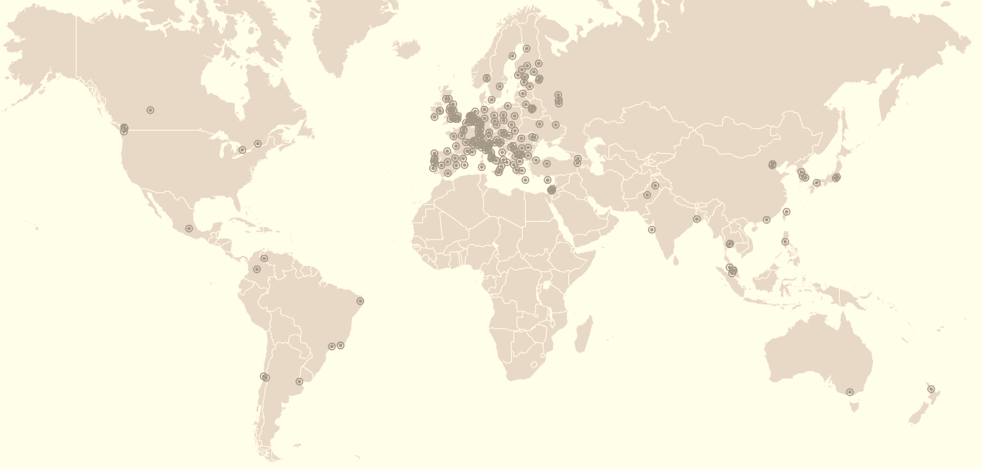
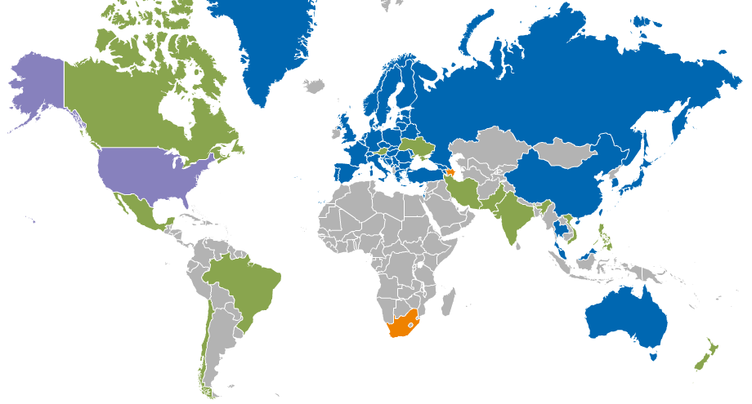
European Grid Infrastructure 2013
Integrated EGI-InSPIRE Partners and
EGI Council Participants
Internal/External RPs being integrated
External RP
Peer RP

Slide 6
Outline
Brief introduction to EGI
EGI Federated Cloud
EGI’s Cloud strategy for the future & H2020

Slide 7
From Pilot to Production
Objectives:
  Identify and investigate the capabilities needed to federate private clouds
    Promote adoption of defined open standard interfaces (OCCI,CDMI)
  Identify the technical solutions, deploy proof of concepts in a pre production testbed, test the solutions with real use cases
    Integrate the cloud services with the EGI core platform
Capabilities
  Manage VM instances
  Data access/transfer interface
  Cloud service information federation
  Resource consumption management
  Cloud service availability
  Notification & Automation
  Federated AAI
  VM Image Management
  Brokering
  Contextualisation
  SLA & Business Models
Setup 09.2011
Consolidation 09.2012
Integration 03.2013
Preproduction 09.2013
Production 05.2014
Notes:
Define the Cloud Federation layer
Promote adoption of common interfaces (OCCI,CDMI)
Investigate the capabilities for the federation of clouds
Integrate the cloud services with the EGI core platform
auth and authz, accounting and monitoring, service registry, service

Slide 8
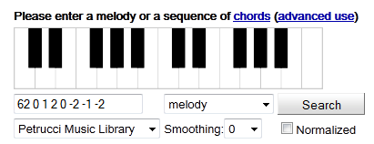









Participation – Nov 2013
Cyfronet
FZJ
OeRC
EGI.eu
CESNET
GWDG
BIFI
INFN-BARI
CNRS
IN2P3
Technologies
OpenNebula,
StratusLab,
OpenStack,
Synnefo,
WNoDeS,
Cloudstack,*
PERUN,
SlipStream.
KTH
Members
~72 individuals
~34 institutions
>14 countries
Masaryk
FCTSG
INFN-CNAF
CETA
CESGA
IGI
Stakeholders
23 Resource Providers
  10 production
10 Technology Providers
10 User Communities
4 Liaisons
SARA
RADICAL
IFCA
STFC
SZTAKI
BSC
GRNET
ISRGrid
DANTE
LMU
IPHC
IISAS
SixSq
100%IT
CSC
IFAE
SRCE
Notes:
- Highlight arrival of commercial provider and that the institutions are from all three stakeholder communities, Resource providers, technology providers and user communities
-

Slide 9
EGI Platform architecture
Core Infrastructure

Slide 10
EGI Core Infrastructure
Services that federate and integrate the functional services deployed in the production infrastructure
Information
Service
AAI
Service
Monitoring
Accounting
Metrics visualisation
Service Registry
Messaging
For e-Infrastructures & Research Infrastructures

Slide 11
EGI Platform architecture
Virtual Research Environment
(VRE)
VRE
VRE
Core Infrastructure
VRE
VRE
VRE
Community PaaS
High-Throughput
Data Analysis
Platform
Federated IaaS Cloud

Slide 12
EGI’s Cloud Infrastructure
Enable an open ecosystem of services
EGI Collaboration Tools
EGI Cloud Infrastructure Platform
OCCI
CDMI
VM
Mgmt
Storage
Mgmt
Image Repository
Cloud Management Frameworks
(OpenStack, OpenNebula, Stratuslab …)
OVF
EGI Application DB
EGI Core Infrastructure
SAML
GLUE2
UR
Federated AAI
Service
Discovery & Status
Monitoring
Accounting

Slide 13
Open Standards approach
OCCI: Open Cloud Computing Interface
  RESTFul API to manage virtual machine in the Cloud
  From OGF
CDMI: Cloud Data Management Interface
  RESTFul API to create, retrieve, update and delete data elements from the Cloud
  From SNIA
OVF: Open Virtualization Format
  Standard format for packaging and distributing virtual machines
  From DMTF
SAML: Security Assertion Markup Language
  Standard for conveying identity tokens and attributes
  From OASIS
GLUE2:
  Standard to describe and publish information on structured distributed infrastructures
  From OGF
UR: Usage Records, v2
  Standard to express, collect and aggregate usage accounting records
  From OGF

Slide 14
Cloud service provisions
EGI.eu
Service availability monitoring
Application/VM database
Other providers
Meta service-brokering
Resource usage accounting
Federated AAI coordination
Service discovery (GOCDB & BDII)
VM Image distribution network
User community management
IaaS Cloud storage
IaaS Cloud compute
Resource Providers

Slide 15

Federated Cloud Users
New services to meet user demand
  Use case driven
Proof of concepts being successfully demonstrated (http://go.egi.eu/PoC)
  Hosting of services for data dissemination (SaaS) – ENVRI, EISCAT_3D, BNCWeb/CLARIN
  Digital Libraries and Digital Preservation services for memory institutions and human science - DCH-RP
  Integrated Cloud Iaas-SaaS services to avoid large data transfers (ESA)
  Virtual laboratories (PaaS and IaaS) – BioVel, LifeWatch
  Hadoop clusters on demand (PaaS) – Peachnote, BioVel
  Researcher training in safe, low cost environments on community tools – WeNMR
  Repeatable and controllable software development and build environments – SCI-BUS
  Science gateway hosting and access to resources – CSGF
  …

Slide 16
Use cases 1
Platform | Description | Key services | Use cases
Data dissemination/Open data | Cloud storage provides an infrastructure to collect and disseminate scientific data. Data intake is curated, data access is inherently open (anonymous) or tracked (social identity?) | SaaS catalogues tailored to user communities (ex. EO, Biology, etc…) Custom Data ACL Federated AAI for data access Monitoring of data usage | ENVRI GeoCatalogue EISCAT 3D Peachnote
Secure Storage | Stored data is protected even from RP access (e.g. through encryption). Safe for storing (personal) confidential data. | Keys management Server-side encryption Secure data deletion Data sharing with ACL | Arvados
Location-based computing | Input data is stored on the cloud, processing is on the same cloud or in federated data-centers to have high data access throughput with own applications; “ | Integrated Cloud Iaas-SaaS services to avoid large data transfer IaaS to provide processing flexibility Input data stored openly to attract different communities | ESA G-POD Arvados
Virtual Laboratories | Tools to customize and manage virtual laboratories for different communities. Laboratories have shared tools to access data from different sources. User communities manages the instruments, EGI operates the underlying infrastructure and provides the generic tools to access storage (cloud storage, etc...) | Common shared tools to access data from different resources Tools to ease laboratories setup Underlying IaaS and SaaS to support running of the laboratories and store user data storage (with easy scalability) Simple user interface to request laboratories access | BioVeL virtual e-laboratory LifeWatch virtual laboratory

Slide 17
Use cases 2
Platform | Description | Key services | Use cases
Data preservation | Data long-term preservation. To provide consolidation, persistency, integrity, redundancy, and usability over long periods of time. | Data consolidation (ensure all the data is harmonized in terms of format, nomenclature, access, etc…) Data integrity and redundancy (ensure no loss of data) Data access preservation (ensuring software to read and analyze the data is maintained) | EISCAT 3D DCH-RP HEP
Platform-as-a-Service | Pre configured processing facilities with integrated access to data, running on top of cloud IaaS and SaaS solutions. Possible PaaS services are: Grid Computing Hadoop Clusters on demand Generic High Avaliability service | Scalability (adapt to the workload) High Availability (resources are always available) Resource sharing (different services share the same underlying physical resources) | Peachnote BioVeL HA

Slide 18
Outline
Brief introduction to EGI
EGI Federated Cloud
EGI’s Cloud strategy for the future & H2020

Slide 19
EGI Vision
To support the digital European Research Area through a pan-European research infrastructure based on an open federation of reliable services that provide uniform access to national computing, storage and data resources.
EGI federated Cloud vision for H2020:
10M cores Cloud compute
1 EB Cloud storage
Notes:
Support digital Research Area
Pan-European research infrastructure
Open federation of reliable services
Uniform access to national resources

Slide 20
Technology Evolution
Broader support for open standards in Cloud management frameworks
Federated Network as a Service / Software defined networks
Messaging network as a Service
Improve Application Database to App Marketplace
  Stable market for cloud services, cloud products and applications between providers and consumers from the academia, public sector and enterprise
Strengthening the underpinning platform

Slide 21
Technology Innovation
Use federated IaaS Cloud as EGIs backbone
Open standards for open platforms
Innovate and deploy PaaS & SaaS on top
Engaging in PoCs & EC projects with EGI customers
Value added services for VRCs

Slide 22
EGI Cloud service tiers
Reliable IaaS services
  Expose federated IaaS Clouds to customers
  User driven choice of provider depending on high level criteria
General purpose platform services
  Expose platform services as individual service offerings
  Customer mixes and matches according to need
Platform as a Service
  Consistent platforms comprising of individual platform services
  Platform services integrated/configured in meaningful way
  Targets customer segments (e.g. CH) or usage scenarios (data preservation)
Zero ICT infrastructures
  Specific customer infrastructures delivered as SaaS
  Extends beyond ICT into complete VRE supply (e.g. lab facility management)
Notes:
With these investigating with diffferent communities different pricing & support models

Slide 23
Marketplace(s) for Cloud Services
Standardisation of Cloud interfaces empowers freedom of choice for customers, better competition among providers and emergence of cloud marketplaces
EGI Marketplace
  Rich and diverse set of individual offerings
  Application/VM Image repository
  User community choice of provider at all levels
  Academic and commercial resource & service providers
Helix Nebula Marketplace
  EGI Federated Cloud as service provider
  “Hidden” behind Slipstream/CGI broker
EU Cloud for Europe marketplace
  Integrate EGI’s solution and service portfolio
  Provide services for academia, government and business

Slide 24
Value proposition
Open standards, open technologies
  Use of Open Standards is key to the establishment of an effective, fair and transparent cloud market in Europe
  Open Source components raise the barrier for hidden backdoors, thus lead to more trusted services
Firmly rooted in Europe
  Strong public sector involvement through NRENs, NGIs, EIROs are EGI’s members
  European commercial Cloud resource providers, including SME
A single cross-border market
  Reaching out for research, government & business sectors
  Level playing field for innovation and services on multi-service tiers

Slide 25
Fit for the Digital Agenda
Action 1: | Interoperable, federated IaaS Cloud infrastructure
Action 2: | Public sector Cloud federation for Cloud for Europe marketplace
Action 3: | Engage in and lead H2020 e-Infrastructure, ICT LEIT & CEF projects to boost Cloud service market
Action 4: | Transparent, accounting, billing & SLAs; common T&Cs
Action 5: | EGI maintains close relationships with policy makers through strategic partnerships (e.g. SIENA, CloudWATCH projects, e-IRG) and concertation meetings (e.g. ICT, Cloudscape series)

Slide 26
Conclusion
EGI: Community of resource providers with long-term tradition in providing federated ICT services for research
EGI Federated Cloud: Paving the way for a federated cloud in Europe
  Open standards, open technology
  Open membership, open processes
  Full production, May 2014

Slide 27

Thank you!
Questions?

