Slide 1
Virtualisation and Cloud Computing at EBI
Steven Newhouse, Head of Technical Services

Slide 2

European Bioinformatics Institute
Outstation of the European Molecular Biology Laboratory
International organisation created by treaty (cf CERN, ESA)
20 year history of service provision and scientific excellence
EMBL-EBI has 500+ Staff & €50 Million Budget
Provide services to a wide range of users using an “easy-as-possible” usage model
Thin-client model
  Web browser & web services
  Equivalent to SaaS

Slide 3
The Challenge Facing Bioinformatics
Volume and variety of genomic data expanding
  Data at EBI doubling every year - replication is challenging
  >10,000 CPUs & 30PB (but need more!)
Complex analysis
  Access to both public and managed access data sets
  Bespoke workflows and tools across a variety of domains
  Issues with disk to memory bandwidth
EMBL-EBI Provides
  Public & restricted data sets
  Web and programmatic access to services (3M unique users)

Slide 4
Impact on EMBL-EBI’s Infrastructure
Grow the capacity of the current data centres
  Commodity infrastructure – blades and NAS (50 racks)
  RDBMS and SAN for high throughput transaction processing
  Tape backup is no longer feasible
Provide a resilient topology by geographical separation
  Against local & regional disaster in the UK
  Against national disaster through international collaboration
Enable new easier science through the cloud
  Provide access to the increasingly hard to replicate data sets
  Embassy Cloud: IaaS service coupled to public data sets

Slide 5
Overview EMBL-EBI IT infrastructure
Data centre virtualised throughout with VMWare
Notes:
Overview of the IT infrastructure in better detail focusing on the data lifecycle:
The Hinxton Production DC can be logically thought of two main areas:
a production area: where data and applications go through their dev/test/prod cycle
a staging area: this is a pre-release area where data and applications that are in their final state prior to be released to the public are transferred and undergo any necessary tests. The IT infrastructure in the staging area is (in smallest scale) consistent with the IT infrastructure in the 2 LDCs. This means that this is not an area to run performance tests but it’s an area to run any test to verify the application/data behavior in an environment as the LDC public-facing.
The green circles represent respectively the Primary data in HX and the Mirrored data in FC. Approximately in 2007/2008 EBI has abandoned backups of filesystem unstructured data on tapes and opted for data mirroring instead.
The orange circles represent the pre-release data in Hinxton and the released data in LDCs.
The green arrows represent the data propagation methods from the production to the staging environment where needed.
The orange arrows represent the data propagation methods from the staging environment to the LDCs.
The data synchronization methods between HX and LDC differ according to the optimal architecture for the public facing service backend dataset: some datasets are unstructured data on filesystem and some are relational databases (Oracle and MySQL)
to synchronize unstructured data we use the native data mirroring mechanisms offered by the storage vendors allowing to transfer delta blocks across the dedicated WAN links
to synchronize databases we use:
for Oracle: Active Standby for continuous data releases
for Oracle: RMAN cloning for periodic discrete data releases
for MySQL: an in-house built online mirroring mechanism based on Netapp snapmirror
The grey ensemble composed of LAN, Comp, web, NAS storage, DBs is repeated in all logical sections of EBI facilities and symbolizes the repetition (in different scales) of same structure in the different DCs.
in the next slides will be illustrated in more detail the storage, computing, networking elements showing also some usage statistics

Slide 6
Overview Datacentre facilities and function
Public Facing
(data published for public)
Public Facing
(data published for public)
T3
T3
Power Gate, London, UK
Oliver’s Yard, London, UK
Janet5
Primary Content
(data received)
Hinxton, Cambridge, UK
T1
Disaster Recovery
10Gb/s
T1
1Gb/s
Duxford, Cambridge, UK
Notes:
EBI facilities span (in the UK territory) over 4 datacentres: 2 Tier 1 and 2 Tier 3
EBI’s external connection is over the Janet research and education communities network. Janet is a UK Government funded company.
Datacentres:
Hinxton: Primary Content storage and compute: this is generally where the data is uploaded to EBI and enters the Data Processing cycle. The Production, Development, Test environments are hosted in this DC.
Duxford (Flint Cross): is the disaster recovery and data mirroring (for backup purposes) site.
London Datacentres: 2 Tier 3 DCs: Oliver’s Yard and Power Gate: their function is to serve the infrastructure to present external facing services and data to the general public.
The services are load balanced across the two DCs in most of the cases in an Active-Active configuration and only in a handful of cases in an Active-Passive configuration

Slide 7
ELIXIR European Data Centre
Internet

Slide 8
Upgraded WAN topology from Jan 2014
OY
PG
Janet6
HX
FC
Lightpaths (virtual circuits)
10Gb/s physical
Multiples of 10/40Gb/s physical
Notes:
JB slide

Slide 9
EMBL-EBI Embassy Cloud
Pilot service hosted at EMBL-EBI data centres
  Logically isolated outside EBI’s LANs
  Secure flexible infrastructure for both tenant and host
  File based access to EBIs’ data sets
    Currently, only the 1000 Genomes dataset exposed
Expect both academic and commercial users
  Wishing to move their compute and data to EBI’s ‘big-data’
Resources exposed using VMware’s vCloud Director
  SSL Connections to the web management interface
  Provide isolated IaaS clouds to multiple tenant organisations

Slide 10
Why ‘Embassy’ Cloud?
An embassy is sovereign territory in a host country
  Host Country: EMBL-EBI Data Centre
  Sovereign Territory: Host Country not allowed to enter
Virtualisation provides the protection for ‘tenant’ and ‘host’
  Host puts boundaries in place to protect it from the tenant
  Tenant has freedom and control within those boundaries
Added value from EMBL-EBI over other clouds:
  Machines and data hosted in known jurisdiction
  File access to hosted data sets (public & managed access)
  Direct network access to public EMBL-EBI services

Slide 11
Adopting an IaaS Model
Tenant organisations get an empty virtual infrastructure
  They establish their own VMs and networks
Tenant organisation establishes their own access rules
  Firewall to control access and site to site VPN tunnelling
  Can use LDAP or manually create users
  Users can be assigned access to specific vApps (VM groups)
Tenant organisations to the work
  Run their own services but with fast access to EBI’s datasets
  System administration performed by the tenant
  EMBL-EBI staff have no access to the VMs

Slide 12

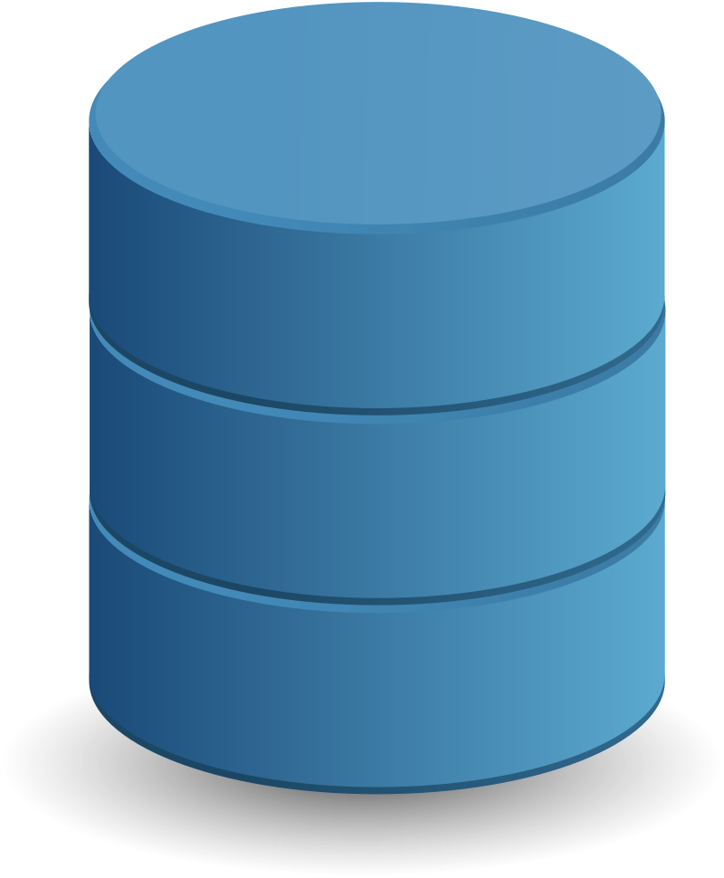


Embassy Cloud
Internet
EBI
Services & Databases
EMBL-EBI
Firewall
Global Load
Balancer
Exposed Resources
Embassy Cloud

Slide 13
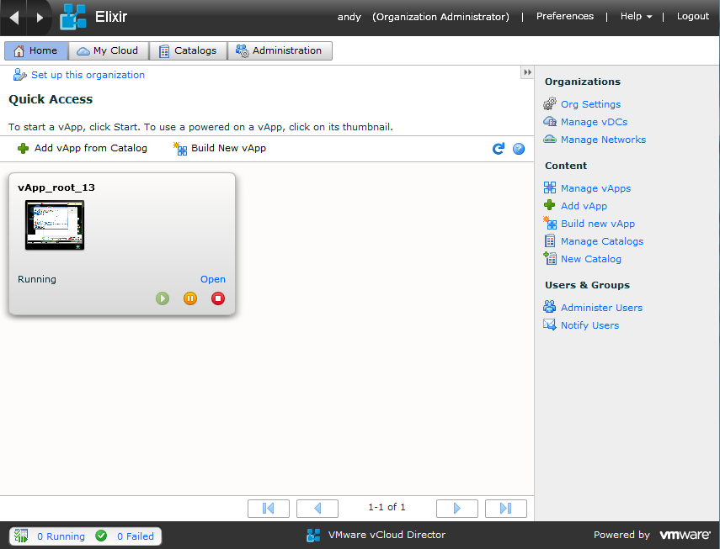
Embassy Cloud – User (Operator) Experience

Slide 14
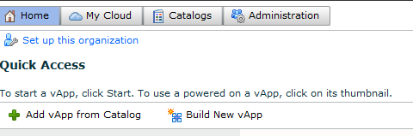
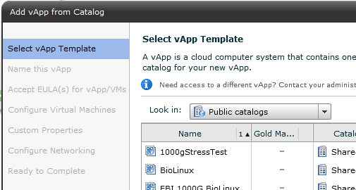
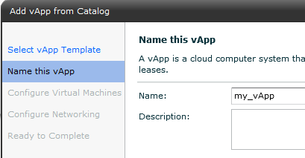
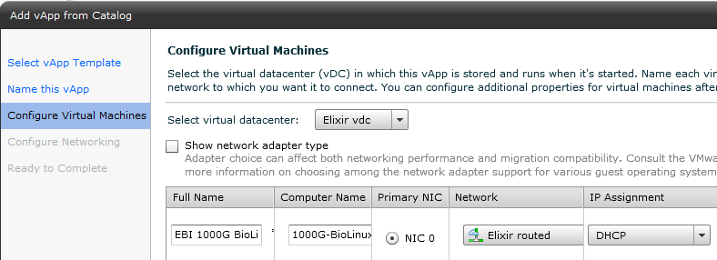
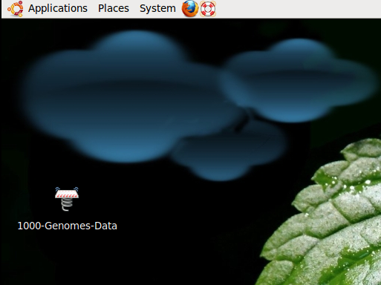
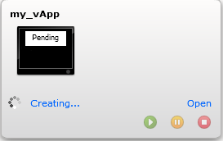
Adding a preconfigured Application
Notes:
Adding a preconfigured vApp:
Click Add vApp from Catalog
Select the public catalog and the vApp you want to deploy
Provide a name for your new vApp
Configure the networking (which network, DHCP or static, MAC address
The vApp and it’s VMs are created
Click on the screen to access the console
14

Slide 15
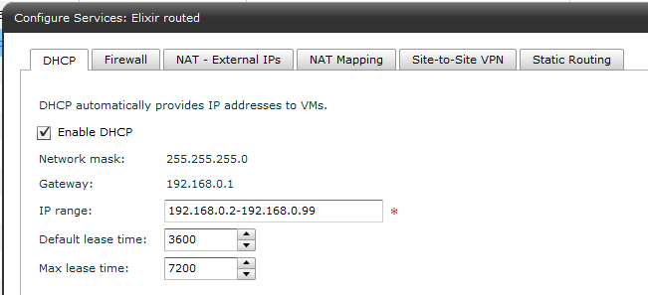
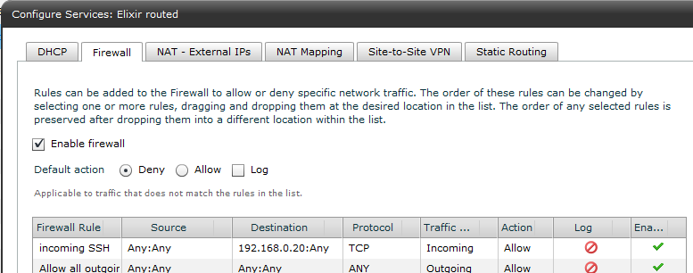
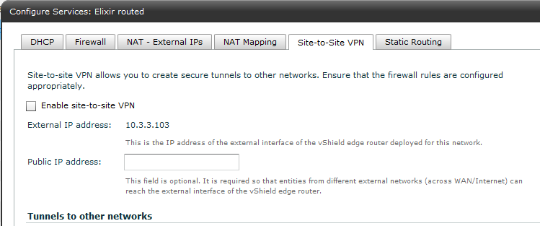
Networking
Notes:
Each organization network has it’s own appliance that offers DHCP, firewall, NAT, VPN and routing options.
Each organizations IP packets use a separate VLAN, separating them from the other organizations.
15

Slide 16
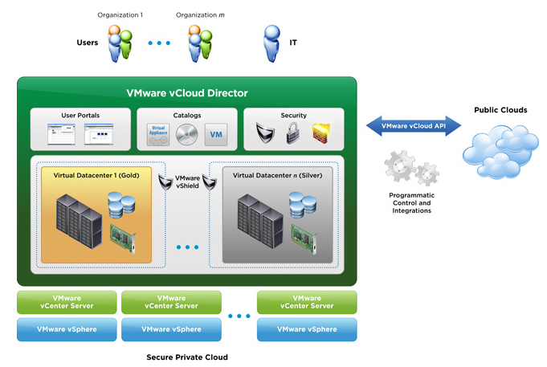
Technical Solution

Slide 17

Hardware and Software
Hardware
  349 GHz CPU
  2.26 TB RAM
  33TB HDD
Software
  VMware ESXi 5 installed
  Managed by vCloud Director
  Provides the cloud layer & automates provision of the physical resources to tenants

Slide 18
Benefits of using VMWare’s vCloud Director
Easy to install and manage
Strong security both between tenant organizations, and between each tenant and the EBI LAN
Good user documentation
Utilises VMware ESXi hypervisor, which is very robust
The hypervisors are clustered, allowing automatic restart of VMs if a hypervisor fails
Hypervisors can be maintained without downtime to VMs
We get support from VMware

Slide 19
Other Cloud Activity at EMBL-EBI
Use Amazon to provide geographical distribution
  Direct link to globally replicate databases
HelixNebula
  Integration of commercial cloud providers with big research
Benefit of additional security assurances
  For use by pharmaceutical companies
  For on-demand personalised medicine
Explore using IaaS to supplement/replace data centres
  Put DC on cloud, scale out services (service + database), etc.

Slide 20
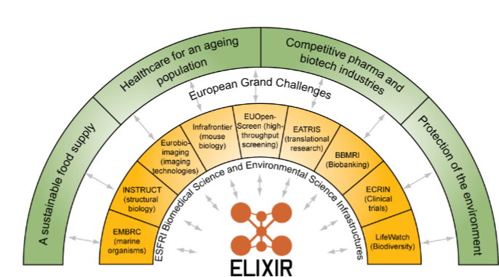
The Future
Exploitation by ELIXR
  An e-Infrastructure for Life Science
Develop the Embassy Cloud
  Commercial Use
  Secure access to restricted datasets
  Open up access to more external users
  Explore use for internal service delivery teams
Assess mixed model
  Use of commercial IaaS and public sector resources
  Use of OpenStack
GÉANT, DANTE, EGI.eu, PRACE, etc

Slide 21
Any questions?
Contact Points
  steven.newhouse@ebi.ac.uk
  embassycloud@ebi.ac.uk
Acknowledgements
  Andy Cafferkey
  Pete Jokinen
  EMBL-EBI Systems Team

