Slide 1
SM WW Background Analysis for H->WW->lvlv
Nicholas Luongo
Advisors:
Jianming Qian
Magda Chelstowska

Slide 2
Overview
SM WW is an irreducible background of the H->WW->lvlv process, both produce the same final state that is caught by the detector
Still possible to distinguish between these processes
The final-state leptons produced by H->WW->lvlv will have small differences in direction, resulting in low DPhill and Mll values
Final state of SM WW will include leptons moving opposite or near-opposite one another

Slide 3
Treating Backgrounds
In order to have a clear understanding of our signal, we must account for background processes
Major backgrounds involved:
WW
Ttbar
Z+jets
W+jets
Single Top
Normalization factors must be applied to each individual background in order to bring them in line with the data.
Process for accomplishing this:
Cut in such a way that produces a region that is reasonably pure in the desired background
Factors themselves are the ratio between background-subtracted data and MC for that process in the CR
Factor is calculated from the control region, then applied to all regions, including signal
Repeat this process for each background

Slide 4
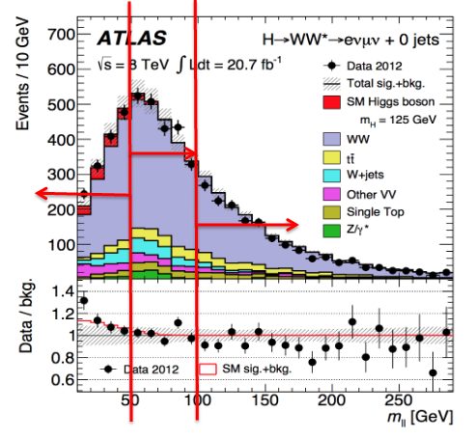
Current Control Region
Left – Signal Region
Middle – Control Region
Right – Validation Region
Separate analyses for differing final-state jets
Opposite-flavor channel selected because same-flavor has significantly higher Z+jets presence
Previous CR was 80+ GeV
CR chosen because extrapolation uncertainties (from CR to SR) are smaller than those from 80+ GeV
Notes:
0,1 jets produced by ggF – focused on 0-jet
2 jets produced by VBF

Slide 5
Improving CR
Normalization factor for the 50-100 GeV Control Region is 1.22, which is quite large
SM WW group sees a similar large normalization factor in their WW process
We would like to consider extending the Control Region to 50+ GeV
This would improve our statistical uncertainty, but increase our extrapolation uncertainty
Discrepancies between data and MC exist that warrant attention

Slide 6
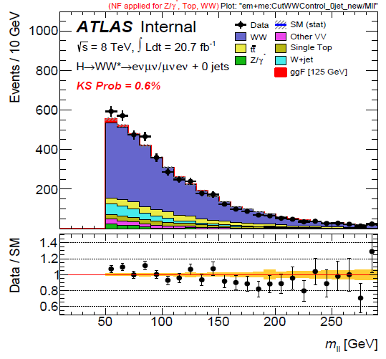
Causes?
New Physics?
Excesses may be due to physics not understood and so not able to be modeled
Problems with MC generators not producing important processes
Detector simulation may be detecting false events or missing events

Slide 7
Normalization Factors
Applied several different cuts on the invariant mass
Initially, code used the normalization factor calculated from 50-100 GeV on all cuts, so it was necessary to modify it to calculate new NFs for any given region
Along with NF for each of these cuts, also produced histograms for the following variables: MET, METRel, Mll, MT, Ptll, Dphill, jet#, and pt and eta for leading and subleading leptons
Normalization Factors
em+me
CutWWControl_0jet_old (80+ GeV) | 1.081 +/- 0.030
CutWWControl_0jet (50-100 GeV) | 1.221 +/- 0.036
CutWWControl_0jet_new (50+ GeV) | 1.128 +/- 0.025
CutWWvalreg_0jet (100+ GeV) | 1.028 +/- 0.034
CutWWAoI_0jet (120-180 GeV) | 1.095 +/- 0.053
CutWWAoI1_0jet (120-150 GeV) | 1.167 +/- 0.069
CutWWAoI2_0jet (150-180 GeV) | 0.974 +/- 0.083
CutWWControl_1jet_new (80+ GeV) | 1.069 +/- 0.052
CutWWControl_1jet_old (50+ GeV) | 1.041 +/- 0.059
CutWWvalreg_1jet (100+ GeV) | 1.063 +/- 0.069

Slide 8
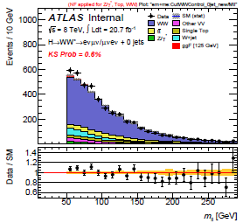
First Area of Interest
50+ GeV, intended control region
Want to focus on a specific range of values
Chose the first regions to be 120-150 GeV and 150-180 GeV

Slide 9
Going Forward
Look at other variables that are available for clues as to what is causing these unexpected values
Recalculate normalization factors using same flavor channels and same and different flavor channels
Remake graphs and NFs using different Monte Carlo simulators and compare how this affects the discrepancy between data and Monte Carlo

Slide 10
Questions?

Slide 11
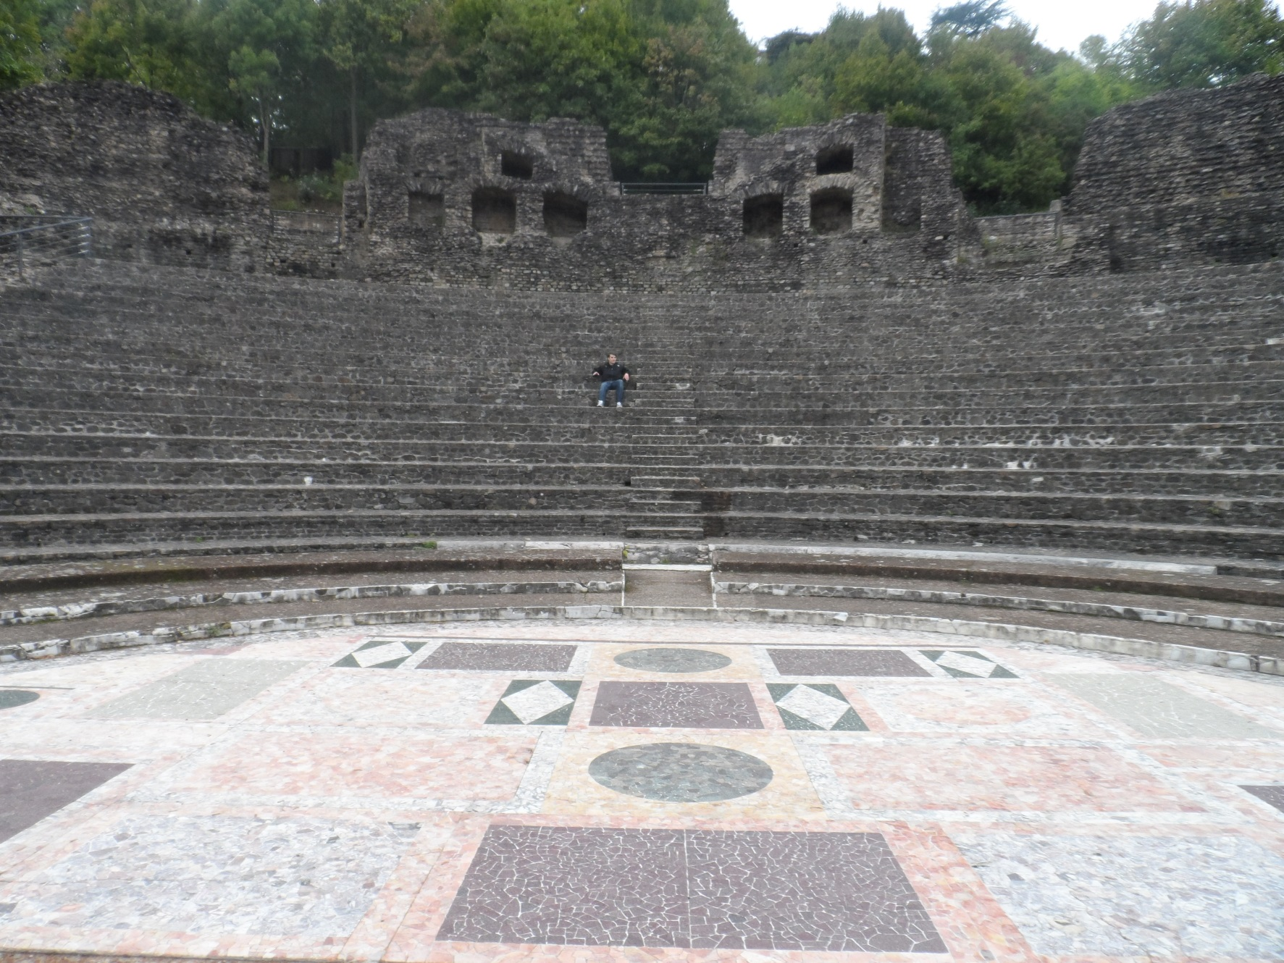
Roman Amphitheatre - Lyon

