Slide 1
From Quark to Jet: A Beautiful Journey
Lecture 2
Jet Clustering, Classification, and Personal Computing
Tyler Dorland
Deutsches Elektronen-Synchrotron (DESY)
Inverted CERN School of Computing, 24-25 February 2014

Slide 2
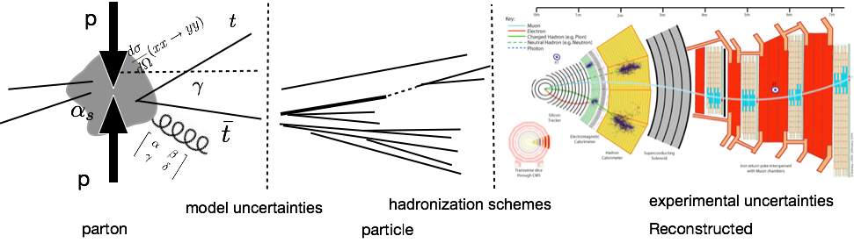
Explaining the Title: An outline
Theoretical
Quarks
Mathematical Objects:
Matrices, operators, etc.

Slide 3
Explaining the Title: An outline
Theoretical
Hadronization
Quarks
Mathematical Objects:
Matrices, operators, etc.
Particles
intermediate and quasi-final state objects

Slide 4
Explaining the Title: An outline
Theoretical
Hadronization
Reconstruction
Quarks
Mathematical Objects:
Matrices, operators, etc.
Particles
intermediate and quasi-final state objects
Jets
Energy deposits in detector used to recreate particles

Slide 5
Explaining the Title: An outline
Theoretical
Hadronization
Reconstruction
Quarks
Mathematical Objects:
Matrices, operators, etc.
Particles
intermediate and quasi-final state objects
Jets
Energy deposits in detector used to recreate particles

Slide 6
Explaining the Title: An outline
Theoretical
Hadronization
Reconstruction
Quarks
Mathematical Objects:
Matrices, operators, etc.
Particles
intermediate and quasi-final state objects
Jets
Energy deposits in detector used to recreate particles
Huge numbers of complex equations
Entirely Simulated, particles are subjected to decay conditions
Detector simulation, Algorithmic reconstruction

Slide 7
Explaining the Title: An outline
Theoretical
Hadronization
Reconstruction
Quarks
Mathematical Objects:
Matrices, operators, etc.
Particles
intermediate and quasi-final state objects
Jets
Energy deposits in detector used to recreate particles
Different computing solutions used to tackle the unique challenges at each step
Huge numbers of complex equations
Entirely Simulated, particles are subjected to decay conditions
Detector simulation, Algorithmic reconstruction

Slide 8
Explaining the Title: An outline
Theoretical
Hadronization
Reconstruction
Quarks
Mathematical Objects:
Matrices, operators, etc.
Particles
intermediate and quasi-final state objects
Jets
Energy deposits in detector used to recreate particles
Different computing solutions used to tackle the unique challenges at each step
The Second lecture will explore jet clustering, classification and how they are adapted for use on personal scale computers
Huge numbers of complex equations
Entirely Simulated, particles are subjected to decay conditions
Detector simulation, Algorithmic reconstruction

Slide 9
Ask Questions here
Use theory to make predictions for observables of particles
Design detectors to detect these observables
Reconstruction algorithms to remake the objects

Slide 10
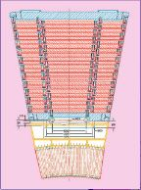
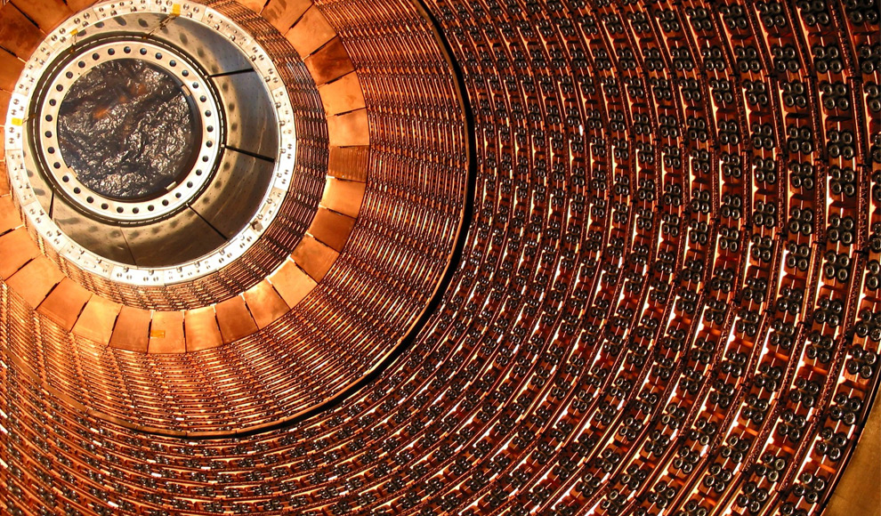
Calorimeters
Calorimeters are designed to capture the energy of particles
Two different types are in use at LHC
  Homogeneous – Capture all of the energy of the incident particle
  Sampling – capture a portion the incident energy and make a correction

Slide 11
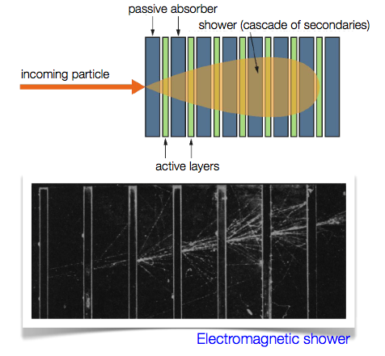
Sampling Calorimeter
Sampling calorimeters have a sensitive layer sandwiched between to heavy absorber layers
  Absorber layers useful to create showers of secondary particles
Useful for hadrons because a homogeneous detector would be too large
  Worse resolution, though

Slide 12
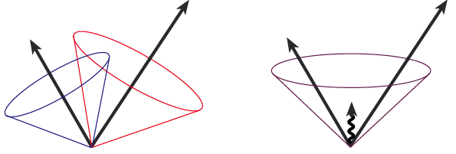
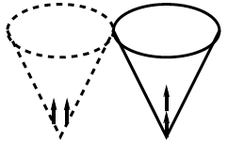
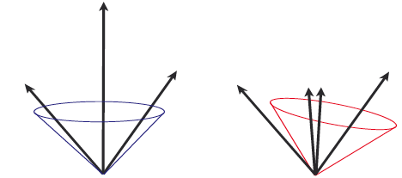
Jet clustering
Because we are measuring decay products we must find a way to cluster them together to accurately represent the original particle
A few theoretical considerations
Infrared Safe
  Should not be sensitive to soft radiation
Collinear Safe
  Should not be sensitive to collinear radiation

Slide 13

Cone Algorithms
“Seed” defines approximate jet direction
All energy deposits within a given radius are put into the jet
The centroid is determined summing all particles within the cone
The centroid becomes the new seed
  Iterated until stable
seed
tracks or towers
R_{cone}
centroid = new seed
R_{cone}

Slide 14
Mid-point cone algorithm
Search for missing jets using the midpoint of all jet pairs as a seed
If there is a stable cone consider the energy deposits shared between the two jets (E_{Shared})
Take f = E_{Shared}/E_{jet2}
  If f> 50% merge the jets; else split the jets
midpoint
JET #1 p_{Tjet1}>p_{Tjet2}
JET #2

Slide 15
K_{T} algorithm
Begin with a list of hits and calorimeter towers
Calculate
  For each precluster i:
  For each pair (i,j):
Find the minimum, d_{min}, of all d_{i} and d_{i,j}
If d_{min} is a d_{i,j}, remove preclusters i and j from the list and replace with a new merged precluster
If d_{min} is a d_{i}, precluster I is not “mergeable” and can be added to the list of jets
Repeat until list is exhausted

Slide 16
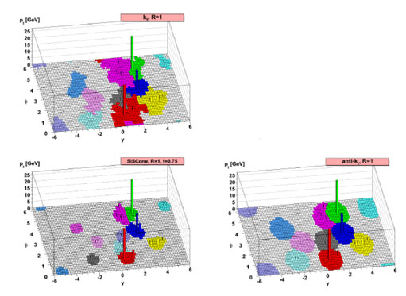
Some different Examples

Slide 17
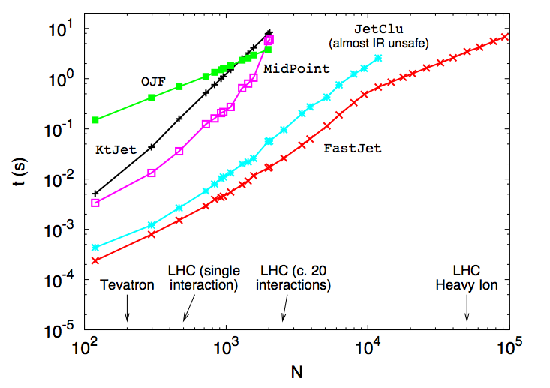
FastJet Software
FastJet (fastjet.fr) is a commonly used tool in HEP that calculates cones for many different algorithms
It also contains many algorithmic improvements
  K_{T} algorithm is O(N³)
  FastJet KT is O(NlnN)
  Identical results
Used in many experiments, so it’s input structure is independent

Slide 18

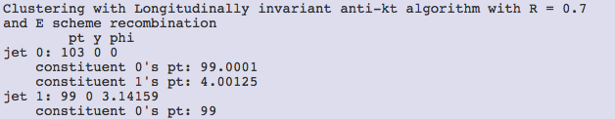
Fast Jet Input
FastJet is only a clustering algorithm
  It doesn’t need information about the detector, beam, etc.
The only thing it needs as input are momentum 4-vectors
It only outputs 4-vectors (improtant later)

Slide 19
Some different Examples

Slide 20
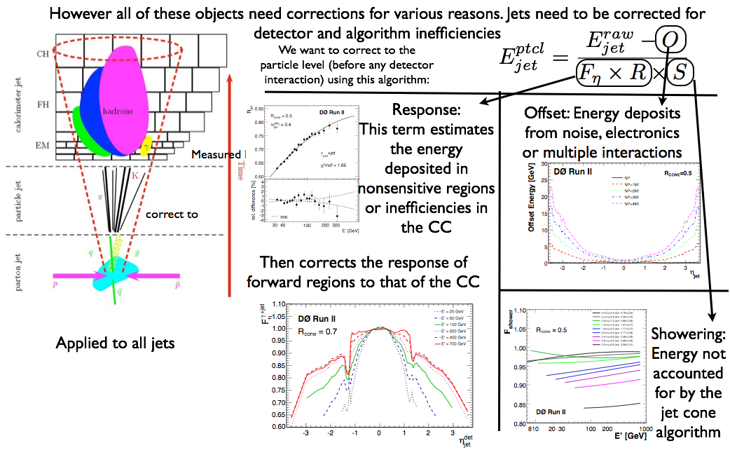
Corrections

Slide 21
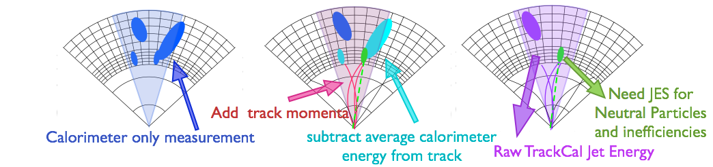
Combining Measurements
It can be advantageous to use different parts of the detectors for different measurements for the constituents of the jets
For example, we can sometime replace a calorimeter measurement with a tracker measurement associated to it
  For low momenta, the tracker measurements are more precise

Slide 22
Jet Questions
Calorimeters are designed to collect all particle energy
Particles are scattered and not individually measured
Reconstruction attempt to safely reconstruct the original energy

Slide 23
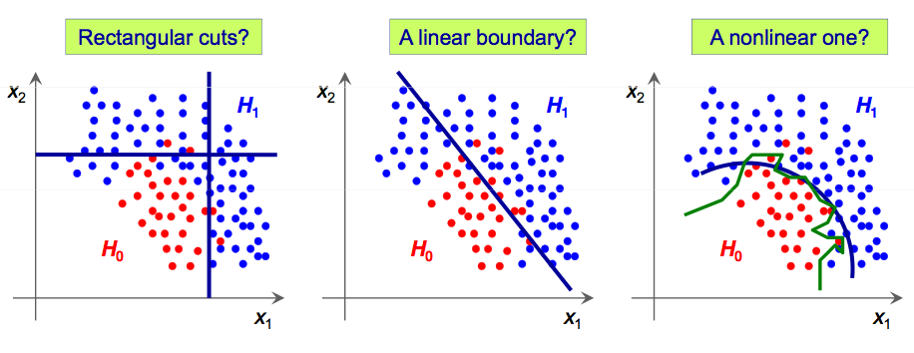
Classifcation Techniques
Found two variables
What is the best cut

Slide 24
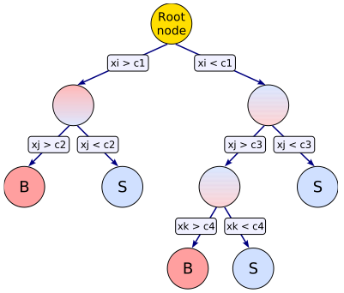
Multivariate Techniques
Finally we can combine all these measurements in to very power multivariate analysis (MVA) techniques
  These can give a measure of how likely a jet is to be a b-jet
One technique is a decision tree that makes a series of cuts on different input variables
  Then reclassified by the Gini index p(1-p)

Slide 25
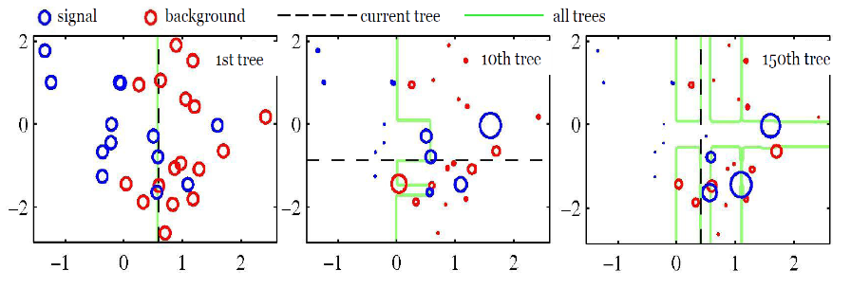
Decision trees - weighting
The tree is trained against a known truth (from MC)
Misclassified events are given a larger weight then retrained

Slide 26
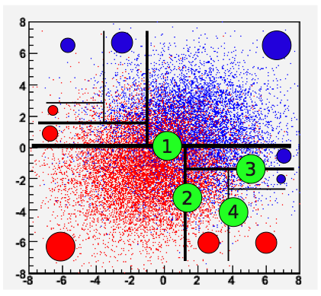
Sample Result
In the end we get a better discriminator than any simple cut

Slide 27
TMVA Software
The Toolkit for Multivariate Analysis (TMVA [http://tmva.sourceforge.net/]) is the standard software for implementation of classification/regression techniques in HEP
It contains algorithms for many Classification/Regression techniques
Standard Tool for BDTs etc in HEP

Slide 28
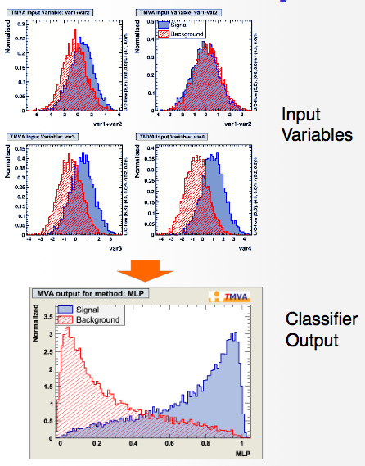
TMVA Inputs
TMVA again is experiment independent
  It doesn’t want or need details about your detector, beam, etc.
All it takes for input are histograms (important for latter)
  Or properly formatted vectors
It returns a function such that all it will need are the input variables of the event

Slide 29
Classification Questions Questions
Calorimeters are designed to collect all particle energy
Particles are scattered and not individually measured
Reconstruction attempt to safely reconstruct the original energy

Slide 30
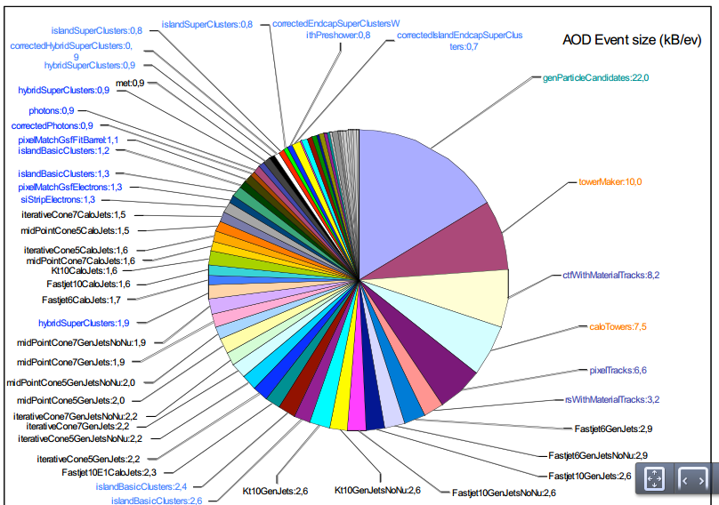
Laptops – A Powerful Tool in HEP
LHC experiments store 10s of petabytes of information
  But not all of it is useful for every part of every analysis

Slide 31
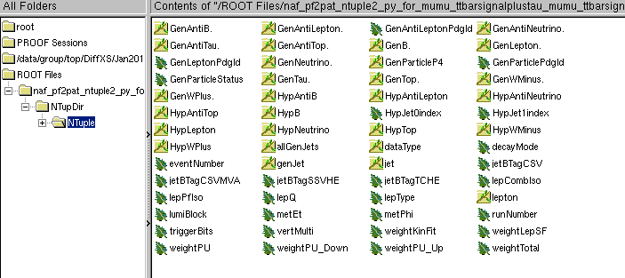
Laptops – A Powerful Tool in HEP
LHC experiments store 10s of petabytes of information
  But not all of it is useful for every part of every analysis
Subset used for a top analysis

Slide 32
Event Flow
What you could do
Or we could introduce intermediate steps
Full event reconstruction, TMVA, Jet clustering, Mathematical operations, Corrections, studies
Plotting and Final Results
Event Reconstruction
Object selection
Reduce size of trees
TMVA, or reclustering, or studies
Final Results

Slide 33
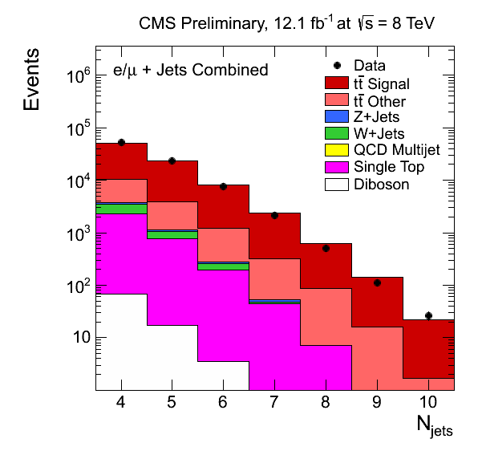
MC Samples
Many different samples for many different backgrounds
Sometimes over 20 samples per analysis
Each can be treated separately

Slide 34
Mass Parallelization
Event Reconstruction
Object selection
Reduce size of trees
TMVA, or reclustering, or studies
Final Results
Event Reconstruction
Object selection
Reduce size of trees
TMVA, or reclustering, or studies
Final Results
Event Reconstruction
Object selection
Reduce size of trees
TMVA, or reclustering, or studies
Final Results
Event Reconstruction
Object selection
Reduce size of trees
TMVA, or reclustering, or studies
Final Results
Event Reconstruction
Object selection
Reduce size of trees
TMVA, or reclustering, or studies
Final Results

Slide 35
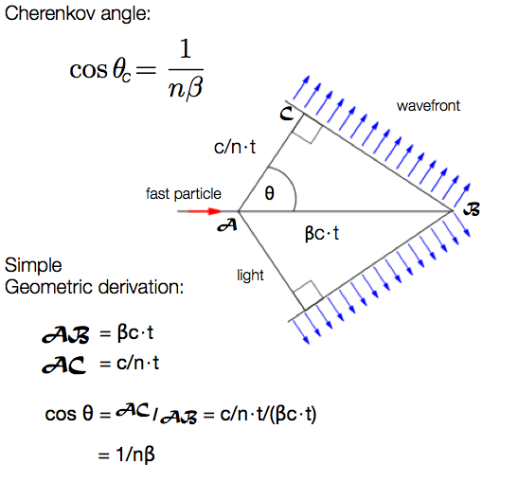
Particle ID - RICH
Cherenkov raditation is emitted when a particle passes through a medium and is initially going faster than the speed of light in that medium
A ring of light is emitted that is proportional to the momentum

Slide 36
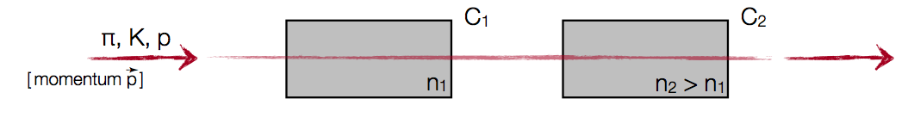
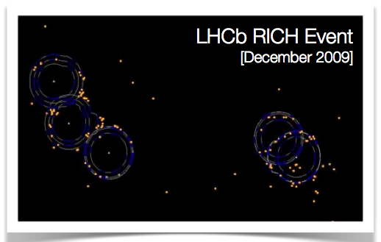
Particle ID - RICH
By choosing the correct media, we can use this as a for of particle identification
  Light in C₁ and C₂ = Pion
  Light in just C1 = Kaon
  No light = proton

Slide 37
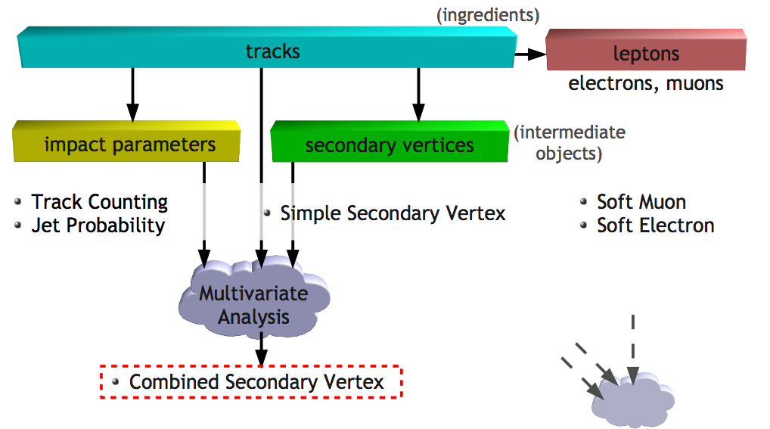
B-tagging Inputs

Slide 38
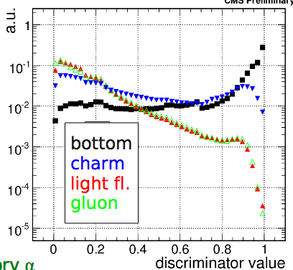
Output
Using the inputs from multiple parts of the detector we can make a better judgement on if the jet we are measuring came from a b-quark or another source

Slide 39
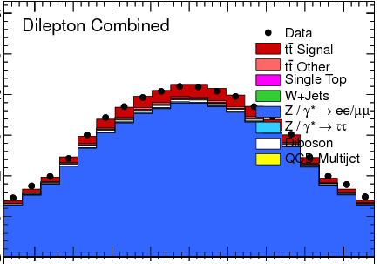
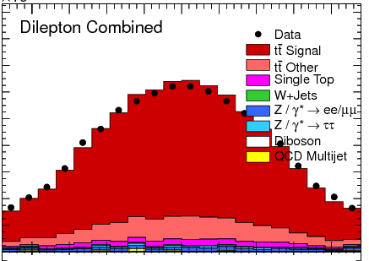
Physics Analysis
B-tagging can reduce some background by over 90%
As well as increase the signal-to-noise ratio!

Slide 40
Conclusions
Jet algorithms are designed to make up for the inefficiencies created by finite resolution of our calorimeters
These algorithms are well suited for personal computing
Aspects from many different portions of the detector can be combined using statistical tools such as decision trees to determine how likely it is that a particular jet came from a b-quark
Thanks for listening!

Slide 41
Backup

Slide 42
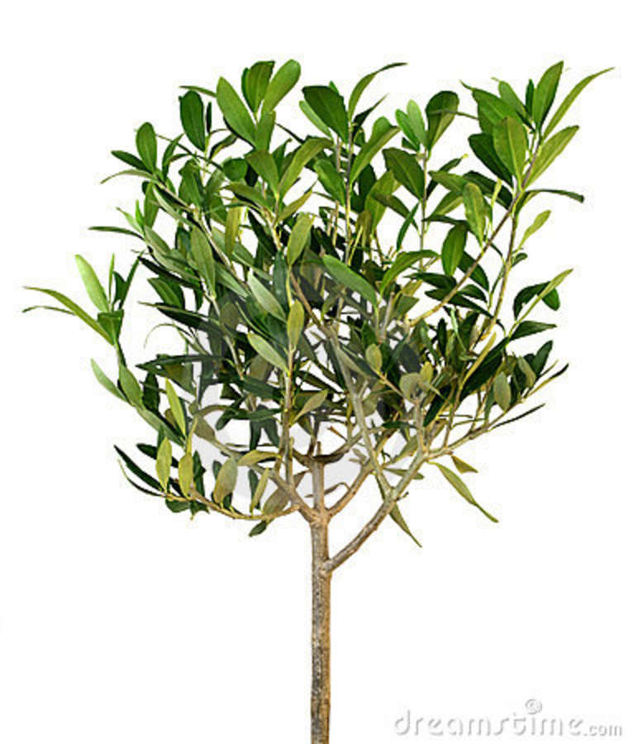
Data Storage - NTuples

