Slide 1
Network Programming
Lecture 2
Building Highly Distributed Systems
Within 5 Minutes
Jonas Kunze
University of Mainz – NA62
Inverted CERN School of Computing, 24-25 February 2014

Slide 2
Outline
Motivation
Boost.Asio
Message Passing
ØMQ
Apache Thrift

Slide 3
TCP in C code
#include <stdio.h>
#include <netinet/in.h>
#include <sys/socket.h>
#include <sys/types.h>
int main( int argc, char *argv[] ) {
int sockfd, newsockfd, portno, clilen;
char buffer[256];
struct sockaddr_in serv_addr, cli_addr;
int n;
sockfd = socket(AF_INET, SOCK_STREAM, 0);
bzero((char *) &serv_addr, sizeof(serv_addr));
portno = 1324;
serv_addr.sin_family = AF_INET;
serv_addr.sin_addr.s_addr = INADDR_ANY;
serv_addr.sin_port = htons(portno);
bind(sockfd, (struct sockaddr *) &serv_addr,
sizeof(serv_addr));
listen(sockfd,5);
clilen = sizeof(cli_addr);
while (1) {
newsockfd = accept(sockfd,
(struct sockaddr *) &cli_addr, &clilen);
pid = fork();
if (pid == 0) {
close(sockfd);
dosomething(newsockfd);
exit(0);
} else {
close(newsockfd);
}
}
}
The BSD socket API is minimalistic
  No intrinsic multithreading support
    Handling multiple connections typically via fork()
  No data management (messaging)
  Configuration a bit awkward
There is no exception handling or OOP in C
There is no C++ socket API in the std library
  std::socket will never come

Slide 4
Outline
Motivation
Boost.Asio
  Asynchronous operations
  Concurrency without threads
  Multithreading
Message Passing
ØMQ
Apache Thrift

Slide 5
Boost.Asio
Boost.Asio is a C++ library for low-level I/O programming with a consistent asynchronous model including a BSD socket interface
BSD Socket API (Linux) | Equivalents in Boost.Asio
socket descriptor – int | For TCP: ip::tcp::socket For UDP: ip::udp::socket
sockaddr_in, sockaddr_in6 | For TCP: ip::tcp::endpoint For UDP: ip::udp::endpoint
accept() | For TCP: ip::tcp::acceptor::accept()
bind() | For TCP: ip::tcp::socket::bind() For UDP: ip::udp::socket::bind()
... | ...

Slide 6
Boost.Asio
Boost.Asio uses an object as an interface to the operating system: io_service
The io_service object is passed to I/O objects like tcp::socket
The I/O objects will forward requests to the io_service object
  io_service runs the required syscalls
boost::asio::io_service io_service;
boost::asio::ip::tcp::socket socket(io_service);
boost::asio::ip::tcp::resolver resolver(io_service); // gethostbyname wrapper
socket.connect(*resolver.resolve({hostname, portNum}));
socket.send(boost::asio::buffer("message"));

Slide 7
Boost.Asio: Asynchronous operations
I/O objects implement non-blocking/asynchronous operations
  E.g. boost::asio::ip::tcp::socket::async_connect
Completion handler function passed to async_ functions
io_service.run() calls the completion handler as soon as results of async_ functions are available

Slide 8
Boost.Asio: Asynchronous operations
Simple TCP connection example:
Even simpler with C++11 using a lambda function:
void MyClass::handle_connect(const boost::system::error_code& error) {
if (!error) { doSomething(); }
}
...
socket.async_connect(socket, *resolver.resolve({hostname, portNum}),
boost::bind(&MyClass::handle_connect, this, boost::asio::placeholders::error));
workWhileConnecting();
io_service.run(); // Runs handle_connect as soon as the connection is established
socket.async_connect(*resolver.resolve({hostname, portNum}),
[this](boost::system::error_code error, tcp::resolver::iterator) {
if (!error) { doSomething(); }
});
workWhileConnecting();
io_service.run();

Slide 9
Concurrency without threads
Handling multiple TCP connections
One io_service can handle several I/O objects and async_ operations
io_service::run() will block until all requests have been handled
sock1.async_read_some(readBuffer, [](boost::system::error_code error, std::size_t){
if (!error) {std::cout << "Socket 1 received something" << std::endl;}
});
sock2.async_read_some(readBuffer, [](boost::system::error_code error, std::size_t){
if (!error) {std::cout << "Socket 2 received something" << std::endl;}
});
io_service.run();
cout << “Both sockets received something” << endl;

Slide 10
Multithreading
io_service::run() can be called by multiple threads simultaneously
async_ operations will be distributed among these threads
A common approach is to launch a thread pool running the whole lifetime
  N threads spawned at the beginning handling all async_ operations
  Recursive calls of async_ operations (io_service::run() never returns)

Slide 11
Server with a Thread Pool
boost::asio::io_service io_service;
EchoServer s(io_service, 1234); // calls socket.async_read...
std::vector<std::thread> threadPool;
for (std::size_t i = 0; i < std::thread::hardware_concurrency(); ++i) {
threadPool.push_back(
std::thread(
[&]() {
io_service.run();
})
);
}
for(auto& thread : threadPool){
thread.join();
}

Slide 12
Outline
Motivation
Boost.Asio
Message Passing
ØMQ
Apache Thrift

Slide 13
Message passing via TCP
TCP only offers a continuous data stream
  Although data is typically sent to sockets in chunks, the receiver may see different chunks (scaling window)
  The application layer program has to split the stream into messages
There are three possible approaches to indicate messages in the stream:
  Protocol defines the message length implicitly
  The message length is explicitly specified in a message header
  Line-Based: Messages in the stream are separated by delimiters

Slide 14
Message passing via TCP
Line-Based approach easily implemented with Boost.Asio:
Other approaches are much more efficient
  But also hard work to implement
ØMQ implements fast message passing using the explicit format
boost::asio::read_until(socket, msgBuffer, "\r\n");
No need to reinvent the wheel!

Slide 15
Outline
Motivation
Boost.Asio
Message Passing
ØMQ
  Messaging Patterns
  Broker
  Multithreading
Apache Thrift

Slide 16
ØMQ
What ØMQ says about their socket library (http://zguide.zeromq.org/page:all):
We took a normal TCP socket, injected it with a mix of radioactive isotopes stolen from a secret Soviet atomic research project, bombarded it with 1950-era cosmic rays (...) It's sockets on steroids.

Slide 17
ØMQ
ØMQ offers a uniform API (ØMQ sockets) to transport messages over different channels:
  TCP, multicast, IPC (process to process), inproc (thread to thread)
Cross Platform (Linux, Windows, Mac, etc...)
Implementations in many(!!!) different languages:
  C/C++, Java, Python, Ruby, PHP, Perl, Node.js, C#, Clojure, CL, Delphi, Erlang, F#, Felix, Go, Haskell, Haxe, Lua, Objective-C, Q, Racket, Scala...
OpenSource

Slide 18
ØMQ – Messaging Patterns
ØMQ sockets express several messaging patterns
  REQ and REP
  PUB and SUB
  PUSH and PULL
  REQ and ROUTER
  DEALER and REP
  DEALER and ROUTER
  DEALER and DEALER
  ROUTER and ROUTER
  PAIR and PAIR

Slide 19
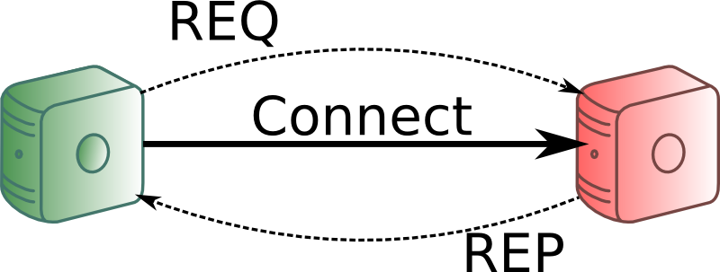
ØMQ – REQ-REP
Clients “connect” to a service and send a REQuest message
The server REPlies to each request with a single message
Sending is done asynchronously in the background
  User writes simple non-blocking code
  If the remote endpoint is down the message will be sent later
This represents a remote procedure call pattern

Slide 20
ØMQ – Simple REQ Client
int main() {
zmq::context_t context(1); // Similar to io_service
zmq::socket_t socket(context, ZMQ_REQ);
socket.connect("tcp://REPServerHostName:5555");
zmq::message_t request(6);
memcpy((void *) request.data(), "Hello", 5);
socket.send(request);
zmq::message_t reply;
socket.recv(&reply);
return 0;
}

Slide 21
ØMQ – Simple REP Server
int main() {
zmq::context_t context(1); // Similar to io_service
zmq::socket_t socket(context, ZMQ_REP);
socket.bind("tcp://*:5555");
while (true) {
zmq::message_t request;
socket.recv(&request);
zmq::message_t reply(5);
memcpy((void *) reply.data(), "World", 5);
socket.send(reply);
}
return 0;
}

Slide 22
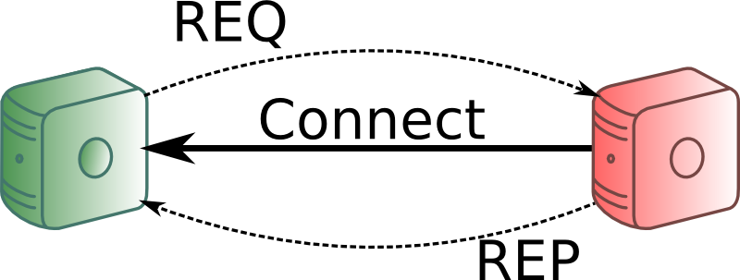
ØMQ – REQ-REP Notes
The REQ-REP socket pair is in lockstep
  Server and client have to call send and recv alternately
  Server automatically sends to the node it got the last message (recv) from
    All the connection handling is done by ØMQ
The connection can be established from both sides (true for all patterns)

Slide 23
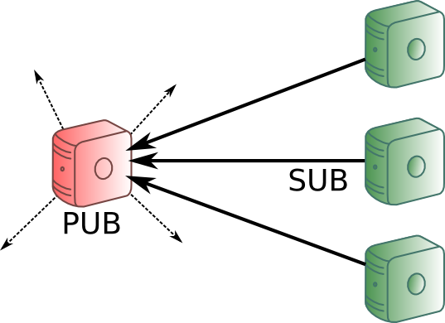
ØMQ – PUB-SUB
Server PUBlishes data to all connected clients
Clients SUBscribe to the data by connecting to the server
Subscription to messages by data prefix (filter)
If no client is connected the data will be lost

Slide 24
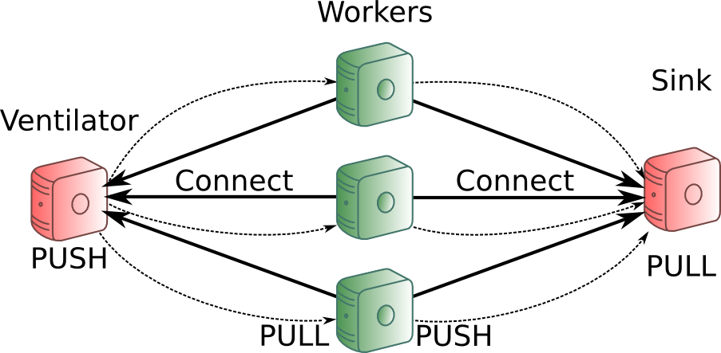
ØMQ – Pipeline
Ventilator: Produces task that can be processed in parallel
These tasks are then PUSHed evenly to the connected Workers
After processing the tasks the Workers push the results to a Sink
Basic load balancing

Slide 25
ØMQ – Pipeline Worker
int main() {
zmq::context_t context(1);
zmq::socket_t ventilatorSocket(context, ZMQ_PULL);
ventilatorSocket.connect("tcp://ventilator:5557");
zmq::socket_t sinkSocket(context, ZMQ_PUSH);
sinkSocket.connect("tcp://sink:5558");
while (1) {
zmq::message_t task;
ventilatorSocket.recv(&task); // PULL
zmq::message_t result = doSomeWork(task);
sinkSocket.send(result); // PUSH
}
}

Slide 26
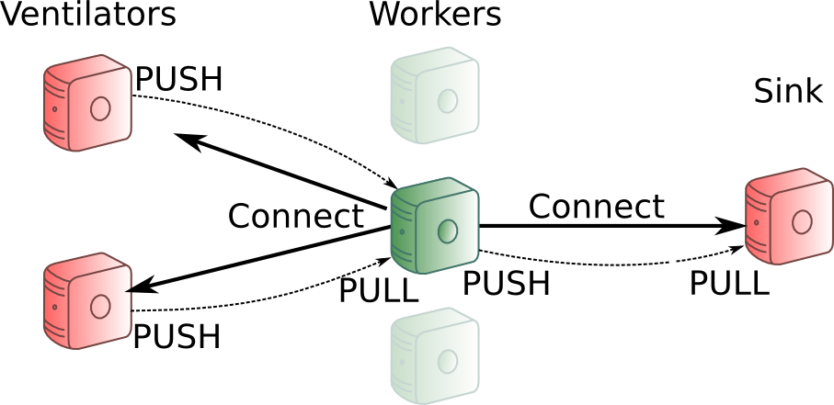
ØMQ – N-to-M communication
So far we had N workers pulling from one ventilator
It is possible to connect one ØMQ socket to several endpoints
The messages will be scheduled fairly from all ventilators
ventilatorSocket.connect("tcp://ventilator1:5557");
ventilatorSocket.connect("tcp://ventilator2:5557");

Slide 27
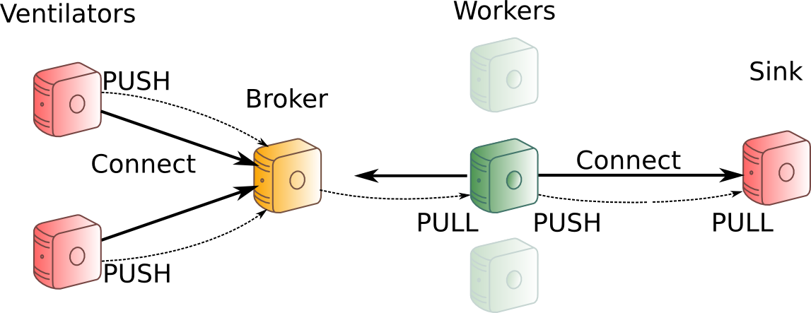
ØMQ – Broker
With the last design the workers need to know all ventilators (hostnames)
If a new ventilator is added all the workers have to connect (evtl. Restart)
One easy design to fix this: Add a central broker

Slide 28
ØMQ – Broker
This is easily implemented with a zmq_proxy forwarding messages:
zmq::context_t context(1);
// Socket facing ventilators
zmq::socket_t frontend(context, ZMQ_PULL);
frontend.bind("tcp://*:5556");
// Socket facing workers
zmq::socket_t backend(context, ZMQ_PUSH);
backend.bind("tcp://*:5557");
// Pass messages from ventilators to workers
zmq_proxy(frontend, backend, NULL);

Slide 29
ØMQ – Broker
Now you only have to change one line in the ventilator:
And connect the worker to the broker instead of the ventilators
And again you can start ventilators, workers, broker and sink in whatever order you like:
Messages are queued as close to the receiver as possible
socket.bind("tcp://*:5559"); → socket.connect("tcp://broker:5559");
ventilator.connect("tcp://ventilator1:5557");
ventilator.connect("tcp://ventilator2:5557"); …
Turns to:
ventilator.connect("tcp://broker:5557");

Slide 30
ØMQ – IPC
So far we used: socket.bind("tcp://*:5555");
To run the same programs locally one should use:
  socket.bind("ipc:///tmp/helloWorld"); // For processes
  socket.bind("inproc:///helloWorld"); // For threads
Start developing your software with many modules communicating with IPC
Then outsource heavy loaded services to external boxes just by changing
inproc/ipc://... → tcp://...

Slide 31
ØMQ – Multithreading
ØMQ sockets are not thread safe!
But they are extremely lightweight
  Create one (or more) sockets per thread
  Use these ØMQ sockets to exchange messages between the threads
  Use a proxy to distribute work among the threads

Slide 32
ØMQ – Multithreaded Worker
void workerThread(zmq::context_t& context) {
zmq::socket_t ventilatorProxy(context, ZMQ_PULL);
ventilatorProxy.connect("inproc://workers");
zmq::socket_t sink(context, ZMQ_PUSH);
sink.connect("tcp://sink:5558");
while (1) {
zmq::message_t task;
ventilatorProxy.recv(&task);
zmq::message_t result = doSomeWork(task);
sink.send(result);
}
}

Slide 33
ØMQ – Multithreaded Worker
int main() {
zmq::context_t context(1);
zmq::socket_t ventilatorProxy(context, ZMQ_PULL);
ventilatorProxy.connect("tcp://broker:5557");
zmq::socket_t workers(context, ZMQ_PUSH);
workers.bind("inproc://workers");
std::vector < std::thread > threadPool;
for (std::size_t i = 0; i < std::thread::hardware_concurrency(); ++i) {
threadPool.push_back(std::thread([&]() {
workerThread(context); // will connect with inproc://workers
}));
}
zmq::proxy(ventilatorProxy, workers, NULL);
}

Slide 34
ØMQ – Notes
With ØMQ messages still need to be translated to procedure executions
Object serialization has to be implemented on top of ØMQ
There's much more functionality in ØMQ!
Read the great guide: http://zguide.zeromq.org
The examples in this lecture are based on the examples from the zguide

Slide 35
Outline
Motivation
Boost.Asio
Message Passing
ØMQ
Apache Thrift

Slide 36
Apache Thrift
Remote Procedure Calls (RPCs):
Executing subroutines (functions, methods) on a program running remotely
Thrift is a scalable cross-language RPC framework developed by Facebook
  It implements the missing object serialization
It's an open source project in the Apache Software Foundation

Slide 37
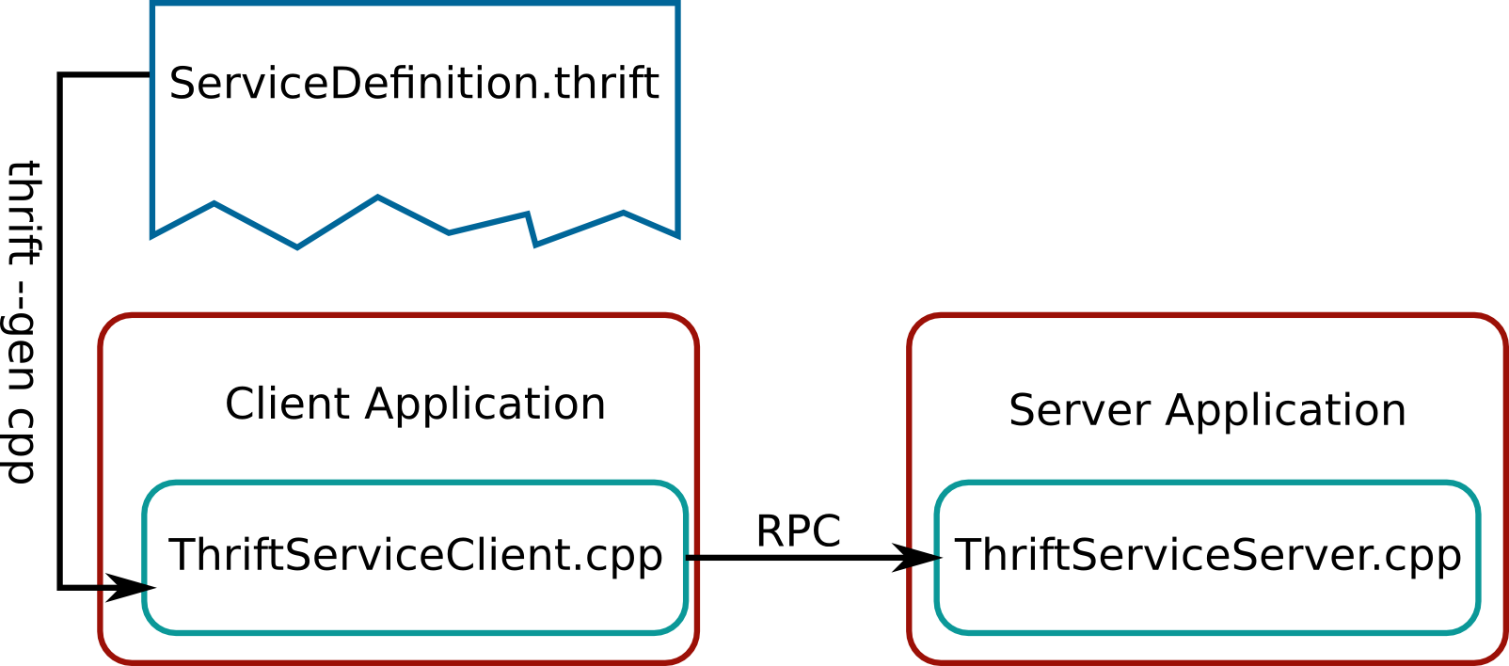
Apache Thrift
The developer defines services in an Interface Definition Language (IDL) file
Thrift generates code (Interfaces) to be used to call these services remotely
  E.g. calling a Java Method from a PHP script running on a remote host

Slide 38
Thrift – Interface Definition
Interface Definition Language (.thrift) files
  Define namespace, data structures, types, methods, services
  Similar to C syntax
  Basic types are bool, byte, i16/32/64, double, string, map<t1,t2>, list<t1>, set<t1>
namespace cpp ch.cern.icsc14
enum Operation {
ADD = 1,
SUBTRACT = 2,
MULTIPLY = 3,
DIVIDE = 4
}
struct Work {
1: i32 num1,
2: i32 num2,
3: Operation op
}
service Calculator {
i32 calculate(1:Work w)
}

Slide 39
Thrift – Compiling Thrift Files
Thrift compiles the IDL files to server (and client) source code
It generates thousands of lines of code with placeholders
Calculator_server.skeleton.cpp:
using namespace ::ch::cern::icsc14;
class CalculatorHandler : virtual public CalculatorIf {
public:
CalculatorHandler() {
// Your initialization goes here
}
int32_t calculate(const Work& w) {
// Your implementation goes here
}
};

Slide 40
Thrift – Documentation
There is only very little documentation online
Useful links:
  http://wiki.apache.org/thrift/ThriftUsage
  http://thrift-tutorial.readthedocs.org/
  http://www.slideshare.net/dvirsky/introduction-to-thrift
  http://diwakergupta.github.io/thrift-missing-guide
Good Luck!

Slide 41
Summary
There is no native C++ library for network programming
There are many different libraries for different purposes
  Boost.Asio for easy asynchronous and multithreaded socket programming
  ØMQ additionally provides message passing and helpful patterns
  Apache Thrift provides an efficient RPC framework
All these libraries are cross-platform capable
ØMQ and Thrift provide interfaces for many languages
Visit https://github.com/JonasKunze for code snippets and these slides

