Slide 1

MC format interface to DD4hep

Slide 2
Introduction
MC generators data formats
Integration of LCIOInterface within DD4hep/geant4
Example of processing

Slide 3
HepLCIOInterface
An interface is needed to use MC particles in the LHeC simulator and select relevant final states.
LHeC HepLCIOInterface is an extension of the same interface used for ILC simulations. (Mokka).

Slide 4

Sherpa MC output
Sherpa Generates output in HepMC::IO_GenEvent format (HepMC 2).
Geant4 allows to get input from a HepMC event, it processes all the HepMC particle objects (with status code = 1 ,undecayed particle).
HepMC can be loaded through the LHeD simulator
ATLAS, CMS, and LHCb are also using HepMC format for simulated events and data persistency while LHeC simulator uses LCIO .
HepMC are converted in LCIO format within the DD4Hep/Geant4 .

Slide 5
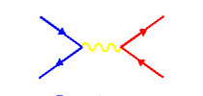
MadGraph/MadEvent/pythia MC output
MadGraph/Madevent LHEF or ROOT (LHEF)
Pythia6 - hepevt or ROOT
Delphes - hepevt or ROOT
Hepevet samples processed with HepLCIOInterface

Slide 6
It acts as a Particle Gun in geant4 able to process events from MC simulations. Uses Madgraph/pythia and Sherpa in order to have “real” physics for the detector simulation.
HepLCIOInterface
gen_action = new LHePrimaryGeneratorActionFromFile(lcdd, evfile_hepevt , HepLCIOInterfaceNew::hepevt);
gen_action = new LHePrimaryGeneratorActionFromFile(lcdd, evfile_stdhep , HepLCIOInterfaceNew::stdhep);
gen_action = new LHePrimaryGeneratorActionFromFile(lcdd, evfile_lhe , HepLCIOInterfaceNew::lhe);
gen_action = new LHePrimaryGeneratorActionFromFile(lcdd, evfile_lcio , HepLCIOInterfaceNew::lcio);
gen_action = new LHePrimaryGeneratorActionFromFile(lcdd, evfile_hepmc , HepLCIOInterfaceNew::hepmc);
The HepLCIOInterface accesses MC files and uses LCIO interface to generate LCIO collections (arrays of LCIO objects containing MCParticles and all relevant information regarding the event).
A run, as a collection of events from a MC Generators, can also be stored in an LCIO file and used in future analysis feeding it back to the simulator.

Slide 7
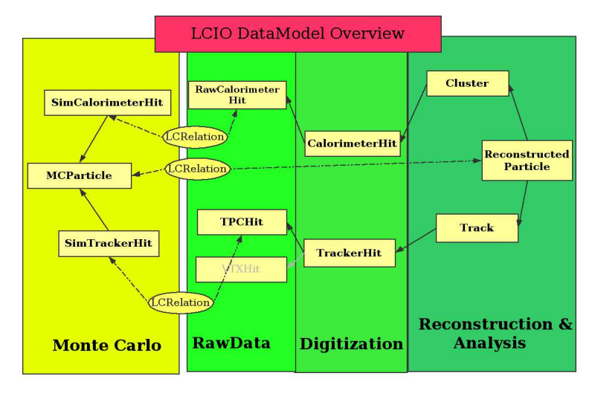
Data Model (LCIO) integrated in DD4Hep
LCIO persistency and data model for LC simulation and reconstruction - Gaede, F. et al.

Slide 8
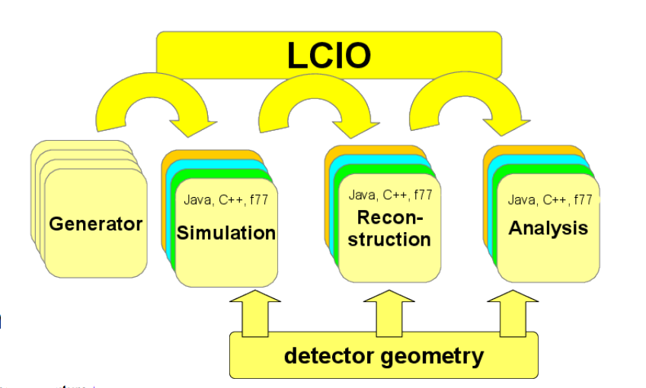
Data Model (LCIO) integrated in DD4Hep
LCIO persistency and data model for LC simulation and reconstruction - Gaede, F. et al.

Slide 9
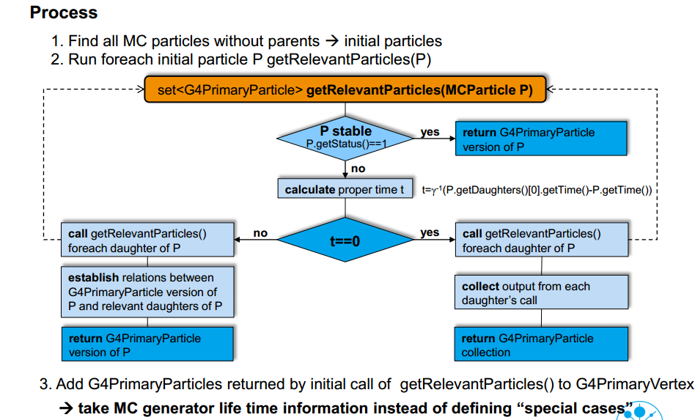
HepLCIOInterface (hepevt, stdhep, lhe, lcio, hepMC)
Courtesy of Benedikt Vormwald (Desy)

Slide 10
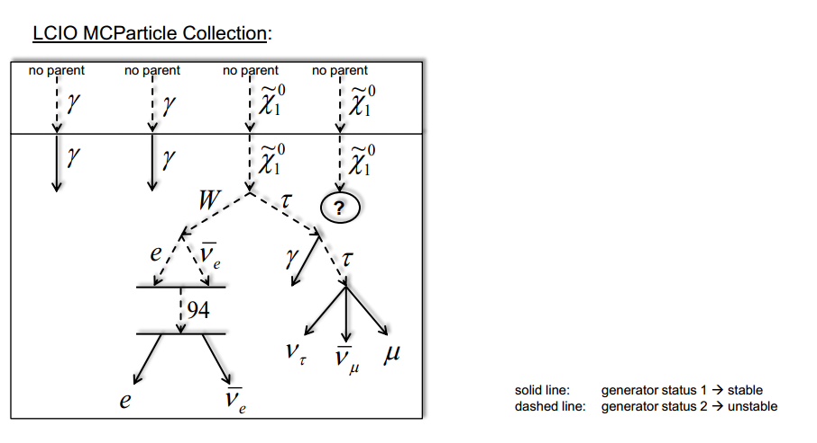
HepLCIOInterface (hepevt, stdhep, lhe, lcio, hepMC)
Courtesy of Benedikt Vormwald (Desy)

Slide 11
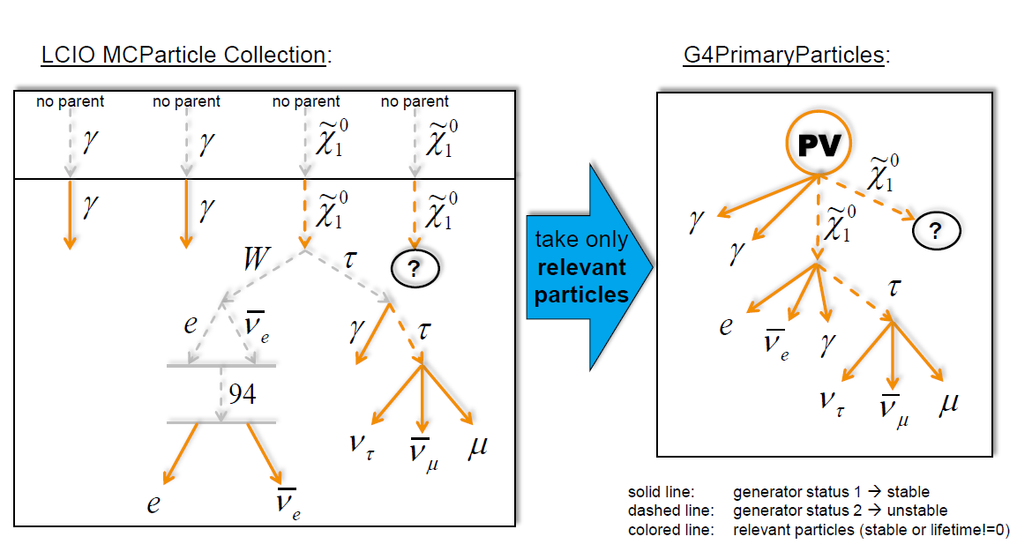
HepLCIOInterface (hepevt, stdhep, lhe, lcio, hepMC)
Madgrap/Madevent
Sherpa (under development for ep)
Courtesy of Benedikt Vormwald (Desy)

Slide 12
Status
hepLCIOinterface has been tested for all the relevant file types in the production of primary particles within Geant4.
Building geant4 app to assess energy deposition through the materials of the detector.
Simulation computation speed, open.

