Slide 1

LHeC Detector Meeting
Introduction
CERN November 7th - 8th 2013
https://indico.cern.ch/conferenceDisplay.py?confId=281921

Slide 2
Introduction (i)
Aim of the meeting
  Where we stand, review CDR baseline detector
  Update from machine and interaction region (beam pipe)
  Refresh/update physics requirements
  List and review the ongoing studies and address those topics which are most urgent for progress on detector design
  Review where we stand w.r.t. simulation environment and software development
  Define a Roadmap and preparation for the Chavannes’ workshop in January 20th - 21st

Slide 3
Introduction (ii)
Structure of the Meeting:
  3 informal sessions:
  Detector Design (Thursday Nov 7th, Morning 10:00 → …)
    Present baseline, updates from Machine and interaction region
  Physics requirements (Thursday 7th Afternoon, 14:30 →…)
    Studies from golden Analyses Higgs, HFL, eA, etc.
  Simulation Environment (Friday Morning 8th, 10:00 → … )
    LHeC Software, Ongoing detector studies,
    DD4Hep, LHeC Software Tutorial

Slide 4

Design of the
LHeC Detector
P. Kostka, A. Polini
Outline:
Introduction
Interaction Region
Detector Subcomponents
Points of Attention

Slide 5

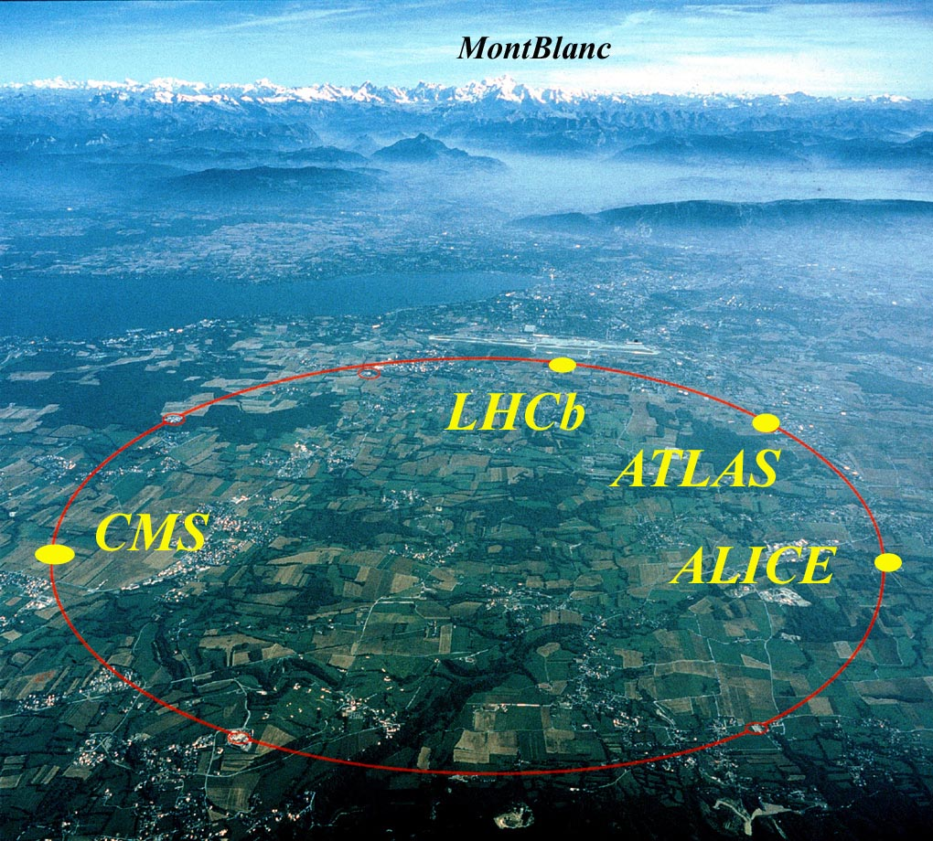
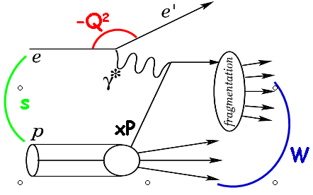
LHeC Challenge
Add an electron beam to the LHC
Next generation e±p collider
e± polarized beam
eA collider
Rich physics program: ep physics at TeV energies
precision QCD & electroweak physics
boosting precision and range of LHC physics results
beyond the Standard Model
high density matter: low x and eA
Tevatron/LEP/HERA (Fermiscale) → LHC/LC/LHeC (Terascale)
100 fold increase in luminosity, in Q² and 1/x w.r.t. HERA
LHC

Slide 6
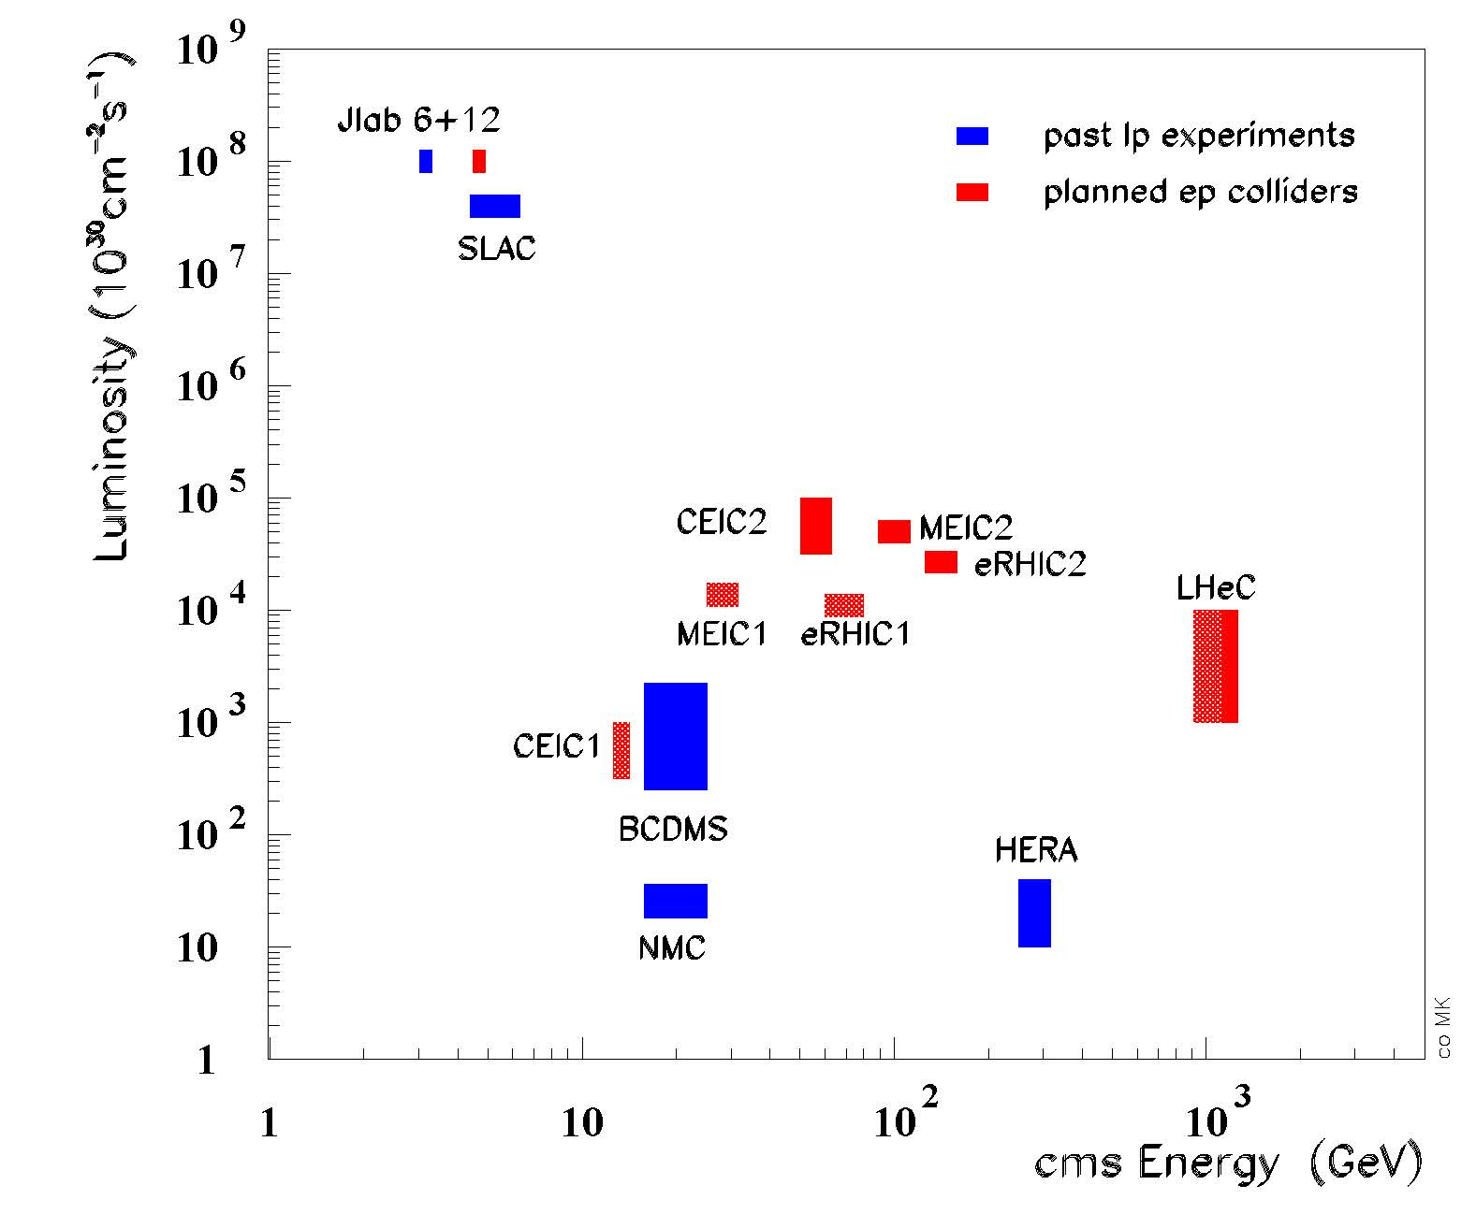
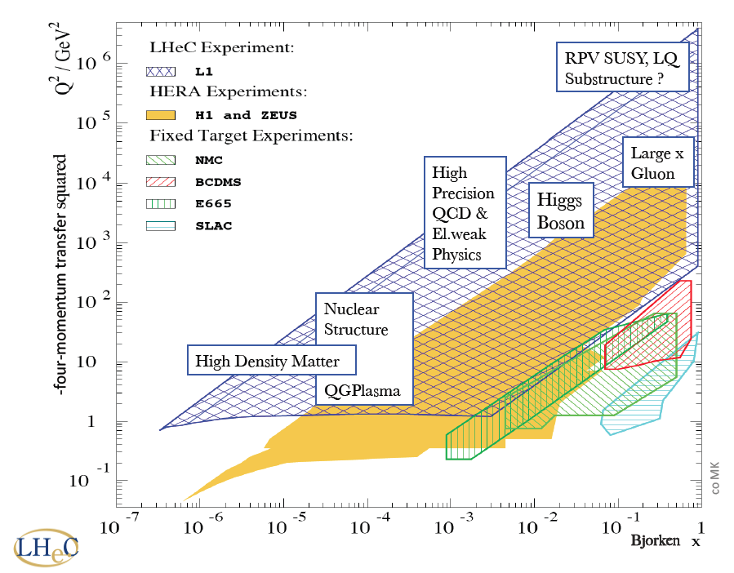
LHeC Context
Latest & most promising idea
to take lepton-hadron physics
to the TeV centre-of-mass scale
… at high luminosity
Designed to exploit
intense hadron beams
in high luminosity
phase of LHC running
from mid 2020s

Slide 7
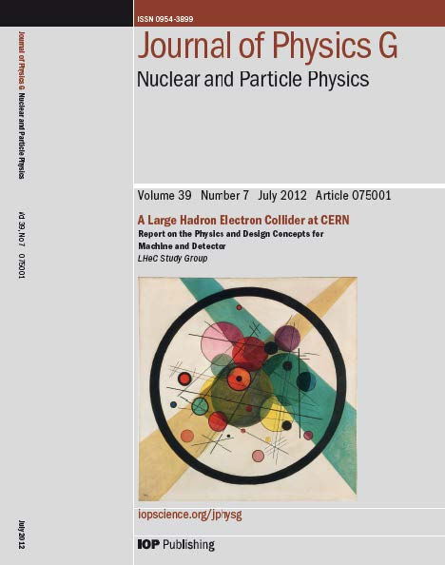
Conceptual Design Report
J. Phys. G: Nucl. Part. Phys. 39 (2012) 075001
[arXiv:1206.2913]
Published July 2012
630 pages, summarizing 5 year workshop commissioned by CERN, ECFA and NuPECC
~200 participants, 69 institutes
http://cern.ch/lhec
Additional material in subsequent updates:
“A Large Hadron Electron Collider at CERN” [arXiv:1211.4831]
“On the Relation of the LHeC and the LHC” [arXiv:1211.5102]

Slide 8
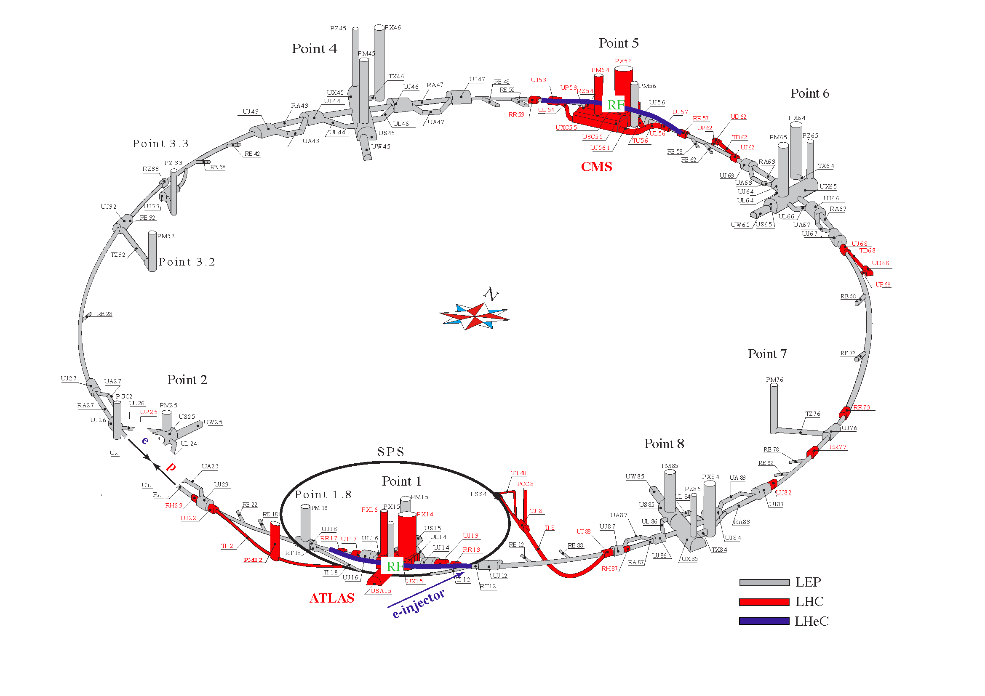
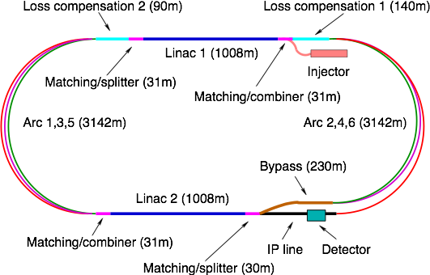
e± beam options: RR and LR
10 GeV
10, 30, 50 GeV
10 GeV
Ring-Ring
  e-p and e-A (A=Pb, Au, …) collisions
  More “conventional” solution, like HERA, no difficulties of principle - at first sight - but constrained by existing LHC in tunnel
  polarization 40% with realistic misalignment assumptions
Linac-Ring
  e-p and e-A (A=Pb, Au, …) collisions, polarized e⁻ from source, somewhat less luminosity for e⁺
  New collider type of this scale, Energy Recovery Linac

Slide 9
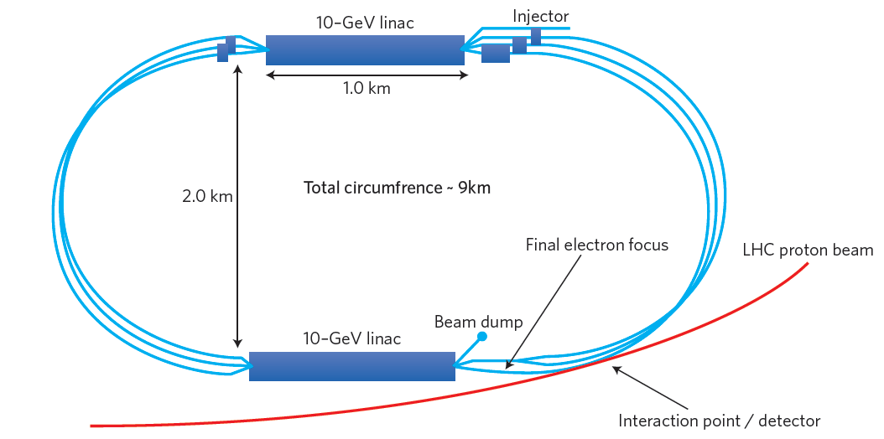
Baseline: Energy Recovery Linac
R. Thomas et al. 2013
Design constraint: power consumption < 100 MW → E_{e} = 60 GeV
Two 10 GeV linacs,
3 returns, 20 MV/m
Energy recovery in same structures
Luminosity [10³³cm⁻²s⁻¹] | 1-10**
Detector acceptance [deg] | 1
Polarization [%] | 90
IP beam sizes [μm] | 7
Crossing angle [mrad] | 0
e- L* [m] | 30
Proton L* [m] | 15
e- beta*_{x,y} [m] | 0.12
Proton beta*_{x,y} [m] | 0.1
Synchrotron power [kW] | 10
ep Lumi 10³³ (10³⁴ cm s⁻² s⁻¹ )**
10 - 100 fb⁻¹ per year
100 fb⁻¹ – 1 ab⁻¹ total
eD and eA collisions have always been integral to programme
e-nucleon Lumi estimates ~ 10³¹ (10³² ) cm s⁻² s⁻¹ for eD (ePb)
** High Luminosity proposal exists

Slide 10
Baseline: Energy Recovery Linac
R. Thomas et al. 2013
Design constraint: power consumption < 100 MW → E_{e} = 60 GeV
Two 10 GeV linacs,
3 returns, 20 MV/m
Energy recovery in same structures
Luminosity [10³³cm⁻²s⁻¹] | 1-10**
Detector acceptance [deg] | 1
Polarization [%] | 90
IP beam sizes [μm] | 7
Crossing angle [mrad] | 0
e- L* [m] | 30
Proton L* [m] | 15
e- beta*_{x,y} [m] | 0.12
Proton beta*_{x,y} [m] | 0.1
Synchrotron power [kW] | 10
ep Lumi 10³³ (10³⁴ cm s⁻² s⁻¹ )**
10 - 100 fb⁻¹ per year
100 fb⁻¹ – 1 ab⁻¹ total
eD and eA collisions have always been integral to programme
e-nucleon Lumi estimates ~ 10³¹ (10³² ) cm s⁻² s⁻¹ for eD (ePb)
** High Luminosity proposal exists
With the Higgs discovery and measured cross section σ ~ 200fb there is a striking option to make the LHeC a clean Higgs factory with maximum luminosity

Slide 11
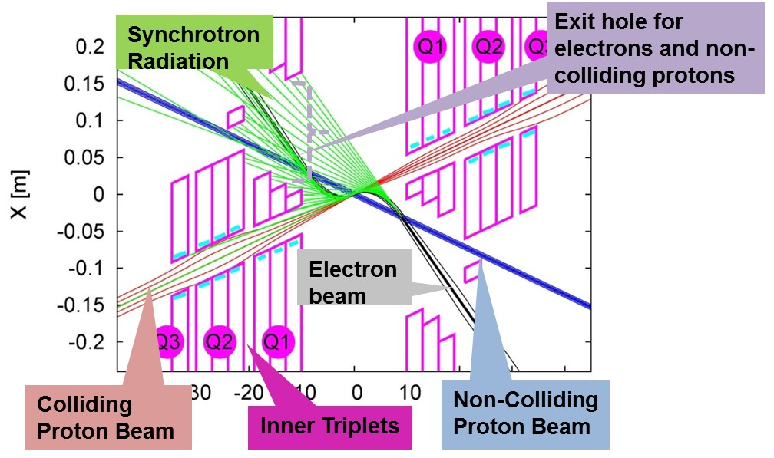
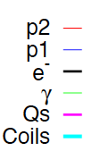
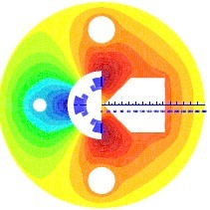
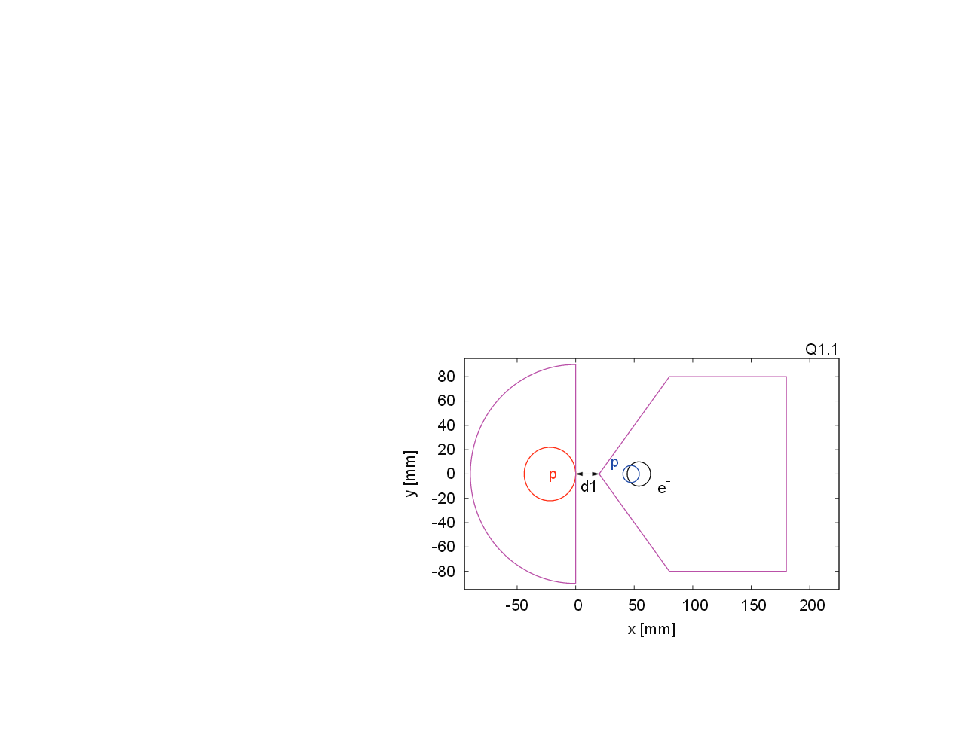
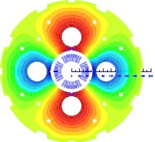
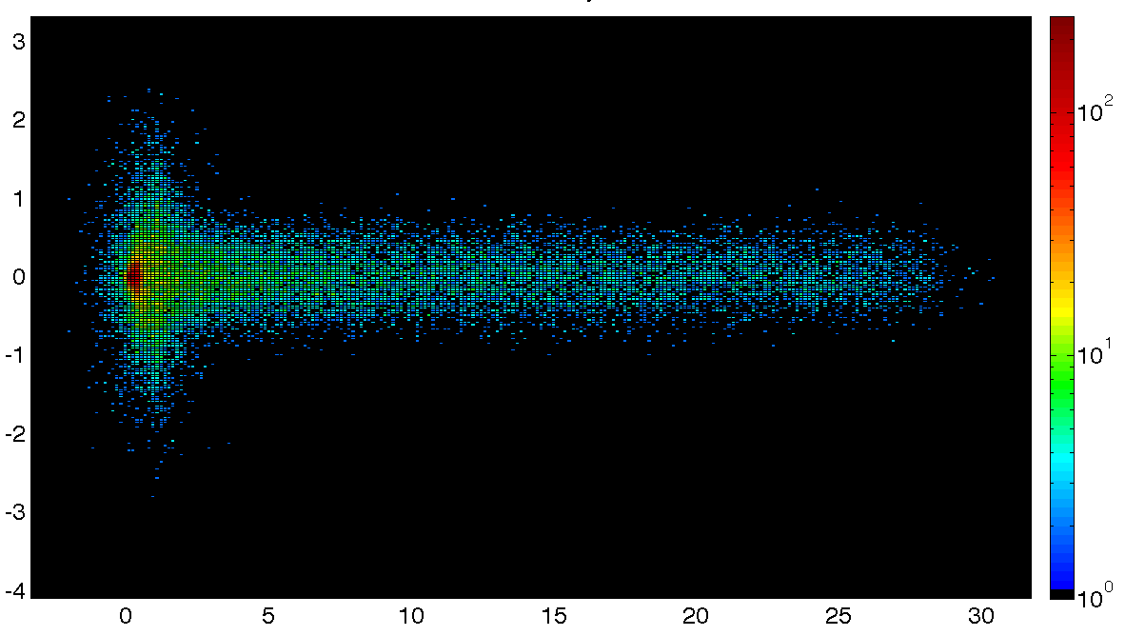
The Interaction Region
3 beam interaction region
Optics compatible with LHC running and β*=0.1m
Only the p beam colliding with the e- is focused
Head-on collisions achieved via long dipole across interaction region
High synchrotron radiation
load
Dipole in main detector
Q1
Q2
Photon Number Density at the IP
y [mm]
Q1
Q2
x [mm]

Slide 12
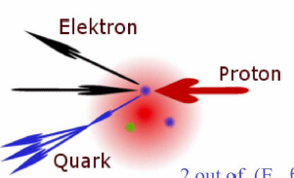
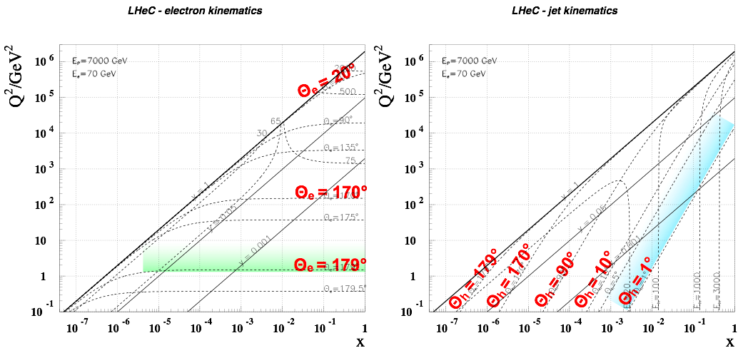
LHeC Kinematics
High x and high Q²: few TeV HFS scattered forward:
➔ Need forward calorimeter of few TeV energy range down to 10º and below █
Mandatory for charged currents where the outgoing electron is missing
Scattered electron: ➔ Need very bwd angle acceptance for accessing the low Q² and high y region █

Slide 13
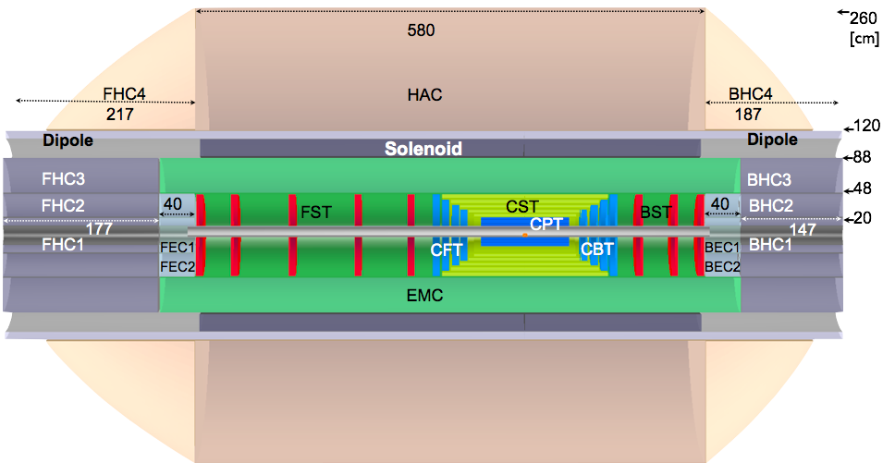

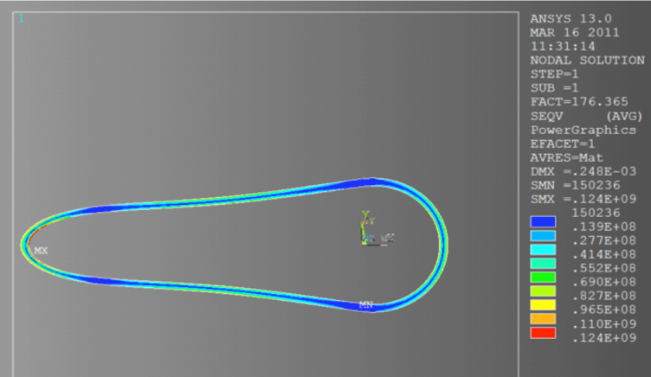
Baseline Detector
Central Tracker Si-Layers
e∓
p/A
Beam Pipe Design
High acceptance Silicon Tracking System ~1°
Liquid Argon EM Calorimeter,
Iron-Scintillator Hadronic Calorimeter
Forward Backward Calorimeters: Si/W Si/Cu

Slide 14
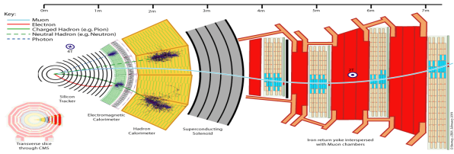
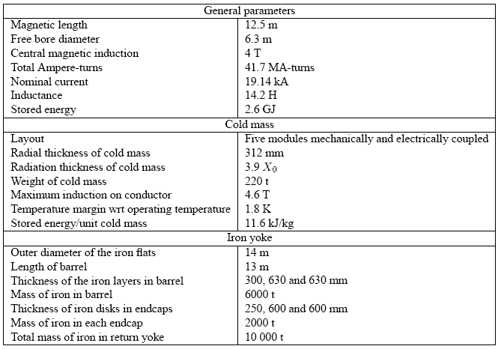
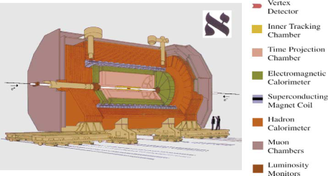
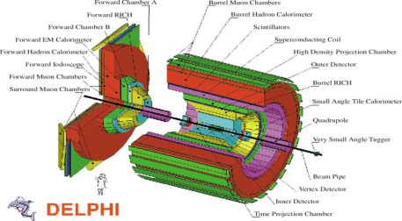
Solenoid Options
Large Coil
Large Solenoid containing the Calorimeter
3.5 T Solenoid of similar to CMS/ILC
Precise Muon measurement
Large return flux either enclosed with Iron or
Option of active B shielding with 2nd solenoid
Small Coil
Smaller Solenoid placed between EMC and HAC
Cheaper option
Convenient displacement of Solenoid and Dipoles in same cold vacuum vessel (Linac-Ring only)
Smaller return flux (less iron required)
Muon p, p_{t} measurement compromised
HAC
EMC
EMC
EMC
COIL

Slide 15
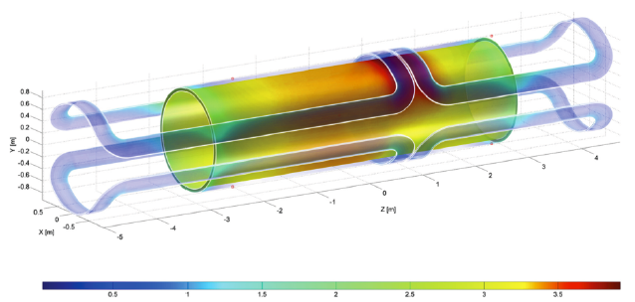
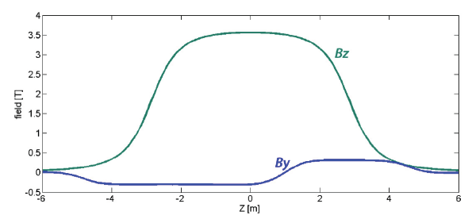
Magnets
Baseline Solution:
Solenoid (3.5 T) + dual dipole 0.3 T (Linac-Ring Option)
Magnets (may be) embedded into EMC LAr Cryogenic System
Need of study the Calorimeter Performance and impact of dead material between EMC and HAC sections; it might be possible placing the magnet system even in front of the EMC - at even lower radius at just outside of the tracking system

Slide 16
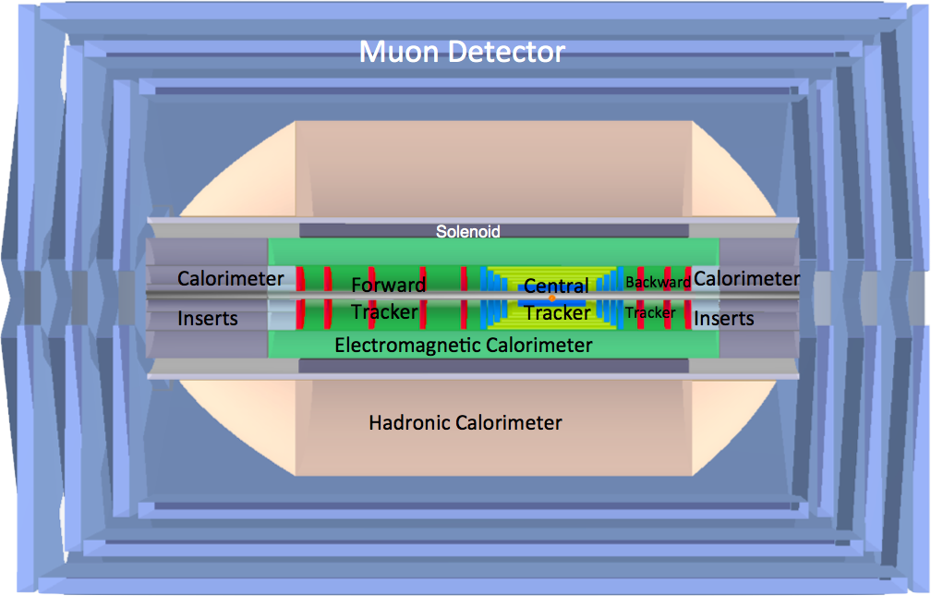
Baseline Detector
dipole
dipole
e∓
p/A
Forward / backward asymmetry reflecting beam energies
Present size 14m x 9m (c.f. CMS 21m x 15m, ATLAS 45m x 25m)
e/γ taggers ZDC, proton spectrometer integral to design from outset system providing tagging, no independent momentum measurement

Slide 17
Detector Design Approach
Provide a baseline design which satisfies the Physics requirements along with the constraints from the machine and interaction region for running during the PHASE II of LHC
Having to run along with the LHC, the detector needs to be designed and constructed in about 10 years from now to be able to run concurrently with the other LHC experiments designed for pp and AA studies in the ep/eA mode, respectively.
  While avoiding large R&D programs, the final LHeC detector can profit from the technologies used nowadays at the LHC and the related developments and upgrades
  Modular and flexible design to accommodate with upgrade programs; Detector assembly above ground; Detector maintenance (shutdown)
  Affordable - comparatively reasonable cost.
More refined studies are required and will follow with the TDR and once a LHeC collaboration has been founded

Slide 18
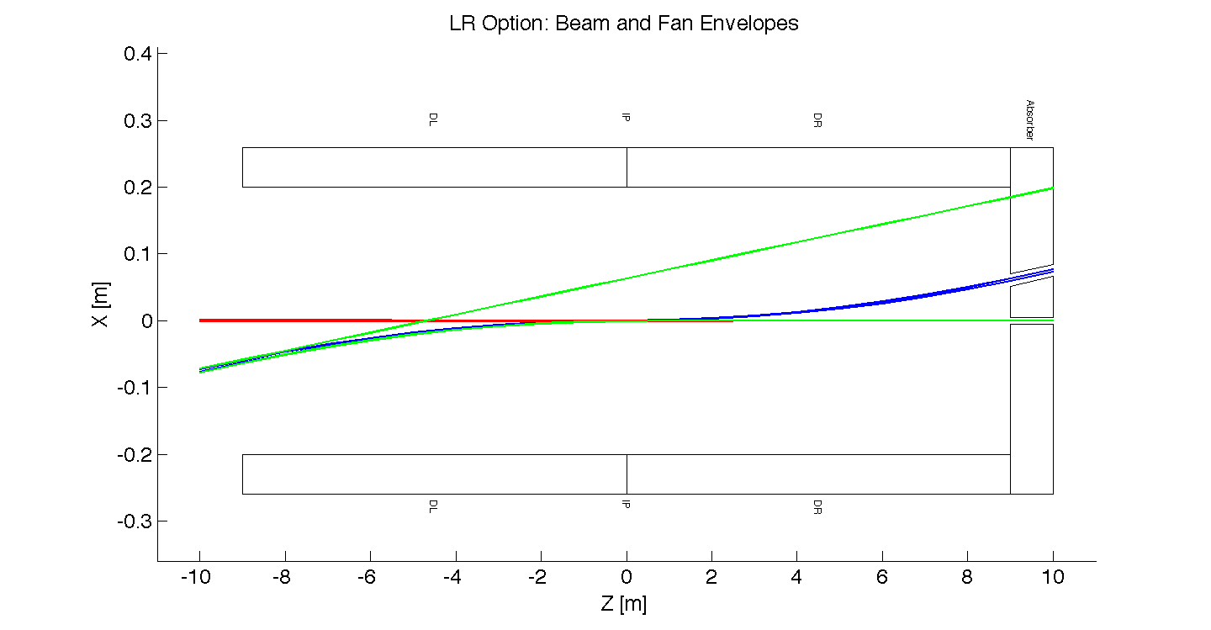
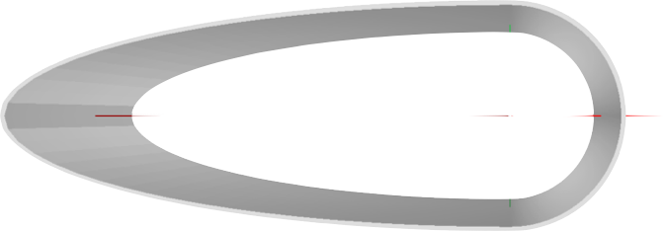
LR Interaction Region
Dipole Field along the full interaction region needed
B = ±0 .3 Tesla for z = [–9m , +9m]
SR Fan growth with z
LR Option - Beam & Fan Envelopes
e p
x [mm]
Triplet Position z= ~10m
Linac-Ring Beampipe:
Inner Dimensions
Circular(x)=2.2cm; Elliptical(-x)=-10., y=2.2cm
Material: Be 2.5-3.0 mm wall thickness
Stress Test: Pipes would be sufficient to resist the external pressure
Note: 1⁰ track passing 1.5 ~ 3.0mm thick Be wall -
X/X0=21% ~ 45% → R&D and/or move to composite beampipe…
z [mm]
y=2.2cm
x= -10cm
x=2.2cm
18

Slide 19
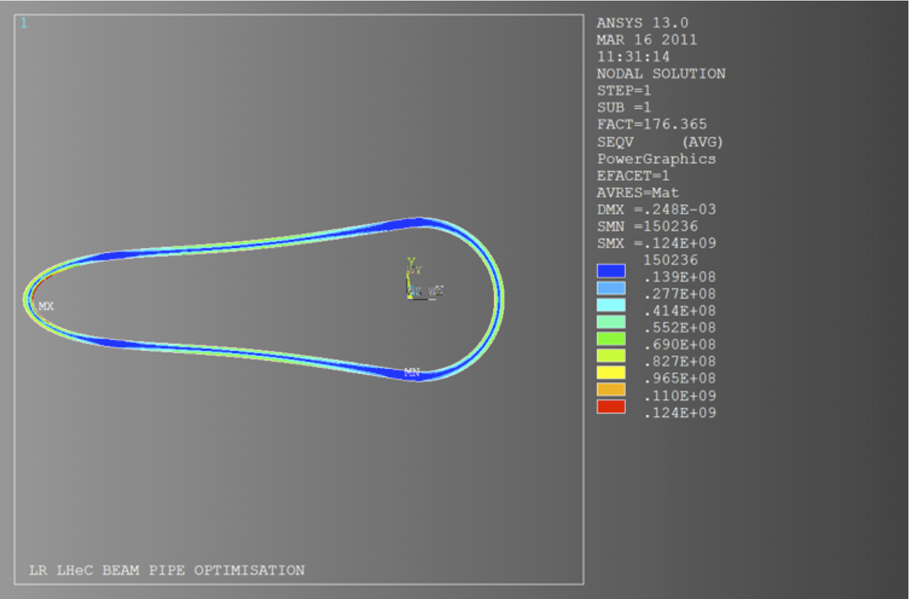
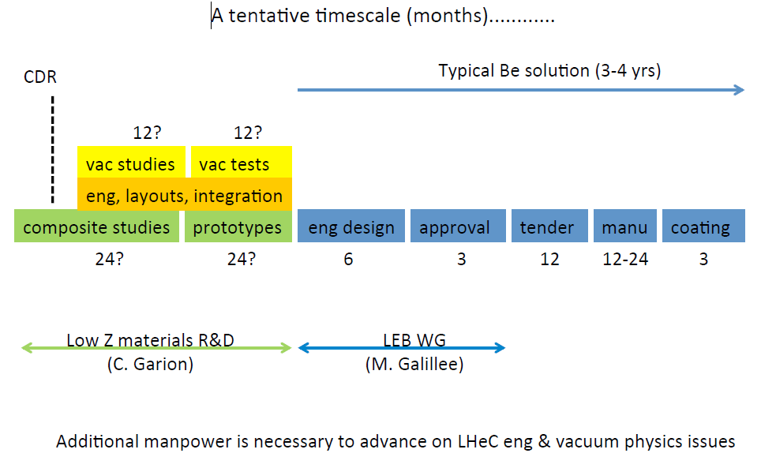
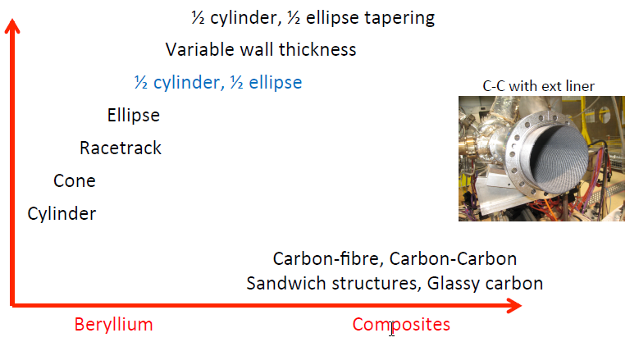
Beam Pipe Considerations
J, Bosch, P. Krushank, R. Veness, - LHeC Chavannes 2012
CDR Design:
Beryllium 2.5-3 mm thickness
Central beam pipe ~ 6 meters
Constant x-section
TiZrV NEG coated
Periodic bakeout/NEG activation at ~220C (permanent system?)
Wall protected from primary SR (upstream masks)
Minimised end flanges, minimised supports
CHAMBER COST
EXECUTION
TIME, RISK
Stress Test’s:
Pipes would be sufficient to resist the external pressure
BUT 1⁰ track passing 1.5mm thick Be wall -
X/X0=25% → R&D important

Slide 20
LR Interaction Region
Dipole Field along the full interaction region needed
B = ±0 .3 Tesla for z = [–9m , +9m]
SR Fan growth with z
LR Option - Beam & Fan Envelopes
e p
x [mm]
Triplet Position z= ~10m
Linac-Ring Beampipe:
Inner Dimensions
Circular(x)=2.2cm; Elliptical(-x)=-10., y=2.2cm
Material: Be 2.5-3.0 mm wall thickness
Stress Test: Pipes would be sufficient to resist the external pressure
Note: 1⁰ track passing 1.5 ~ 3.0mm thick Be wall -
X/X0=21% ~ 45% → R&D and/or move to composite beampipe…
z [mm]
The beam pipe design is a critical item especially when aiming for tagging at high rapidities
Need very light design, different shapes etc.
y=2.2cm
x= -10cm
x=2.2cm
20

Slide 21
Detector: Requirements from Physics
High resolution tracking system
  excellent primary vertex resolution
  resolution of secondary vertices down to small angles in forward direction for high x heavy flavor physics and searches
  precise p_{t} measurement matching to calorimeter signals (high granularity), calibrated and aligned to 1 mrad accuracy
The calorimeters
  electron energy to about 10%/ √ E calibrated using the kinematic peak and double angle method, to permille level
    Tagging of γ's and backward scattered electrons -
    precise measurement of luminosity and photo-production physics
  hadronic part 40%/√ E calibrated with p_{t_e} /p_{t_h} to 1% accuracy
  Tagging of forward scattered proton, neutron and deuteron - diffractive and deuteron physics
Muon system, very forward detectors, luminosity measurements

Slide 22
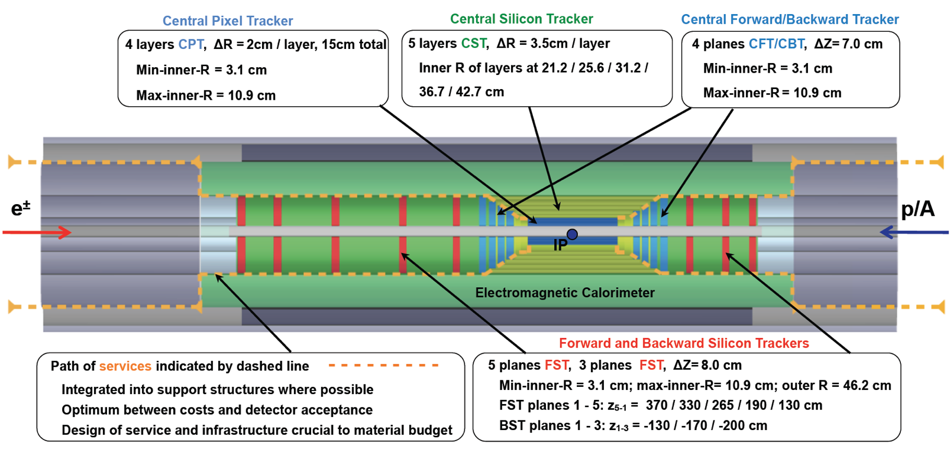
High acceptance tracking design
BST
Very compact design, contained within the electromagnetic calorimeter:
(small radius due to constraints from the magnet (dipole system. Adequate B field.
More coverage in the proton direction: dense forward jet production (down to 1º in θ)
Services and Infrastructure need very careful design being the main contributor to Material Budget

Slide 23
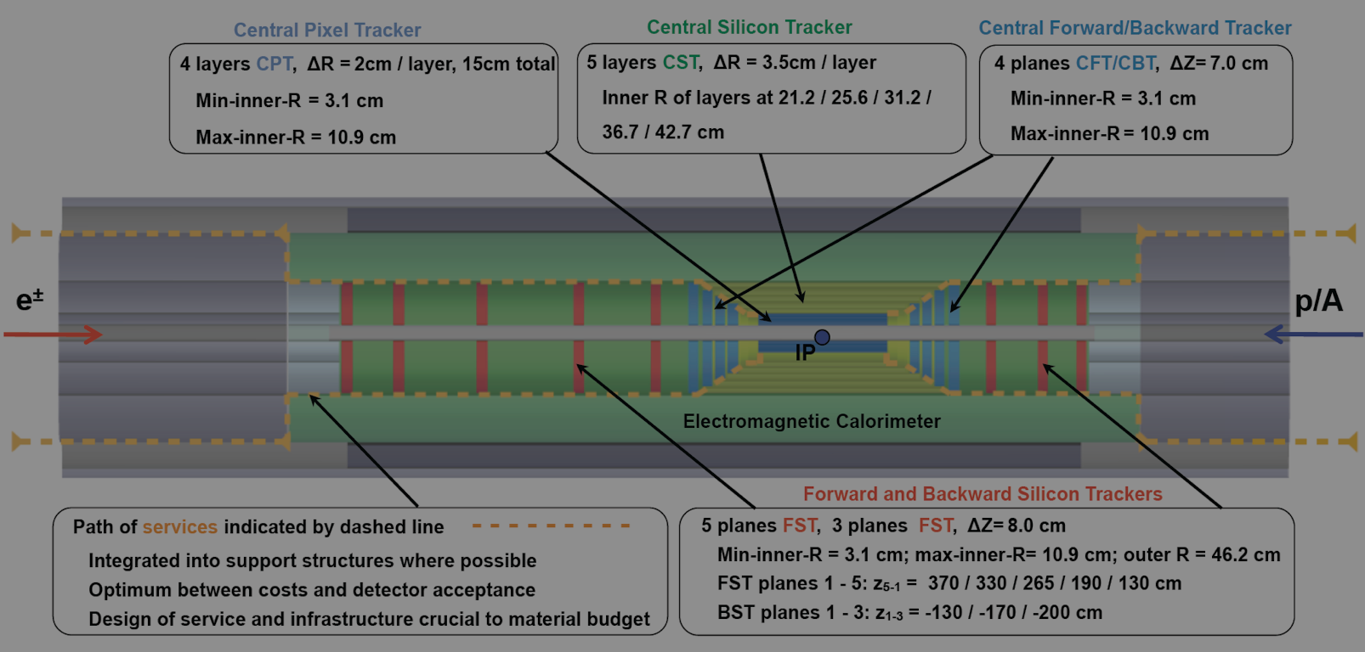
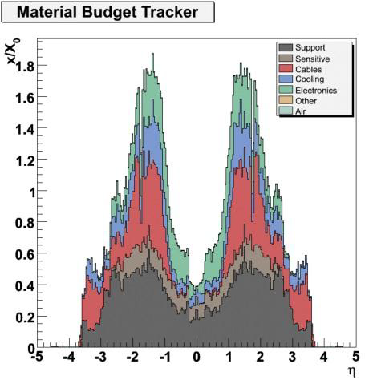
High acceptance tracking design
BST
Very compact design, contained within the electromagnetic calorimeter:
(small radius due to constraints from the magnet (dipole system. Adequate B field.
More coverage in the proton direction: dense forward jet production (down to 1º in θ)
Services and Infrastructure need very careful design being the main contributor to Material Budget

Slide 24
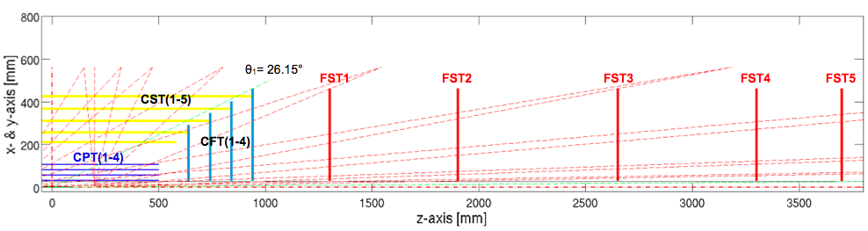
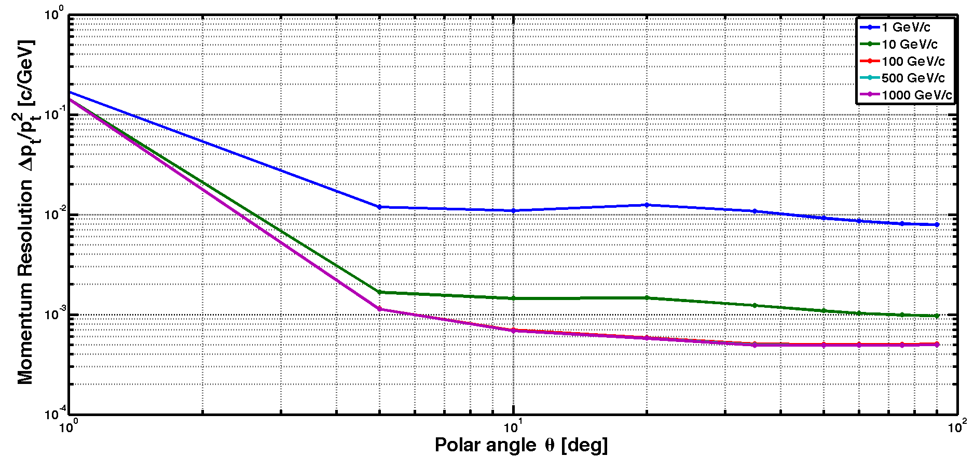
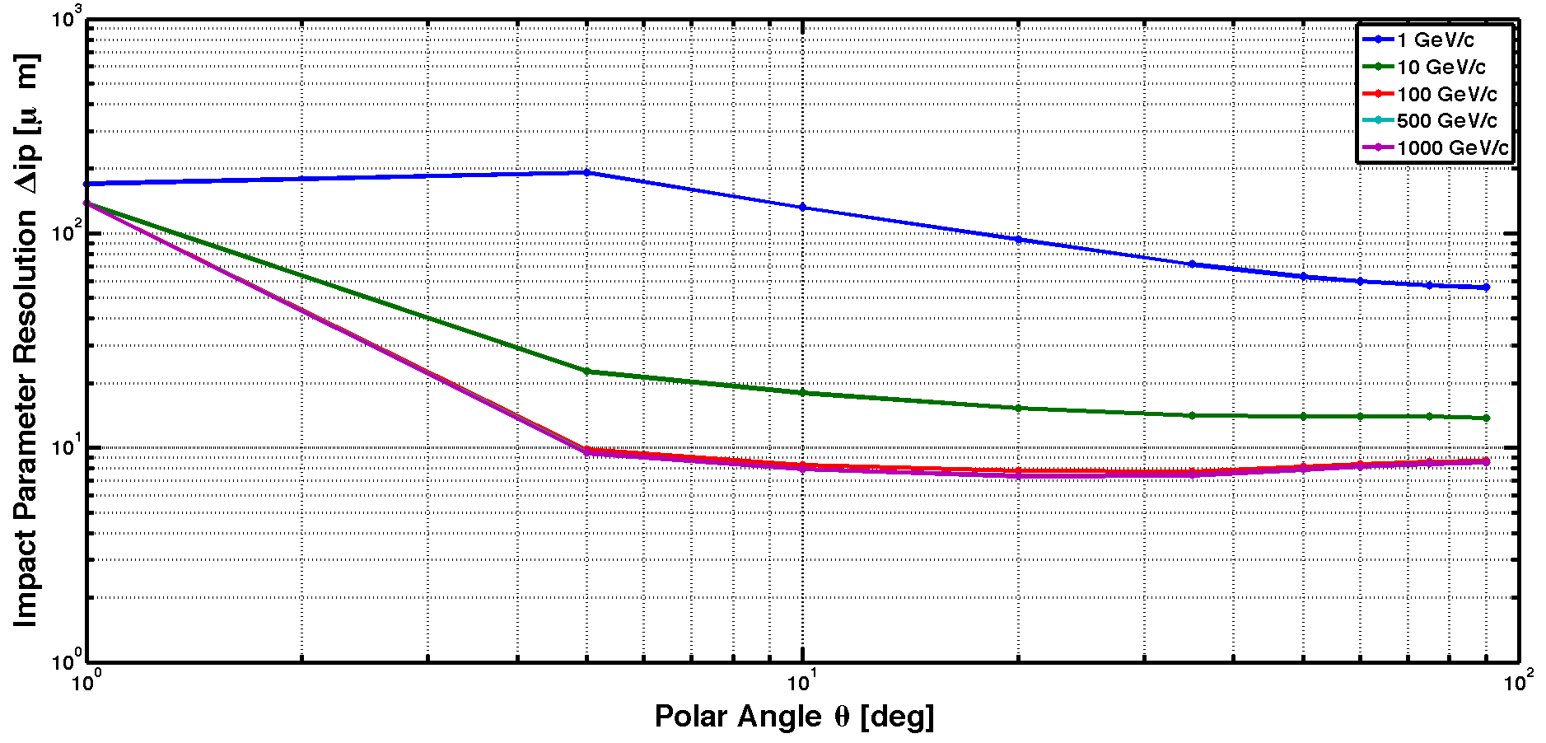


Tracker Simulation
LicToy
http://wwwhephy.oeaw.ac.at/p3w/ilc/lictoy/UserGuide_20.pdf
LicToy 2.0 Simulation - Simplified Geometry
Silicon: compact design, low budget material, radiation hard

Slide 25
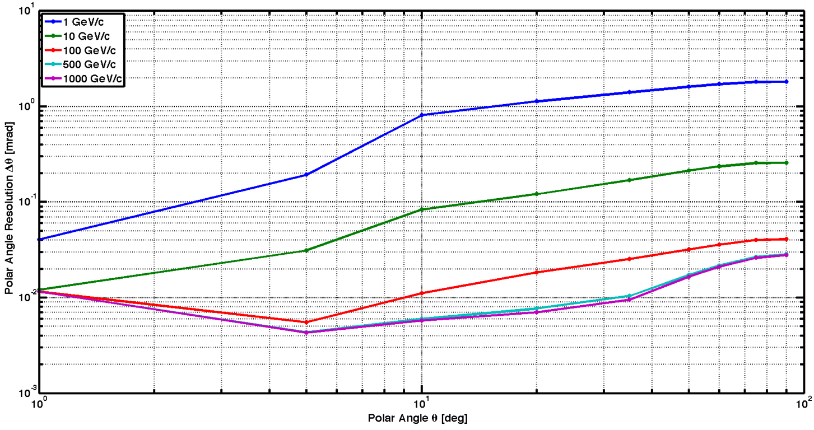
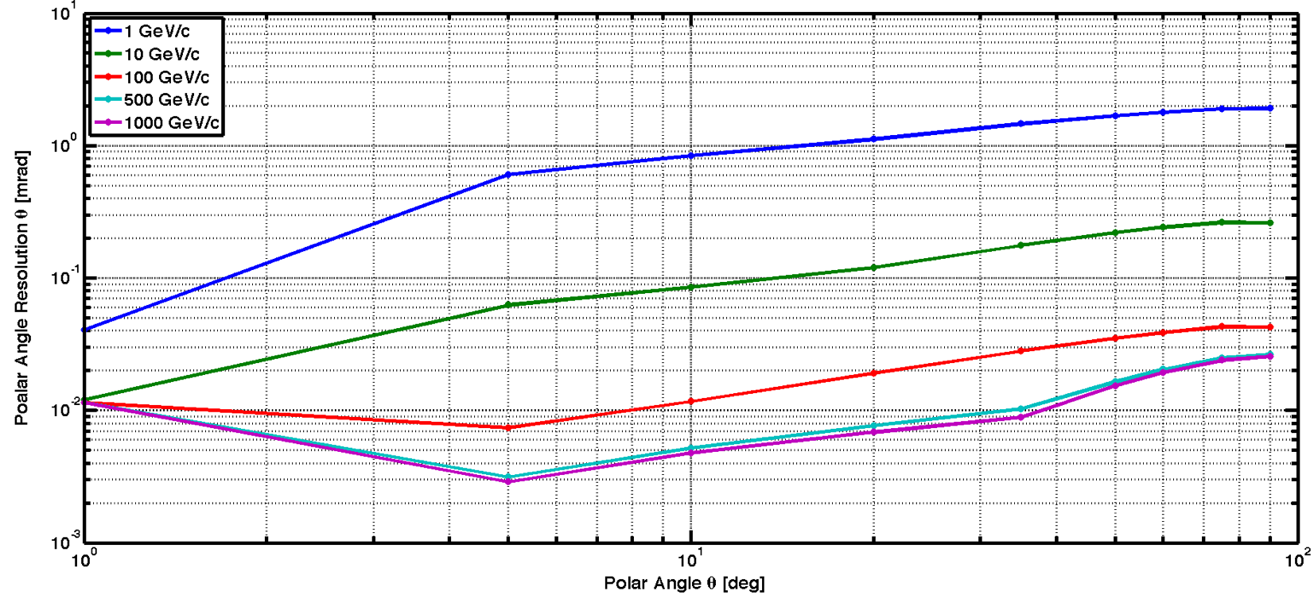
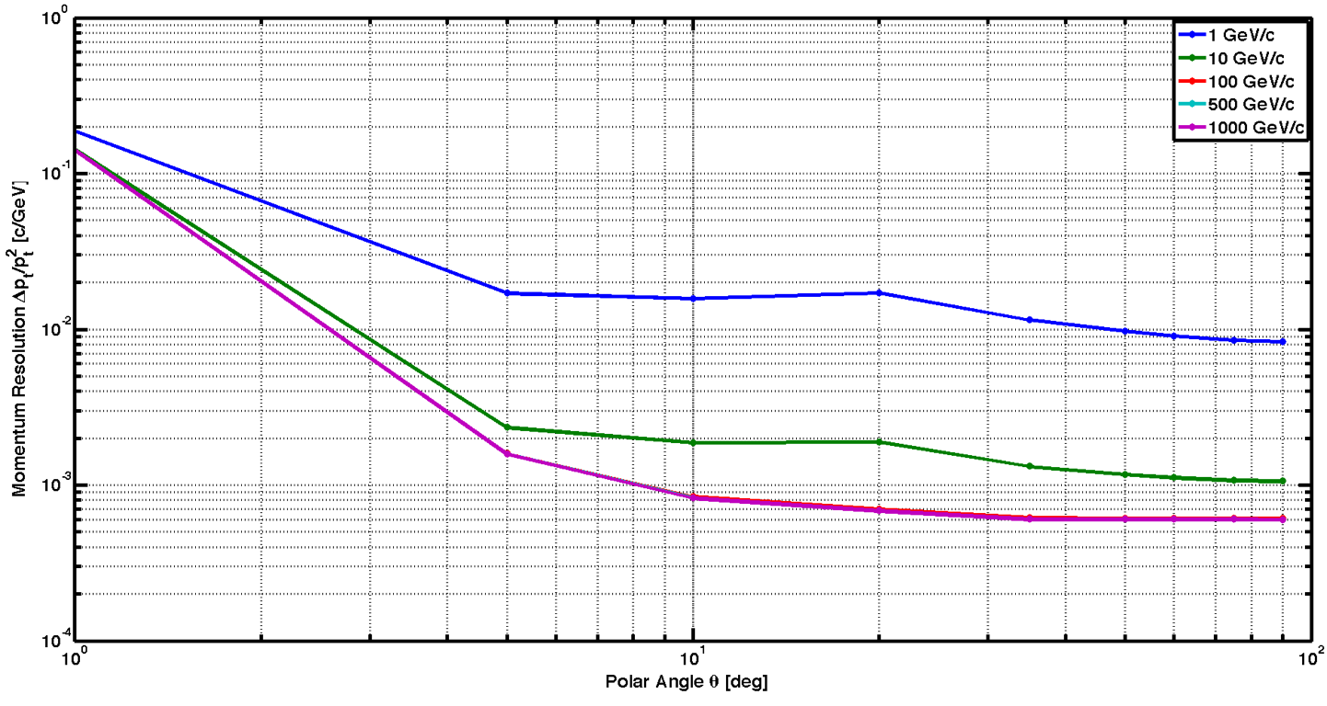
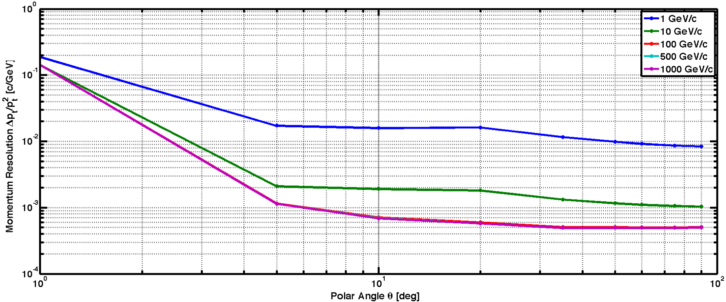
Tracker Simulation (ii)
90⁰
90⁰
1⁰
1⁰
1⁰
1⁰
90⁰
90⁰
Same plots (left) and (small) deterioration in case of innermost barrel layer failure (right)

Slide 26
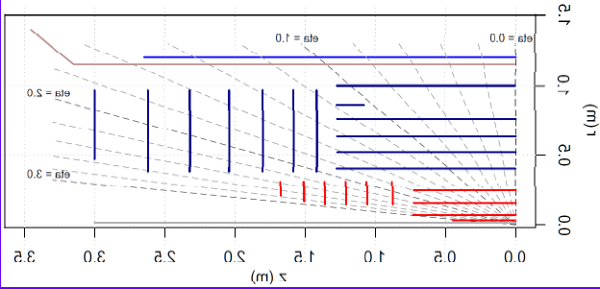
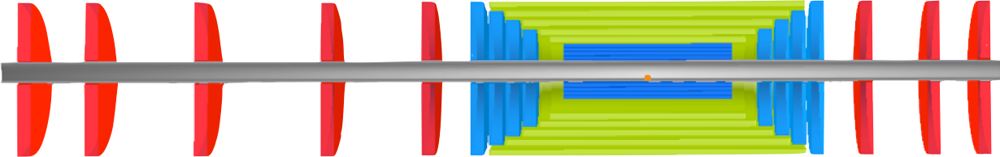

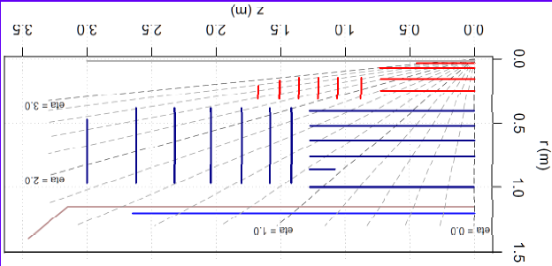
Tracker Technology
ATLAS Upgrade
48 cm
e∓
p/A
All Silicon design, employing (e.g) Pixel and strip detectors, using available technologies from the LHC experiments
  Advantages of Silicon: compact design, low budget material, radiation hard
Radiation hardness in LHeC not as challenging as for the LHC
Study of neutron fluences using GEANT4 and FLUKA show rates far lower than LHC (~ 5 x 10¹⁴)
Studies ongoing

Slide 27
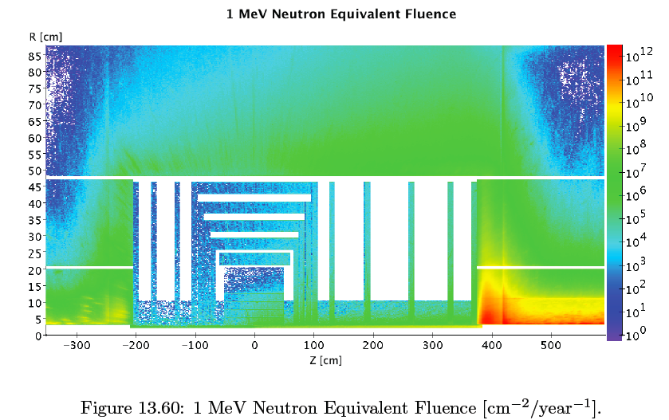
GEANT4 - Fluences
To be re-checked and reworked for
the advanced HL-LHC optics
Similar studies being done with FLUKA
Most critical the forward region
Rates far lower than LHC (LHC ~5 x 10¹⁴)

Slide 28
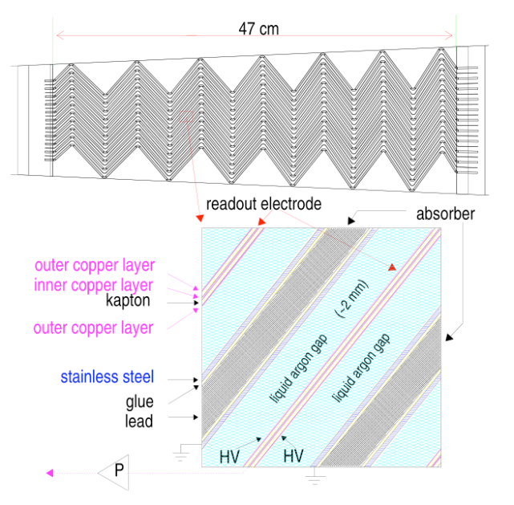
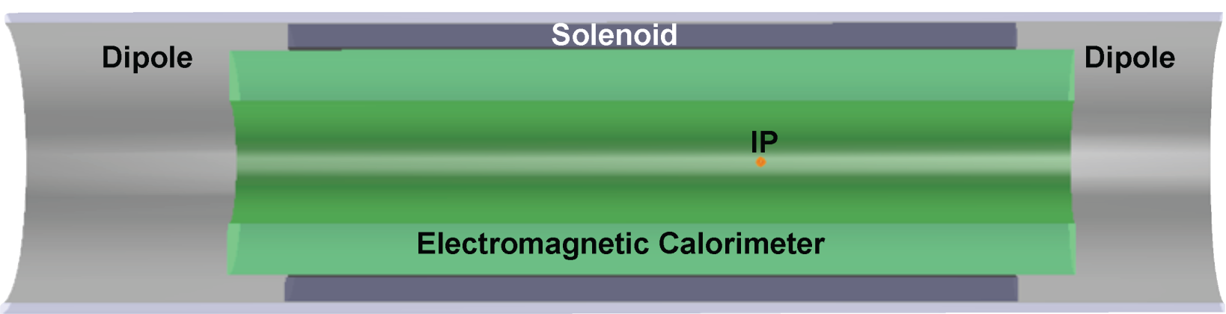
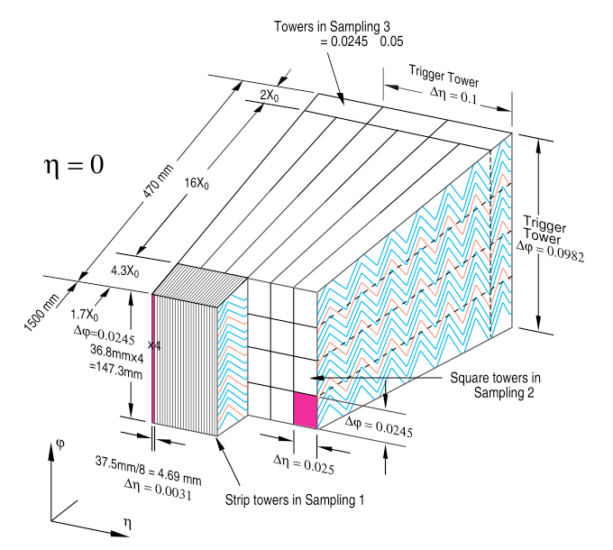
Electromagnetic Calorimeter (i)
Baseline Electromagnetic Calorimeter
LAr for barrel EMC calorimetry - ATLAS (~25-30 X₀)
  Advantage: same cryostat used for solenoid and dipoles
  GEANT4 simulation (*)
  Simulation results compatible with ATLAS
  barrel cryostat being carefully optimized pre-sampler optimal
  3 different granularity sections longitudinally
ATLAS
ATLAS
(*) F. Kocak, I. Tapan Uludag Univ.

Slide 29
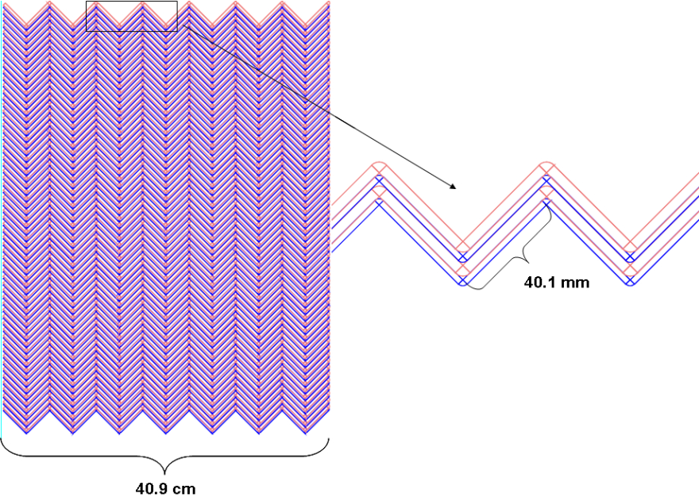
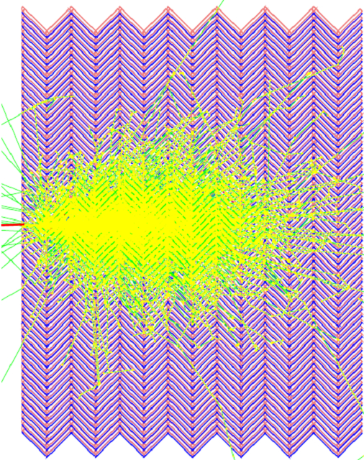
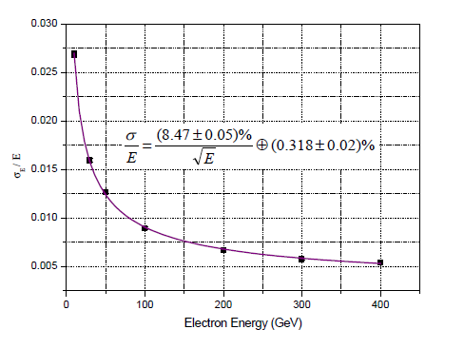

Electromagnetic Calorimeter (ii)
LHeC
F. Kocak, I. Tapan Uludag Univ.
Simulation with simplified design w.r.t.Atlas
LAr Calorimeter : good energy resolution, stable performance
Simulation results compatible with ATLAS
Warm (Pb/Sci) option also investigated
30X₀ (X₀(Pb)=0.56 cm; 20 layers) ➔

Slide 30


Hadronic Calorimeter (i)
Baseline Design
  HAC iron absorber (magnet return flux)
  scintillating plates (similar to ATLAS TILE CAL)
  Interaction Length: ~7-9 λ_{I}
Setup:
GEANT4 + FLUKA simulations
performance optimization:
  containment, resolution, combined HAC & EMC response
  solenoid/dipoles/cryostat in between
Tile Rows | Height of Tiles in Radial Direction | Scintillator Thickness
1-3 | 97mm | 3mm
4-6 | 127mm | 3mm
7-11 | 147mm | 3mm

Slide 31



Hadronic Calorimeter (ii)
Preliminary studies of the impact of the magnet system on calorimetric measurements (GEANT4 & FLUKA *)
Energy resolutions
Shower profiles
*) F.Kocak, I.Tapan, A.Kilic, E.Pilicer Uludag Univ.; E.Arikan, H.Aksakal Nigde Univ.

Slide 32

Forward Energy and Acceptance

Slide 33


Forward/Backward Calorimeters (i)
Forward/Backward Calorimeters
Forward FEC + FHC:
  tungsten high granularity
  Si (rad-hard)
  high energy jet resolution
  FEC: ~30X₀; FHC: ~8-10 λ_{I}
Backward BEC + BHC:
  need precise electron tagging
  Si-Pb, Si-Fe/Cu (~25X₀, 6-8 λ_{I} )
GEANT4 simulation *
  containment, multi-track resolution (forward)
  e± tagging/E measurement (backwards)
* A. Kilic, I. Tapan - Uludag University

Slide 34


Forward/Backward Calorimeters (ii)
Highest energies in forward region
Radiation hard
High Granularity
Linearity
Calorimeter Module | Layer | Absorber | Thickness | Instrumented Gap | Total Depth
FEC(W-Si) 30x0 | 1-25 26-50 | 1.4 mm 2.8 mm | 16 cm 19.5 cm | 5 mm | 35.5 cm
FHC (W-Si) | 1-15 16-31 32-46 | 1.2 cm 1.6 cm 3.8 cm | 39 cm 48 cm 78 cm | 14 mm | 165 cm
FHC (Cu-Si) | 1-10 11-20 21-30 | 2.5 cm 5 cm 7.5 cm | 30 cm 55 cm 80 cm | 5 mm | 165 cm
BEC (Pb-Si) | 1-25 26-50 | 1.8 mm 3.8 mm | 17 cm 22 cm | 5 mm | 39 cm
BHC(Cu-Si) 7.9 | 1-15 16-27 28-39 | 2.0 cm 3.5 cm 4.0 cm | 39.75 cm 49.8 cm 55.8 cm | 6.5 mm | 145.35cm

Slide 35

Muon System Baseline
dipole
dipole
e∓
p/A
Baseline Solution:
Muon system providing tagging, no independent momentum measurement
Momentum measurement done in combination with inner tracking
Present technologies in use in LHC exp. sufficient (RPC, TGC, MDT)

Slide 36

LHeC Detector Installation (i)
A. Herve, A. Gaddi - LHeC Chavannes 2012
LHeC Detector assembly on surface
The strategy proposed is to complete as much as possible the assembly of the detector on surface. The detector has been split in the following main parts:
  1) Coil cryostat, including the superconducting coil, the two dipoles and eventually the EMCal, if the LAr version is retained.
  2) Three barrel wheels and two endcaps of HCal tile calorimeter, fully instrumented and cabled.
  3) Two HCal inserts, forward and backward.
The maximum weight of a single element to be lowered from surface to underground has been limited to 300 tons, in order to make possible the lowering by renting a standard crane, as already applied by L3 for its barrel HCal. The superconducting coil and the two integrated dipoles will be tested at nominal current on surface, whilst the field mapping will be performed underground.

Slide 37

LHeC Detector Installation (ii)
The assembly on surface of the main detector elements as approximately 16 months
The Coil system commissioning on site three additional month, preparation for lowering one month and lowering one week per piece
Underground completion of the integration of the main detector elements inside the L3 Magnet would require about two months, cabling and connection to services
Some six months, in parallel with the installation of Muons Tracker and the EMCal
The total estimated time is thus 30 months
The field map would take one extra month.
Some contingency is foreseen between the integration inside the L3 Magnet of the same elements (2 months).
Tight but doable
A. Herve, A. Gaddi - LHeC Chavannes 2012

Slide 38
Summary and Outlook
Status
A LHeC baseline detector concept has ben worked out
The design depends heavily on the constraints from the machine and interaction region
For all cases a feasible and affordable concept which fulfills the physics requirements has been presented
As a baseline many improvements available. A more precise design will follow from more detailed physics simulations and studies, engineering and the knowledge of the machine constraints
The Future
Start a new phase in detector design
A complete software simulation environment needed
Collect people, experience, information
Identify and address critical items, discuss the timeline for realization
Build a collaboration and move next steps towards a Technical Design

Slide 39
Some Points of Attention
Beam Pipe
Acceptance (forward and backward)
Magnet system
Tagging efficiency
Precision (magnets)
Heavy Ion Running

Slide 40
Backup

Slide 41
High Luminosity Proposal
 | protons | electrons
beam energy [GeV] | 7000 | 60
Luminosity [10³³] | 1 ‐> 10
normalized emittance γε_{x,y} [µm] | 3.75 ‐> 2 | 50
IP beta function β*_{x,y} [m] | 0.1 ‐> 0.05 | 0.12 ‐> 0.032
rms IP beam size σ*_{x,y} [µm] | 7.2 ‐> 3.7 | 7.2 ‐> 3.7
beam current [mA] | 860 | 6.4 ‐> 12.8
bunch spacing [ns] | 25 | 25
bunch population | 1.7x10¹¹ ‐> 2.2x10¹¹ | 1x10⁹ ‐> 2x10⁹
Eﬀective crossing angle | 0.0

Slide 42


Muon System Extensions
e∓
p/A
Forward Air Core Toroid
Extensions:
Independent momentum measurement
Large solenoid (incompatible with LR dipoles)
Dual Coil System (homogeneous return field)
Forward Toroid System

Slide 43
Outer Detectors
Present dimensions: LxD =14x9m² [CMS 21 x 15m² , ATLAS 45 x 25 m²]
e∓
p/A
Detector option 1 for LR and full acceptance coverage
Electron outgoing direction: → Tag photo-production (Q2~0), Luminosity Detectors, Electron Taggers
Proton/Ion outgoing direction: Very forward nucleons → Zero Degree Calorimeter, Forward Proton Spectrometer

Slide 44


Luminosity measurement: physics processes
Bethe-Heitler (collinear emission):
very high rate of ‘zero angle’ photons and electrons, but sensitive to the details of beam optics at IP
requires precise knowledge of geometrical acceptance
suffers from synchrotron radiation
aperture limitation
pile-up
QED Compton (wide angle bremsstrahlung):
lower rate, but
stable and well known acceptance of central detector
Methods are complementary, different systematics
NC DIS in (x,Q²) range where F₂ is known to O(1%)
for relative normalisation and mid-term yield control
(σ_{vis}^{DIS,Q2>10GeV2} ~ 10nb for 10º and ~150nb for 1º setup)
BH σ^{vis} >100μb
QEDC σ^{vis} >100nb
NC σ^{vis} >1nb

Slide 45

Luminosity measurement: Bethe-Heitler (ep→eγp)
For LR option (zero crossing angle) the photons travel along the proton beam direction and can be detected at z≈-120m, after the proton bending dipole.
→ Place the photon detector in the median plane next to interacting proton beam
Main limitation – geometrical acceptance, defined by the aperture of Q1-Q3. May be need to split dipole D1 to provide escape path for photons.
Geometrical acceptance of 95% is possible, total luminosity error δL≈1%.
clarify p-beamline aperture in the range z=0-120m
need to calculate acceptance and its variations due to beam optics; (but this is essentially HERA setup, so we can use similar detectors/methods)

Slide 46

Electron Tagger
Detect scattered electron from Bethe-Heitler (also good for photoproduction physics and for control of γp background to DIS)
Clean sample – background from e-gas can be estimated using pilot bunches.
Three possible positions simulated→ acceptances reasonable (up to 20÷25%)
62m is preferable – less SR, more space available. Next steps: detailed calculation of acceptance and variations due to optics (beam-tilt, trajectory offset) and e-tagger position measurement and stability
Need a precise monitoring of beam optics and accurate position measurement of the e-tagger to control geometrical acceptance to a sufficient precision (e.g. 20mm instability in the horizontal trajectory offset at IP leads to 5% systematic uncertainty in the σ_{vis})
Main experimental difficulty would be good absolute calibration and resolution (leakage over the detector boundary)

Slide 47

Luminosity measurement: QED Compton
electron and photon measured in the main detector (backward calorimeter)
σ_{vis} ~3.5nb (low Q² setup); 0.03nb (high Q² setup)
Install additional ‘QEDC tagger’ at z≈-6m →increase visible cross section for QEDC up to ~3-4 nb
→ e.g. two moveable sections approaching the beam-pipe from top and bottom (assume angular acceptance θ≈0.5÷1º)
Detector requirements:
good position measurement, resolution, alignment for the movable sections of QEDC tagger
good energy resolution,linearity in 10-60 GeV range
small amount of dead material in front (and well known/simulated)
efficient e/γ separation → a small silicon tracker in front of calorimeter modules (this also allows z-vertex determination)

Slide 48

Zero Degree Calorimeter
The position of ZDC in the tunnel and the overall dimensions depend mainly on the space available for installation (~90mm space between two beampipes at z~ 100m)
→ need detailed info/simulation of beam-line
One can consider also the ZDC for the measurement of spectator protons from eD or eA scattering (positioned external to proton beam as done for ALICE)
ZDC

Slide 49


Zero Degree Calorimeter for the LHeC
ALICE ZDC

Slide 50


Forward Proton Detection
ep→ eXp’ diffractive scattering
(proton survives a collision and scatters at a low angle along the
beam-line)
ξ ≈ 1-Ep’/Ep ~ 1%
The feasibility to install forward proton detectors along the LHC beamline investigated at the ATLAS and CMS
→ the results of R&D studies are relevant for LHeC
ξ
from ATLAS
AFP Project
_{420 Meters from IP}

Slide 51

Acceptance for Forward Protons
Scattered protons are separated in space from the nominal beam: (x_{offset}=D_{x} × ξ ; D_{x} - energy dispersion function)
Acceptance window is determined by the closest approach of proton detectors to the beam, and by the size of beam-pipe walls
Assume closest approach 12σ_{beam} (σ_{beam}=250μm at 420m), R_{beampipe}≈2cm, D_{x}≈ 1.5m
|t| GeV²
~100% acceptance
Good acceptance for 0.002<ξ<0.013
ξ× 100

Slide 52


Tracker Dimensions

Slide 53

Calorimeter Dimensions

Slide 54


Detector Magnets
Dipole (for head on LR) and
solenoid in common cryostat,
perhaps with electromagnetic LAr
3.5T field at ~1m radius to house
a Silicon tracker
Based on ATLAS+CMS experience

Slide 55

Muons Fwd Bwd Region
Coverage up to 1º<θ < 10º and 170º< θ<179º for superior acceptance of vector mesons, Top decay products, Leptoquarks etc.
Stand alone momentum measurements needed
  Poor performance of Inner tracker in this region
Some overlap with the Forward region
  needed to understand efficiencies, fakes and resolution of Stand Alone muons.
In Forward direction high momentum muons, opening angles between muons very small
  Very good two tracks resolution
    Highly segmented detectors
    Micromegas or GEMs
High momentum resolution can be achieved with air core toroids.
Vector meson Acceptance

Slide 56







LR Synchrotron Radiation (cdr)

Slide 57


Composite Pipes
Motivation to reduce cost in materials and manufacture
Possibly improve radiation transparency
  Sandwiches constructions – but increased wall thickness
Long-term R&D on low Z composite chambers is under way at CERN which may provide an alternative.
Carbon-fibre composites (aluminium, glass/ceramic in matrix)
Carbon-carbon composites (with/without metal liners)
Glassy (vitreous) carbon
Sandwich constructions (honeycomb & metal foam cores with thin skins )
Recent development of unbaked coatings may be advantageous w.r.t. to known temperature limitations of some composites – a-C coating used in SPS.¹
Material | Radiation length X₀ [cm] | Notes
Beryllium | 35
Epoxy | 30-36 | Very low E !
Carbon | 29 | Includes C-C & Glassy
Carbon/Al (90/10) | 24 | Impregnated C matrix
Carbon/Al (60/40) | 17 | Impregnated C matrix
AlLi | 10-11
Al | 9
Al2O3 | 7
SiC | 8
Amorphous Carbon Coatings for mitigation of electron cloud
in the CERN SPS, C. Yin Vallgren et al.

Slide 58
CERN Mandate
Studies and prototyping of key technical components:
Superconducting RF system for CW operation in an ERL
SC Magnet development of the insertion regions of the LHeC with 3 beams
Studies related to the experimental beam pipes with large beam acceptance
The design and specification of an ERL test facility for the LHeC
The finalization of the ERL design for the LHeC (optics design, beam dynamics studies and identification of potential performance limitations)
(S.Bertolucci at Chavannes workshop 6/12 based on
CERN directorate’s decision to include LHeC in the MTP)

Slide 59






Linac Design
In the CDR: 8 cavities per 14 m long module
Choice between O(720 MHz) and O(1.3 GHz)
~ 720 MHz had been baseline for CDR
Post CDR:
➔ FINAL CHOICE: 801.58 MHz
Frequency of a future LHC harmonic system
It is (to less than a few kHz) equal to the existing SPS Landau system
LOWER FREQUENCY
ADVANTAGES DISADVANTAGES
Reduced losses
Somewhat higher RF cost
Might be offset by reduced cryo
cost or improved performance
Less required cooling power
Reduced wakefield

Slide 60





CERN ERL Test Facility
100-MeV scale energy recovery demonstration of a recirculating superconducting linear accelerator
Built-in flexibility
Roadmap up to 1-GeV scale energy recovery demonstration of a recirculating superconducting linear accelerator
5 MeV Injector
Dump
5 MeV Injector
Dump
5 MeV Injector
Dump

Slide 61

LHeC Planning and Timeline
Installation decoupled from LHC operation and shutdown planning
Infrastructure investment with potential exploitation beyond LHeC

