Slide 2
Highly transparent vacuum chambers
Outline:
Context
Present solutions
New material development
  Alternative to beryllium
  Figure of merit
  Type of material
  Status of different alternatives
Conclusion and next steps
Workshop on Advanced Materials and Surfaces

Slide 3
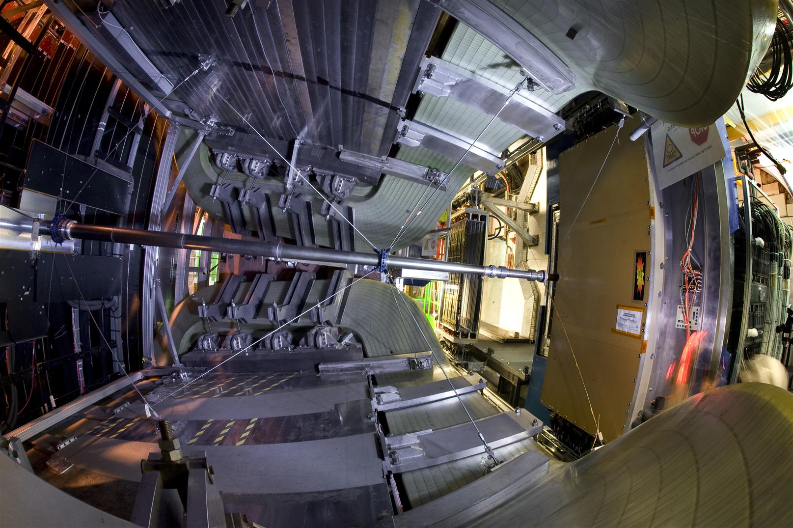
Highly transparent vacuum chambers
In high energy physics detectors, transparent vacuum systems are required to:
Reduce the interaction of particles with the matter,
Reduce the activation of the materials,
Reduce the background to the experiments.

Slide 4
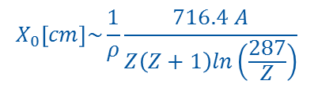

Highly transparent vacuum chambers
Main requirements are:
Vacuum compatibility (leak tightness, low outgassing and permeation),
Temperature resistance (in the range 230 C)
Mechanical stiffness and strength
thickness of the chamber
$\frac{t}{X_{0}}$
Transparency of the chamber is defined as:
Atomic weight
radiation length
$$X_{0}\left[cm\right]\sim \frac{1}{ρ}\frac{716.4 A}{Z\left(Z+1\right)ln\left(\frac{287}{Z}\right)}$$
density
Atomic number

Slide 5
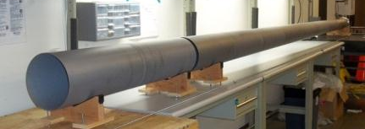
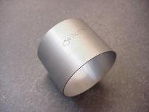
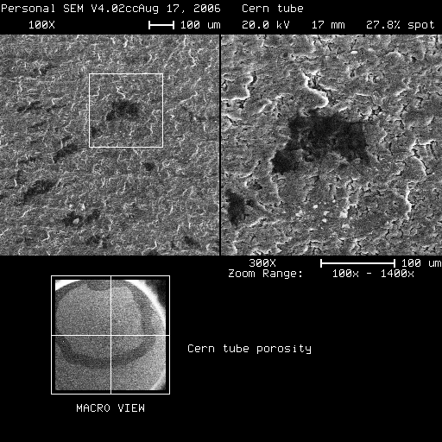
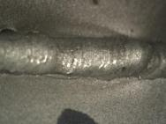
Present solutions for transparent vacuum chambers Beryllium
Beryllium is used for vacuum chambers in the experimental area due to its transparency and stiffness.
Range of geometry:
Thickness: 0.8 mm to 2.6 mm
Diameter: 34.4 to 260 mm
Length: up to 7.3 m
Main drawbacks:
Brittle
Toxicity
A few suppliers, cost
Technical difficulties:
Material porosity thin walled vacuum chambers (0.8 mm);
Welding: cracks in welded joints

Slide 6
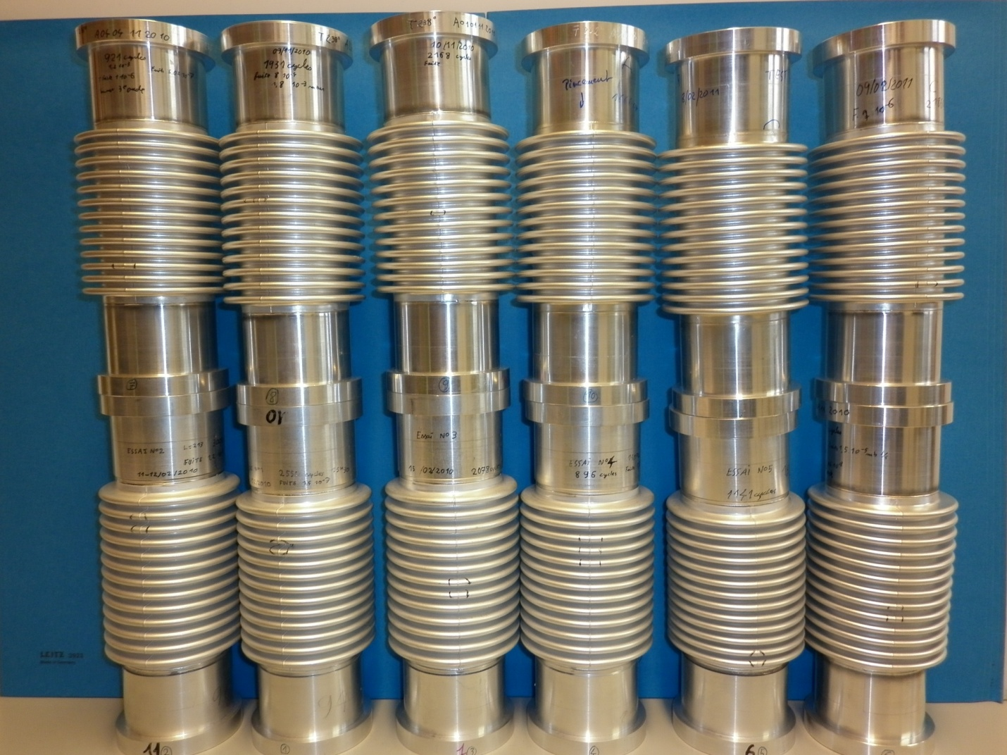
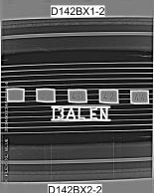
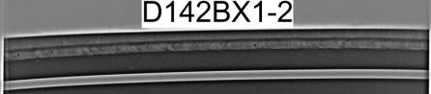

Present solutions for transparent vacuum chambers Aluminum alloys
Two grades are used for our applications:
2219 for the vacuum chambers, thickness down to 1 mm
5083 for the bellows expansion joints, thickness 0.3 mm, internal diameter ~ 60 mm
Issues: welds, deformation after bake out
Aluminium bellows
Porosities
Porosities in EB welds between 2219 and 5083 for a bellows

Slide 7
LHC transparent vacuum chambers
Characteristics: pre-LS1, (post-LS1), (post-LS2)
Type | Feature | ATLAS | CMS | LHCb | ALICE
Central | Materials | Be/Al | Be/st.st (Be/Al) | Be/Al | Be/st.st (Be/Al)
 | Length (m) | 7.3 | 6.2 | 1.85 | 4.82 (5.50)
 | Int. dia (mm) | 58 (47) | 58 (43.4) | 50-260 | 58 (34.4)
 | Wall (mm) | 0.8 | 0.8 | 1.0 | 0.8
 | Configuration | Cyl | Cone/Cyl/Cone | Cone (UX85/3) | Cyl (Cone/cyl/cone)
Forward | Materials | St.st (Al) | St.st (Al) | Be | Cu/St St
 | Length (m) | 4.2-5.35 | 1.65-7.6 | 3.7-6.05 | 5.0-6.9
 | Int. dia (mm) | 60 – 120 | 55.1-318 | 50-260 | 60-506
 | Wall (mm) | 1 – 2.2 | 1.2-2.8 | 1.0-2.6 | 1.5-2.8
 | Configuration | Cyl | Cone/cyl | cone | Cyl/cone

Slide 8
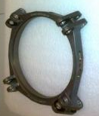
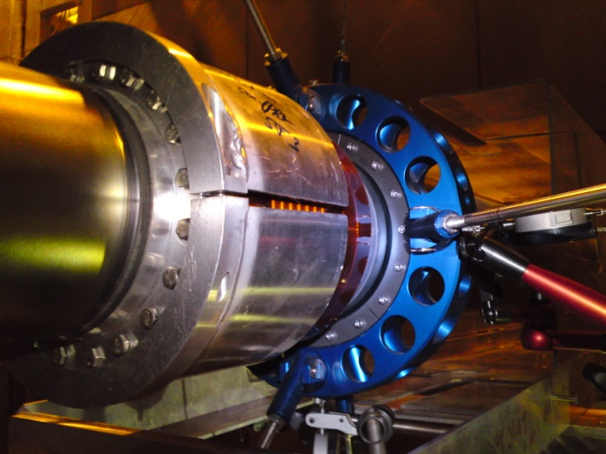
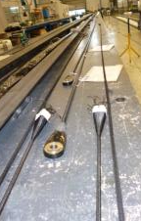
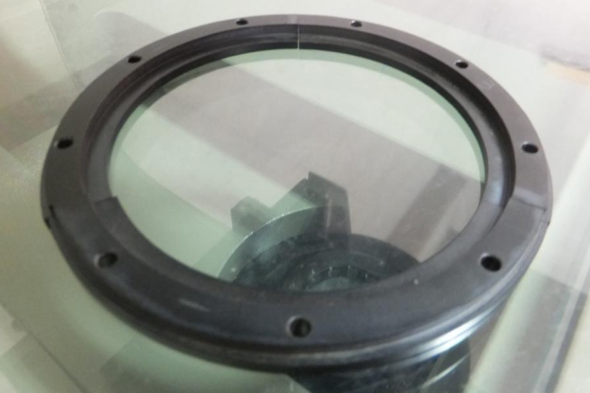
Present solutions for transparent vacuum chambers Supporting system
“old” support to new design
Aluminium to beryllium collar
PBI (Celazole) interface pieces (can be used during bake out)
Stainless steel to titanium screws
Stainless steel to CFRE or aramid fibres (Technora) wires
All polymeric materials have been tested and qualified under radioactive environment.

Slide 9
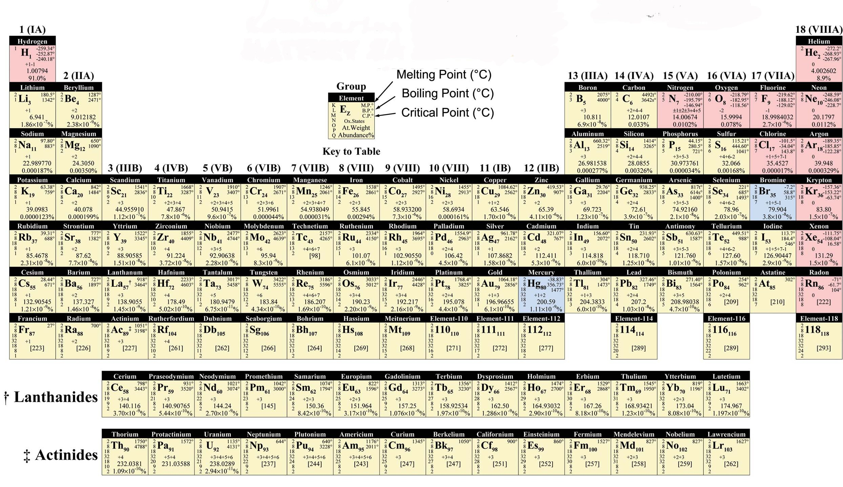
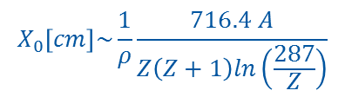
New material development for transparent vacuum chambers
Material choice
Transparency is given by:
$$X_{0}\left[cm\right]\sim \frac{1}{ρ}\frac{716.4 A}{Z\left(Z+1\right)ln\left(\frac{287}{Z}\right)}$$

Slide 10
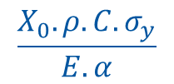

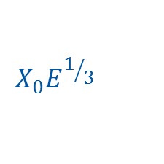

New material development for transparent vacuum chambers – Figures of merit
Several figures of merit, characterizing the material, can be used depending on the final application.
Temperature rise in transient regime:
$$X_{0}.ρ.C.T_{f}$$
Thermal fatigue:
$$\frac{X_{0}.ρ.C.σ_{y}}{E.α}$$
Temperature rise in steady state:
$$X_{0}.λ\text{.}T_{f}$$
Mechanical Stability (buckling):
$$X_{0}E^{1/3}$$

Slide 11
New material development for transparent vacuum chambers
Figure of merit for thin vacuum chambers
 | Radiation length [cm] | Young Modulus [Gpa] | X0E^{1/3}
Beryllium | 35 | 290 | 230
Epoxy | 30-36
CFRE | 30 | ~ 200 | 175
Carbon | 29 | 35 (GC) | 95
Carbon/Al (60/40) | 17 | 120 (short fibers, randomly oriented) | 84
SiC | 8 | 450 | 61.3
Al2O3 | 7 | 390 | 51
AlLi | 10-11 | 78 | 43
Al | 9 | 70 | 37
Ti | 3.7 | 113 | 18
316L | 1.8 | 200 | 10.5

Slide 12
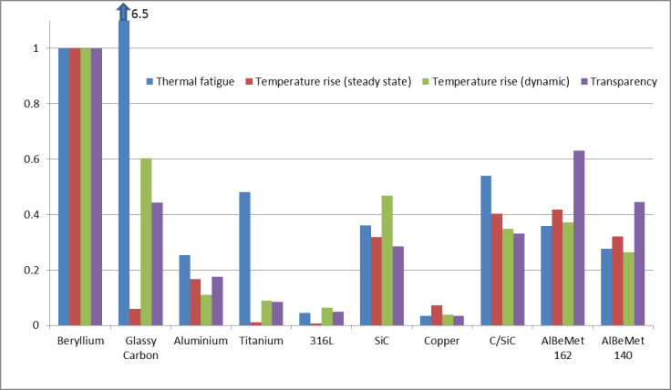
New material development for transparent vacuum chambers
Figure of merit of different materials, normalized w.r.t. beryllium

Slide 13
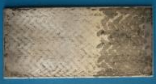
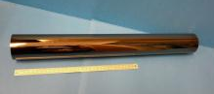
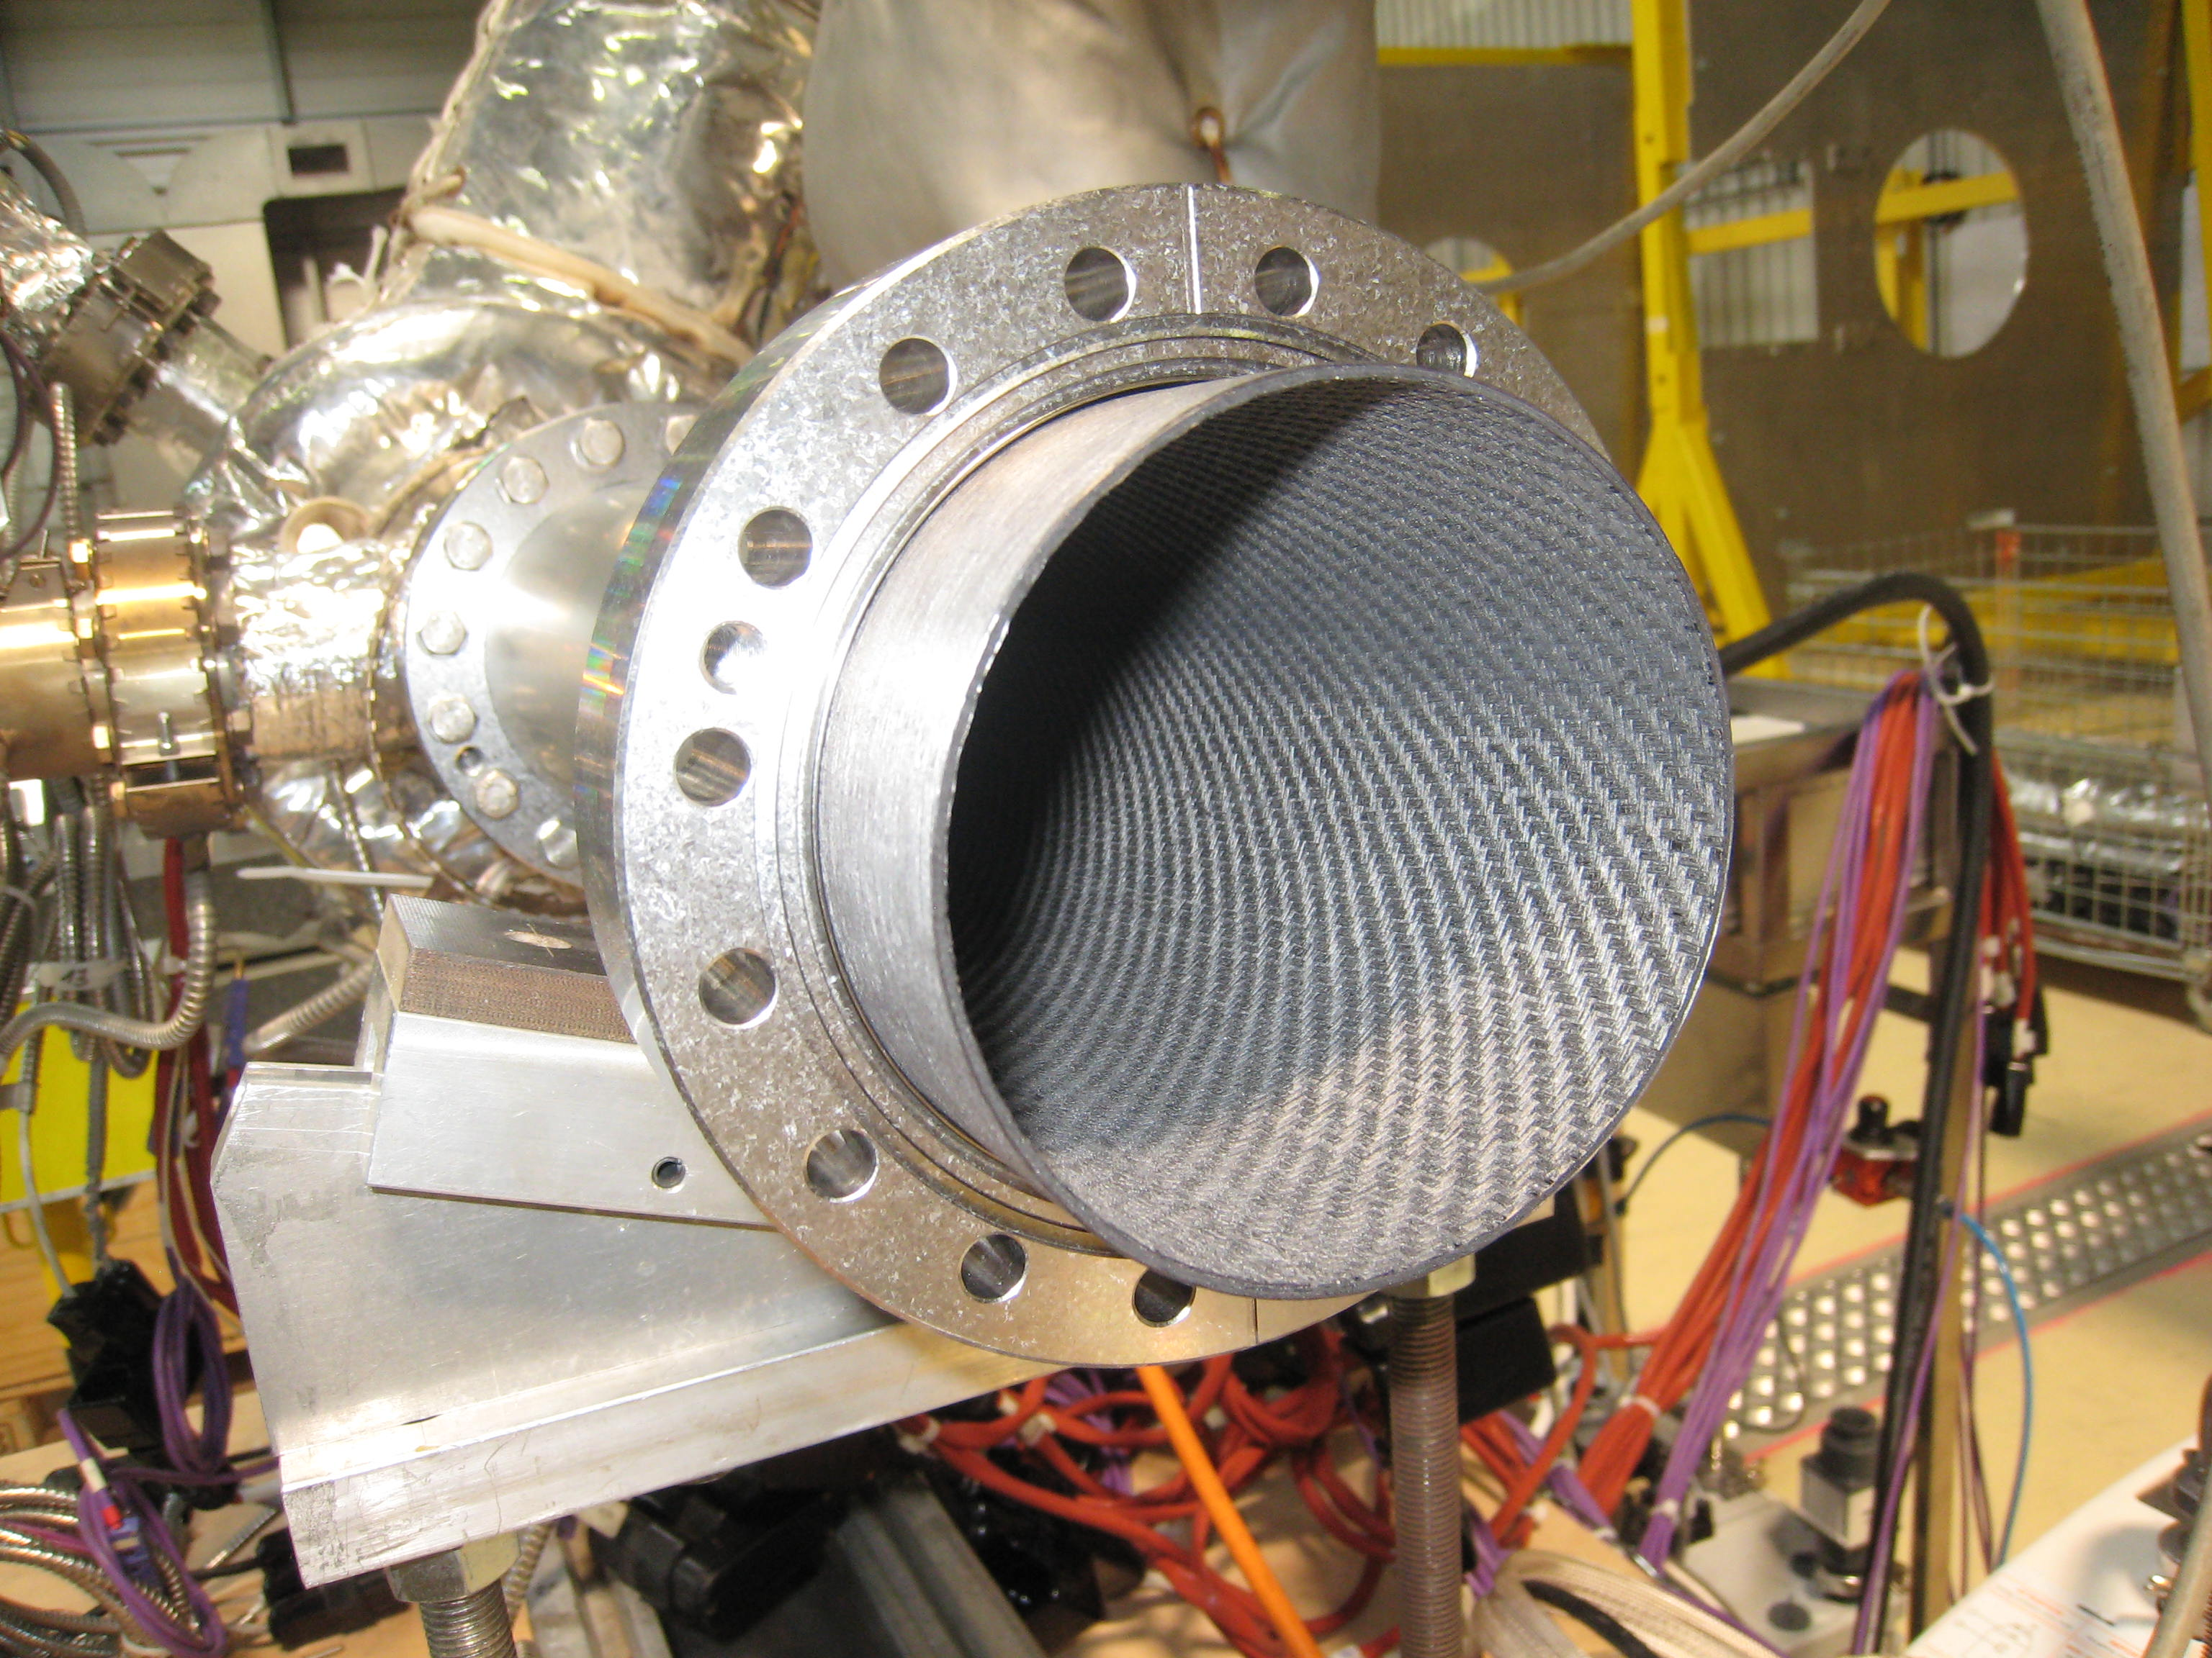
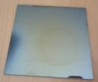
New material development for transparent vacuum chambers
Low Z material for beam pipe
Raw material
Composite material
Structural composite
Carbon (Glassy carbon)
Al alloys
SiC
Carbon reinforcement: long fibers short fibers particulates | Matrix: Aluminium Epoxy + coating
C/C + liner
Sandwich/ Honeycomb composite
As a back-up solution and for very thin chamber
C/C tube and titanium tube set-up

Slide 14
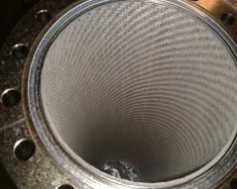
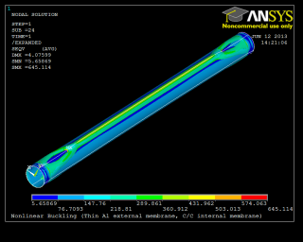
New material development for transparent vacuum chambers – Structural composite
Case of an external thin leak tight aluminium envelop with internal C/C reinforcement
☺ Good vacuum performance:
Outgassing rate ~ 10-12 mbar.l.s-1.cm-2 after bakeout
Compatible with NEG coating
 | Activation 200 ◦C for 24h | Activation 250 ◦C for 6h
H₂ Pumping Speed [l/s] | 310 | 530
Sticking probability [-] | 5.9*10⁻³ | 1*10⁻²
Pumping speed with NEG coating
Internal C/C tube
☹ Issue with the mechanical behaviour:
Differential thermal expansion → buckling of the thin aluminium envelop
Strain concentration
Need to have significant envelop thickness
Either not reliable or not interesting
Buckling mode of long tube

Slide 15
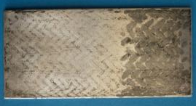
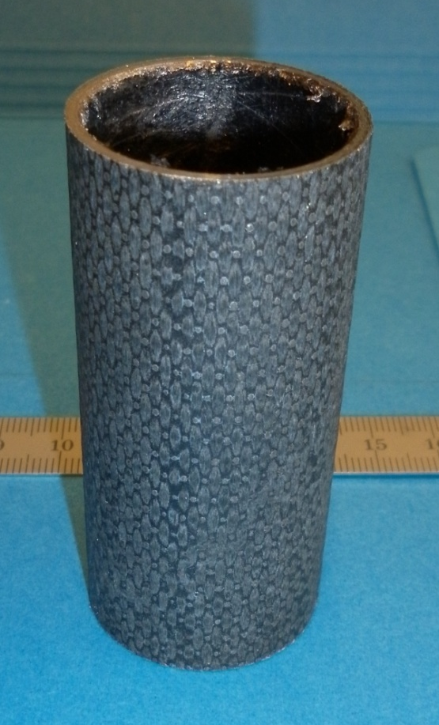
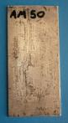
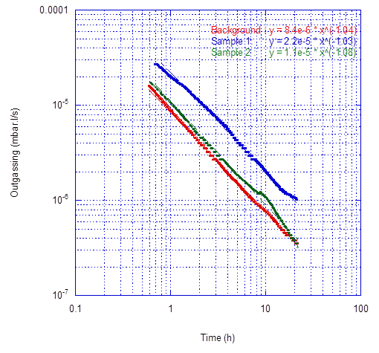
New material development for transparent vacuum chambers – Carbon fiber reinforced aluminum
Material obtained by aluminium infiltration of a carbon perform.
Tests on samples from Thales Alenia Space and Dresden University.
Tube and plates of long carbon fibres in aluminium matrix
☺ Vacuum tests :
Leak tightness
Preliminary outgassing tests promising for unbaked sample
Reliability with thermal cycles not assessed
Compatibility C/Al: corrosion, cleaning
☹ Material not available at the industrial scale.
Outgassing of C/Al composite (4.25 cm²)
→ Tentative to find company to try short carbon fibers or graphen in aluminium matrix: not successful (yet).

Slide 16
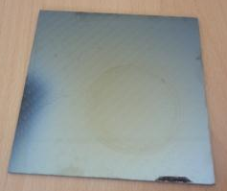
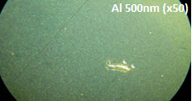
New material development for transparent vacuum chambers – Carbon fiber reinforced epoxy + coating
Long carbon fibres reinforced epoxy resin
Aluminium sputtering coating (up to ~500 nm),
Defects
Surface observations
Long carbon fibre epoxy resin with metallic coating
☹ Vacuum tests not successful due to pin holes
Try to coat in several steps with intermediate cleaning
Other coating process (ionic liquid)

Slide 17
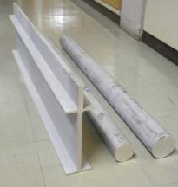
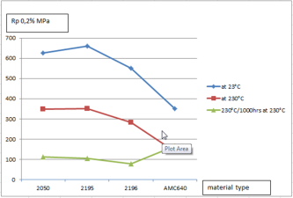
New material development for transparent vacuum chambers – Aluminum alloys
New grades with Lithium being qualified: 2050, 2195:
Transparency
Stiffness
Weld ability
Promising strength
Thin walled manufacturing:
Conventional machining
Chemical machining
Strength of different aluminium alloys
Are grades in 5XXX series with Lithium available?
Small grain size aluminium alloys

Slide 18
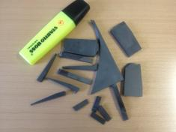
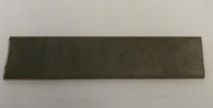
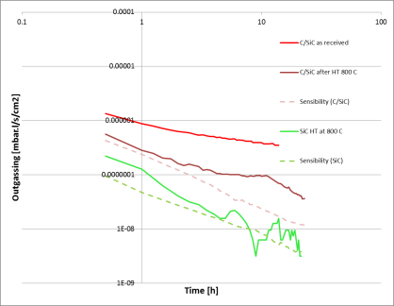
New material development for transparent vacuum chambers – SiC
Carbon-fiber reinforced silicon carbide or silicon carbide ceramic are considered:
Small C/SiC plate sample
SiC plate sample
Preliminary results:
SiC and C/SiC are both leak tight
Low outgassing rate for unbaked SiC
Higher outgassing for C/SiC
C/SiC improvement?
Vacuum tests for baked samples
Manufacturing of thin wall
Outgassing curve of SiC materials

Slide 19

New material development for transparent vacuum chambers – Glassy carbon
Glassy carbon (GC):
Obtained by the pyrolysis at high temperature of a highly reticulated resin.
Two grades have been considered. Grade K is obtained after a heat treatment at 1000 °C whereas 3000 °C is used for the grade G.
Chemical analyses have been done by EDS. The material is composed of around 98 % (weight) of carbon and 2% of oxygen.
Glassy carbon tube

Slide 20
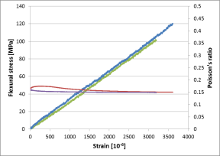
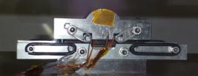
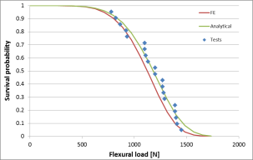
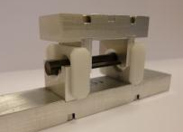
New material development for transparent vacuum chambers – Glassy carbon
Mechanical properties:
Stiffness:
4 points bending tests on plates equipped with strain gauges
Young modulus and Poisson’s ratio
4 points bending test on plates
 | Young Modulus [GPa] | Poisson’s Coefficient
Grade G | 32.4 ±0.8 | 0.155
Grade K | 32.5 ±1 | 0.17
Elastic properties
Strength:
4 points bending tests on bars (avoid chips during cutting)
Compression tests
Weibull’s distribution
4 points bending test on rods
Survival probability for the bending test
 | Average strength [MPa] | Standard deviation [MPa} | Weibull shape parameter | Weibull scale parameter [Mpa]
Flexure | 206 | 37 | 5.6-6.3 | 375-416
Compression | 1012 | 73 | 13.5-14.6 | 1587-1644

Slide 21
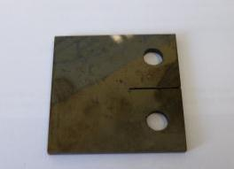


New material development for transparent vacuum chambers – Glassy carbon
Fracture toughness:
Notched bar under 4 points bending test:
Notched bar
Sample | Groove depth [mm] | Force to failure [N] | Bending stress [MPa] | K_{Ic} [MPa.m^{1/2}]
1 | 0.04 | 697 | 123 | 7.8
2 | 0.023 | 973 | 172 | 6.3
3 | 0.049 | 964 | 170 | 13.1
CT specimen: test in preparation
CT specimen and crack propagation simulation
→ Two methods will be used to determine the toughness: Maximum force for a given stress intensity factor or load decrease during crack propagation.
→ Crack growth test is also foreseen

Slide 22
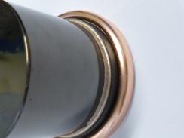
New material development for transparent vacuum chambers – Glassy carbon
CusilABA inteface layer
Transition to metallic parts:
Soldering with intermediate ceramic part:
Compatible thermal expansion
Higher mechanical strength
Glassy carbon
Ceramic
Preliminary tests on crucible:
No failure
Initial gaps to be adjusted to have a good flow of the solder
GC crucible soldered with a copper ring

Slide 23
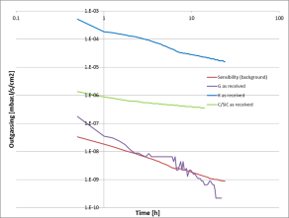
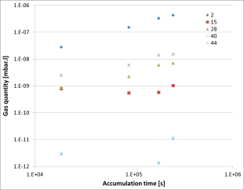
New material development for transparent vacuum chambers – Glassy carbon
Outgassing rate:
Unbaked material:
Throughput method
Grade K : high outgassing
Grade G : low outgassing
Outgassing curve of unbaked glassy carbon
Baked material:
Gas accumulation method
Grade G : outgassing rate of 1.5E-13 mbar l s⁻¹ cm⁻²
Outgassing of baked glassy carbon

Slide 24

New material development for transparent vacuum chambers – Glassy carbon
Possibility to improvement the material properties:
Reinforcement with carbon nanotubes:
mechanical properties ↑
thermal conductivity ↑

Slide 25
Highly transparent vacuum chambers
Conclusion
Highly transparent vacuum chambers are required in high energy physics domain.
Beryllium and aluminium are two material presently used for vacuum chambers.
Materials, alternative to beryllium, are studied for transparent vacuum chambers.

