Slide 1
FCC
Status on RF considerations
Erk Jensen
…summarizing some preliminary discussion with Olivier Brunner, Elena Shaposhnikova, Andy Butterworth, Rama Calaga, Michael Benedikt and Frank Zimmermann

Slide 2
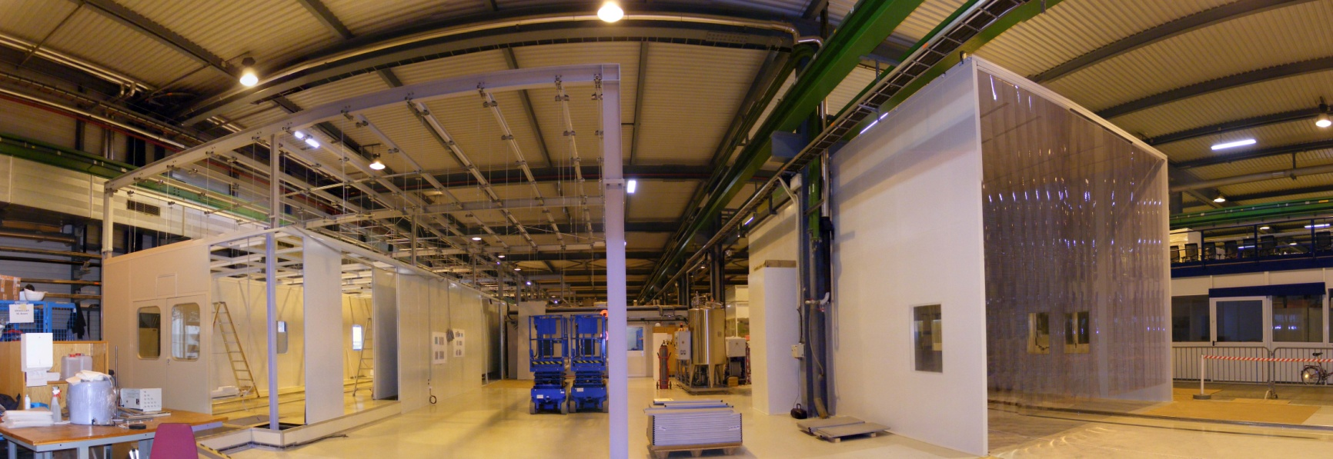
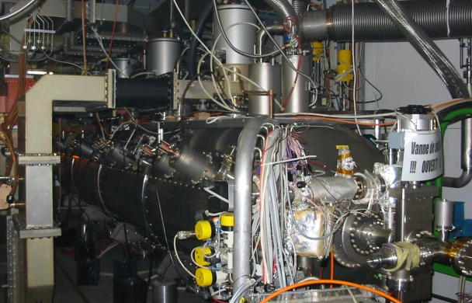
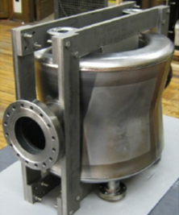
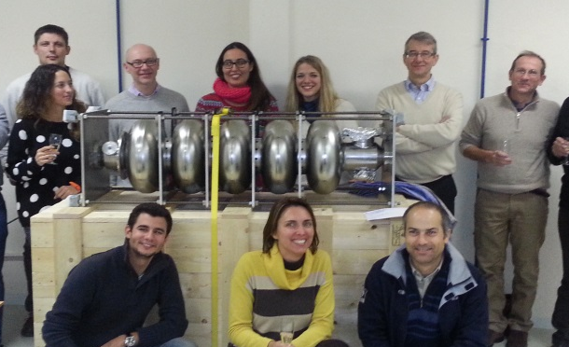
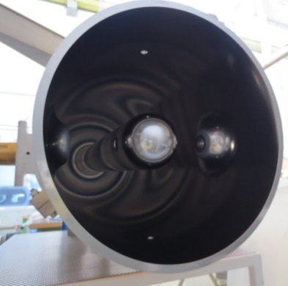
Context
CERN (BE-RF, TE-VSC & EN-MME) is
strengthening capabilities in SC RF:
  Upgrading CERN’s infrastructures for cavity
  fabrication, assembly and testing (SM18 and
  others)
  Significant relevant progress for LHC, HL-LHC Crab Cavities, SPL Cavities, HIE-ISOLDE
  Relevant SCRF R&D on new coating techniques (e.g. HiPIMS, ALD …), diagnostic techniques, additive machining … has started.
  Mandate to make a Design Study for an Energy Recovery Linac Test Facility
SM18 upgrade in progress
LHC Spare module
Crab Cavity
SPL 5-cell cavity 704 MHz
HIE-ISOLDE

Slide 3
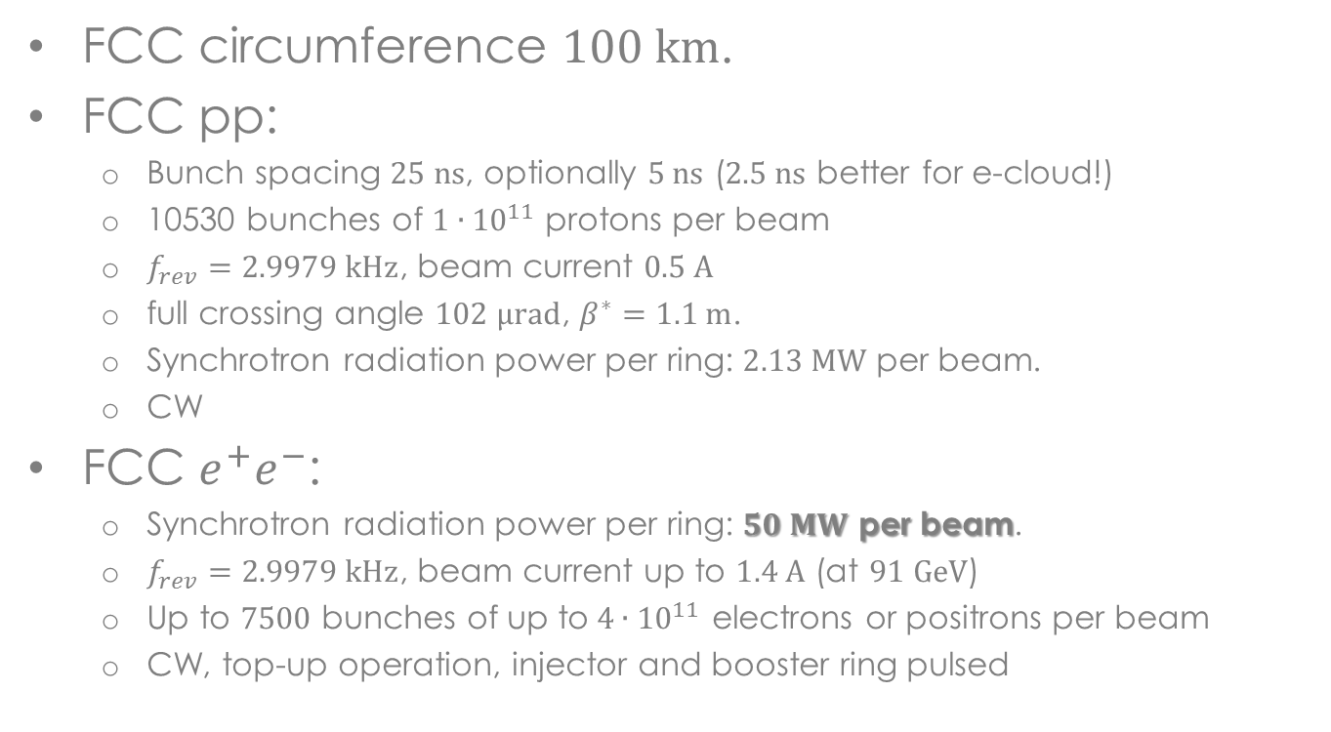
FCC Relevant parameters
FCC circumference $100 km$.
FCC pp:
  Bunch spacing $25 ns$, optionally $5 ns$ ($2.5 ns$ better for e-cloud!)
  10530 bunches of $1∙{10}^{11}$ protons per beam
  $f_{rev}=2.9979 kHz$, beam current $0.5 A$
  full crossing angle $102 μrad$, $β^{∗}=1.1 m$.
  Synchrotron radiation power per ring: $2.13 MW$ per beam.
  CW
FCC $e^{+}e^{−}$:
  Synchrotron radiation power per ring: $50 MW$ per beam.
  $f_{rev}=2.9979 kHz$, beam current up to $1.4 A$ (at $91 GeV$)
  Up to $7500$ bunches of up to$4∙{10}^{11}$ electrons or positrons per beam
  CW, top-up operation, injector and booster ring pulsed

Slide 4

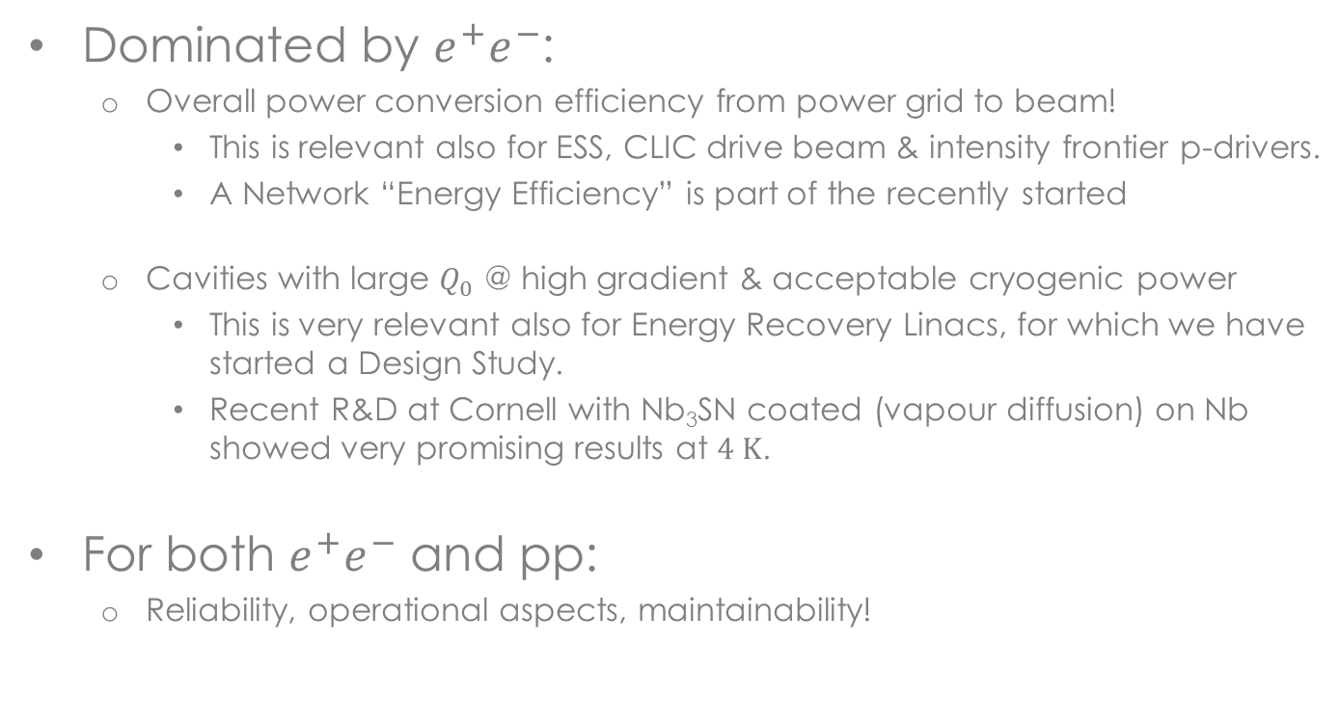
Main areas for RF R&D
Dominated by $e^{+}e^{−}$:
  Overall power conversion efficiency from power grid to beam!
    This is relevant also for ESS, CLIC drive beam & intensity frontier p-drivers.
    A Network “Energy Efficiency” is part of the recently started
  Cavities with large $Q_{0}$ @ high gradient & acceptable cryogenic power
    This is very relevant also for Energy Recovery Linacs, for which we have started a Design Study.
    Recent R&D at Cornell with Nb₃SN coated (vapour diffusion) on Nb showed very promising results at $4 K$.
For both $e^{+}e^{−}$ and pp:
  Reliability, operational aspects, maintainability!

Slide 5

Sample parameter space
To narrow down parameter space, we will look at RF systems synergetic with what we have or have planned.
This will allow focused R&D without limiting us.
Initially, we will look at $200 MHz$, $400 MHz$and $800 MHz$.

Slide 6
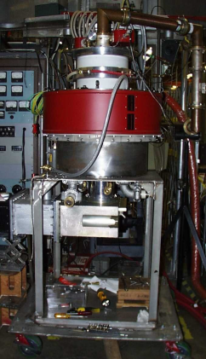
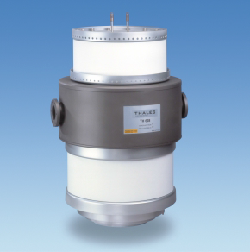
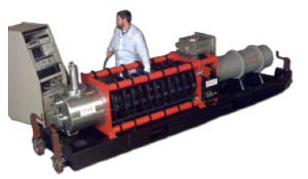

What scales how with frequency?
High efficiency, high power RF sources?
  200 MHz: Tetrodes, Diacrodes;
  probably least expensive/MW;
  efficiency > 70%
  400 MHz, 800 MHz:
      Klystrons: $η\sim 65\%$; R&D for larger $η$ has started
      IOTs: today limited to $<100 kW$;
      R&D on MB IOT ($1.5 MW$ pulsed) has started with ESS!
CPI MB-IOT prototype, 1MW, 700MHz
Thales 1MW diacrode
LEP 1.3 MW CW klystron

Slide 7
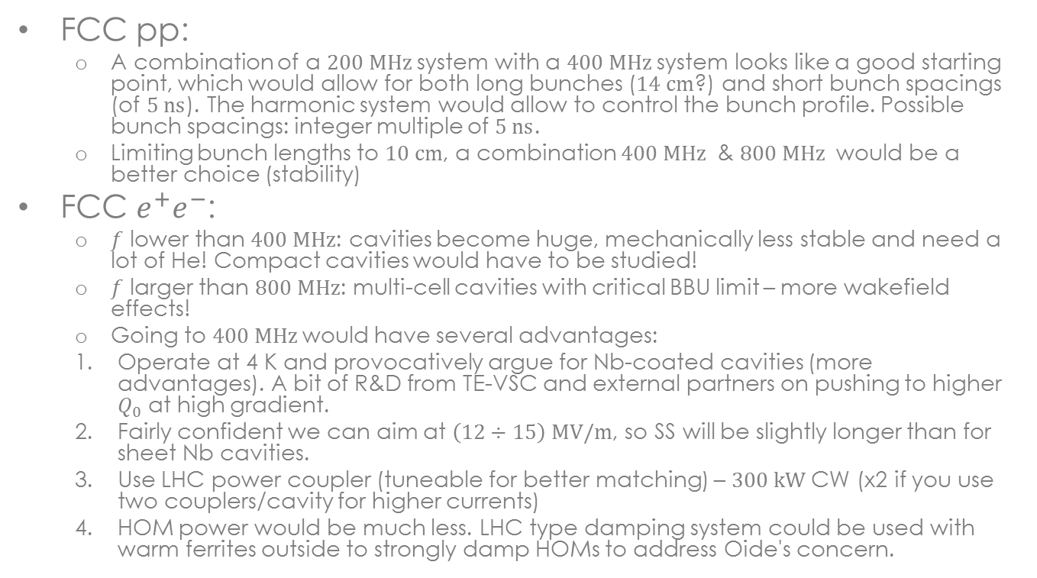
Choice of frequency
FCC pp:
  A combination of a $200 MHz$system with a $400 MHz$system looks like a good starting point, which would allow for both long bunches ($14 cm$?) and short bunch spacings (of $5 ns$). The harmonic system would allow to control the bunch profile. Possible bunch spacings: integer multiple of $5 ns$.
  Limiting bunch lengths to $10 cm$, a combination $400 MHz$ & $800 MHz$ would be a better choice (stability)
FCC $e^{+}e^{−}$:
  $f$ lower than $400 MHz$: cavities become huge, mechanically less stable and need a lot of He! Compact cavities would have to be studied!
  $f$ larger than $800 MHz$: multi-cell cavities with critical BBU limit – more wakefield effects!
  Going to $400 MHz$would have several advantages:
  Operate at 4 K and provocatively argue for Nb-coated cavities (more advantages). A bit of R&D from TE-VSC and external partners on pushing to higher $Q_{0}$ at high gradient.
  Fairly confident we can aim at $\left(12÷15\right) MV/m$, so SS will be slightly longer than for sheet Nb cavities.
  Use LHC power coupler (tuneable for better matching) – $300 kW$CW (x2 if you use two couplers/cavity for higher currents)
  HOM power would be much less. LHC type damping system could be used with warm ferrites outside to strongly damp HOMs to address Oide's concern.

Slide 8
… that’s all for now
… à suivre

Slide 9
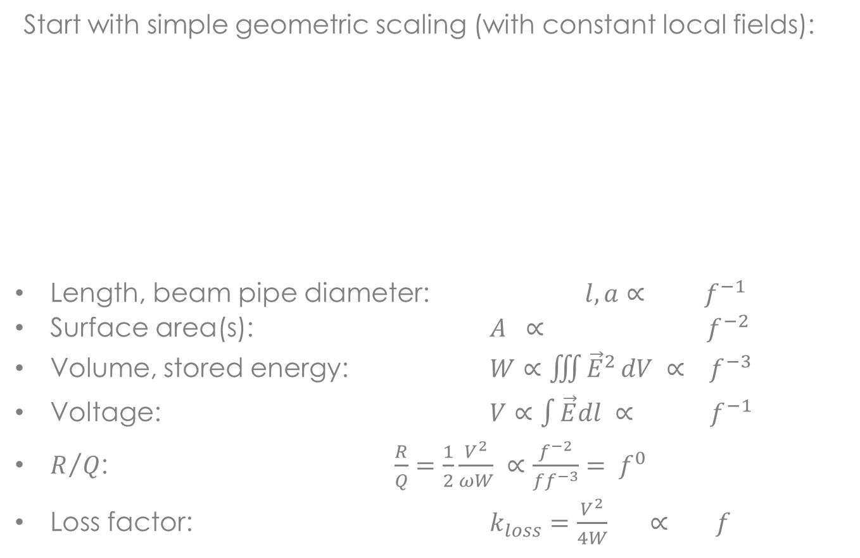


Scaling 700 MHz → 1400 MHz
(J. Tückmantel, 2008 for SPL)
Start with simple geometric scaling (with constant local fields):
Length, beam pipe diameter: $l, a∝ f^{−1}$
Surface area(s): $A ∝ f^{−2}$
Volume, stored energy: $W∝\iiint{{\vec{E}}^{2}}dV ∝ f^{−3}$
Voltage: $V∝\int{\vec{E}dl} ∝ f^{−1}$
$R/Q$: $\frac{R}{Q}=\frac{1}{2}\frac{V^{2}}{ωW} ∝\frac{f^{−2}}{ff^{−3}}= f^{0}$
Loss factor: $k_{loss}=\frac{V^{2}}{4W} ∝ f$
$$f=1400 MHz$$
$$f=700 MHz$$

Slide 10
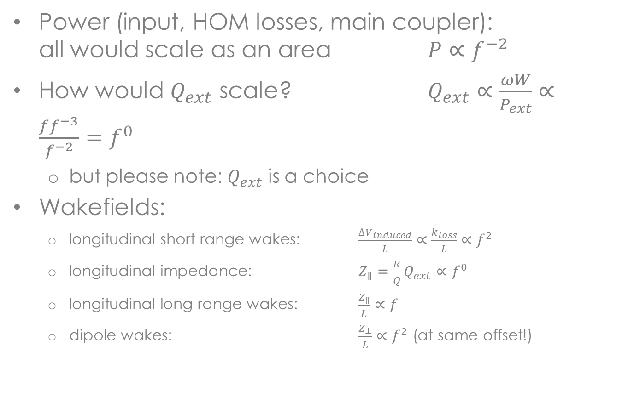
Scaling 700 MHz → 1400 MHz
Power (input, HOM losses, main coupler):
all would scale as an area $P∝f^{−2}$
How would $Q_{ext}$ scale? $Q_{ext}∝\frac{ωW}{P_{ext}}∝\frac{ff^{−3}}{f^{−2}}=f^{0}$
  but please note: $Q_{ext}$ is a choice
Wakefields:
  longitudinal short range wakes: $\frac{{∆V}_{induced}}{L}∝\frac{k_{loss}}{L}∝f^{2}$
  longitudinal impedance: $Z_{∥}=\frac{R}{Q}Q_{ext}∝f^{0}$
  longitudinal long range wakes: $\frac{Z_{∥}}{L}∝f$
  dipole wakes: $\frac{Z_{⊥}}{L}∝f^{2}$ (at same offset!)

Slide 11
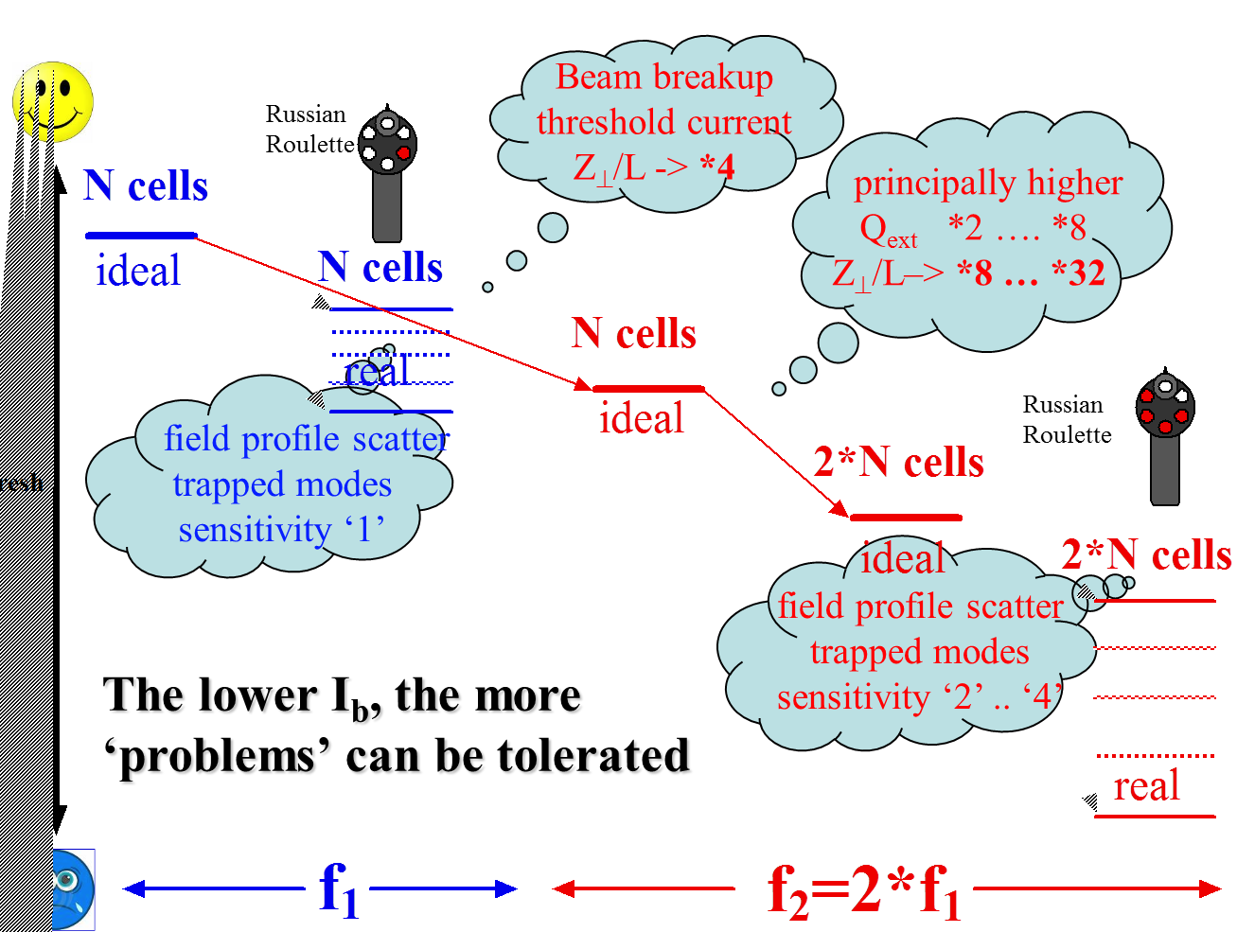


Lower f, larger currents possible
Stable beam current limit

Slide 12
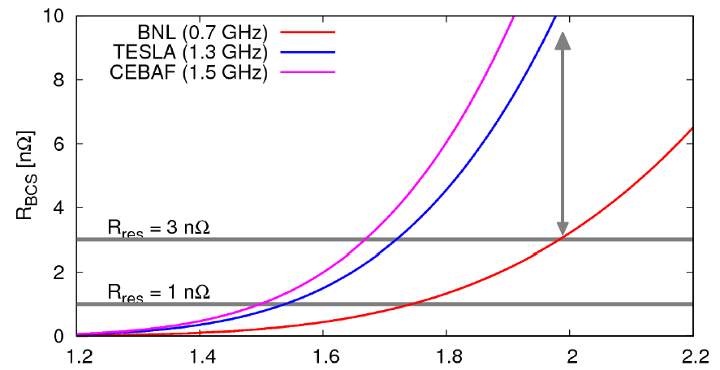
Dynamic wall losses
R_{s} = R_{BCS} + R_{res}
T [K]
For small R_{res}, this clearly favours smaller f.

Slide 13
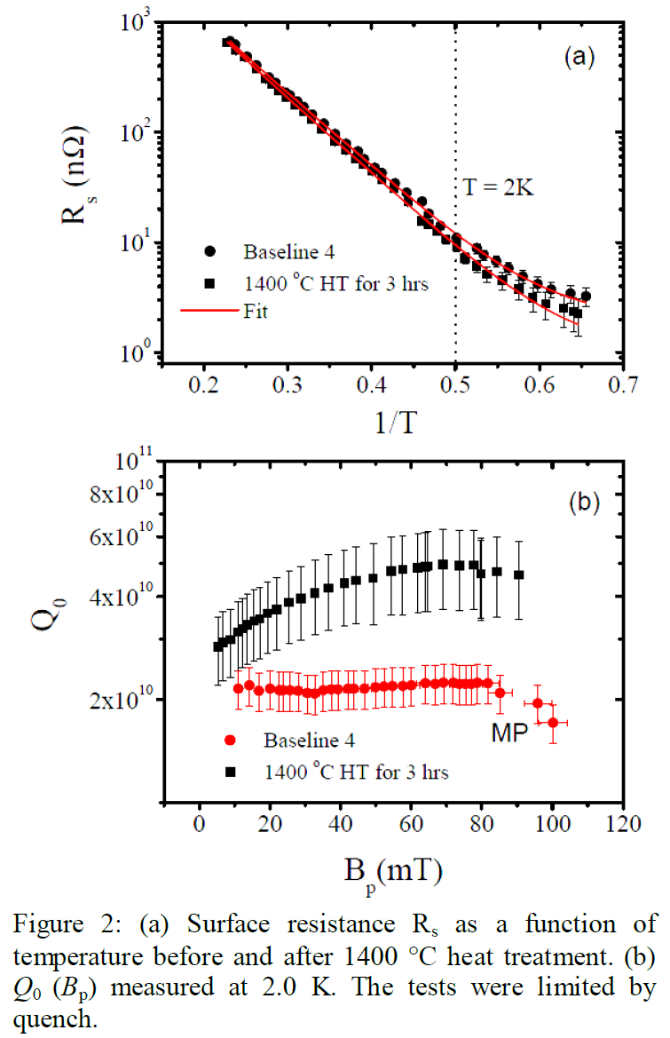
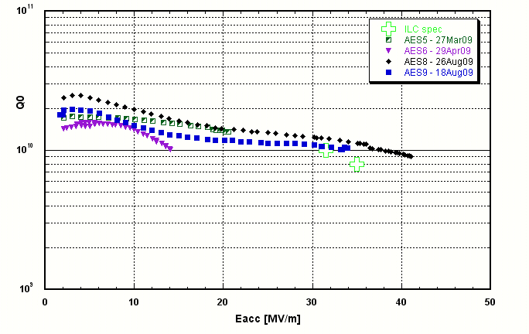
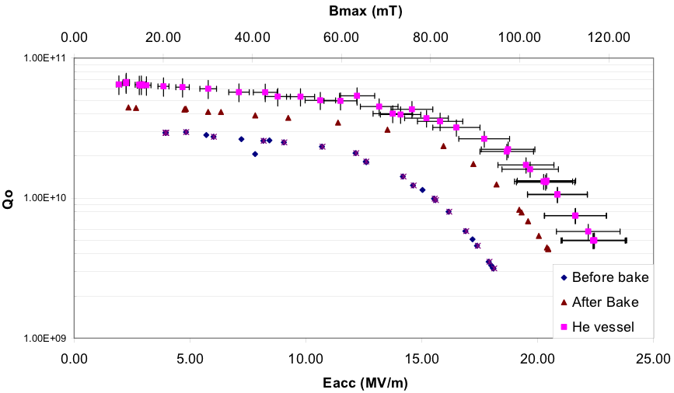
One should aim for very large Q₀
ILC Cavities 1.3 GHz, BCP + EP (R. Geng SRF2009)
BNL 704 MHz test cavity, BCP only! (A. Burill, AP Note 376, 2010)
first cavities – large potential
JLAB, 1.5 GHz, (Dhakal, Ciovati, Myneni 2012: http://arxiv.org/abs/1205.6736

Slide 14
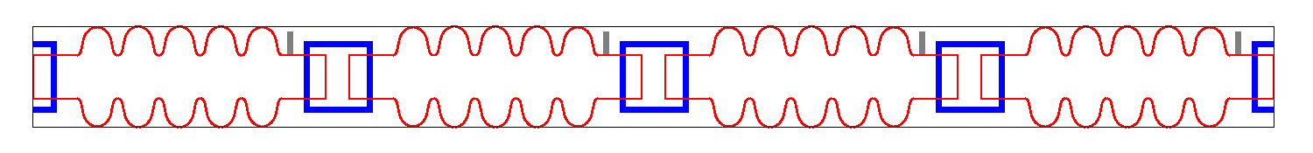
ERL-TF @ CERN
Dump
SCL2
200-400 MeV ERL Layout
4 x 5 cell, 721 MHz
SCL1
5 MeV Injector
~6.5 m
 | units | 1-CM | 2-CM
Energy | [MeV] | 100 | 200-400
Frequency | [MHz] | 721 | 721
Charge | [pC] | ~500 | ~500
Rep. rate |  | CW | CW

Slide 15
Why ERL TF @ CERN?
Physics motivation:
  ERL demonstration, FEL, γ-ray source, e-cooling demo!
  Ultra-short electron bunches
One of the 1st low-frequency, multi-pass SC-ERL
  synergy with SPL/ESS and BNL activities
High energies (200 … 400 MeV) & CW
Multi-cavity cryomodule layout – validation and gymnastics
Two-Linac layout (similar to LHeC)
  …could test CLIC-type energy recovery from SCL2 → SCL1
MW class power coupler tests in non-ER mode
Complete HOM characterization and instability studies
Cryogenics & instrumentation test bed
A place to work, practise and to train people!

