Slide 1
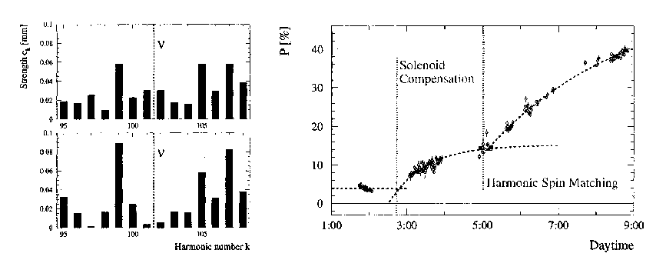
examples of spin matching (I)
Solenoid spin matching : fully deterministic (know kick from exp. solenoids)
Deterministic Harmonic spin matching
measure orbit, decompose in harmonics, cancel components near to spin tune. ☺ NO FIDDLING AROUND.
This worked very well at LEP-Z
and should work even better at TLEP-Z if orbit is measured better.

Slide 2
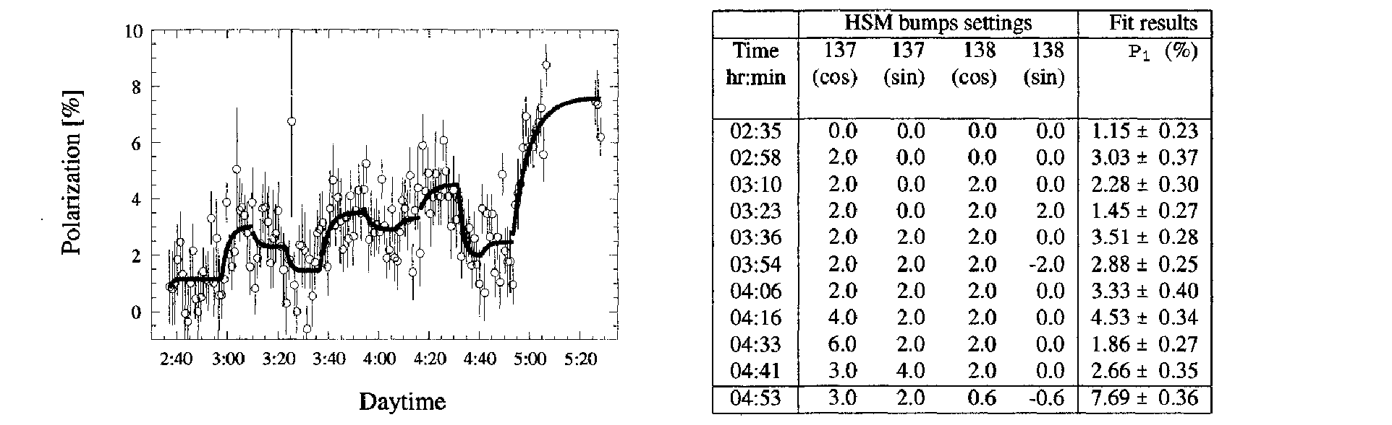
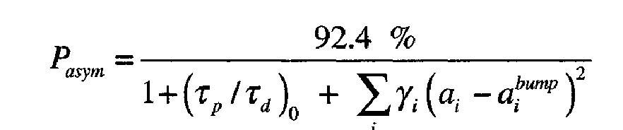
examples of harmonic spin matching (II)
When all else fails, empirical spin matching: excite harmonics one by one to measure directly their effect on polarization and fit for pole in 4-D space.
Here 8% polarization at 61 GeV.

Slide 3
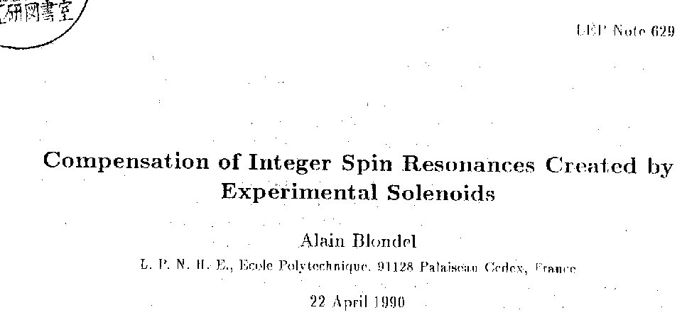

Slide 4
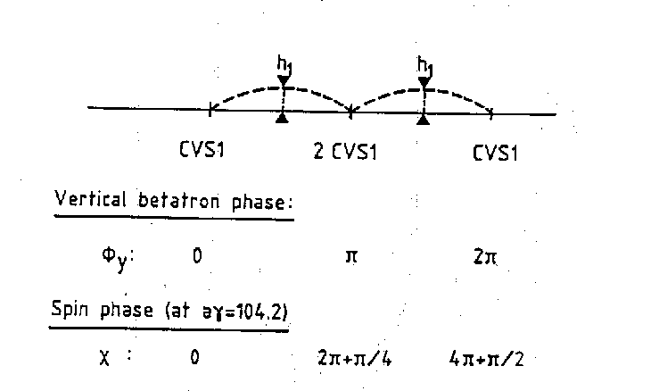
Spin matching bumps were are double-pi bumps
small spin rotator
Double pi bumps:
vertical orbit and
vertical dispersion cancel except inside bumps themselves.
-- effect of errors?
-- effect of dispersion inside bumps?

Slide 5
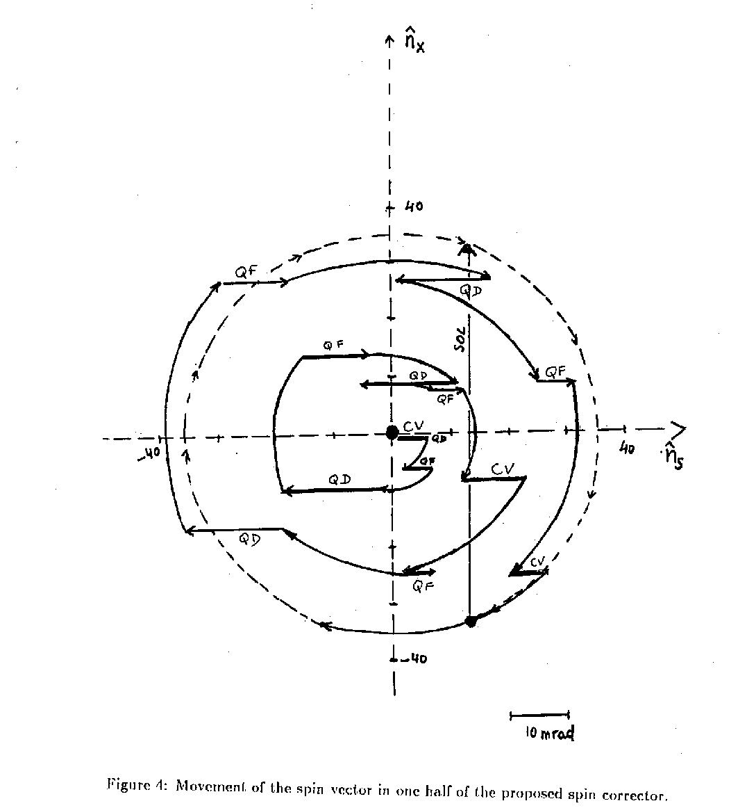

Slide 6
from LEP to TLEP
1. Double pi bumps worked very well at LEP.
There was a particular relationship between phase advances and spin tune
This has to be studied again before concluding that scheme can work for TLEP
2. the same principle (2 pi bumps) as for solenoids was used for harmonic
and empirical spin compensation
3. and can be used in principle to spin-match small vertical orbit kicks (<1mrad)
such as proposed for having TLEP in Butterfly shape -- this may or may not work
for achieving a large (> 10mrad) kick by decomposing it into several small ones

Slide 7
The butterfly
a single kick of 10mrad
is way too large
to swallow ...
break it up
artist view
arc bends interspaced
with vertical bends
top view
vertical kicks
interspaced
with arc bends
Can one design kicks so
that spin motion cancels?
side view

