Slide 1
Management of the MICE construction effort and interface to operations and analysis

Slide 2
Evolution of management of MICE project:
MICE construction project:
  Host laboratory:
    Substantial construction project across two sites (RAL & DL):
      Project Engineer; full time job;
    Substantial planning/management/reporting job:
      Project Manager; full time job
    MICE International Project Office:
      Updated to address needs of the construction project
MICE experiment: operations and analysis
  MICE Experiment Management Office:
    Opportunity:
      Construction project the responsibility of the MIPO, experimental collaboration “freed up” to ensure proper development of experimental/scientific side of project
    MEMO organogram:
      Being discussed within the collaboration; work in progress
        Reviewed by MICE Executive Board at its last meeting (08Nov13)

Slide 3
Organogram of construction project:

Slide 5
Notes:
PM, PE, MEMO will need to review the meeting structure.

Slide 6
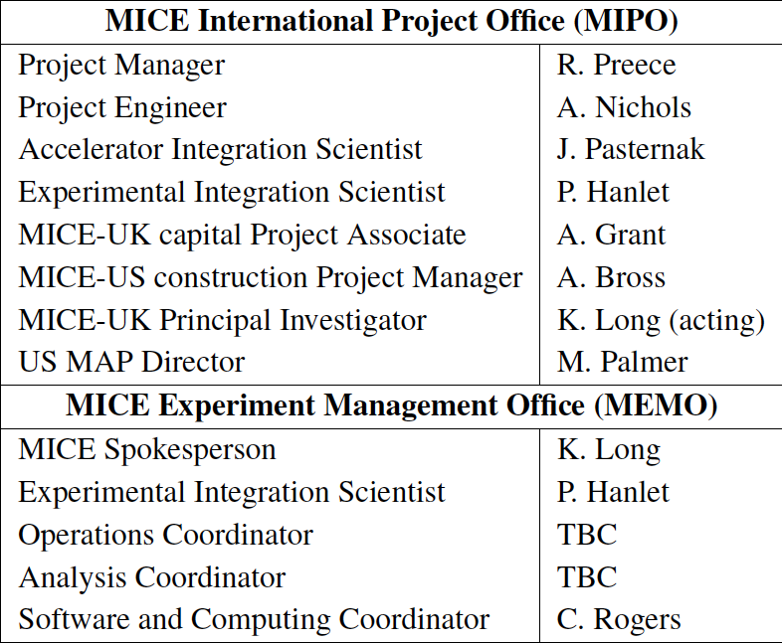
MIPO; MEMO; interface:

Slide 7
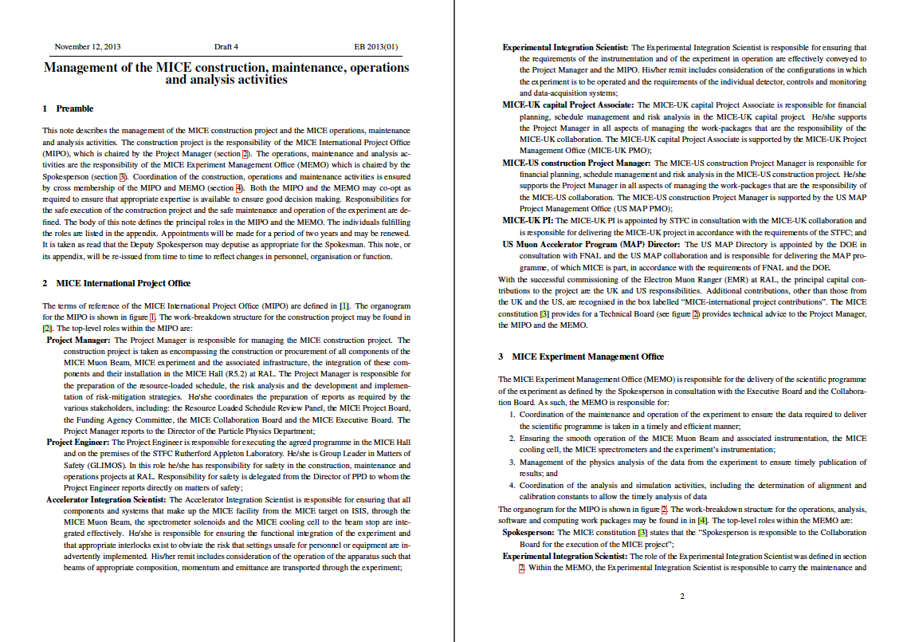

Slide 8
Evolution:
Collaboration charter:
  Drafted 2003
  MIPO/MEMO invented recently
    Not reflected in Charter
  MICE CB has asked MICE EB to instigate a review

Slide 9
Preface to budget/schedule presentations from UK and US PIs:
US leveling; based on budget assumptions presented to the RLSR Panel in May13:
  Changes delivery dates for some components;
  Includes contingency and appropriate float;
    More robust going forward:
      Principal issue:
        Impact and management of R&D risks
UK analysis of spend profile which will include explicitly called out working margin and contingency:
  Document(s) [cost, schedule, risk] in preparation:
    Requires another iteration to take into account full outcome of US levelling;
      Principal issue:
        Management of contingency
So, cost/schedule analysis still “a work in progress”:
  But, more advanced on both sides than in May13;
  Now seek to rebaseline full project (Step IV; Step V or VI) by ~March 2014

