Slide 1
PASCOS 2013 Summary
John Ellis
King’s College London
(& CERN)

Slide 2
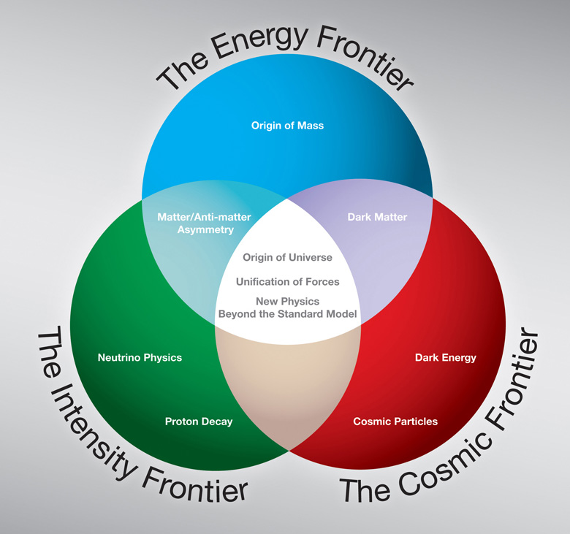
String to rule them all?

Slide 3
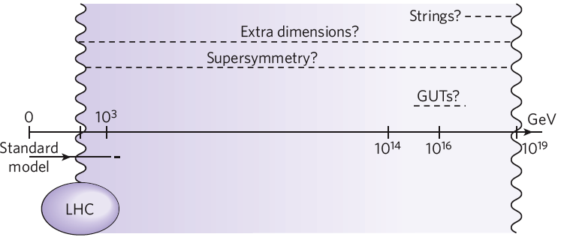
At what Energy is the New Physics?
Top-down
Dark matter?
Origin of mass
Some accessible only via
astrophysics & cosmology,
CMB, neutrinos
Bottom-up

Slide 4
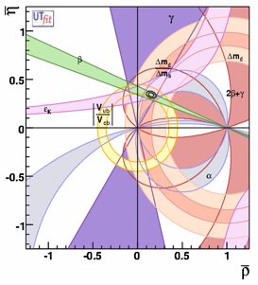
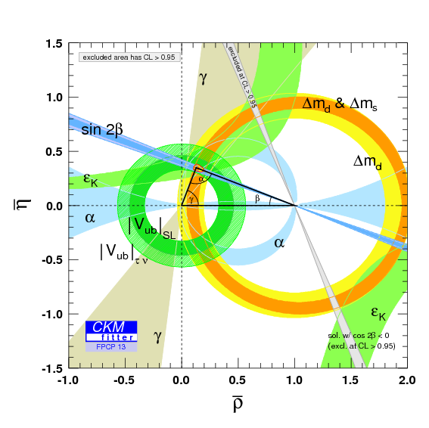
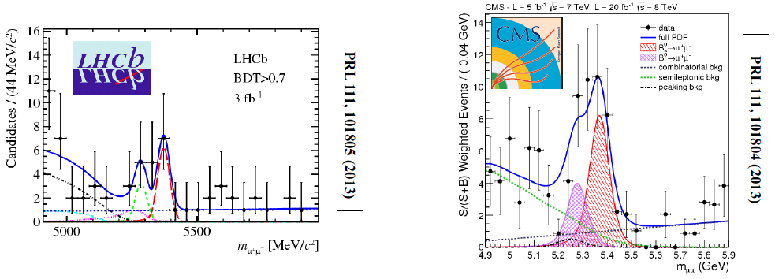
Quark Flavour
Physics Successes
Good global fits to CKM model
Rare B decays to μ⁺μ⁻ observed
μ⁺μ⁻
Rodrigues

Slide 5
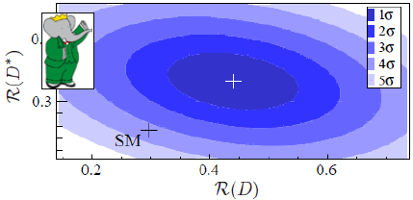
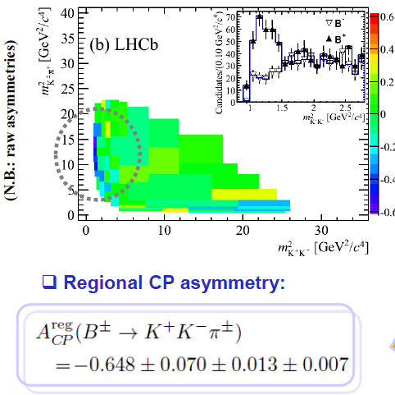
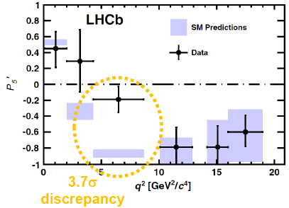
Quark Flavour Physics Puzzles
K⁺K⁻π±
D*τν
K*μμ
Rodrigues

Slide 6
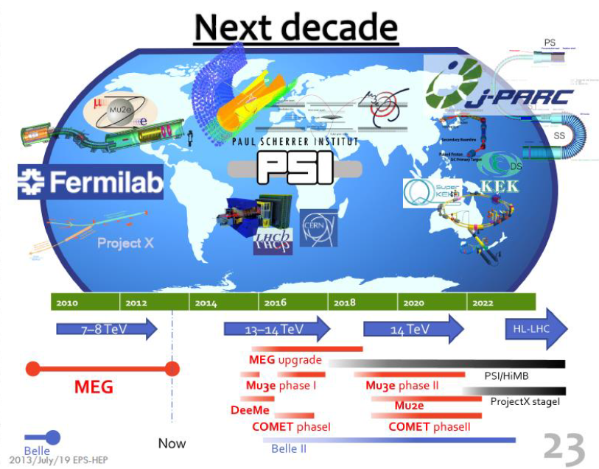
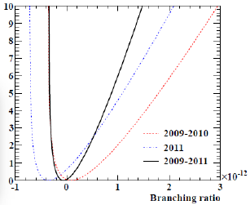

Slide 7
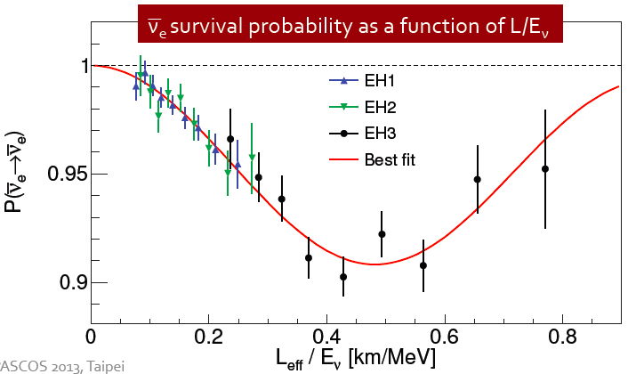
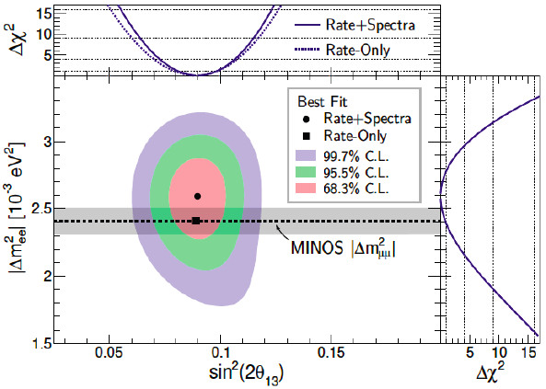
Neutrino Oscillations @ Daya Bay
Almost a complete cycle observed
Accurate value of θ₁₃
Next ν step: CP violation?
Wang

Slide 8
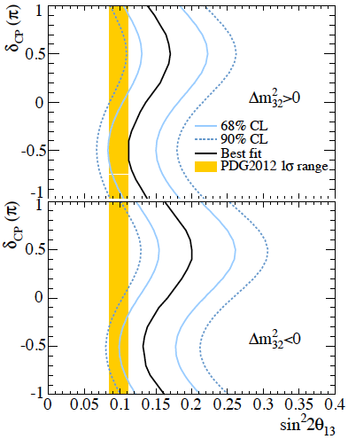
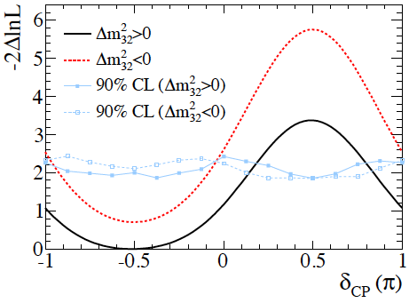
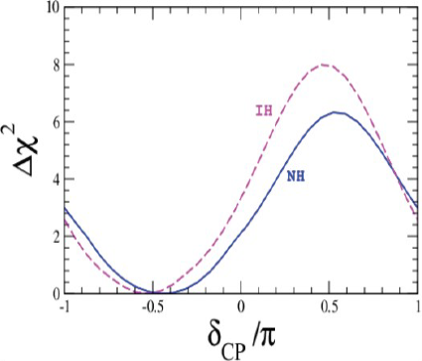
CP Violation in the Neutrino Sector?
Not yet, but hint from T2K data on ν_{e} appearance
Look forward to more data!
Valle
Nakadaira

Slide 9
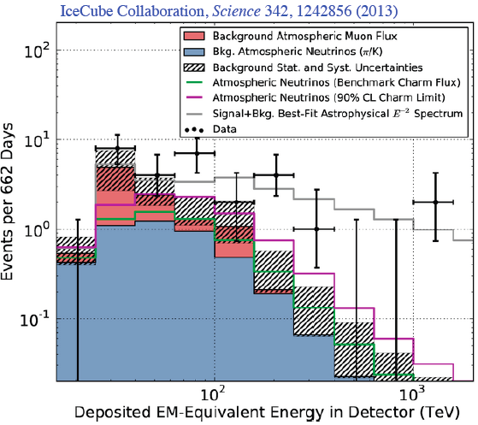
High-Energy Neutrino Astronomy
Rott
Finally, some other particle besides the photon!

Slide 10
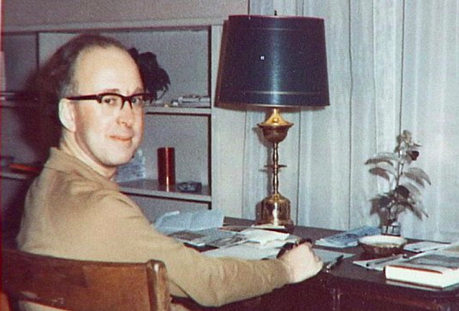
What we (don’t) know What else is there?
How to discover it?
Wingerter-Seez
Ganjour

Slide 11
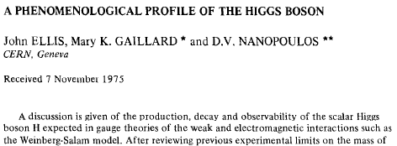
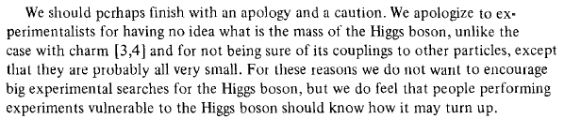
A Phenomenological Profile of the Higgs Boson
First attempt at systematic survey

Slide 12
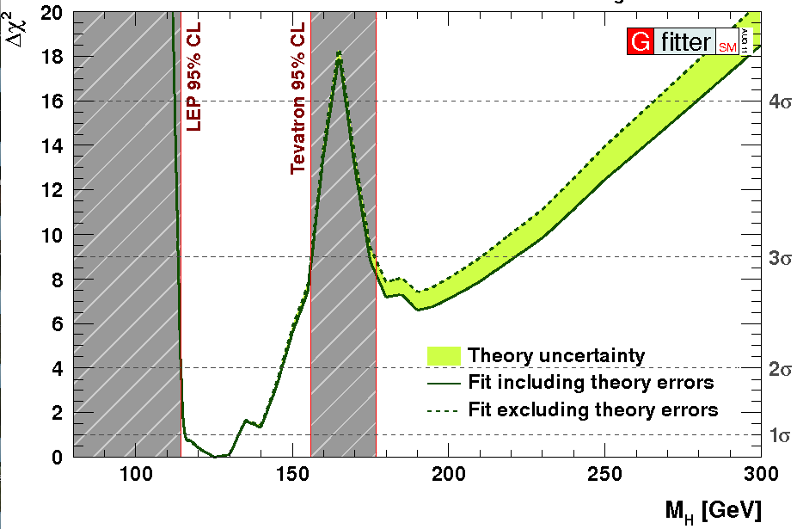
2011: Combining Information from Previous Direct Searches and Indirect Data
m_{H} = 125 ± 10 GeV
Gfitter collaboration

Slide 13
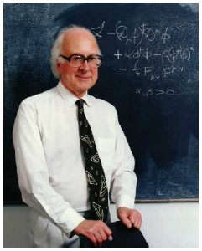
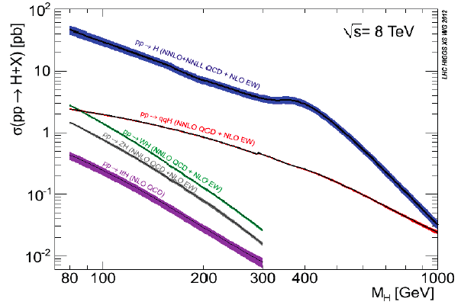
Higgs Production at the LHC
A la recherche du
Higgs perdu …
Many production modes measurable if M_{h} ~ 125 GeV

Slide 14
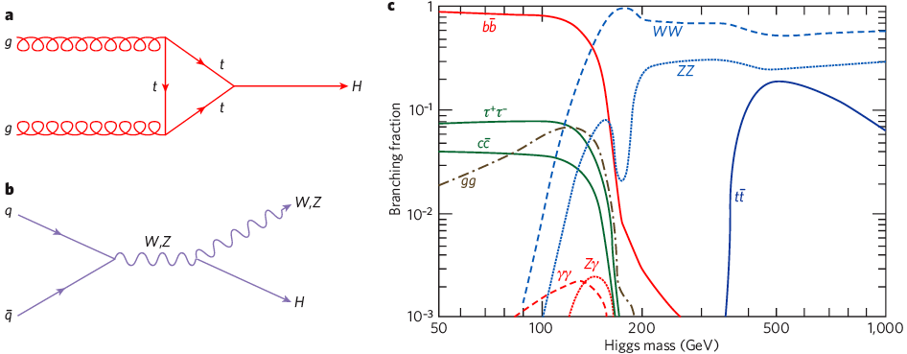
Higgs Decay Branching Ratios
Couplings proportional to masses (?)
Important couplings through loops:
  gluon + gluon → Higgs → γγ
Many decay modes measurable if M_{h} ~ 125 GeV

Slide 15
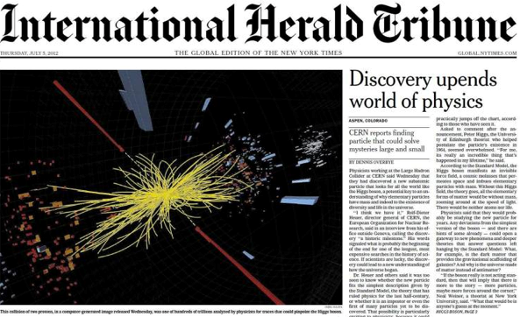
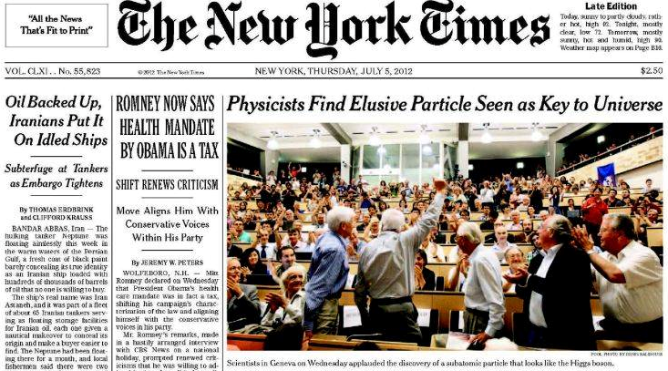



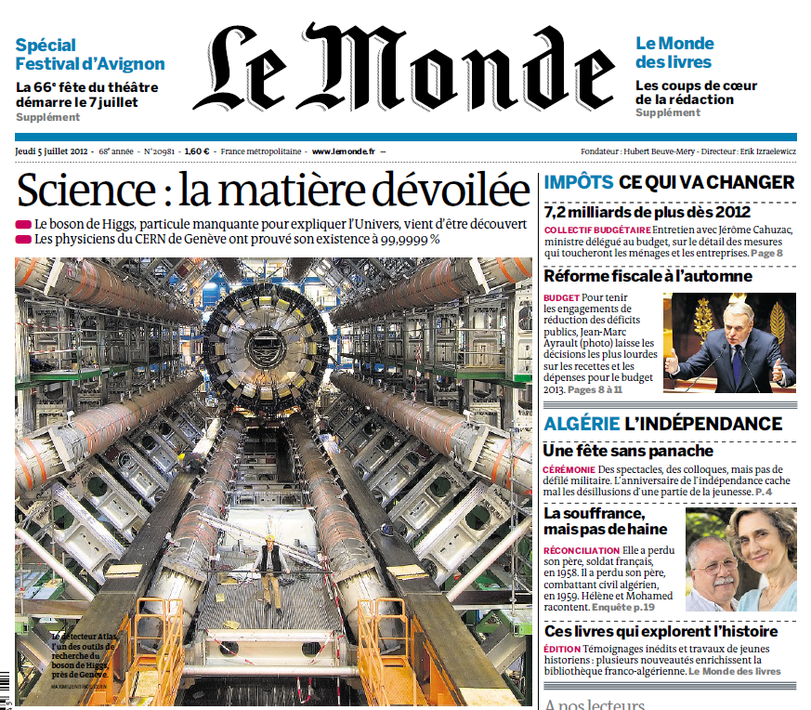



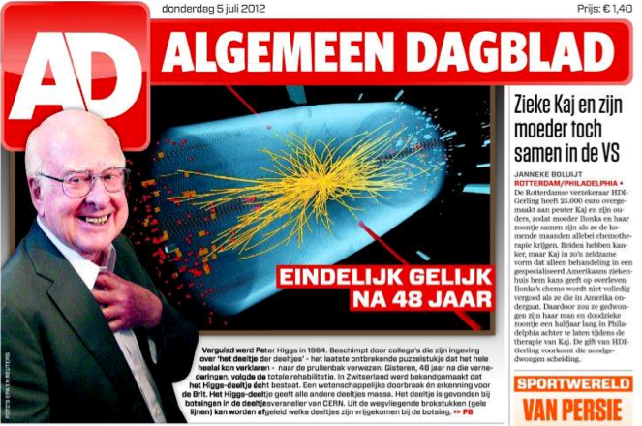



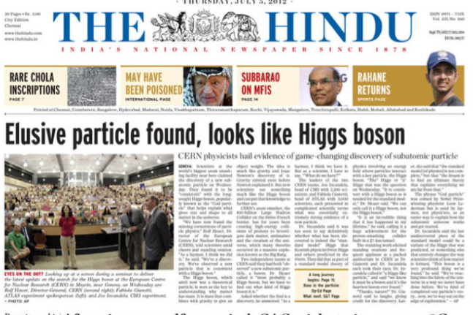


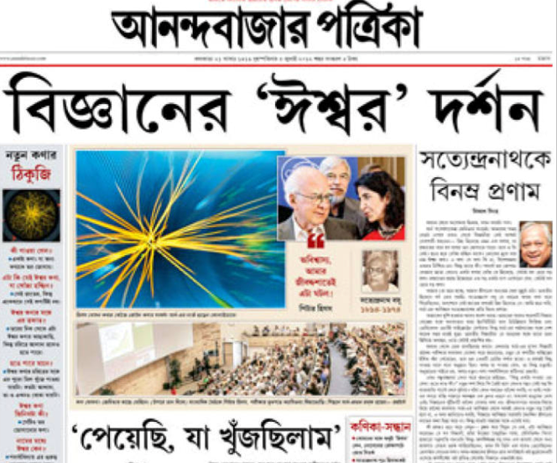
July 4th 2012
The Higgs discovery

Slide 16

The Particle Higgsaw Puzzle
Is LHC finding the missing piece?
Is it the right shape?
Is it the right size?

Slide 17
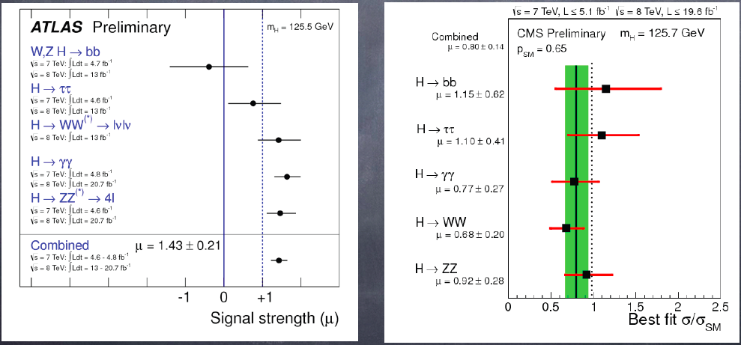
From Discovery to Measurement
Mass measurements:
125.6 ± 0.3 GeV
Signal strengths ~ SM
in many channels
Frontiers:
  VBF significance 2σ in several channels, 3σ combined
  Decay to ττ emerging
  Decay to bbbar emerging (CMS, Tevatron)
  Indirect evidence for ttbar coupling
  Still to come: ttbar + H, t + H, H to Zγ, …
Wingerter-Seez
Ganjour

Slide 18
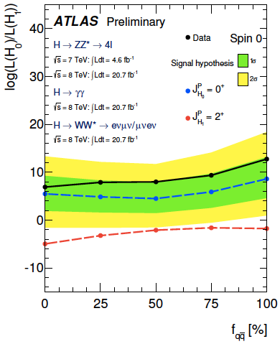
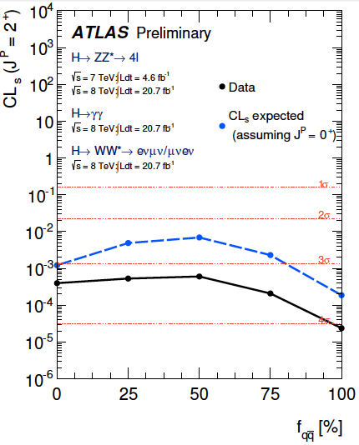
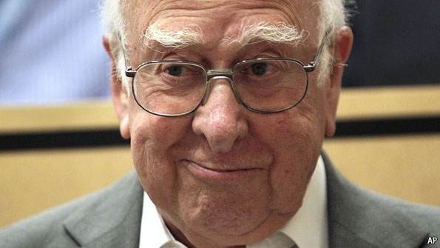
The ‘Higgs’ Spin is probably 0
Graviton-like spin-2 disfavoured at 99.9% CL

Slide 19
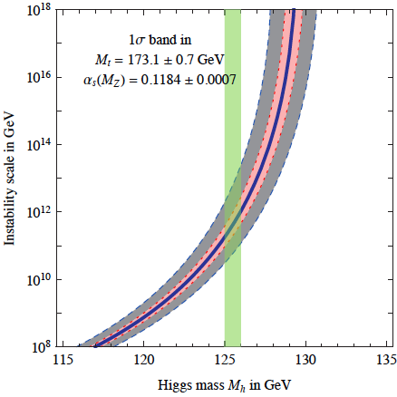


Theoretical Constraints on Higgs Mass
Large M_{h} → large self-coupling → blow up at low-energy scale Λ due to
renormalization
Small: renormalization
due to t quark drives
quartic coupling < 0
at some scale Λ
→ vacuum unstable
Vacuum could be stabilized by Supersymmetry
Instability @
10¹⁰ – 10¹³ GeV
Ibanez,
Kobakhidze //
Degrassi, Di Vita, Elias-Miro, Giudice, Isodori & Strumia, arXiv:1205.6497

Slide 20
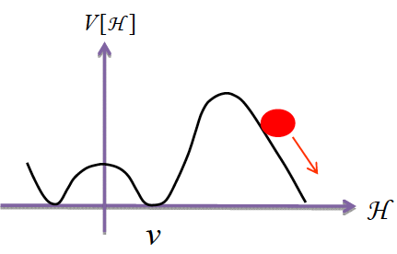
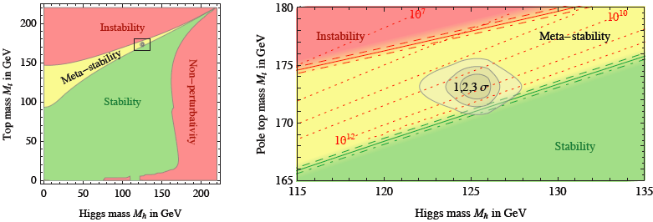
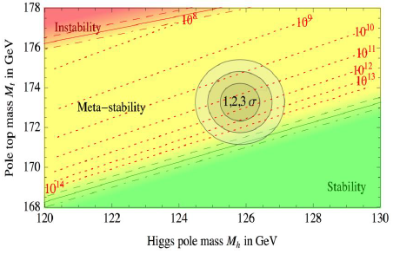
Vacuum Instability in the Standard Model
Very sensitive to m_{t} as well as M_{H}
Present vacuum probably metastable with lifetime >> age of the Universe
Ibanez,
Kobakhidze //
Degrassi, Di Vita, Elias-Miro, Giudice, Isodori & Strumia, arXiv:1205.6497

Slide 21
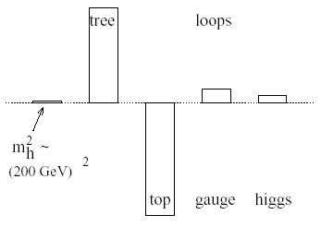
Elementary Higgs or Composite?
Higgs field:
<0|H|0> ≠ 0
Quantum loop problems
Fermion-antifermion condensate
Just like QCD, BCS superconductivity
Top-antitop condensate? needed m_{t} > 200 GeV
e.g., cutoff
Λ = 10 TeV
New technicolour force?
Heavy scalar resonance?
Inconsistent with
precision electroweak data?
Cut-off Λ ~ 1 TeV with
Supersymmetry?

Slide 22
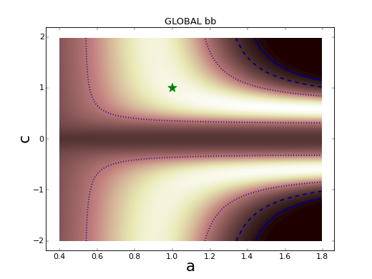
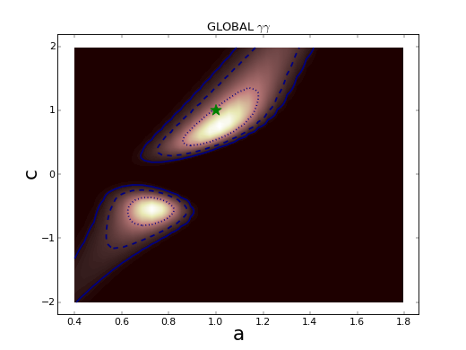
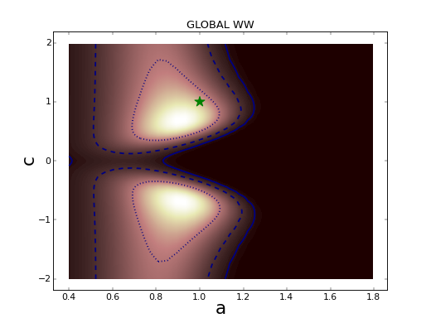
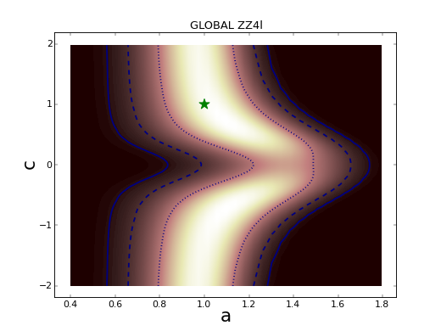
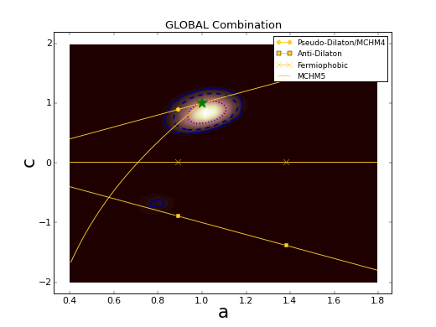
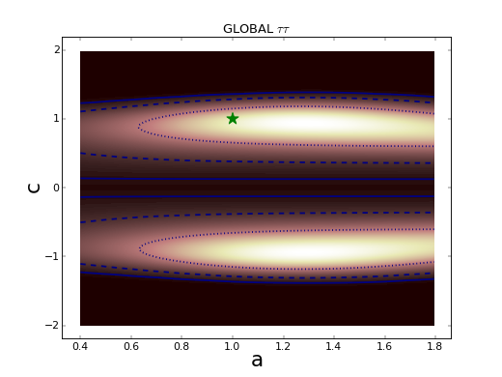
Global Analysis of Higgs-like Models
Rescale couplings: to bosons by a, to fermions by c
Standard Model: a = c = 1
Lee
No evidence for
deviation from SM
W W
Global
b bbar
τ τ
γ γ
Z Z
JE & Tevong You, arXiv:1303.3879

Slide 23
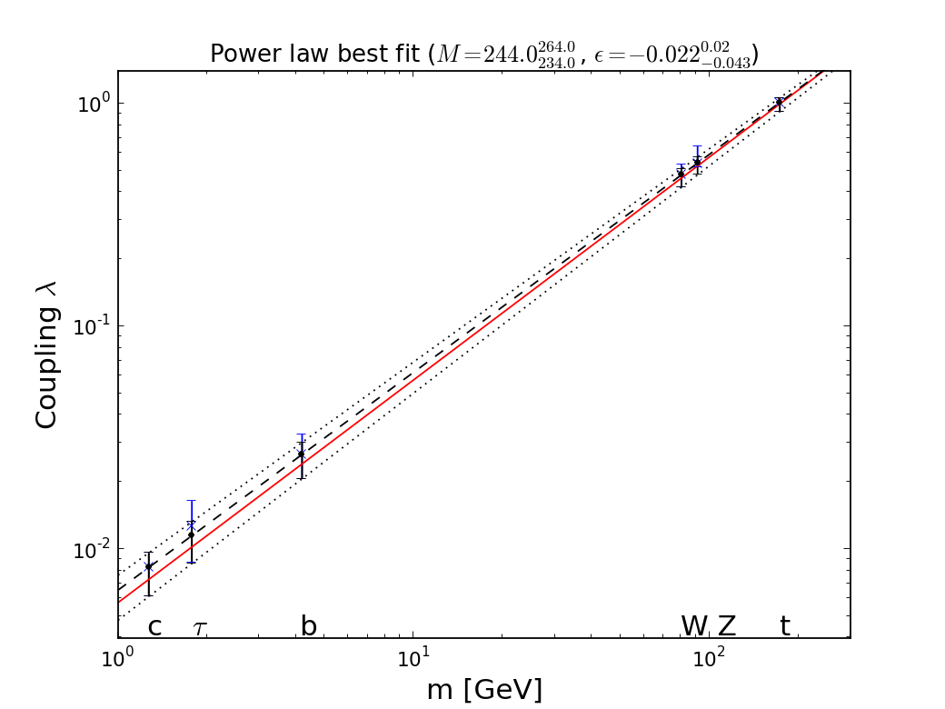


It Walks and Quacks like a Higgs
Do couplings scale ~ mass? With scale = v?
Red line = SM, dashed line = best fit
Global
fit
Lee
JE & Tevong You, arXiv:1303.3879

Slide 24

Dixit Swedish Academy
Today we believe that “Beyond any reasonable doubt, it is a Higgs boson.” [1]
http://www.nobelprize.org/nobel_prizes/physics/laureates/2013/advanced-physicsprize2013.pdf
[1] = JE & Tevong You, arXiv:1303.3879

Slide 25
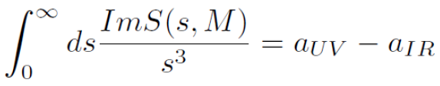
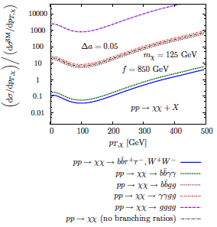
From a-Theorem to Double-Higgs Production?
Beautiful new, fundamental result in field theory
Infra-red scale anomaly < ultra-violet anomaly
Dilaton scattering sum rule,
anomalous couplings
Higgs = electroweak dilaton
Anomalous couplings in
composite Higgs models
Double-Higgs production?
Schwimmer
Dolan, Englert & Spannowsky

Slide 26
What else is there?
Supersymmetry
Successful prediction for Higgs mass
  Should be < 130 GeV in simple models
Successful predictions for Higgs couplings
  Should be within few % of SM values
Could explain the dark matter
Naturalness, GUTs, string, … (???)

Slide 27
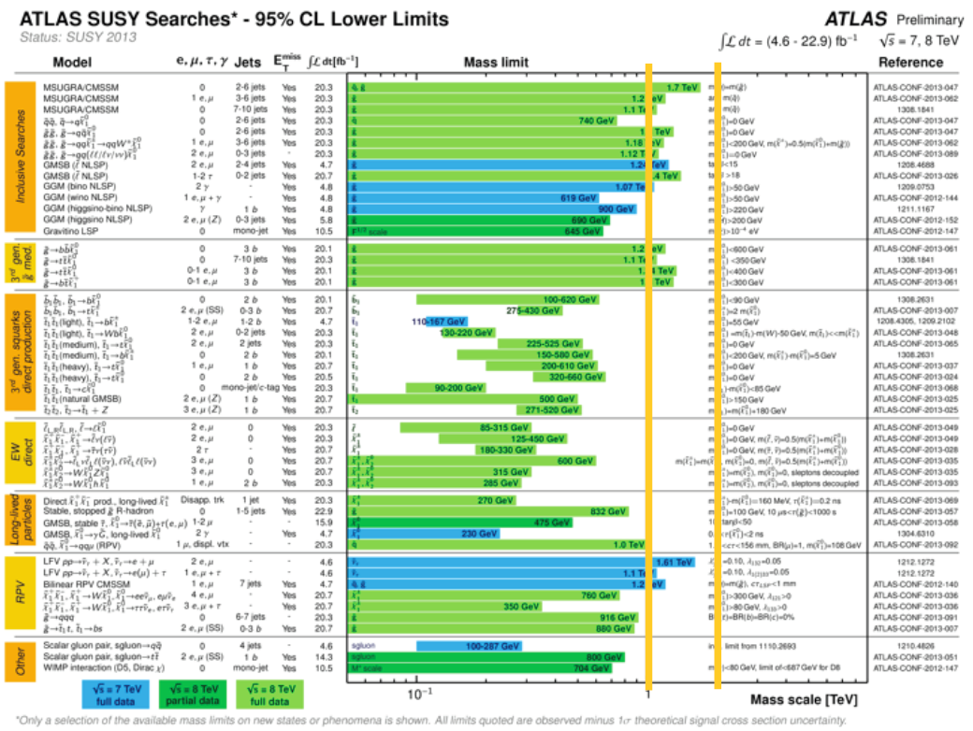
Wingerter-Seez

Slide 28
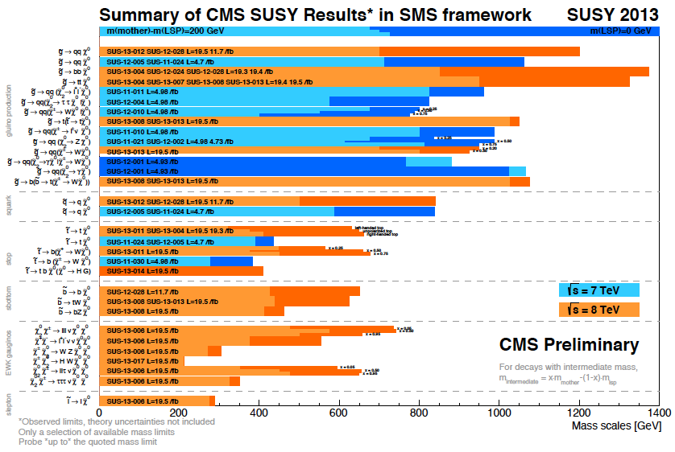
(Over-)Simplified Models
Ganjour

Slide 29
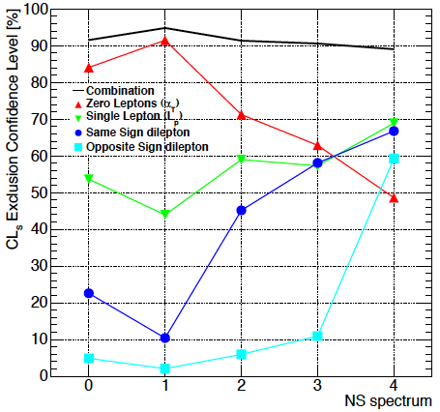
Simplified Models: Caveat Emptor
Any realistic model will yield signature with probability < 100%
Any realistic model will yield > 1 signature
Develop tools to combine
simplified signatures
Significance may be not
depend on model details
Kulkarni //
Buchmueller & Marrouche

Slide 30

Ibanez

Slide 31


Searches ~ 5/fb @ 8 TeV
Searches with 8 TeV Data
“Classic” missing-energy search
Wingerter-Seez
Multiple searches including b, leptons
Notes:
31

Slide 32


2012
20/fb
Scan of CMSSM
Olive
Update of Buchmueller et al: arXiv:1207.3715
p-value of simple models ~ 5%, ~ SM

Slide 33



2012
1
5
20/fb
Reach of LHC at
High luminosity
Gluino mass
CMSSM
Nojiri
Olive
Update of Buchmueller, JE et al: arXiv:1207.3715
Favoured values of gluino mass significantly
above pre-LHC, > 2 TeV

Slide 34



Introduction
New Particles:
Years from Proposal to Discovery
Supersymmetry |--------------------- ?
Notes:
All the particles of the standard model, from conception to discovery, with the higgs the last missing piece. History will remember the higgs discovery of this year as closing the chapter on an amazing century of unraveling the subatomic world and building the SM. End with “given the particle content of the SM and their quantum numbers…”
(Alternatively): The picture of fundamental physics at the start of the last century was a classical one in which all that was left was to measure to increasing precision, with a few anomalies here and there like blackbody radiation or the precession of mercury…

Slide 35

What Next: A Higgs Factory?
Nojiri
To study the ‘Higgs’ in detail:
The LHC
  Rethink LHC upgrades in this perspective?
A linear collider?
  ILC up to 500 GeV
  CLIC up to 3 TeV
    (Larger cross section at higher energies)
A circular e⁺e⁻ collider: LEP3, TLEP
  A photon-photon collider: SAPPHiRE
A muon collider

Slide 36

Possible Luminosities and Energies of e⁺e⁻ Colliders
Nojiri
TLEP if you want
high luminosity
CLIC if you want
high energy

Slide 37

A Vision for the 21st Century
350 GeV Circular e⁺e⁻ collider
100 TeV proton-proton collider
Similar ideas in China

Slide 38

Comparison of Possible Higgs
Factory Measurements

Slide 39
TLEP:
Part of a Vision for the Future
Exploration of the 10 TeV scale
Direct (VHE-LHC) + Indirect (TLEP)
Need major effort to develop the physics case
Work together

Slide 40

Cosmological Inflation in Light of Planck
A scalar in the sky? Supersymmetry/gravity?
Bouchet

Slide 41

Inflationary Landscape
Bouchet
Ringeval //
Starobinsky
R + R² model

Slide 42
Inflation Cries out for Supersymmetry
Want “elementary” scalar field
(at least looks elementary at energies << M_{P})
To get right magnitude of perturbations
Prefer mass << M_{P}
(~ 10¹³ GeV in simple φ² models)
And/or prefer small self-coupling λ << 1
Both technically natural with supersymmetry
JE, Nanopoulos, Olive, & Tamvakis: 1983

Slide 43
No-Scale Supergravity Inflation
The only good symmetry is a local symmetry
Early Universe cosmology needs gravity
Supersymmetry + gravity = Supergravity
BUT: potentials in generic supergravity models have potential ‘holes’ with depths ~ – M_{P}⁴
Exception: no-scale supergravity
Appears in compactifications of string
Flat directions, scalar potential ~ global model + controlled corrections
JE, Nanopoulos & Olive, arXiv:1305.1247, 1307.3537

Slide 44



No-Scale Supergravity Inflation
Good inflation for
Looks like R² model
Deviations possible
JE, Nanopoulos & Olive, arXiv:1305.1247

Slide 45

Look for B-Mode Polarization
Brandenberger
Blueshift in string gas
Redshift in inflation
Komatsu

Slide 46

No-Scale Framework for Particle Physics & Dark Matter
Incorporating Starobinsky-like inflation, leptogenesis, neutrino masses, LHC constraints, supersymmetric dark matter,
Stringy origin…?
JE, Nanopoulos & Olive, arXiv:1310.4770

Slide 47

String Model-Building
Ibanez
Quevedo
Lukas
Shiu
Many possible approaches:
Many possibilities within each approach

Slide 48

E.g., Systematic Approach to Calabi-Yau Spaces
How to choose between them?
Optimal use of bottom-up information?
Still ambiguity? A******** principle?
Lukas
Ibanez

Slide 49


Calabi-Yau-Ology
Quevedo

Slide 50




Sample Approaches
Ibanez
High SUSY-breaking scale?
Large volume?
Efforts to engage with phenomenology:
  Higgs mass Dark matter Models of inflation
Quevedo
Ibanez
Quevedo
Shiu

Slide 51




From Inflation to Structures
Seljak
- Growth of structures
- Baryon acoustic oscillations
- Weak lensing, …

Slide 52




Direct Searches for Dark Matter
CDMS Si result
New LUX result
Sorensen //
Akerib et al.
Best limit: XENON100 with 225 days of data
Confusion at low WIMP masses?
New best limit: LUX with 85 days of data
Resolves confusion at low WIMP masses?
Aprile et al.
Notes:
52

Slide 53

Global Fit to Supersymmetric Model
2
20/fb
Spin-independent
Dark matter scattering
Excluded by
XENON100
Excluded by
LUX
Excluded by LHC
Olive
Update of Buchmueller, JE et al: arXiv:1207.3715
Favoured values of dark matter scattering
cross section significantly below XENON100, LUX

Slide 54
No BSM? History is on our Side
"So many centuries after the Creation, it is unlikely that anyone could find hitherto unknown lands of any value” - Spanish Royal Commission, rejecting Christopher Columbus proposal to sail west, < 1492
“The more important fundamental laws and facts of physical science have all been discovered” – Albert Michelson, 1894
"There is nothing new to be discovered in physics now. All that remains is more and more precise measurement" - Lord Kelvin, 1900
“Is the End in Sight for Theoretical Physics?” – Stephen Hawking, 1980

Slide 55

Conversation with Mrs Thatcher: 1982
What do you do?
Think of things for the experiments to look for, and hope they find something different
Wouldn’t it be better if they
found what
you predicted?
Then we would not know how to progress!

Slide 56

Effective Potential in Single-Field Model
Consider single real field with double-well potential:
Shallower than φ² for
0 < φ < v
Better tensor-to-scalar
ratio r for 0 < φ < v
Steeper than φ² for
φ < 0 or > v: worse r
Good
inflation
Croon, JE & Mavromatos: arXiv:1303.6253

Slide 57


Effective Potential in Wess-Zumino Model
Effective potential:
Equivalent to single-field
model for θ = 0 (good)
Combination of φ² + φ⁴
for θ = π/2 (no good)
Good inflation for
suitable μ, λ
Good
inflation
Croon, JE & Mavromatos: arXiv:1303.6253

Slide 58

Wess-Zumino Inflation in Light of Planck
Consistent with Planck for x_{i} = 0.3, 0.4
Numbers calculated for N = 50 e-folds
Good
inflation
Croon, JE & Mavromatos: arXiv:1303.6253

Slide 59
Summary
Beyond any reasonable doubt, the LHC has discovered a (the) Higgs boson
A big challenge for theoretical physics!
The LHC may discover physics beyond the SM when it restarts at ~ 13 TeV
If it does, priority will be to study it
If it does not, natural to focus on the Higgs
In this case, TLEP offers the best prospects
  and also other high-precision physics

Slide 60
No-Scale Supergravity Inflation
Good inflation for
Looks like R² model
JE, Nanopoulos & Olive, arXiv:1305.1247, 1307.3537

Slide 61

Inflationary Models in Light of Planck
Planck CMB observations consistent with inflation
Tilted scalar perturbation spectrum:
n_{s} = 0.9585 ± 0.070
BUT strengthen upper limit on tensor perturbations: r < 0.10
Challenge for simple
inflationary models
Starobinsky R² to rescue?
Supersymmetry to rescue?
Croon, JE & Mavromatos: arXiv:1303.6253

Slide 62

Supersymmetric Inflation in Light of Planck
Supersymmetric Wess-Zumino (WZ) model consistent with Planck data
ϕ⁴
ϕ²
WZ
ϕ
ϕ^{2/3}
Croon, JE, Mavromatos: arXiv:1303.6253

Slide 63
See also …
Nakayama, Takahashi & Yanagida – arXiv:1305.5099
Kallosh & Linde – arXiv:1306:3214
Buchmuller, Domcke & Kamada – arXiv:1306.3471
Kallosh & Linde – arXiv:1306.5220
Farakos, Kehagias and Riotto – arXiv:1307.1137
Roest, Scalisi & Zavala – arXiv:1307.4343
Kiritsis – arXiv:1307.5873
Ferrara, Kallosh, Linde & Porrati – arXiv:1307.7696

Slide 64

2012
1
5
20/fb
Reach of LHC at
High luminosity
Squark mass
CMSSM
χ²
Update of Buchmueller, JE et al: arXiv:1207.3715
Favoured values of squark mass:
~ 2000 GeV or more

Slide 65





The (NG)AEBHGHKMP Mechanism
The only one
who mentioned a
massive scalar boson

Slide 66

Comparison with Electroweak Fit
Quite consistent: Δχ² ~ 1.5

Slide 67



Higgs as a Pseudo-Goldstone Boson
‘Little Higgs’ models
(breakdown of larger symmetry)
Loop cancellation mechanism
Little Higgs
Supersymmetry

Slide 68



H Coupling Measurements Now
@TLEP
M = 246.0 ± 0.8 GeV, ε = 0.0000^{+0.0015}_{-0.0010}
JE & Tevong You

