Slide 1
SiTra DAQ integration into EUDAQ
Zdeněk Doležal, Daniel Scheirich (Charles U. Prague)
Hao Yin, Thomas Bergauer (HEPHY Vienna)

Slide 2
SiTra Job Description
Short:
Provide telescope information for users
Detailed:
measure particle position in N planes
perform alignment
perform tracking
provide entry position and direction at the DUT
?provide full track info (+covariance…)?

Slide 3
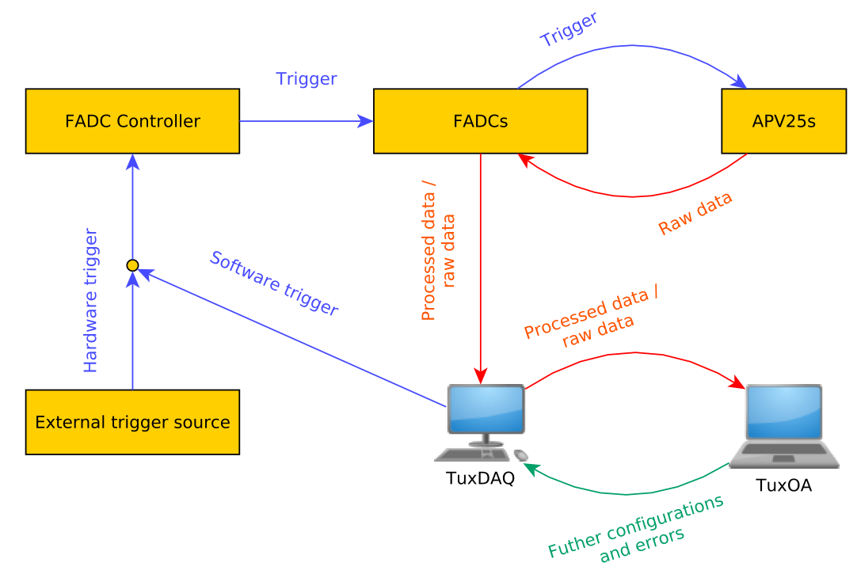
SiTra Architecture
TLU

Slide 4
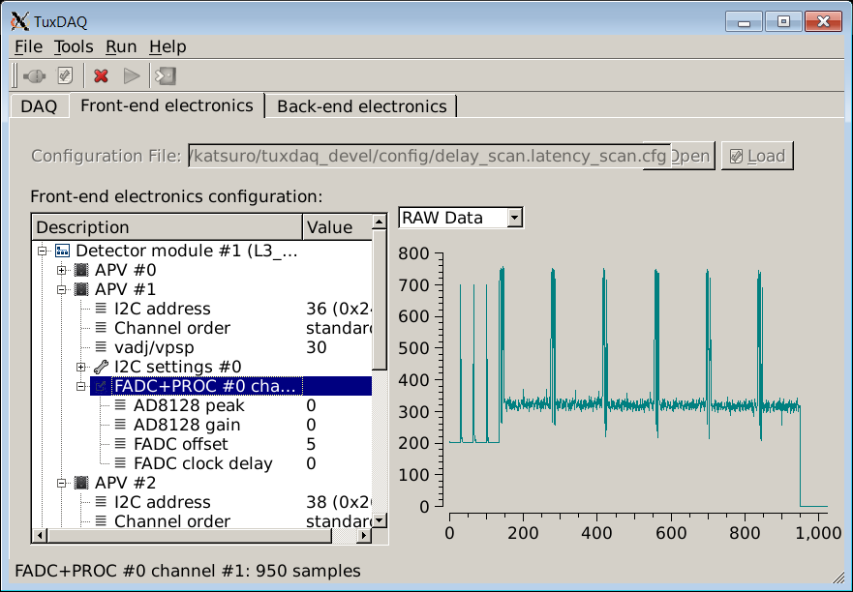
TuxDAQ
DAQ system necessary to control the hardware
I²C communication, flashing firmware,
save calibration data (noise,..) into flash
Run control, to be integrated in EPICS
GUI or command line only mode

Slide 5
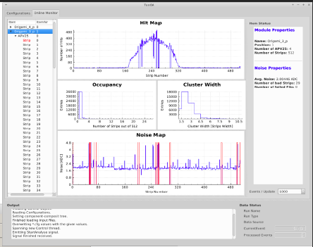
TuxOA
Online Analysis, i.e. monitoring
Provides live
  signal/noise ratios
  Cluster sizes
  Hit map
Communication between TuxDAQ/TuxOA via file (at the moment) and via TCP/IP socket (future)

Slide 6
Data Contents/Formats: EUDAQ
RawDataEvent
  Generic container for unaltered, encapsulated detector response
  Data input: raw block of memory or vector
  Storage of additional information possible
Alternative: StandardEvent
  Decoded detector data
  Can be read by e.g. the EUDAQ Online Monitor
Source: EUDET-Memo-2010-01

Slide 7
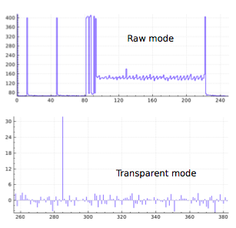
SiTra/TuxDAQ Run modes
Raw Mode/transparent mode
  Provides analog strip values
Zero Suppressed Mode
  (corresponds loosely to EUDAQ StandardEvent)
Single/Multi peak mode
  Single mode: provides the maximum of the shaping curve
  Multi-peak mode: samples shaping curve for offline fitting (used by Belle II to reduce background/occupancy)

Slide 8

Data Analysis
What data is needed for which user:
CALICE
  Probably impact point and direction
  This can be sufficiently achieved with ‘simple’ reco
  Do we have ‘simple’ reco/align/tracking SW?
Generic user (TPC,…)
  Perhaps raw data to perform precision tracking with EUTelescope Analysis Framework
  Who does the analysis? AIDA SW experts?

Slide 9
EUDAQ SiTra Interface
2 modules running within TuxDAQ/OA needed:
Producer
  Configuration
  Receiving Commands from RunControl
  Sending Data to DataCollector
  Communication via TCP/IP
Converter (RawData➔StandardEvent)

Slide 10
Further bits and pieces needed
?Test EUTelescope Analysis Framework applicability to analyse strip data (clustering, alignment, tracking)
?Tune EAF to perform the analysis
For CALICE our ‘simple’ tools might do (to be studied)

Slide 11
Status
TuxDAQ and TuxOA operational
TuxOA TuxDAQ TCP/IP socket communication missing
TCP/IP needed also for TuxDAQ EUDAQ
First tests of TCP/IP communication performed by Daniel Scheirich (Prague CU)
  Low-level C standard kernel functions (socket…)
  ROOT TServerSocket and TSocket
Implementation and test needed for both tasks (can we use ROOT Socket classes?)

Slide 12
Plans
Need to clarify the job description
Meeting with EUDAQ and ECAL DAQ people tomorrow14hrs
Enough info/assumptions to start writing Producer
  Daniel Scheirich with kind assistance of Hao et al. is in charge of this

Slide 13
Question to DAQ/SW group
Do we need to provide more than simple track info?
Can we provide StandardEvent instead of RawDataEvent?
Can we use ROOT TSocket classes on the TuxDAQ side?

