Slide 1
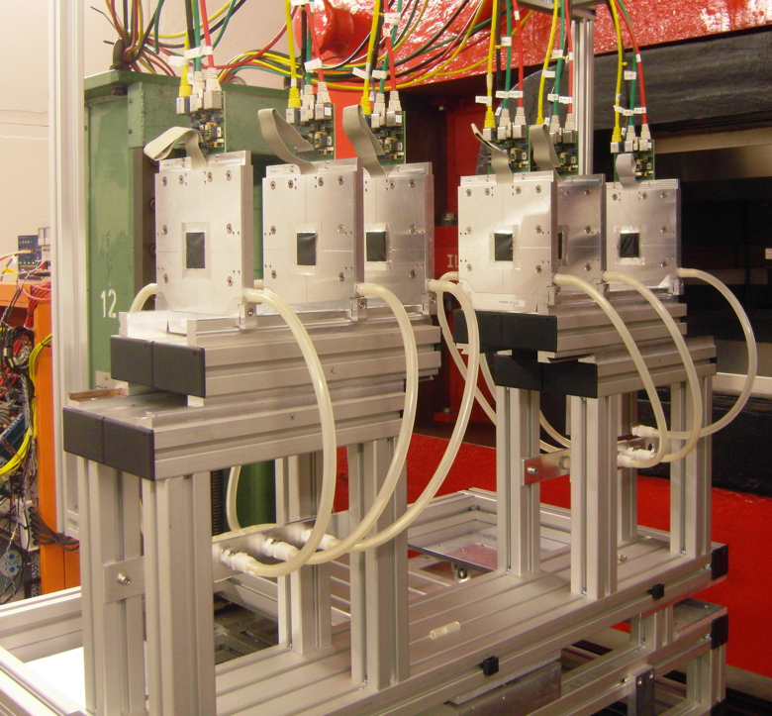

WP9.3 “Precise Pixel Detectors”
Igor Rubinskiy
Overview and deliverables
Timeline to commission the AIDA telescope
- PS & SPS schedule, AIDA WP 9.3.1 time slots
- readiness of subtasks
WP 9.3.1 & WP 8.5, AIDA 3 annual meeting, March 27 2013

Slide 2

Reminder of the objectives WP9.3
Objectives
Development of a versatile beam telescope able to characterize detector prototypes, satisfying the demanding requirements in terms of cooling infrastructure, read-out speed and precision
Development of an off-beam infrastructure for the evaluation of thermo-mechanical properties of Vertex Detector prototypes
This task builds on the telescope infrastructure developed as part of the EUDET.
A versatile and modular pixel telescope is to be built using state-of-the-art pixel devices (Timepix, ATLAS FE-I4 and Mimosa) to meet the requirements of a broad user community. The telescope must provide a precise set of reference measurements and must be capable of LHC-speed response and time-stamping.
CO2 cooling plant
Common analysis tools (EUTelescope at el.)
DCS system
Development of an infrastructure that allows to evaluate the thermo-mechanical performance of fully integrated detector prototypes under a realistic power load.
Deliverable 9.4 months 37
Milestone with design 13
Task 9.3.1 Telescope
Deliverable 9.1 months 33
done!
Task 9.3.2 Thermo-mechanical infrastructure
WP 9.3.1 & WP 8.5, AIDA 3 annual meeting, March 27 2013

Slide 3
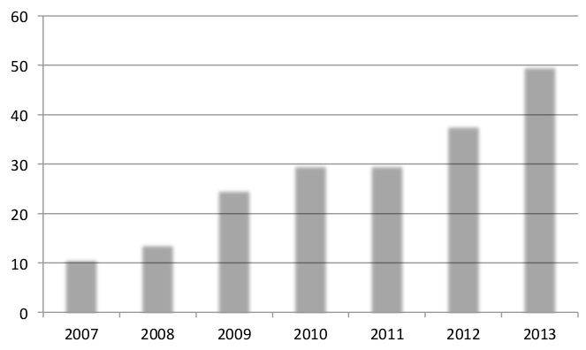
from EUDET into AIDA
Number of weeks per year when a EUDET telescope (≥1) was requested .
EUDET
AIDA
Within AIDA:
- maintain and improve EUDET telescope as highly valuable resource
- vital R&D infrastructure
– overall 5 copies exist
The EUDET telescope
- Mimosa26 sensors
- the NI readout system
WP 9.3.1 & WP 8.5, AIDA 3 annual meeting, March 27 2013

Slide 4
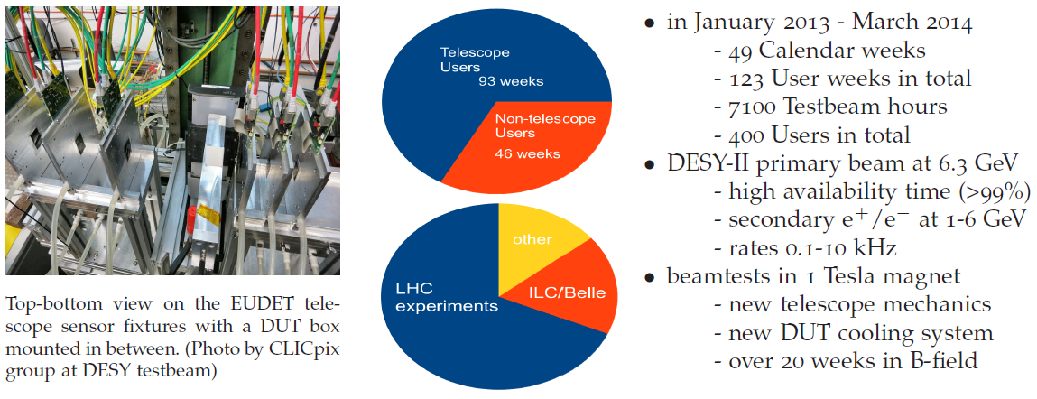
EUDET telescopes in 2013 at DESY
WP 9.3.1 & WP 8.5, AIDA 3 annual meeting, March 27 2013

Slide 5
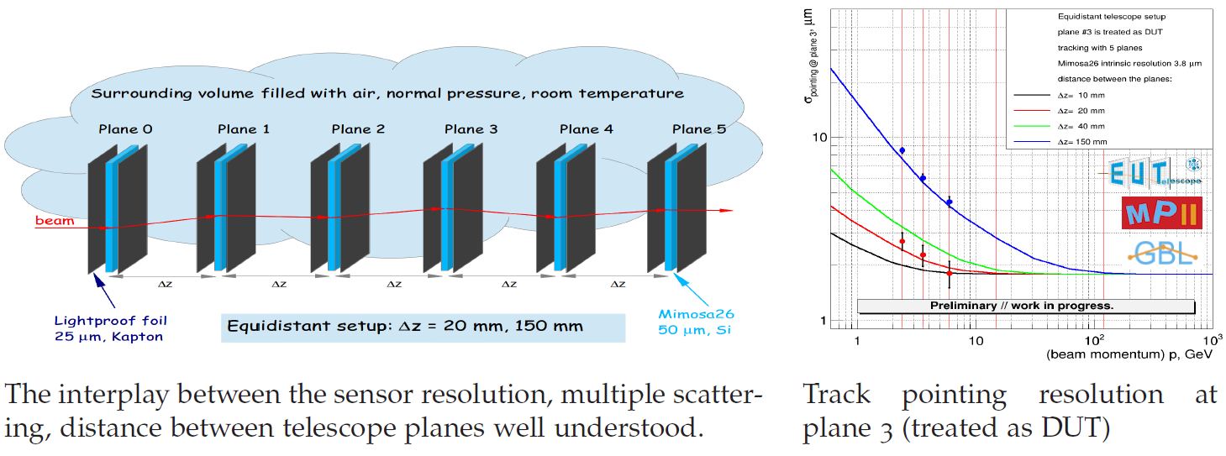
Tracking knowledge consolidated
Very good understanding of the contributions of multiple scattering, planes positioning, beam energy, and their impact on alignment and tracking.
A lot of maintenance&development work ongoing on the software side.
WP 9.3.1 & WP 8.5, AIDA 3 annual meeting, March 27 2013

Slide 6
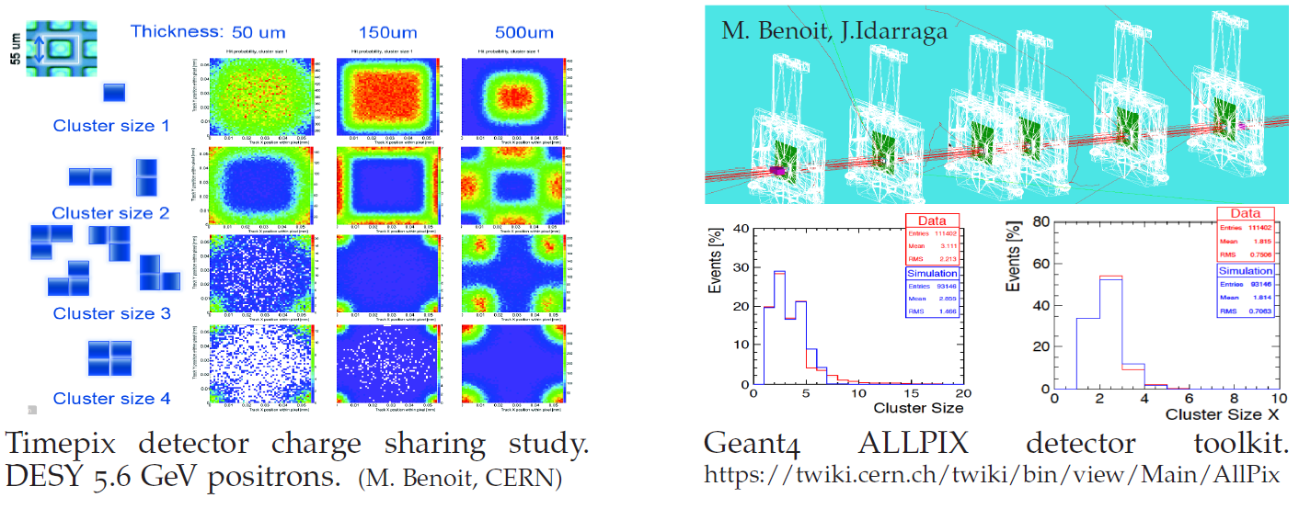
Timepix, precision studies, simulation
Timepix fully integrated with EUDAQ, TLU, EUTelescope //by CLICpix group
Genat4 simulation for DUTs in TB
High res. charge sharing map done at DESY beam 5.6 GeV.
DUT response simulation tools available.
WP 9.3.1 & WP 8.5, AIDA 3 annual meeting, March 27 2013

Slide 7
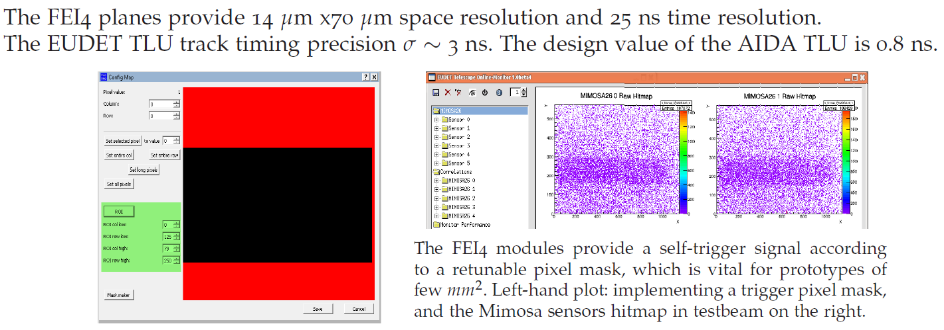
FEI4 as trigger plane
As an LHC-type device with fast readout can provide track timing information.
Single FEI4 plane as trigger plane installed at DESY TB.
Time-stamping of tracks requires more work on the firmware/software
WP 9.3.1 & WP 8.5, AIDA 3 annual meeting, March 27 2013

Slide 8
Testbeam schedule
CERN PS & SPS 2014
Defines intermediate milestones for the AIDA telescope
- Comissioning in the fall 2014
- Final report end of 2014.
WP 9.3.1 & WP 8.5, AIDA 3 annual meeting, March 27 2013

Slide 9
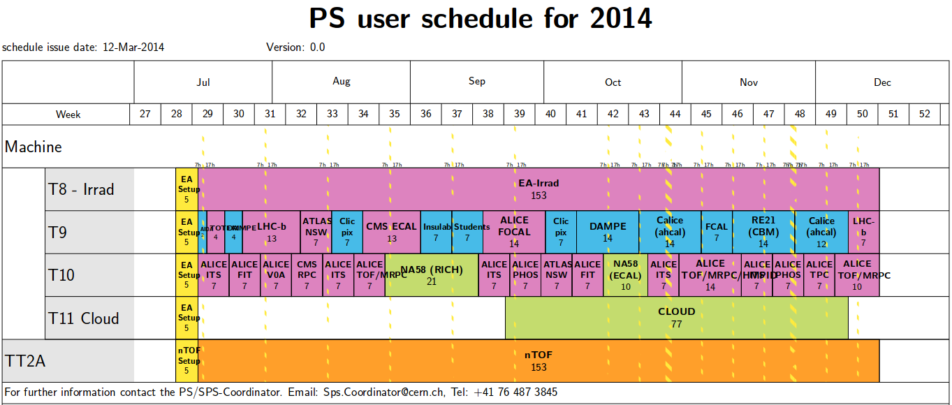
Move to SPS
Two days with ~7 GeV proton beam to test
new EUDAQ 2.0 + AIDA mini-TLU,
Mimosa26 telescope with IPHC readout, FEI4 arm with 1+ planes
Can start installing,
last pre-beam tests
Goal of the TB: test of TLU-EUDAQ2 high duty cycle triggering with distinct timestamping per DAQ system
WP 9.3.1 & WP 8.5, AIDA 3 annual meeting, March 27 2013

Slide 10
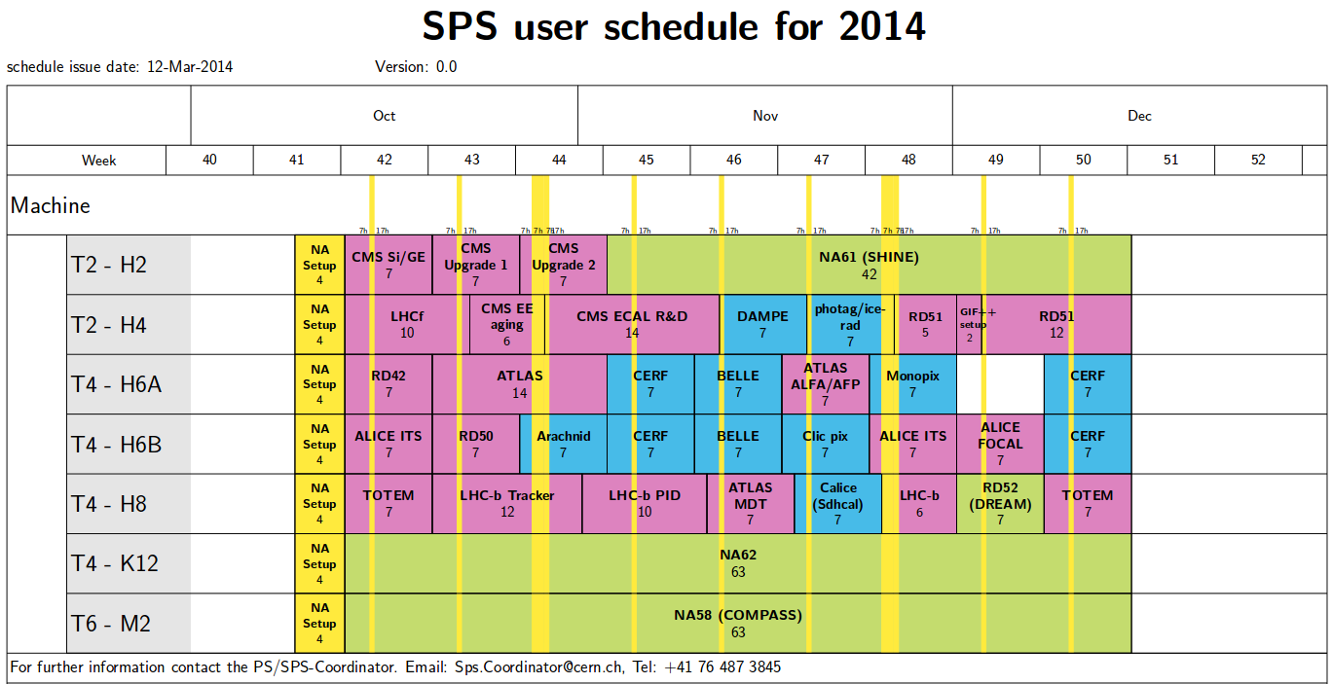
Parasitic installation at H6B
Final TB:
SALAT arm (3 4xMimosa28) and FEI4 quad plane (1+)
with already tested/improved AIDA mini-TLU, EUDAQ 2.0
Setting up
WP 9.3.1 & WP 8.5, AIDA 3 annual meeting, March 27 2013

Slide 11
Final AIDA telescope design
Final AIDA telescope:
WP 9.3.1: Milestone with design (M37)
- key modification is EUDAQ 2.0 + AIDA-TLU
- equal rights between DAQ systems integrated in the telescope
- DAQ systems write own datastreams with timestamping/TLU numbering
- not allowed to block other DAQ system
- exception: buffer overflow, not able to process data any more
- to be tested in lab in April/May, testbeam in July CERN PS
- SALAT arm consisting of 3 SALAT planes
- SALAT plane = 4 Mimosa28 (4x 2x2 cm^2) [already beamtested]
- FEI4 quad planes for triggering and timestamping [to be ready by July TB]
- final beam test in November 2014
- CO2 cooling as general infrastructure
- DCS as generic HV and Climate monitoring system
WP 9.3.2 Thermo-mechanical test setup – complete! Deliverable Report draft.
WP 9.3.1 & WP 8.5, AIDA 3 annual meeting, March 27 2013

