Slide 1
aTLU for AIDA
High Rate
Synchronous as well as Asynchronous

Slide 2
New Features (w.r.t. EUDET)
Synchronous (shared clocks) interface.
  Allows higher trigger rate
Interface by Gigabit Ethernet.
  Readout PC can be remote.
  IPBus protocol
Higher rate discriminators ( ~ MHz count rate)
  Threshold and constant-fraction
  Thresholds remotely controllable.
Timestamps on each scintillator input
  More accurate timing.
  Timestamp granularity increased from 3.2ns to 800ps

Slide 3
Synchronous Interface
Clock from TLU to DUT
  Configurable frequency
Trigger pulse only only clock cycle long
  Trigger rate up to 40MHz ( though photo-multipliers will limit this )
Busy from DUT to TLU
Check synchronization from time-stamp of each trigger ( measured in clock cycles)

Slide 4
Synchronous Interface

Slide 5
Asynchronous Interface
EUDET style asynchronous interface remains
  Synchronous/Asynchronous interface switchable by software
Maximum DUT_Clock frequency increases ( by default to 20MHz ).
  Can read out trigger numbers faster

Slide 6
Asynchronous Interface

Slide 7
Spill/Shutter signal
Optional , programmable spill/shutter signal
In short term will be a fixed on/off period
Could extend to be on for a fixed number of triggers, or a fixed time, or whichever comes first.
Useful for a number of Linear Collider detectors / readout system.

Slide 8
Use for TimePix Telescope
AIDA mini-TLU has only three DUT interfaces
Fan-out one interface to six using Uni Mainz board or Bristol RPC readout fanout (up to 30 DUT) .
  Takes “or” of BUSY signals
  VME format(Mainz) or “Box with connectors”(Bristol)
Allows AIDA mini-TLU to provide synchronization signals for TimePix telescope
  Similar or identical firmware
  Firmware developed by Alvaro Dosil, USC

Slide 9
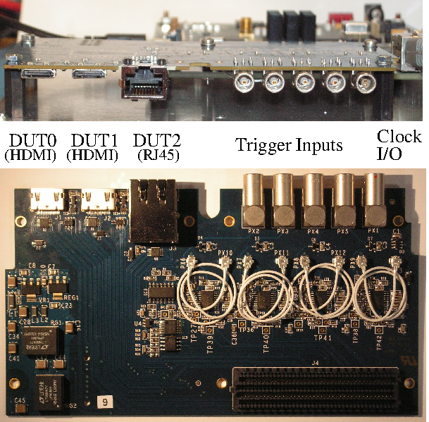
Hardware Status
First prototype:
  Incorrect FMC connector rotation.
  Used to test discriminators, DACs.
Second prototype:
  Ten PCBs fabricated.
  Three had components mounted.
  Has passed all tests so far.
  Test fully then assemble remaining seven.

Slide 10
Firmware/Software Status
EUDAQ Producer for AIDA TLU being written by Francesco Crescioli, LPNHE/IN2P3
  First version ready. Lots more registers to add.
Firmware being written by Alvaro Dosil, USC and D.Cussans, Bristol.
  Builds on Xilinx SP601 as carrier. Will build on SP605
  Debugging underway.
  Synchronous mode will be finished first.

Slide 11
Common DAQ Interface
A proposal for hardware timing and synchronization signals has been
  Draft at https://indico.cern.ch/getFile.py/access?resId=0&materialId=0&confId=284589
Document describing common DAQ in AIDA is in the process of approval.

Slide 12
Summary
New hardware synchronization scheme proposed for high-rate ( ~ MHz ) beams.
New hardware prototype built.
Firmware/software being developed.

