Slide 1
Academia meets Industry
Resistive Plate Chambers
Thin Gap Chambers
24th-25th March 2014
TU Wien

Slide 2

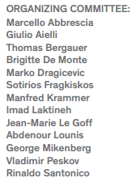

Welcome

Slide 3
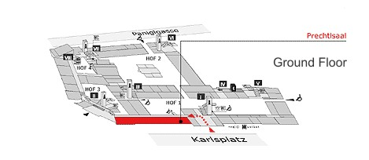
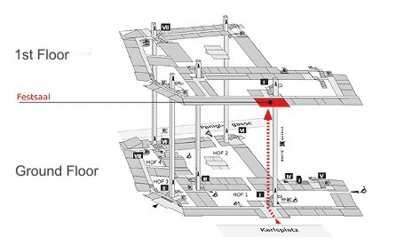
Venue
Meeting
  Festsaal 1st floor
Industry exhibit
  Prechtlsaal (ground floor)
Lunch/Coffee/dinner
  Prechtlsaal

Slide 4
Organisation
Make Industry aware of future HEP detector needs for RPC and TGC
Make Academia aware of Industry capability
Foster collaborations
→ Enjoy your event and make the best use of breaks!

