Slide 1
Overview of Thin Gap Chambers (TGC)
Principle operations of TGC’s
General characteristics
Use in Calorimetry (OPAL)
Use as the End-Cap μ Trigger Chambers in ATLAS.
Possible use as demonstration tool for Laboratory.
Conclusions

Slide 2
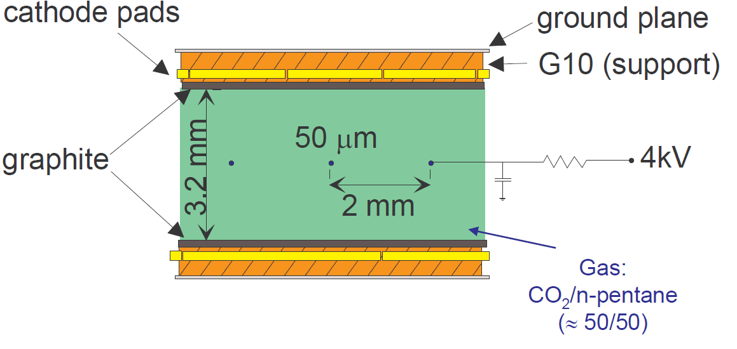
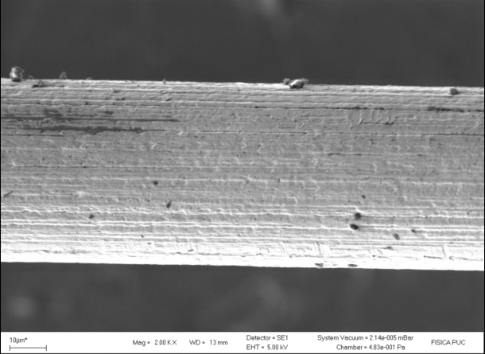
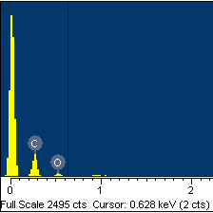
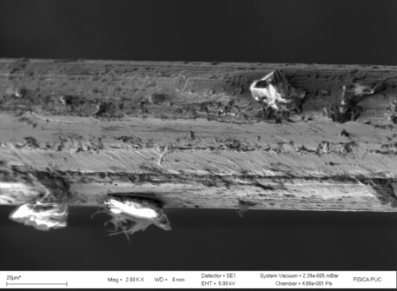
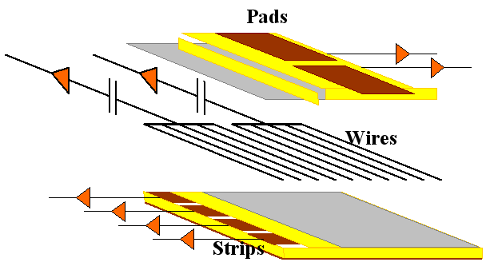
Short Introduction to TGC’s
CSC-like structure, except that anode-to-cathode distance=1.4mm, while anode-to-anode distance=1.8mm.
Anode wires sandwiched between 2 high resistive layers.
Readout behind resistive layers (strips, pads) or anodes.
Operating voltage: 2.9-3.0 KVolts.
Gas: CO2-n Pentane (55%-45%): n Pentane increases the ionization, while absorbing the photons in the avalanche.
  This provides high gain, without sparks.
  N-Pentane acts also as cleaning agent (no major wire deposits after 6 Coulomb/cm).
  For a small volume, one can afford to use flammable gas, and take precautions for leaks. C-H3 chains provide a good quencher, and avoids other problems.
Wires in non-irradiated
And
Irradiated areas

Slide 3
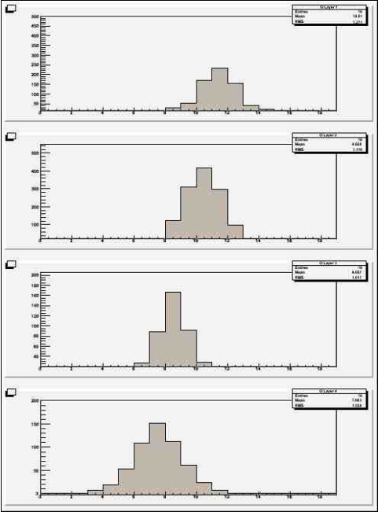
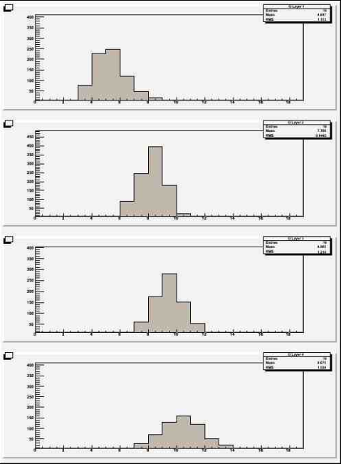
Look at the charge distribution across strips to get good position resolution of MIP’s

Slide 4
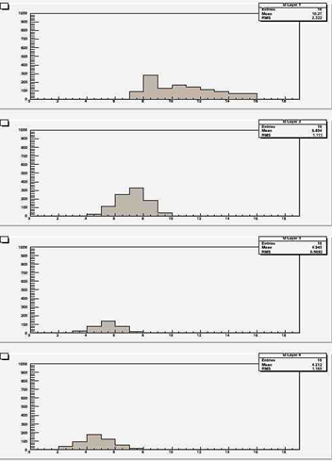
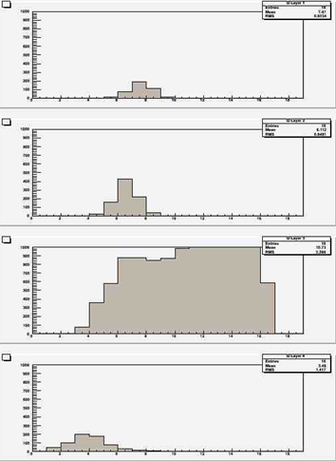
Easy to detect layer containing a neutron or a delta-ray

Slide 5
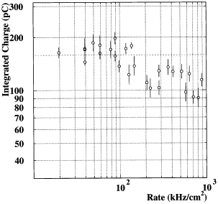
Rate limitations
Graphite
Small TGC’s have been tested under instantaneous rates exceeding 100’s KHz/cm². This is not a problem.
In large detectors, resistive cathode reduces the operating voltage.
Go from present TGC resistivity (1 MΩ/cm²) to 100 KΩ/cm² and reduce gap between strips to cathode (transparency prop. to RC).
Make large detectors to see real conditions.

Slide 6
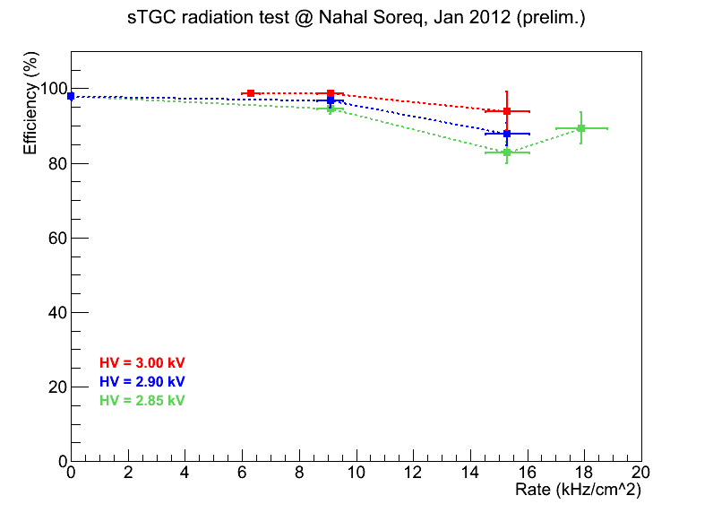
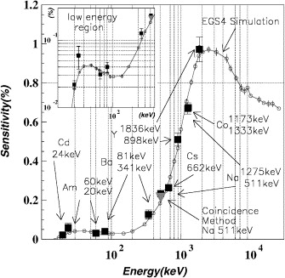
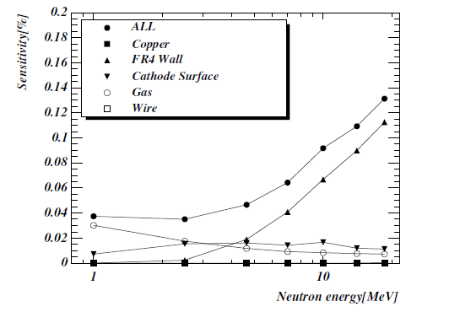
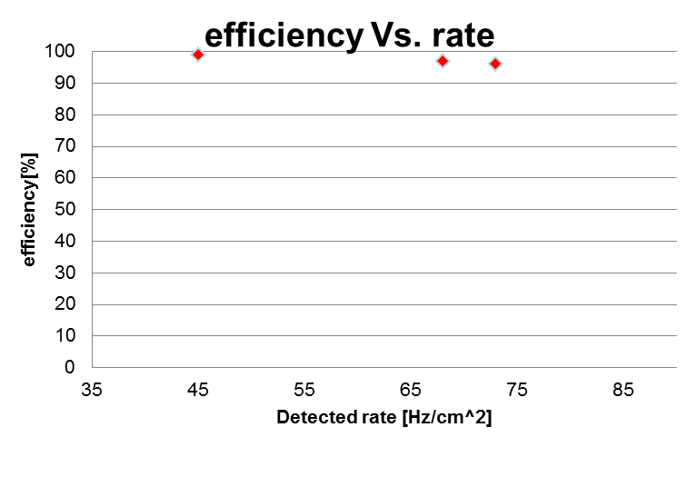
Single layer efficiency is good enough
If your start time is within 25ns, single γ background is not a serious problem (~6%) but δ rays (in time) is more of a problem.
Photon efficiency is different for different detectors (TGC is more like CSC’s=> expect ½ of the rate.
Most of the high Energy neutron sensitivity comes from the cathodes.
Due to the quasi-saturated operation of the TGC, the response is 3-5 times lower than the ionization deposits.
Single layer inefficiency in the presence of ATLAS-like neutrons <6%.

Slide 7
Why resistive coating ?
Having a high resistivity cathode reduces any damage that could be caused by sparking.
By putting the readout layer behind a thin (100µm-1.4mm) G-10 layer, using standard multi-layer PC procedures, one obtains a smooth cathode surface.
The transparency of the resistive layer is proportional to R*C (i.e. the surface resistivity X the capacitance to the readout pattern).
  For low-rates, one can use high-resistivity material and place the readout pattern far from the cathode surface.
  For high rates, one needs has to reduce the gap between the readout pattern and the cathode to a minimum, to have a low resistivity layer.
With a highly quenching gas, there are no problems of space-charge limitations (one can have local rates measured in KHz/mm^2), however high rates on a large surface reduces the operating voltage far from the ground contacts, therefore leading to non-uniform gain.
  Increase the number of ground contacts and make sure that the surface resistivity matches the detector rates.

Slide 8
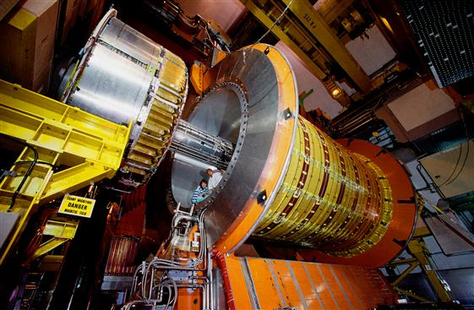
First use was in calorimetry (OPAL)
400 detectors were made that run for 11 years (~2% failure rate).
Important to operate in a quasi-saturated mode to count particles in a hadronic shower and avoid large fluctuations.

Slide 9
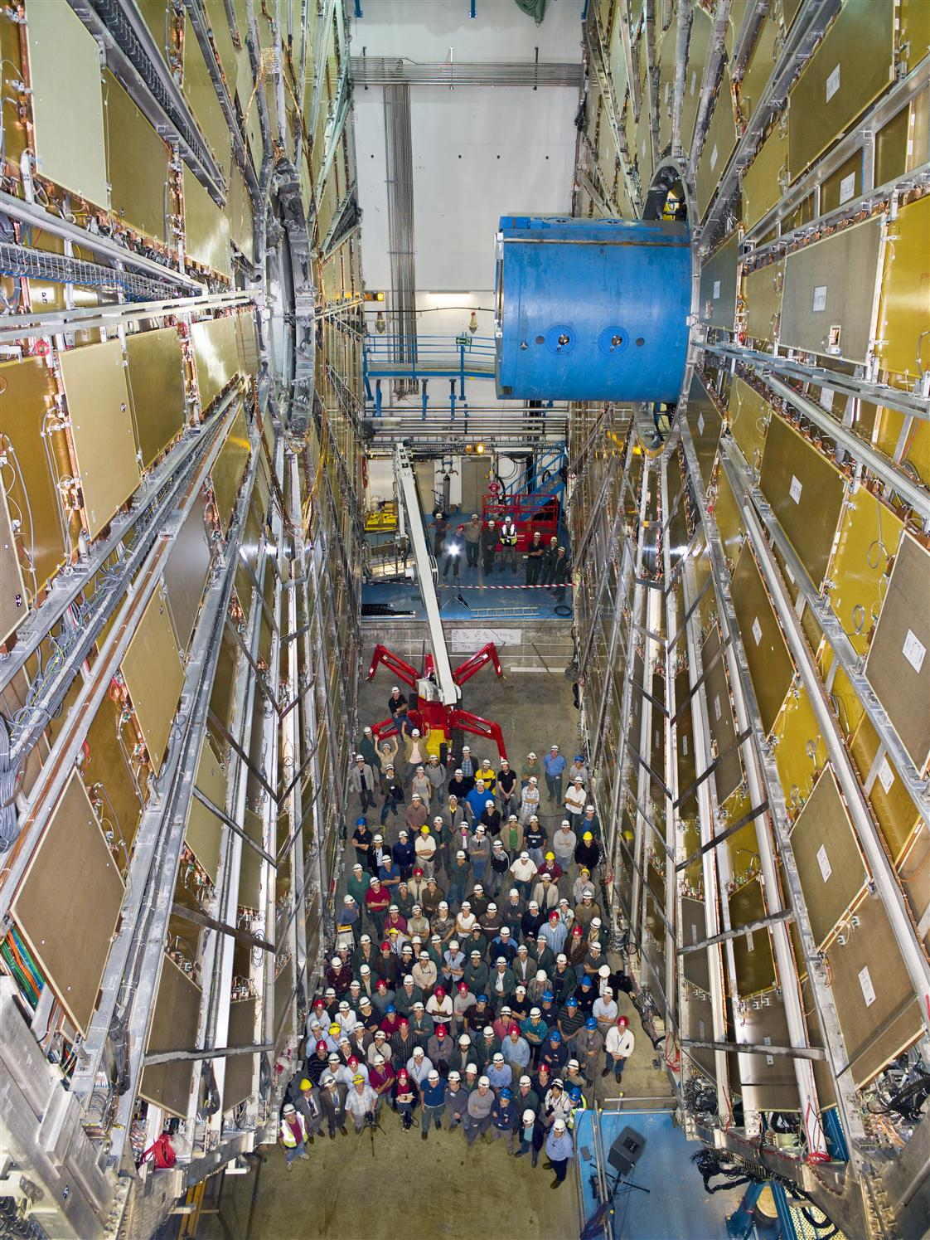
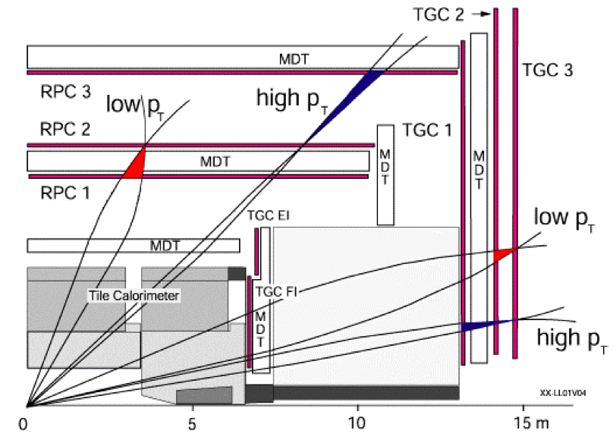
Use of TGC’s in ATLAS as a trigger device
Front plane contains 3 TGC layers, back 2 planes contain 2 TGC layers each.
A cone is open around the hit point in the last 2 planes for an infinite momentum µ, the size of the cone is inversely proportional to the µ momentum.
A coincidence 3-out-of-4 is made within the corresponding cone in the back layer, to match a
2-out-of-3 coincidence in the front layer

Slide 10
Large number of TGC’s have been constructed
Graphite
4,000 large area TGC’s have been constructed.
They provide the End-Cap MUON trigger of the ATLAS MUON Spectrometer (as well as the azimuthal Coordinate for tracking).
350,000 electronic channels
Many steps of QA/QC in the production procedure.
The majority of the chambers were irradiated for 1/2hr with a 3KCu CO(60) source, to find any possible defect:
  Defects are mainly due to irregularities in the surface:
    Drops of glue will charge-up and produce sparks.
    Bad contacts to graphite.
    Hairs from non-properly coated G-10 material.
With 8,000 large area cathodes, one acquires lots of experience on potential problems.

Slide 11
QA/QC of TGC (Israeli Production)
Many tests are performed during chamber production. Tests presented here refer to test performed on final modules (triplets and doublets)
Cut on Module
Uniformity
Cut on Max Current/chamber,
300V above operating Volt.
Cut on Number of
Broken Channels/chamber
Cut on overall module Flatness
Cut on stable chamber operation,
24Hr. At 300V above operation
Number of not operating channels/chamber
Including electronics
Tests of Leak rates in chamber and in Neutral Gas envelopes
Cut on Envelope
Leak rate
Cut on Chamber
Leak rate
Test performed at
2*operating overpressure

Slide 12
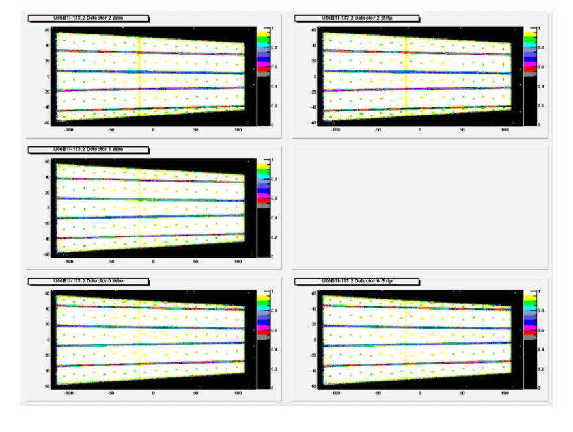
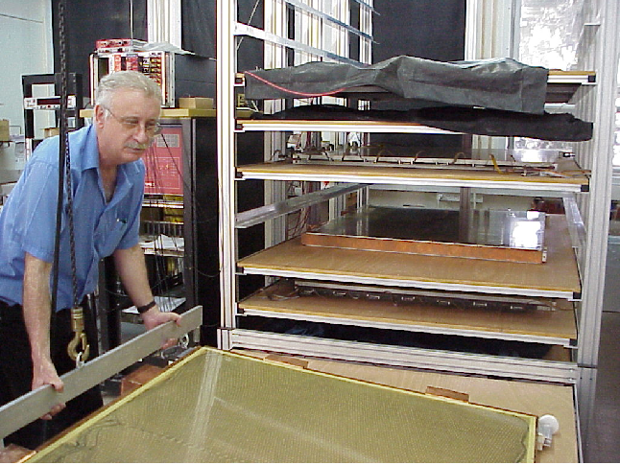
Scan Chamber Scan Using Cosmics
Performed at Technion and Tel Aviv
Impose strict cuts on non-uniformity of the gaps
  Area with less than 95% eff. Should not exceed 5% of Chamber area.
  Overall, 2.7% fail either cosmic or following radiation test (mainly early constructed detectors)
Map of ineff. Area becomes part of data base.

Slide 13
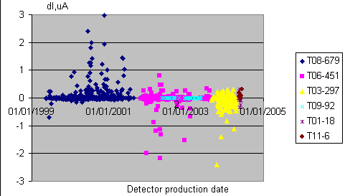
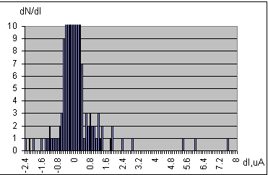
Final Tests of Complete TGC Module
Radiation Tests at 300Hz/cm**2 to 1KHz/cm**2, for ½ hr.
Current-rate correlation after irradiation
After turning off source, chamber current should go back to its original value to within 1microA, and differential rate increase should not be larger than 0.1 Hz/cm**2

Slide 14
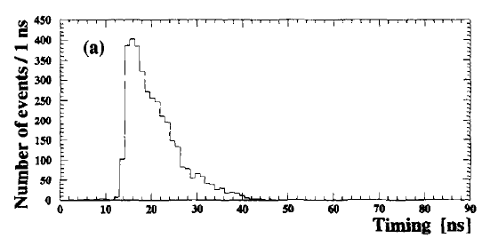
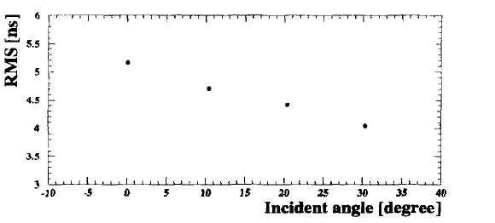
Timing performance
Time resolution depends critically on the incident angle with respect to the wire plane.
Particle passing between 2 wires, give long drift times.

Slide 15
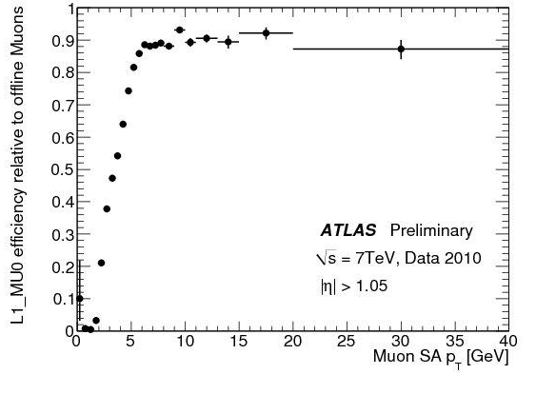
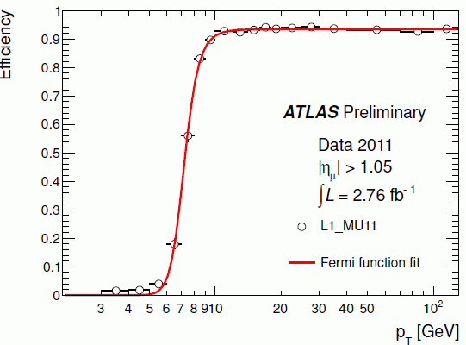
Present Performance of TGC system
Clear improvement from 2010 to 2011 by optimizing trigger cones and performing alignment using tracks

Slide 16
For future upgrades, use timing (pads) and position resolution using strips
sTGC quadruplet
Physical pads, each layer staggered
by ½ pad in both directions
Logical pad-tower defined by projection from 4 layers of staggered pad boundaries
4 planes
of sTGC
4 planes
of sTGC
Pad trigger selects a
band of strips under
row of logical pads
~280 mm
μ
Pad-tower coincidence =
3-out-of-4 overlapping pads
~150 mm
MicroMegas 8 layers

Slide 17
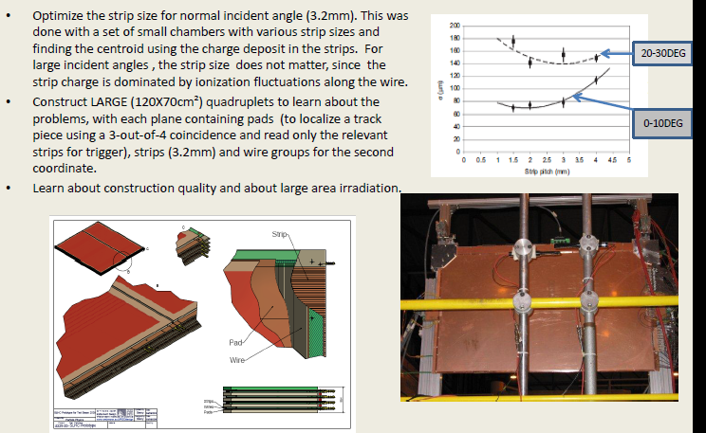
Optimization of strip size to achieve optimal position resolution at various incident angles

Slide 18
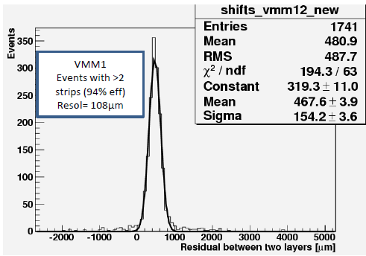
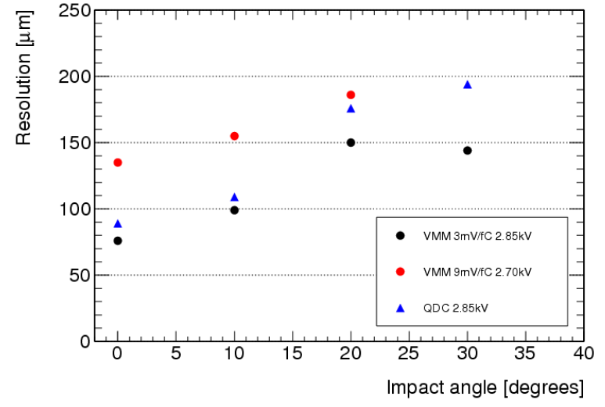
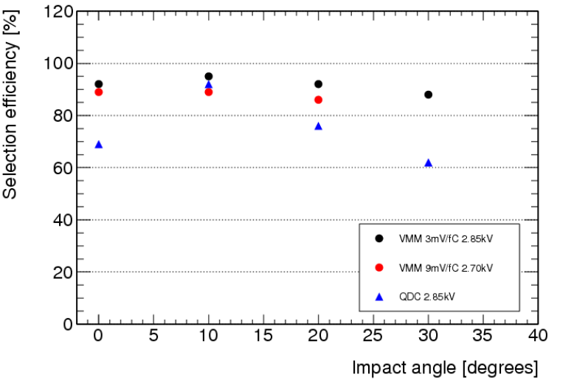
Using a quadruplet of large area detectors, optimize the position resolution and single layer efficiency
Using 3 out of 4 layers to fit a track, one can determined the resolution in finding the position in the 4th layer and the efficiency to find it

Slide 19
Good position resolution implies good mechanics
Although it has been shown the potential to achieve good position resolution in large detectors with the sTGC, such a position resolution can only be achieved in large system if the mechanical precision is of the same quality (~40μm) over large surfaces.
How this is achieve, will be shown in a presentation after the coffee break.

Slide 20
Teaching students with simple devices
It is also important to show students how can one detect particles in a simple way.
TGC’s give high signals (no need of amplifiers) that can be seen outside the amplification volume with a simple scope.
This is due to the use of resistive cathodes, that are transparent to fast signals, which allows to place any kind of readout geometry outside the detector.
Furthermore, one can build non-uniformities in the graphite cathode, to show that the non-uniformity on the electric field leads to sparks.

Slide 21
Conclusions
TGC detectors are reliable devices that can be constructed around the world (China, Japan, Canada, Israel, Chile) with well developed tools.
They can operate in a high background rate environment, with good efficiency for minimum ionizing particles (MIP’s).
They provide a position resolution of 70μm at normal incident angles and a typical time resolution of 5ns (rms).
Some of its possible use can be extended to other fields besides particle physics.

