Slide 1
TGC development and construction for ATLAS upgrade
Introduction
Production steps
Quality Control on the individual detectors and units
Procedure for full assembly
Conclusions

Slide 2
Physics motivations
Various physics motivations for the upgrade program of LHC.
Shut-down during 2017-2018 will allow to exploit the LHC with L=1-2X10³⁴ and collect 300fb⁻¹. This will allow:
  Following the discovery of the Higgs Boson:
    Measured its coupling and prove that it is a Higgs using a single channel WH, to measure H->bb, ττ, μμ, independently of QCD corrections=> this requires an efficient trigger on W->μν for μ with P(T)>25GeV/c.
  Get indications on possible deviations of the SM by looking at VV final states =>this requires an efficient trigger on
  W->μν for μ with P(T)>25GeV/c.

Slide 3
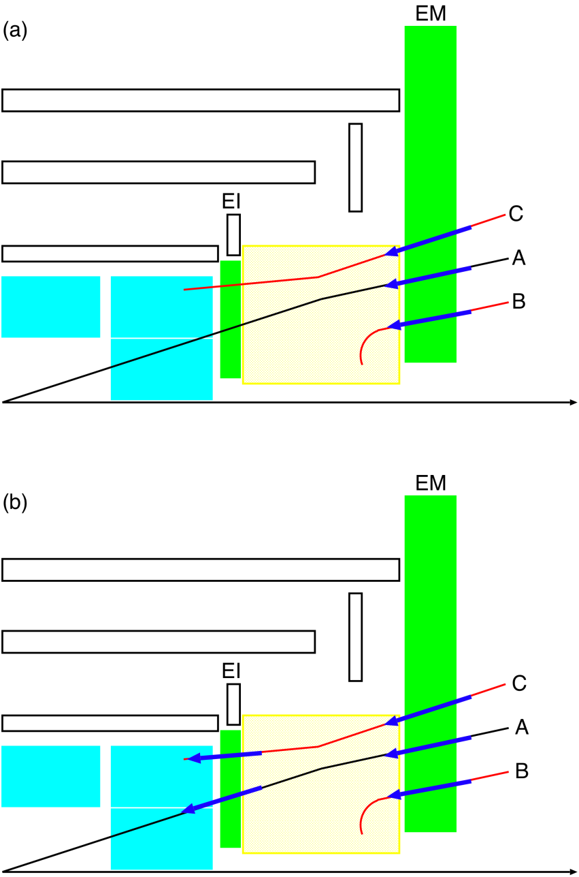
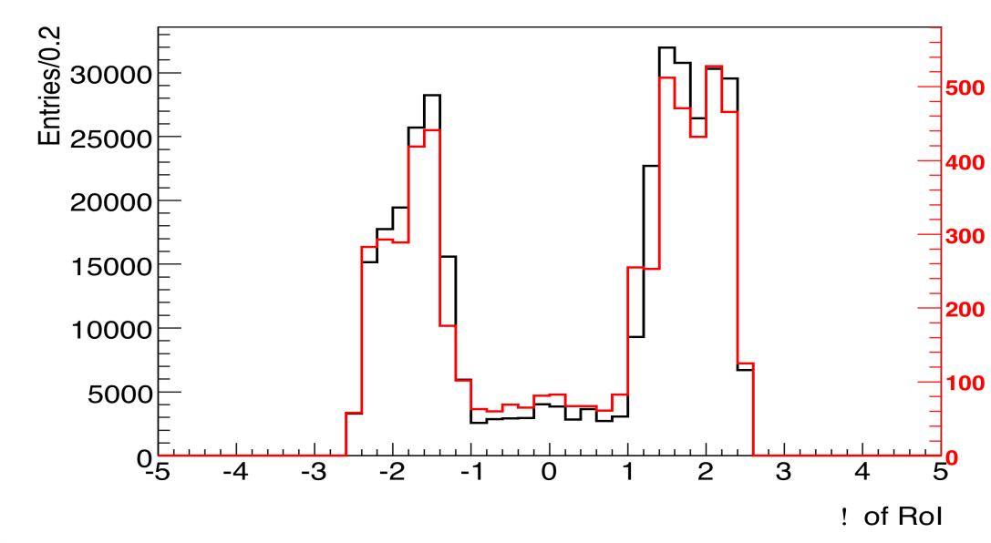
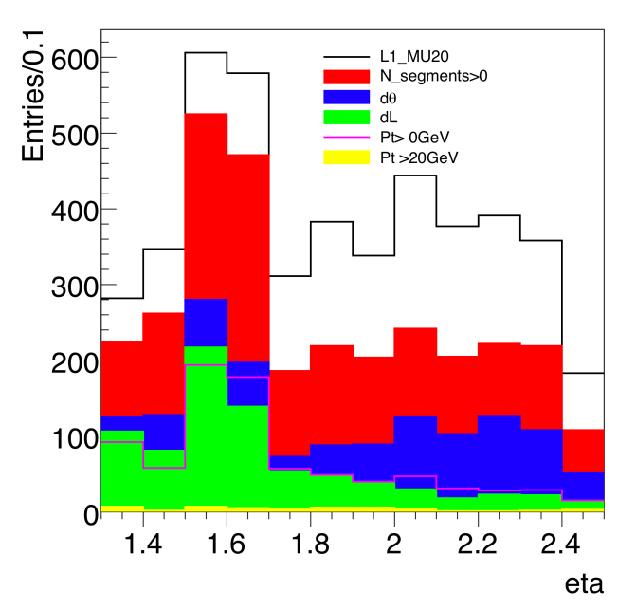
This requires to reduce μ trigger background in forward direction by providing a precise (<1mrad) vector before the magnet
Source of background
Ttrigger rate as function of η
High μ trigger in End-Caps due to backgrounds.
Including innermost layer will improve rates by 100.
Need high resolution (<1mrad)

Slide 4
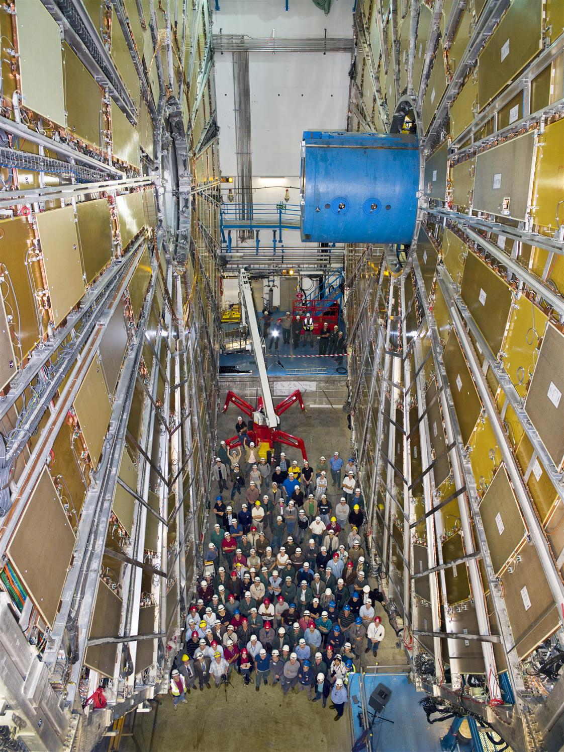
Motivation
1mrad resolution is a very hard requirement, try to simplify the system by requiring 1 trigger track in a small ROI=>use pads to define your interest and simple logic.
Try to have as many as possible layers to quickly discard bad single layer measurement; normally not possible by using one parameter (PH). Also assume that some layers will fail during the running of the experiment =>4+4 layers with pads in each layer.
Try to keep uniformity with the BW-TGC in the trigger system and add a dedicated tracking device.
Use the tracking chambers to resolve problems of multiple-tracks that cannot be resolved at the trigger level.
Main problem is to achieve relative alignment between layers of 50μm in both dimensions (X-Y and thickness).

Slide 5
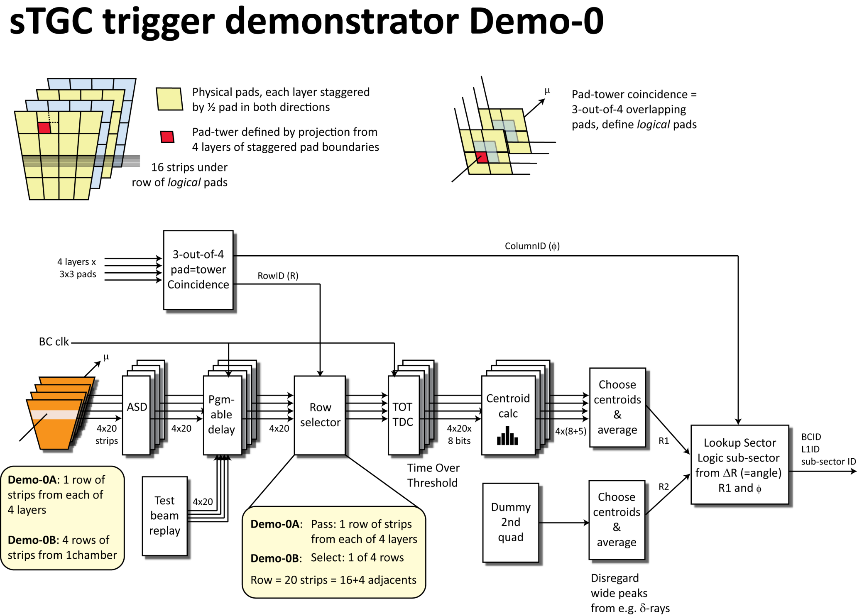

Slide 6
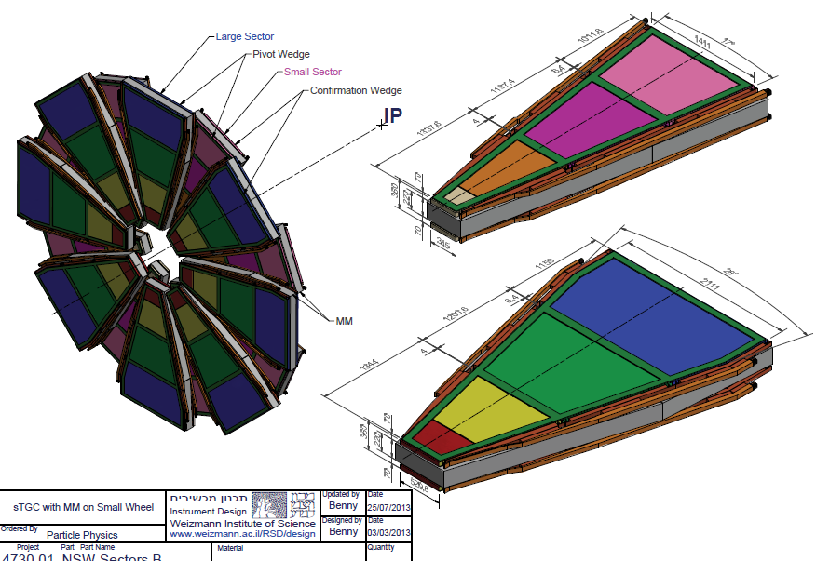
With a technology that can be shared across the world
Canada
64 quadruplets +
6 spares
Chile
32 quadruplets +
3 spares
China
32 quadruplets +
3 spares
Israel
64 quadruplets +
6 spares

Slide 7
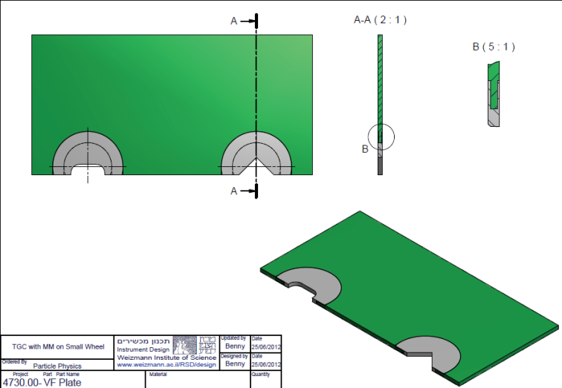
Machined strips board
The brass inserts are machined together with the strips, to use as external references.
Holes are drilled (100μm larger than pins) for chamber assembly.
4 holes are drilled with 20µ large diameter to insert stainless steel pins to be used as references for x-ray cameras on a flat table.
Pad boards are made by etching with feed-through holes to bring signals out, and holes for positioning, using pins.
Machined and etched boards are send to add additional pre-preg layer of 100μm thick (2 layers , one with Cu outside for pads) in a large press . Only Tedler paper should be used during the press to keep porosity of the material.

Slide 8
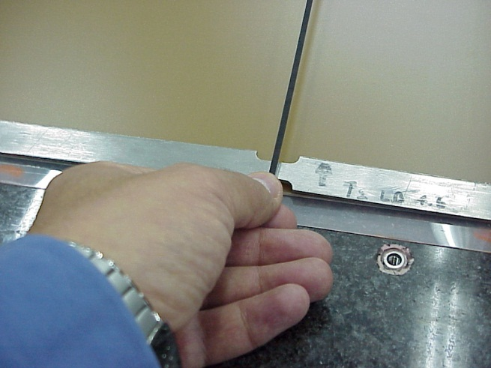
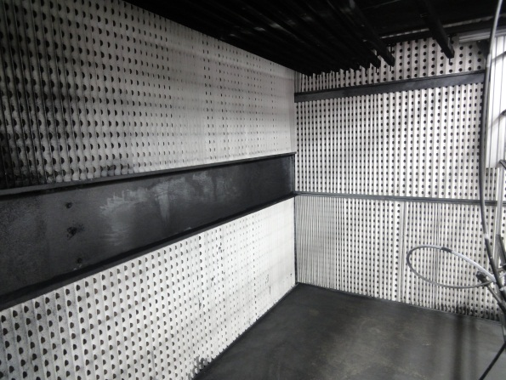
Graphite spray
Clean cathode surface by wiping the cathode using anti-static cloth dipped in Acetone and then in Isopropil-Alcohol, then dry the surface using dry air.
Following the cleaning step, handle all the cathodes with surgical gloves to avoid any fat in the surfaces that will be sprayed.
Cover regions that are going to be used for gluing (masking tape on granite table)
Spraying room should be temperature (25DEG) and humidity (<25%) controlled.
Test the quality of the spray on samples to achieve required resistivity.

Slide 9
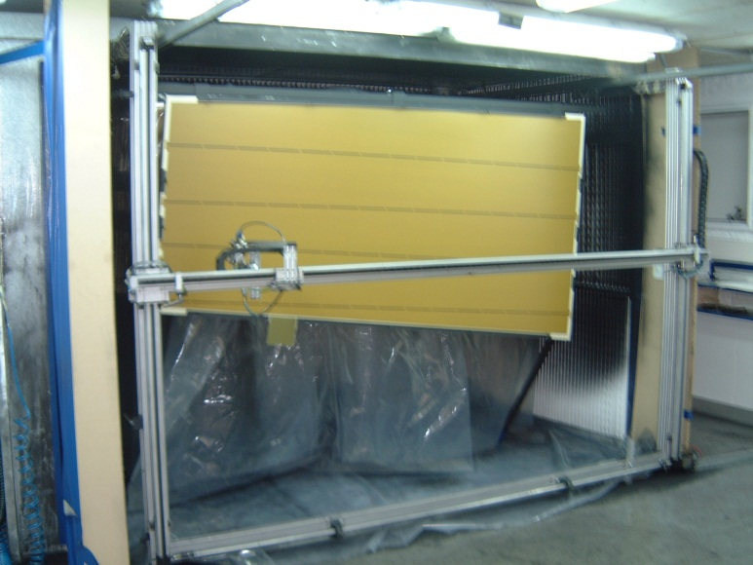
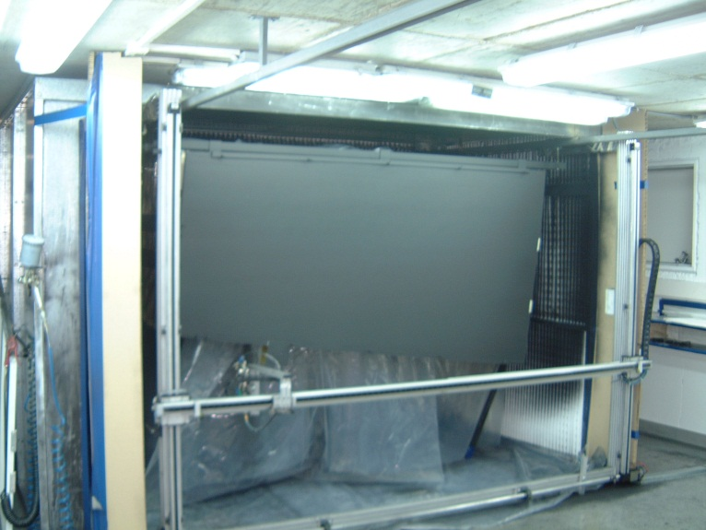
Apply graphite one-by-one
Apply graphite spray (every 5’ new plane)
Let it dry for 12hrs.
Polish and make map of resistivity (if needed correct regions with wrong resistivity, if possible, otherwise repeat the process). If you observe peeling of the graphite (usually due to fat on the surface before spray), repeat the process.
  Its value should range between 90-110KOhm/cm². If there are points where it is higher, those points are further polished with a grinding machine until the above values are achieved. If the resistivity is lower (but higher than 80KOhm/cm²) in only one point, the cathode is accepted; if it is lower in more than measuring point, the graphite coating is rejected and the procedure described from 3-a onwards is repeated. The final surface resistivity measurements are entered into the data-base.

Slide 10
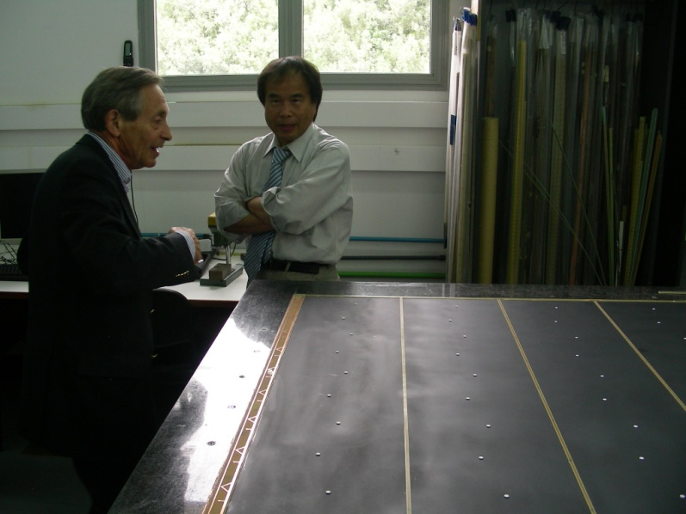
Glue wire support frames
Glue the wire support frames on a flat granite table by locating the outer frame using the pins on the holes pre-drilled in the boards for positioning and placing an internal jig to place the internal supports and buttons.
Use special tool to dose the glue on the frames and buttons.
Use only the glue after vacuum treatment
Use silicon-rubber to press on the supports under vacuum.
Check visually that all supports are properly glued through the Silicon rubber.

Slide 11
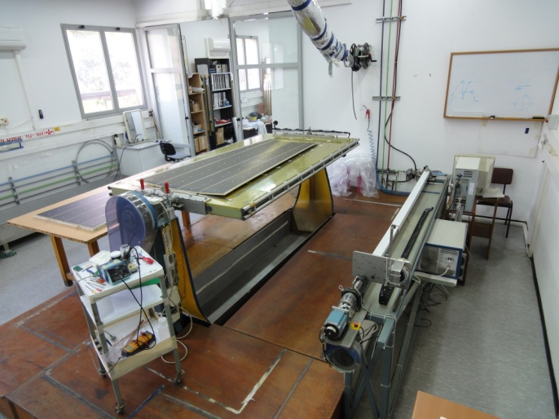
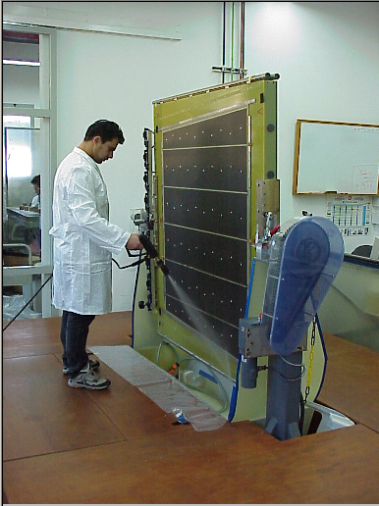
Wiring pad cathode
Wire the cathode using pre-tension on ½ turns
Solder the wires
Wash cathode with demineralized water and dry with dry air
Check wire tension and knicks on wire

Slide 12
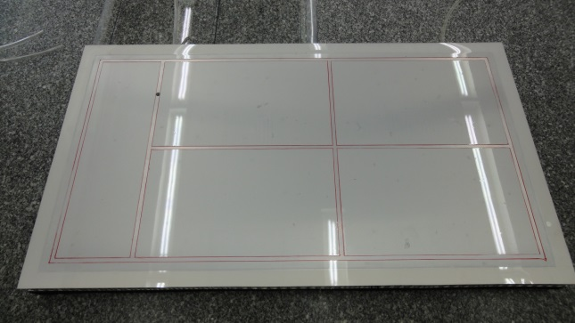
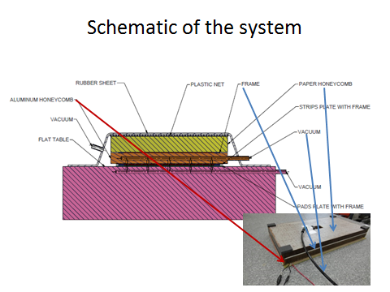
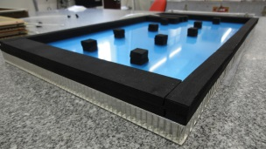
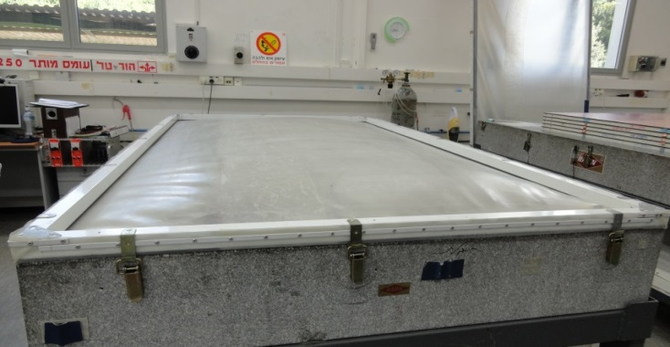
Single detector closing
To be performed in class 10000 clean room.
Solder HV resistors and clean flux with alcohol.
Use position pins for approximate location but never to force positioning, since gluing should be free.
Check detector operation by filling Silicon rubber volume with operating gas after several vacuum cycles.
Glue and let cure for 12hrs.
Check planarity and thickness (data base),

Slide 13
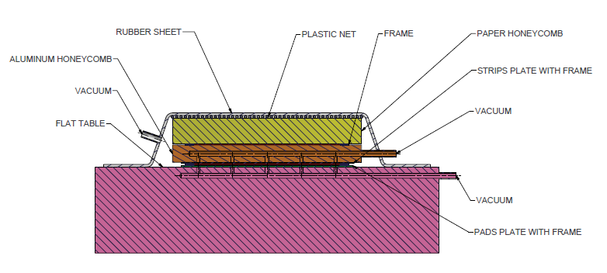
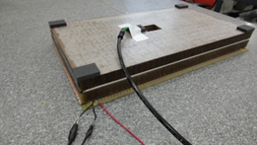
Schematic of the system

Slide 14
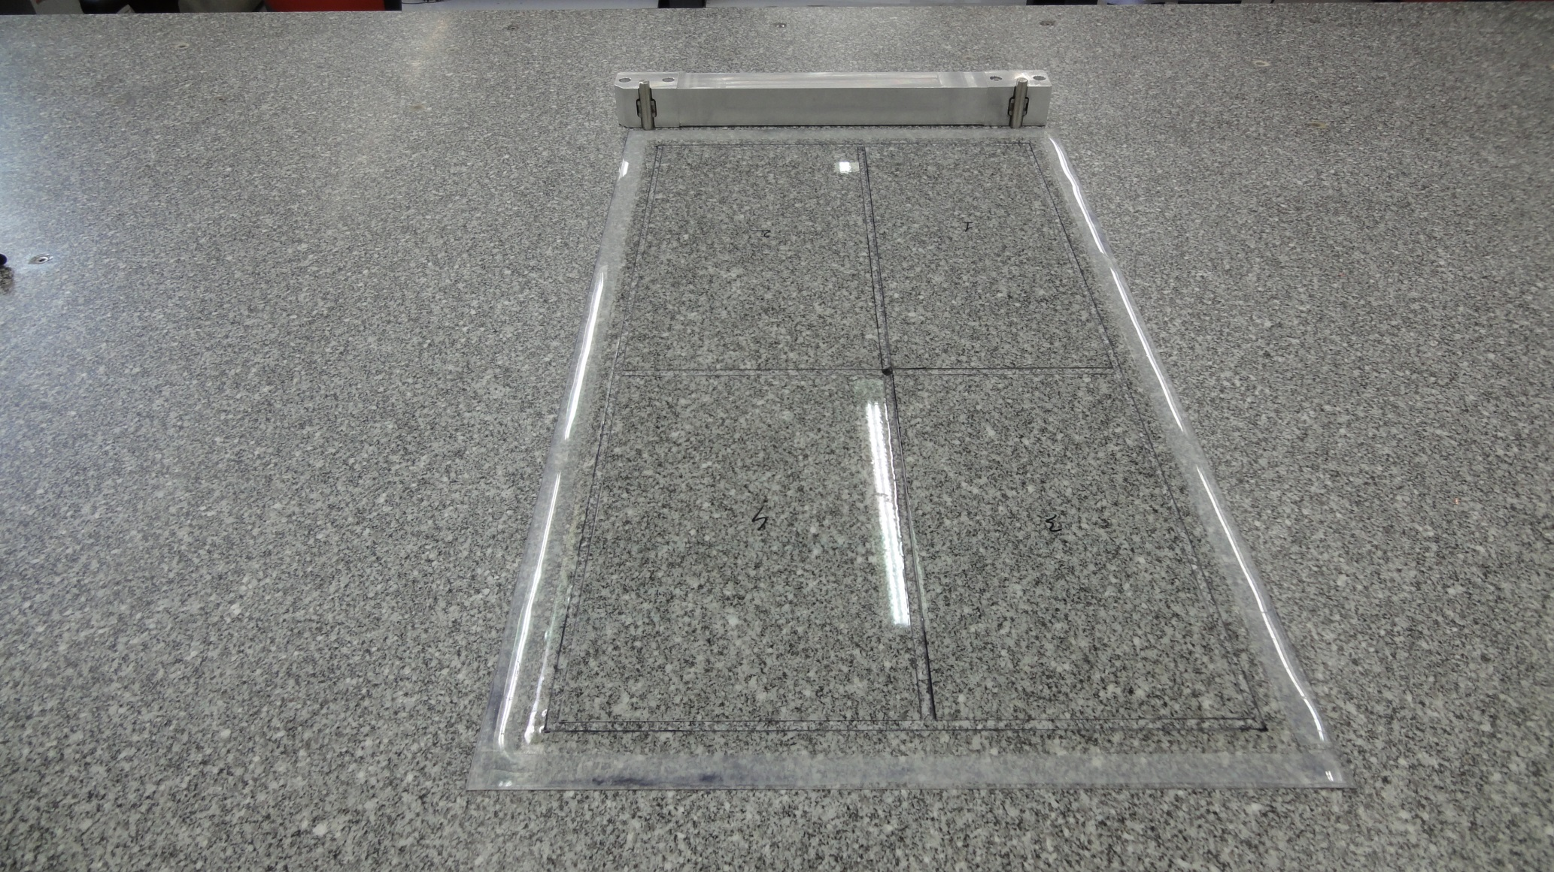
Vacuum system in granite table with jig holding precision pins

Slide 15
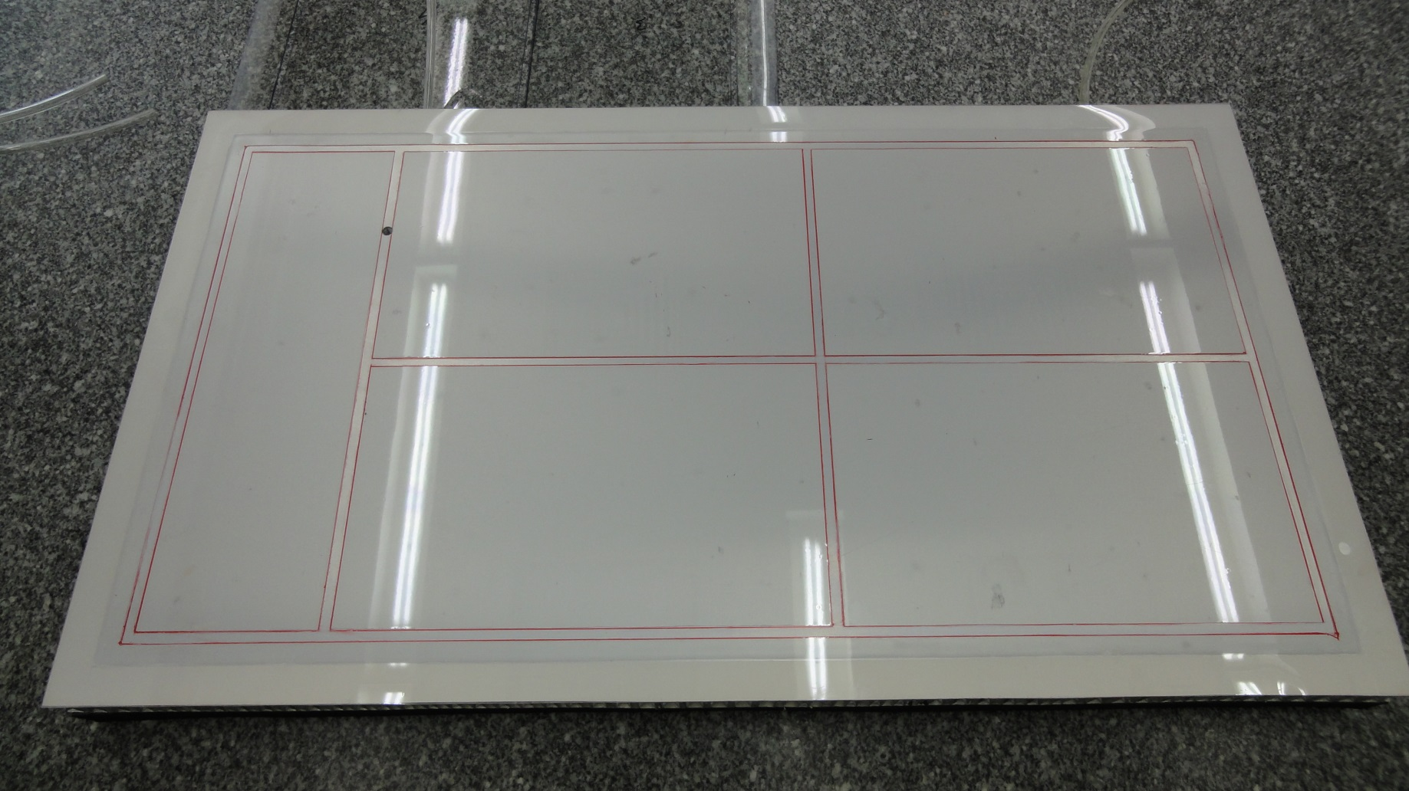
Vacuum arrangements in 2cm thick
Al cover honeycomb

Slide 16

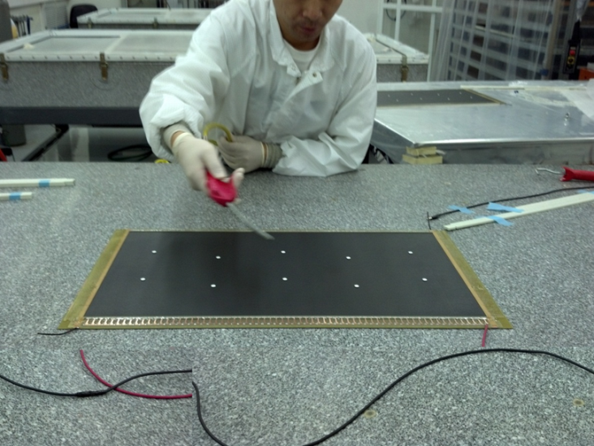
Back of the Al Honeycomb plate
Internal rubber supports only used to close individual planes, so inner chamber supports under pressure.
For gluing layers with 4.9mm honeycomb, 5.1mm glass-fiber frame, only outer frame rubber support is kept.

Slide 17
Sealing of the gas volume
Put detector on rotating tool to seal 10 detectors at the time on each edge.
Test detector volume for leaks
Operate detectors at 3.3KVolts for 1 week
Perform X-Y scan with a source or X-ray generator at 2 operating voltages (plateau and ½ plateau) to check gain uniformity.

Slide 18
Gluing procedure with ½ panel honeycomb in one detector
Gluing of honey-comb ½ panel on the tested single plane detector: The operation is performed on a flat granite table (within 20μm) where the detector is placed with vacuum from underneath. The double honeycomb plate shown before is also used here on top of the honeycomb to be glued but without any vacuum applied and with the 100μm plastic sheet on top of the honeycomb. The assembly is covered with silicon rubber and vacuum is applied from the edge of the granite table.
Gluing of a doublet: the single plane detector with its ½ honeycomb panel is then glued to a single plane detector using the same procedure. This is done 3 hrs after the first glue of the ½ honeycomb has been performed, to avoid asymmetric shrink of the glue. It is performed on a flat granite table (flat to within 20μm). The table contains 2 thick precision machined pins attached to a jig (Transparency 2) to align the 2 planes using the brass inserts of each of the strip planes. While the lower single plane detector is held flat by applying vacuum from underneath, the upper detector with its glued ½ panel honeycomb is kept flat by using the double honeycomb plate shown in transparency 4 with vacuum applied, and with the 100μm plastic sheet removed.
The silicon rubber sheet is placed on top of the full assembly, but with a plastic net in between, to provide some flexibility and avoid that the silicon-rubber moves the various pieces. A vacuum of 50mbars is applied to the assembly.

Slide 19
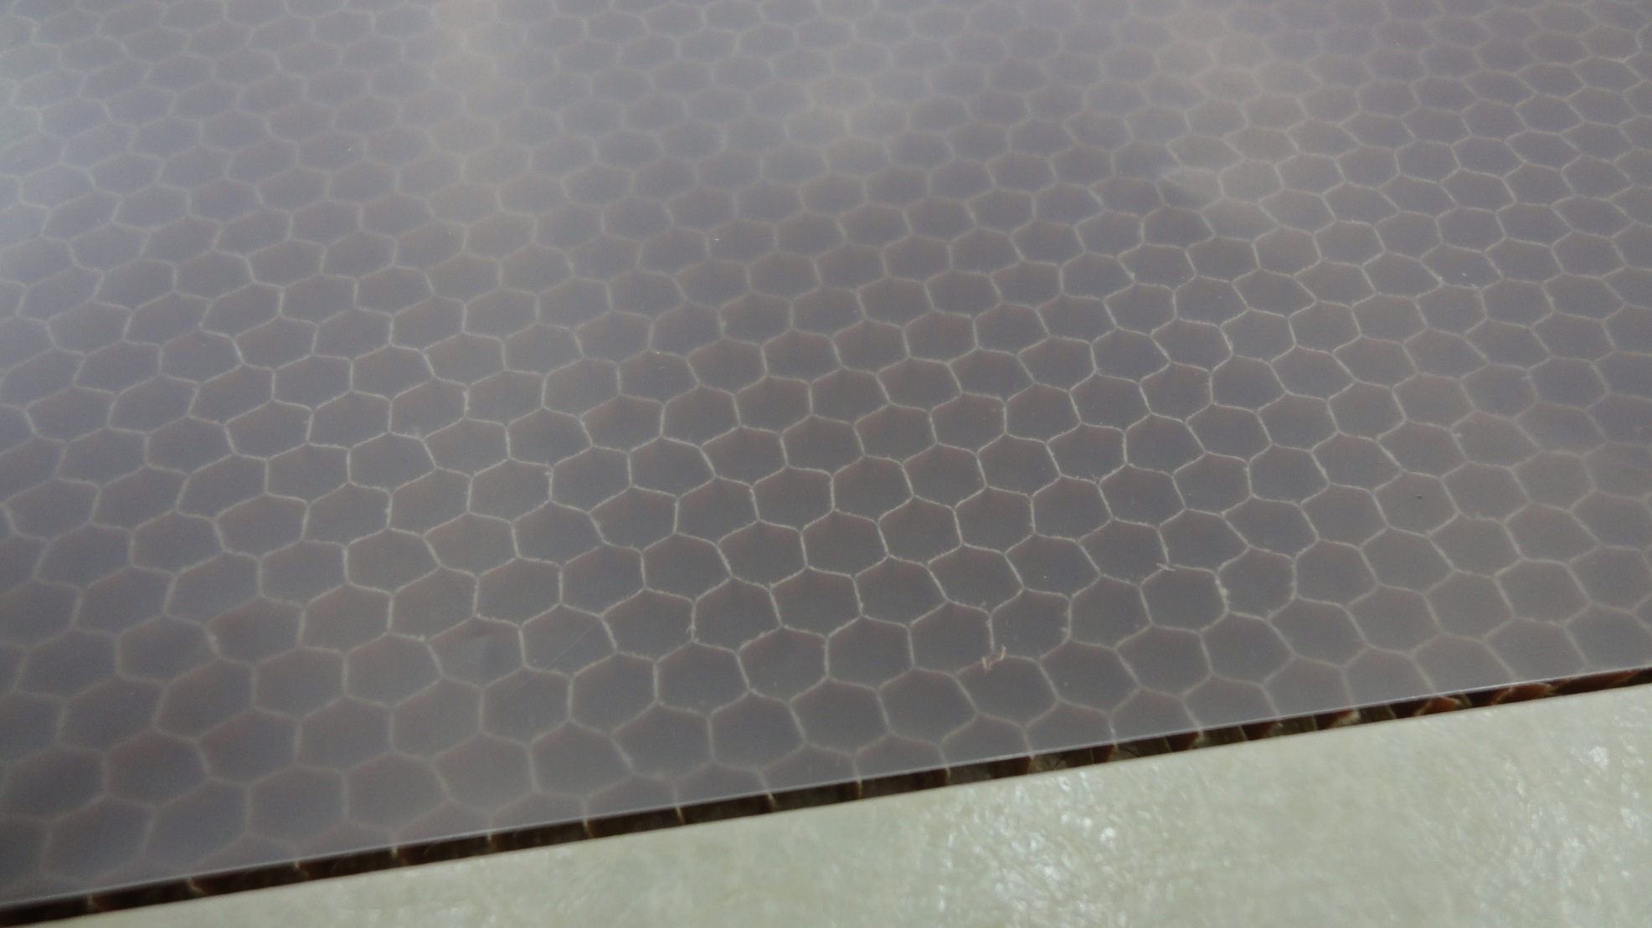
Leave space for glue, when gluing honeycomb, using soft plastic 100μm sheet

Slide 20
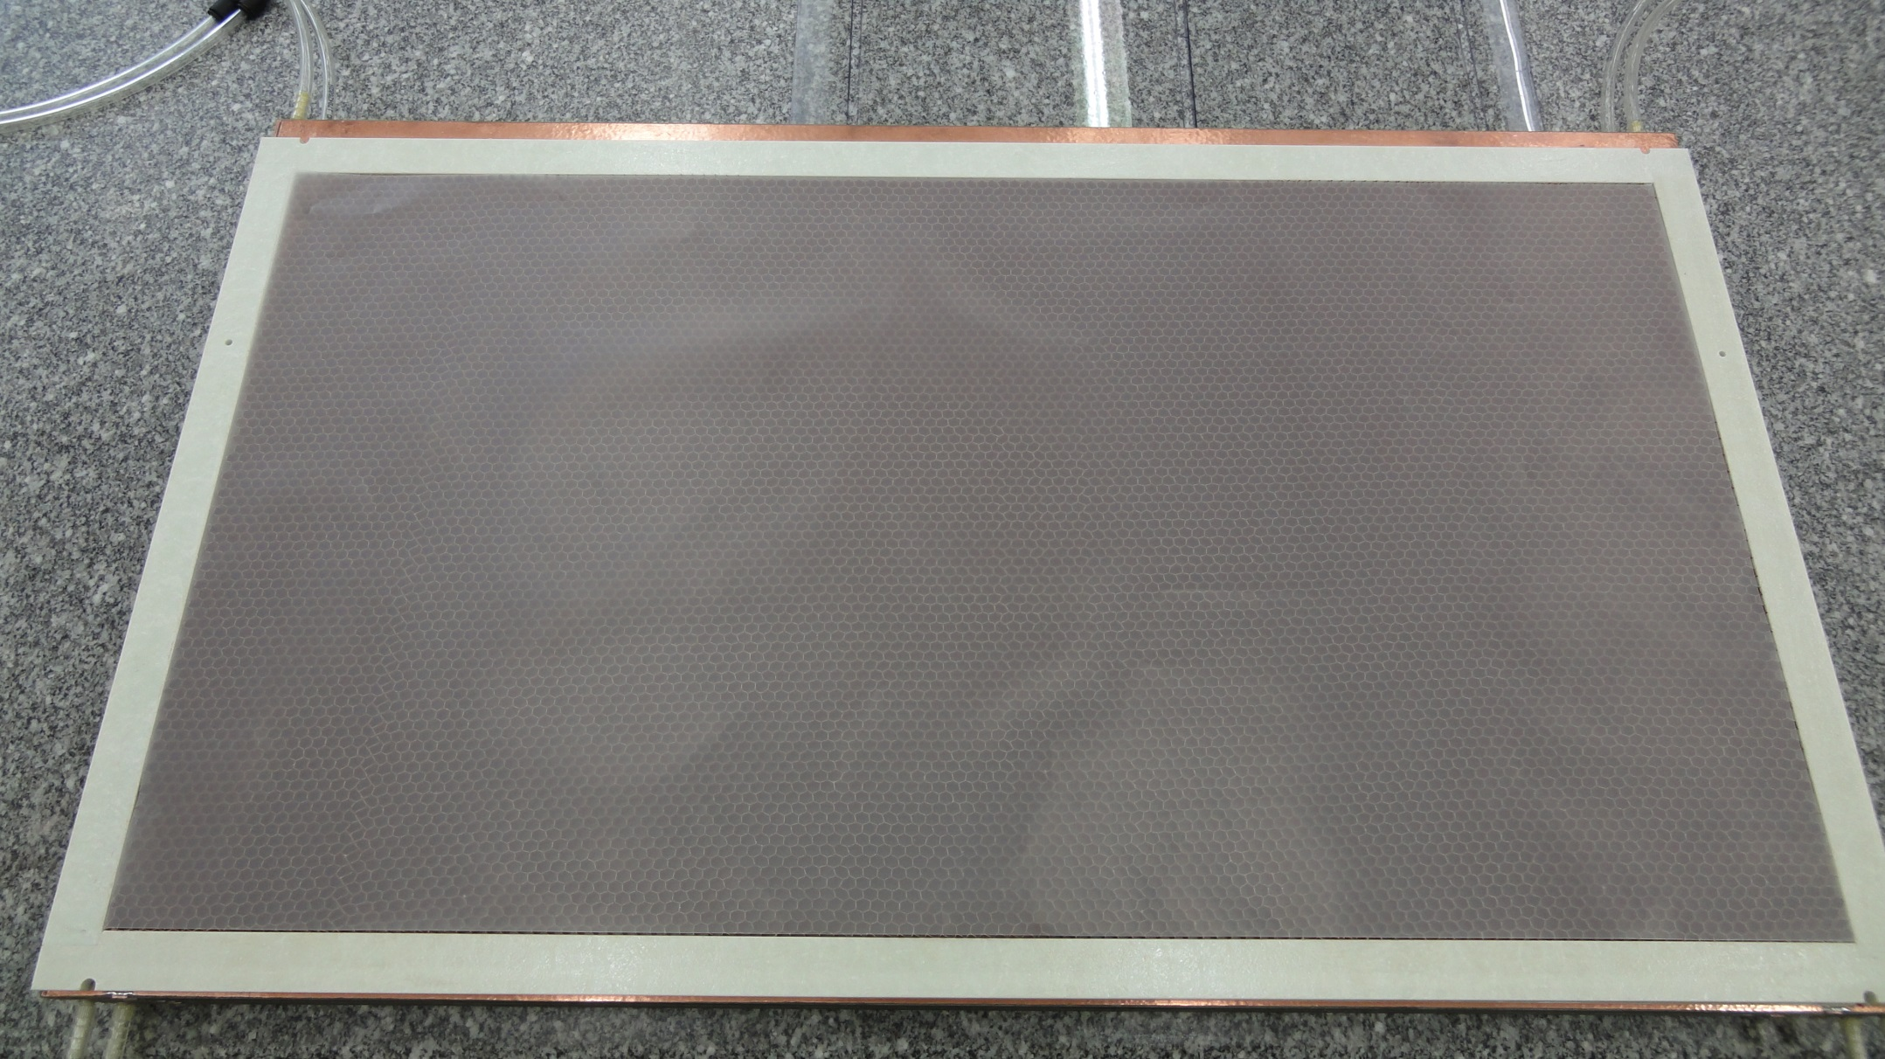
Leave space for glue, when gluing honeycomb, using soft plastic 100μm sheet

Slide 21
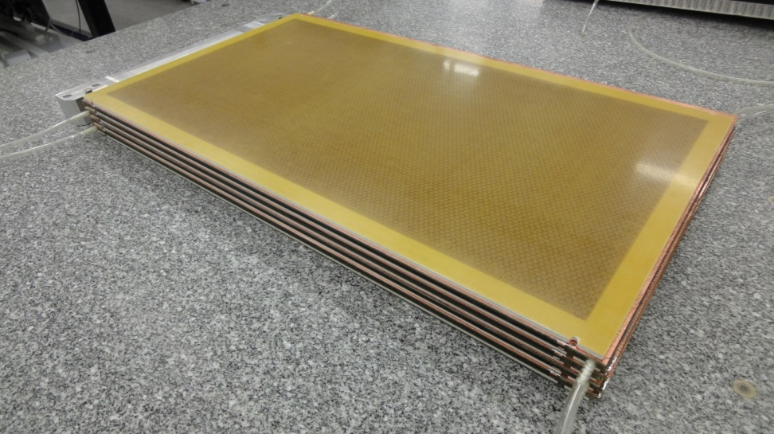
Achieved flatness
Flatness achieved to within 50μm and uniformity of thickness around the edges with Ϭ=48μm with largest deviation ~100μm.

Slide 22
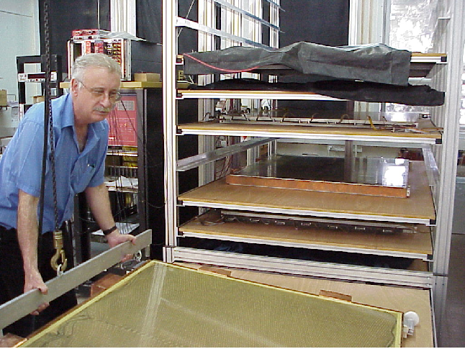
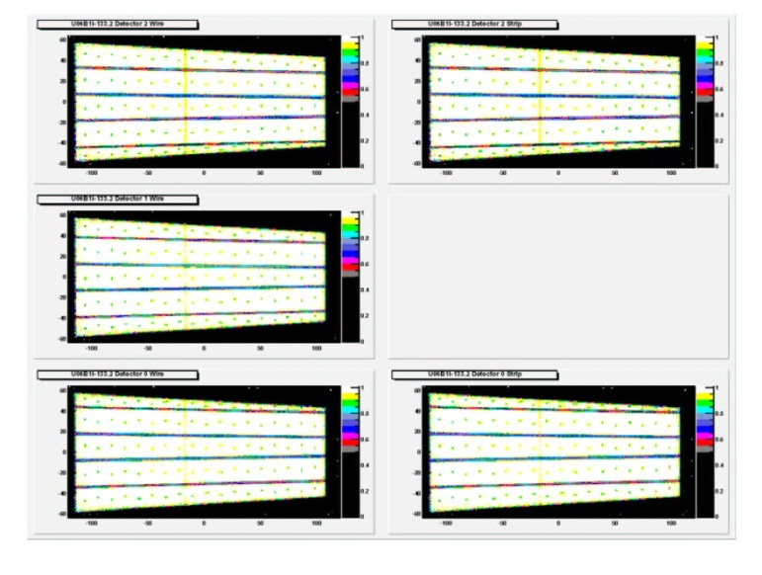
Scan of the detector using cosmics
A mapping of the inefficiencies is performed using cosmics trigger by external scintillators
This should be performed at all the production sites.
Also the local resolution using strips is mapped for each pad by checking the position in adjacent planes.
Since cosmics are not filtered, only resolutions to within 300μm can be tested.

Slide 23
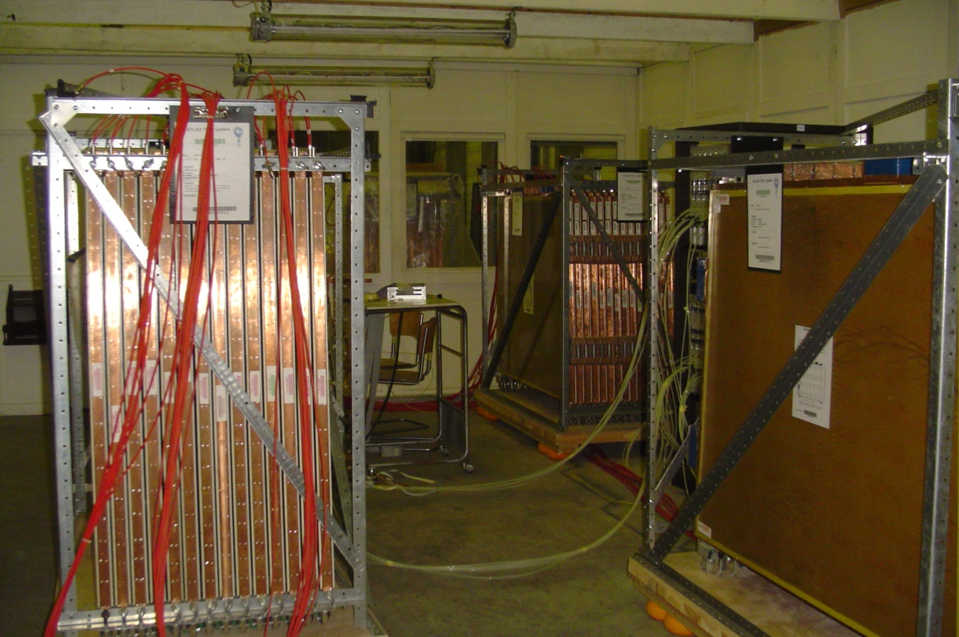
Detectors are transported to CERN on special Temperature controlled containers on palettes with shock absorbers, run for 1 week to check that there is no infant mortality, check that every channel reaches a plateau and then with the same palette brought to GIF++ for irradiation test.
Plateau curve

Slide 24
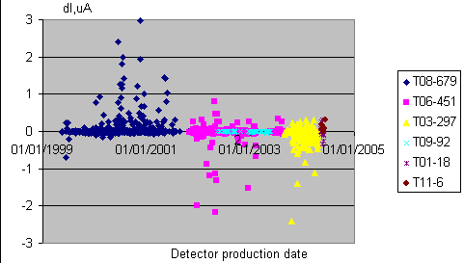
Irradiation test
To be performed at GIF++ for the quadruplets (failure rate/plane 1-2%, not critical if enough spares).
Illuminate the full detector area with 10-20KHZ/cm² of detected photons for 1/2hr and compare initial and final HV current after source is off, difference should be smaller than 1μAmp.
If possible to readout channels, read rate of individual channels (or at least pads) to detect any hot point during irradiation.

Slide 25
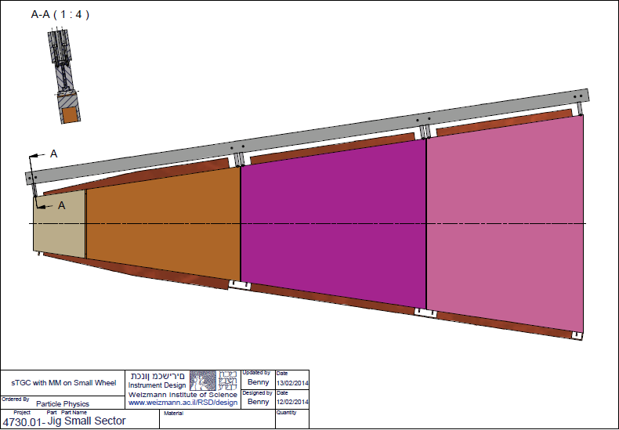
Final assembly into a wedge
The 3 fully qualified quadruplets are brought into contact with the precision alignment pins with pneumatic pressure, and their positions are checked with the X-ray cameras. Vacuum is then applied from underneath (see Fig. 21). The glass-fibre external frame (manufactured within a precision of 150μm) is then glued to the quadruplet assembly. After curing for 12 hrs, the assembly is lifted and turned around, to place it with the 3 quadruplets facing precision Al honeycomb planes in the regions free of the fiberglass frame, and then vacuum is applied from underneath. The second glass-fibre frame is then glued to the assembly. The glue is left to cure for 12hrs. The x-ray cameras are placed to measure the 3-D position of the brass balls. The crane attachment points are placed and the wedge is lifted.

Slide 26
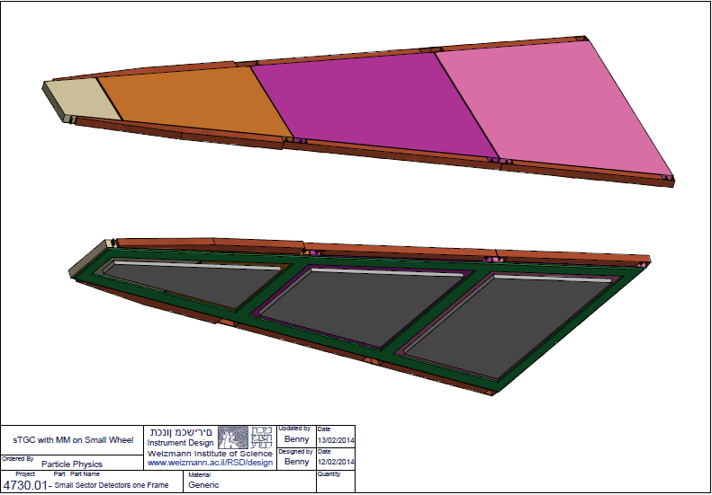
Gluing of alignment elements and 2nd external frame
Upper surface is free and aligned to place alignment elements with respect to external jig
External frame pointing down on granite table
Quadruplets are placed on honeycomb plates with vacuum that are placed on granite table
After placing alignment elements, second frame can be glued.
Assumes 3 days/wedge (1 for each frame and one for the alignment.

Slide 27
Gluing of alignment elements and 2nd external frame
Upper surface is free and aligned to place alignment elements with respect to external jig
External frame pointing down on granite table
Quadruplets are placed on honeycomb plates with vacuum that are placed on granite table
After placing alignment elements, second frame can be glued.
Assumes 3 days/wedge (1 for each frame and one for the alignment.

Slide 28
Wedges are run with their full trigger and readout electronics until they can be integrated with MM
Cosmics tests are continuously performed using CO2 for the full wedge

Slide 29
Conclusions
A procedure has been worked out to perform the construction of the sTGC’s for the ATLAS upgrade.
First prototypes provide the needed accuracy.
Construction should start in 2015 in 4 different places.

