Slide 1
RPC muon tomography
G. Aielli
Academia meets Industry
25/03/2014 Vienna

Slide 2
Introduction
RPC 2014 Conference in Beijing (23-28 February 2014)
Muon tomography has been declared the “hot topic” of the conference
6 Oral presentation given from different institutes shown that in the last years the technology stepped up bringing this application to a pre-industrialization stage
I Acknowledge all the speakers from which I reported some material
In random order…
Mr. Li SHI, Prof. Yi WANG, Ms. Baihui YU, Mr. Ziran ZHAO, Mr. Dufan WU, Mr. Sidong CHEN, Dr. Qite LI, Mr. Xiaoguang YUE, Dr. Paolo BAESSO, Dr. David CUSSANS, Dr. Jaap VELTHUIS, Mr. Christian THOMAY

Slide 3
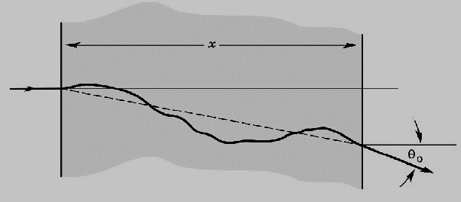
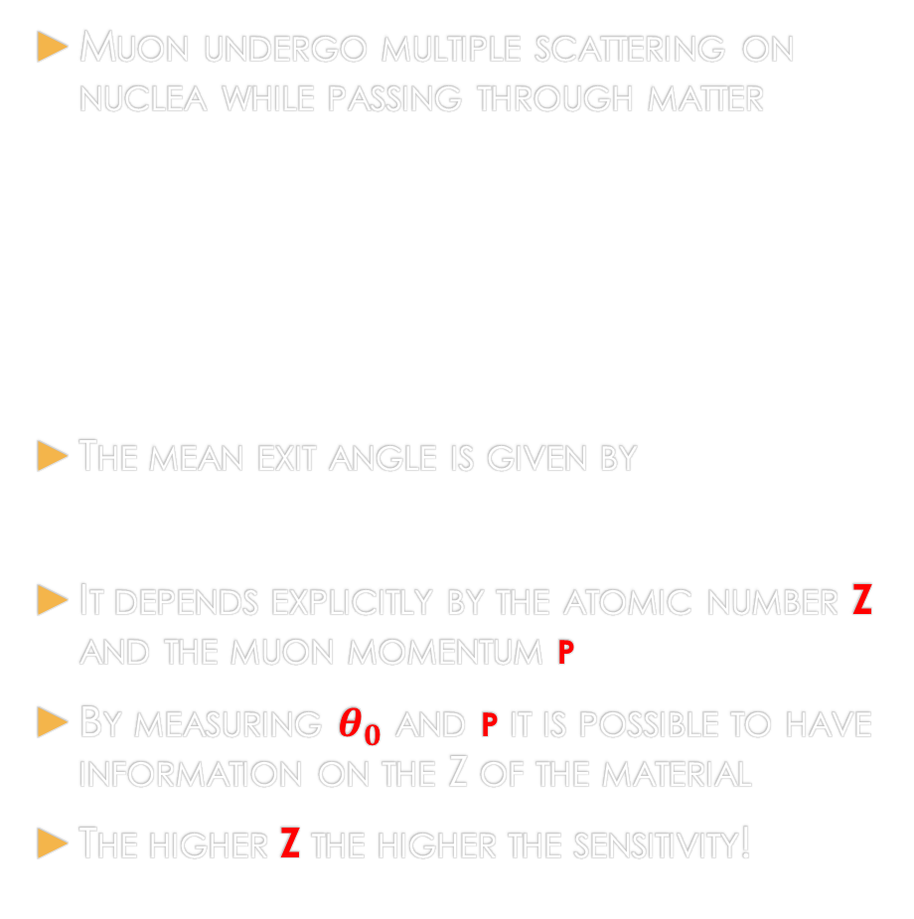

The muon radiography concept
Muons slowly loose energy by ionization passing through matter → high penetration power
MIPs loose ~1-1.5 MeV cm²/g
Iron $ρ$=7.87→ 11.4 MeV/cm
To stop a 3 GeV muon
  → 263 cm of iron
  → 146 cm of Uranium…
Muon undergo multiple scattering on nuclea while passing through matter
The mean exit angle is given by
It depends explicitly by the atomic number Z and the muon momentum p
By measuring $θ_{0}$ and p it is possible to have information on the Z of the material
The higher Z the higher the sensitivity!

Slide 4
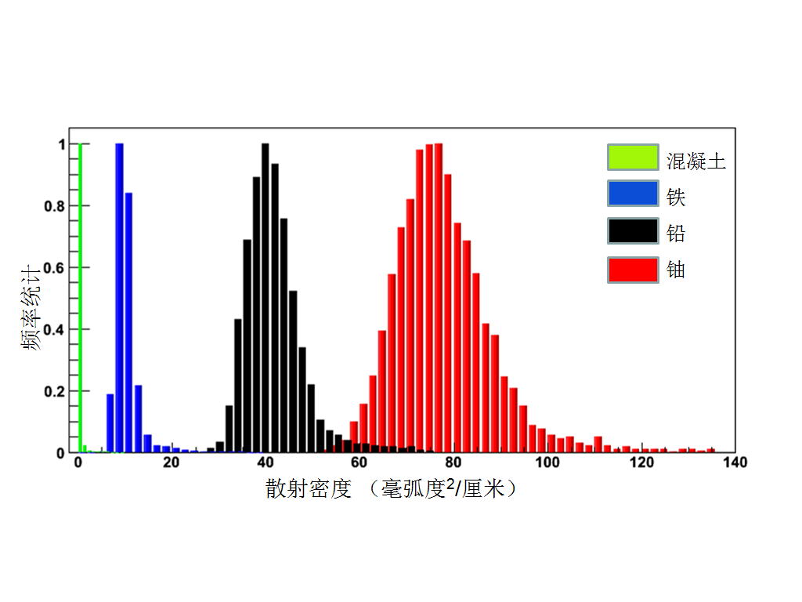



Consequences of the multiple scattering
Almost Gaussian distribution for $θ$
concrete
Fe
Pb
U
L
diffusion density (mrad*mrad/cm)
Warning: different thickness of different materials → same $θ$ → ambiguity and false positives
Pb
U
Multiple scattering in 3D
Notes:
The theory of muon tomography is that: when muon pass through a object, it nearly keep straight because of its high energy. But if the material is consist of high Z molecule, the track will deflect with the effect of multiple Coulomb scattering. A group of detectors can reconstruct the incident and emergent track. The deflect angle of each test is random event, but the distributions of diffuse angle are different when materials are different. So we can identify high z material, such as Uranium and lead.

Slide 5
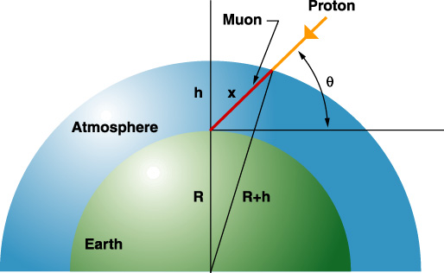
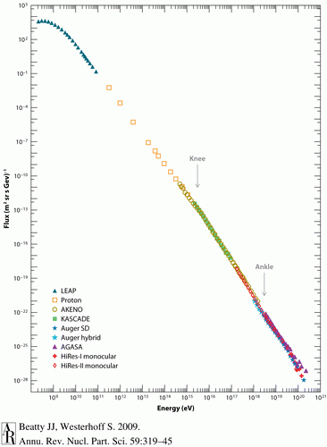
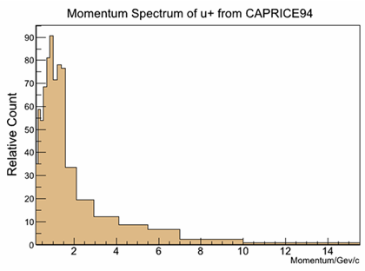
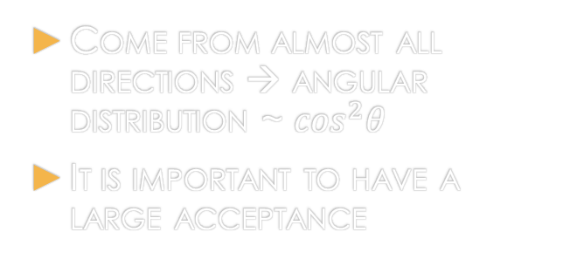
Cosmic Rays
Come from almost all directions → angular distribution ~ $\cos^{2}θ$
It is important to have a large acceptance
Natural source of ionizing radiation
Mostly muons at see level ~100 Hz/m²
The spectrum: Max at 1-3 GeV
100 Hz/m²
Interesting part
1 GeV

Slide 6
Cosmic muons vs. gamma ray scanners
COSMIC RAY muons
Diffusion based radiography
Always available, with flux of ~100 Hz/m² .For free
Wide angle range available→ tomography
Virtually impossible to screen against.
Charged; high detection efficiency.
No radiation hazard → wide application field
No damage of the materials
X/GAMMA RAY scanners
Absorption based radiography
Mainstream solution in home land security applications
Optimal for light materials or light containers (suitcases)
For high Z material need high intensities and energy
  Radiation hazard
  High operation cost
  Not suitable for vehicles and buildings
High sensitivity gamma detector → heavy and expensive
Multiple sources tomography

Slide 7

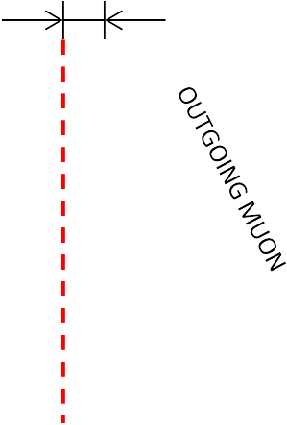
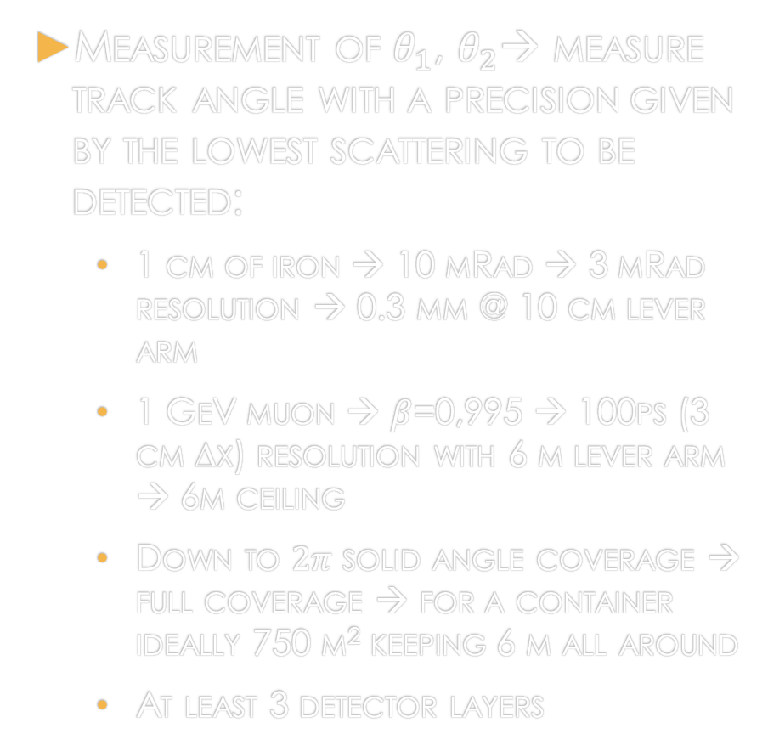
Muon tomography system Design guidelines
Measurement of $θ_{1}$, $θ_{2}$→ measure track angle with a precision given by the lowest scattering to be detected:
  1 cm of iron → 10 mRad → 3 mRad resolution → 0.3 mm @ 10 cm lever arm
  1 GeV muon → $β$=0,995 → 100ps (3 cm Δx) resolution with 6 m lever arm → 6m ceiling
  Down to $2π$ solid angle coverage → full coverage → for a container ideally 750 m² keeping 6 m all around
  At least 3 detector layers
DETECTOR LAYERS
INCOMING MUON
Scattering can happen anywhere in this volume
T
Δx
DETECTOR LAYERS
Δθ

Slide 8
Muon tomography system Design guidelines
From radiography to tomography
  Radiography→ projection on a plane defined by a given direction
    Typical for single source Xray
  Tomography →reconstruct the 3D distribution of the sample by “cutting” it by planes with different angle → need multi directional source
Different directions → the same point is correlated by tracks with different sets of points
Sophisticated software (adaptive networks) can improve the reconstruction as data are collected

Slide 9
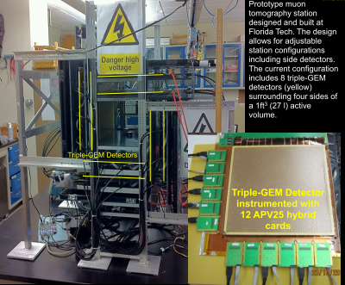
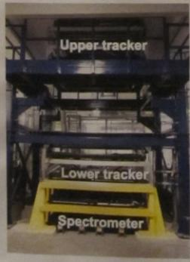
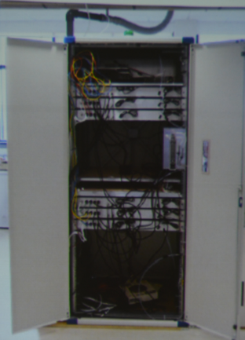
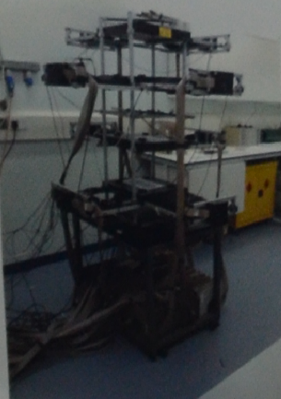
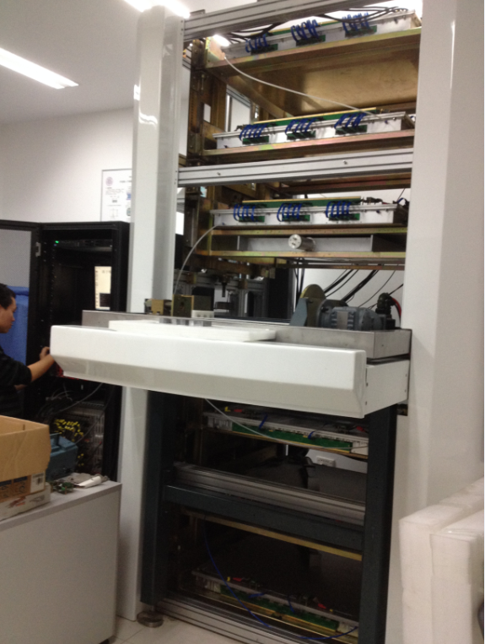
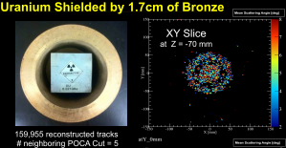
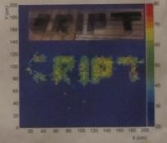
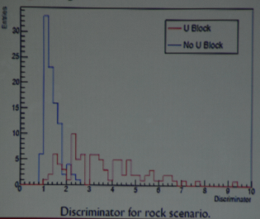
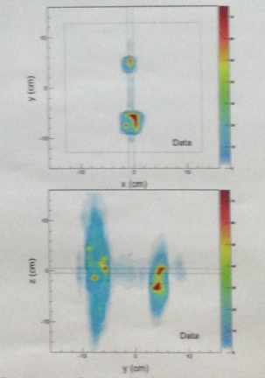
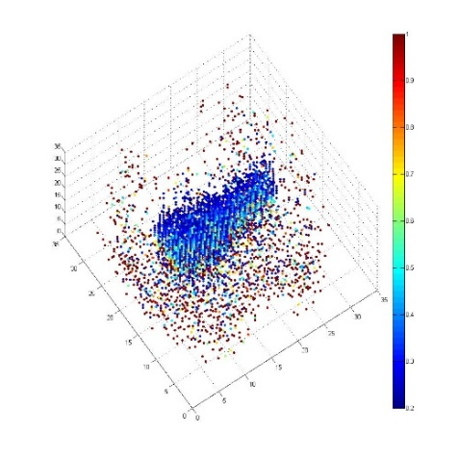
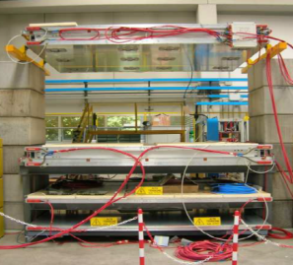

State of the art – present studies
From 2000, several muon imaging facilities had been setup all over the world based on different types of detectors, such as drift tube, drift chamber, GEM, RPC, scintillator and so on.
LANL
FIT
AECL
BU
GU
TSINGHUA

Slide 10

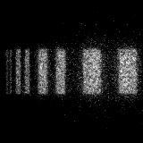
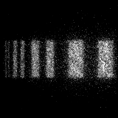
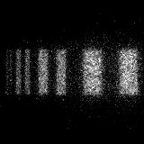
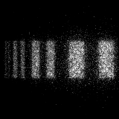
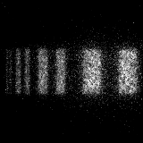
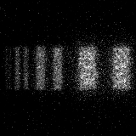
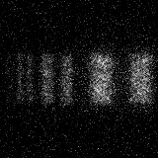
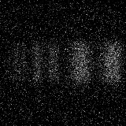
MC studies: spatial resolution
Resolution studies (Tsinghua university)
Message: high special resolution helps also to build compact structures
0.1mm
0.2mm
0.3mm
0.4mm
0.5mm
1mm
2mm
4mm
Detector spatial resolution

Slide 11

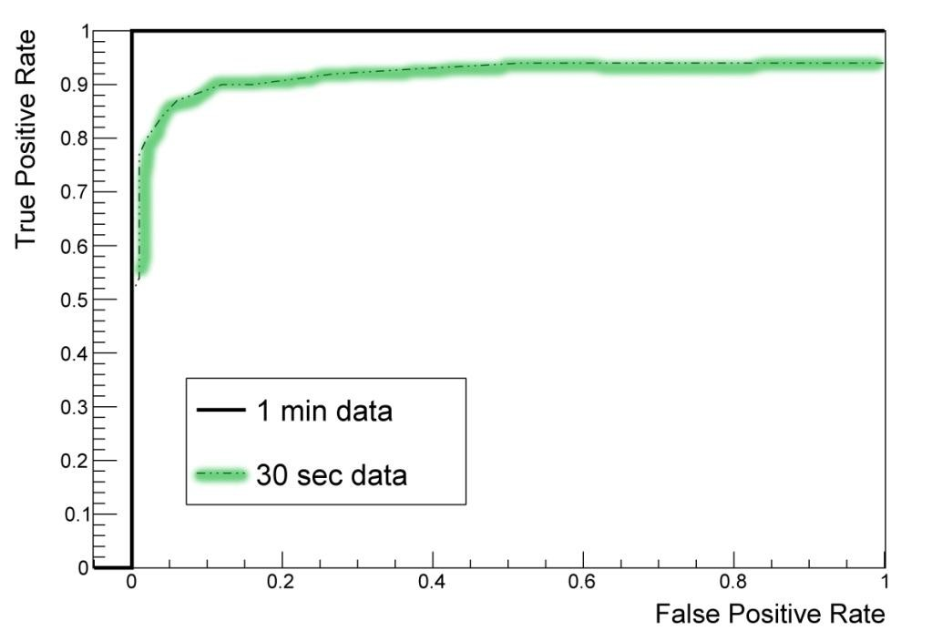
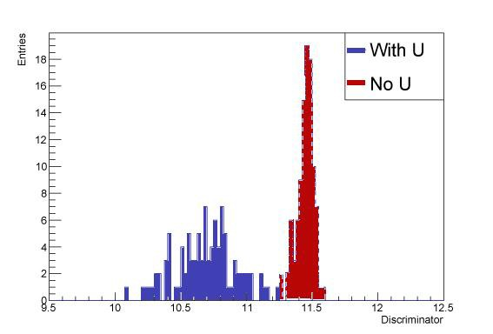
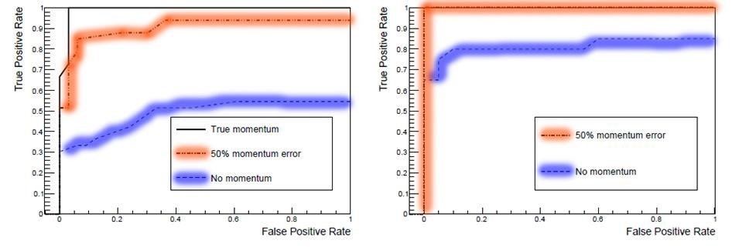
Clustering algorithms
Build a discriminator threshold parameter, function of integrated time and momentum info
Container filled with scrap iron (worst case scenario)
U block found after 3 minutes (left) and 5 minutes (right)
Partial knowledge of momentum is NECESSARY
Cargo container with U in stones
Cargo container with U in scrap iron 3 mins
Cargo container with U in scrap iron 5 mins

Slide 12

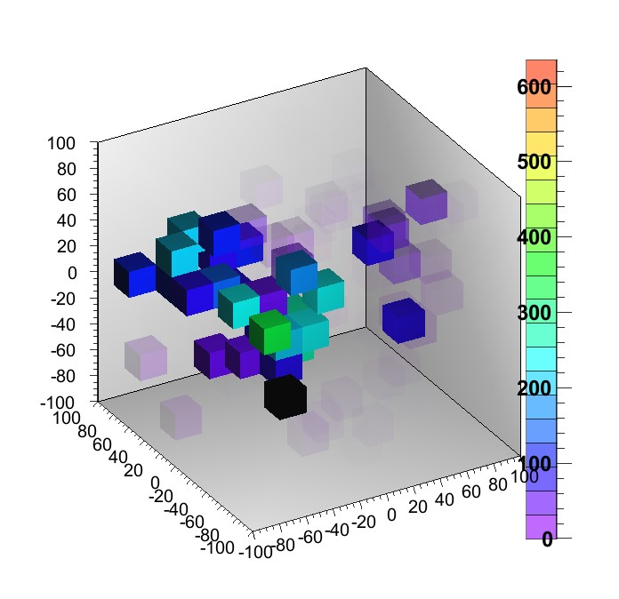
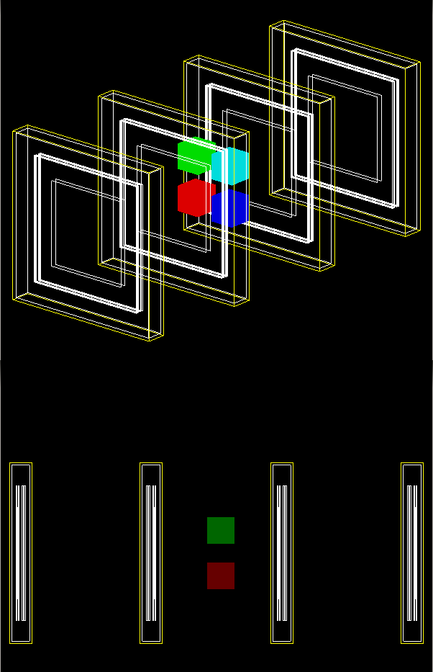
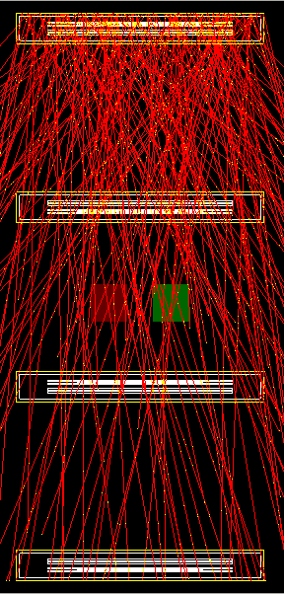
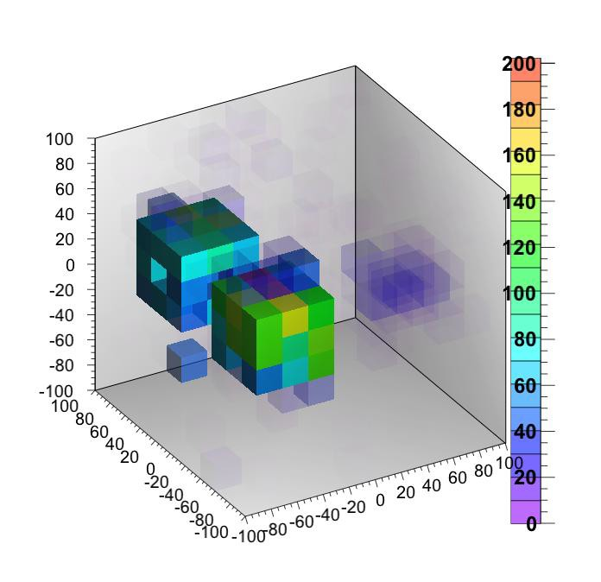
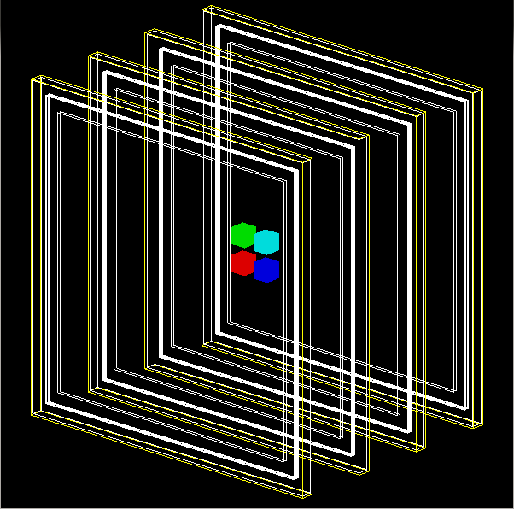
MC studies: the importance of the acceptance
Two algorithms are used: PoCA and EM
PoCA (Point of Closest Approach): simple and light
EM (Expectation Maximization): use iterations
~35min
EM
      20×20 cm²
~7min
EM
      1 m²

Slide 13
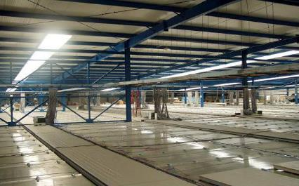
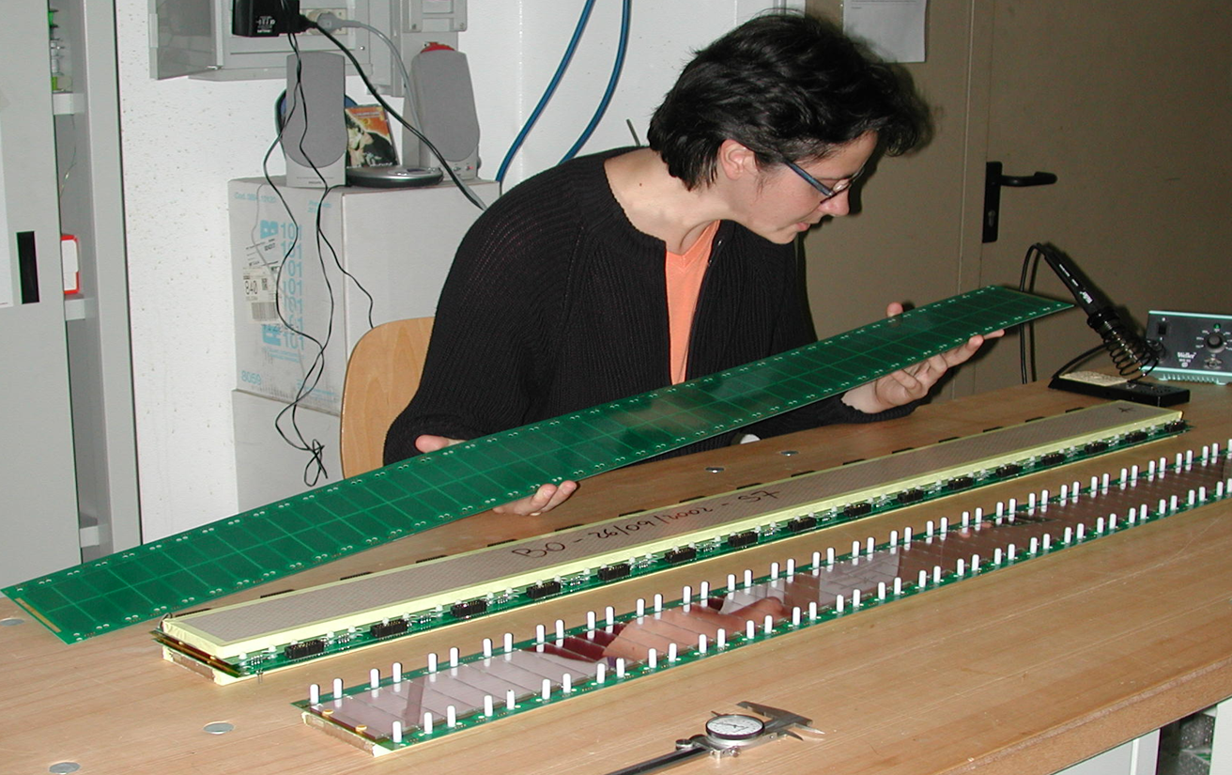
NEW Rpc detectors for muon tomography
What is available What would be needed What is coming soon
“classic” RPCs, same used for ATLAS, CMS argo…
  Robust, cheap, easy to extend to very large surfaces
  Limited performance (timing)
Timing RPCs: multi-micro gap as in Alice or Hades
  Very difficult to make a 2D tracker
  Excellent timing
Spatial resolution in both cases depends on the readout and FE performance
We need to develop a new generation of RPCs taking the best from the two categories above with minor compromises
Present limit of the technology: constrained by FE and materials

Slide 14
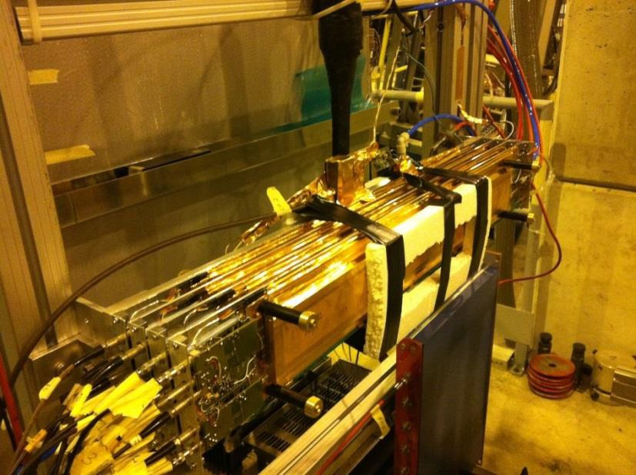
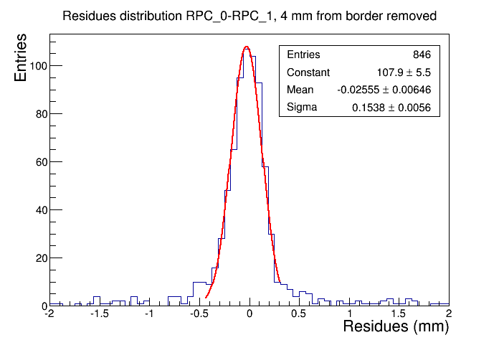

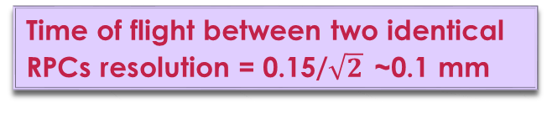
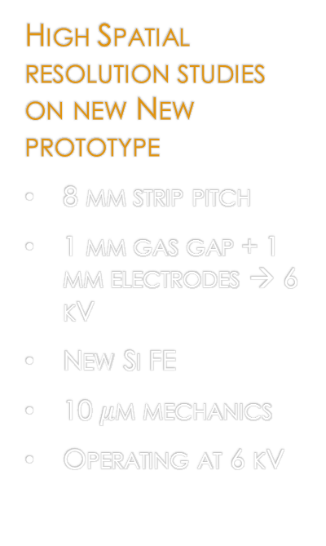
ATLAS spinoff R&D for PHASE2
< 0.1 mm space resolution
< 0.4 ns time resolution
TARGET: unleash the RPC potential through the new FE
  Up to a factor ~200 in the rate capability
  Large freedom in the form factor, gas choice, material choice, the RO electrode
  Cheap access to 100 $μ$m 2D spatial resolution
High Spatial resolution studies on new New prototype
8 mm strip pitch
1 mm gas gap + 1 mm electrodes → 6 kV
New Si FE
10 $μ$m mechanics
Operating at 6 kV
Working principle:
The physic signal is very localized
Centroid method using large strips
  Works if the FE S/N is sufficient
  Strip pitch to be optimized
preliminary
Improve timing through Minimal changes:
1mm gap → 0.5+0.5 bi-gap → 200 ps
Expectations from the new SiGE FE
4 gaps → statistical factor of 2 → 100 ps
Time of flight between two identical RPCs resolution = 0.15/$\sqrt{2}$ ~0.1 mm

Slide 15
Some Application scenarios
Homeland security use cases

Slide 16
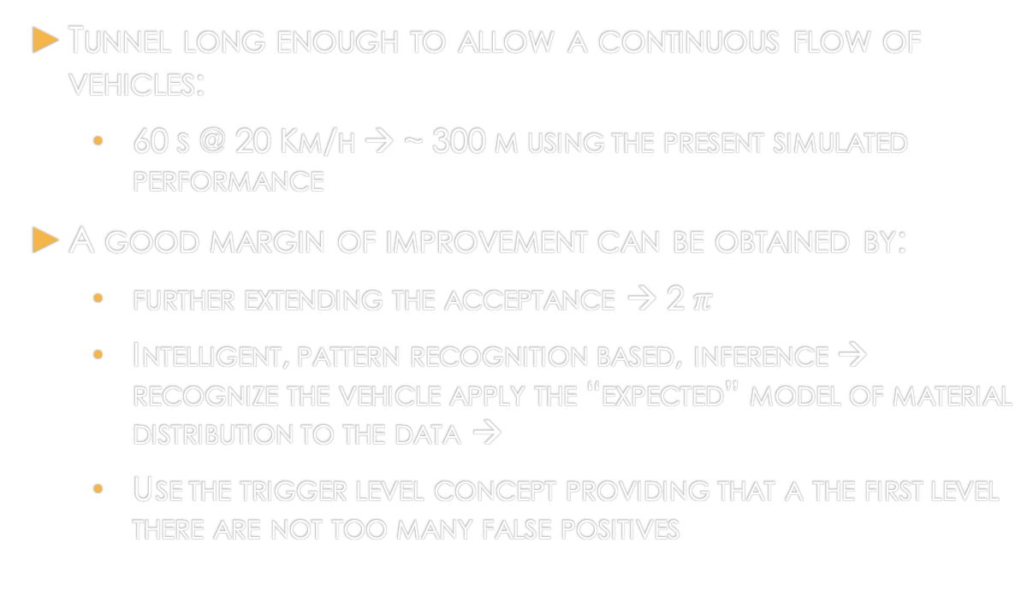
Flawless vehicles control – the muon tunnel -
Tunnel long enough to allow a continuous flow of vehicles:
  60 s @ 20 Km/h → ~ 300 m using the present simulated performance
A good margin of improvement can be obtained by:
  further extending the acceptance → 2 $π$
  Intelligent, pattern recognition based, inference → recognize the vehicle apply the “expected” model of material distribution to the data → Bayesian information criterion
  Use the trigger level concept providing that a the first level there are not too many false positives
Los Alamos test setup
Further
investigation
exit

Slide 17

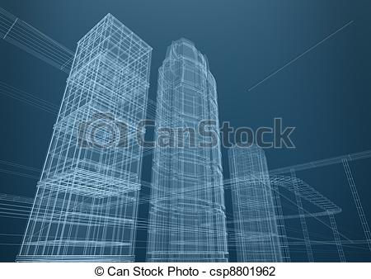
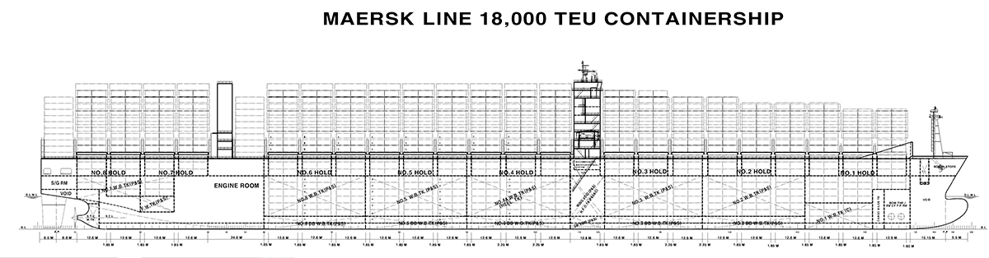
Embedded monitoring of vehicles and buildings
A very different case:
no strict time limits
Structural monitoring
Detectors as part of architectural modules
DAQ/DCS challenge

Slide 18
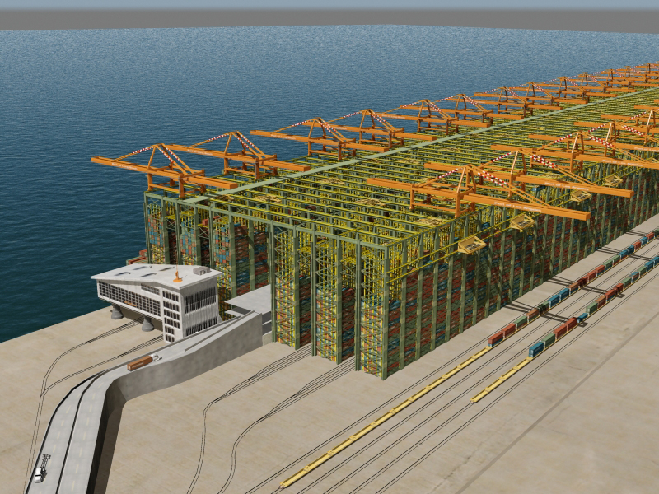
Logistic stocking areas gateways
Useful to replace the gamma ray scanner for entrance and exit validation
Different case: high performance localized station
Tunnel like. The max speed sets the tunnel length
Containers dragged by a tape at the necessary speed
Containers in parallel
Automatic assign the in and out scanning to the container id

Slide 19
Cost and engineering challenges
Production cost of an RPC is very variable with the project size
Traditionally is a chap detector per unit surface.
Atlas RPC CORE 10 M Euro for 7000 m² → 1500/m² all included
Anyway not comparable due to the large engineering still missing
Major RPC challenges are:
  the standardization and modularity
  Use of cheap and un-harmful gases
  Have the legacy simplicity and the new performance…
The RPC technology is substantially mature for a prototype installation also supervised directly by the industry
Detector technology to be merged with computer vision and AR → EOI in AIDA2
Room for spinoff and H2020 projects…

