Slide 1
The LHC Upgrade
Lucio Rossi - CERN
HL-LHC project Leader
CERN-KEK Committee
8th Meeting, CERN 9 December 2013

Slide 2
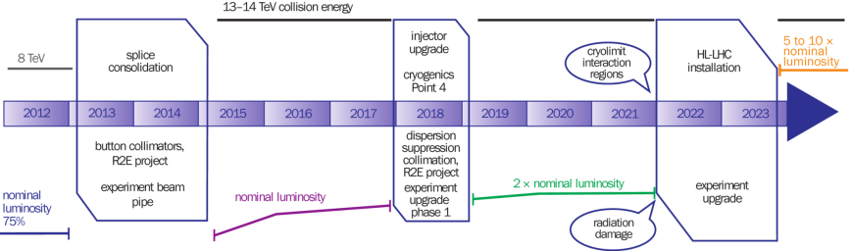
The CERN 10-year plan
(approved early 2011)
0.75 10³⁴ cm⁻²s⁻¹
50 ns bunch
high pile up ∼40
1.5 10³⁴ cm⁻²s⁻¹
25 ns bunch
pile up ∼40
1.7-2.2 10³⁴ cm⁻²s⁻¹
25 ns bunch
pile up ∼60
Technical limits (experiments, too) like :

Slide 3
Recent modification to the LHC plan
Big chance to install CC in SPS!
Install New Cryo in IP4,
Preparation of all Civil and technical works for LS3
The extra time is just what is needed to install all hardware in LS3: opportunity not to miss!

Slide 4
Goal of High Luminosity LHC (HL-LHC) as fixed in November 2010
The main objective of HiLumi LHC Design Study is to determine a hardware configuration and a set of beam parameters that will allow the LHC to reach the following targets:
A peak luminosity of 5×10³⁴ cm⁻²s⁻¹ with levelling, allowing:
An integrated luminosity of 250 fb⁻¹ per year, enabling the goal of 3000 fb⁻¹ twelve years after the upgrade.
This luminosity is more than ten times the luminosity reach of the first 10 years of the LHC lifetime.

Slide 5
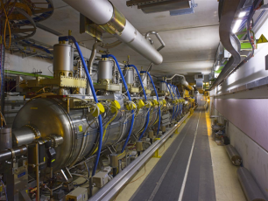
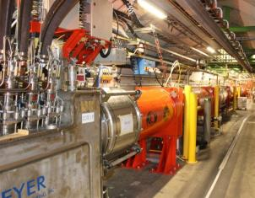
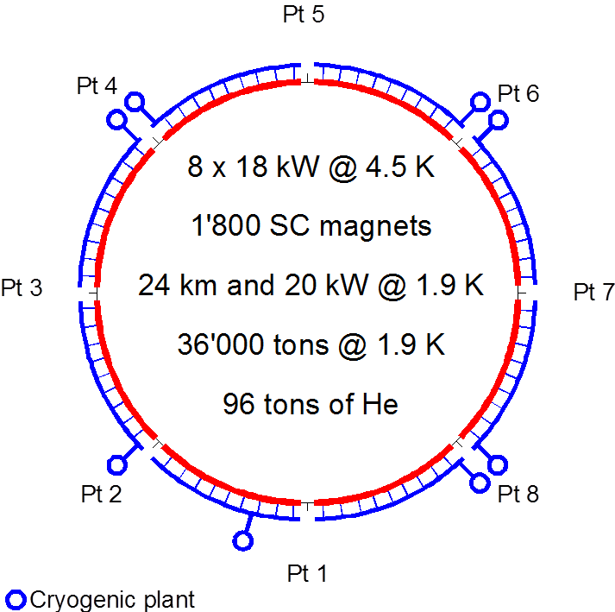
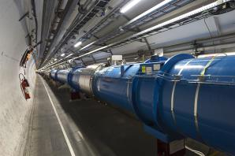
Technical bottlenecks
Cryogenics P4
IT
IT
RF
RF
Never good to couple RF with Magnets !
Reduction of availabe cryo-power and coupling of the RF wiht the Arc (thermal cycle requires > 2 months and many tests)
IT
IT
IT
IT
IT
IT

Slide 6
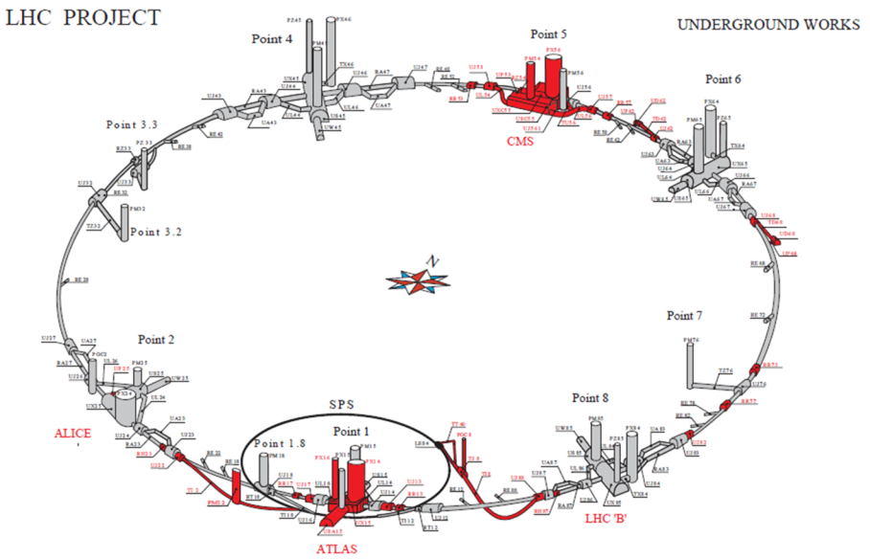
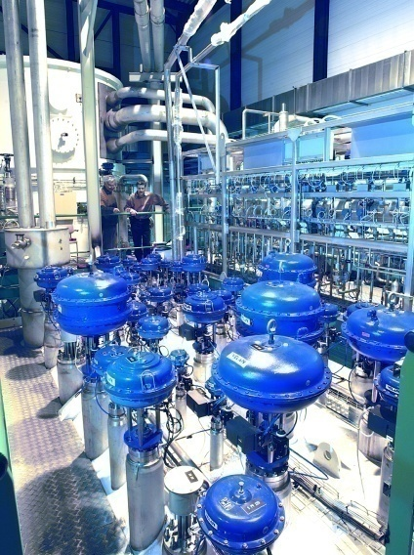
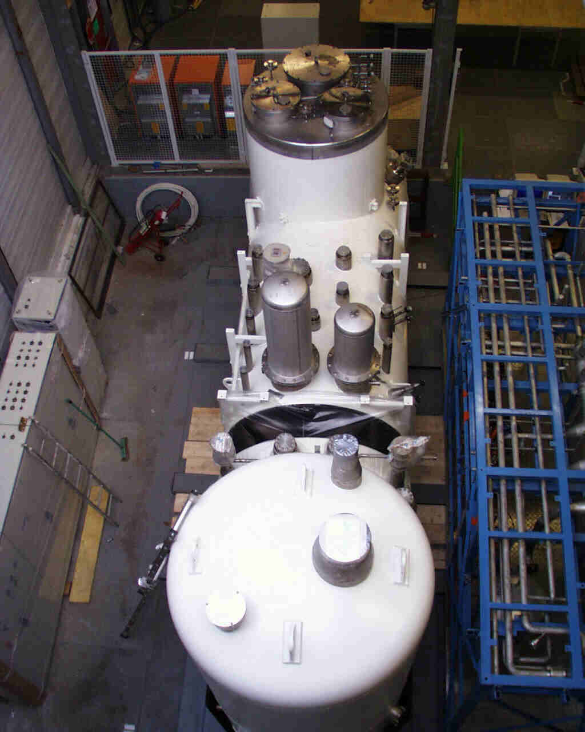
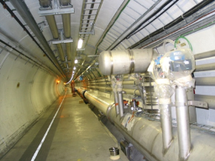
IT cryoplants and new LSS QRL
Availability: separation New Inner Triplets (and IPM in MS) from the arc cryogenics.
Keeping redundancy for nearby arc cryoplant
Redundancy with nearby Detector SC Magnets cryoplant

Slide 7
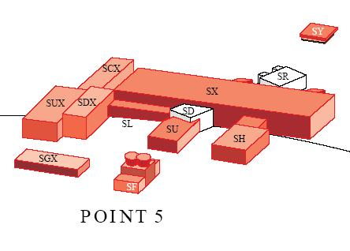
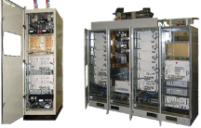
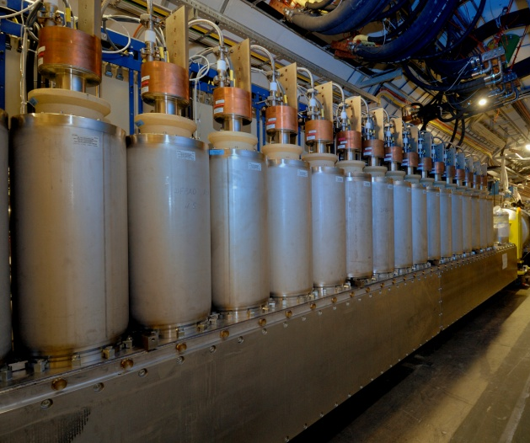
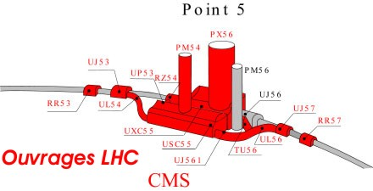
Availability: SC links ⇒removal of
EPCs, DFBs from tunnel to surface
1 pair 700 m 50 kA – LS2
4 pairs 300 m 150 kA (MS)– LS3
4 pairs 300 m 150 kA (IR) – LS3 tens of 6-18 kA CLs pairs in HTS
2×150 kA
A. Ballarino

Slide 8

Parameters (PLC web page)
Parameter | nominal​ | 25ns​ | 50ns
N_{b} | 1.15E+11 | ​2.2E+11 | ​3.5E+11
n_{b} | ​2808 | ​2808 | ​1404
N_{tot} | 3.2E+14 | 6.2E+14 | 4.9E+14
beam current [A] | ​0.58 | 1.11 | 0.89
x-ing angle [μrad]​ | 300 | 590 | 590
beam separation [σ] | 9.9 | 12.5 | 11.4
β* [m] | 0.55 | ​0.15 | ​0.15
ε_{n} [μm]​ | 3.75 | ​2.50 | 3
ε_{L} [eVs]​ | 2.51 | ​2.51 | ​2.51
energy spread​ | ​1.20E-04 | ​1.20E-04 | ​1.20E-04
bunch length [m] | ​7.50E-02 | ​7.50E-02 | ​7.50E-02
IBS horizontal [h] | ​80 -> 106 | 18.5 | 17.2
IBS longitudinal [h] | 61 -> 60 | 20.4 | 16.1
Piwinski parameter | ​0.68 | 3.12 | 2.85
Reduction factor 'R1*H1‘ at full crossing angle (no crabbing) | ​0.828 | 0.306 | 0.333
Reduction factor ‘H0‘ at zero crossing angle (full crabbing) | 0.991 | 0.905 | 0.905
beam-beam / IP without Crab Cavity | 3.1E-03 | ​3.3E-03 | 4.7E-03
beam-beam / IP with Crab cavity | 3.8E-03 | 1.1E-02 | 1.4E-02
Peak Luminosity without levelling [cm⁻² s⁻¹] | 1.0E+34 | 7.4E+34 | 8.5E+34
Virtual Luminosity: Lpeak*H0/R1/H1 [cm⁻² s⁻¹] | 1.2E+34 | 21.9E+34 | 23.1E+34
Events / crossing without levelling | ​19 -> 28 | 210 | 475
Levelled Luminosity [cm⁻² s⁻¹] | - | ​5E+34 | 2.50E+34
Events / crossing (with leveling for HL-LHC) | *​19 -> 28 | 140 | 140
Leveling time [h] (assuming no emittance growth) | - | 9.0 | 18.3
https://espace.cern.ch/HiLumi/PLC/default.aspx

Slide 9
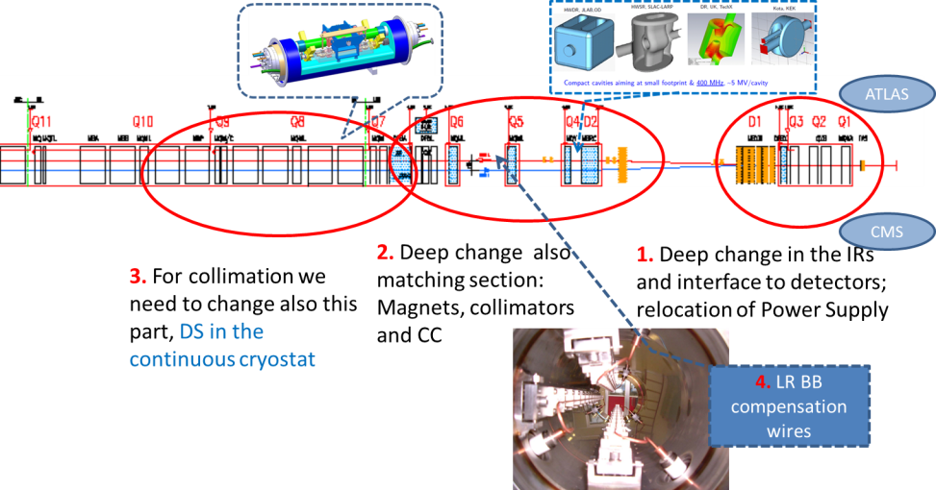
The critical zone around IP1 and IP5
1.2 km of LHC !!

Slide 10
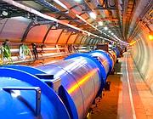
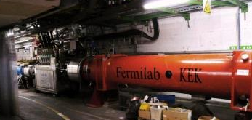
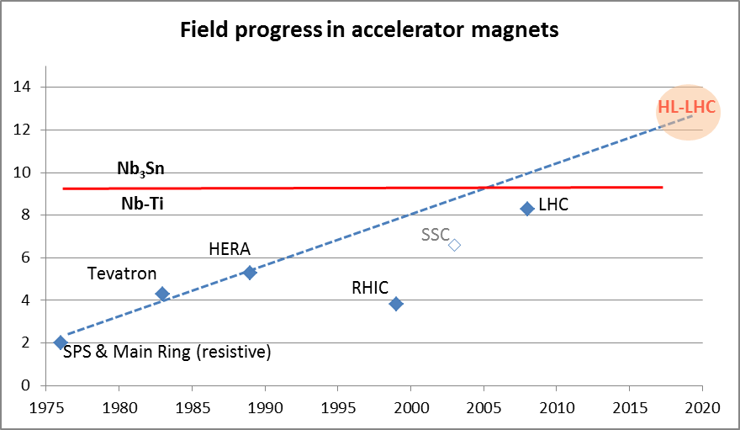
Magnet the progress
LHC dipoles features 8.3 T in 56 mm (designed for 9.3 peak field)
LHC IT Quads features 205 T/m in 70 mm with 8 T peak field
HL-LHC
  11 T dipole (designed for 12.3 T peak field, 60 mm)
  New IT Quads features 140 T/m in 150 mm > 12 T operational field, designed for 13.5 T).

Slide 11
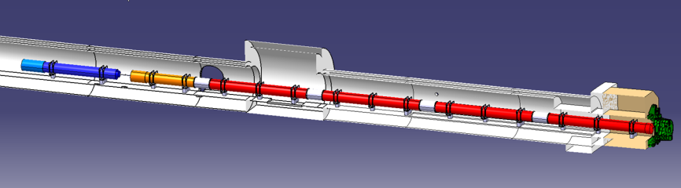
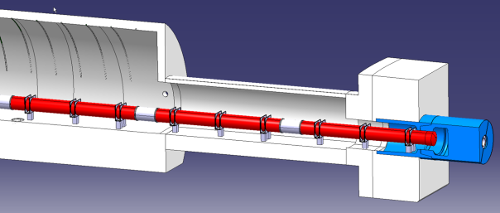
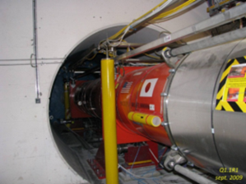
Integration view of IT zone with D1
D1
ATLAS
CMS
P. Fessia
JP Corso and EN-MEF int. team

Slide 12


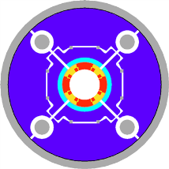
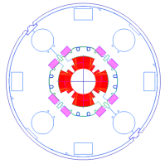
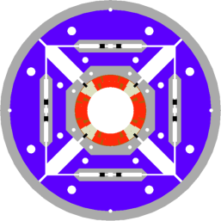
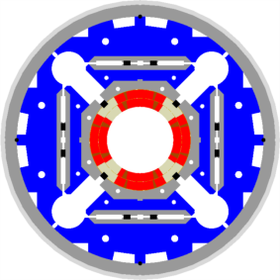
LHC low-β quads: steps in magnet technology from LHC toward HL-LHC
LHC (USA & JP, 5-6 m)
∅70 mm, B_{peak}∼ 8 T
1992-2005
LARP TQS & LQ (4m)
∅90 mm, B_{peak}∼ 11 T
2004-2010
New structure based on bladders and keys (LBNL, LARP)
LARP HQ
∅120 mm,
B_{peak}∼ 12 T
2008-2014
LARP & CERN
MQXF
∅150 mm,
B_{peak}∼ 12.1 T
2013-2020

Slide 13
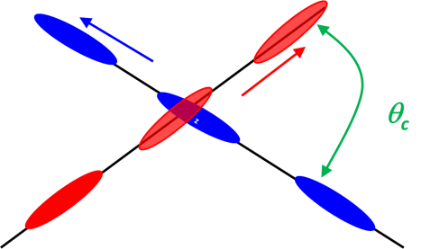
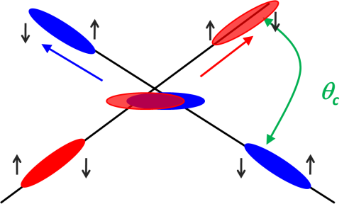
Effect of the crab cavities
RF crab cavity deflects head and tail in opposite direction so that collision is effectively “head on” and then luminosity is maximized
Crab cavity maximizes the lumi and can be used also for luminosity levelling: if the lumi is too high, initially you don’t use it, so lumi is reduced by the geometrical factor. Then they are slowly turned on to compensate the proton burning

Slide 14

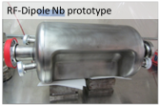
And excellent results: RF dipole > 5 MV
¼ w and 4-rods also tested (1.5 MV) cleaning & vacuum issues: new test under way
2 K result
4.2 K result
Quench
Initial goal was 3.5 MV
however ΔV > 5-6 MV would ease integration
JP Delahayen
We need downselection, and ASAP: but not too early!
5

Slide 15
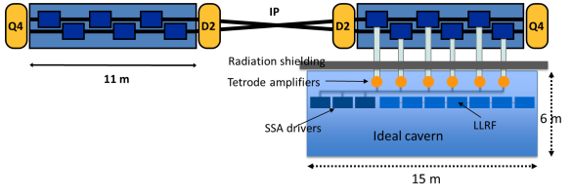
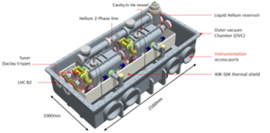
Crab Cavities for fast beam rotation
Present baseline: 3 cavity /cyomodule
4 cavity/cryomod is under study for Crab Kissing
TEST in SPS under preparation (A. MacPherson)

Slide 16
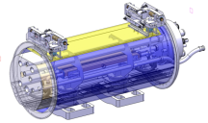
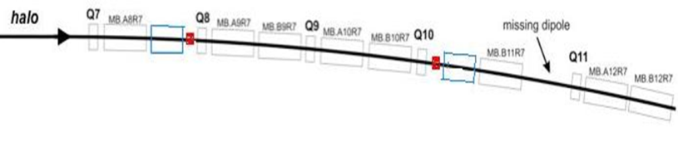
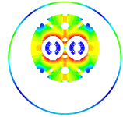


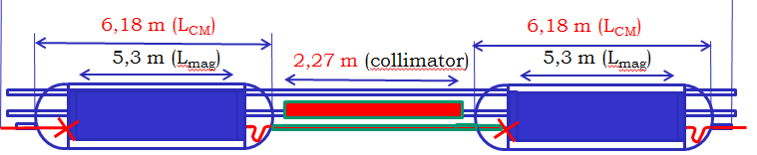
P2 - DS collimators ions – 11 T (LS2 -2018)
Recommended by the Collimation Review
11 T Nb₃Sn
A. Zlobin (FNAL)
M . Karppinen (CERN)

Slide 17
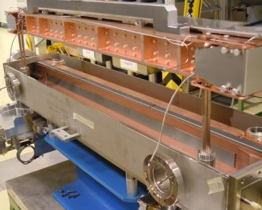
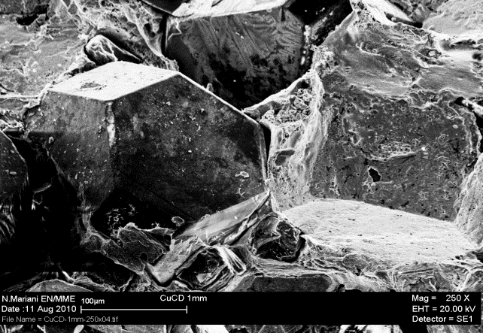
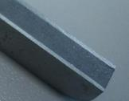
Low impedence collimators(LS2 & LS3)
New material: MoGr
S. Redaelli
A. Bertarelli

Slide 18
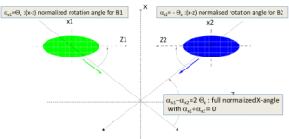

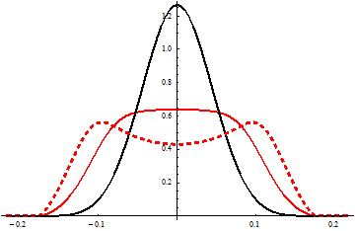
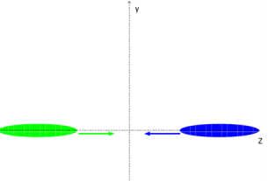
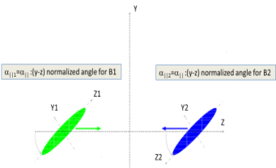

The Crab-kissing (CK) scheme for pile-up density shaping and leveling (S. Fartoukh)
Crab-kissing & variants:
CC also in ||-plane
Baseline: CC in X-plane “only”
$\frac{∂μ}{∂z}$ [mm⁻¹]
z [m]
... Work on-going together with the machine experiments
(S. Fartoukh, A. Valishev, A. Ball, B. Di Girolamo, et al.)

Slide 19



Collaboration: the long way
DOE Nb3Sn R&D
2000
LARP
generic
FP6
CARE
Nb3Sn
The HL-LHC project formally started in 2010; however it is the focal point of 20 years of converging International Collaboration
2005
CERN-KEK R&D
LARP
HiField quads
FP7
sLHC PP
(INJ)
FP7
EuCARD
HiField Dip
2010
CERN-KEK D1 design
LARP
Demo
sLHC INJ implem.
today
FP7 DS
Hi-Lumi LHC
M
2015
Construction
Injector
upgrade
HL-LHC commissioning
2023

Slide 20






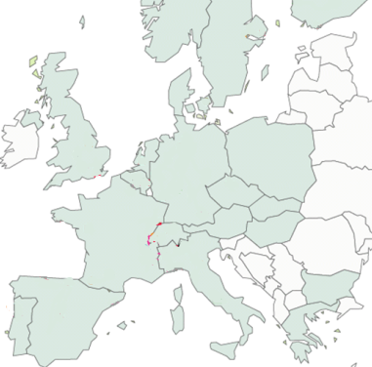












High Luminosity LHC Participants

Slide 21
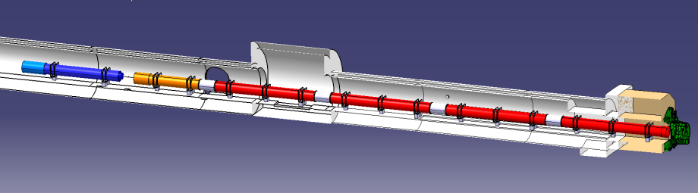




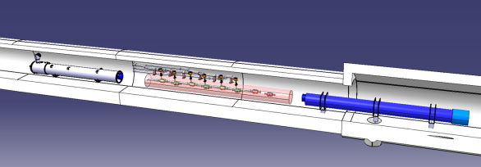


In-kind contribution and Collaboration for HW design and prototypes
ATLAS
CMS
Q1-Q3 : R&D, Design, Prototypes and in-kind USA
D1 : R&D, Design, Prototypes and in-kind JP
MCBX : Design and Prototype ES
HO Correctors: Design and Prototypes IT
Q4 : Design and Prototype FR
CC : R&D, Design and in-kind USA
CC : R&D and Design UK

Slide 22
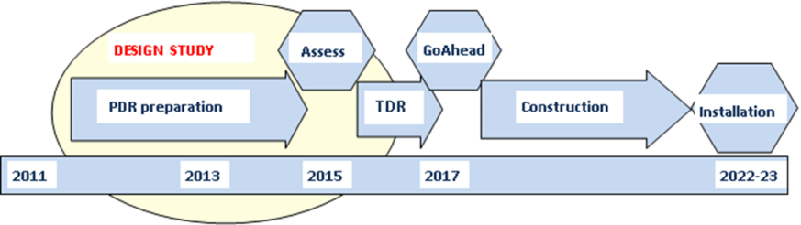
Implementation plan
All WP active, from diagnostics to Machine Protection;
Integration started with vigour as well as QA (workshop soon)
Cryo, SC links, Collimators, Diagnostics, etc. starts in LS2 (2018)
Proof of main hardware by 2016; Prototypes by 2017
Start construction 2017/18 from IT, CC, other main hardware
IT String test (integration) in 2019-20; Main Installation 2022-23
Though but – based on LHC experience – feasible
Cost: 810 MCHF (Material, CERN accounting)

