Slide 1
Linear Collider
R & D Status in Cooperation between CERN and KEK, focusing on ILC
Akira Yamamoto (KEK/LCC)
CERN-KEK Committee, 30 December, 2013

Slide 2


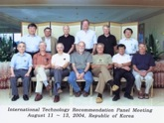
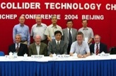
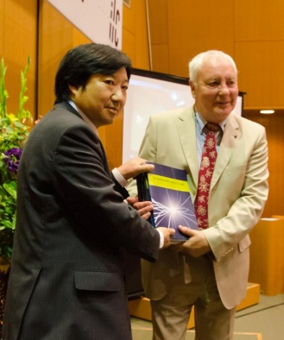
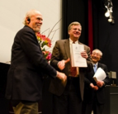
ILC Time Line
1980’ ~ Basic Study
2005
2006
2007
2008
2009
2010
2011
2012
2013
2004
ILC-GDE
LCC
Ref. Design (RDR)
TDR
Tech. Design：TDP1
TDP 2
completion
LHC
Higgs
discovered
Selection of SC Technology
2013.6.12
126 GeV
2012.12.15

Slide 3
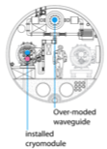
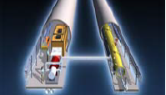
RDR (2007) to TDR (2012)
Cost Containing Effort
Single acc. Tunnel
Reducing # bunches
  w/ smaller damping rings
Allowing gradient spread
  31.5 MV/m +/- 20 %,
Site-dependent RF system:
  Clustered on surface (KCS),
  Distributed in tunnl (DKS)
RDR’07 →
(Reference Design Rep.)
TDR’12
(Technical Design Rep.)
5 m
Flat-land or Mountainous Tunnel Design

Slide 4
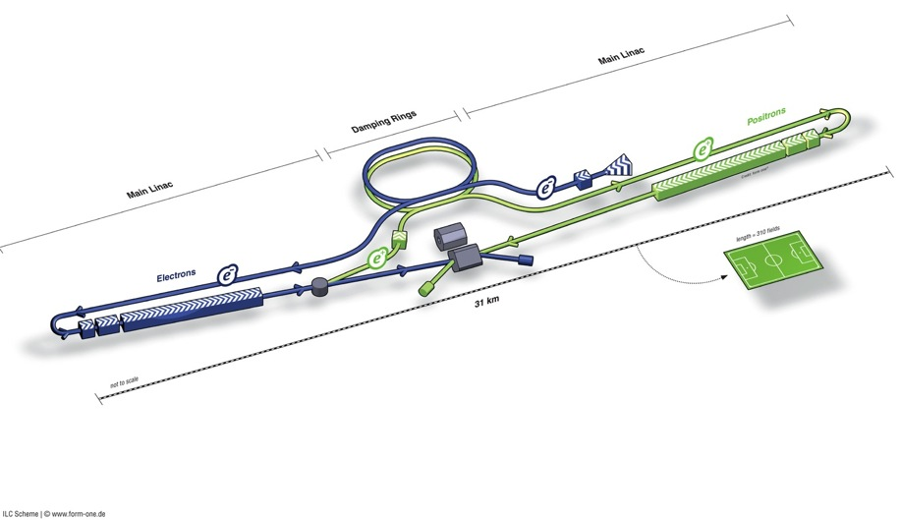
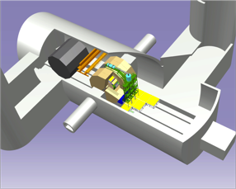
ILC TDR Design
Damping Rings
Polarised electron source
Ring to Main Linac (RTML)
(including
bunch compressors)
e+ Main Linac
e- Main Linac
Parameters | Value
C.M. Energy | 500 GeV
Peak luminosity | 1.8 x10³⁴ cm⁻²s⁻¹
Beam Rep. rate | 5 Hz
Pulse duration | 0.73 ms
Average current | 5.8 mA (in pulse)
E gradient in SCRF acc. cavity | 31.5 MV/m +/-20% Q₀ = 1E10
E+ source

Slide 5
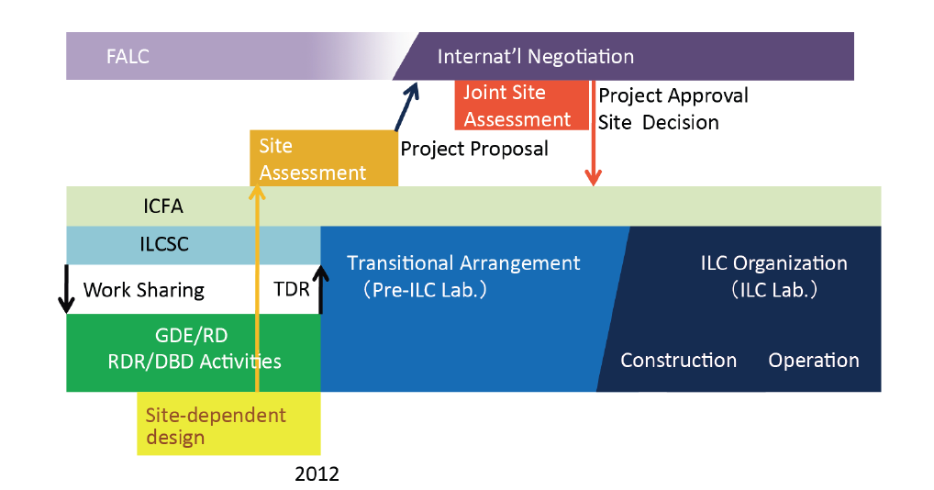
ILC Time Line: Progress and Prospect
Expecting: 3+2 year

Slide 6
ILC Timeline
Proposed by LCC
2013 - 2016
  Negotiations among governments
  Accelerator detailed design, R&Ds for cost-effective production, site study, CFS designs etc.
  Prepare for the international lab.
2016 – 2018
  ‘Green-sign’ for the ILC construction to be given (in early 2016 )
  International agreement reached to go ahead with the ILC
  Formation of the ILC lab.
  Preparation for biddings etc.
2018
  Construction start (9 yrs)
2027
  Construction (500 GeV) complete, (and commissioning start)
  (250 GeV is slightly shorter)

Slide 7
Cooperation of ILC host- and hub-laboratories with worldwide industry (proposed)
ILC Host-Lab
Technical Coordination
for Lab-Consortium
Regional Hub-Lab:
A
Regional Hub-Lab:
E, & …
World-wide
Industry responsible to
‘Build-to-Print’ manufacturing
Regional Hub-Lab:
B
Regional Hub-Lab:
D
Regional Hub-Lab:
C: responsible to
Hosting System Test and Gradient Performance
Regional hub-laboratories responsible to regional procurements to be open for any world-wide industry participation
: Technical
coordination link
: Procurement link

Slide 8
Further Works in Preparation Phase
Accelerator Engineering Design
Positron Source: Conventional source development as backup
Damping Ring: Ultra low emmittance beam, and the stability, Undulators, 650 MHz SCRF
RTML: residual magnetic field effect in long beam transport-line
ML: Cavity integration, CM engineering for cost-effective industrialization, Cryogenic Eng.
BDS: Final focusing with nano-beam, alignment w/ tighter tolerance, and design update
Beam Dynamics: Accurate lattice design based on the specific site
CFS: Site specific work including Detector hall and Central Campus design and others
EDMS: engineering based on the EDMS

Slide 9
Cooperation Anticipated between
KEK-CERN-European Laboratories
Nano-beam handling technology
  Nano-beam and the stability as a common subject for both ILC and CLIC, through ATF collaboration
  Final focusing including magnet and the mechanical stability, as well as commissioning technology, still to be investigated
SCRF cavity integration technology,
  Specially on input-power couplers and tuners, as a common subject for both ILC and SPL for LHC injector upgrade,
Cryogenic engineering
  Specially on handling of large amount of helium inventory, as a specially crucial issue in mountain region,
Civil engineering study
  specially for the detector-hall design,

Slide 10
Cooperation Anticipated between
KEK-CERN-European Laboratories
Nano-beam handling technology
  Nano-beam and the stability as a common subject for both ILC and CLIC, through ATF collaboration
  Final focusing including magnet and the mechanical stability, as well as commissioning technology, still to be investigated
SCRF cavity integration technology,
  Specially on input-power couplers and tuners, as a common subject for both ILC and SPL for LHC injector upgrade,
Cryogenic engineering
  Specially on handling of large amount of helium inventory, as a specially crucial issue in mountain region,
Civil engineering study
  specially for the detector-hall design,

Slide 11

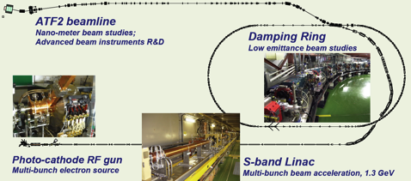
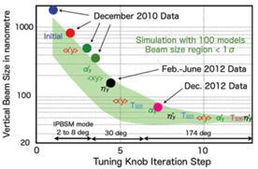
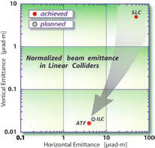
KEK-ATF：Progress
Ultra-small beam
Low emittance : KEK-ATF
  Achieved the ILC goal (2004).
Small vertical beam size : KEK ATF2
  Goal = 37 nm,
    160 nm (spring?, 2012)
    ~65 nm (April. 2013) at low beam current

Slide 12
ATF Future Plan
ATF長期計画(案)
GDE
Next KEK Roadmap
CY
2011
2012
2013
2014
2015
2016
2017
2018
ILC
others
Delay by fire and earthquake
Nano beam orbit control
Develop.(2nmBPM, Fast FB)
Nano beam orbit control (FONT extension)
Beam study
2nm stab. R&D
2nm steady op.
Beam study
37nm
Steady op.
Challenging R&D of the Very high chromaticity optics
Ultra small beam ~ 20 nm
Small beam
Gamma-gamma collider R&D
Develop. / beam study
4-mirror optical cavity (LAL/KEK)
Gamma-gamma laser system R&D
Application
High Field Physics
General R&D
Ex) for KEKB; CSR, RF gun,
Instrument develop.,
Low emittance,…
Test beamline for detector?

Slide 13
Cooperation Anticipated between
KEK-CERN-European Laboratories
Nano-beam handling technology
  Nano-beam and the stability as a common subject for both ILC and CLIC, through ATF collaboration
  Final focusing including magnet and the mechanical stability, as well as commissioning technology, still to be investigated
SCRF cavity integration technology,
  Specially on input-power couplers and tuners, as a common subject for both ILC and SPL for LHC injector upgrade,
Cryogenic engineering
  Specially on handling of large amount of helium inventory, as a specially crucial issue in mountain region,
Civil engineering study
  specially for the detector-hall design,

Slide 14
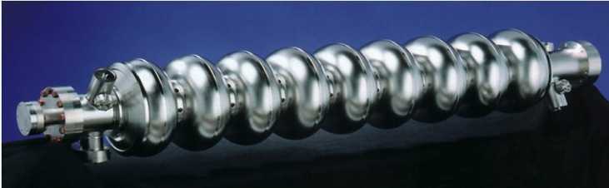
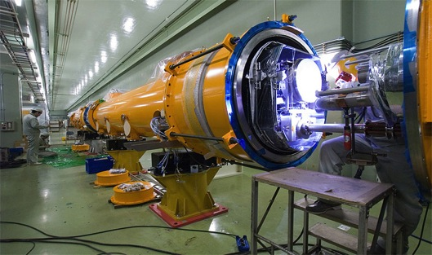
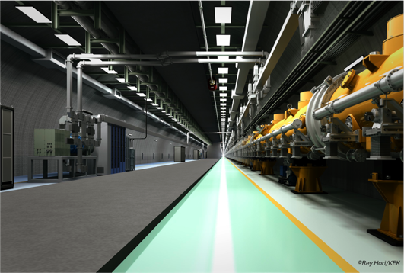
SCRF Linac Technology
1.3 GHz Nb 9-cellCavities | 16,024
Cryomodules | 1,855
SC quadrupole pkg | 673
10 MW MB Klystrons & modulators | 436 / 471 *
* site dependent
Approximately 20 years of R&D worldwide
→ Mature technology, overall design and cost

Slide 15
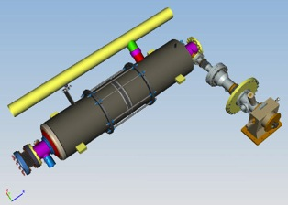
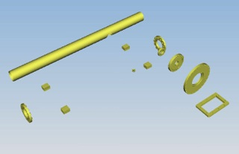
Plug-compatible Conditions
Item | Varieties | Baseline
Cavity shape | TESLA / LL | TESLA
Length |  | Fixed
Beam pipe flange |  | Fixed
Suspension pitch |  | Fixed
Tuner | Blade/ Slide-Jack | Blade
Coupler flange (cold end) | 40 or 60 | 40 mm
Coupler pitch |  | Fixed
He –in-line joint |  | Fixed
Plug-compatible interface established

Slide 16


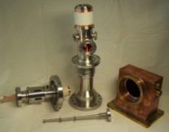
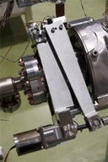
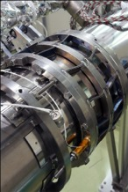
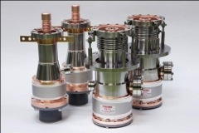
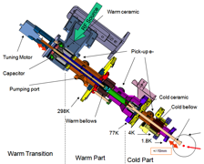
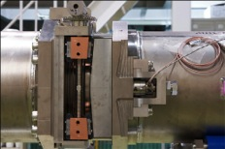
Demonstrations and Evaluation of Various Couplers and Tuners in S1-Global
Every coupler and tuner demonstrated, as expected, and be applicable for ILC cavities
Finding various subjects to be further investigated and settled

Slide 17
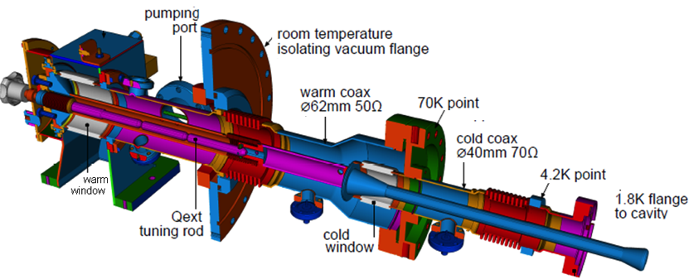
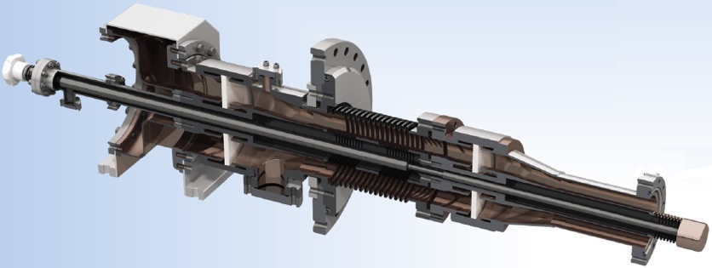
(1) Deep Technical Review of Input Couplers
TTF3/XFEL coupler
TDR coupler
STF-2 coupler
Cu-plating is a key-issue

Slide 18
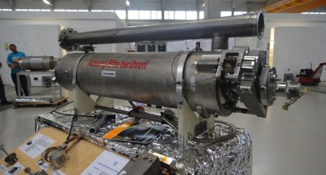
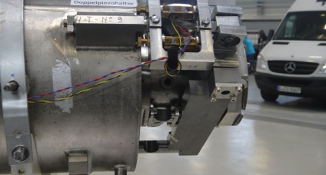
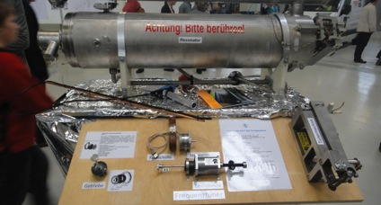
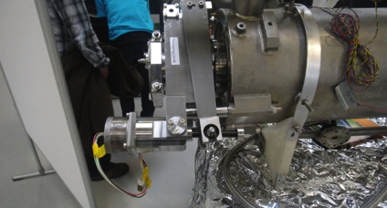
EXFEL Cavity and Tuner

Slide 19
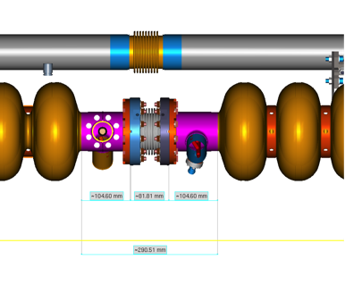
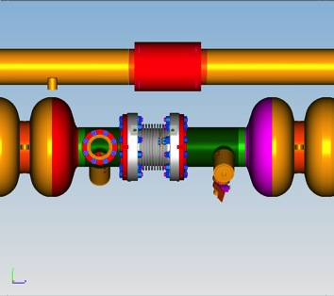
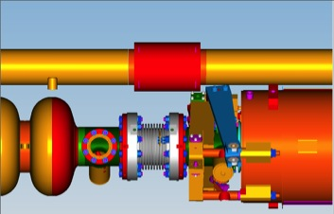
Inter-Cavity Spacing
ILC Type-IV
XFEL
105
82
105
105
108
140
292
353
Reduction in inter-cavity spacing = 61 mm
Bellows: = 108→82 = 26 mm
“Long” cavity end = 140→105 = 35 mm

Slide 20
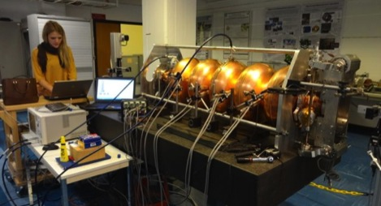
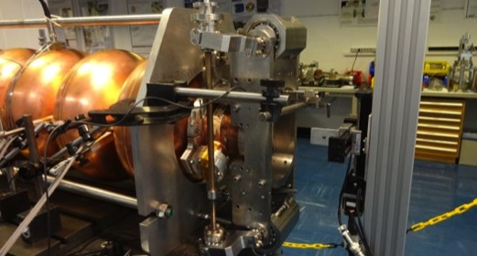
CERN - CEA-Saclay Collaboration for
CERN-SPL SCRF cavity and tuner development
Seeking for the best space-effective and cost-effective tuner, as a common subjects

Slide 21
Cooperation Anticipated between
KEK-CERN-European Laboratories
Nano-beam handling technology
  Nano-beam and the stability as a common subject for both ILC and CLIC, through ATF collaboration
  Final focusing including magnet and the mechanical stability, as well as commissioning technology, still to be investigated
SCRF cavity integration technology,
  Specially on input-power couplers and tuners, as a common subject for both ILC and SPL for LHC injector upgrade,
Cryogenic engineering
  Specially on handling of large amount of helium inventory, as a specially crucial issue in mountain region,
Civil engineering study
  specially for the detector-hall design,

Slide 22
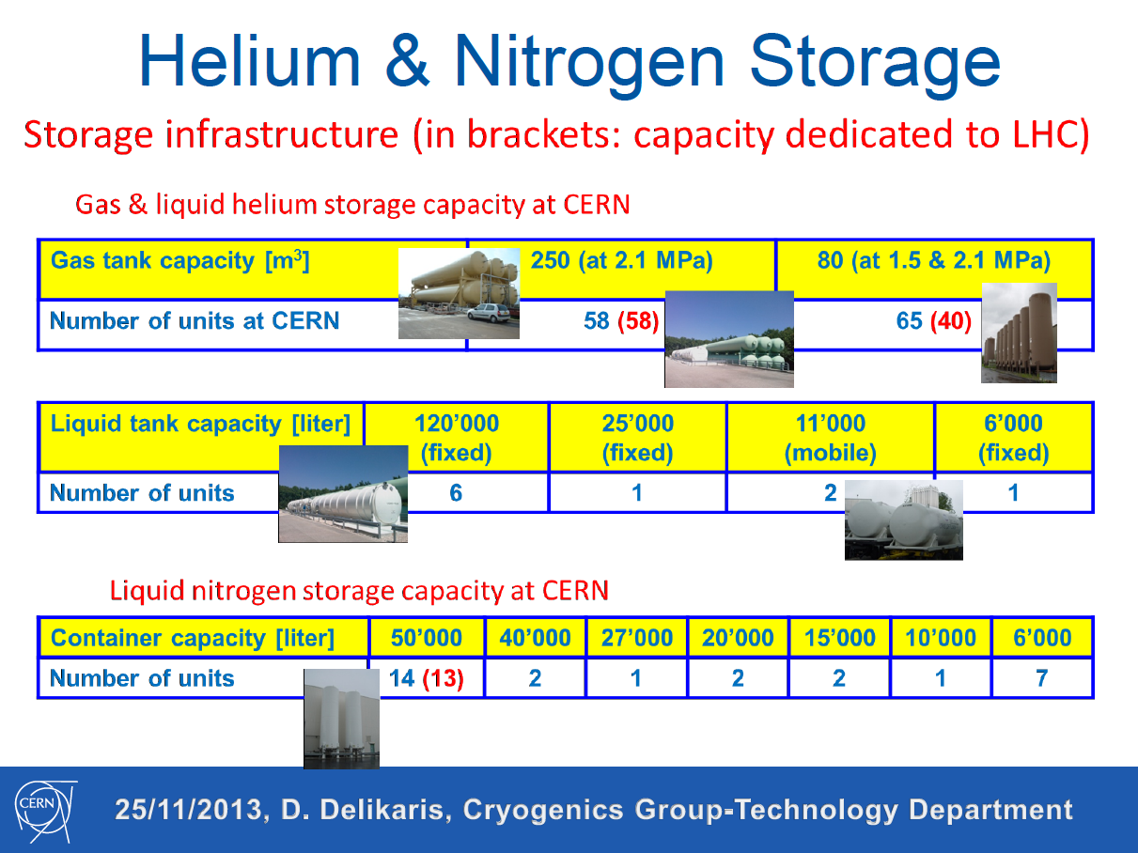
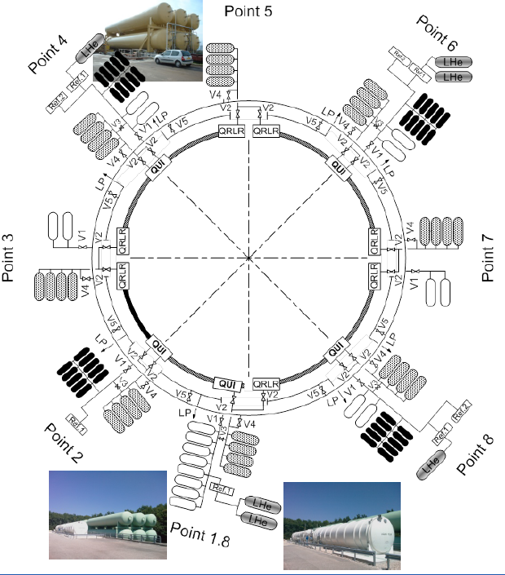
CERN’s Experience for He/N2 Storage to be reflected to the ILC Cryogenics design

Slide 23
Cooperation Anticipated between
KEK-CERN-European Laboratories
Nano-beam handling technology
  Nano-beam and the stability as a common subject for both ILC and CLIC, through ATF collaboration
  Final focusing including magnet and the mechanical stability, as well as commissioning technology, still to be investigated
SCRF cavity integration technology,
  Specially on input-power couplers and tuners, as a common subject for both ILC and SPL for LHC injector upgrade,
Cryogenic engineering
  Specially on handling of large amount of helium inventory, as a specially crucial issue in mountain region,
Civil engineering study
  specially for the detector-hall design,

Slide 24
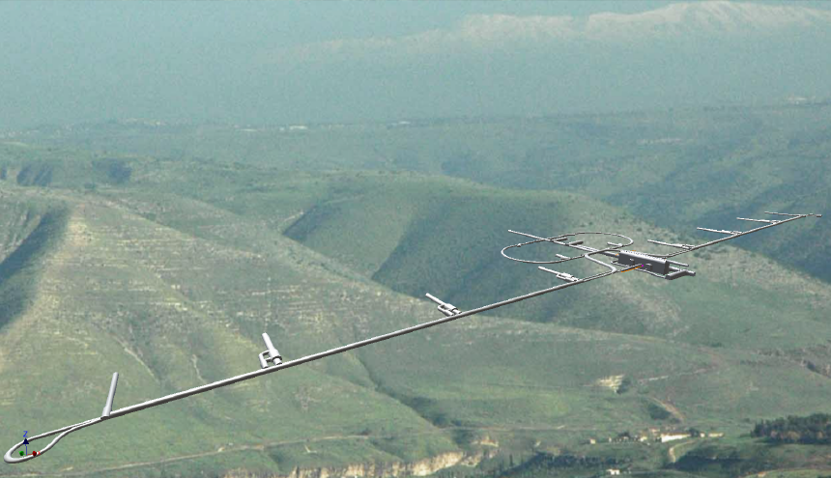
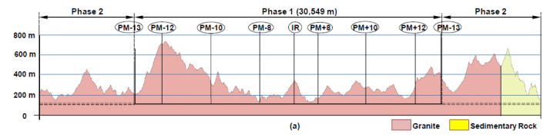
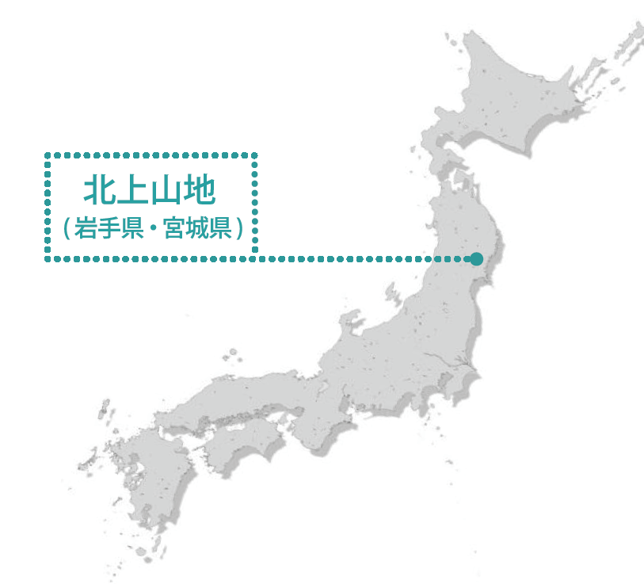
Site Specific Design to be carried out
Kitakami
Candidate
Site
Kitakami-site cross section
Damping Ring
Ring To Main Linac (RTML)
Detector Hall
PM+10
PM+12
PM+13
PM-ab
PM+8
Surface Structures
e+ ML
PM-8
e- Source
Existing surface road
PM-10
PM-12
(Slope <7%)
PM-13
e+ Source
Access Tunnel
Access Hall
PX
(Slope <10%)
(Center Campus)
e- Main Linac (ML)
Existing road
RTML turn-around
(The background photo shows a similar site image, but not the real site.)
Need to establish the IP and linac orientation
Then. the access points and IR infrastructure
Then. linac length and timing

Slide 25
Summary
ILC design has reached the Technical Design Report including the technology demonstration,
“Design to Realization” is the next step, the design and techonology need to be further matured with cost-effective production technology to prepare for the construction stage,
CERN and KEK cooperation is expected, specially on
  Ultra-low emittance and nano-beam handling technology, including final focusing magnet technolgy,
  SCRF cavity integration technology, focusing on power-coupler and tuner technology to be matured for the best cost-effective mass-production, (to be discussed later by SS).
  Cryogenics engineering with a similar scale as that of the LHC, specially focusing on safe and stable helium resource handling,
  Civil engineering, focusing on a large detector hall based on the LHC experience (to be discussed later by SS)
The cooperative works are anticipated to be encouraged and supported by CERN and KEK

Slide 26
backup

Slide 27
ILC Time Scale required
 | 12 | 13 | 14 | 15 | 16 | 17 | 18 | 19 | 20 | 21 | 22 | 23 | 24 | 25
ILC TDP/TDR
ATF-II | Beam test
ATF-future |  |  | Extended program
STF
QB | Beam test
STF2- CM1+CM2a |  |  | Beam test
STF-Future |  |  |  | Extended program
CFS
Civil eng.
Site-survey
 |  |  | 14 19 |  | 16 21 |  |  | 19 24 |  |  |  |  |  | 25 30
ILC constr. |  |  |  |  |  |  |  |  |  |  |  |  |  | Commissioning
Fabrication |  |  | Preparation for the project |  | Preparation for industrialization |  | Fabrication and tests, preparation for installation
Inst/commission. |  |  |  |  |  |  |  |  |  |  | Installation
After getting Green Sign、
・Preparation for contract： ~ 2 years
・Construction period： ~ 10 years
・If the green sign given in 5 years、
ILC to be realized by 2030

Slide 28
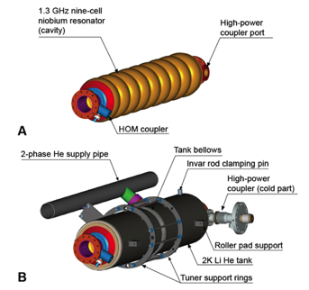
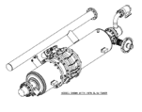
Cavity Integration
9-cell resonator
Input-coupler
  TTF-III coupler
Frequency tuners
  Blade tuner
He tank
Magnetic shield
  Inside He tank

Slide 29
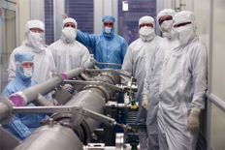
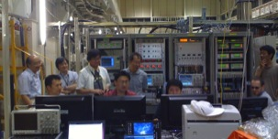
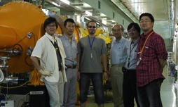
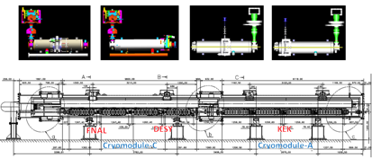
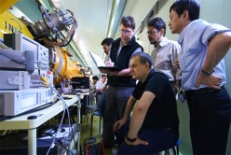
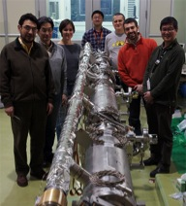
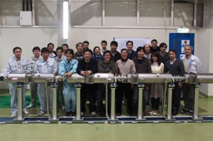
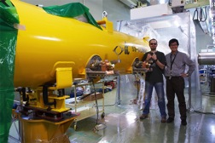
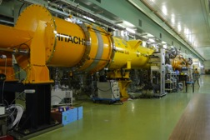
S1-Global hosted at KEK:
Global cooperation to demonstrate SCRF system
DESY, FNAL, Jan., 2010
DESY, Sept. 2010
FNAL & INFN, July, 2010
INFN
and
FNAL
Feb.
2010
March, 2010
DESY, May, 2010
June, 2010 ~

Slide 30






coupler assembly
TTF-III Coupler: various support jigs are required.
KEK STF Coupler:self standing

Slide 31




Legend
top
bottom
Toward pick-up side
Toward coupler side
coupler side
motor side
Preassembled parts
Driving unit support elements are already installed on the tuner halves.

