Slide 1


Progress Report on Magnet R&D and Further Plans for CERN-KEK Collaboration
T. Nakamoto
KEK
CERN-KEK Committee, CERN. Dec. 9, 2013.

Slide 2
R&D Items
R&D for beam separation dipole D1 for HL-LHC
  Conceptual design, engineering design
  2m model magnet development
  * Renovation of development area, test stand.
  Irradiation tests
Fundamental R&D (by Japanese grant)
  Nb₃Al subscale magnet
Reviewed by “LHC/ATLAS Upgrade Review at KEK, Nov. 21-22, 2013”

Slide 3
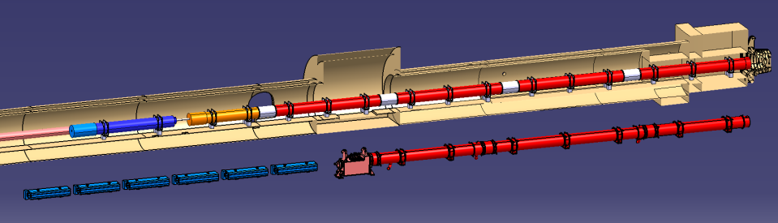
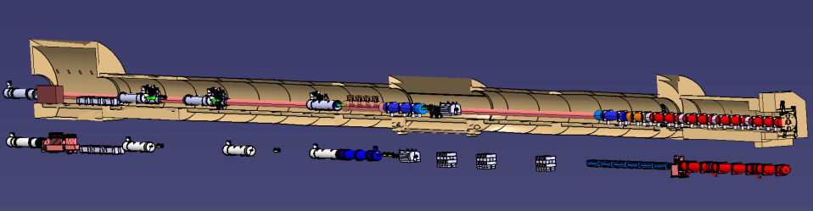
Layout of IR Magnets
IT Quads.& D1
HL-LHC
Corrector
Package
SC D1
IP
IT Quads.
Nominal LHC
NC D1
Long Straight Section
HL-LHC
New Crab Cavity
SC D1
Nominal LHC
Q4
D2
NC D1
Short distance btw D1 and D2.
A large aperture of 150 mm.
NEW D1 SC magnet for HL-LHC

Slide 4
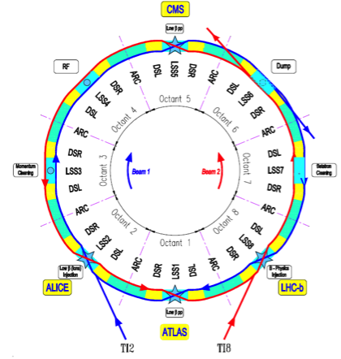
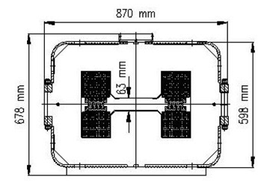
Objective: New D1
For HL-LHC upgrade, needs for new Inner Triplet system at IR1 & IR5.
  Large aperture (150 mm) HF Quadrupoles, corrector package and D1.
New beam separation dipole (D1) should be accommodated with large aperture IT Quads; which will need a large aperture (large beam size) and 50 % increase in original integrated field (distance btw D1-D2 shortened).
Schematic layout of the LHC
Conceptual design study and
model magnet development for D1 by KEK
W/ funding by CERN-KEK budget and KEK internal budget
Current D1 (MBXW) at IR1 & IR5
Schematic layout of the IR for HL-LHC
New superconducting D1

Slide 5
Latest Design Parameters of D1
Coil ID: 150 mm
Integrated field:35 T m (26 Tm at present LHC)
  5.59 T at 12 kA. L_{coil}=6.3 m
T_{op}: 1.9 K by HeII cooling
Op. point (2D coil): 75 %
Coil layout: 1 layer of 15.1 mm cable
  Better cooling. Saving space for iron yoke.
Conductor: Nb-Ti LHC MB outer cable
Structure: Collared yoke structure by keying
  RHIC dipole, LHC MQXA, J-PARC SCFM
  Enhancing iron material for stray field issue
Field quality: < 10⁻⁴ at R_{ref} = 50 mm
Cold mass OD: 550 +10 x 2 = 570 mm
Cryostat OD: 914 mm, same as MB cryostat
Radiation, energy deposition:
A few 10 MGy, 1~2 mW/cm³
4
8
13
44 turns
Stress management
High saturation, stray field, flux return cryostat
Radiation resistance, cooling capability
19
Option C: LL75%

Slide 6
Variation of Multipole Coefficients (2D)
b₃
b₃ to b₁₁
Injection
Nominal current
Nominal current
Injection
Control of the iron saturation effect on field quality.
Successful adjustment of multipole coefficient (< 1 unit) at the nominal current.

Slide 7
Field Integral & Magnet Length: Option C (LL75)
RE
S.S.
LE
*For Mechanical Coil Length: 6.416 m (-3209 < z < +3207)
Field Integral | Return End (-4000 < z < -2041) | S.S. (-2041 < z < +2041 mm) | Lead End: (+2041 < z < +4000 mm) | Total (Tm) | Ratio of integral (unit)
B1 | 6.1715 | 22.8779 | 6.1711 | 35.2204 | 10000
B3 | -0.0156 | 0.0090 | -0.0138 | -0.0205 | -5.82
B5 | -0.0019 | -0.0003 | -0.0004 | -0.0025 | -0.71
B7 | 0.0009 | -0.0005 | 0.0011 | 0.0016 | 0.44
A1 | 0.0000 | 0.0002 | -0.0046 | -0.0044 | -1.26
A3 | 0.0000 | 0.0000 | 0.0014 | 0.0014 | 0.40
A large B₃ of 0.009 Tm (+4 unit) generated in S.S. due to the end effects while the one in 2D is almost zero.
The integral of B₃ (-6 unit) could be minimized by adjusting B₃ in S.S. to a certain value.
Other multipoles less than 1 unit looks acceptable except A₁.
The whole magnet length estimate: 6.92 m
    >> Acceptable for the vertical cold test at KEK

Slide 8
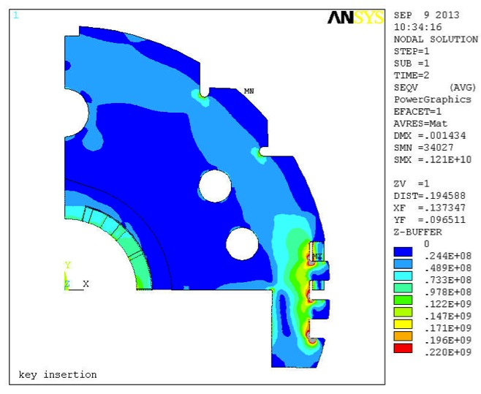
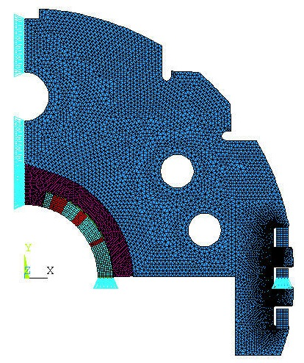
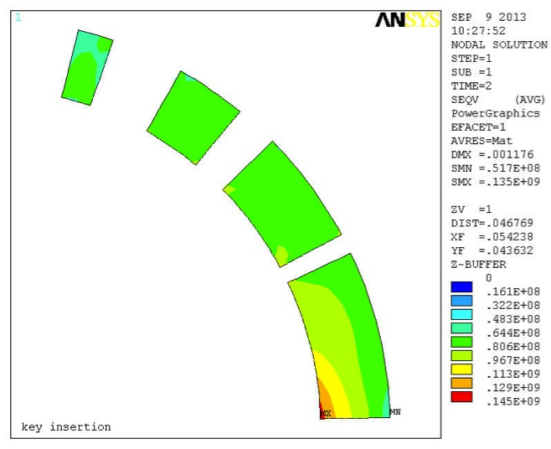
Mechanical Analysis for Key insertion
Shear stress in lock-keys is not included
UX = 0
Key slots: below 220 MPa in most areas >> feasible
Stress in the yoke
0.5 unit
thickness
Yoke
Spacer
Coil
UY = 0
Remove load from the yoke shoulder and insert the load-key; The gap between top and bottom yokes keep closed at both ends.
Stress in the coil
8

Slide 9
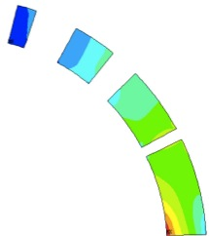
Coil Stress at Each Step
150 mm aperture, Option C (LL75) with 110% of the nominal current.
  At Assembly: σ_{Pole_Ave.} of 70 MPa, σ_{MP_Ave.} of ~95 MPa
  At excitation: σ_{Pole_Ave.} of ~5 MPa, σ_{MP_Ave.} of 90 MPa
  Peak stress below 150 MPa

Slide 10
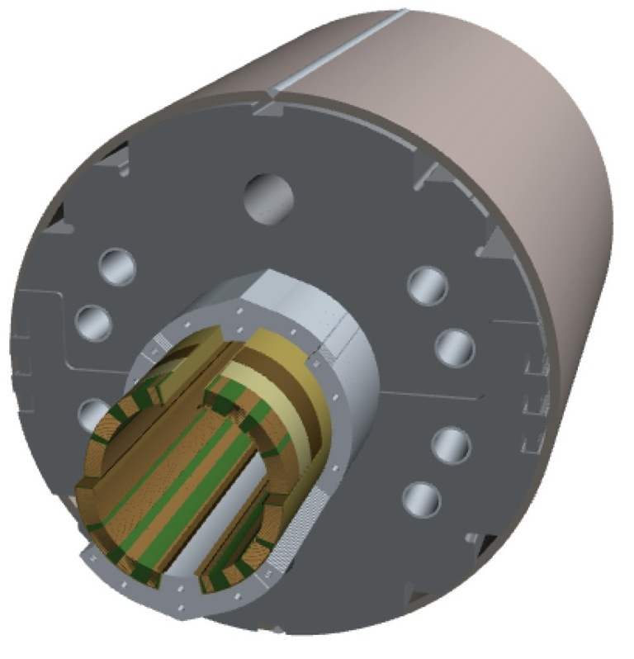
2m-long Model Magnet - Overview
Single-layer coil, 4-split spacer collars, collared yoke by keying
φ 50 mm HX hole
Notches and φ 34 mm holes for iron saturation effects
Brass shoes
Shell: SUS304L
4 split stainless steel spacer collars: YUS130S (NSSC) or SUS316L
Same outer-interface for J-PARC SCFM jigs
Collaring keys
NbTi SC cable (LHC MB outer) + Apical insulation
Horizontal split iron yoke:
low-carbon steel (EFE by JFE steel)
Radiation resistant GFRP (S2 glass + BT resin) wedges

Slide 11
SC Cable Supply & Schedule
NbTi LHC MB outer cable will be supplied by CERN for the new D1 .
Delivery Date | Objective | Requirement | Remark
Feb. 2013 | 10 stack meas. (a piece length > 0.3 m) | ~50 m w/ MB type insulation | Both MB inner and outer cables w/ MB type insulation
Jan. 2014 | 2 practice coils* + 2 real coils for the 1st 2-m long model | 220 m** x 4 | LHC MB outer cables w/ MB type Apical insulation
Jan. 2015 (possibly) | 2 practice coils + 2 real coils for the 2nd 2-m long model | 220 m x 4 | LHC MB outer cables w/ MB type Apical insulation
JFY2016 (prospect) | 6 or 7 full-scale magnets + 4 practice/spare coils | 600-640 m x 18 | LHC MB outer cables w/ MB type Apical insulation
Done!!
* 1 coil >> Top or Bottom of D1 coil (a half of cross section)
** 44 turns x 2 sides x 2 m + 40 m >> 220 m

Slide 12
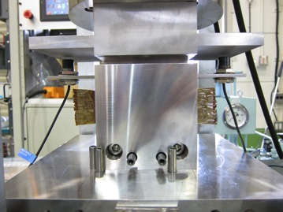
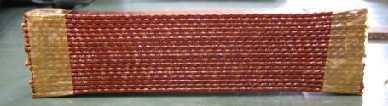
Cable Size Meas.
Courtesy of R. Iwasaki
Hypothesis
Max. experienced stress: 100 MPa
Design stress: 80 MPa
38.55 mm for 22 cable stack
  Design cable size @ 80MPa: 1.7545 mm w/ insulation
Azimuthal Insulation 0.135 mm
Radial Insulation 0.155 mm
  E modulus 5.5 Gpa - 17.5 GPa
Reference data for calculations (ROXIE, ANSYS)

Slide 13
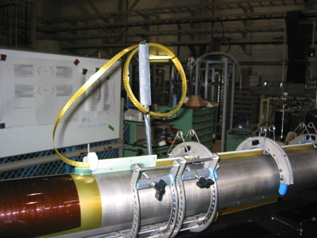
Coil Design
Modeled by ROXIE.
Engineering started.
Same “Layer Jump” concept realized in
J-PARC SCFM.
CAD “Layer Jump” model
CAD model: LE end spacers
Modeled with “Bricks” in ROXIE (blue)
13

Slide 14

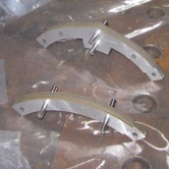
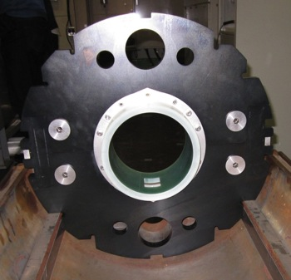
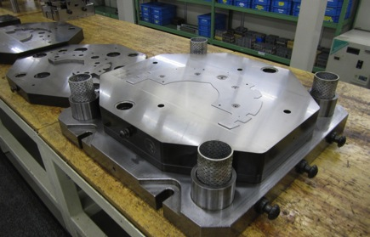
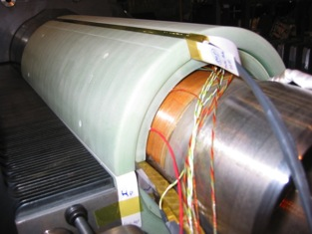
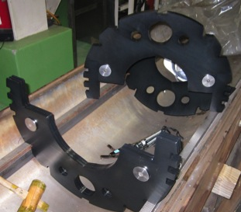
Collar (Body and LE), Yoke
A collared yoke structure (Originated at RHIC-dipole, followed by LHC MQXA)
  Stainless steel collar as a spacer. 4-split collars to avoid warp of the sheet.
  Vertically split iron yoke locked by keys.
  Crucial for mechanical support, field quality (alignment, shaping, saturation, packing factor).
Fine-Blanking technology to be adopted for the full-scale magnets.
  Very expensive investment
  Consideration on cooling scheme and analysis of temp. profile are still underway. Not fixed yet.
  Further adjustment of field quality.
  >> Risk of iron cross section change >> laser-cut and machining for the 2-m long model.
Discussions with vendors (JFE, NSSC) for low carbon EFE steels and YUS130S. Very positive answers to supply the materials even for the 2-m long models.
GFRP collar at LE, same concept already realized in J-PARC SCFM.
LE GFRP collar for J-PARC SCFM
Fine-blanking dies for J-PARC SCFM
Dummy mock-up of D1

Slide 15
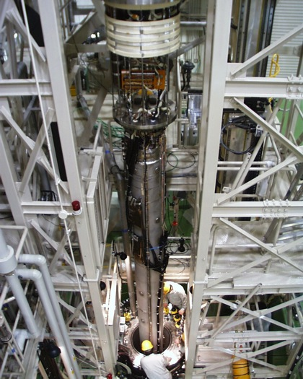
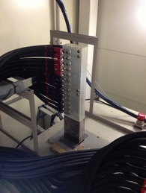
Preparatory Work for Cold Tests
Resume of the cryogenics for the cold testing.
  Repair works
Modification and procurement of the cryostat for
“12 kA, 150 mm aperture” D1 magnet.
  Current Spec: 7.5kA, 70 mm aperture
  New top flange w/ larger warm bore and 15 kA CL.
Consolidation of PC and bus lines. (7.5 kA >> 15 kA).
New DAQ systems
Modified 15kA Bus lines
New flanges, λ plate, warm bore
New 15kA-DCCT
Cold test of LHC-MQXA

Slide 16
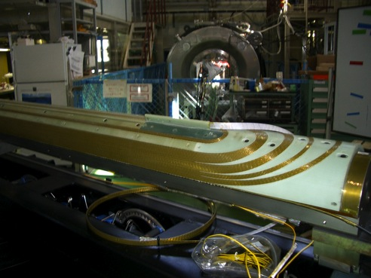
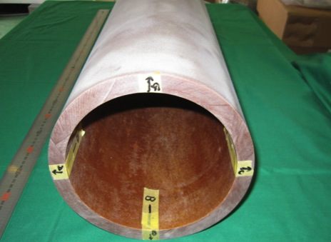
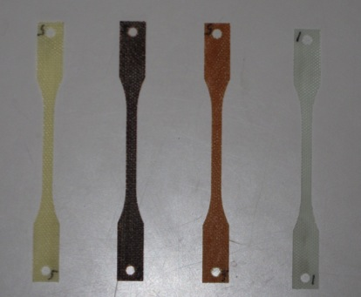
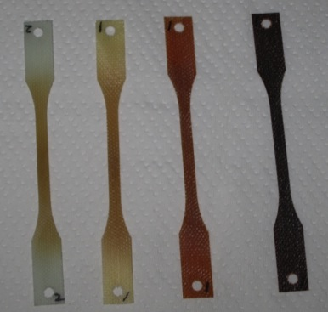
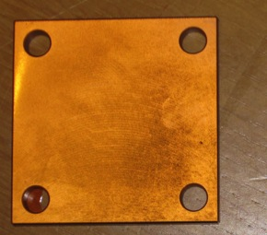
Radiation Resistant Materials R&D
Ordinary SC coils (J-PARC SCFM) with G10 (epoxy + E glass) end spacers and wedges.
New radiation resistant GFRPs (w/ S-2 Glass or T-Glass) are baseline for coil wedges, end spacers.
  Cyanate Ester & Epoxy
  BT (Bismaleimide Triazine)
  BMI (Bismaleimide)
Trial production has been made: prepreg sheets, laminated plates and pipes.
Backup plan (in case of higher dose) would be metallic parts with Polyimide coating by "Vapor Deposition Polymerization" technology.
Irradiation test by electron and gamma rays
  Gamma rays (Co⁶⁰ ), 2 MeV electron at JAEA Takasaki
  30 MeV electron at KUR
After irradiation of 10MGy with 30 MeV electron beam
CE
BMI
BT
Epoxy
(G10)
Epoxy
(G10)
CE
BT
BMI
BT-GFRP pipe for end spacers and pipe（φ160, L1000）
Backup Plan: Polyimide coating on metal parts

Slide 17
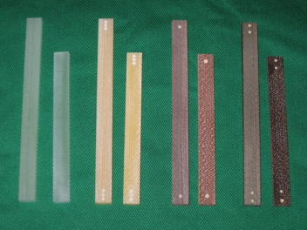
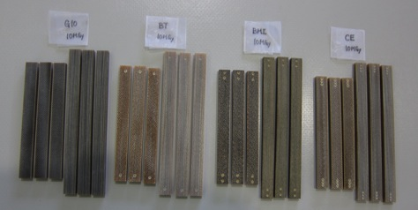
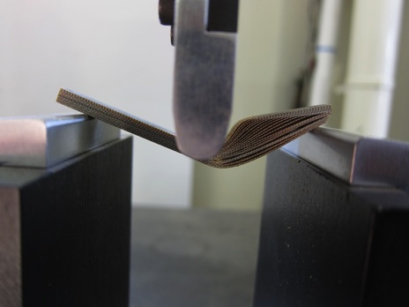
G10
CE
BT
BMI
RT Gamma-ray Irradiation Tests
New GFRPs (CE&Epoxy, BT, and BMI) show good radiation resistance up to 100 MGy.
Ordinary G10 (for MQXA) already showed significant degradation even at 10 MGy.
GFRP (S2 glass & BT resin) will be adopted for the new D1
After irradiation of 13 MGy
Flexural strength test （G10, 30MGy）

Slide 18
R&D Plan of D1 Development and Budget in 2014

Slide 19
Plans for D1 Model Development
JFY2013 (until March 2014)
Conceptual design study
Engineering design (coil winding, curing, etc.)
Practice coil winding. Mechanical short model
JFY2014
Engineering design (collaring, yoking, splices, shell)
1st 2m long model magnet assembly, and cold test at 1.9K.
JFY2015 or later, new funding for the construction (including R&D) will be needed.
JFY2015
(if necessary) 2nd model magnet assembly, and cold test at 1.9 K.
Conceptual design and engineering design for the cryostat.
TDR for HiLumi-LHC Design Study (EC-FP7)
Financial support by CERN-KEK Budget, KEK internal (IPNS/ATLAS-Japan).
But the official budget in KEK is still not approved yet.

Slide 20
Accounting & Budget for D1 model R&D
 |  | JFY2013 Accounting |  | JFY2014 Budget
 |  | Prediction | Inventory on order | Proposal | Min. Req.
Income | Carry over from the last year | 8.40 | - | 0 | 0
 | CERN-KEK Budget | 21.17 | - | 21.10* | 21.10*
 | KEK (ATLAS-J + ? ) | 85.00 | - | 126.00 | 80.00
 | Total | 114.57 | - | 147.10 | 101.10
Expenditure | Conceptual Design | 0.00 + 1 FTE | - | 0.00 + 0.2 FTE | 0.00 + 0.2 FTE
 | Engineering (CAD support) | 7.52 + 1 FTE | - | 7.00 + 1 FTE | 7.00 + 1 FTE
 | Materials for D1 model magnet | 52.81 | 34.60 | 55.00 | 44.50
 | Test stand | 44.97 | 7.50 | 47.00 | 25.00
 | Technical support | 5.41 | 2.21 | 12.00 | 12.00
 | Travel & others | 3.87 | 1.00 | 5.00 | 2.60
 | Carry over to the next year | 0 | 0 | 21.10 | 10.00
 | Total | 114.57 | 45.31 | 147.10 | 101.10
Unit: MJYen (~10kCHF)
* Assuming 100 JYen=1 CHF

Slide 21
KEK Contribution for HL-LHC with D1
Proposal reviewed at “LHC/ATLAS Upgrade Review” at KEK

Slide 22
Possible Contribution Items – to be discussed
In-kind contribution
  1 full-scale prototype (magnet and cryostat), maybe used for the string test at CERN.
  6 (at a maximum) full-scale production magnets assembled in cryostats.
    4 for HL-LHC machine, 2 for spares.
Evaluation tests
  Warm MFM: ALL magnets.
  Vertical cold tests at 1.9 K:
    Training quench (105% of I_{op} ?): ALL magnets.
    MFM: ALL magnets.
  Horizontal cold tests (presumably around lambda point) for cryostatted magnets.
    Only applied for 1 prototype, 1 or 2 production magnets. NOT ALL.
    Excitation test.
    MFM
    Reasons: special permission by government for each test, insufficient cryogenics power, limited manpower.
Items to be supplied by CERN
  NbTi SC cables with insulation.
  Insulated cold bore-tube with tungsten radiation shield.
  HeII internal HX ??

Slide 23
Contribution Plan of D1: Plan, Budget Profile, Manpower
Item | sub-item | 2013 | 2014 | 2015 | 2016 | 2017 | 2018 | 2019 | 2020 | 2021 | 2022 | 2023 | Total
2-m long model |  | 127,370 | 126,000 | 81,600 |  |  |  |  |  |  |  |  | 334,970
Full-scale magnets | Prototype magnet (1) |  |  |  | 100,000 | 100,000
 | Production magnets (6) |  |  |  |  |  | 500,000 | 300,000 | 200,000 | 100,000 | 100,000
 | Prototype cryostat (1) |  |  |  |  | 70,000
 | Prodcution cryostats (6) |  |  |  |  |  | 70,000 | 210,000 |  | 70,000 | 70,000
 | Transportation to CERN |  |  |  |  |  |  |  | 10,000 | 10,000 | 10,000
 | Warm MFM bech at vendor |  |  |  | 100,000
 | String test or installation in tunnel |  |  |  |  |  |  |  |  | 18,000
sub-total |  |  |  |  | 200,000 | 170,000 | 570,000 | 510,000 | 210,000 | 198,000 | 180,000 | 0 | 2,038,000
Test at KEK | Cryogenics consolidation |  |  | 20,000 | 70,000 | 30,000 | 0 | 0 | 0 | 0 | 0 | 0
 | Horizontal HeII test bench |  |  | 20,000 | 150,000 | 80,000 | 10,000 | 10,000 | 10,000 | 10,000 | 10,000
sub-total |  |  |  | 40,000 | 220,000 | 110,000 | 10,000 | 10,000 | 10,000 | 10,000 | 10,000 | 0 | 420,000
Manpower cost | Post-doc fellows (x2) |  |  |  | 14,000 | 14,000 | 14,000 | 14,000 | 14,000 | 14,000 | 14,000 | 14,000
 | Outsourcing of cryogenics operation |  |  |  | 10,080 | 90,720 | 120,960 | 120,960 | 120,960 | 80,640 | 60,480 | 0
sub-total |  |  |  |  | 24,080 | 104,720 | 134,960 | 134,960 | 134,960 | 94,640 | 74,480 | 14,000 | 716,800
Travel |  |  |  |  | 2,000 | 2,000 | 2,000 | 2,000 | 3,000 | 5,000 | 5,000 | 4,000 | 25,000
Total |  | 127,370 | 126,000 | 121,600 | 446,080 | 386,720 | 716,960 | 656,960 | 357,960 | 307,640 | 269,480 | 18,000 | 3,407,400
 |  |  |  |  |  |  |  |  |  |  |  |  | Unit: kJYen
JFY2013-2015: Conceptual design study and the model magnet development for the new D1
Pursued by Cryogenics Science Center (KEK-CSC) with a technical support of Mechanical Engineering Center (KEK-MEC)
A financial support from KEK/KEK-IPNS/ATLAS-Japan.
~JFY 2013 2 FTE of permanent staff, 1 FTE of fellow.
JFY2014~ 3 or 3.5 FTE of permanent staff, 1 FTE of fellow, outsourcing of technical supports.
JFY2015-2023 (some overlap): Full-scale prototyping and a series production of the new D1
Manufacturing by a manufacturer, with KEK’s responsibility (like MQXA).
Warm field measurements and cold tests at KEK for ALL magnets and SOME cryo-assemblies.
Predicted manpower: 4 FTE of permanent staff at least, and 2 FTE of fellows, outsourcing particularly for the cryogenics operation.

Slide 24
Slides from Closeout of Review

Slide 25
Slides from Closeout of Review

Slide 26
Summary (1/2)
Conceptual design study for the new D1 has been pursued by KEK:
φ150mm, 35 Tm, load line ratio of 75 % in 2D (78 % in total).
  Nominal field of 5.59 T at 12 kA, with a peak field of 6.75 T (78% at 1.9K).
  Field quality in 2D along excitation is acceptable and successfully optimized at nominal current under high saturation effect.
  Coil end effects are still observed at S.S. of the full-scale model and further optimization on field integral of B₃ would be necessary.
  The whole magnet length of 6.9 m will fit to the vertical cryostat at KEK.
  Mechanical analysis: this option is feasible.
  To be addressed: quench protection studies.

Slide 27
Summary (2/2)
2-m long model magnet development.
  Engineering work underway. Procurement started.
  Renovation of development area, consolidation of cold test stand ongoing.
  Collaboration (& technical support) with CERN
Funding for the new D1 construction as a part of “ATLAS/LHC upgrade project” is necessary.
  In total, 34 MCHF for the new D1 from JFY2014 to JFY2023.
In-kind contribution items to HL-LHC is planned.
  1 full-scale D1 prototype (magnet and cryostat)
  6 (at a maximum) full-scale D1 production magnets assembled in cryostats.
    All magnets tested at 1.9 K.
    Horizontal cold tests only for 1 prototype, 1 or 2 production magnets.
Some concerns about:
  Coordination with the manufacturer.
  Horizontal cold test bench.
  Limited manpower at KEK.

