Slide 1
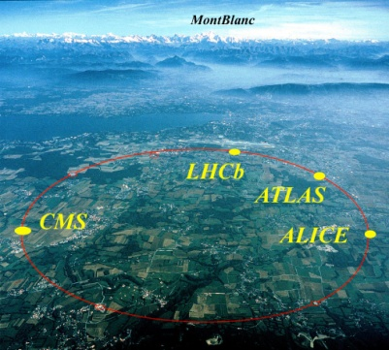
ATLAS and its upgrade
Katsuo Tokushuku
KEK

Slide 2
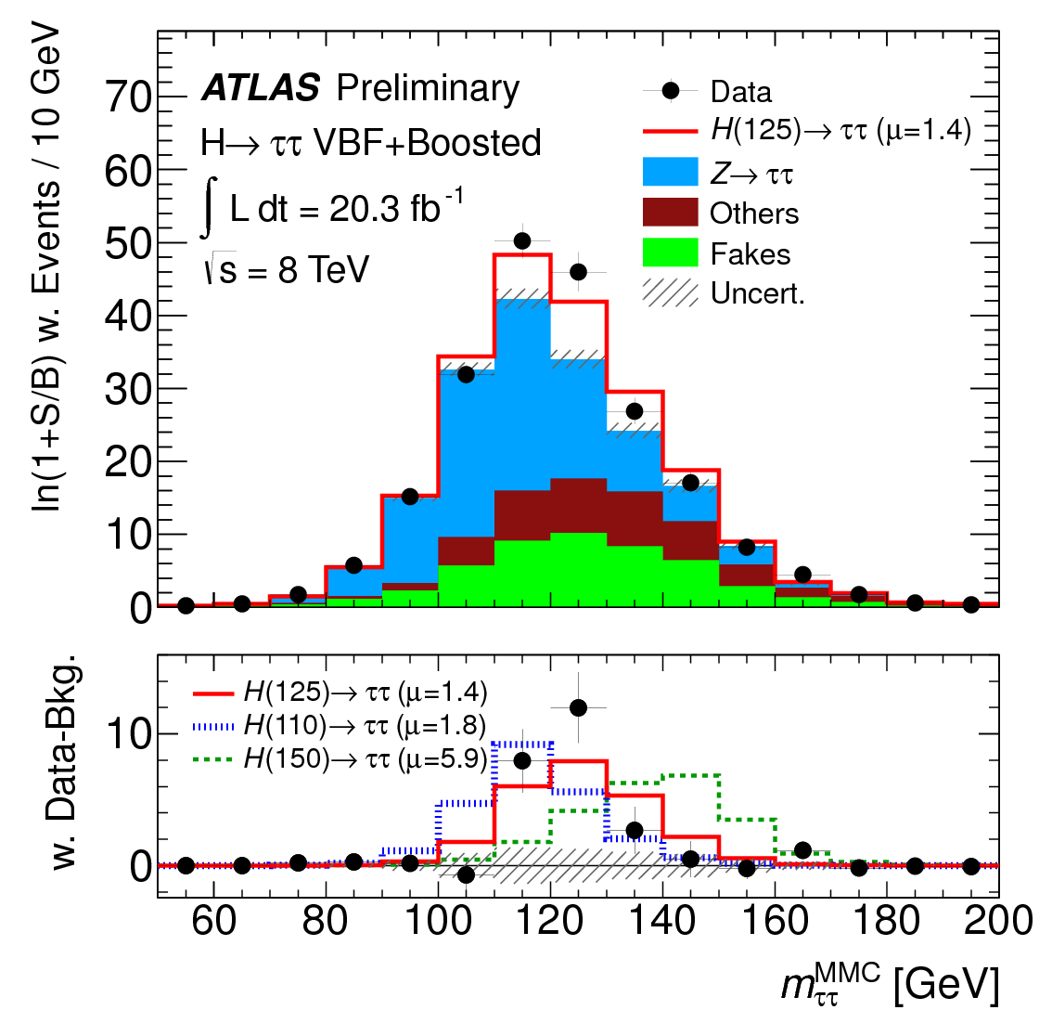
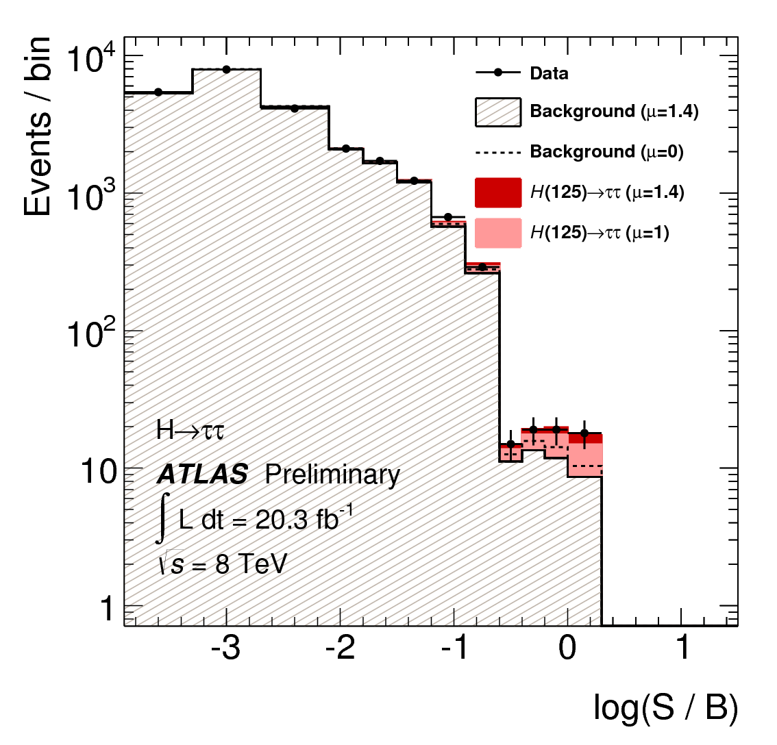
New Higgs result: H→ττ
4.1σ sigunificnce:
μ= 1.4^{+0.5} _{-0.4}

Slide 3
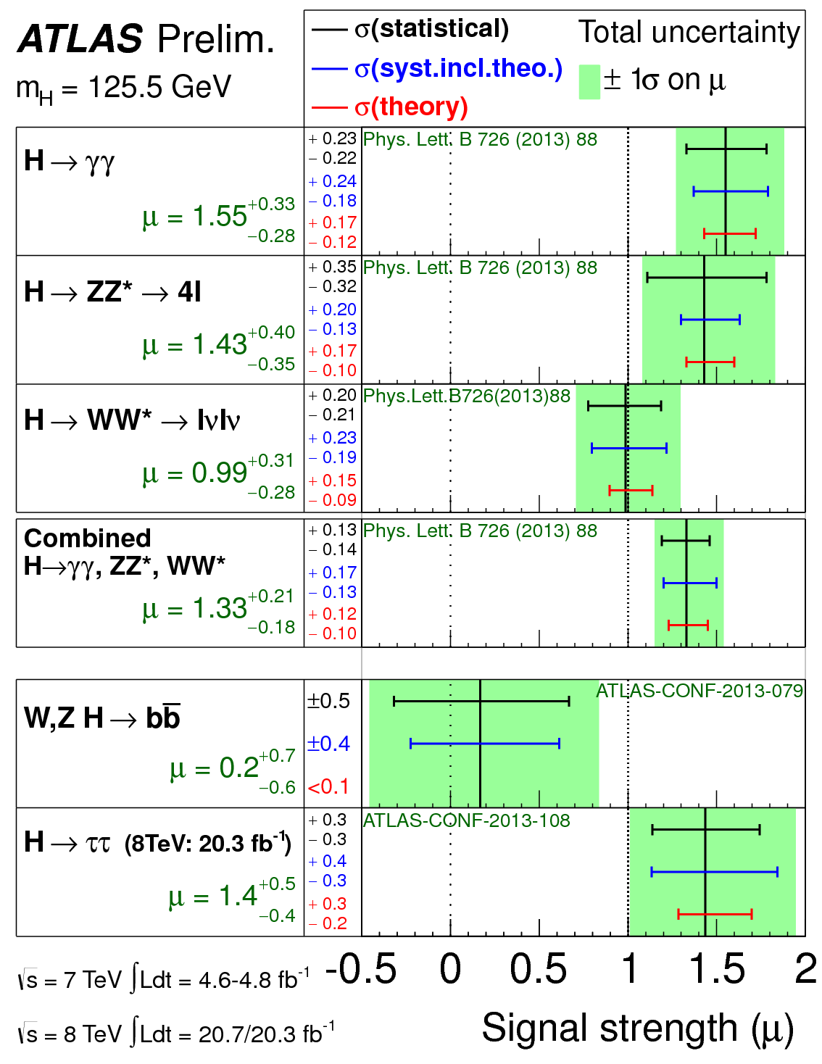
Clear signal in γγ、 ZZ, WW, ττ modes
H-> bb : consistent to 0 (and to the SM within the error)
=> We need Run 2 data
H->μμ
μ＜10 :
=> We need HL-LHC

Slide 4
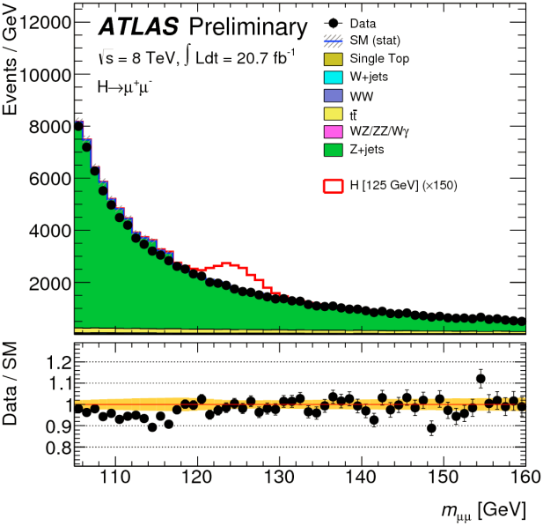
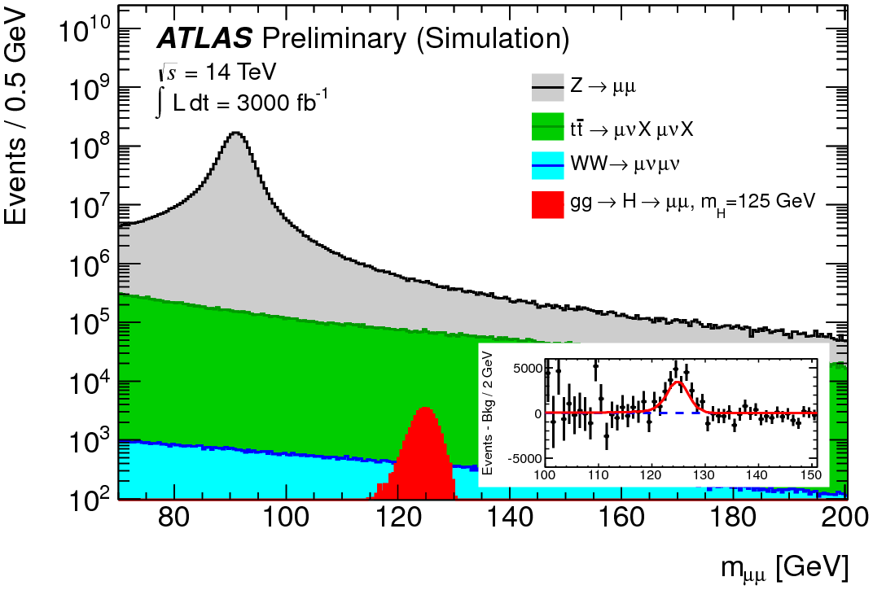
H-> μμ
In the SM:
BR(H->tau tau) =
288 x BR(H -> μμ）
If the 126GeV new particle is (lepton) flavor neutral particle (such as Z, W), we should have already seen in the mu muy channel

Slide 5

ATLAS Detector: construction and commissioning
Superconducting Central Solenoid (Japanese contribution:100%)
Time-to-digital conversion chips for muon drift tubes (100%)
End-cap muon triggering system (TGC) (~30%)
Silicon microstrip tracking system (SCT) (~20%)
Lvl-2 muon trigger (Software)
Tracking (|η|<2.5, B(solenoid)=2T) :
-- Si pixels and strips
-- Transition Radiation Detector (e/π separation)
Calorimetry (|η|<5) :
-- EM : Pb-LAr
-- HAD: Fe/scintillator (central), Cu/W-LAr (fwd)
Muon Spectrometer (|η|<2.7) :
air-core toroids with muon chambers
Length : ~ 46 m
Radius : ~ 12 m
Weight : ~ 7000 tons
~ 10⁸ electronic channels
~ 3000 km of cables

Slide 6
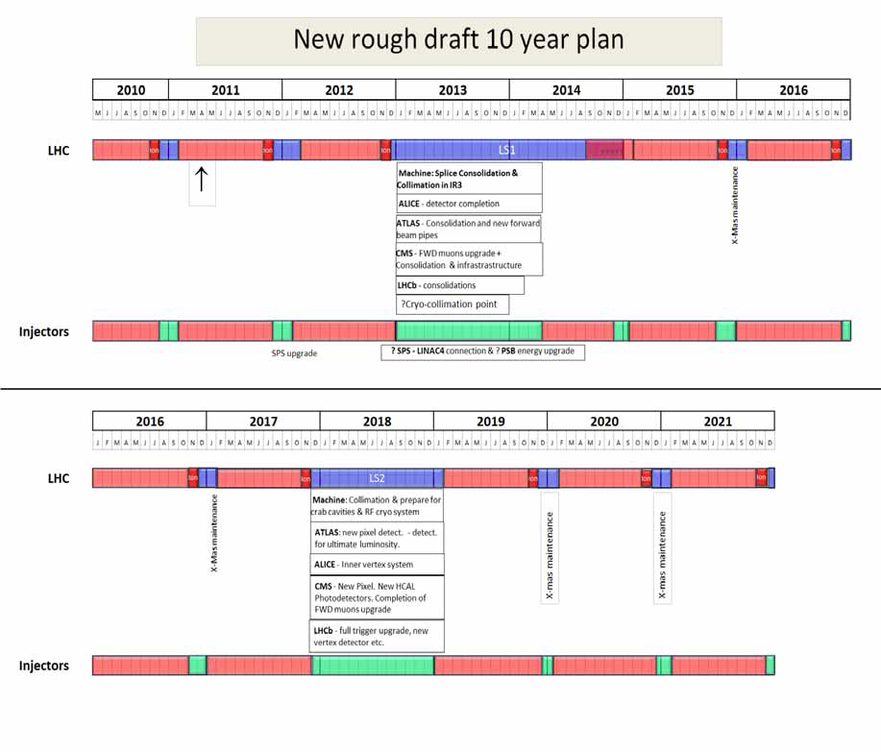
Phase 0 upgrade
IBL
Old Schedule
^{8TeV}
Phase 1 upgrade
Muon
Phase 2 upgrade
Inner Tracker
13-14 TeV ~ 100fb⁻¹
14 TeV ~ 300fb⁻¹
HL-
LHC
L~ 1x 10³⁴ cm⁻²s⁻¹
L~ 2x 10³⁴ cm⁻²s⁻¹
3000fb⁻¹ by 2030

Slide 7
ATLAS upgrade and Japanese contributions
Phase 0: IBL
Phase 1: ATLAS (~33MCHF : Project)
  muon trigger upgrade (Trigger + small contribution to nSW)
  FTK (by Waseda Univ.)
  New contribution to Liquid Argon Calorimeter: (digital signal processing)
Phase 2: ATLAS (~275MCHF : Project)
  Contributions to inner trackers (strips/pixels)
  Further muon trigger upgrade
  We need new resources for Phase2

Slide 8
Japanese contribution to LHC/LIU/ATLAS (request) core+noncore
Year | 2014 | 2015 | 2016 | 2017 | 2018 | 2019 | 2020 | 2021 | 2022 | 2023 | Sum
（Oku yen ~MCHF）
Accelerator upgrade | 1.440 | 1.396 | 5.061 | 4.467 | 7.530 | 6.690 | 3.700 | 3.196 | 2.815 | 0.300 | 36.594
ATLAS upgrade | 1.306 | 1.723 | 5.191 | 5.636 | 7.595 | 9.838 | 8.849 | 6.330 | 2.880 | 1.530 | 50.877
Sum | 2.746 | 3.119 | 10.252 | 10.103 | 15.125 | 16.527 | 12.548 | 9.526 | 5.695 | 1.830 | 87.471
Oku-yen

Slide 9
ATLAS-J budget request
(in Oku-yen ~ MCHF)

Slide 10
International Review
Japanese Participations on LHC upgrade (Accelerators + ALTAS) were reviewed on 21-22/Nov by following referees
Accelerator:
Mike Lamont (CERN)
Bruce Strauss (DOE)
Lucio Rossi(CERN, HL-LHC head)
Kaoru Yokoya (KEK)
Experiment:
Jonathan Dorfan (OIST)
Eckhard Elsen (DESY) – Chair person
Fabiola Gianotti (CERN)
Jordan Nash (IC London, CMS)
Mihoko Nojiri (KEK, Theory)
Andreas Schopper (CERN LHCb)
http://kds.kek.jp/conferenceDisplay.py?confId=13329
The recommendation document is in preparation (ready by Christmas)
Generally the plan was well received.
Some concerns (man power etc.)

Slide 11
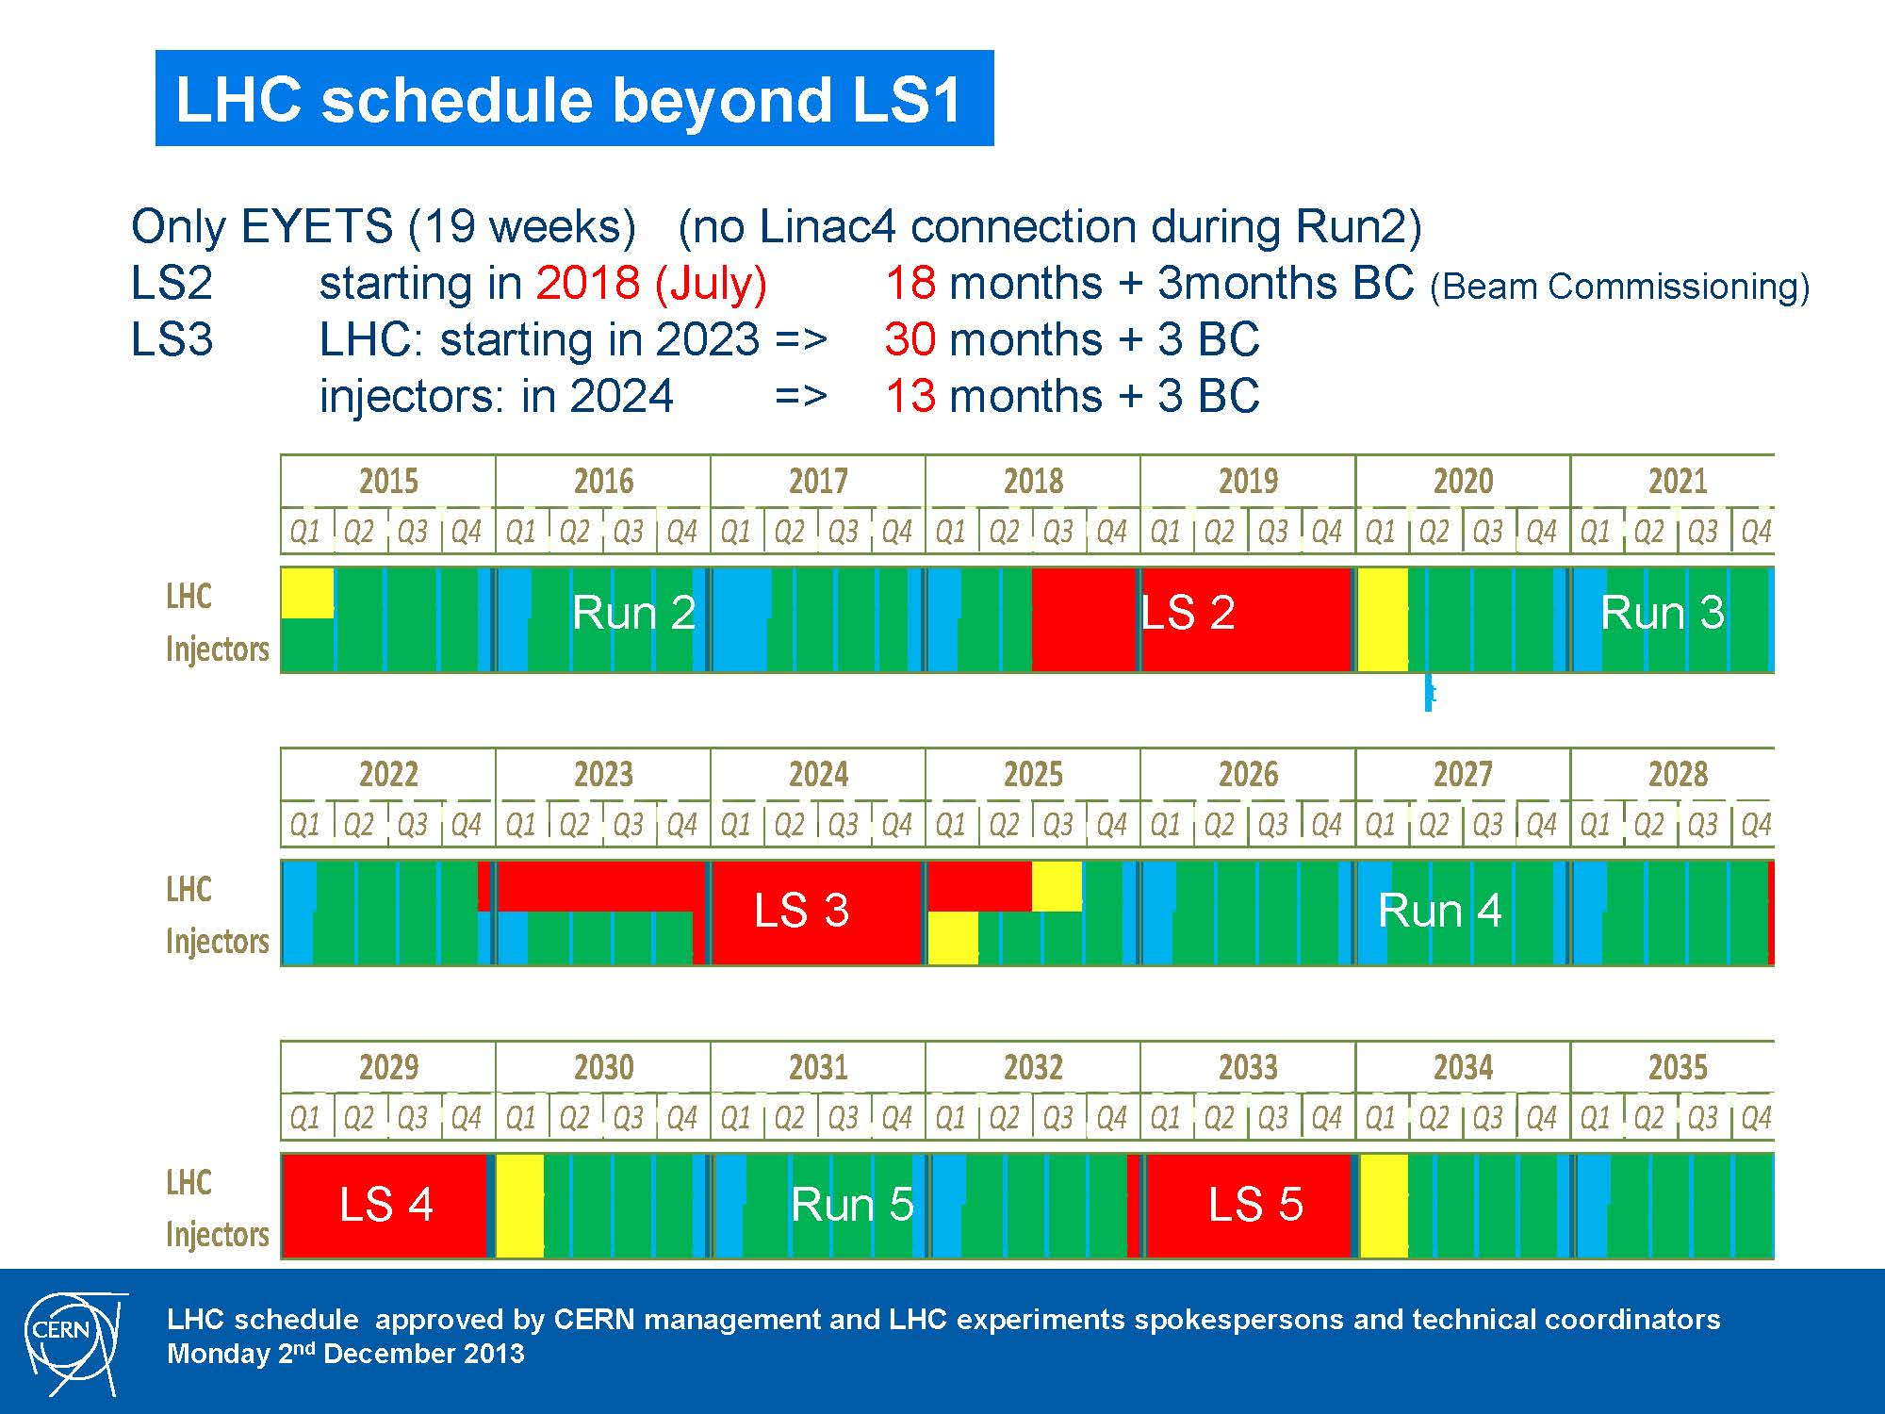
New Schedule!
Our tentative strategy:
Keep accelerator upgrade schedule as it is .
1~2 year delay for ATLAS upgrade

Slide 12
Strategy
Keep R&D activities with the available fund
Re-tune the funding profile with the updated LHC plan.
Negotiation with KEK/Mext
with the updated plan and review outcome.

Slide 13
Backup

Slide 14
ATLAS-Japan contribution plan
Strategy:
  Keep responsibilities on what we already committed but with some priorities.
    Muon:
      The most responsible part is to generate the LVL1 muon trigger. -> Full responsibility on LVL1 Trigger electronics
      R&D and component supply for chamber production. I.e. large-scale production at Japanese site is unlikely
      Contribution to HLT, mainly on muon triggers but also on other objects such as taus depending on the physics interests
    Inner Tracker:
      New contribution to pixel detectors. N-on-p planar type (with Hamamatsu)
      Considering ‘fair share’, Japanese contributions on ~25% of overall pixel and ~10% of overall strip detectors are the targets. But it depends on how much our designs are adopted in the ATLAS collaboration.
      Development of strip detectors with the alternative (back-up) option (super module configuration) for prototyping with new readout chips.
  Encourage new developments
    FTK: Mainl contribution on the input mezzanine boards: Waseda group, with (mostly) with their own JSPS fund.
    Liquid Argon: Readout signal processing (interests from the physics analysis (H-> gamma gamma, for example)
  Contribution to some common items, if necessary
    CPUs for trigger processing
Details will be discussed in the dedicated sessions. In this talk, one page summary for each project and summary of organization and cost are presented

Slide 15
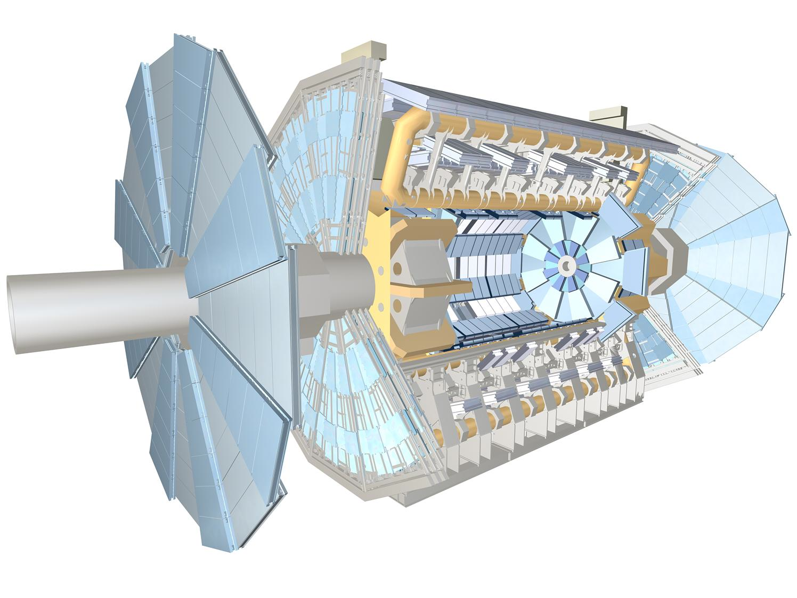
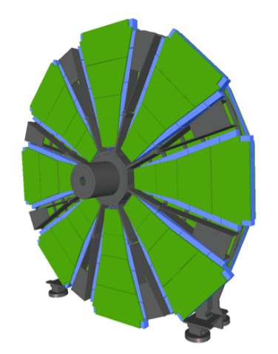
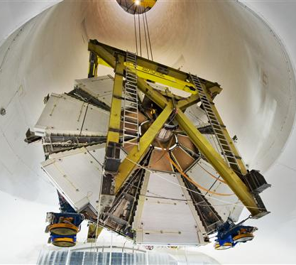
The innermost station of the muon endcap
Located between endcap calo and toroid
The small wheels
L1 trigger
chambers
New Small Wheels
EI station
small wheel
Micromegas
sTGC

Slide 16
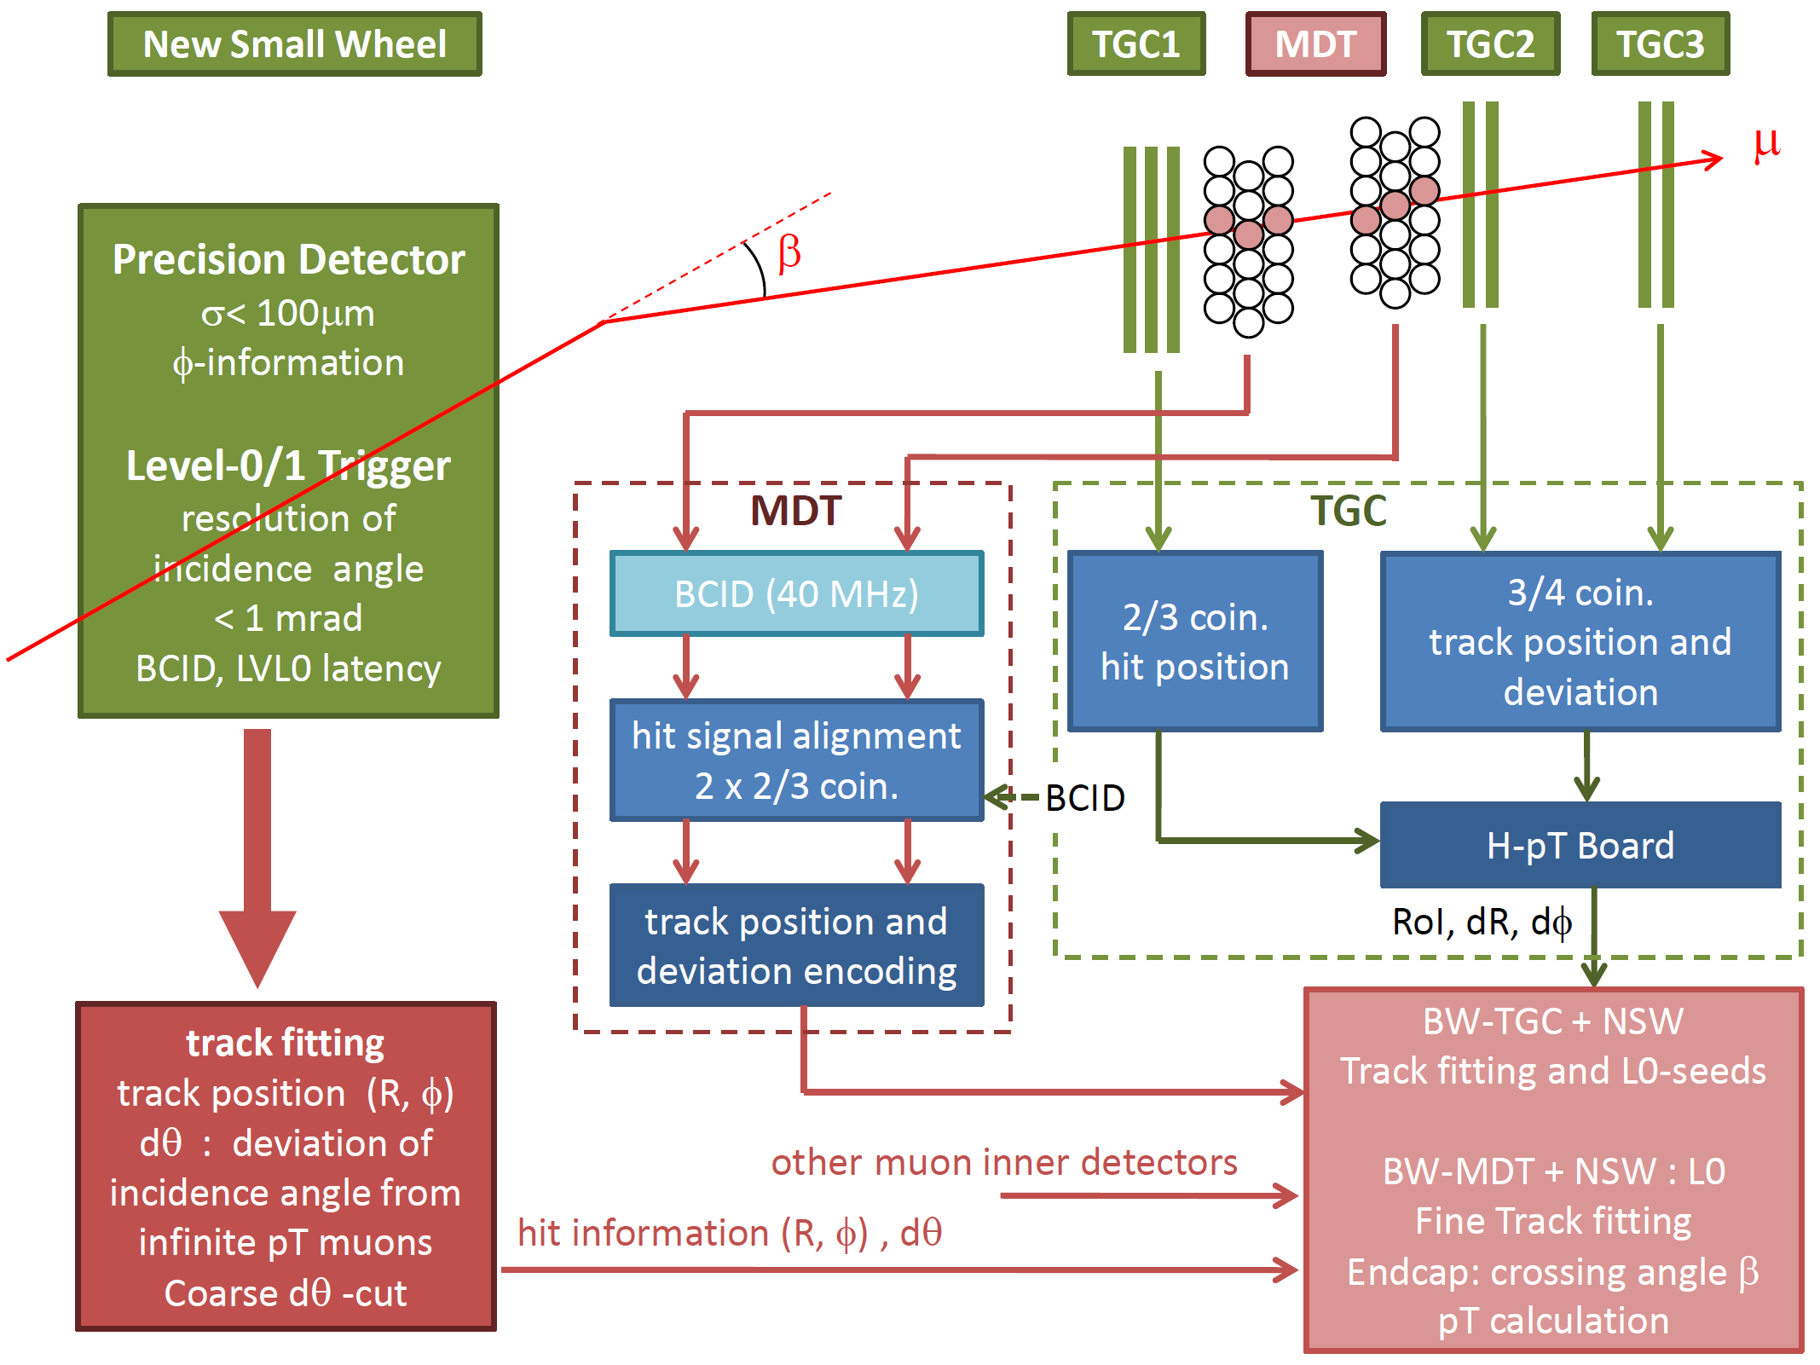
Muon Trigger Phase-1/2 Upgrade

Slide 17
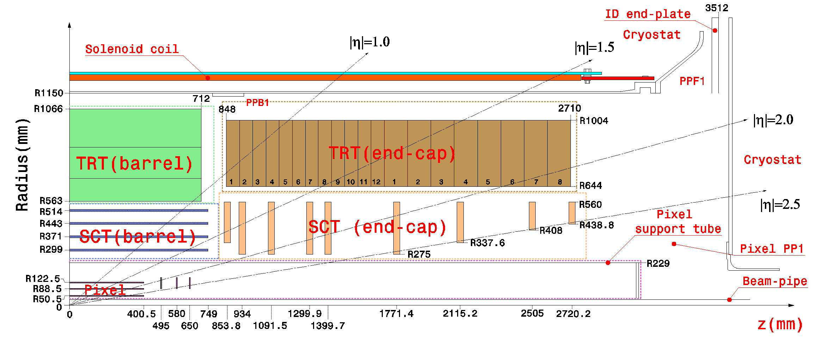
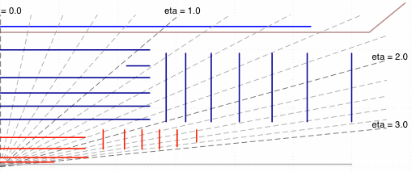
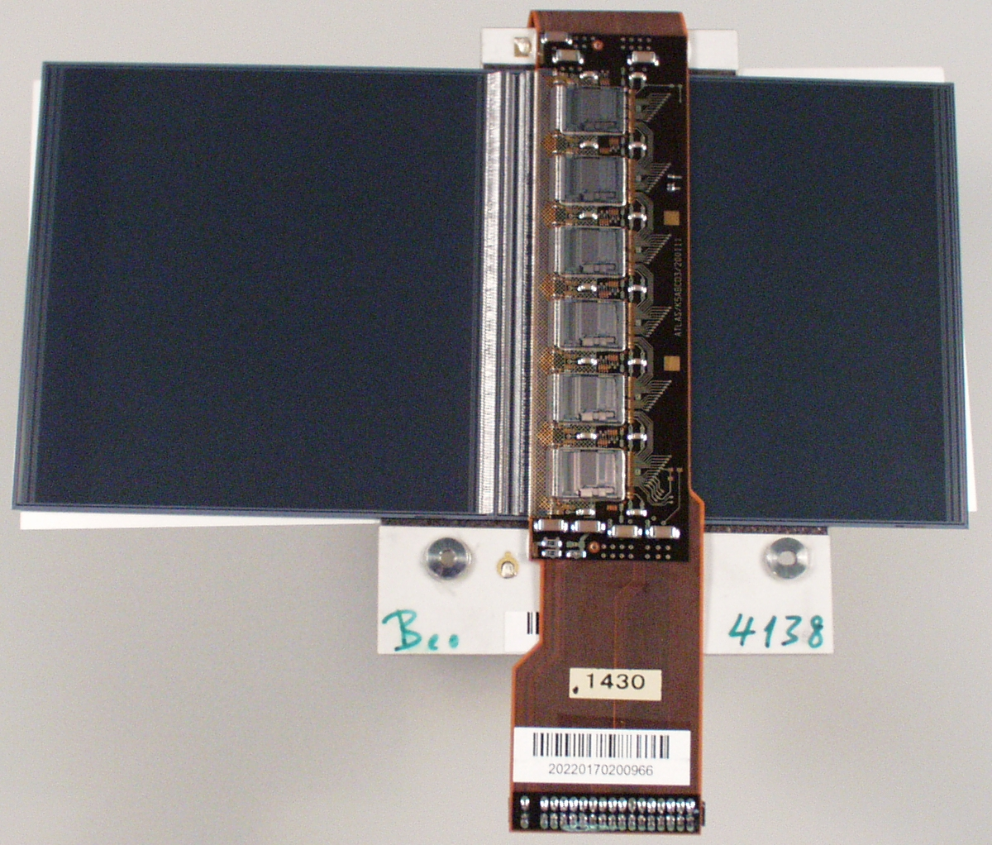
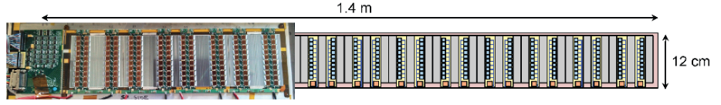
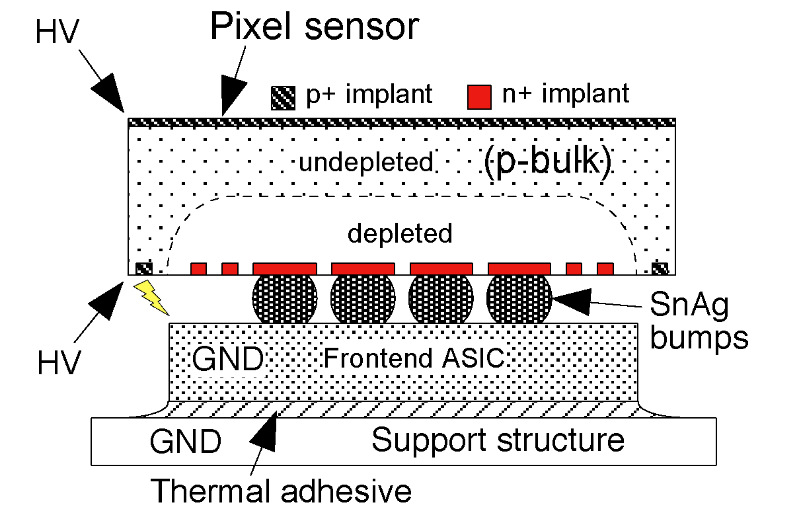
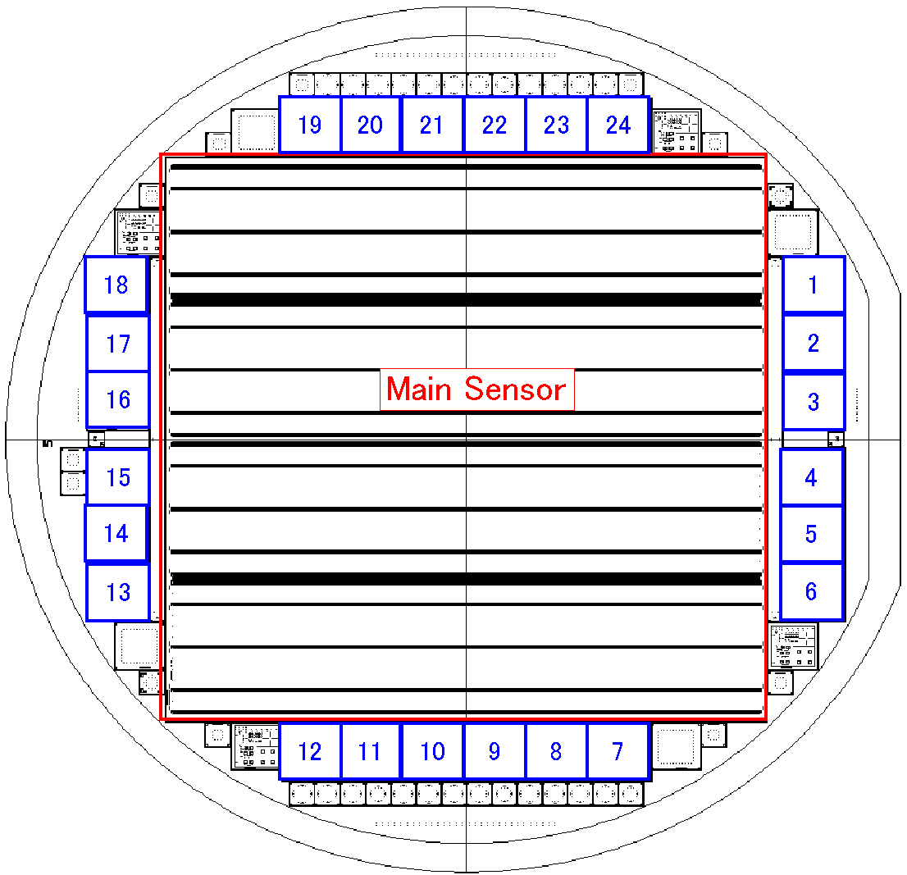
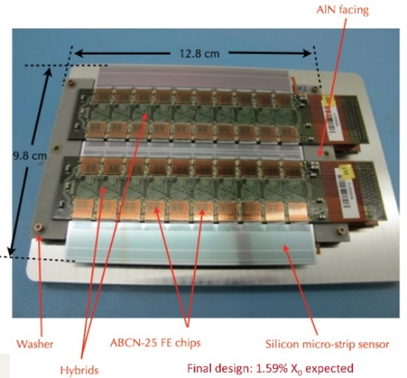
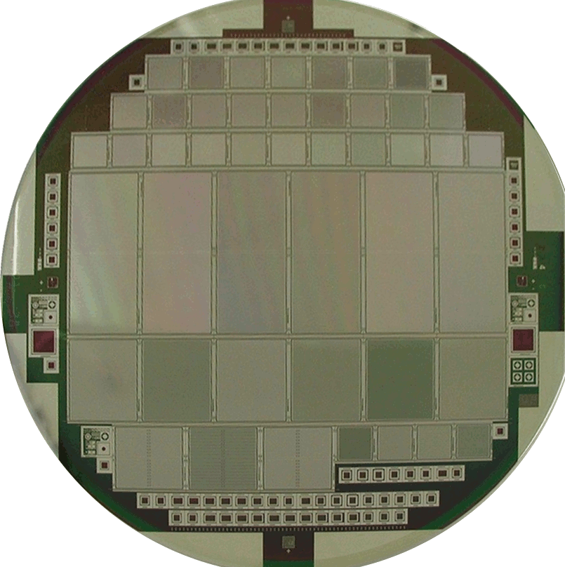
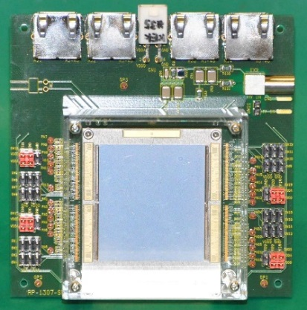
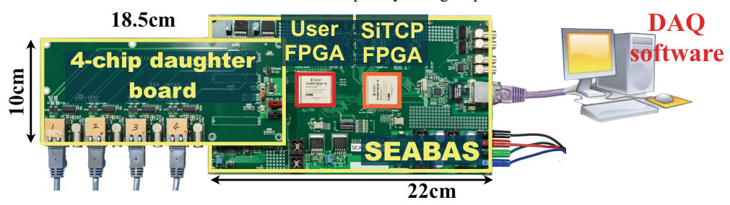
Inner Tracker
Barrel Strips
Forward Strips
Barrel Pixel
Forward Pixel
LHC
HL-LHC
Hybrid
STRIPS
PIXELS
Microstrip
sensor
axial
SCT barrel module
stereo
FE-I3 1-chip pixels
FE-I4 2-chip pixels
FE-I4 1-chip pixels
FE-I3 4-chip pixels
Pixels/Strips: Sensors, Hybrids, Modules, DAQ…

Slide 18
FTK: Fast TracKer (Phase0→1)
Fast Tracker (FTK) : Online hardware tracking system for ATLAS upgrade.
FTK reconstructs all tracks with PT>1 GeV/c for LVL1 accepted events and provides track information at the beginning of LVL2 trigger processing.
→ Allows to implement more efficient
and complex algorithms at LVL2.
Calo
Muon
Pixel/SCT
LVL1
Trigger
ROD
ROD
ROD
FTK
ROB
ROB
ROB
Japanese Participation:
- Waseda University
* responsible for Input mezzanine etc.
LVL2 CPU Farm
2014
Production
2015
2016
R&D
Global Test
Installation
&Commissioning
Operation

Slide 19
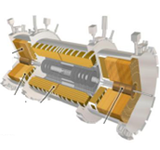
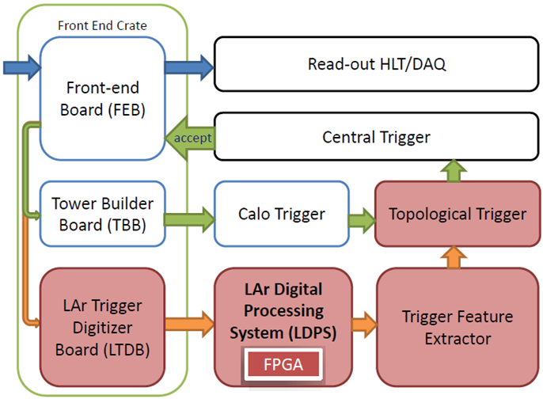
Phase1 LAr readout scheme
Trigger upgrade at Phase-I
  Introduce new components with keeping Legacy electronics
Introduce Super-Cells (10 times finer granularity)
  ΔηxΔφ = 0.1x0.1 → 4 layers with 0.025x0.1 in middle layers.
Main
New components:
Summed signals are digitized at Front-End (FE).
Converted to E_{T} by Digital signal processing at Back-End (BE)
  → ATLAS-J contribution
Send to Feature extractor (FEX) to make L1-Trigger.
Fast data transfer is key
  25 Tbps (FE→BE)
  41 Tbps (BE→FEX)
Legacy
New
Phase-1 components shown by the red dashed lines.

