Slide 1
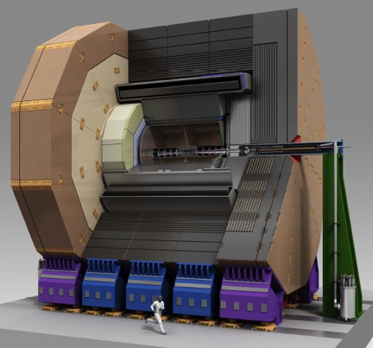
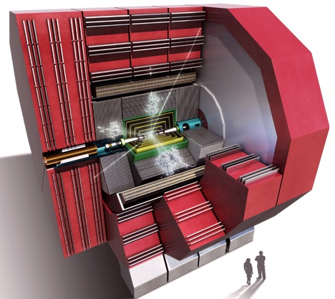
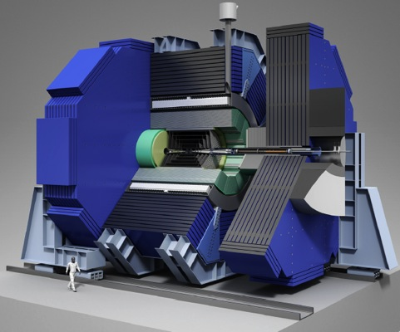


CERN-KEK collaboration on Linear Collider detectors
Lucie Linssen (CERN)

Slide 2


Detector concepts
ILD
SiD
Both ILD and SiD have two implementation variants: one for ILC and one for CLIC
Detector R&D for ILC and CLIC detector => Similar challenges => developed in common
e.g. fine-grained calorimetry, forward calorimetry, forward tracking, engineering design, superconducting solenoid, power delivery and power pulsing
Many of the software tools are common:
e.g. physics event generation, particle flow analysis, flavour tagging, grid computing
Overall, KEK activities involve mostly ILD, CERN activities involve ILD+SiD

Slide 3
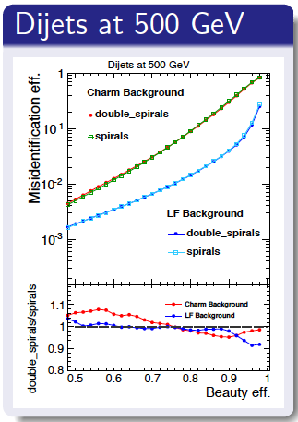
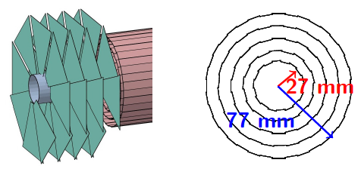
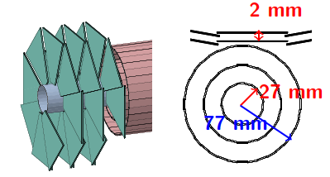
Common software => LCFIplus
LCFIplus = Flavour Tagging software for quark-flavour tagging
Complex software package
Improved and maintained by Japanese groups (KEK, Tokyo Univ.)
Used in all Linear Collider physics studies
Example: ➔
Use of LCFIplus for CLIC
vertex detector optimisation ⬇

Slide 4

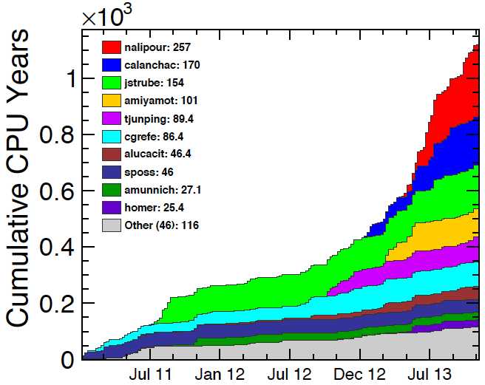
Common software => ILCDIRAC
common Grid production tool
ILCDIRAC is a complete Grid solution for all Linear Collider applications
ILCDIRAC was used in the mass productions for CLIC (CDR) and SiD (DBD)
ILCDIRAC is now also in use by the ILD detector group
Currently adding CVMFS (file system)
Currently adding Whizard2 (event generation with beam spectra)
Active support from the CERN PH-LCD group
CERN
KEK
CERN
KEK
KEK
CERN
CERN
CERN
DESY
SLAC
Example of user jobs ➔
Main users from CERN and KEK

Slide 5
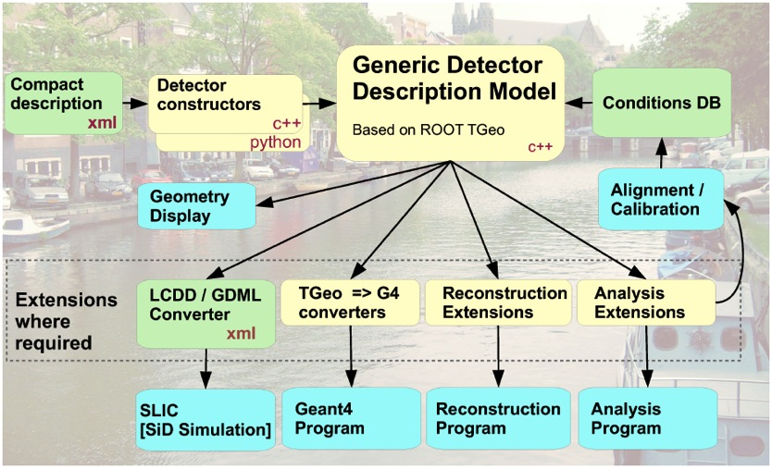
Common software => DD4hep
DD4hep = Detector Description for High-Energy Physics
General purpose detector geometry package, for thefull experiment life-cycle:
  simulation
  reconstruction,
  visualisation
Currently under development:
  developers from all LC concepts
Main architecture set up by CERN
Aim to have it ready by end 2014

Slide 6
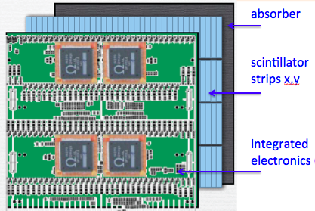
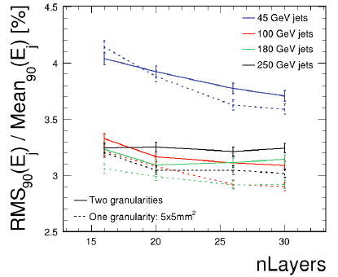
Detector optimisation => ECAL
Common studies for optimised and cost-effective ECAL
Requires:
Software development
ECAL optimisation in simulation studies
Hardware development for small ECAL scintillator cells
Main partners in the study: Japan groups, Cambridge, CERN
Detector optimisation
for varying ECAL layout

Slide 7
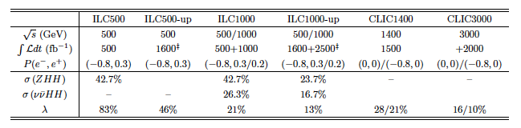
LC physics studies
Linear Collider physics studies
Frequent scientific exchanges
Use of common analysis tools
Physics studies by ILC-members for CLIC CDR
Physics studies by CLIC-members for ILC DBD
In 2014: many physics studies for Snowmass process
Example ⬆
Comparison ILC-CLIC in σ×BR accuracy for double-Higgs production (Snowmass report)

Slide 8
summary
Many common activities between the KEK and CERN linear collider detector studies
Recent focus of collaboration has mostly been on:
Common software tools
Linear Collider physics studies
Detector optimisation studies
In 2013 there was an exchange of:
2 invited physicists from Tokyo/KEK to CERN
1 invited physicists from CERN to KEK
thank you

