Slide 1
CERN-KEK in the area of LCs
European Strategy for Particle Physics
High-priority large-scale scientific activities
After careful analysis of many possible large-scale scientific activities requiring significant resources, sizeable collaborations and sustained commitment, the following four activities have been identified as carrying the highest priority.
d) To stay at the forefront of particle physics, Europe needs to be in a position to propose an ambitious post-LHC accelerator project at CERN by the time of the next Strategy update, when physics results from the LHC running at 14 TeV will be available. CERN should undertake design studies for accelerator projects in a global context, with emphasis on proton-proton and electron-positron high energy frontier machines. These design studies should be coupled to a vigorous accelerator R&D programme, including high-field magnets and high-gradient accelerating structures, in collaboration with national institutes, laboratories and universities worldwide.
Post-LHC options for high energy frontier machines:
Proton-Proton: FCC
Electron-positron: CLIC

Slide 2
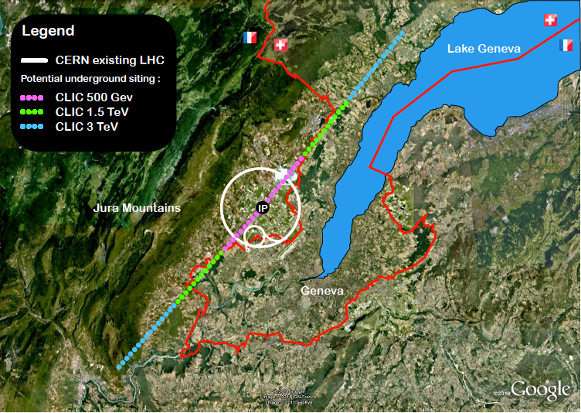
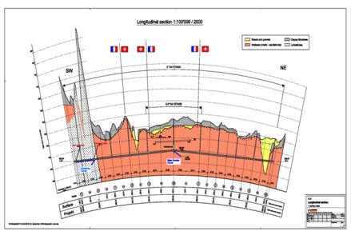
CLIC developments towards 2018
A re-baselined staged project plan, cost and power optimisation, increased industrialisation effort for cost-drivers
High Gradient structure development and significantly increased test-capacity for X-band RF-structures
System-test programmes in CTF3, at ATF and FACET, as well as system-tests in collaborative programmes with light-source laboratories
Technical systems developments, related among others to complete modules, alignment/stability, instrumentation and power sources
Physics studies related to energy frontier capabilities and potential new physics as it emerges from LHC
Tunnel implementations (laser straight)
Central MDI & Interaction Region
Notes:
Main points:
After the work done for the CDR there are several key points that need to be addressed or improved in the coming years (mention the five points on the fly in)
Several of them, for example costing-power-physics-some technical developments, can and will be done in collaboration with similar work for the large ring

Slide 3
































CLIC Collaboration
29 Countries – over 70 Institutes
Accelerator
collaboration
Detector
collaboration
Accelerator + Detector collaboration
Notes:
The CLIC accelerator and detector&physics studies are already set up at international collaboraitons with wide participation from member and non-member states

Slide 4
European Strategy for Particle Physics
High-priority large-scale scientific activities
After careful analysis of many possible large-scale scientific activities requiring significant resources, sizeable collaborations and sustained commitment, the following four activities have been identified as carrying the highest priority.
e) There is a strong scientific case for an electron-positron collider, complementary to the LHC, that can study the properties of the Higgs boson and other particles with unprecedented precision and whose energy can be upgraded. The Technical Design Report of the International Linear Collider (ILC) has been completed, with large European participation. The initiative from the Japanese particle physics community to host the ILC in Japan is most welcome, and European groups are eager to participate. Europe looks forward to a proposal from Japan to discuss a possible participation.
At CERN ILC efforts continue
in the framework of the overall LC efforts:
Common CLIC-ILC technical and design activities for several parts of the accelerator
Common activities related to detectors and physics studies
Some limited contributions to the SCRF development
Hosting LCC Directorate at CERN

Slide 5
CERN-KEK in the area of LCs (ongoing)
Xband testing
ATF (instrumentation, stabilisation, FF magnet(s), kicker tests, BBA and operation) – also supporting UK and possibly Spanish contributions
Design studies for the BDS (common work ILC-CLIC)
ILC support for couplers and tuners
LC directorate, CE studies
Detector and Physics (see slides later)
Some (non comprehensive) examples in the following …

Slide 6
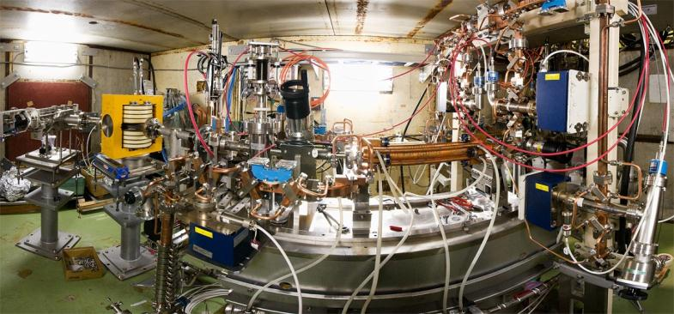
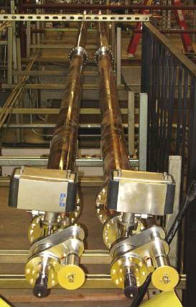
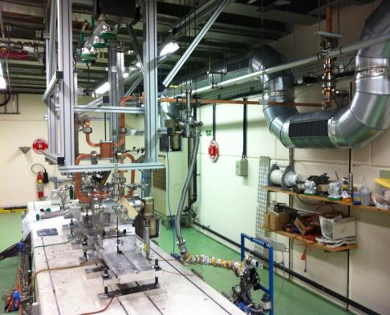
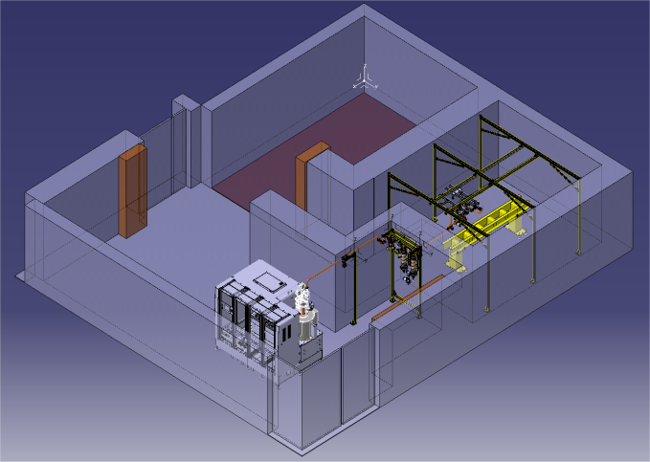
NEXTEF at KEK
ASTA at SLAC
Previous:
Scaled 11.4 GHz
tests at SLAC and KEK.
XBOX1 at CERN with SLAC klystron
XBOX2 at CERN, industrial klystron
ready next … then XBOX3
100 MW can be provided in pulses of 250 ns, 50 Hz.
Can power two CLIC accelerating structures.
Planned capacity : power six CLIC accelerating structures
Important goal: greatly increased X-band rf test capability, at 12 GHz, at CERN

Slide 7
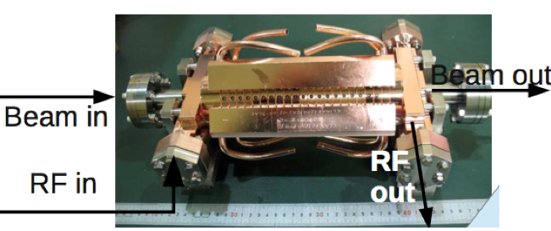
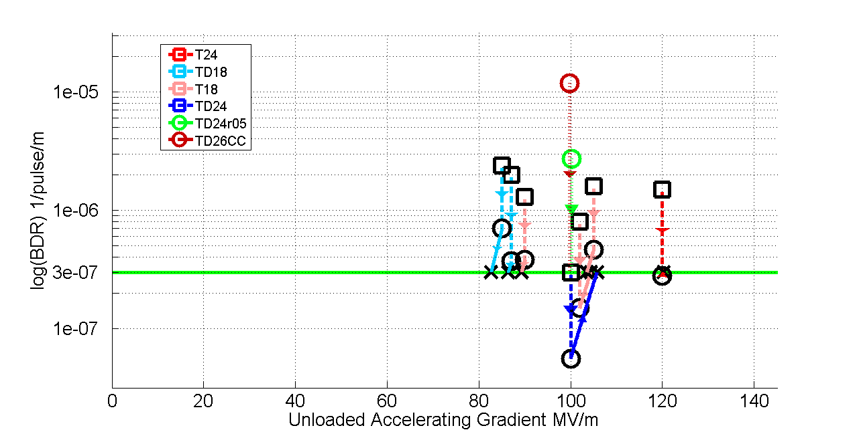
CLIC main linac structure (12 GHz Cu TW)
100 MV/m gradient (loaded), BDR < 3 x 10⁻⁷/pulse/m, Rf pulse length: t_{p} = 240 ns
Gradients depends on BDR and pulse-length, the lines represent the scaling to the correct BDR and pulse-length
TD24 structure (blue) at 106 MV/m unloaded (expect 0-16% less with loading)
Still under conditioning

Slide 8
Stabilisation Experiment

Slide 9
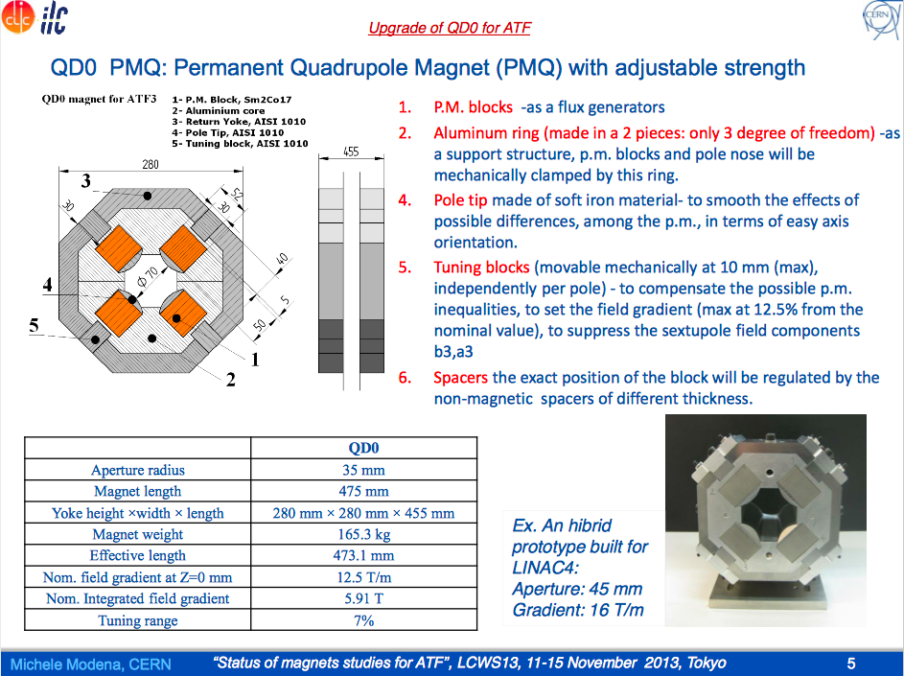

Slide 10
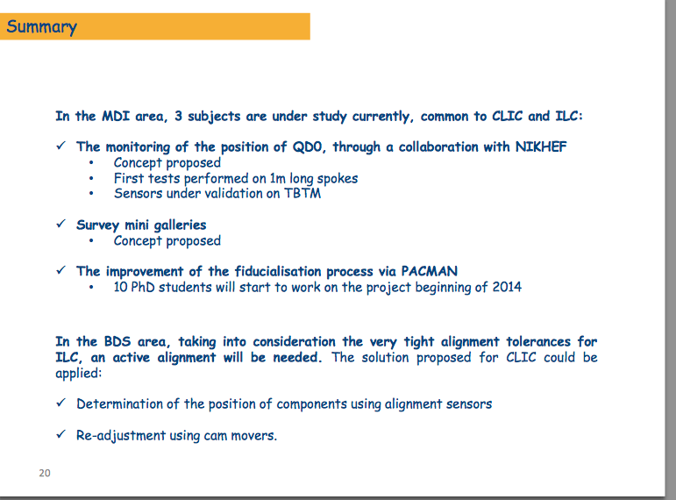
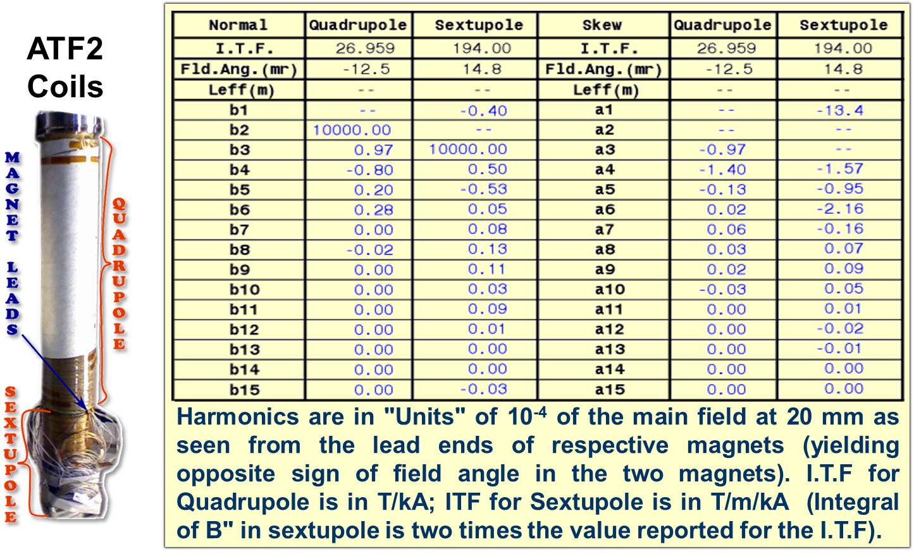
ATF2 Superconducting Final Focus.
Can the ATF2 superconducting FF coils still be used?
Slide from Helene Mainaud Durand
Completed ATF2 FF Coil Package
Measured Magnetic Field Harmonics for ATF2 FF Coil Package

Slide 11
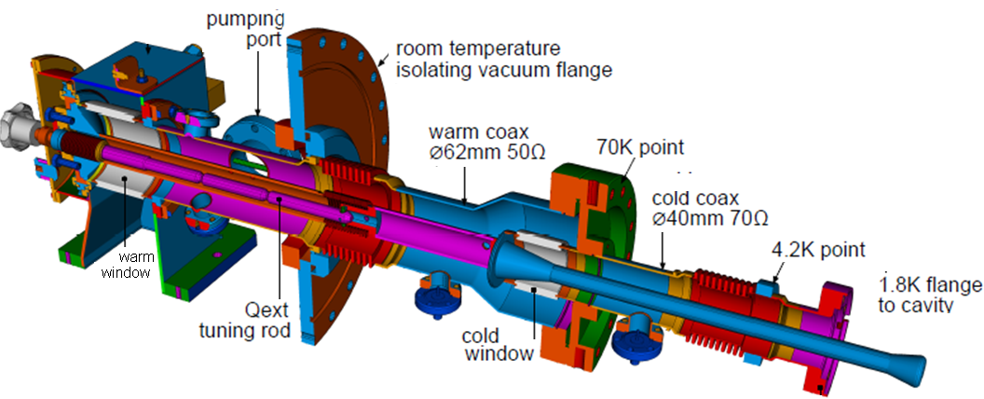
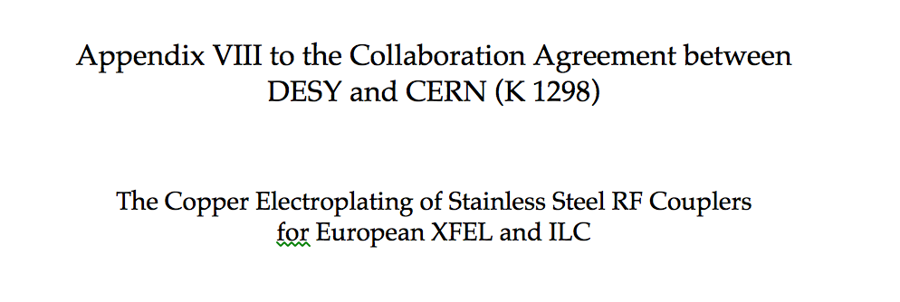
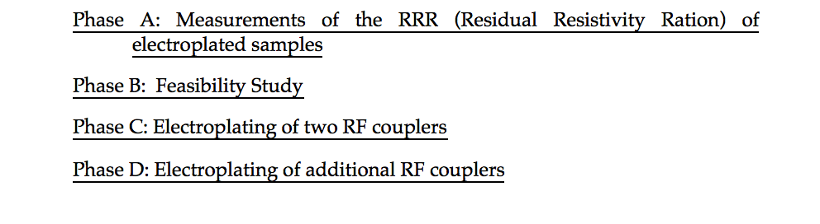

Slide 12
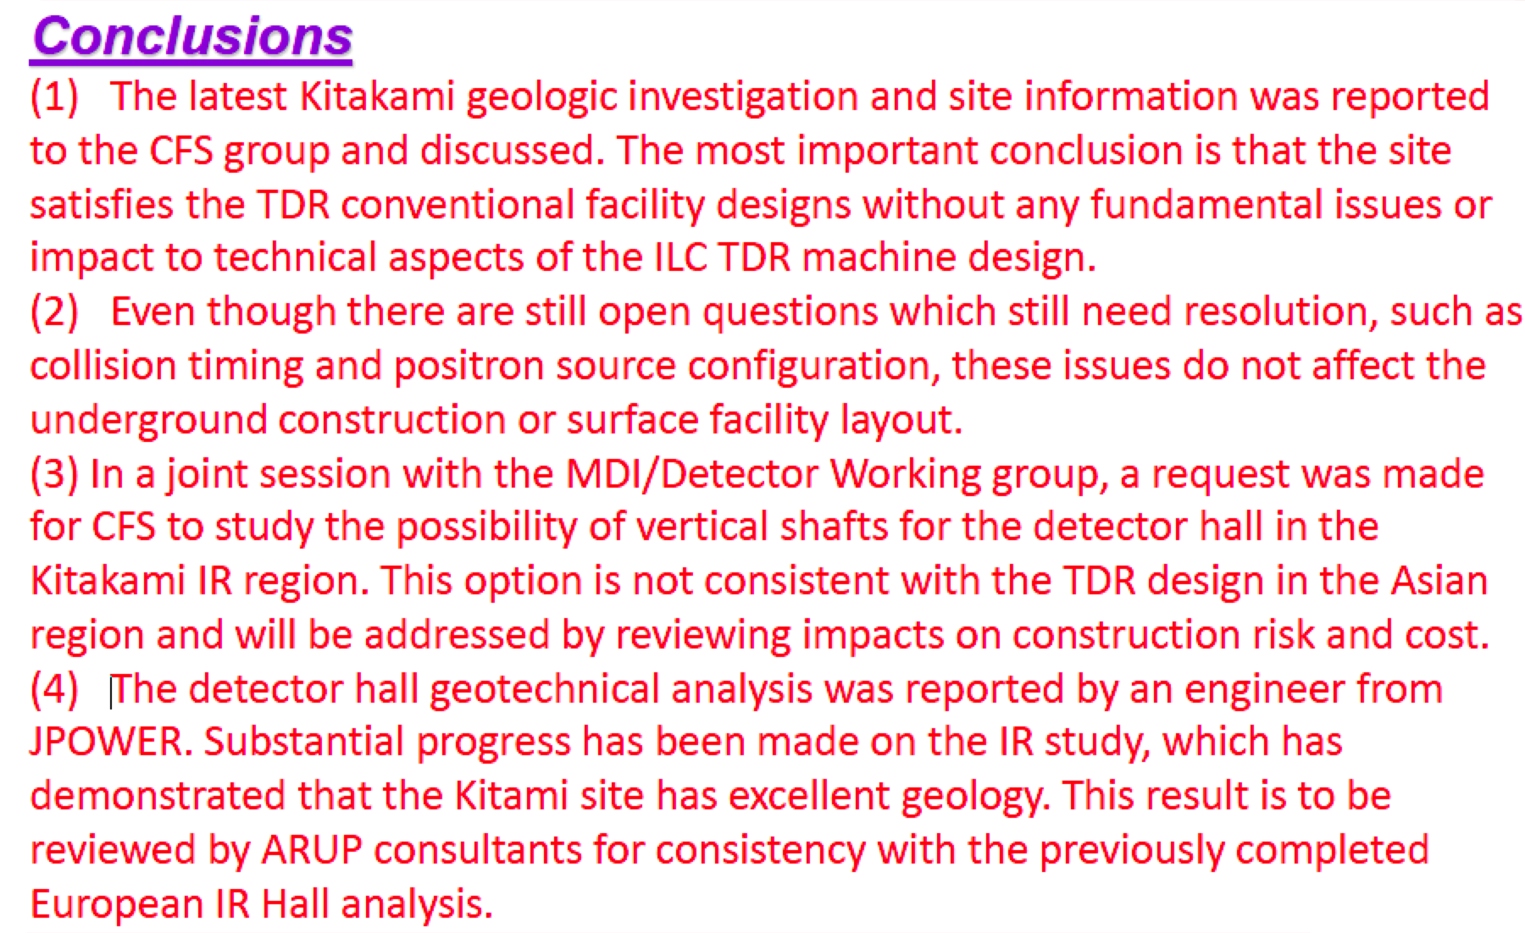
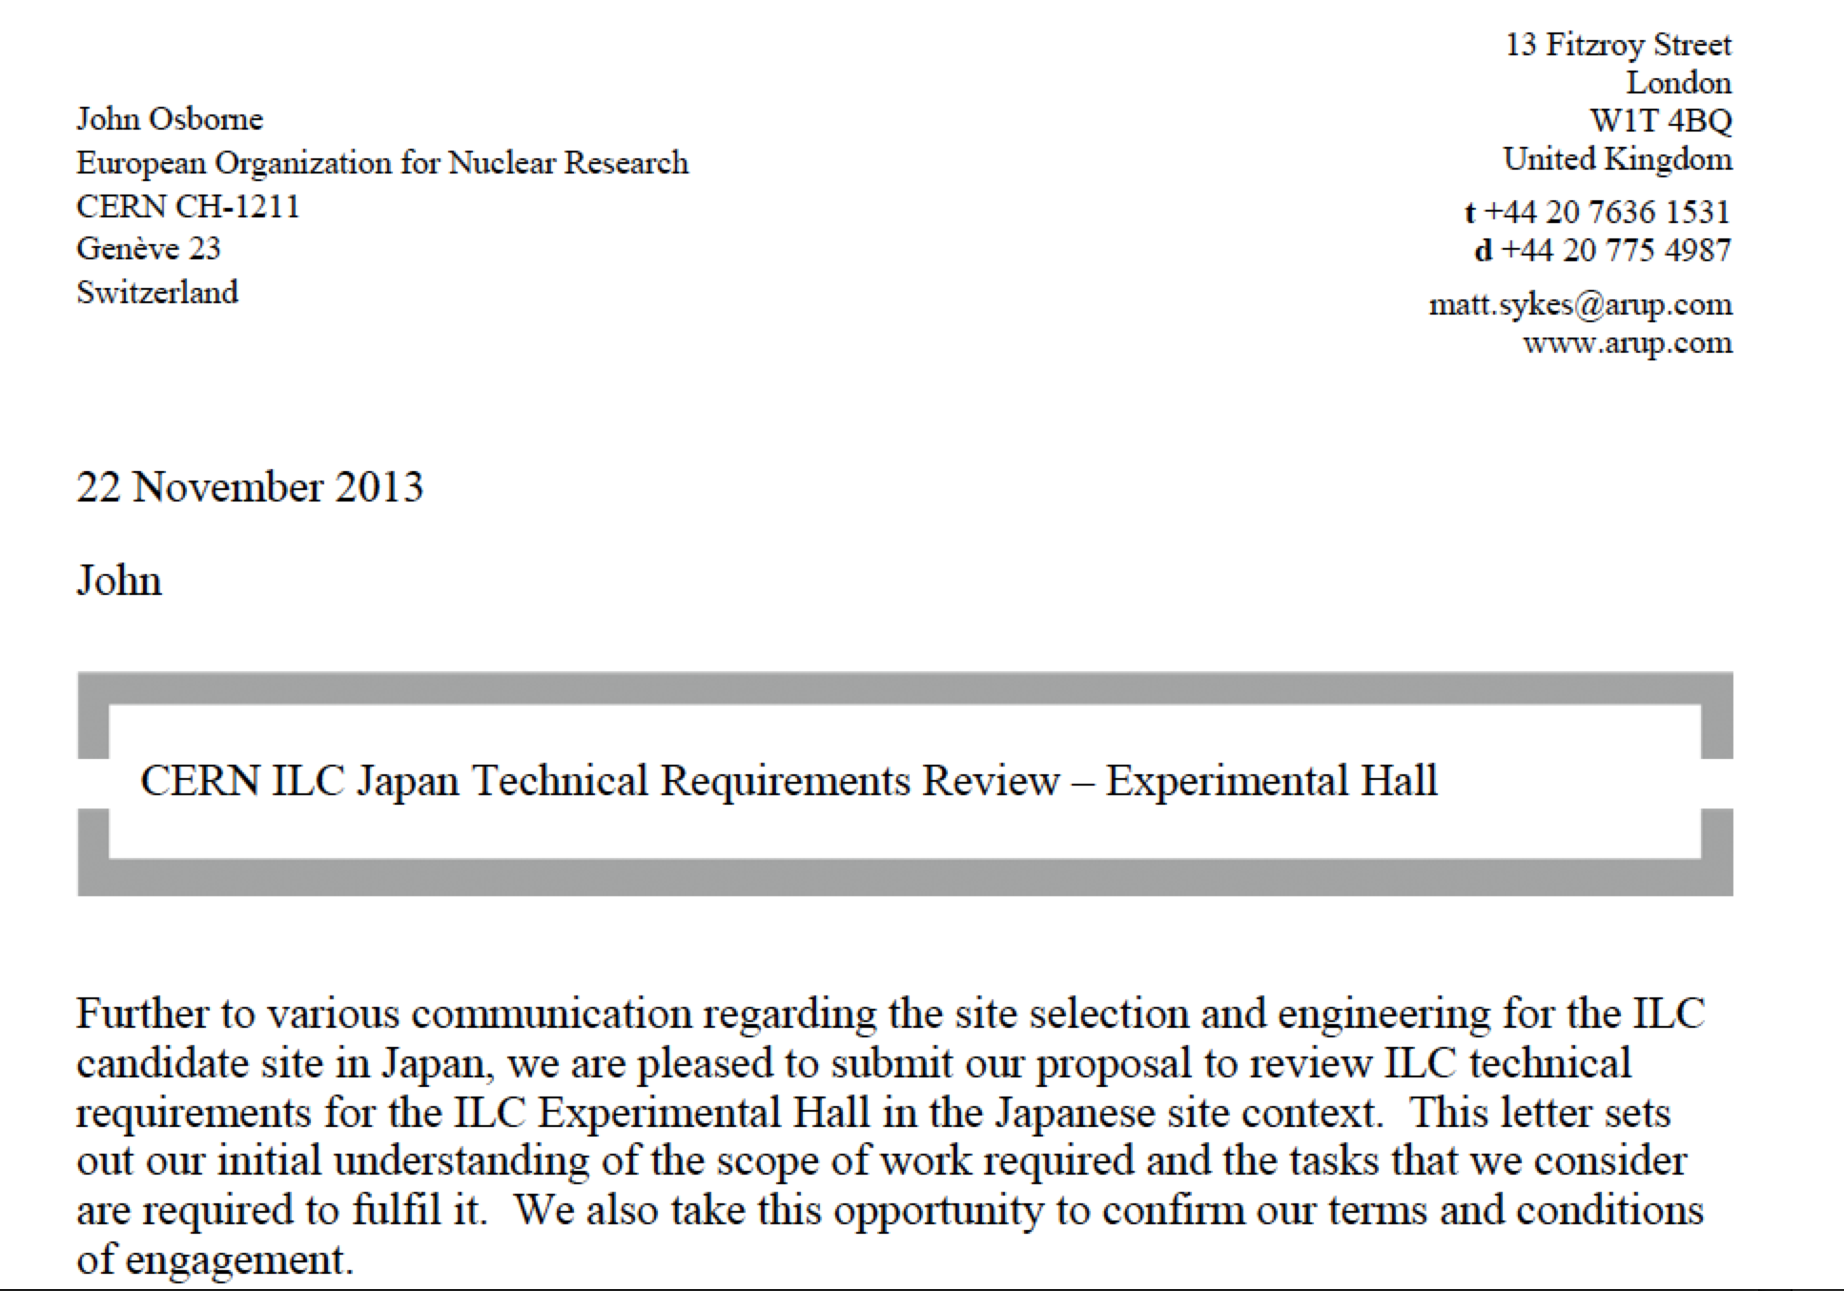

Slide 13
Developments
LC common activities many and increasing
In the next 4-5 year period we expect/hope some them to increase, others to remain stable:
  ATF (instrumentation, stabilisation, FF magnet(s), kicker tests, BBA and operation)
  Design studies for the BDS
  Xband testing
  ILC support for couplers and tuners
Should consider revising current annex/information/planning for common work in this area for new phase (2014-2017)

