Slide 1





Welcome

Slide 2
Welcome to the Thematic School
Alberto Pace

Slide 3
Opening Session
Welcome addresses
  Ivica Pulijak (Local Organizer)
  Damir Lalas (Vicedean of FESB)
School Introduction
Followed by the Inaugural Scientific Lecture from
prof. Claude Charlot (Ecole Polytechnique, France)

Slide 4
The CERN School of Computing
Aims at creating a common culture in scientific computing among young scientists and engineers involved in particle physics or other sciences, as a strategic direction to favor mobility and to facilitate the development of large computing-oriented transnational projects.
  http://cern.ch/csc
Participants come from worldwide laboratories and universities with typically of 15 to 30 different nationalities (60 different nationalities over the past 10 years).
  http://cern.ch/csc/alumni

Slide 5
… but also
To help bridge the gap between computing and science
  Computing is today the main technology used by many sciences to boost their research productivity
The unprecedented technological evolution in computing has profited directly to several scientific research project, in particular in high energy physics
It is therefore essential that:
  Physicists understand and master computing as the main tool for their research
  Computer scientists understand the science object of the investigation to deliver computing services that meet the needs of the research project
Hence: The CERN School of computing !

Slide 6
In addition: Knowledge Transfer
Another aim of the school is
  to transfer to academic, institutional and industrial circles in Member States and other countries, CERN skills and know-how in computing and ICT.
  These skills and know-how, find direct or potential applications in all spheres of the society (as exemplified with the Web, developed by CERN and now, the Grid).

Slide 7

The CERN School of computing
The Main School
  Two weeks, 60 participants
  The school tackles multiple topics all associated on how to handle computing in large scientific projects.
The Inverted school
  At regular CSCs, the sum of the knowledge of the students exceeds the one of lecturers teaching, and that it is frequent to find in the room real experts on particular topics. This is the idea behind iCSC.
  At the end of each school, we call students present to make proposals. When we receive sufficient proposals of appropriate quality, we organize an inverted school.
The Thematic school (this school)

Slide 8
The Thematic School
Goes more in depth on a particular topic
  This year, 2nd Edition
  “Future high-throughput scientific computing”
Shorter duration: one week (5 days of tuition)
Limited participation: 24 participants
Clear goals
  Academic dimension
  Theory and practice
  Networking and socialization

Slide 9

Academic dimension
The tCSC …
  It is not a conference
  few lecturers
    Improved consistency
  Not a place for lecturers to present their work, promote their projects

Slide 10
Not a training session
No replicate of common training available at home institutes
Focus on persistent knowledge,
less on knowhow
Training
Programme
C++
Java
Oracle SQL
Oracle Forms
PERL

Slide 11
Knowledge versus Knowhow
A key concept in Education sciences
Knowledge | Knowhow
Articulated to other knowledge of the learner | Generally stand-alone information
By nature, when taken by the learner, different between learners | Initially, the same for every learner
Transferable, adaptable to other environments | Transfer requires effort
When taken by the learner, persistent | Will be forgotten if not practiced
Requires related knowledge pre-exist | Limited pre-requirements

Slide 12
The tCSC is a summer university
Selected topics are most relevant in Scientific Computing for High Energy Physics
No drastic change from one year to the other, programme relatively stable (like at University)
Always a partnership with an University. This school:
  University of Split
  FESB
UNIVERSITY OF SPLIT FACULTY OF ELECTRICAL ENGINEERING, MECHANICAL ENGINEERING AND NAVAL ARCHITECTURE

Slide 13
But what is that gives the most value to the school ?

Slide 14
THE PARTICIPANTS!
Why ?

Slide 15
Let’s have a look at who we have in the room …

Slide 16
Let’s have a look at who we have in the room …
24 participants, 19 nationalities
  Austrian , British, Croatian, Czech, Danish, Dutch, Australian, Finnish, French, German, Indian, Italian, Norvegian, Polish, Portuguese, Romanian, Spanish, Swiss, Ukrainian.
21 % female (5/24)
21 institutes !!

Slide 17
Participants from 21 institutes
ADI Agencia de Inovacao (Portugal),
CERN (Switzerland),
Technische universität München (Germany),
CNRS (France),
Technical University Prague (Czech Republic),
DESY (Germany),
FESB (Croatia),
Helsinki Institute of Physics (Finland),
HEPHY Vienna (Austria),
KTH Royal Institute of Technology (Sweden),
National Academy of Sciences (Ukraine),
National Centre for Nuclear Research NCBJ (Poland),
National Technical University of Ukraine (Ukraine),
Nikhef (Netherlands),
Tata Inst. of Fundamental Research (India),
Istituto Nazionale di Fisica Nucleare INFN (Italy),
Universite Montpellier II (France),
University of Mainz (Germany),
University of Manchester (UK),
Warsaw University of Technology (Poland)

Slide 18















National
Technical
University
of Ukraine
Laboratoire Leprince-Ringuet

Slide 19
So …
We have quite some diversity
But is this valuable?

Slide 20
Excerpts from your reference letters
Mr. xxxx is productive, extremely knowledgeable (in both breadth and depth), furthermore, I suspect that his presence will enrich your school, given his broad experience outside of physics computing.
Mr. xxxx is familiar with basics of applied mathematics, in particular stationary iterative schemes for linear equation systems as they arise from elliptic partial systems. Furthermore, a sound understanding of C++ implementation idioms, basics of software engineering, as well as the interplay of numerical kernels with state-of-the-art hardware was essential. Recent tasks of his include handwritten, optimised kernels with a special focus on recent vector architectures into context with the emerging field of stencil compilers for scientific computations.

Slide 21
Excerpts from your reference letters
Mr xxxx has successfully completed a first prototype of template method of one geometrical shape, demonstrating clearly the portable coding method proposed and identifying advantages and limitation of the approach. He has shown the ability to absorb quickly the essential elements of complex software and an excellent understanding of the complex interactions of C++ features including templates and inheritance. He has also demonstrated drive and inventiveness, and the ability to create clear, well engineered code
In his work, xxxx has successfully mastered a steady progression of new technologies, including experiment workflow management systems (esp Condor), laaS platforms (eg Openstack), image building and management systems, contextualization frameworks and fabric monitoring (eg Ganglia). Beyond successfully evaluating and demonstrating aspects of these technologies, he has shown a notable awareness of how all these components could fit together architecturally and what compromise and advantages follow from different technology choices

Slide 22
Excerpts from your reference letters
In his work, Mr xxxx has successfully certified, configured and made operationally functional new grid site CIS-NCBJ, providing computing and storage resources for the LHCb experiment at CERN.
I am confident that xxxx has very good potential to do well in HEP computing. If possible, we would like him to take up bigger and more important roles in the context of CMS computing efforts whch always need skilled personnel. Thus, I feel the exposure of xxxx to the tCSC will be very beneficial for him.
Compared to other Ph.D. students, xxxxx is clearly out-standing, certainly being among the top 10% of all Ph.D. students. Since his Ph.D. work is a direct application of computer architecture and networking for high data-throughputs, being the main topic of the 2nd Thematic CSC 2014, he would greatly benefit from attending the School.

Slide 23
He contributed to the study of math and algebra libraries, leading to the decision to replace CLHEP with Eigen in ATLAS reconstruction. He helped redesigning the tracking EDM which showed up in his studies as problematic because of its overly involved C++ design that caused inefficient memory usage and prevented automatic code optimisation, including vectorisation. In parallel to this code analysis and optimisation work xxxx started investigating how the track reconstruction could be modified to make it suitable for multi-processing. Current tracking strategies in ATLAS are highly sequential and novel algorithmic ideas are needed to optimally use future many core architectures.! !
Xxxx is a highly motivated and skilful student. Over the first year of his thesis work he has contributed several studies on code analysis and optimisation, concurrent programming, compilers and processing techniques to the ATLAS Software project. The program of the 2nd thematic CERN School of Computing covers exactly the subjects and technologies that are of direct relevance for the thesis work of xxxx. Participation in the school will give him the deeper knowledge and required overview of modern programming techniques that he requires for his thesis work. I therefore would be delighted if his application would be accepted and he would be given the opportunity to participate in this school !

Slide 24
Excerpts from your reference letters
Xxxx has already implemented the sequential version of the track nder, and thus is familiar with large-scale software systems such as the Belle II (Kek Japan) analysis framework, the C++ programming language and various avors of the Linux operating system. The school is a wonderful opportunity for him to learn more about high-performance computing and parallel programming. I am sure that he and his work will greatly benet from the attendance of the school.
xxxx's contributions to ATLAS are too many to list. Some examples of his achievements are being the driving force in ATLAS behind the alignment of the inner tracking detectors and implementing improvements to the electron reconstruction which led to great improvements in the energy resolution for electrons undergoing bremsstrahlung. His technical skills, his sharp mind, his friendly demeanor and his outstanding leadership qualities has led to xxxx being selected for several leadership positions in ATLAS, and he is currently a member of the physics coordination group overseeing the whole ATLAS physics program.

Slide 25
Excerpts from your reference letters
Xxxx was appointed as a site administrator for the Bogolybov Institute for Theoretical Physics (BITP), Ukraine and subsequently as a regional expert for all Ukrainian computing sites providing CPU and storage resources for the ALICE experiment. Xxxx excelled at this function, quickly learning the complex site operation procedures and Grid software. Under her competent management, the computing resources were always operational. xxxx was also selected a as non-member state Summer Student at CERN and assigned to the ALICE Core offline team.

Slide 26
Who are the tCSC participants ?
… you are young, diverse, you come from many countries, from different institutes …
… you have all an incredible potential and a passion for both computing and science.
You will work together one week to widen your skills but also and establish lifetime links between yourselves and across research institutes that will be useful throughout your entire career.
This is probably why you are here !

Slide 27
Who are you ?
Adam
Adrien
Anthony
Bianca-Cristina
Brij Kishor
Chiara
Cristovao Jose
Elvin
Hao
Henryk
Jakob
Johannes
Jonas
Jukka
Katarzyna
Lada
Luc
Marco
Mehdi
Miguel
Oksana
Pavlo
Robert
Wilco

Slide 28
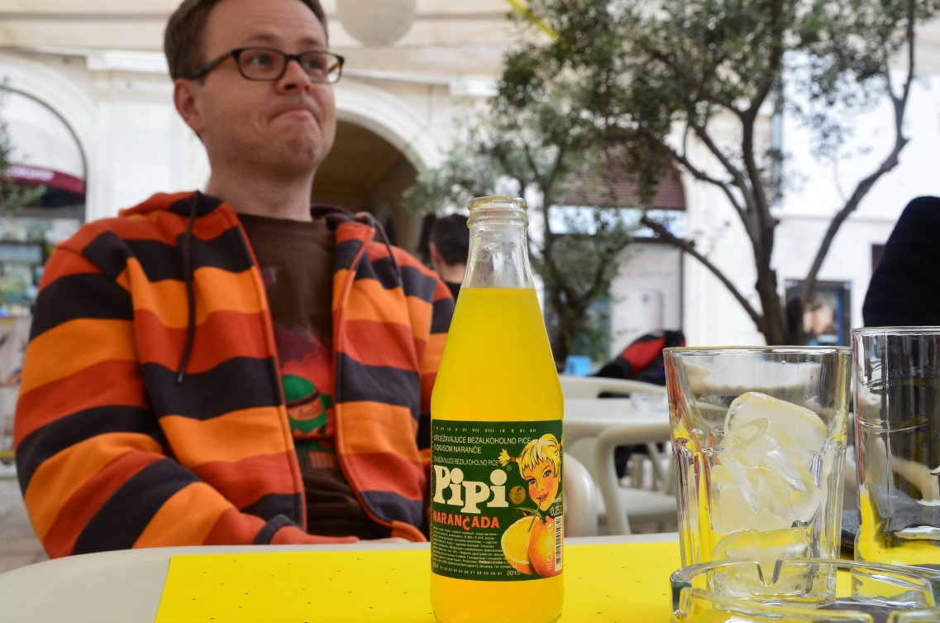
Introducing your coaches
Andrzej

Slide 29
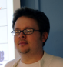
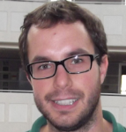
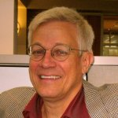
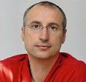
Introducing your coaches
Andrzej
Danilo
Sverre
Claude
Ivica

Slide 30
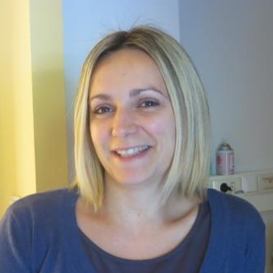
Introducing your Local Organisers
Irena
  From Medils

Slide 31
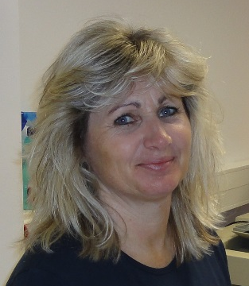
Introducing your Local Organisers
Irena
  From Medils
Lilia
  From Medils

Slide 32
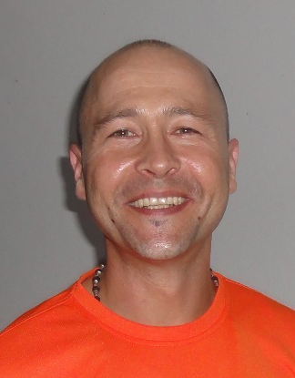
Introducing your Local Organisers
Irena
  From Medils
Lilia
  From Medils
Tommy
  Cathering

Slide 33
Introducing your Local Organisers
Irena
  From Medils
Lilia
  From Medils
Tommy
  Cathering
Ivica
  Chairman Local Organizing Committee

Slide 34
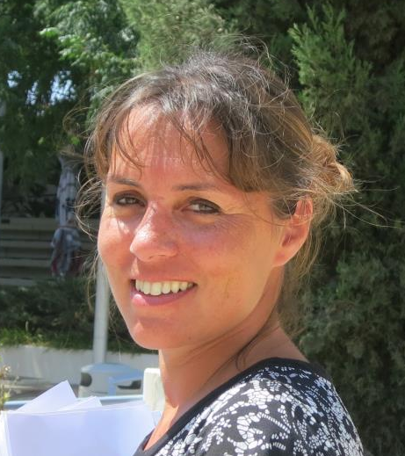
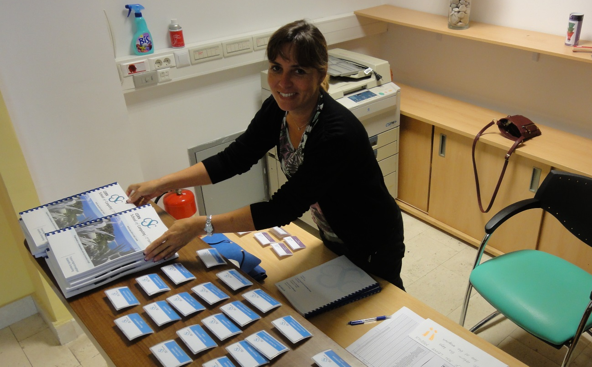
Introducing your CERN Organisers
Yasemin
  School administrative manager

Slide 35
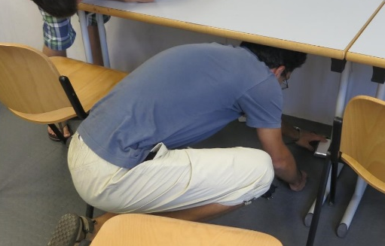
Introducing your CERN Organisers
Yasemin
  School administrative manager
Giuseppe
  School technical manager,

Slide 36
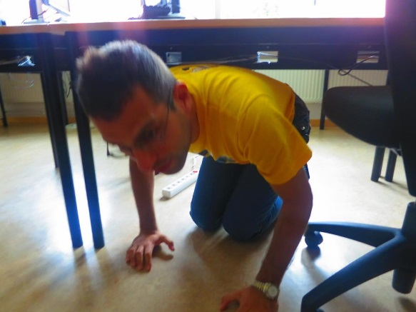
Introducing your CERN Organisers
Yasemin
  School administrative manager
Giuseppe
  School technical manager,

Slide 37
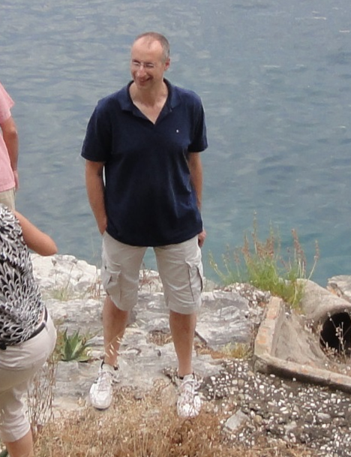
Introducing your CERN Organisers
Yasemin
  School administrative manager
Giuseppe
  School technical manager,
Ivica
  Chairman of the CSC Advisory Committee

Slide 38
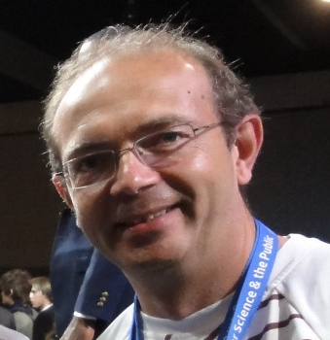
Introducing your CERN Organisers
Yasemin
  School administrative manager
Giuseppe
  School technical manager,
Ivica
  Chairman of the CSC Advisory Committee
Myself, Alberto
  School director

Slide 39
School Logistics

Slide 40
School rule #1
You must always be on time
  If the schedule says the lecture starts at 9:00, you must have signed the presence form and be in the room before 9:00.
    Presence forms will be removed at the scheduled start time.
  If the schedule says the bus leaves at 9:00, the bus will leave at 9:00.
    Not 9:05, nor 9:10.
    The bus may leave late for many reasons which do not include waiting for missing participants

Slide 41
School Rule #2
Your presence to the lectures and exercises is …
  MANDATORY
  You must sign the presence sheet after every breaks between lectures and exercise sessions
    beginning of the day, after any coffee, lunch and sports break
The school also expects your presence to meals, dinners, coffee breaks. Up to the enddate of the school
On the other hand, participation to social and sports events is …
  Optional
  However, you must let us know whether you participate or not

Slide 42
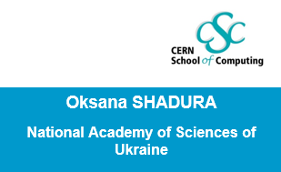
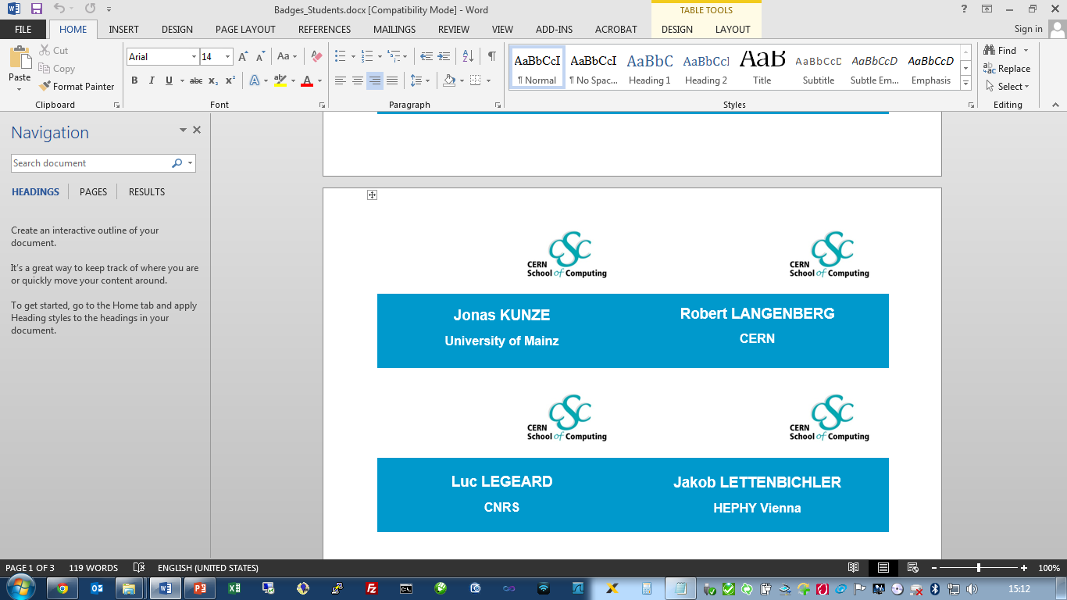
School Rule #3
Wear your badge

Slide 43
School web site
The CERN School of Computing
  http://cern.ch/csc
This School
  http://indico.cern.ch/e/tcsc2014

Slide 44
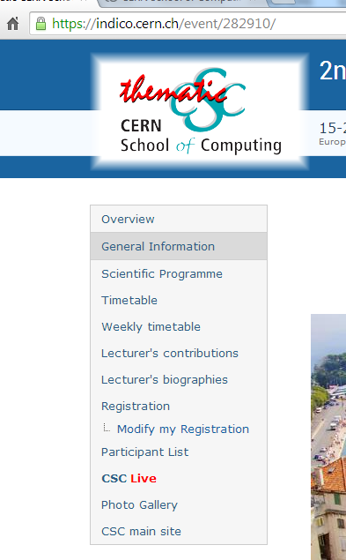
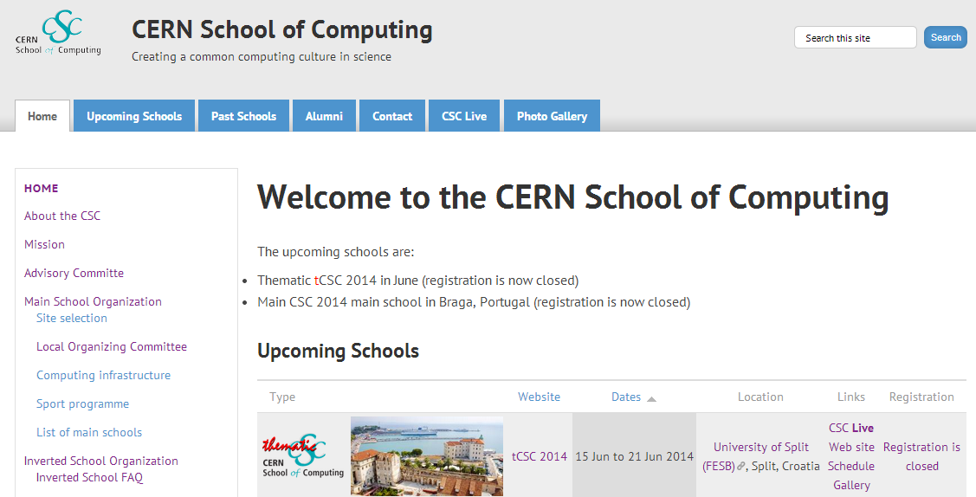
Keeping you informed – CSC Live
All the communication between the school organizers and the participants will be made using the CSC Live web page
You MUST read this page at least once a day in case you missed an announcement or a programme change

Slide 45
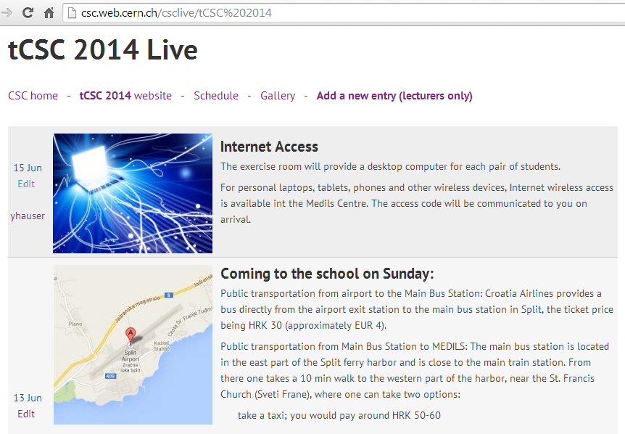

Slide 46
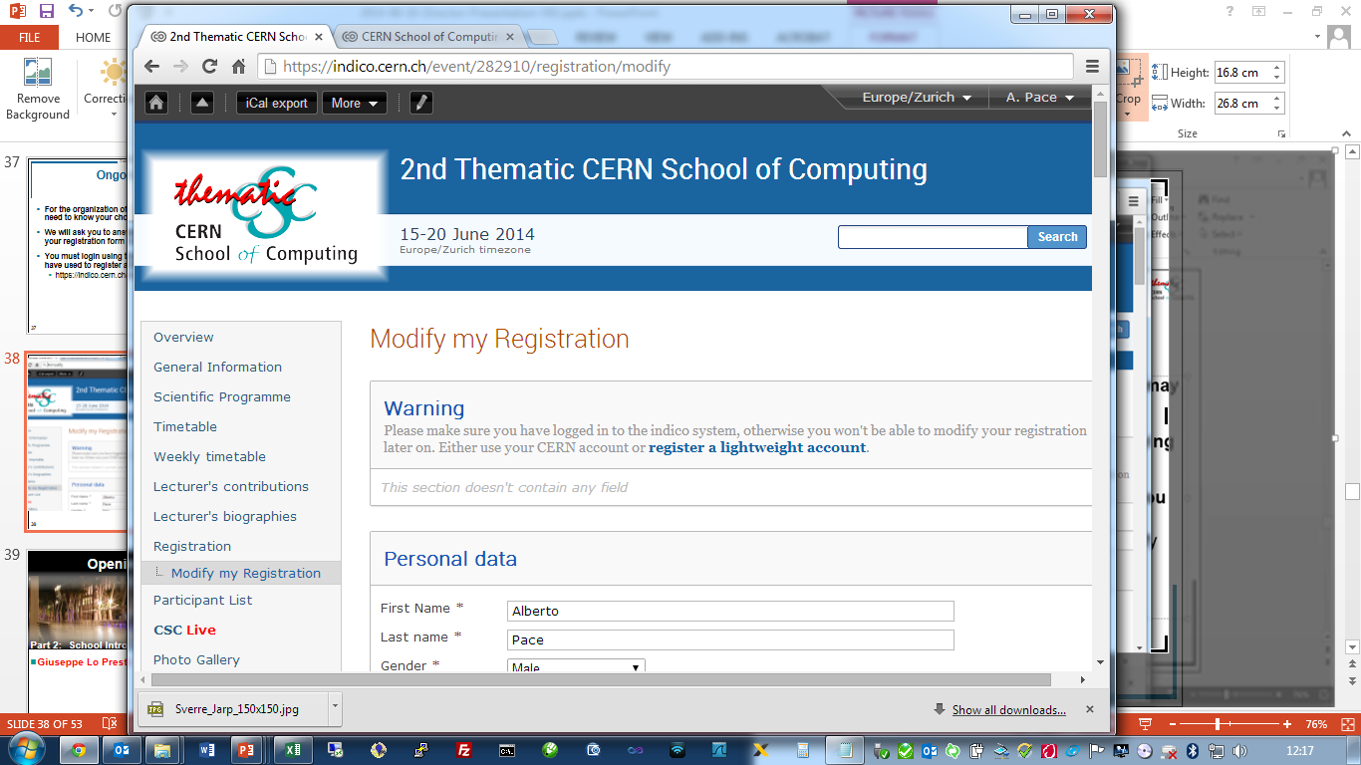
Ongoing surveys
For the organization of social and sports events we may need to know your choice or if you participate
We will ask you to answer to our question by modifying your registration form on the School web site
You must login using the same email address that you have used to register at the school
  https://indico.cern.ch/event/282910/registration/modify

Slide 47
Login with your email address
Update your registration

Slide 48
Photo Gallery
The School web site has a photo gallery
  You are encouraged to upload your best photos
Post only “appropriate” content
  The gallery is public
  If you have any problem with photos of you being published on the photo gallery, let other participants know.
  If you would like a photo of you to be removed from the gallery, ask directly to the person who published it to remove it.
  If someone asks you to remove his/her photo that you have published, please do so.

Slide 49
Photo Gallery

Slide 50
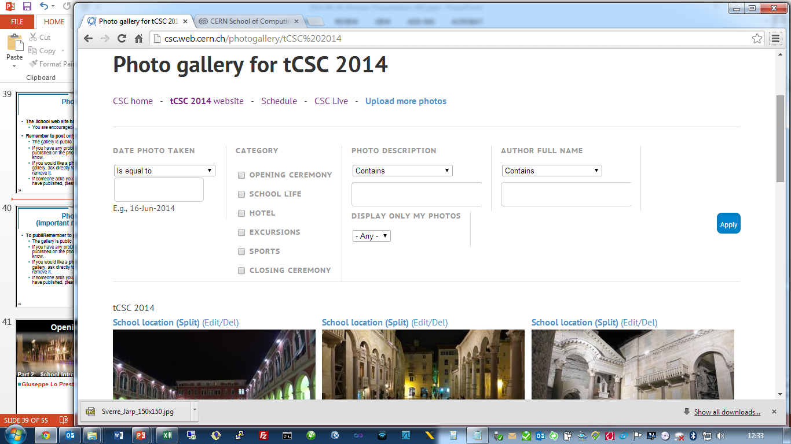
http://csc.web.cern.ch/photogallery/tCSC%202014

Slide 51
Photo Gallery
(Important recommendations)
To publish / upload a photo, you must login using your email address
Ensure that the date/time of your camera is set correctly !
  Do not upload photos from 1-Jan-2001
  If you have a GPS, ensure that the GPS tag is correct
Fill accurate Description, Date and Category
You can aggregate multiple photos with the same description in a unique upload. Do so only when the description is common. Otherwise, uploads multiple times with relevant descriptions.
Do not “Dump” your memory card on the CSC web site. Make a selection of your best photos worth sharing !

Slide 52


Slide 53
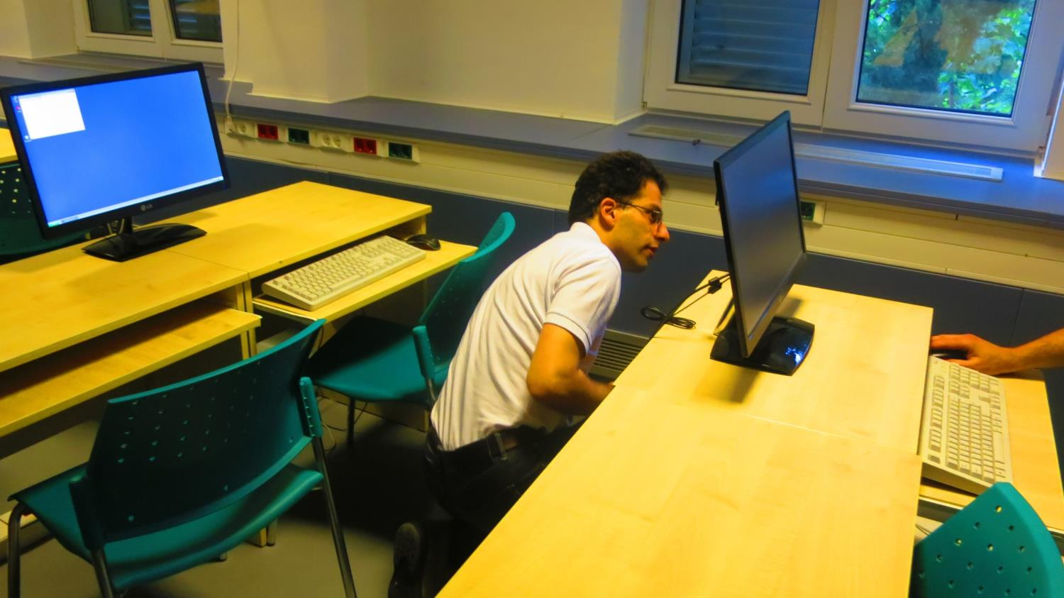

Slide 54
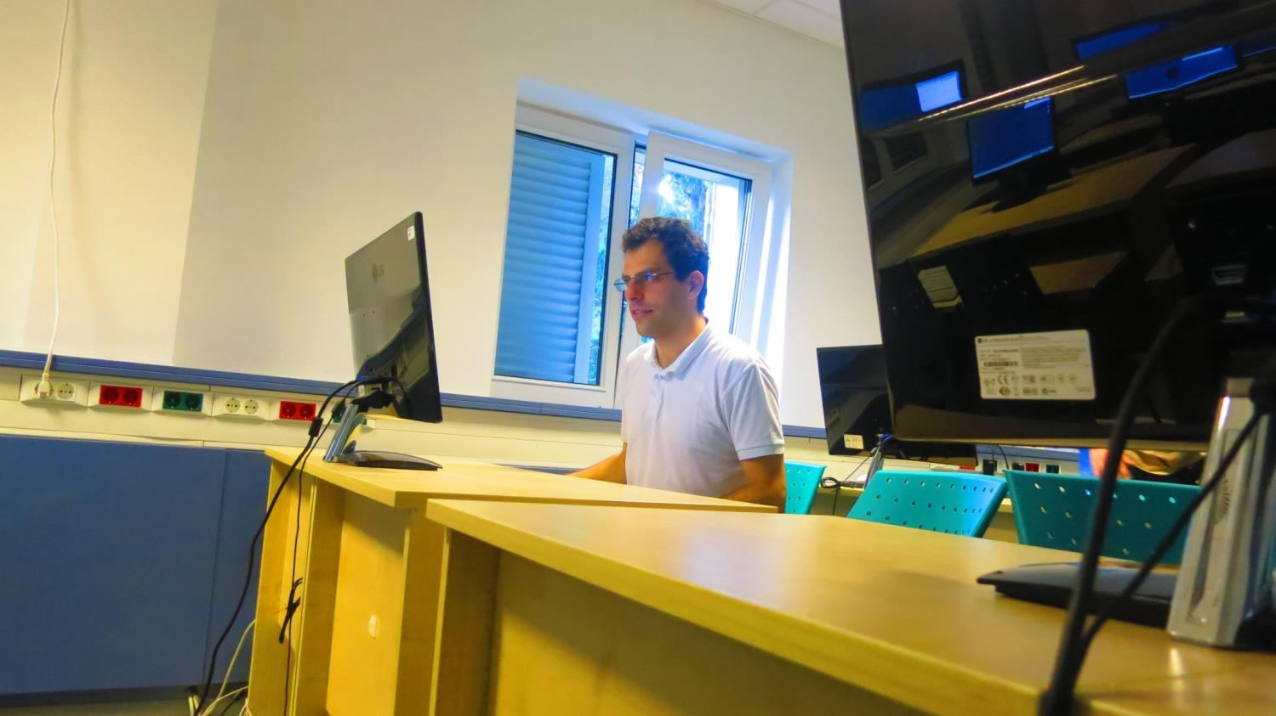
Technical infrastructure

Slide 55
Technical infrastructure
Client-server model
Clients:
  Windows XP desktops located here
  Or your own laptops
Servers: Linux boxes located at CERN Computer Centre
  32 cores, no HT, Intel Xeon E5-2650 v2 @ 2.60GHz

Slide 56

Access from the Windows desktops
Login with username summer,
password school
Nomachine NX client available as an
X server/terminal
  You will find a tcscN.nxs config file, 01 ≤ N ≤ 12, directly on your desktop
Putty available for text-only ssh
  Not pre-configured

Slide 57
Access from your laptop
The Nomachine NX client is available here:
  http://www.nomachine.com/download.php
  Or use your favourite ssh client in your laptop
Please take the NX configuration file from your assigned desktop
  Or do-it-yourself if you know NX
  The CERN servers are named cscNN.cern.ch

Slide 58
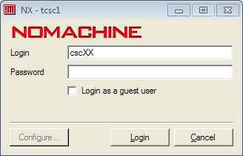
Access (continued)
Use cscMM as username, MM between 01 and 24, and same password.
  Choose MM according to your alphabetical order
  Change the password at your convenience
All nodes have all accounts
Once logged in, you have a full X terminal

Slide 59
Access (continued)
csc01 | BAAN HOFMAN, Wilco | csc13 | LEGEARD, Luc
csc02 | BELHAY, Mehdi | csc14 | LETTENBICHLER, Jakob
csc03 | CRISTESCU, Bianca-Cristina | csc15 | MORLEY, Anthony
csc04 | DE FINE LICHT, Johannes | csc16 | RUBIO-ROY, Miguel
csc05 | DEVRESSE, Adrien | csc17 | SHADURA, Oksana
csc06 | DOMINGUES CORDEIRO, Cristovao Jose | csc18 | SINDRILARU, Elvin Alin
csc07 | DUCHECKOVA, Lada | csc19 | STACHYRA, Katarzyna
csc08 | GIEMZA, Henryk | csc20 | STRUTZ, Marco
csc09 | JASHAL, Brij Kishor | csc21 | SVIRIN, Pavlo
csc10 | KOMMERI, Jukka | csc22 | WEGRZYNEK, Adam
csc11 | KUNZE, Jonas | csc23 | YIN, Hao
csc12 | LANGENBERG, Robert | csc24 | ZAMPOLLI, Chiara

Slide 60
Running the exercises
The systems are provided with Linux SLC6.5 and a perf-enabled 3.11 kernel
The default compiler is gcc 4.9
  Installed in /var/gcc-4.9.0 along with its libraries, system libraries in /usr/lib64 are NOT compatible!
Your home directory is located on a rather small partition (~ 5 GB free), please use /var/csc
(> 1 TB free) as a scratch area
  World-writable => be serious :-)

Slide 61
Have a good time at tCSC 2014!
Feel free to ask me any (*) questions,
I’m around to help.
(*) I don’t know the gory details of the lectures and exercises as much as you (will) do!

Slide 62
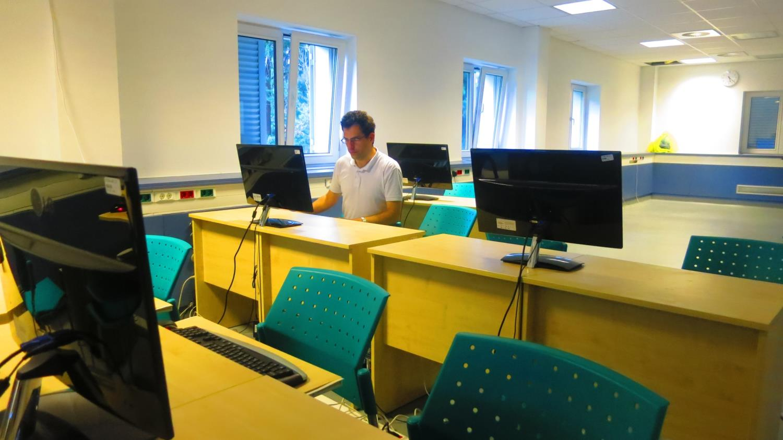

Slide 63
End of School Introduction
Inaugural Scientific Lecture from professor Claude Charlot
(Ecole Polytechnique, France)

