Slide 1
Impedances
A.Lachaize HPPS meeting 13/11/13

Slide 2
Resistive wall impedance :
Simulation with ReWall (ICE) :
3 types of chamber in HPPS:
Dipoles : Elliptic (128mm × 105 mm) 138 × 4m => 552 m
Quads First family Circular (R= 58mm) 60 × 1.5 m => 90 m
Quads second family Circular (R= 64mm) 48 × 2 m => 96 m
SS Circular (R= 58mm) => 518 m
A.Lachaize HPPS meeting 13/11/13

Slide 3
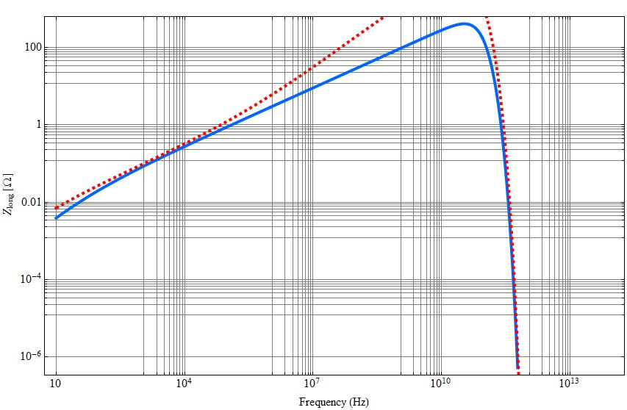
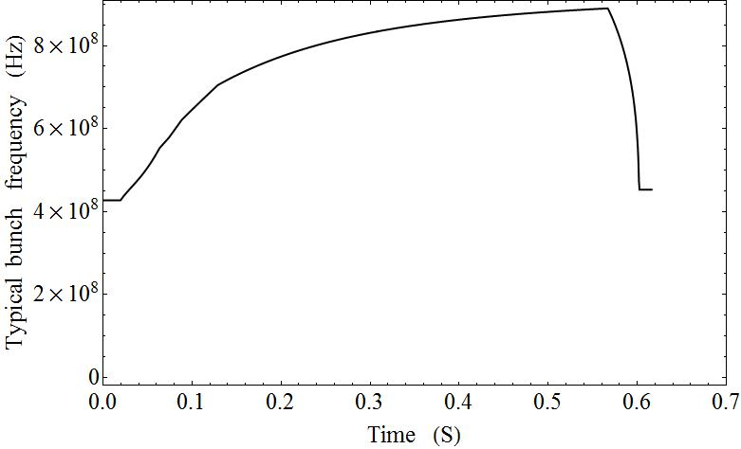

Resistive wall impedance :
Selection of frequencies $ω=\frac{c}{σ_{z}}$:
A.Lachaize HPPS meeting 13/11/13

Slide 4
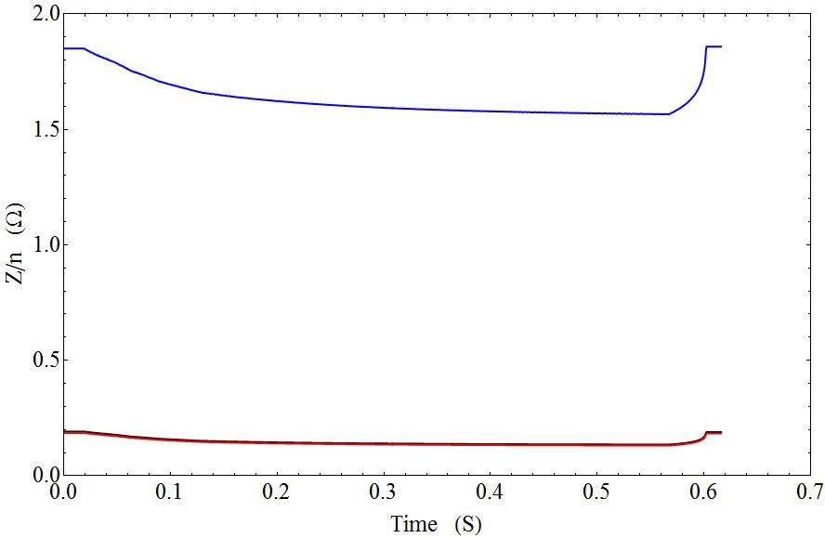
Resistive wall impedance :
Results to be compared with analytical formula : $Z=(1−i)\frac{C}{2πbδ_{s}σ_{c}}$
Great agreement for real part of impedance, but NOT for imaginary part…
A.Lachaize HPPS meeting 13/11/13

Slide 5
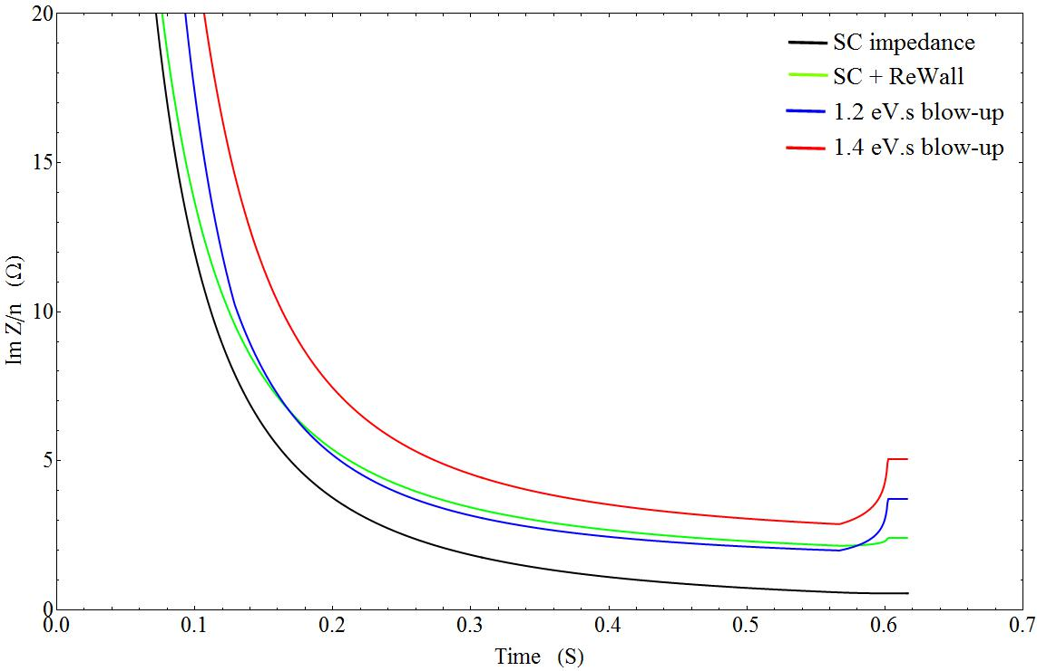
Resistive wall impedance :
A.Lachaize HPPS meeting 13/11/13

