Slide 1
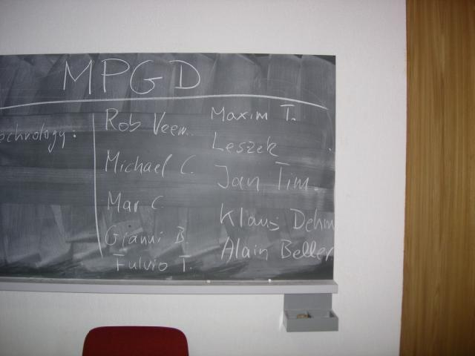
RD 51 Collaboration News
Leszek Ropelewski (CERN) / Maxim Titov (CEA Saclay)
HOW
everything
has started ?
…
Kick-off
Meeting (CERN):
September
10-11, 2007 !
…
RD51
Collaboration
2008-2013 !!!
Micro Pattern Gas Detectors: Towards an R&D Collaboration
http://indico.cern.ch/conferenceDisplay.py?confId=16213
13th RD51 Collaboration Meeting, CERN Geneva, February 5-7, 2014

Slide 2
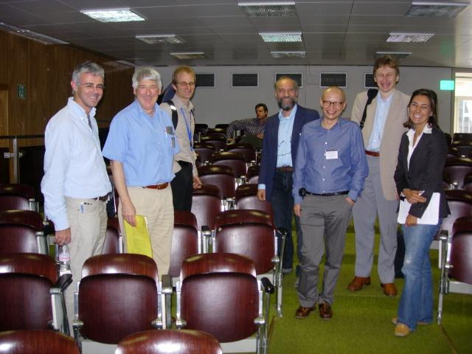
How Everything Has Started (2008-2013) …
2008 (Original MoU):
54 RD51 Institutes
December 2013:
91 RD51 Institutes
First (Very Preliminary)
1st RD51 Meeting: April, 2008 – NIKHEF, Amsterdam

Slide 3
13th RD51 Collaboration Meeting (Feb. 5-7, 2014)
https://indico.cern.ch/conferenceOtherViews.py?view=standard&confId=283108
Today:
Wednesday, February 5 (30-7-018 - Kjell Johnsen Auditorium)
10:00 – 12:00 RD51 Collaboration Board Meeting
13:00 – 15:00 RD51 Collaboration Plenary session
15:00 - 19:00 WG4 Software
Thursday, February 6 (30-7-018 - Kjell Johnsen Auditorium)
09:00 – 13:00 WG1 MPGD Technologies and New Structures
14:00 – 15:45 WG6 Production
15:45 - 16:15 WG7 Test Beams
16:15 - 18:00 EU H2020 Discussion / MPGD Community Input
20:00 - 23:00 RD51 Collaboration Dinner (let us know if you are interested)
Friday, Friday 7 (30-7-018 - Kjell Johnsen Auditorium)
09:00 – 13:00 WG5 Electronics
14:00 - 17:00 WG2 Physics Issues

Slide 4
RD51 Prolongation for the 5-Years Term (2014-2018)
LHCC Minutes (June 12-13, 2013):
In summary, RD51 is a successful R&D Collaboration with well-defined and important future
plans. In view of the above and given the modest request for resources for further work, the
referees recommend that the RD51 R&D project be continued for five years beyond 2013
and for CERN to continue to provide the limited requested support to the Collaboration. A
status report is expected to be submitted to the LHCC in one year’s time. The Committee
agrees to the continuation of the project on this basis.
CERN Research Board Minutes (August 28, 2013):
Existing R&D projects RD39, RD42, RD50 and RD51 were reviewed. RD39 studies 3D-trenched,
cryogenic charge injection devices (CID) and CVD diamond detectors, with applications for beam monitoring at the LHC. The LHCC recommends emphasis on the BLM development, and R&D on the CID sensors should be progressively integrated into RD42 and RD50. RD42 is comparing scCVD and pCVD detectors, with applications in specialized detectors such as the PLT for CMS and BCM for ATLAS, and with potential for pixel detectors. RD50 is a productive and diversified R&D collaboration for radiation-hard semiconductor development. RD51 is a large collaboration studying advanced gas-avalanche micro-pattern gas detectors (MPGD) of various types and readout technologies. The Research Board approved the continuation of these projects for the coming year; for RD39 further continuation would be subject to new results being produced during that time; for RD51 the approval is for five years.

Slide 5
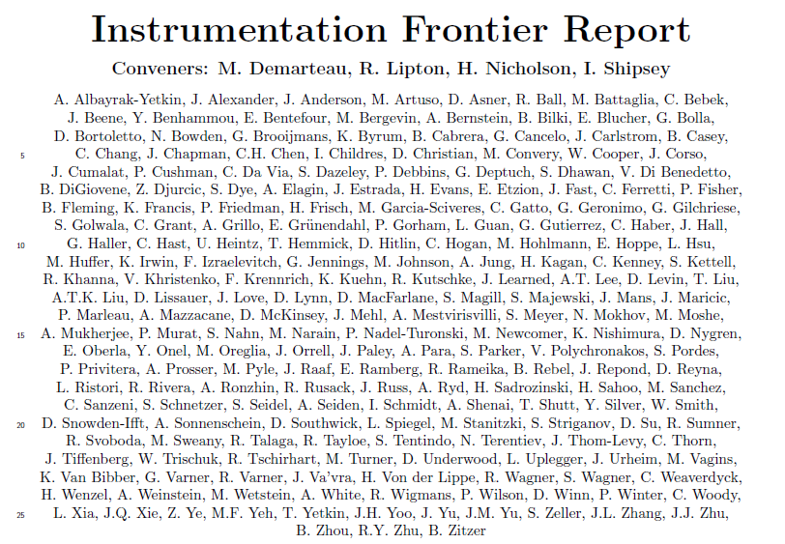
2013: USA Snowmass Instrumentation Frontier Report
Contribution to “Large – Area Arrays”:
(special thanks to
M. Hohlmann, R. Rusack, A. White):
http://www.snowmass2013.org/
tiki-index.php?page=Instrumentation%20Frontier
“Micro-pattern gas detectors (MPGDs) for charged particle tracking and muon detection are an alternative to pixelated silicon vertex and tracking detectors [85]. These low-mass detectors have the potential of economically covering large areas and provide high tolerance against radiation damage, high spatial resolution (of order 10μm), and good time resolution (of order 1ns). Future work is needed to reduce the readout cost by developing highly integrated, radiation-hardened front-end readout electronics with at least 4000 channels/chip and high density detector electronics interconnects and integrating ex-circuit readout electronics directly into the MPGD structure. Work is also required to develop innovative signal induction structures to reduce cost, improve performance, and provide stability against electric breakdown. It is important to develop materials with resistance to aging and radiation damage, as well as cost-effective MPGD construction techniques for high-volume production.”

Slide 6
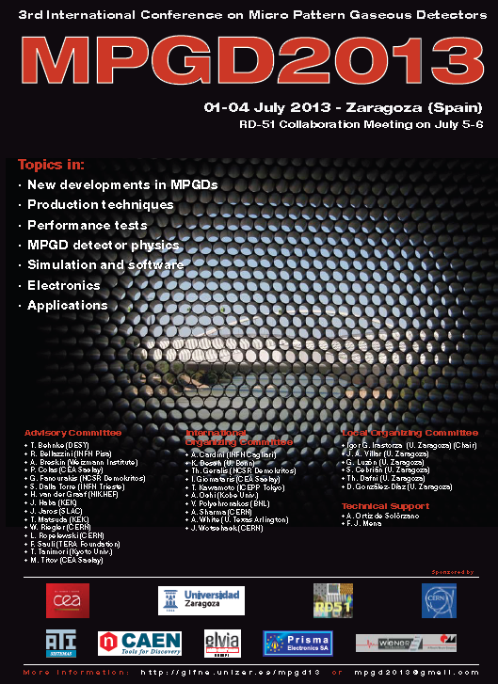
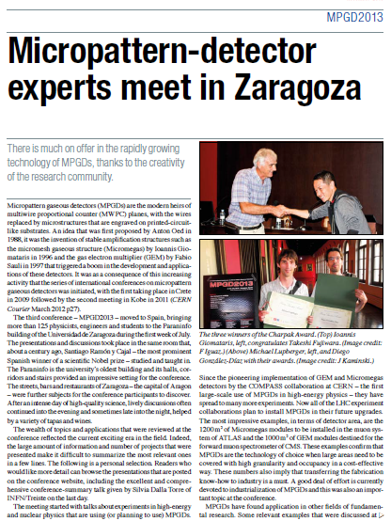
June 2013: RD51 Events - MPGD Conference and Collaboration Meeting in Zaragosa
Three winners of the
Charpak Award:
http://gifna.unizar.es/mpgd13

Slide 7
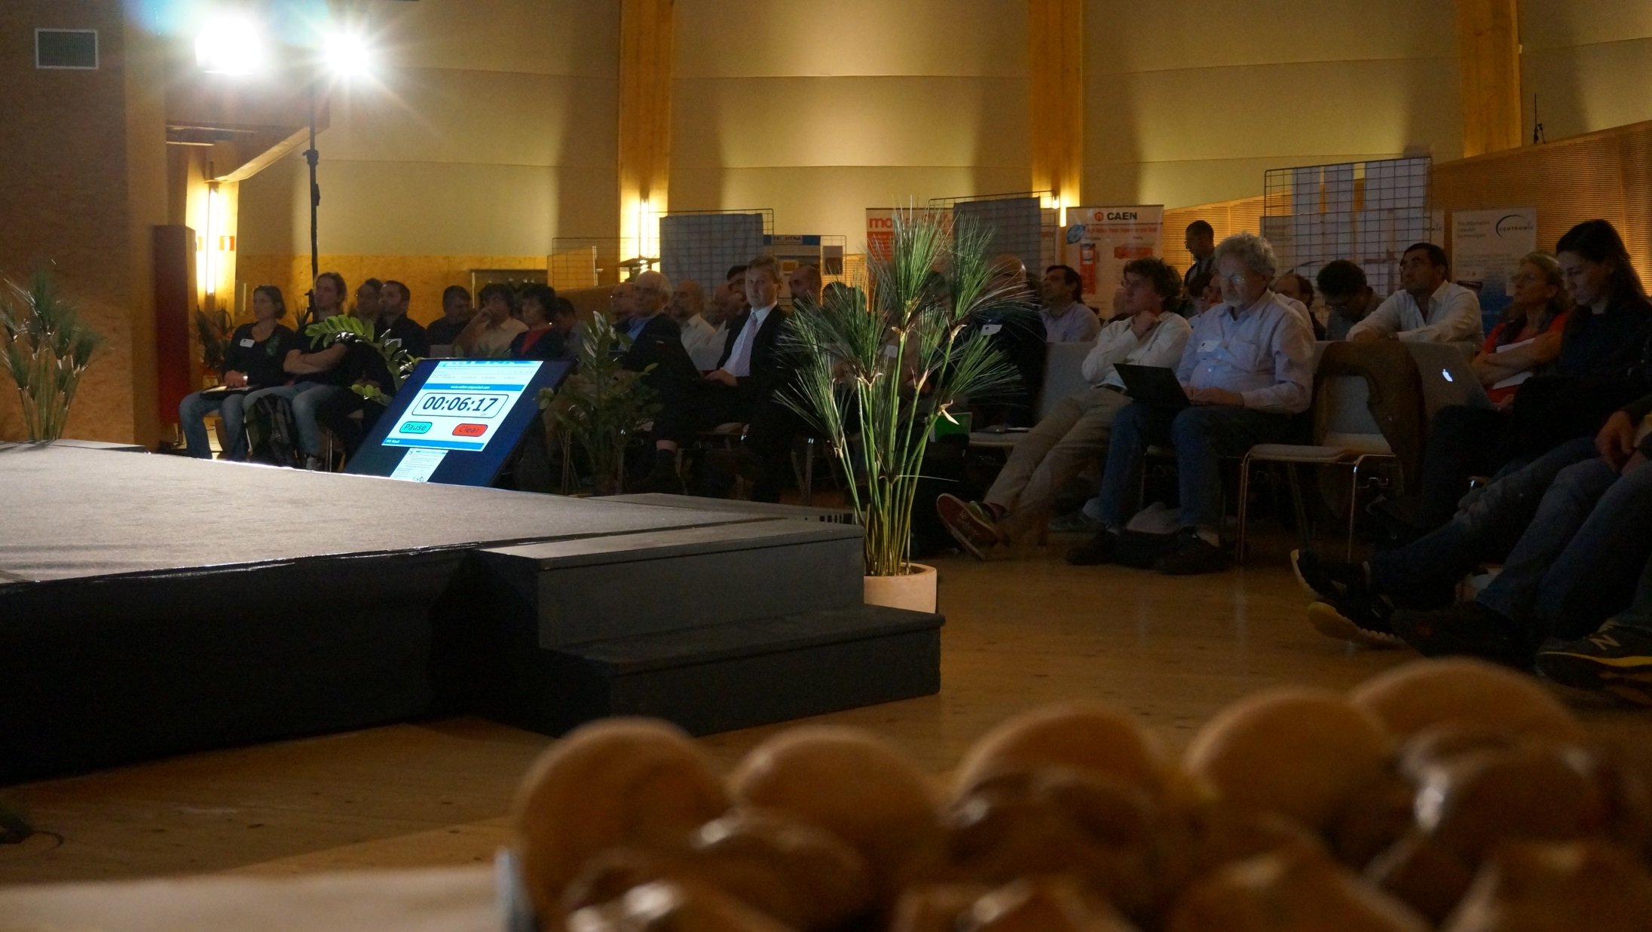
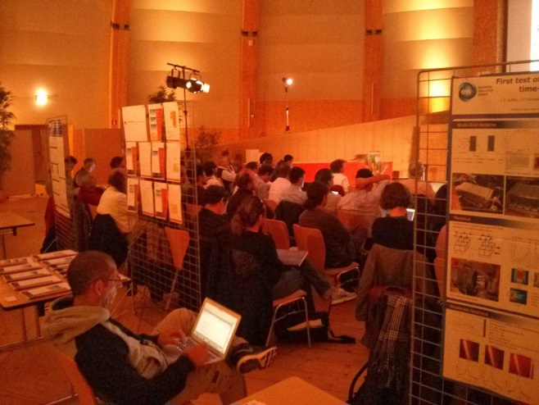
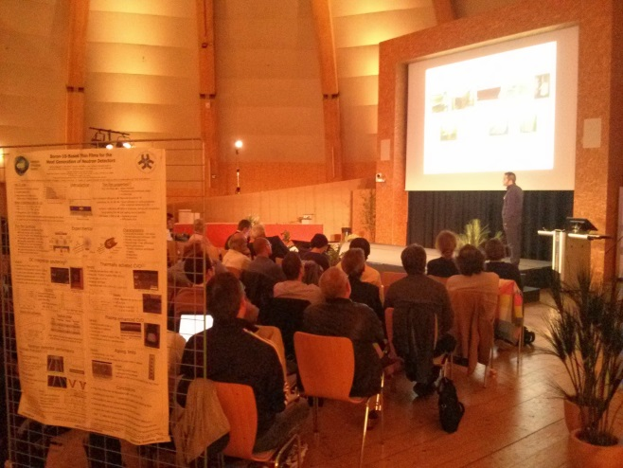
14-15 October 2013: 1st RD51 Academia – Industry Matching Event
“Special Workshop on Neutron Detection with MPGDs”
Research + industry + potential users focused on dedicated applications
91 participants: https://indico.cern.ch/conferenceDisplay.py?confId=265187

Slide 8

14-15 October 2013: 1st RD51 Academia – Industry Matching Event
“Special Workshop on Neutron Detection with MPGDs”
Summary papers based on workshop contributions:
Richard Hall-Wilton: “The importance of defining proper methods to characterize the detectors; detector needs for ESS”
Bruno Guerard: “Status of MPGDs already used in NSS; fabrication and physical constraints of neutron gas detectors”
Fabrizio Murtas: “Performance of MPGDs, and development status in HEP”
Robert McKeag: “Lesson learned from a technology transfert from NSS to the industry”
→ The follow-up RD51 session is expected in one year (end of 2014) …

Slide 9
2014 RD51 Collaboration Meetings and Communications:
5 - 7 February: RD51 Collaboration Meeting (CERN)
3 - 5 February: RD51 Electronics School (CERN)
16 – 20 June: RD51 Mini-Week (CERN)
16 – 17 June: 2nd Academia-Industry Matching Event
(Special RD51/HEPTECH Workshop on dissemination of the
MPGD technologies "Detecting Photons with MPGDs")
September/October: RD51 Collaboration Meeting (OUTSIDE CERN)
Two proposals received: Kolkata, India and Aveiro, Portugal
8-12 December: RD51 Mini-Week (CERN)
Communications:
RD51 Collaboration Meetings Agenda:
http://rd51-public.web.cern.ch/RD51-Public/Meetings/CollaborationMeetings.html
CB minutes:
https://espace.cern.ch/test-RD51/CB%20meeting%20minutes/Forms/AllItems.aspx
MB minutes:
https://espace.cern.ch/test-RD51/MB%20meetings/Forms/AllItems.aspx

Slide 10
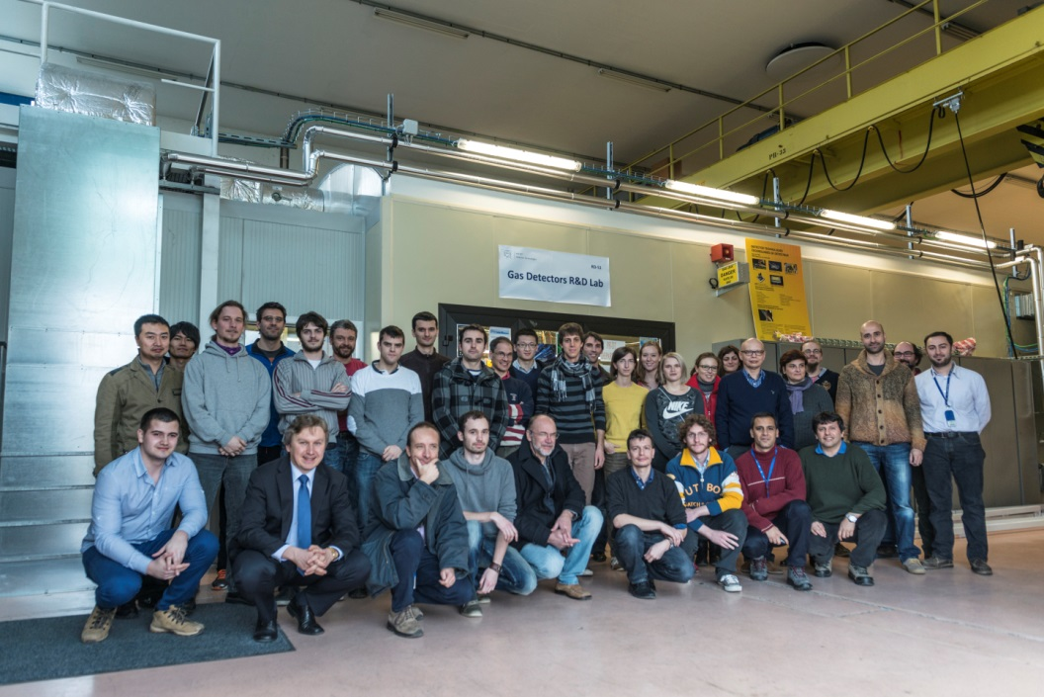
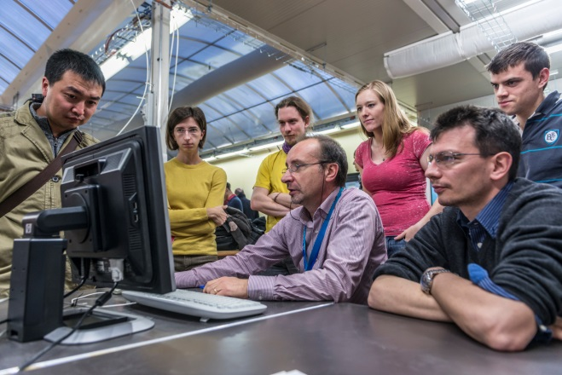
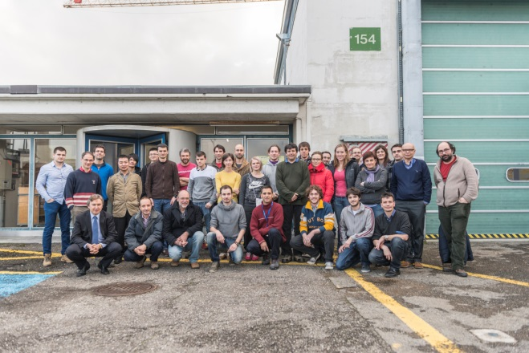
RD51 SRS Electronics School (February 3 – 5, 2014)
30 participants from the RD51 Collaboration Institutes: Lectures & Training Sessions
https://indico.cern.ch/conferenceDisplay.py?confId=283113
RD51 SRS Electronics School Pictures: http://cds.cern.ch/record/1646429?ln=en

Slide 11
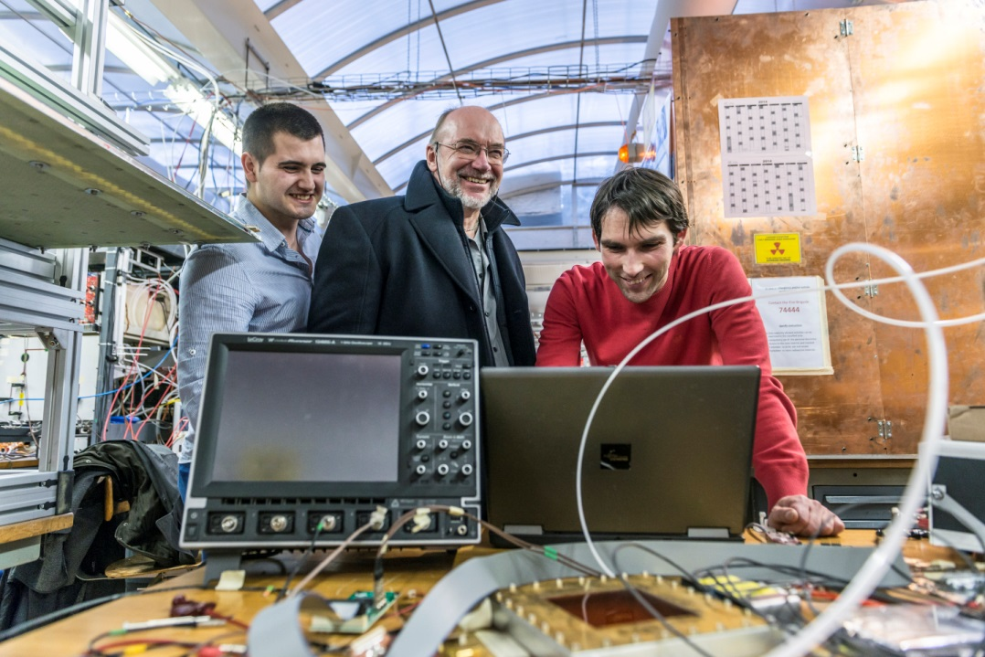
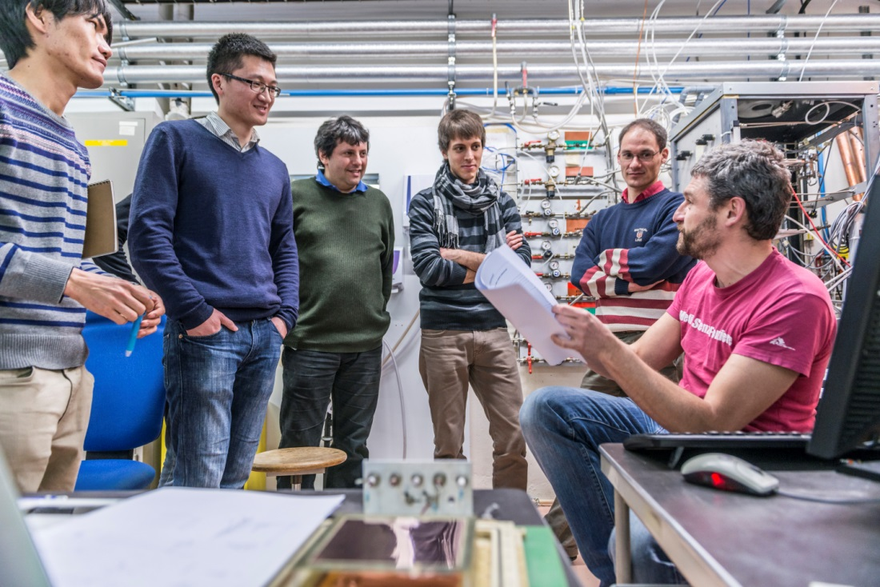
RD51 SRS Electronics School (February 3 – 5, 2014)
Tremendous amount of work →
Fantastic school organization by
Hans, Eraldo and team of 12
speakers and supervisors
VERY WELL RECEIVED BY
PARTICIPANTS
THANK YOU VERY MUCH !!!
Training improved as school progressed
(Eraldo mail to Hans, Monday late night):
Silent people doesn't mean sleeping people.
They got a lot of info and they probably
need time to elaborate.
If you want we can test today with
the high voltage if they are silent
or sleeping!?!

Slide 12
RD51 Common Projects (2011, 2012) and Future
2012: 3 Projects Approved
R&D on large area GEMs for the ALICE TPC upgrade (GSI/ Tokyo / UNAM)
High resolution UV scanner for MPGD applications (Wigner FCP/INFN Trieste/ INFN Bari )
Large-area THGEM detector evaluation with SRS electronics (Weizmann/Coimbra/Aveiro)
2011: 4 Projects Approved
Thin and high-pitch laser-etched mesh manufacturing and bulking (Saclay / CERN / Bari)
Development of innovative resistive GEM alpha detectors for earthquakes prediction
and homeland security (INFN Bari / UNAM, Mexico / INFN Padova / INFN Frascati)
MPGDs technology laboratory for training, development, fabrication, applications
and innovation (Universidad Antonio Nariño, Columbia / Brookhaven National Laboratory/
Helsinki Institute of Physics / HEPTech / GSI Helmholtzzentrum)
A low mass microbulk with real XY strips structure (NCSR Demokritos / Saclay/ Laboratorio
de Física Nuclear y Astropartículas, Universidad de Zaragoza / CERN )
Management Board reviewed and proposed changes to the Common Project
Submission and Evaluation Procedures
→ see talk A. White in the RD51 Plenary Session today
→ New Call for 2014 Common Projects is ready to go

Slide 13
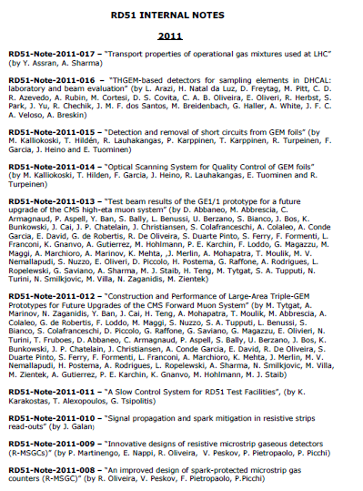
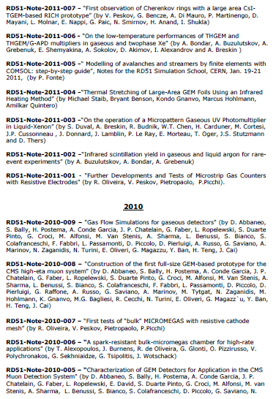
RD51 Collaboration Notes
https://espace.cern.ch/test-RD51/RD51%20internal%20notes/Forms/AllItems.aspx
RD51 Notes: 8 in 2013
12 in 2012
17 in 2011;
9 in 2010;
7 in 2009
Please submit results of your work, in parallel with journal publication, as RD51 Note:
Efficient way to disseminate your results to the MPGD/RD51 community
(rd51-all email goes to ~ 500 people)

Slide 14
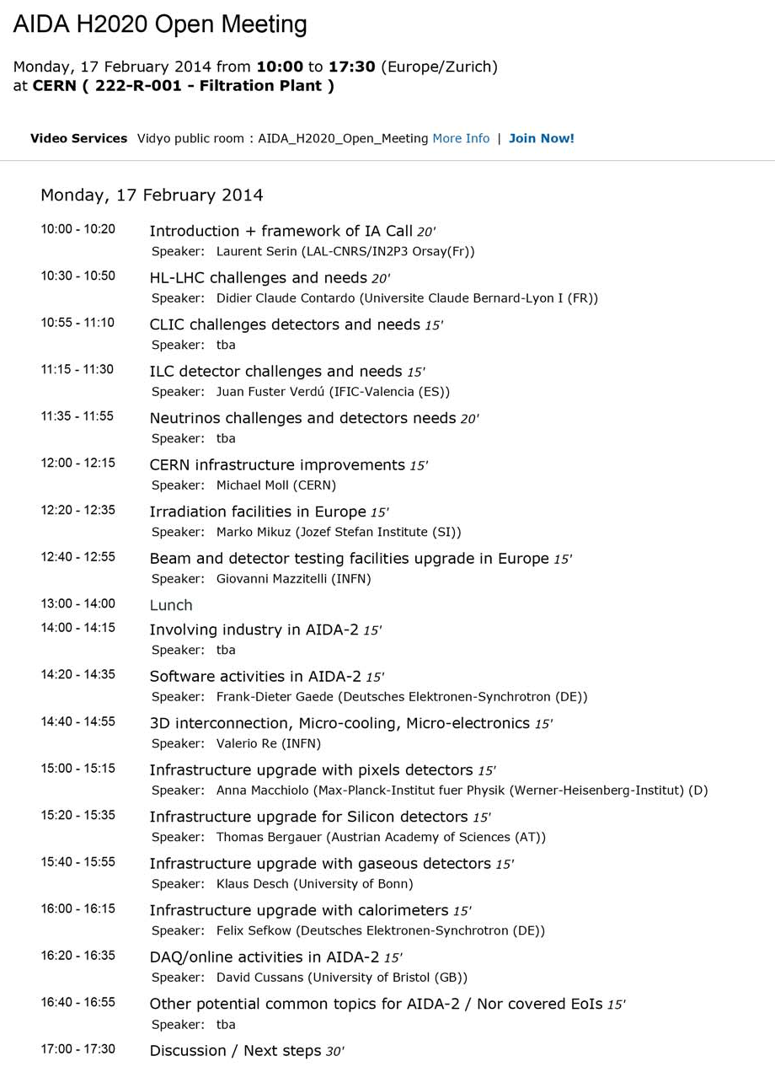
EU H2020 Discussion / MPGD Community Input
Special RD51 Session on
Thursday, 16:00 – 18:00:
→Discuss participation of
MPGD/RD51 groups in different
EU Calls and Networks
Expression of Interest of the
MPGD Community in AIDA2
H2020
AIDA2 Town Hall Meeting
(February 17, 2014 @ CERN):
http://indico.cern.ch/conference
Display.py?confId=289451

Slide 15
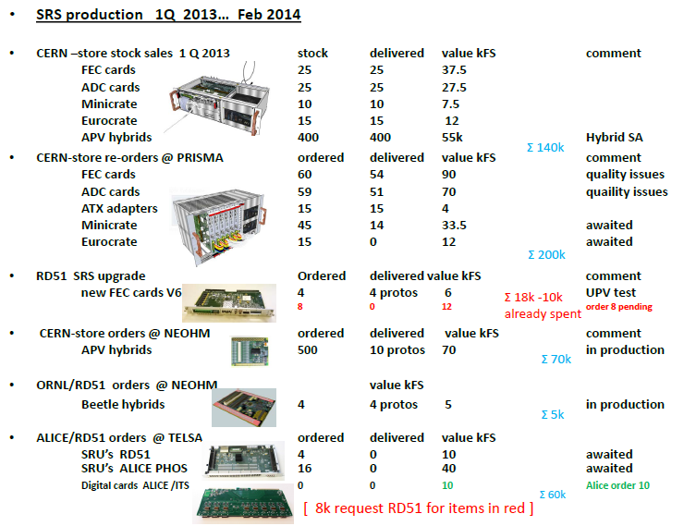
WG5 – Scalable Readout Systems Status Overview 2013 / 2014

Slide 16
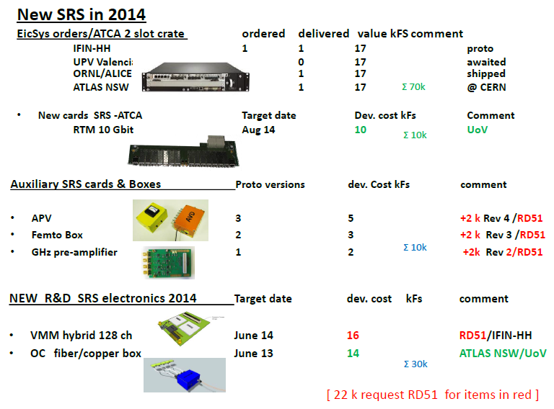
WG5 – NEW Scalable Readout Systems (EicSys/ATCA)

Slide 17
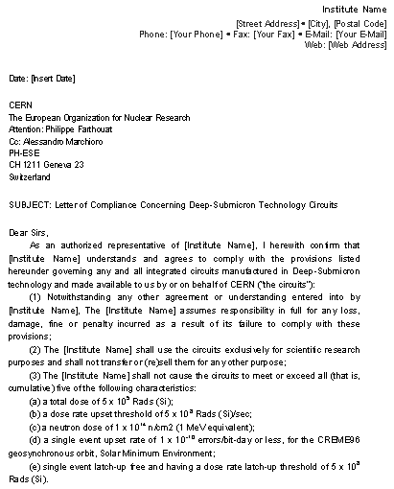
WG5 – Electronics & Scalable Readout Systems
Legal documents required for SRS distribution to the RD51 institutes are finalized
Caveat: situation only resolved for countries, which does not require license, based on “Commerce Control List” (cat. NS2) – mostly Europe, Switzerland & few others
SRS Distribution Procedure;
Every institute has to sign “Letter of Compliance” with RD51 spokes and send original to A. Marchioro
Order your SRS systems/hybrids from CERN Store
Pick-up hybrids from A. Marchioro office
(PH-ESE-ME, 77319)

Slide 18
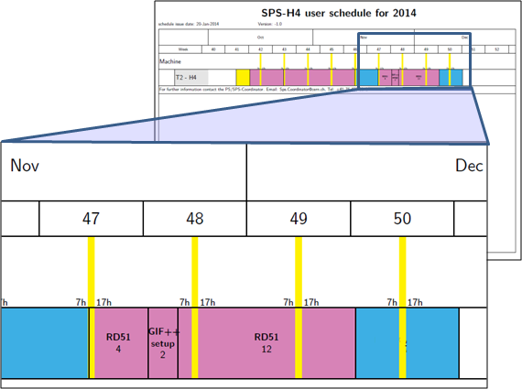
WG7 – Test Beams
2014 SPS North Area Test beam
Very Preliminary schedule
Beam availability for rd51 as
main user (H4):
16 days
Period:
End of November,
Beginning of December
13th RD51 Collaboration Meeting
WG7 - Common facilities
Thursday, 6 February 2014 15:45 - 16:15
Overview of the facility and of the available services (for new users).
Brief discussion about the preliminary schedule and the options provided by the SPS coordinator in view of the final schedule.
Specific requests from the users that have expressed interest on participating to our really-welcome-2014-test-beam (electronics, trackers, magnet,…).
aob

Slide 19
RD51 Roadmap: Creating New Projects and Continuing Earlier Ones…
Continuation of the R&D support for the experiments in many domains (…),
and LHC upgrades, in particular (WG1);
Generic R&D (new structures/ideas, det. physics) – RD51 Common Projects (WG2)
Development of new structure and consolidation of the existing structures
Applications – organization of series of specialized workshops disseminating
MPGD applications beyond fundamental physics –
RD51 research + industry + potential users (WG3)
Development and Maintenance of Software & Simulation Tools;
basic studies & software support for the RD51 community (WG4)
Development and Maintenance of the SRS Electronics (WG5)
An extended support for the SRS including new developments and
implementation of additional features …
MPGD Industrialization and QA Control – GEM, Micromegas, THGEM (WG6);
Completion of the industrialization of main technologies (GEM, MM, THGEM)
Maintenance and extension of the RD51 lab and Test-Beam Infrastructure (WG7)
MPGD Education and Training: organization of schools for students and
newcomers & academic Training (NEW WG)

Slide 20
13th RD51 Collaboration Meeting (Feb. 5-7, 2014)
https://indico.cern.ch/conferenceOtherViews.py?view=standard&confId=283108
Wednesday, February 5 (30-7-018 - Kjell Johnsen Auditorium)
10:00 – 12:00 RD51 Collaboration Board Meeting
13:00 – 15:00 RD51 Collaboration Plenary session
15:00 - 19:00 WG4 Software
Thursday, February 6 (30-7-018 - Kjell Johnsen Auditorium)
09:00 – 13:00 WG1 MPGD Technologies and New Structures
14:00 – 15:45 WG6 Production
15:45 - 16:15 WG7 Test Beams
16:15 - 18:00 EU H2020 Discussion / MPGD Community Input
20:00 - 23:00 RD51 Collaboration Dinner (let us know if you are interested)
Friday, Friday 7 (30-7-018 - Kjell Johnsen Auditorium)
09:00 – 13:00 WG5 Electronics
14:00 - 17:00 WG2 Physics Issues

