Slide 1
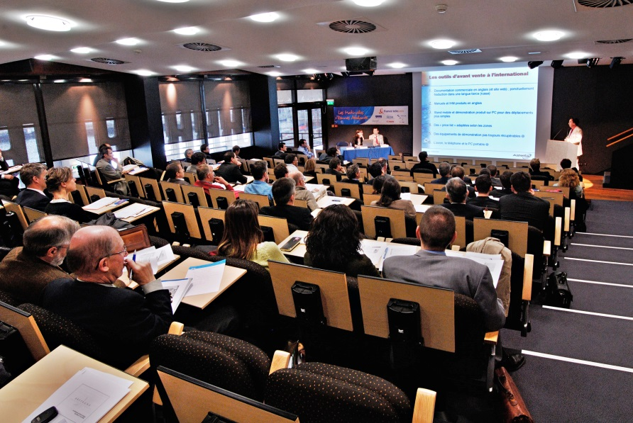
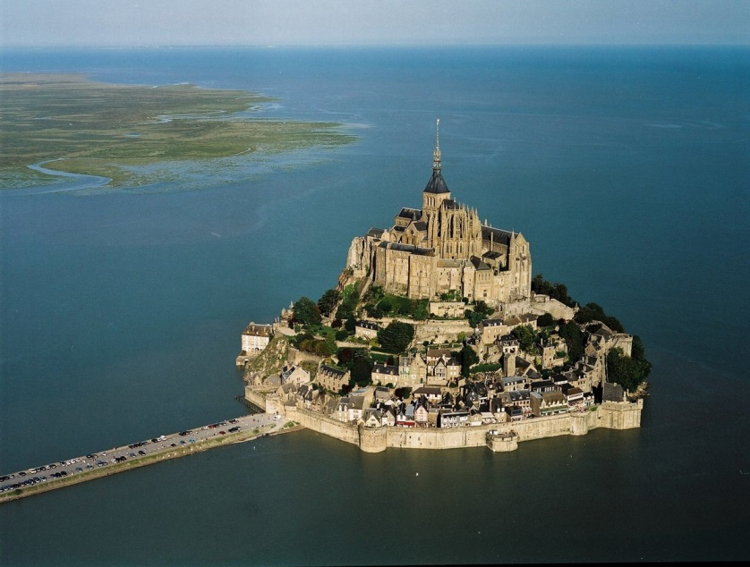
MPGD 2015 at Saint Malo, France
Paul Colas

Slide 2
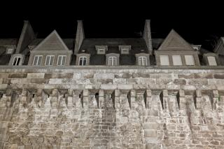
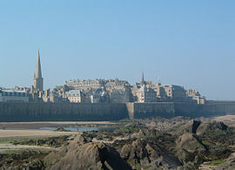
Saint Malo
‘Corsaire’ city of Surcouf, Duguay-Trouin
Old walled city
Large port for sailboat races around the world

Slide 3
Saint Malo
Access: TGV from Paris Montparnasse or Charles de Gaulle Airport.
Airport (RyanAir)
Boat from Southampton

Slide 4
The Palais du Grand Large
Large space for talks, posters, lunches
(see movie)

Slide 5
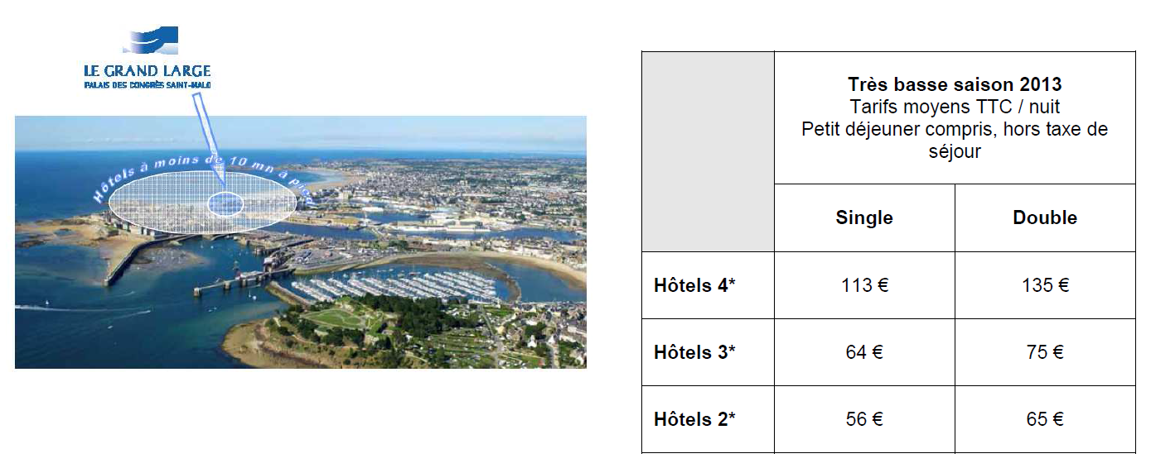
Cost
2450 rooms, 900 at less than 15 min walking

Slide 6
Cost
Cheaper accomodation
Support, sponsors: CEA, CNRS, industrial partners
Cost estimate based on 150 participants to the conference, 75 to the RD51 Collaboration meeting: Full cost 204 euro + 184 euro
This includes 24€ x 5 lunches and does not include the banquet (60 €)
Sponsoring and external funding is expected

Slide 7
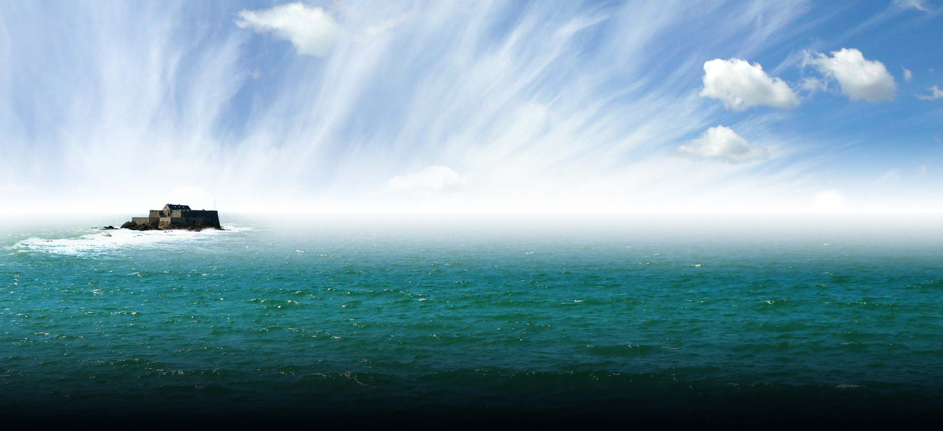
Dates
Preferably end of June-beginning of July
  Usually good weather. Temperatures 20-25°C
Also possible before end of March
Other dates are possible but at +20% cost

Slide 8
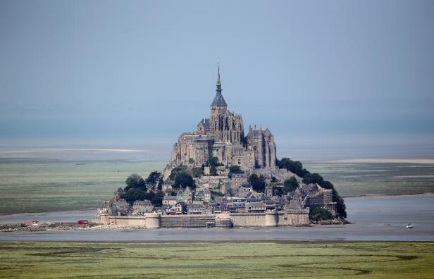
Excursion
Several possibilities, including Mont St Michel (90 €), Cape Frehel, Fort Lalatte, city tour,…

Slide 9
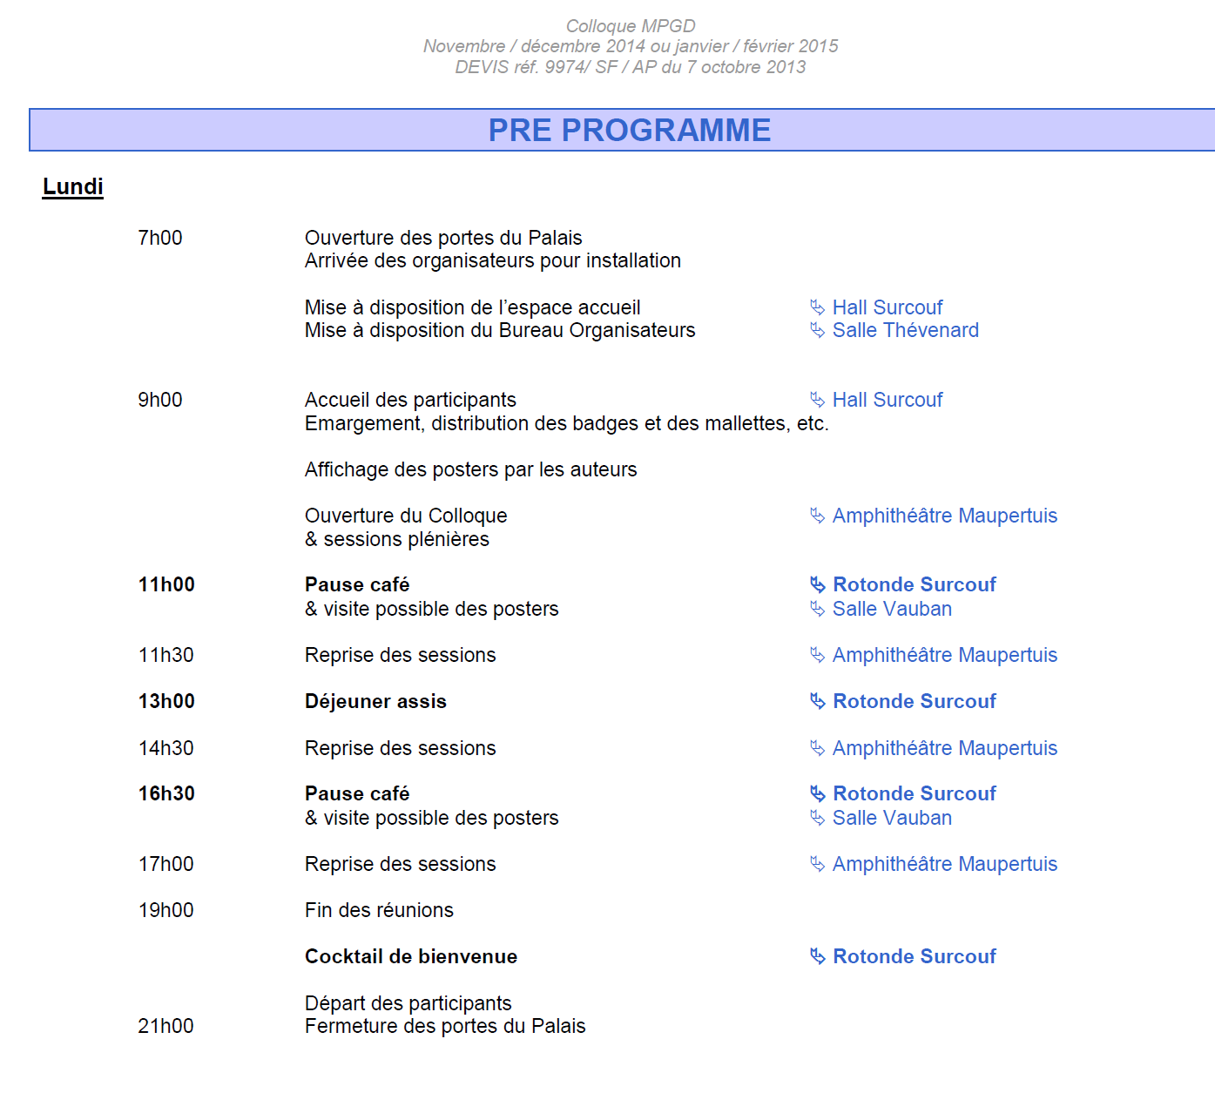

Slide 10
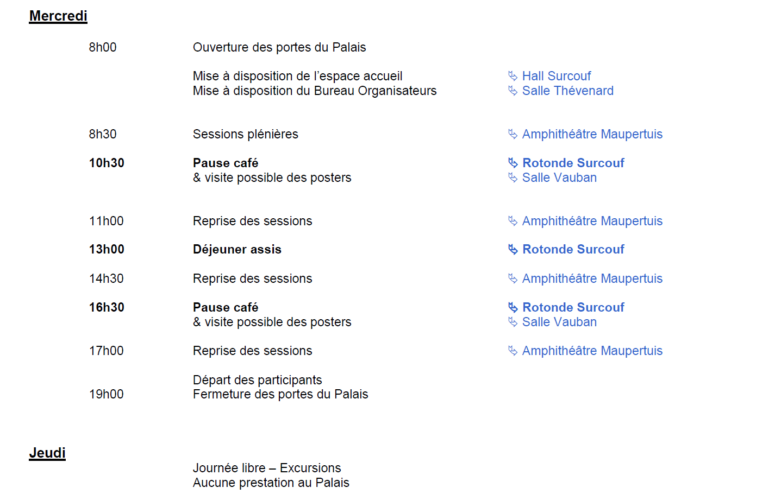

Slide 11
