Slide 1
Pilot Management and Resources Provisioning
Daniele Spiga
Computing Common Projects – Brainstorming
21 November 2013

Slide 2

Introduction: The Process
Define “Resource Provisioning” and its goal(s)
Brainstorming
  Try to focus on
  principles rather than on implementations
Wrap-up

Slide 3
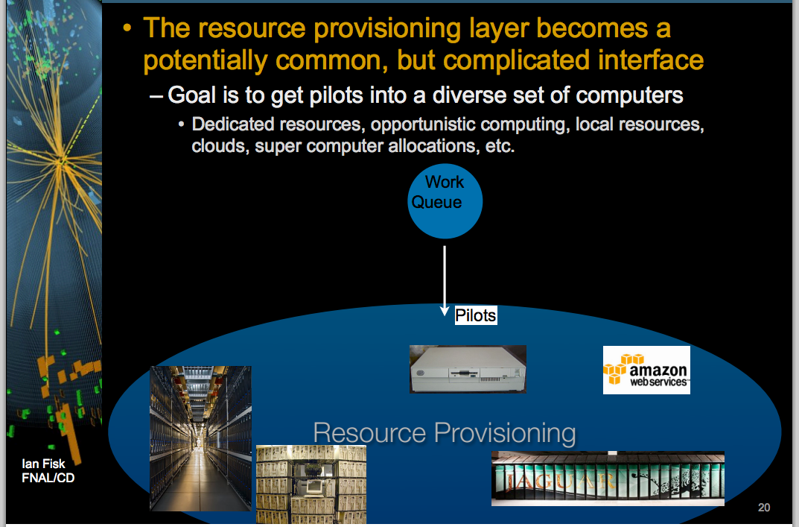
Resource Provisioning: Definition
Resource Provisioning (RP) is about how we get pilots into diverse set of computers
  Completely experiment free: common
The key to RP is effective management and exploitation of all computing resources
  Goal is to allow experiments to get groups of instances for periods of time
Ian Fisk : WLCG WS
Nov.11th-12th
Global queue:
  Experiment specific queue for workload
Pilot:
  Here is meant as a entity which can communicate with experiment’s queue

Slide 4
Brainstorming: Start
Experiment’s queue can be agnostic about the RP
  Don’t need to know if pilot is on desktop/HPC/cloud…
    But some specs info are needed: time floor, memory, storages
RP deals with VO shares
  At which level experiments would need to influence shares, if any
    Priority may be completely on queue side under experiment control

Slide 5
Still Brainstorming
RP should make easy for people to give local resources
  For private transient resources management
    Security… , only matter of policies?
RP can be influenced by experiment
  To give people special access to resources they provide
RP should guarantee to make the most efficient use of the all available resources
  Being responsible to allow the experiment getting N instances for M hours
    Avoid wasting money, avoid wasting people time

Slide 6
More Brainstorming
…

