Slide 1
FGC integration
feedback from OP
A. Akroh, J-F. Comblin, P. Freyermuth, B. Mikulec, R. Steerenberg , J-L. Sanchez Alvarez.

Slide 2
Outline
  PS: FGC2
  Booster: FGC3
  LINAC 4: FGC3
  Conclusion

Slide 3
FGC2 in the PS
The first FGC in the COMPLEX PS has arrived in 2010 to regulate the PS generator. Followed by another one to regulate the PoPS.
The software in the FGC had to be adapted for the Pulse to Pulse Modulation operation.
Work on the InCA side was necessary to integrate this new standard.
A specific application had to be developed.
Benefit : A robust and reliable system, better regulation and diagnostics, post mortem available.

Slide 4
FGC2 in the PS
PS Main power supply:
Cycle editor MGS
Cycle editor PoPS
Trim history
Archives
PR.MPS
PR.GSBSIM
Simulated Btrain (GFA)
Inca
PR.MPC
FGC2 – 52 property model
FGC2 – 53 property model
FGC2 - 52
FGC2 - 53
Motor-Generator Set
PoPS – Capacitor bank
Cycle precisely defined using polynomial functions.
Properties accessible through Inca standards.
Regulation modes available on class 53 (Field, Current, voltage).
Class 53 precise Warning and Fault bitmask definition on a web page.
FGC 2 Limited subscription does not allow automatic synchronization of multiple opened editors.
Analog signal acquisition can require Filters not supported by Japc standards. Requires specialist application to be unlocked after a fault.
Signals in OASIS would be an advantage

Slide 5
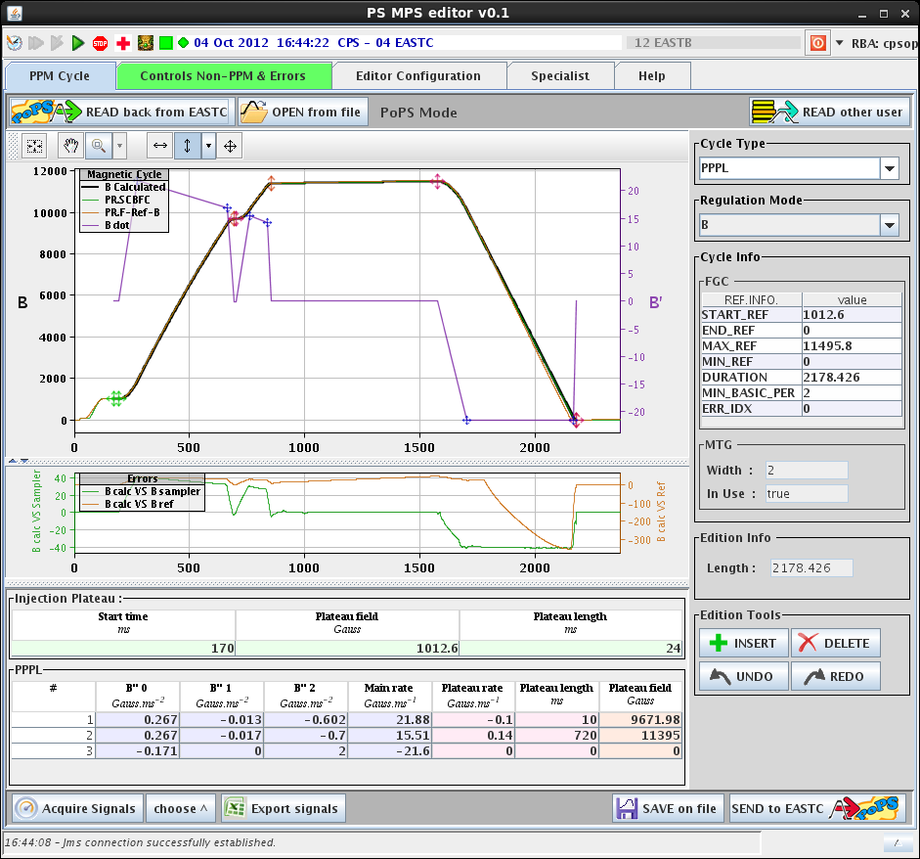
FGC2 in the PS
FGC2 PPPL calculation algorithm integrated in OP software to display a cycle preview.
Limit values can be read from hardware (Max Bdot, voltage,…) , and FGC2 avoid the set of values exceeding maximums.
FGC2 Integration was done after a few meetings with the specialists.

Slide 6
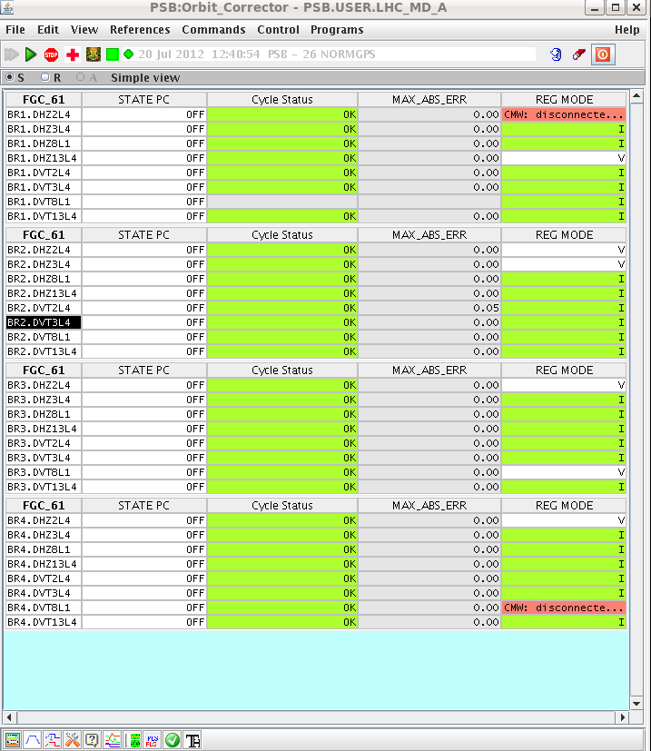
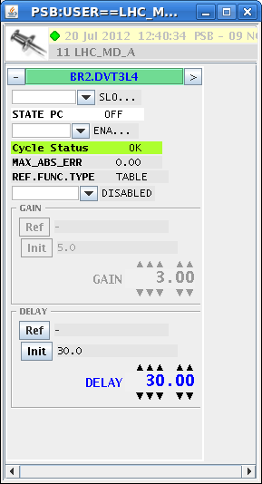
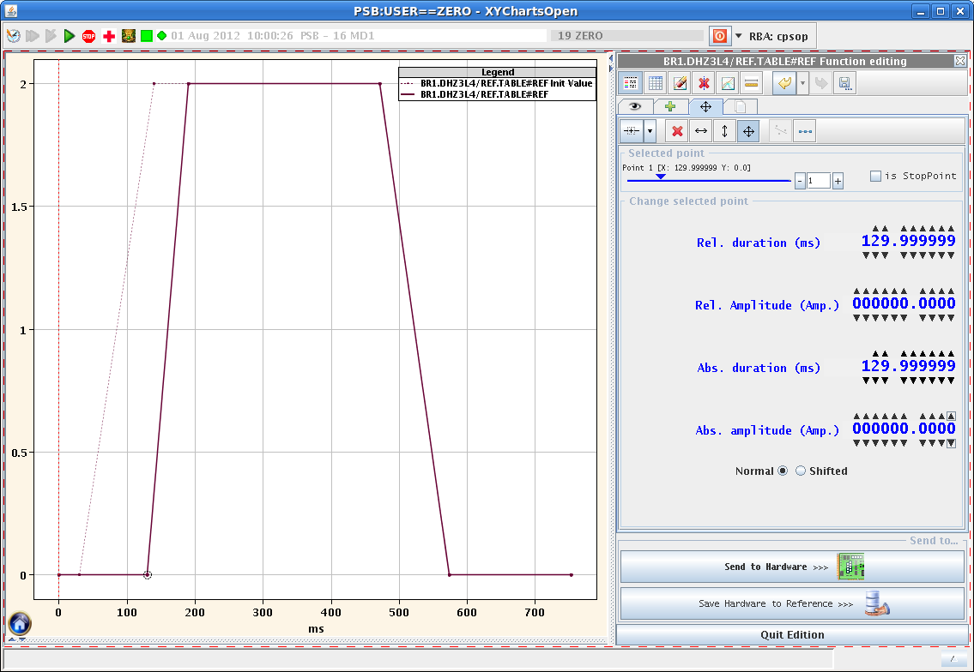
FGC3 in the PSB
In 2012, 32 FGC3 have been installed and commissioned in the PSB with the orbit correction dipoles. These power supplies were not used for standard operation.
Our requirements were to use only generic applications (WorkingSet, Knobs, Function editor, YASP) to control these equipment avoiding specific applications like in the PS. (Many standard power supplies, MPS/PoPS is special case)
Functions to be generated by table(2D-array) and not piece-wise functions.

Slide 7
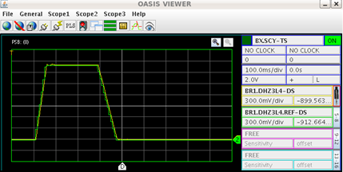
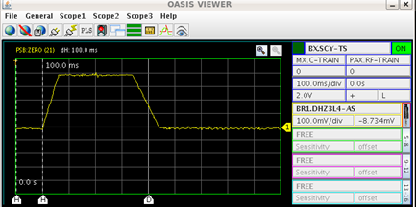
FGC3 in Oasis
During commissioning OP has asked for 8 independent OASIS channels to cross-check the FGC3 acquisitions. FGC3 provide digitized datasource with absolute time stamps.
Productive collaboration between EPC, CO and OP.
Worry: to have the FGC signals synchronous with other machine signals.

Slide 8
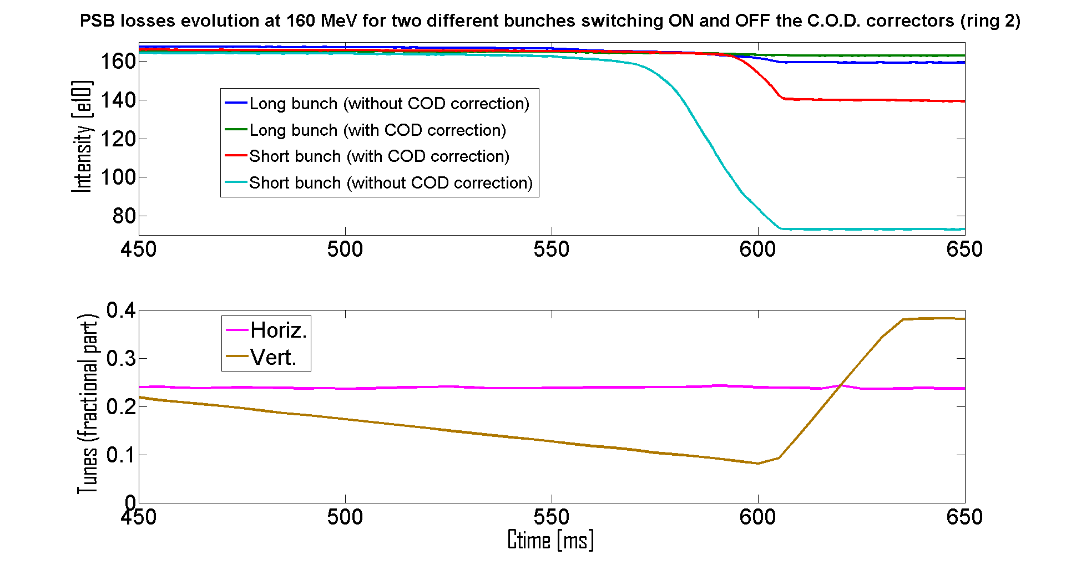
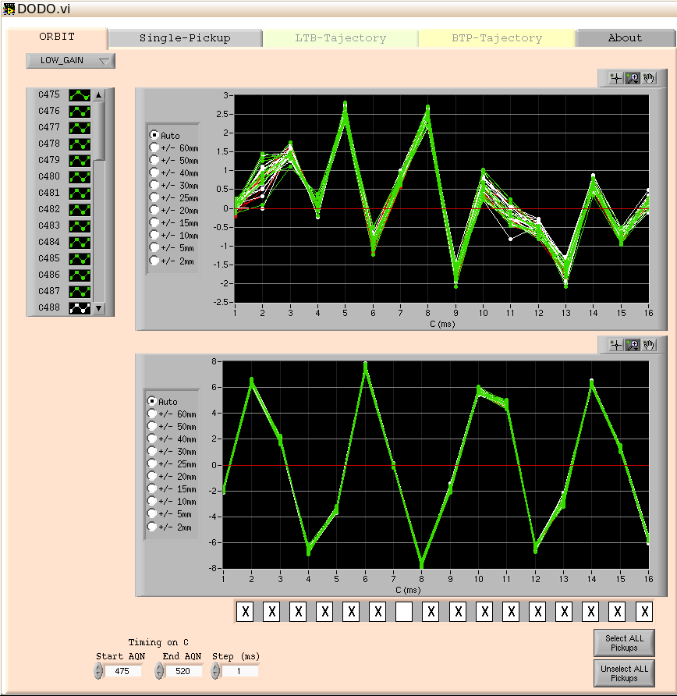
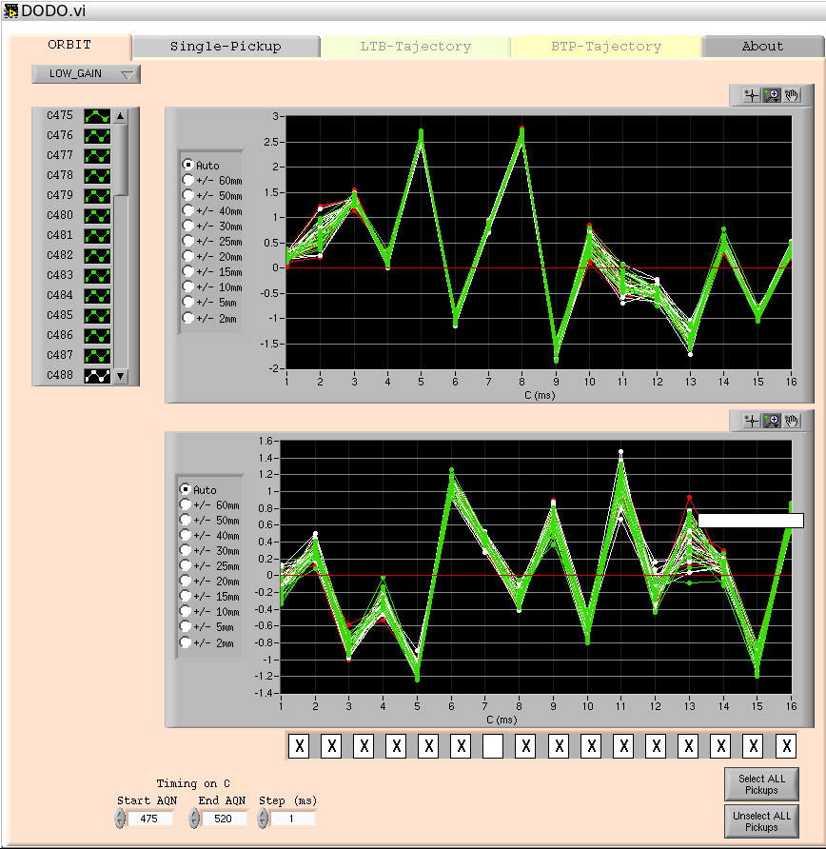
MD results using PSB orbit correctors
Orbit before correction (up to 8 mm in vertical)
Orbit after correction (up to 1.6 mm in vertical)
MD: Dynamic tune variation towards Qv=4
  Without the orbit correction it would have been impossible to distinguish between the losses caused by the orbit excursions and the ones generated by the resonance amplification effects.
Courtesy of Vicenzo Forte et al.

Slide 9
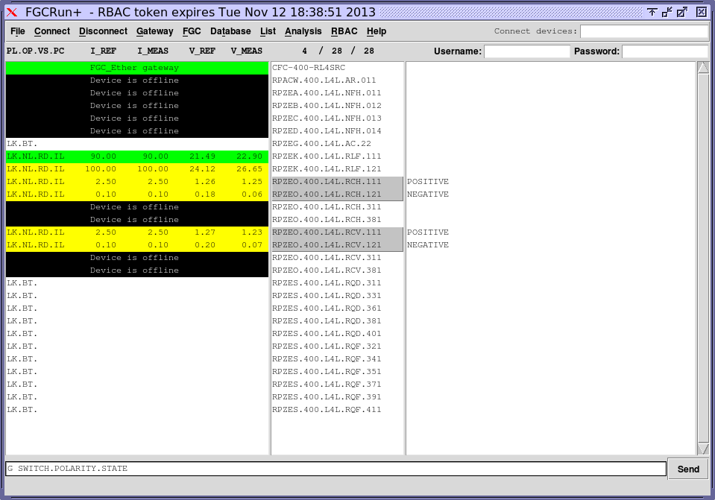
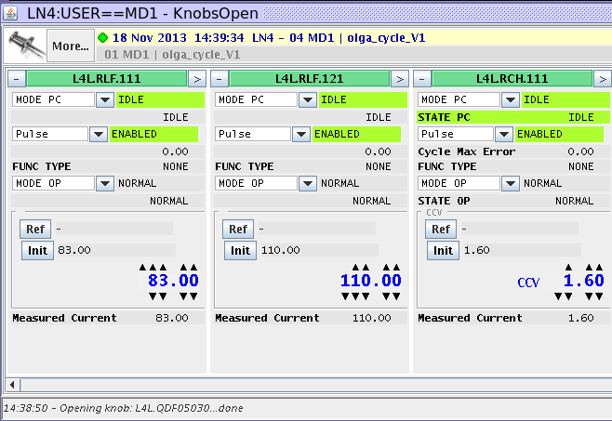
FGC3 in the LINAC 4
Linac 4 has 2 solenoids and 4 correction dipoles working in DC mode. The control is OK unless we have to change the polarity.
  To change the polarity: We have to launch a specialist application FGCRun+, Log in, select the FGC3 and send the command “s switch.polarity.state POSITIVE (or NEGATIVE) ”. To be improved!
  The current acquisition displayed by the knobs shows the absolute value.
  The only way to know the polarity is to use the specialist application: “g switch.polarity.state”. To be improved!

Slide 10
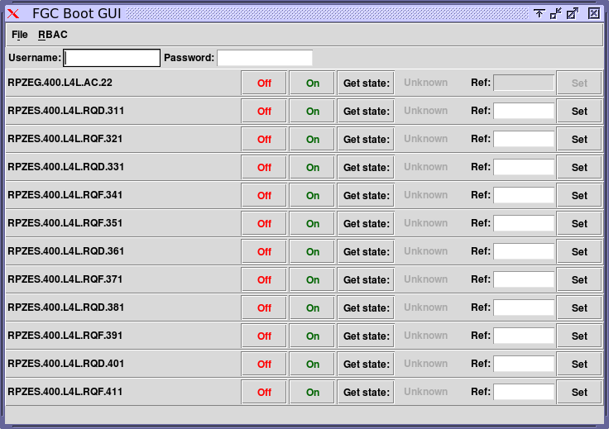
FGC3 Linac 4
Quadrupoles in the LEBT
  Control only with a specific application FGC boot GUI. Switch ON/OFF, Get the state and set the reference value.
  Impossible to acquire the current or even read the old reference value.
  Waiting for FGC3 software to become available and to control through InCA/knobs.

Slide 11
Conclusion
The integration of the FGCs in the PS and PSB was successful thanks to continuous effort between specialists from EPC, CO and OP.
FGC2 in PS: signals through OASIS would be beneficial (signal unlock after fault issue to be solved).
FGC3 in PSB: First results already obtained for ABP benchmarking studies thanks to FGC3 control of orbit correctors.
  FGC3 datasource integration in OASIS: commissioning to be finalized.
  Hardware commissioning of additional >80 FGC3 for PSB multipoles.
  Dry-Runs before the start-up 2014 is necessary after LS1 period.
FGC3 in LINAC4: The integration process is in work. The FGC3 software is delayed, which poses some problems for the ongoing commissioning.
Restart Periodic meetings organized by ECP. Follow-up of issues open.

