Slide 1
LS1 Status Report
LS1@LHCC – 116th LHCC
Frédérick Bordry
4th December 2013

Slide 2
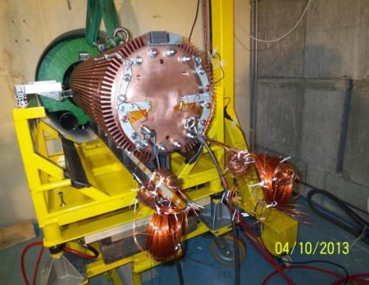
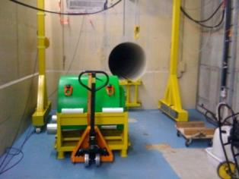
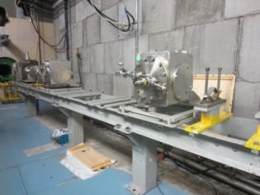
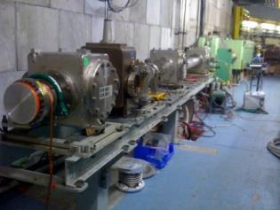
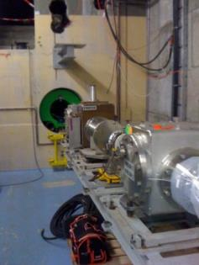
Booster
Access system installed
Cabling complete
Beam dump replacement in progress
  New dump installed
  Re-installation of the BTM & BTY lines
Maintenance of the different equipment on schedule
Already preparing for LS2: cranes renovation, new cable trench
PSB beam dump
27/09
01/11
15/11
29/11

Slide 3
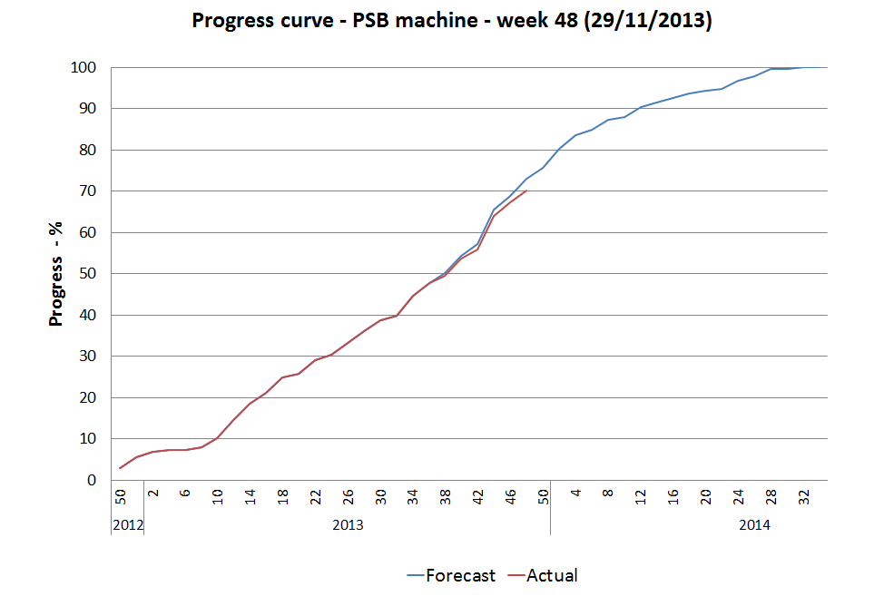
Booster

Slide 4
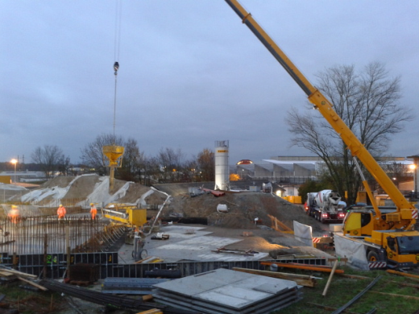
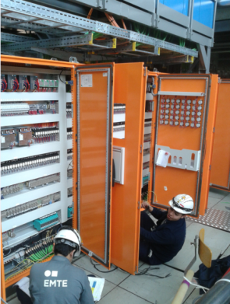
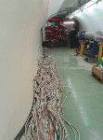
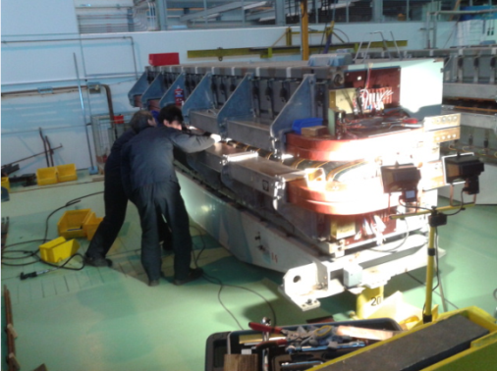
PS
Access system
Ventilation renewal progressing well
  Dismantling is finished
  Automation test in progress
Septum 16 shielding
  Piling work is complete
  Formworks going on
Cabling campaign (and it starts with de-cabling !!)
Magnet maintenance in progress
  6/7 main units are being overhauled in the workshop
Renovation of the power house is in progress
Septum 16 shielding - formworks
CV cabling works
6th MU being consolidated in workshop
TT2 decabling

Slide 5
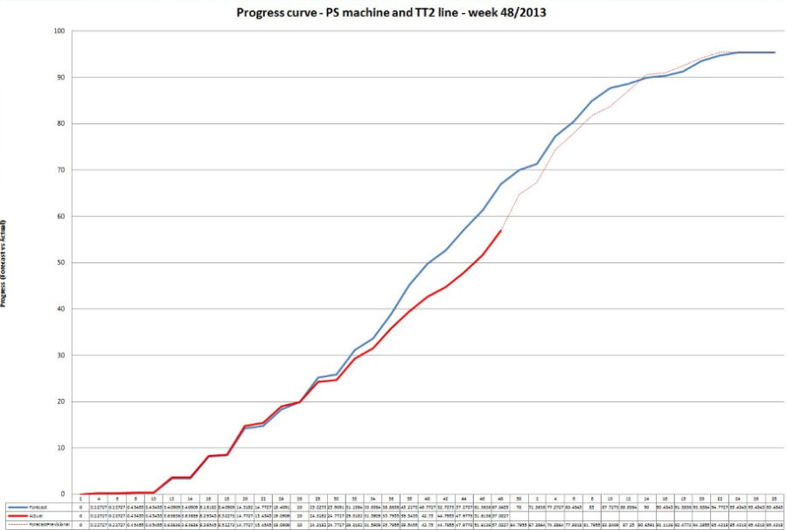
PS
Mainly due to delay for the start of magnet maintenance – no impact on the end date

Slide 6
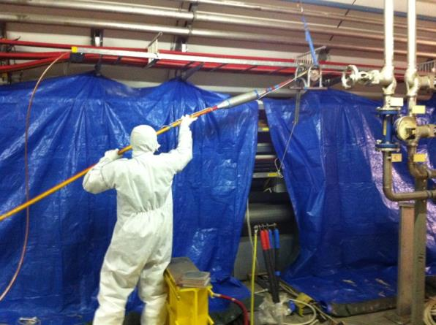
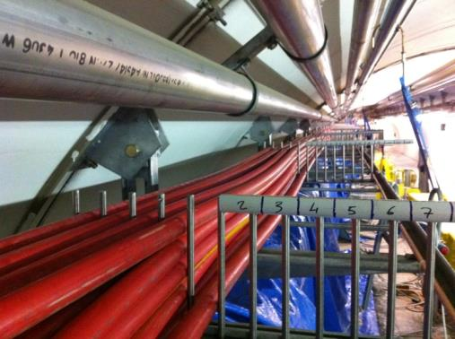
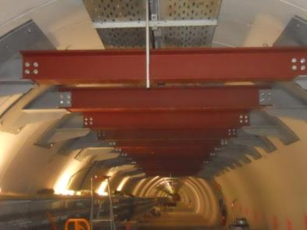
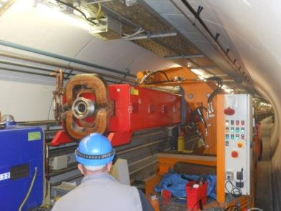
SPS
BA1 - Irradiated cabling campaign
  Progressing very well
  slightly ahead of schedule
TT10 – repair of the vault on going
  Beam supports in place
  Installation of protective mesh in progress
Refilling of the primary circuits started
Septa replacement in BA23 in progress
Kickers conditioning in progress
Magnet exchange
Cabling and optical fibers campaign on going
BA1 -irradiated cabling campaign
SPS magnet exchange
TT10 vault

Slide 7
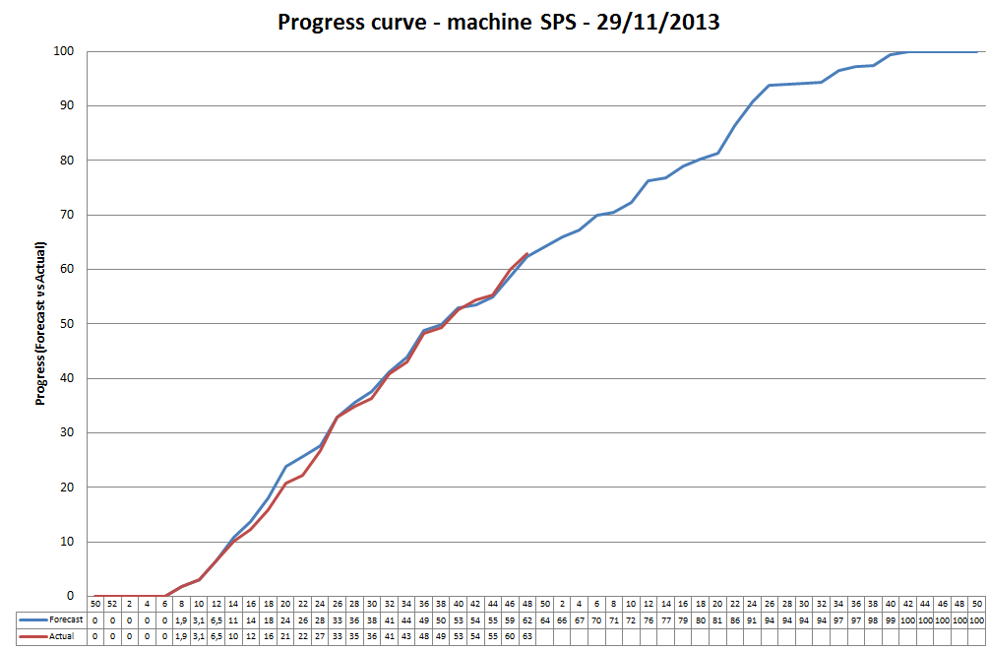
SPS

Slide 8
LS 1 from 16th Feb. 2013 to Dec. 2014
16th Feb.
4th December
2013
2014
2015
F
M
A
M
J
J
A
S
O
N
D
J
F
M
A
M
J
J
A
S
O
N
D
J
F
M
A
LHC
SPS
PS
PS Booster
beam to beam
available for works
Physics
Beam commissioning
Shutdown
Powering tests

Slide 9
115th LHCC Meeting (25th September 2013)

Slide 10
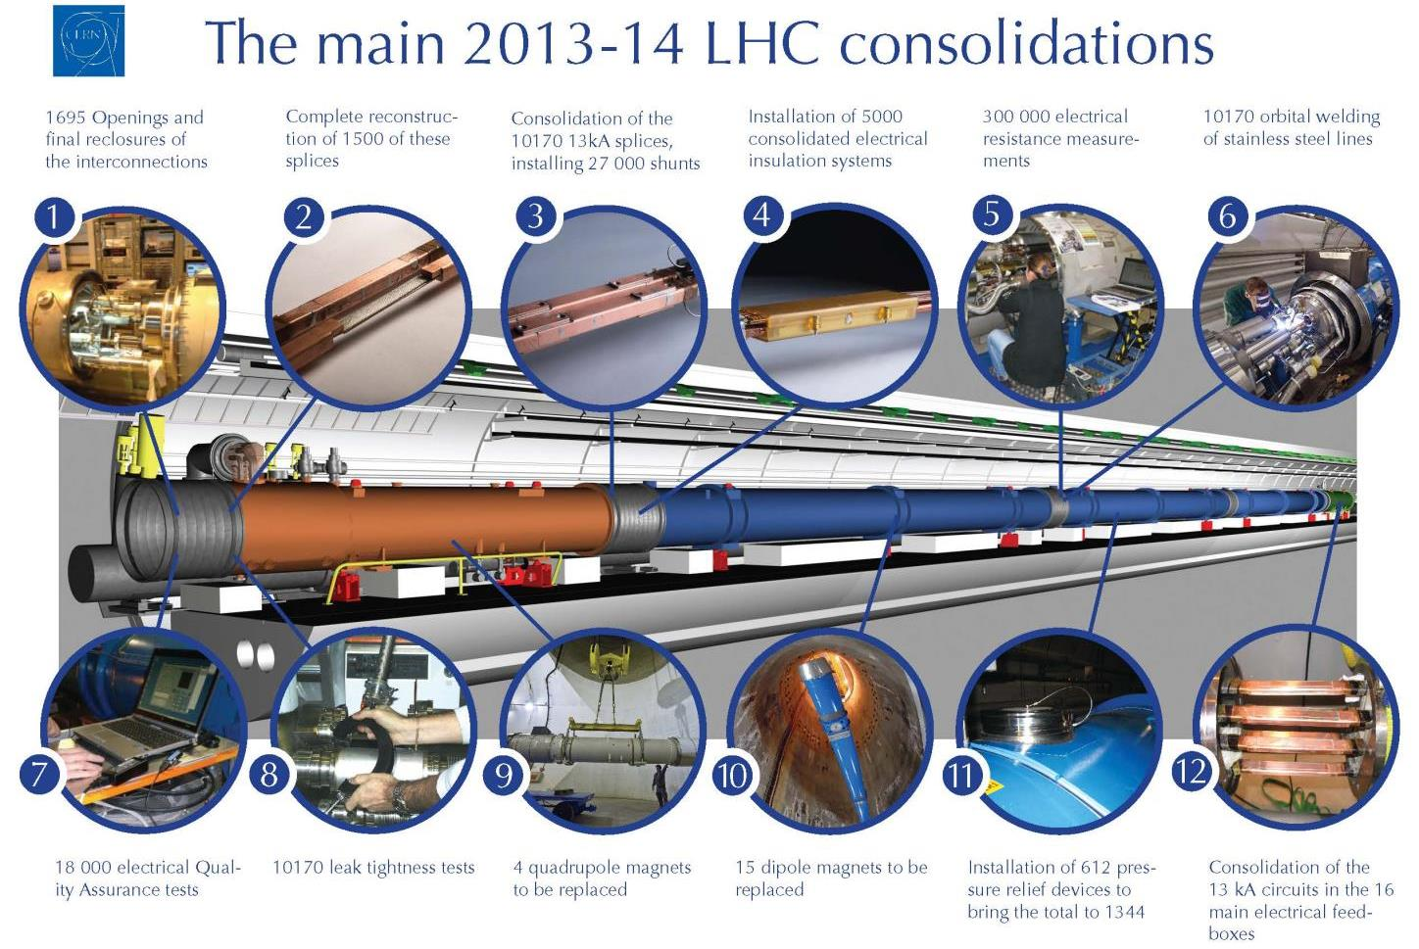
60 % done
3000
3
Done
Done
Done

Slide 11
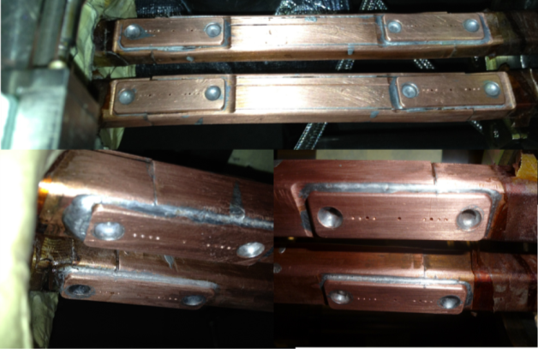
Reasons for splice repairs
In average 31% of the splices in the sectors 56, 67, 78, 81 and 12 have been redone for different reasons.
In sectors 12 and 23 the number of redone splices is significantly influenced by magnet replacements (72 splices in 12 and 36 splices in 23 redone after magnet replacement).
Reasons for splice repairs in the different sectors (*updated 13.11.2013; **about 30% without magnet replacements).
 | Sector 56 | Sector 67 | Sector 78 | Sector 81 | Sector 12 | Sector 23*
Number of splices | 1216 | 1266 | 1272 | 1216 | 1208 | 486
Repaired (%) | 27 | 32 | 30 | 30 | 35** | 36**
R-8 excess >5 µΩ (%) | 3 | 14 | 14 | 15 | 12 | 13
Geometrical (%) | 21 | 16 | 12 | 12 | 15 | 14
Other (%) | 3 | 2 | 4 | 3 | 8 | 9
Courtesy of C. Scheuerlein

Slide 12
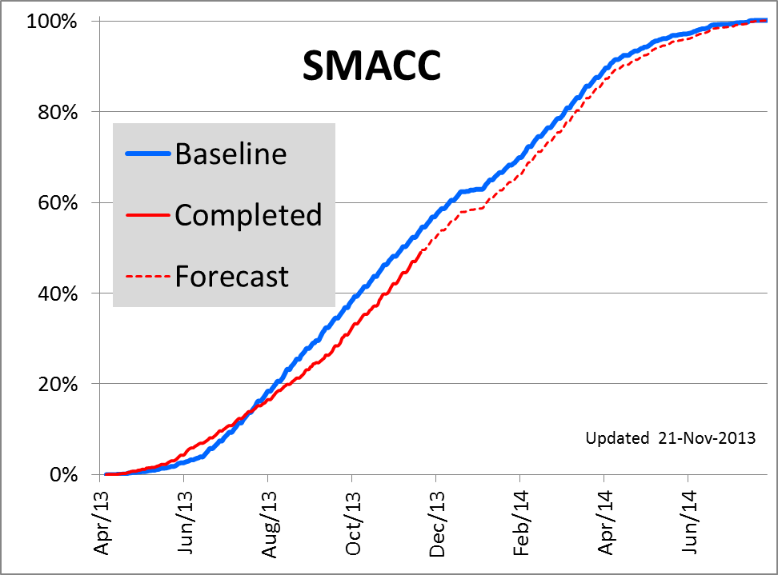
SMACC Dashboards
3 weeks
Superconducting Magnets and Circuits Consolidation (SMACC).

Slide 13
Top ten R-8 outliers (*updated 13.11.2013)
Dipole splice* | R-8 (µΩ) | Quad splice* | R-8 (µΩ)
QBBI.B24R7-M3-Ext-R | 77.5 | QQBI.20L8-M1-Ext-L | 116
QQBI.22L8-M3-Ext-L | 52.6 | QBQI.27R1-M1-Int-L | 54.8
QBBI.A14L8-M3-Int-R | 49.9 | QBBI.B18R2-M1-Int-L | 52.5
QQBI.16R8-M3-Int-R | 47.4 | QBBI.B25L8-M1-Int-R | 51.4
QQBI.22R7-M3-Int-L | 43.3 | QBBI.B31R1-M1-Int-L | 45.9
QQBI.19L1-M3 Ext-L | 41.8 | QQBI.30L8-M1-Int-L | 44.5
QBQI.32R7-M3-Int-L | 41.6 | QEBI.11L1-M1-Ext-L | 43.7
QBQI.31R6-M3-Ext-L | 40.6 | QBBI.B16R6-M1-Int-L | 41.7
QBBI.B27R7-M3-Ext-R | 39.1 | QBQI.19R1-M2-Ext-L | 41.4
QQBI.30R7-M3-Ext-R | 39.0 | QBQI.32R1-M2-Int-R | 41.3
Highest R-8 values of dipole and quadrupole splices per sector.
Sector | Max R-8 RB | Max R-8 RQ
56 | 34.2 µΩ (QBQI.18L6-M3-Ext-L) | 30.4 µΩ (QBQI.26L6-M1-Int-L)
67 | 40.6 µΩ (QBQI.31R6-M3-Ext-L) | 41.7 µΩ (QBBI.B16R6-M1-Int-L)
78 | 77.5 µΩ (QBBI.B24R7-M3-Ext-R) | 116 µΩ (QQBI.20L8-M1-Ext-L)
81 | 47.4 µΩ (QQBI.16R8-M3-Int-R) | 43.7 µΩ (QEBI.11L1-M1-Ext-L)
12 | 35.2 µΩ (QBQI.21L2-M3-Ext-L) | 54.8 µΩ (QBQI.27R1-M1-Ext-L)
23* | 31.5 µΩ (QBQI.10R2-M3-Int-L) | 52.5 µΩ (QBBI.B18R2-M1-Int-L)
Courtesy of C. Scheuerlein

Slide 14
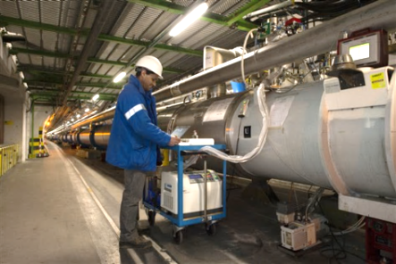
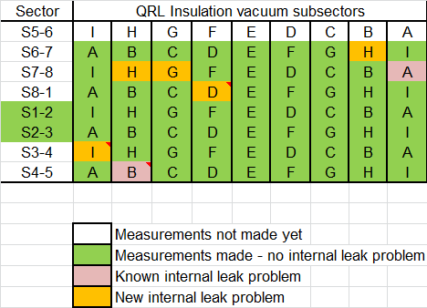
LHC Preliminary leak tests
Arc subsectors all tested: 20 internal helium leaks identified
  14 identified to component (for repair).
  For 6 leaks not identified to component,
  further tests to be performed in phase 2.
QRL
  2 existing internal leak known
  5 new internal leaks – under investigation
Winter stop 2010-2011

Slide 15
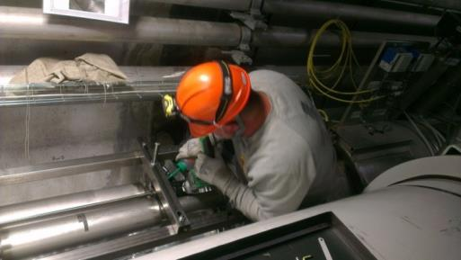
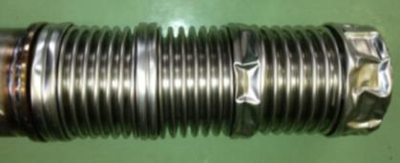
Repair plan for QRL compensators

Slide 16
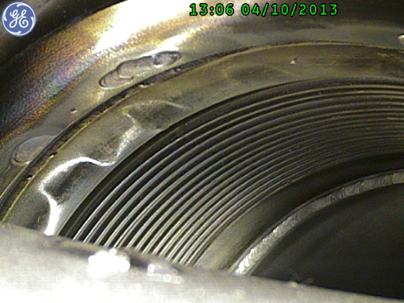
DFBA gimbal bellows status
Thanks to EN-MME, TE-MSC, TE-VSC, EN-HE & EN-MEF!
DFBAK
DFBAO
Status: DFBAI (lower gimbal) in-situ repair completed in S45
DFBAF (lower gimbal) ready for in-situ repair in S34
DFBAK (in S56) (upper gimbal) under repair in B112 workshop
DFBAO (in S78) (upper gimbal) → meeting on 5/12 for decision (in-situ or workshop)

Slide 17
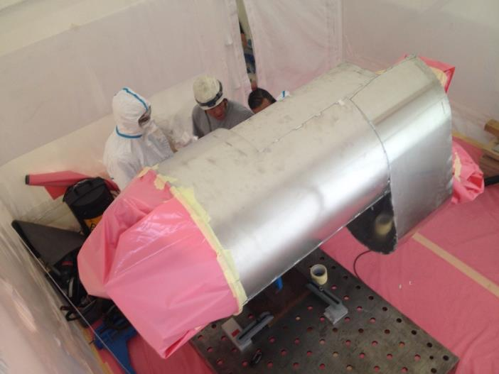
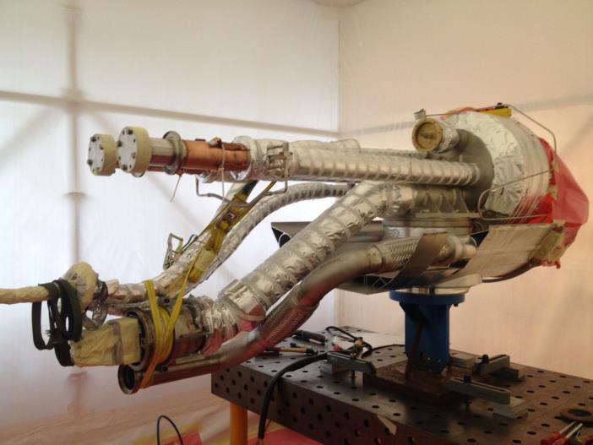
SMACC Progress report DFBA
DFBAK shuffling module has been transported to workshop according to RP rules
Courtesy TE-CRG, TE-MSC, TE-VSC, EN-HE, EN-MEF, EN-MME and …

Slide 18
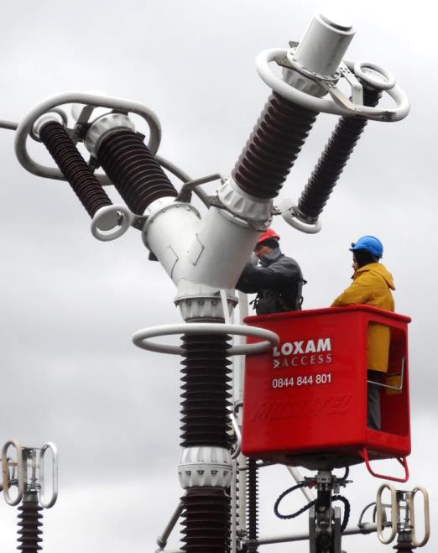
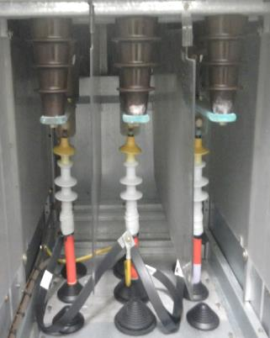
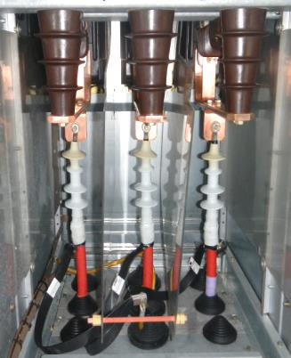
Maintenance
Electricity Distribution Equipment
Before
After
400 kV & 66 kV circuit breakers
18 kV & 3.3 kV circuit breakers

Slide 19
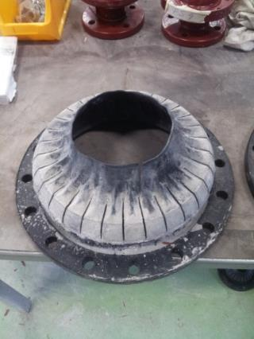
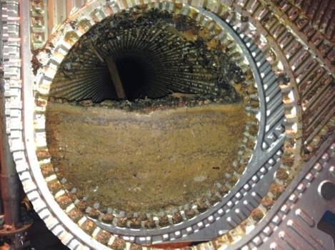
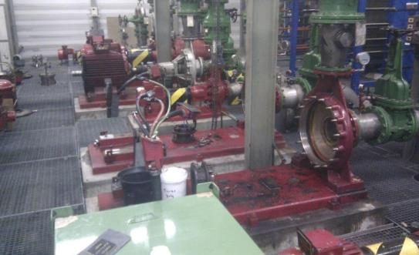
Maintenance
Cooling and Ventilation Equipment
Lack of maintenance for several years …
Replacement campaign of the membranes of one-way valve or of flexible sleeves
… mud inside a heat exchanger
Three years mechanical maintenance of motors and pumps.
Several critical situations found (e.g. shaft damaged at the connection with the impeller )

Slide 20
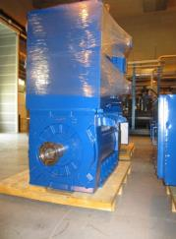
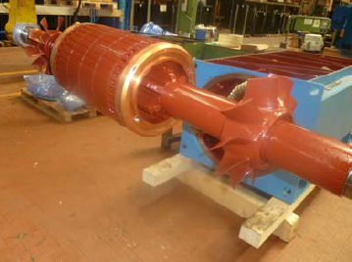
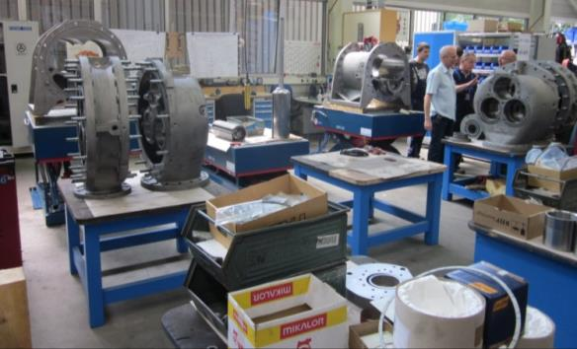
Major overhauling of cryoplants
Electrical
Motors
(66 units 3.3 kV)
(54 units 400 V)
Compressors
(75 units)
Aerzen
Courtesy of Laurent Tavian

Slide 21
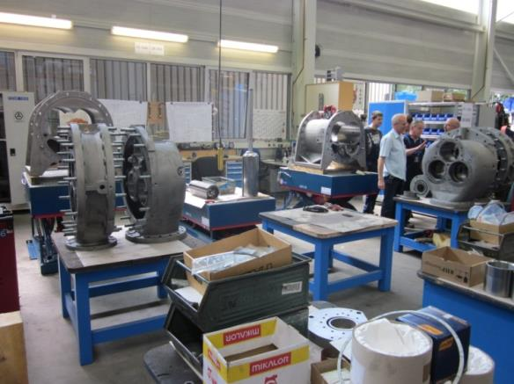
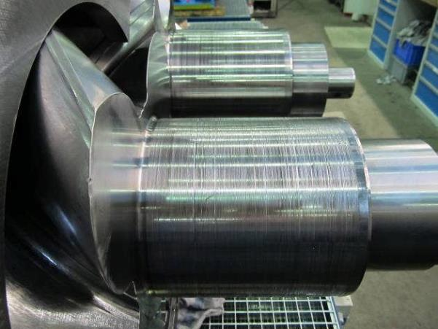
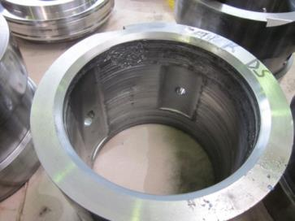
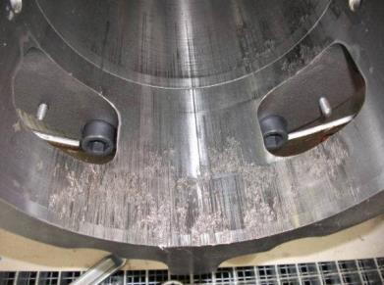
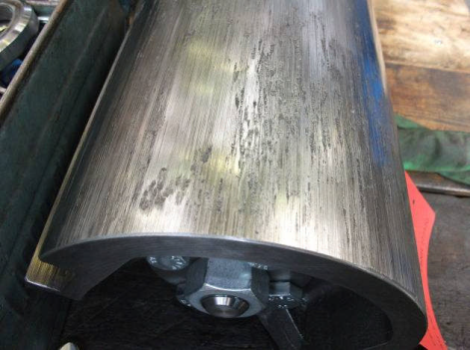
LS 1 : major overhaul of LHC cryo compressors
Damaged slide bearing seat (QSCB-4-CP1)
Capacity slide valve and support P6
Courtesy of Laurent Tavian

Slide 22
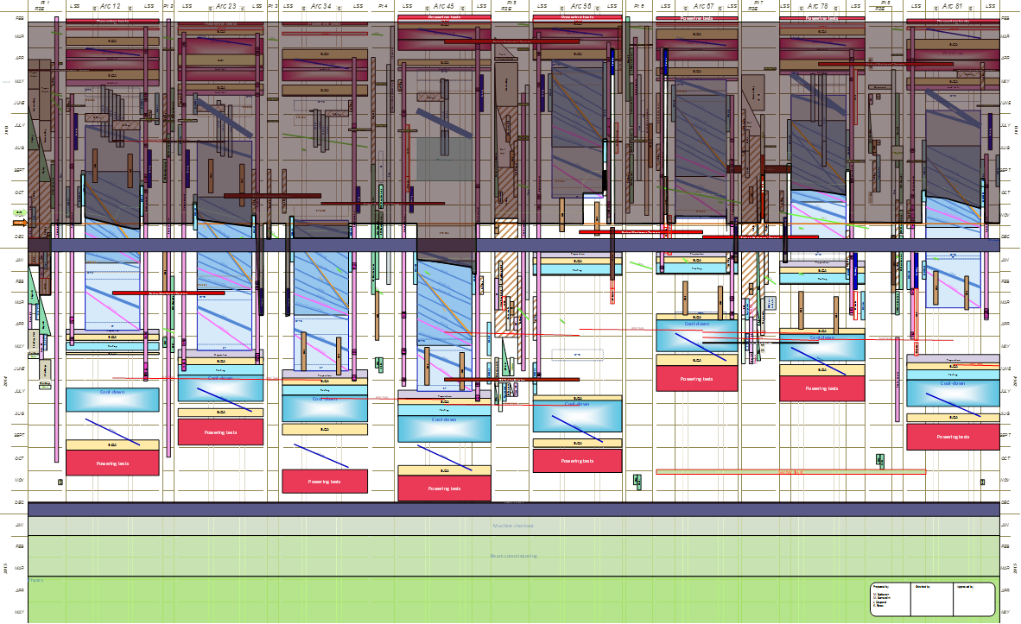
Conclusion
So far, LS1 is on schedule
for beams in January 2015 for LHC
http://cern.ch/ls1dashboard

Slide 23
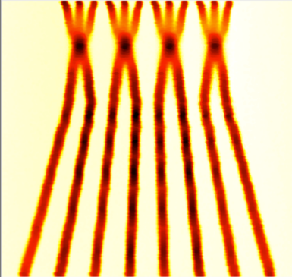
Expectations after Long Shutdown 1 (2015)
Collisions at 13 TeV c.m.
25 ns bunch spacing
  Using new injector beam production scheme (BCMS), resulting in brighter beams.
Batch Compression and Merging and splitting (BCMS)
β* ≤ 0.5m (was 0.6 m in 2012)
Other conditions:
  Similar turn around time
  Similar machine availability
Expected maximum luminosity: 1.6 x 10³⁴ cm⁻² s⁻¹ ± 20%
  Limited by inner triplet heat load limit, due to collisions debris
Courtesy of the LIU-PS project team
 | Number of bunches | Intensity per bunch | Transverse emittance | Peak luminosity | Pile up | Int. yearly luminosity
25 ns BCMS | 2508 | 1.15 × 10¹¹ | 1.9 µm | 1.6×10³⁴ cm⁻²s⁻¹ | ~43 | ~42 fb⁻¹

Slide 24

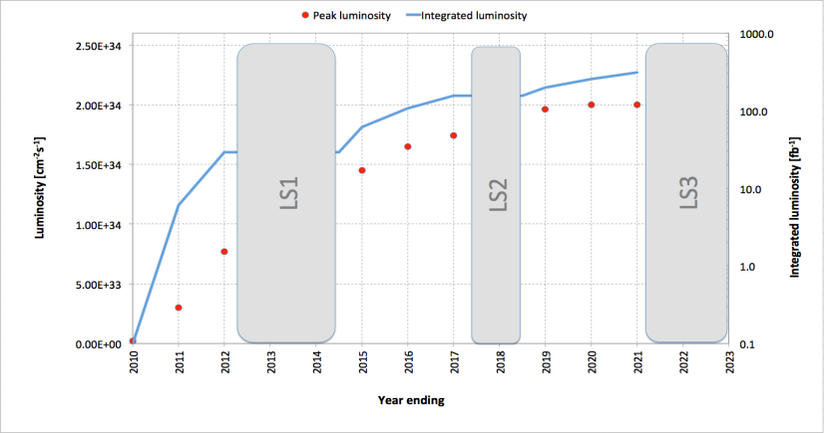
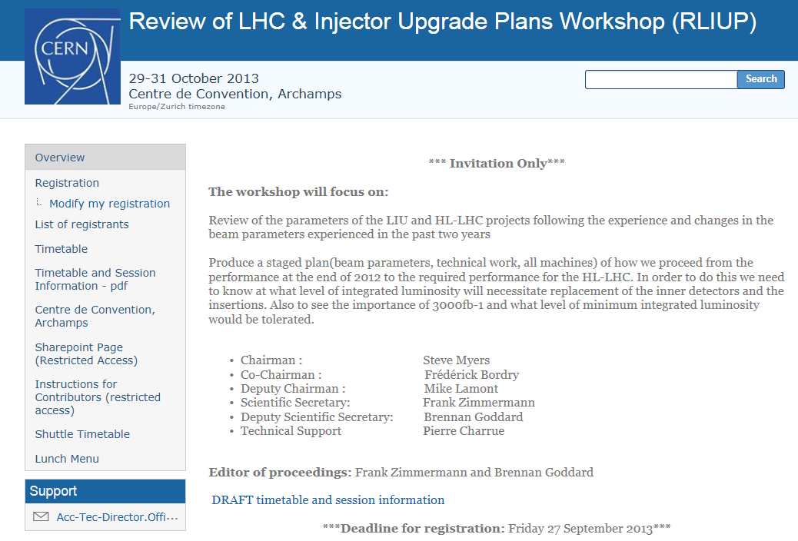
“Baseline” luminosity
~300 fb⁻¹

Slide 25
LHC schedule beyond LS1
Only EYETS (19 weeks) (no Linac4 connection during Run2)
LS2 starting in 2018 (July) 18 months + 3months BC (Beam Commissioning)
LS3 LHC: starting in 2023 => 30 months + 3 BC
injectors: in 2024 => 13 months + 3 BC
Run 2
LS 2
Run 3
LS 3
Run 4
LS 4
Run 5
LS 5
LHC schedule approved by CERN management and LHC experiments spokespersons and technical coordinators
Monday 2nd December 2013

