Slide 1
Em physics
Recent verification and validation tests
Sabine Elles, Jean Jacquemier, Michel Maire
(Lapp/Annecy)

Slide 2
old-new verification/validation plots
Em2/egs4
  e- 30GeV shower profile
Em5/berger
  e- 1MeV in thin layer
Em5/tramu
  muon 1 TeV
Em5/mumsc
  muon 10 GeV
Em11/sandia
Em12/berger
  depth dose profile, e- 10keV → 1MeV
fanoCavity
fanoCavity2
  e- transport : eV →MeV
based on public TestEm serie: code unchanged, approriate macro
each subdirectory has ‘data’, ROOT and PAW scripts to plot them

Slide 3
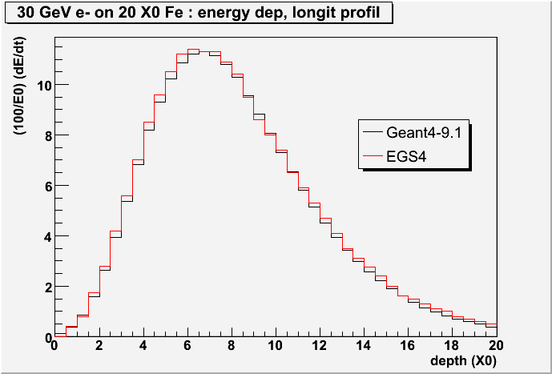
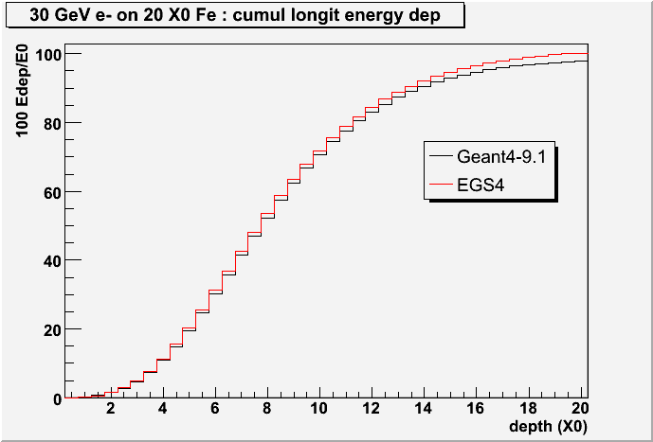
Em2/egs4
EGS4 from PDG plot

Slide 4
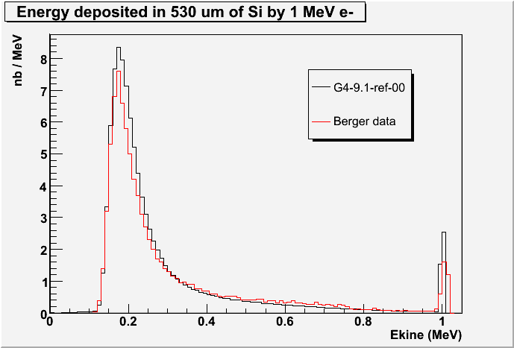
Em5/berger
Berger et al.
NIM 69 p.181

Slide 5
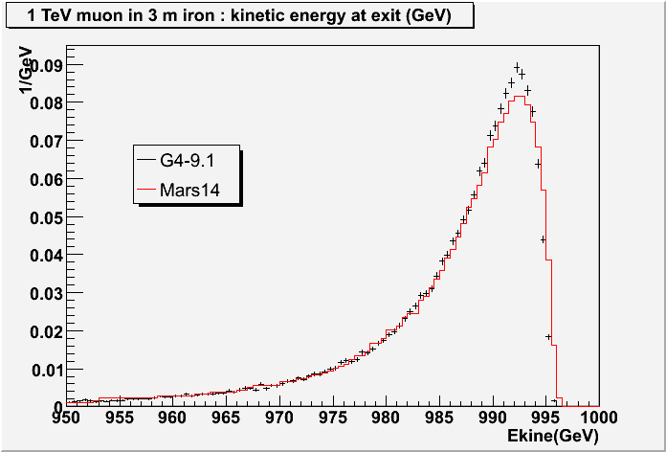
Em5/tramu
Mars14 from PDG plot

Slide 6
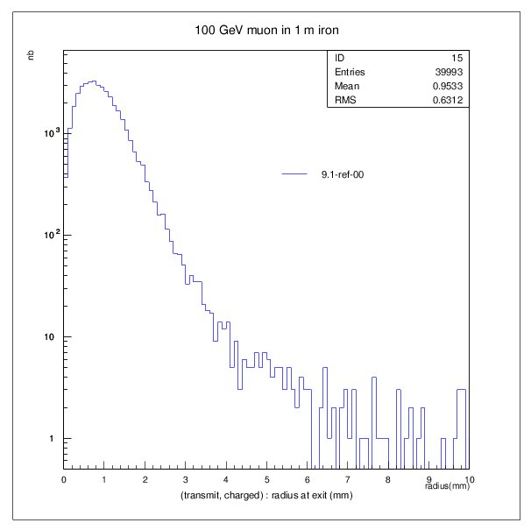
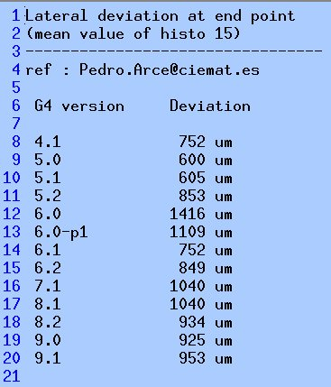
Em5/mumsc

Slide 7
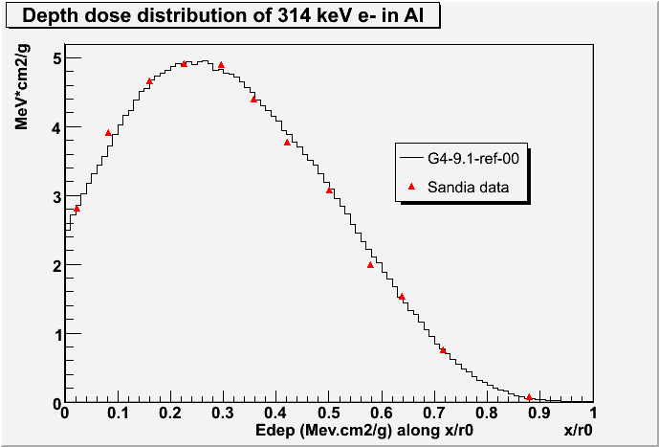
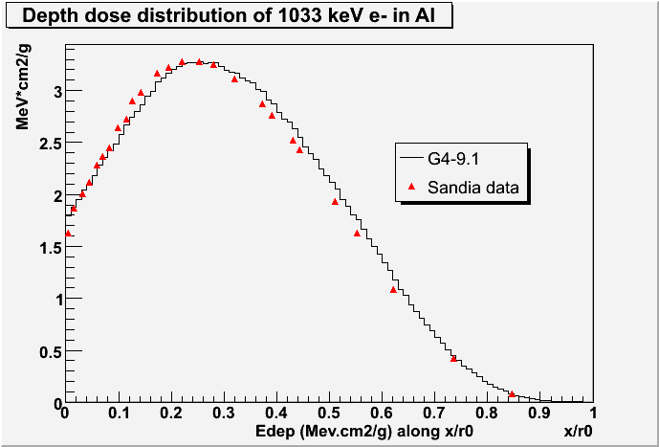
Em11/sandia (1)
Sand79-0414.UC-34a (Feb.1987)
O.Kadri et al. NIM B 258 (2007) p.381

Slide 8
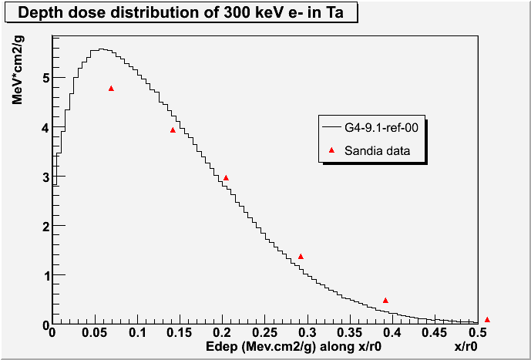
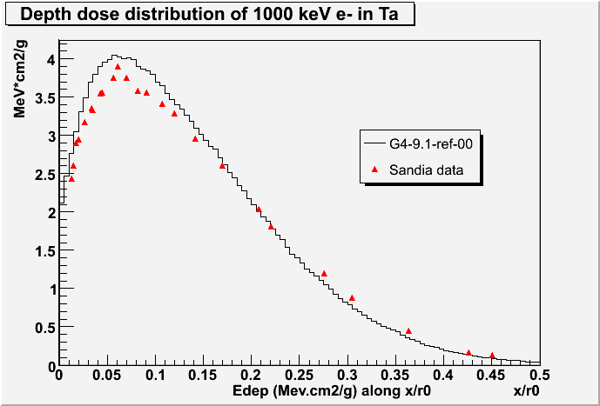
Em11/sandia (2)
Sand79-0414.UC-34a (Feb.1987)
O.Kadri et al. MIN B 258 (2007) p.381

Slide 9
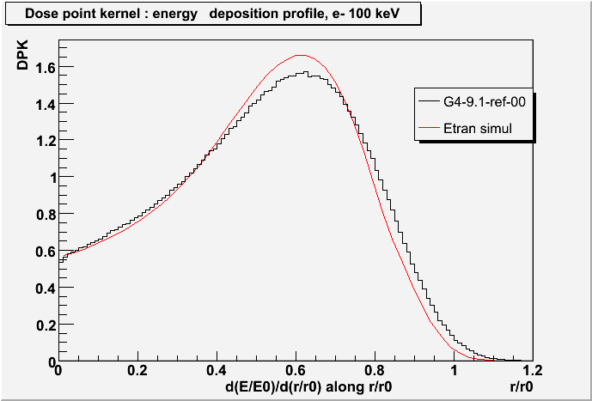
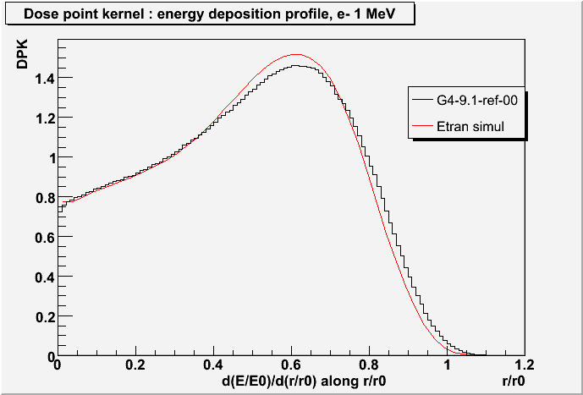
Em12/berger (1)
Seltzer Appl. Radiat. Isot. 42 (1991) p. 917
L. Ferrer et al Cancer Bio. Rad. 22-1 (2007)

Slide 10
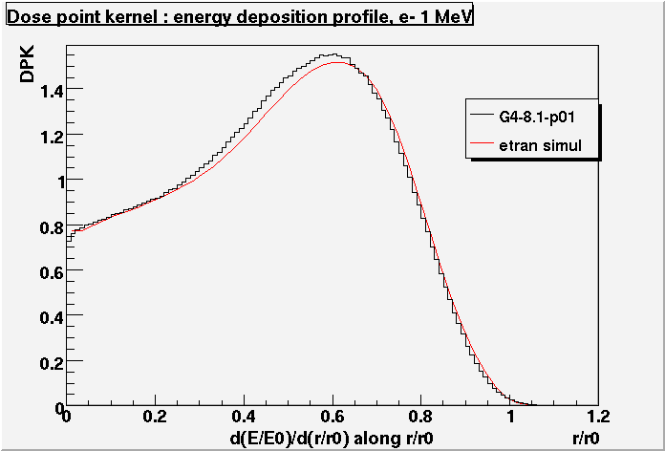
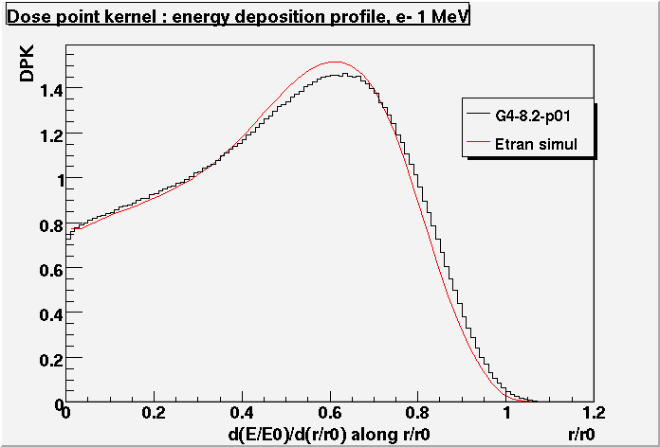
Em12/berger (2)
G4 8.1 versus G4 8.2
Seltzer Appl. Radiat. Isot. 42 (1991) p. 917
L. Ferrer et al Cancer Bio. Rad. 22-1 (2007)

Slide 11
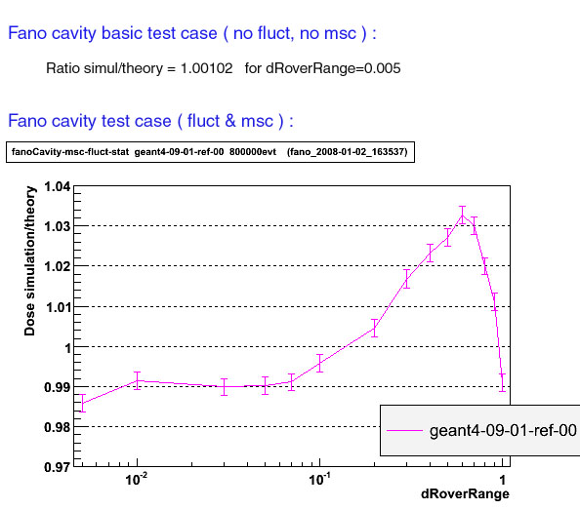
FanoCavity (1)

Slide 12
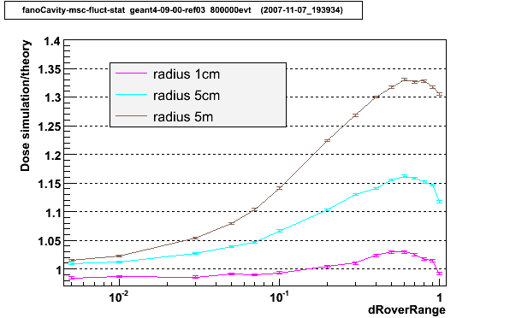
FanoCavity (2)

Slide 13
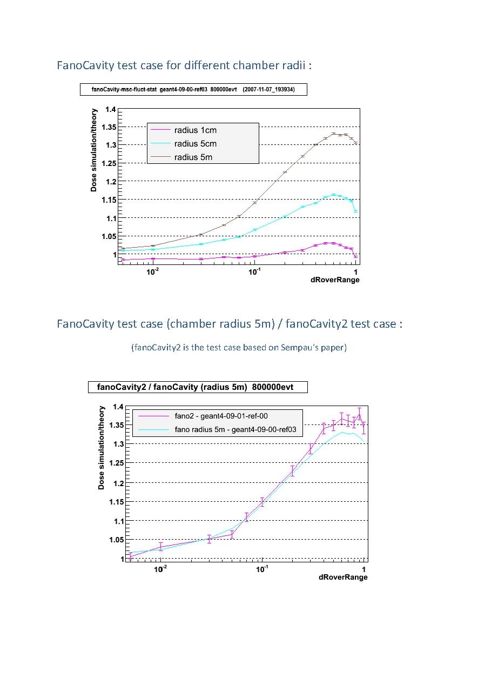
FanoCavity2 (3)

Slide 14
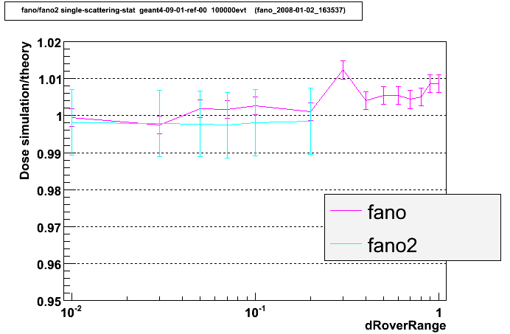
FanoCavity (4) : single scattering

