Slide 1

ALICE report
LHCC Referees meeting
3 June 2014

Slide 2
RUN 2 physics programme and rates
Target - integrated luminosity of 1nb⁻¹ of Pb-Pb collisions (combined RUN 1+RUN 2)
  Consistent with the ALICE approved programme
  4-fold increase in instant luminosity for Pb-Pb
Double event rate of TPC/TRD
Increased capacity of HLT system and DAQ
  Rate up to 8GB/sec to T0

Slide 3
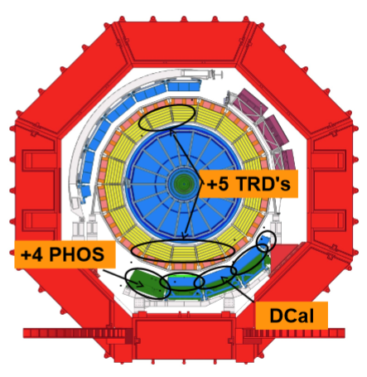
RUN 2 detector upgrades
TPC, TRD readout electronics consolidation
TRD full azimuthal coverage
(+5 modules)
+1 PHOS calorimeter
module
New DCAL calorimeter
+1

Slide 4
RUN 2 resources considerations
Same CPU power needed for reconstruction
25% larger raw event size
  Additional detectors
  Higher track multiplicity with increased beam energy and event pileup
ALICE requirements for RUN2 were approved by CRSG in April 2014
The CPU request growth is compatible with ‘flat’ budget, i.e. depends purely on technology development
Major demand on resources towards the end of 2015 (Pb-Pb data taking)

Slide 5
Software and process improvements
Moving one calibration iteration to online
  Software under tests
Using HLT track seeds for offline reconstruction
  Comparison of methods ongoing
Improving performance of GEANT4 simulation for ALICE + development of fast and parameterized simulation
  Speed-up of G4 simulation by factor 2 already achieved
Collaborating with other experiments to explore contributed resources (i.e. spare CPU cycles on supercomputers)
  Centres in US, leveraging existing PanDA development

Slide 6
Software and process improvements (2)
HLT farm for offline processing
  Additional 3% CPU resources
Improving the performance of organized analysis trains
  Faster turnaround
Speeding up and improving the efficiency of the analysis activities by active data management
  Consolidation of datasets where applicable, introduction of smaller containers (nanoAODs) for specific analysis types

Slide 7
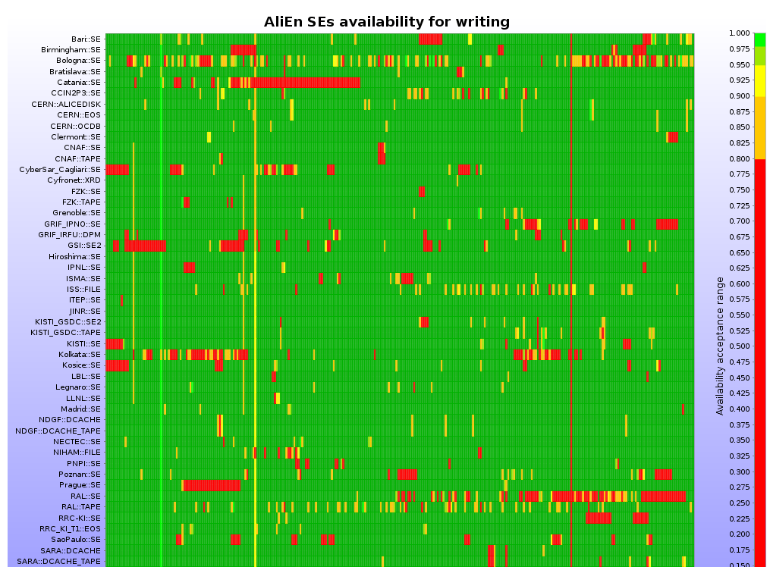
Infrastructure improvements
Focus on SE stability – major factor for successful analysis and high CPU efficiency
Goal for all SEs >98% availability

Slide 8
Infrastructure improvements (2)
LHCone programme
  Europe is largely covered, focus on South America and Asia
  Larger data volumes, more to transfer between sites
  Remote access to storage in certain analysis/reconstruction scenarios

Slide 9
Infrastructure improvements (3)
IPv6 readiness
  IPv4 address depletion is already a fact for new sites
  ALICE services are IPv6 ready
  xrootd v.4 should be IPv6 ready (release end of May)
  Other services are being brought into compliance

Slide 10
Infrastructure improvements (4)
Refurbishment of SAM/SUM tests
  WLCG monitoring consolidation project in advanced status
Site tests will reflect more and more the VO tests
  In the ALICE case – provided by MonALISA

Slide 11
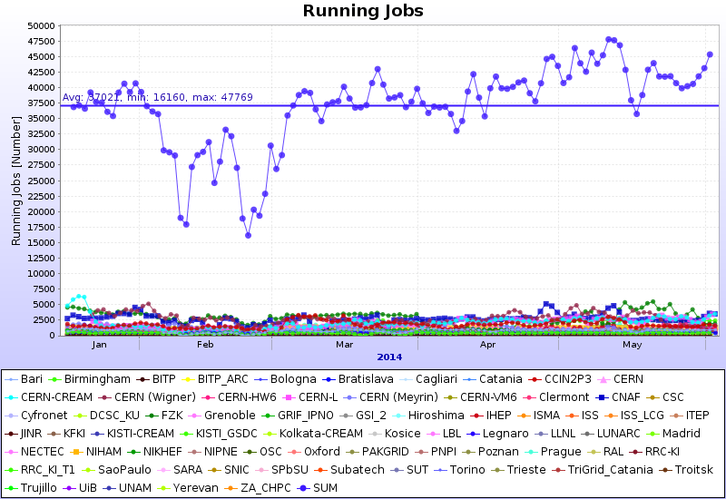
Operations in 2014
Steady running: 37K jobs

Slide 12
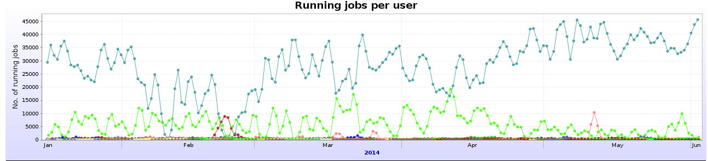
Jobs by user since January 2014
76% MonteCarlo (unchanged)
16% Organised analysis in trains (+6%)
2% RAW data reconstruction (-8%, software upgrades)
6% Individual user analysis (-6%)
QM’2014 preparations

Slide 13
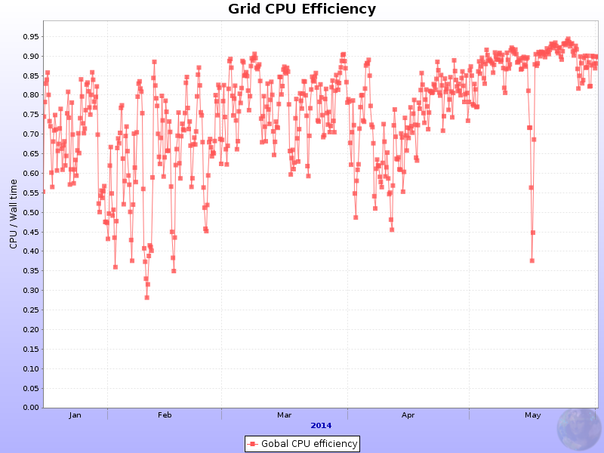
Efficiency since January 2014
Small effect due to high volume user activities
A fix in replica access algorithm (bug discovered in April) further increases the overall analysis efficiency
Continue pushing for larger share of organized analysis (daily software AN tags)
QM’2014 preparations
All sites

Slide 14
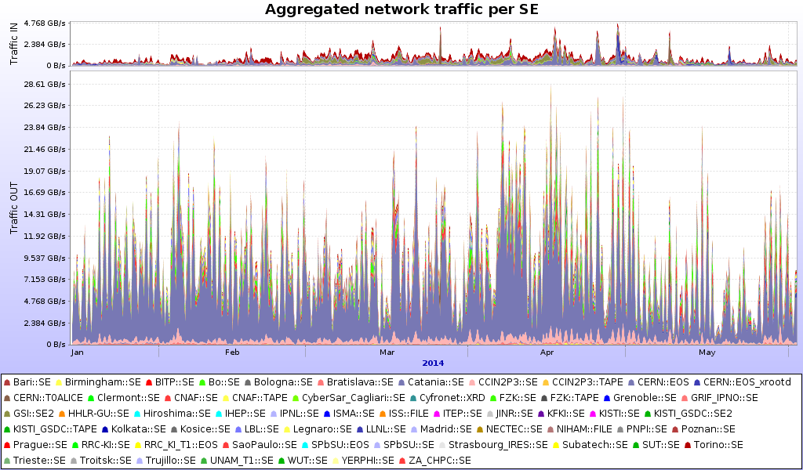
Data volumes since January 2014
111.4 PB read, 10.5 PB written
Regular ‘inactive data sets’ cleanups, popularity service being put in production

Slide 15
Plans for the next 6 months
Pass 2/3 of 2011 p-p data and associated MC
  Full detector recalibration, 2 years of software updates
Pass 2 of LHC12 p-p, Pass3 of p-Pb data
From August/September – start cosmics trigger data taking
  Upgraded detectors readout, Trigger, DAQ, HLT
  Data will be reconstructed Offline
No special plans for Grid data challenges
  All data processing aspects are covered by daily activities

Slide 16
ALICE upgrade
13 Computing Working Groups (see last LHCC report for a list and tasks)
Particulars
  Data flow simulation
  Data transport model
  FLP (first level processors)/EPN (event processing nodes) traffic shaping, buffers and system scalability
  Computing platforms
  Software framework development (ALFA)
Computing TDR writing in progress
  Detailed report: Status of O2 project and TDR

Slide 17
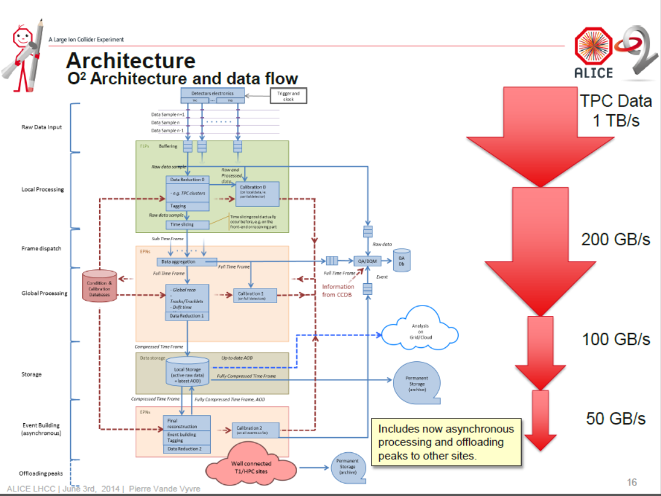

Slide 18
Summary
Steady operations in the past 6 months
  Emphasis on increasing the share of organized analysis and overall efficiency
Gradual software and infrastructure upgrade plans leading up to Run2
  No dramatic changes of computing and operations model
Resources will be adequate to cover the ALICE physics programme
  Resources request 2015-2017 endorsed by CRSG
Preparations for the ALICE upgrade
  Ongoing work on system design and simulations, software demonstrators and Computing TRD

