Slide 1
News

Slide 2
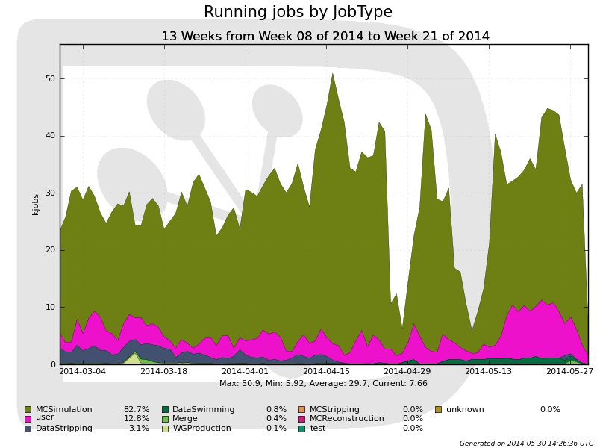
Operations Mar 2014 to May 2014
Running jobs by activity
  Montecarlo simulation main activity
    No issue with CPU resources this quarter
  User jobs
  Spring 2014
  incremental
  stripping

Slide 3
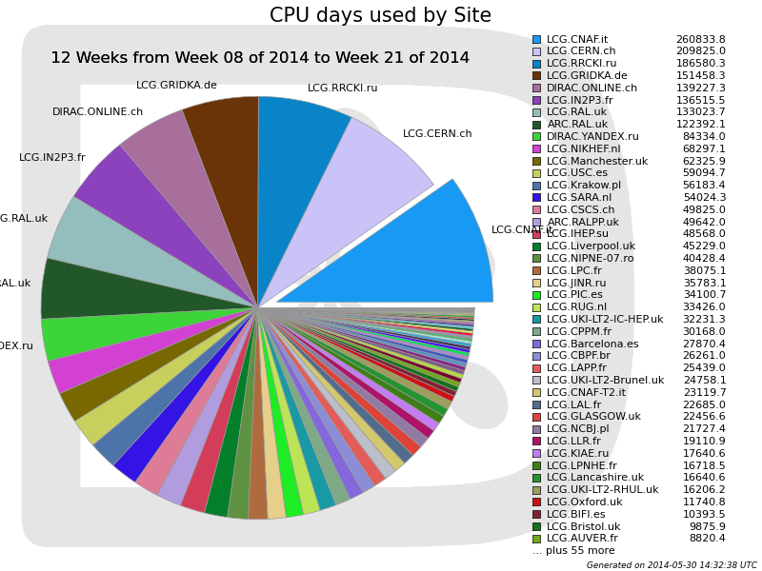
Operations Mar 2014 to May 2014
CPU usage by site
  Russia Tier1 (RRCKI.ru) successfully used in production
    CPU resources as expected
  Ongoing large scale tests of ARC CE at RAL
  Sub-optimal use of HLT farm
    Cooling stop
    ~1 month
    Migration
    to SLC6

Slide 4
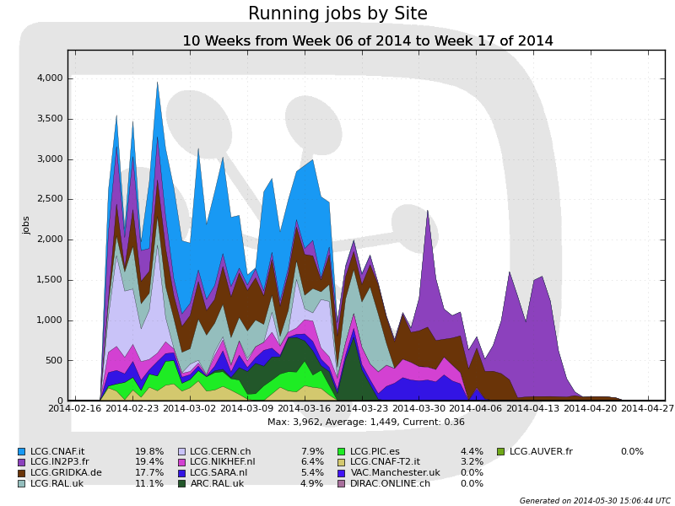
Operations Mar 2014 to May 2014
Spring ‘14 incremental stripping
  Excellent staging performance at all sites
  Took 8 weeks (6 weeks expected)
    Due to misconfiguration of one site in DIRAC, problem noticed when other sites had completed

Slide 5
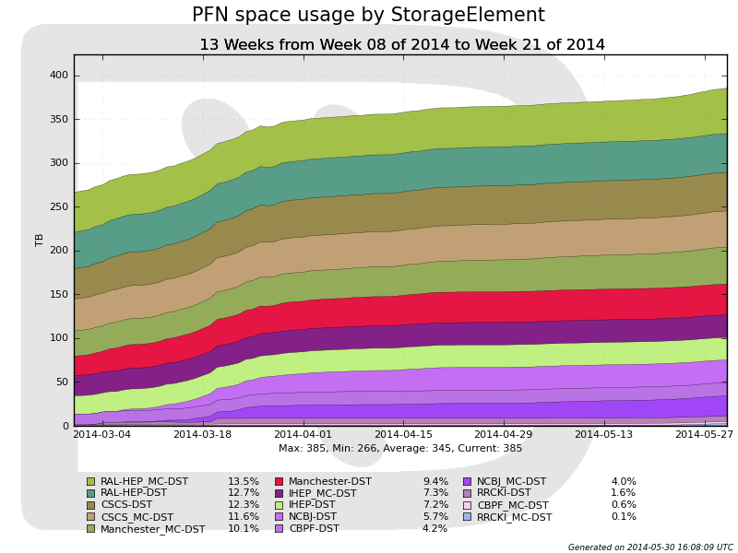
Operations Mar 2014 to May 2014
Tier 2 disk
  1.26 PB now pledged for 2014
      Two new candidate sites currently under discussion
    Plus 0.96 PB pledged at Kurchatov (Russia Tier-1)
      Currently 0.17PB installed, successfully commissioned

Slide 6
Data processing plans, next quarter
Reprocessing of 2010 data
  To provide legacy dataset with reconstruction consistent with 2011 and 2012
    Considerable work to back-port alignment and calibration
    Used opportunity to further automate, in view of 2015
  ~Ready to start
Full restripping of 2011 and 2012 data
  Applying latest calibrations
  Intended to be legacy dataset
  Used also to commission microDST for all stripping lines ahead of 2015 data-taking
  Plan to commission during summer, run in autumn.
    Expected to take 6 weeks of staging + processing
Simulation of 2015
  Small productions, mainly to prepare HLT

Slide 7
Software commissioning
HLT commissioning is major software activity for 2014
  Commissioning of split HLT
    HLT1 in real time, HLT2 deferred
    Requires also changes to monitoring
  Commissioning of automatic online calibration
    Changes needed to condDB replication policies
  Optimisation of HLT algorithms
  Highest priority for 2014 computing effort
Migration to ROOT 6
  Decided to migrate to ROOT 6, before run 2
  Tight schedule:
    ROOT 6.00.00 out this week
    ROOT 6.02.00 in December
      HLT software stack to be frozen before then
  Still some issues with dictionaries
  Worries about memory footprint
    Not an issue for HLT

Slide 8
2015 resources
Concern about length of 2015 run
  All experiment computing resources requests based on 3M seconds of LHC live time
    And 5M seconds in 2016
  Numbers based on 2010, 2011 experience
    Surely more efficient commissioning next year?
    We know there are more days of physics scheduled in 2015 than in 2010
    We know that LHCb will saturate trigger rate from the beginning
Too late to change 2015 requests, but can we be more realistic (or less pessimistic) for 2016?
  Ideally, would like an official statement on the 2016, 2017 and 2018 schedules from the CERN management
    LHCC can help?

Slide 9
LHCb Trigger and Online Upgrade TDR
R&D on many-core computing
    The main aim of the R&D on the many-core computing is to optimize the cost / performance ratio for the EFF [34]. It would also help to mitigate the risk related to the number of trigger processes per CPU node which might not scale as the Moore’s law in the coming years. The R&D would study the relative performance of the trigger algorithms on different computing platforms like the Intel Xeon/Phi and GPGPUs, and the related issues of code portability.
Continuous benchmarking & optimisation
    The technology of microprocessors, both x86 and alternative architectures, will be monitored continuously making it possible to choose the most cost efficient option for the EFF. The trigger software will undergo optimisation, both within the trigger group and as part of future collaboration-wide optimisation activities. We foresee an optimisation programme that will adapt the experimental software to optimally exploit modern hardware, both in the general design of the software framework and in individual algorithm.

Slide 10
Run 3 output rate
Physics program limited by HLT output rate
    At a total output rate of 20 kHz the physics program at LHCb will need to be restricted. At 50 kHz a diverse beauty program will be possible, while a charm program of similar scope to that of Run 1 can be carried out. At 100 kHz the beauty program reaches its full potential, while the charm program records the legacy dataset of charm physics.
    This study strongly motivates writing data out at a high rate. The limit on what can be written will be determined by the offline-computing resources available. One way to increase the physics output without increasing the need for additional offline-computing resources is to decrease the event size. This may be possible for certain types of events, e.g., those selected by charm triggers. Another option would be to put certain types of data onto tape and delay analysing them until the offline-computing resources required become available. These approaches will be exercised during Run 2.

Slide 11
Conclusions
Operations
  Business as usual, no major issues
  Progress in commissioning of Russia Tier1
Preparations for Run 2
  Software commissioning in full swing
  Concerns about resources planning assumptions
Upgrade
  Required software improvements in line with strategy outlined in computing models paper
    Major new effort has to be found within the collaboration
  Proposed trigger rate represents up to an order of magnitude more data than in Run 2
    Even reducing the event size will not compensate
  In order to achieve this we should get full support from LHCC that LHCb physics program is of highest importance and justifies such an increase in computing resources

