Slide 1
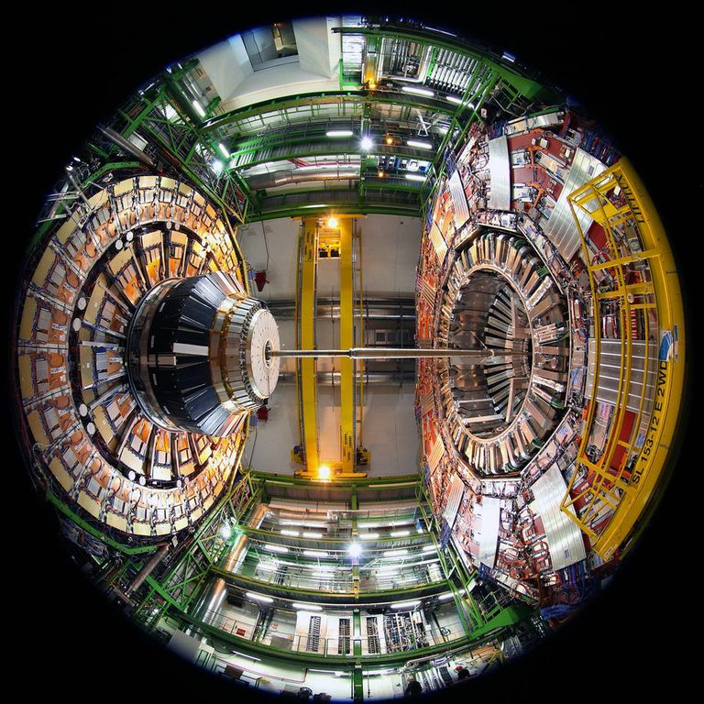
CMS Computing
Status and Plans
Maria Girone
LHCC Meeting
3rd June 2014
Notes:
1

Slide 2
Outline
Q1 2014 WLCG Resource Utilization
    Commissioning the HLT for data reprocessing and MC production
Preparing for Run II
  Data Management, Analysis Tools evolution
    Progress on the Tier-0 and AI
    Data Federation
    Dynamic Data Placement
    CRAB3
The CMS summer 2014 Computing, Software and Analysis challenge (CSA14)
Outlook

Slide 3
Q1 2014 Resource Utilization
Resources fully used so far, with high-priority requests for selected physics results (Heavy Ion, precision W mass measurements, ..) CSA14 preparation samples and detector upgrade studies
  Tier-1 pledge utilization has been close to 125%
  89% CPU efficiency for organized processing activities
Tier-2s are still the bulk of the first step of simulation production, and the primary analysis resource
  99.8% pledge utilization
  80% average CPU efficiency, factoring in the analysis efficiency as well
The opening the Tier-0 for production tasks like a Tier-1, and analysis activity like a Tier-2 have given CMS the opportunity to start commissioning the CERN AI infrastructure, building on the success of the HLT farm commissioning

Slide 4
Production Activities
Computing is utilizing the resources for the high priority tasks of CMS
  Simulation is divided into GEN-SIM, which is concentrated at Tier-2s, and reconstruction (AOD), which is currently Tier-1
  Events may be reconstructed more than once for different pile-up conditions
650M evts/month
1B evts/month
System extremely busy with many production tasks running, all high priority!
  Upgrade, W mass measurements, CSA14 sample preparation, and Higgs and Exotica Studies

Slide 5
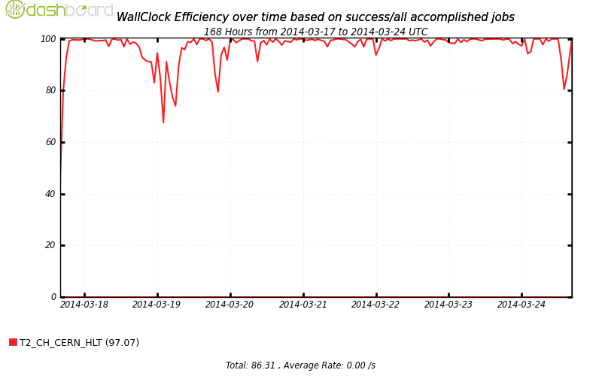
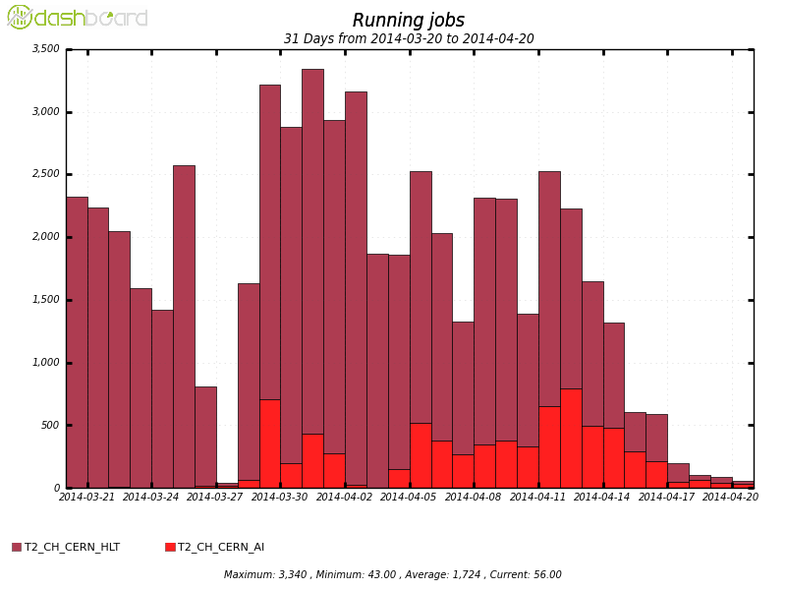
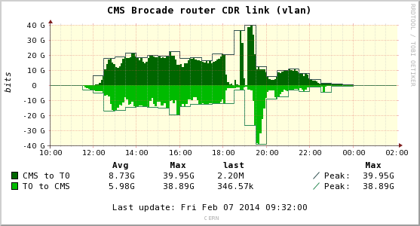
The HLT and AI for HI data reprocessing
The HLT, with an AI contribution, has been very successfully used for a high-priority data reprocessing of the 2011 Heavy Ion data
  Made a very tight schedule of one month before Quark Matter 2014
  Whole node cloud provisioning allows to provide higher memory slots for HI
  Upgraded network allows high CPU efficiency for data reprocessing using the whole farm
    No bottleneck reading from EOS
Events Processed
Heavy Ion 2011 Data
HLT CPU
Efficiency
  Excellent test of a thorough commissioning work of 6000 virtual cores set up as Openstack Cloud resources over 8 months
      during the winter shutdown the HLT farm will roughly increase the Tier-1 reprocessing resources by 40%
    Able to start all virtual machines on the HLT quickly compatibly with usage in inter-fill periods, which can provide some contingency with additional resources during the year

Slide 6
Preparing for Run2
CMS computing has evolved around two concepts
  Flexibility in where resources are used
    We are developing the ability to share workflows across sites and access the input from remote storage
      Data Federation and disk/tape separation
    Dedicated cloud resources from AI (Tier-0) and HLT
    Opportunistic Computing
      Bootstrapping CMS environment on any resource using pilots, utilizing allocations on super computers and leadership class machines
      Academic Cloud Provisioned resources
        Commissioned new opportunistic cloud resource in Taiwan
  Efficiency in how resources are used
    Dynamic data placement and cache release
    Single global queue for analysis and production with Glide-In WMS
    New distributed analysis tools for users: CRAB3

Slide 7
2014 Milestones
Data Management milestone: 30 April 2014
  Demonstrate the functionality and scale of the improved Data Management system
    Disk and tape separated to manage Tier-1 disk resources and control tape access
    Data federation and data access (AAA)
Analysis Milestone: 30 June 2014
  Demonstrate the full production scale of the new CRAB3 distributed analysis tools
    Profiting from the refactoring in the Common Analysis Framework project
    Main changes are reducing the job failures in handling of user data products, improved job tracking and automatic resubmission
Organized Production Milestone: 31 October 2014
  Exercise the full system for organized production
    Utilize the Agile Infrastructure (IT-CC and Wigner) at 12k cores scale for the Tier-0
    Run with multi-core at Tier-0 and Tier-1 for data reconstruction
    Demonstrate shared workflows to improve latency and speed

Slide 8
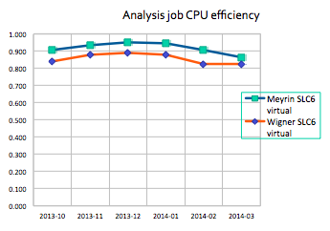
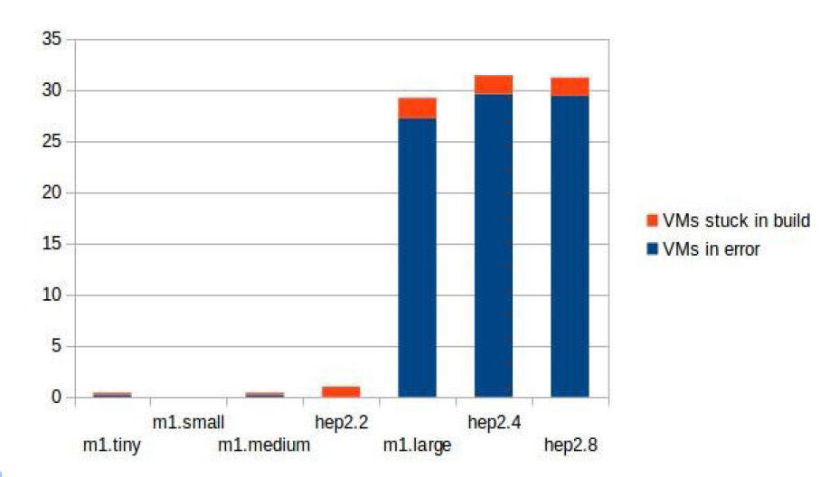
Progress on Tier-0 and AI
We are planning to provision the Tier-0 resources directly on OpenStack through glide-In WMS
  We currently cannot reach the same ramp-up performance as the HLT due to a high rate of VMs failures on AI
    Discussion planned with AI experts
Analysis jobs: 6% drop
Wigner CPU efficiency has been measured for both CMS production and analysis jobs
  We see only a small decrease in CPU efficiency in I/O bound applications reading data from EOS Meyrin
    CMSSW is optimized for high latency I/O performance using advanced TTree secondary caching techniques
Requesting
100 VMs of
various flavors

Slide 9
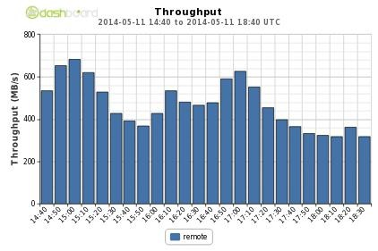
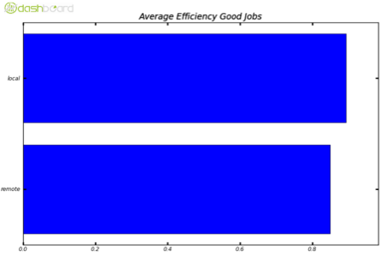
Progress on Data Federation
Provide access to all CMS data for analysis over the wide area through Xrootd
  access 20% of data across wide area, 60k files/day, O(100TB)/day
File-opening test complete
  Sustained rate is 200Hz – much higher than what we expect in production use
File-reading test: we see about 400MB/s (35TB/day) read over the wide area
    Thousands of active transfers
Purely Local Reading
Small penalty in CPU efficiency for analysis jobs that read data remotely using data federation
Purely Federation Reading

Slide 10
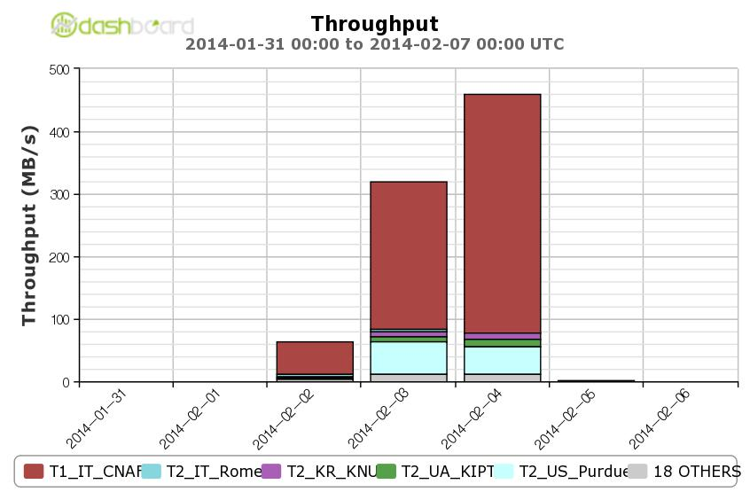
Data Federation for Reprocessing
CMS would like to make use of data federations for reprocessing use cases
  Allowing shared production workflows to use CPU at multiple sites and data served over the data federation
FNAL
CNAF
We had an unintended proof of principle. FNAL accidently pointed to an obsolete DB and production traffic failed over to Xrootd
  Data was read from CNAF disk at 400MB/s for 2 days
Regular tests have been added to our 2014 schedule, also during CSA14; larger reprocessing campaigns will be executed in Q3-Q4 2014

Slide 11
Dynamic Data Placement
The development of dynamic data placement and clean-up is progressing
  Prototype placement and clean-up algorithms are in place
    The current CSA14 and upgrade samples are placed at Tier-2 sites automatically and the centrally controlled space is under automatic management
Next step is to more aggressively clear the caches of underutilized samples
  Will be exercised during the CSA14 challenge and monitor that we improve the storage utilization efficiency
Due to effort redirection in CERN-IT, CMS has been building expertize
  Exploring with ATLAS on expanding the scope of central operations

Slide 12
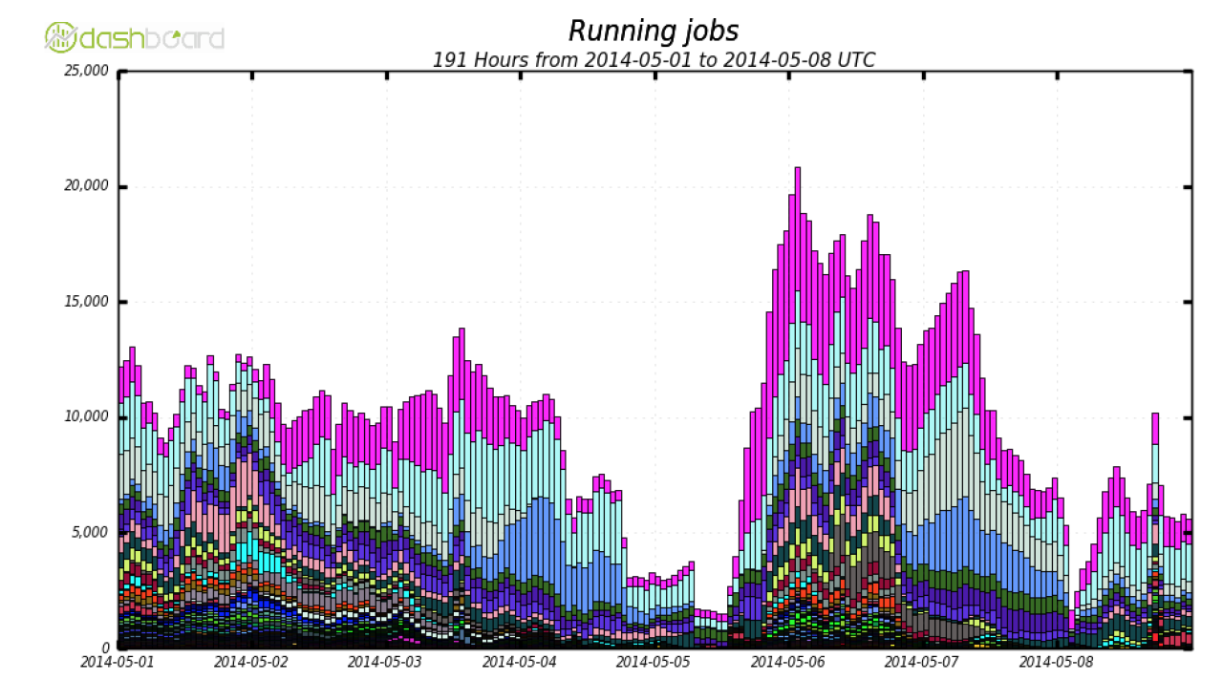
Distributed Analysis Tools
CRAB3 is currently in integration and validation tests before being handed to users for CSA14
    Improved elements for job resubmission and task completion, output data handling and monitoring
  20k running cores have been achieved in the validation, production target is 50% higher
  Physics power users are expected to give feedback this month
Underlying services have also been updated
  FTS3 for output file handling
  Central Condor queue for scheduling

Slide 13
CSA14
CMS is preparing for nominal LHC beam conditions of Run II
  Unique opportunity for early discovery ⟶ we need to make sure that all the key components will be in place and working since the very beginning, to ensure this CMS is performing a Computing Software and Analysis Challenge in July and August
    Users will perform analysis exclusively using CRAB3 and Data Federation and Dynamic Data techniques
    Production will exercise access through data federation
    System performance will be monitored
Ongoing preparatory work, including samples preparation for 2B events at 50ns and <PU>=40 & 20 and 25ns and <PU>=20

Slide 14
Outlook
We believe we are on schedule for the improvement work to allow CMS to function in the challenging 2015 environment and within the resources requested
  The schedule had little contingency, but we are making steady progress
The CSA14 challenge will be important to expose the users to new data access techniques and new analysis tools
Effort to sustain the progress on improvements continues to be an issue
CMS has a brainstorming workshop in mid-June to discuss Upgrade activities
  There are innovative ideas, but a coherent direction is still forming

Slide 15
Backup Slides

Slide 16
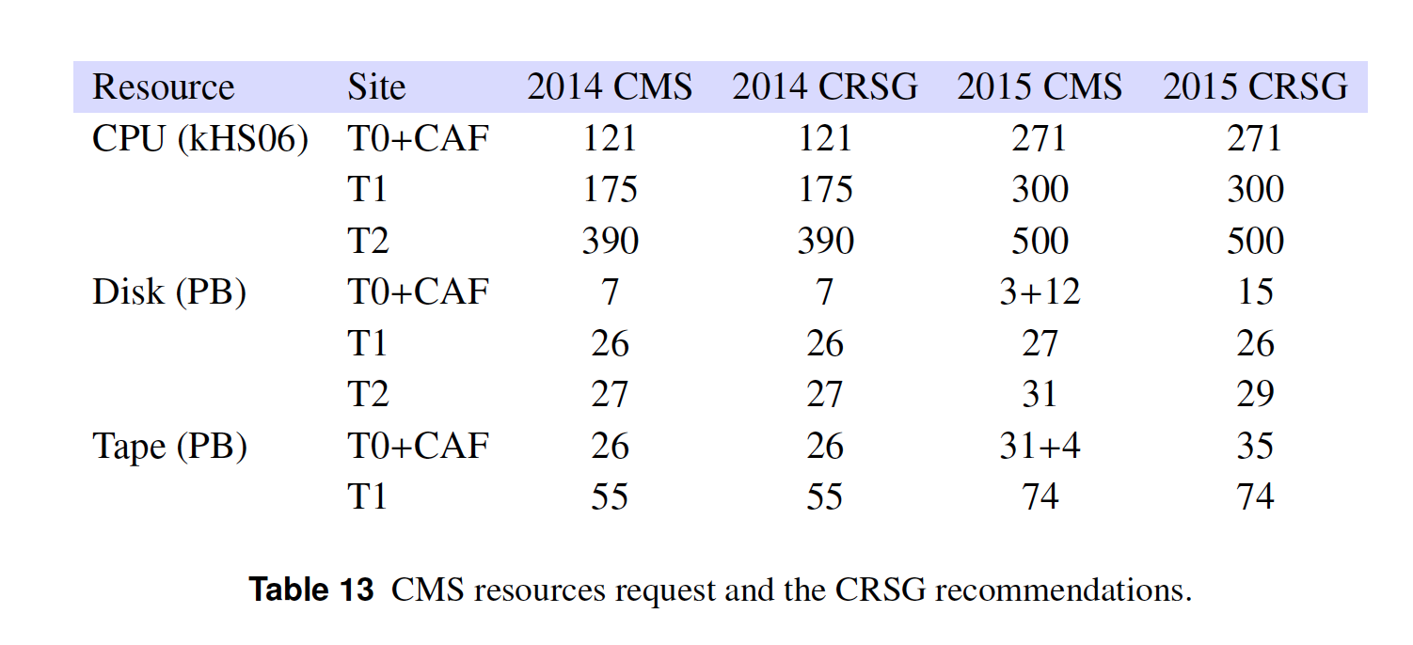
Resource Summary Table

