Slide 1
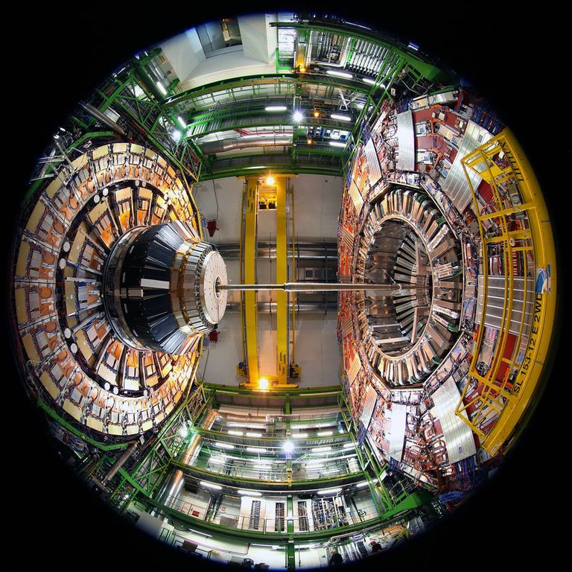
CMS Software
Status and Plans
Liz Sexton-Kennedy, Peter Elmer, David Lange
LHCC Meeting
3rd June 2014
Notes:
1

Slide 2
CMSSW release plans
CMSSW_7_1_0 release: 17 June 2014
  Usage:
    Generation and Simulation samples for run 2 startup
    Limited digitization and reconstruction reprocessing, post-CSA14
    Mid-week global runs starting in July
  Major new features:
    Finalized simulation geometry for the 2015 CMS detector
    Integration of GEANT 4.10
    Deployment of the multi-threaded CMSSW framework
    Significant progress in moving to ROOT 6, however it is not yet thread-safe.
CMSSW_7_2_0 release: 24 November 2014
  Usage:
    Digitization and reconstruction for run 2 startup

Slide 3
Multi-threaded framework
Goal for phase 1:
  Using 4 threads in a single process achieve roughly the same throughput as 4 processes running on four cores, BUT with much less memory, resulting in much easier computing operations.
  In a multi-core era where sufficient memory per core is available to process an entire event this is all we need.
    Recently: major progress in percentage of compliant reconstruction code
      In a 4-core job, reconstruction workflows now achieve a 200-300% throughput increase relative to a single threaded application with only 30-40% increase in RSS size.
Goal for phase 2:
  Once many-core solutions are required, we will aim to deploy finer-grained parallelism which could achieve better throughput compared to multiple processes and reduction of long tails.

Slide 4
Also In the Next Release
Adoption of Geant 4.10
  In the beginning of Mar. we made a build of Geant 4.10 for testing
  A quick validation showed no major problems so we have moved to it as default for more intense validation
  Depending on physics process we get a 17-30% speedup
New scheme of mixing for pileup
  Create a pileup dataset that contains the correct pileup distribution (25ns vs. 50ns, correct mu) once and reuse it for multiple signal samples
  Plan to use this scheme in CSA14 for the most challenging PU scheme of 25ns and mu of 40
Many improvements in the reconstruction
MiniAOD, 10 times smaller then the AOD
  benefits from the lessons learned from run 1

Slide 5
About the future
There is a significant effort in R&D
  More details are available in the slide presented at the last meeting in the backup
Many of us in CMS are very interest in collaboration with the HEP Software Foundation and have contributed white papers.

Slide 6
Backup

Slide 7
R+D towards future architectures
Issues driving CMSSW
  Technology evolution is a driver for change in CMSSW for the medium/long term
  How to improve performance and scalability in throughput/cost for future
  How to make continued efficient use of existing resources and open possibilities to access additional resources (e.g., HPC)
Taking first steps to setup software environment for development
  Building demonstrators within for software components on new architectures (GPU, ARM, Xeon Phi, etc)
    Moving standalone development into CMS environment to ease cost of entry for collaboration involvement
  Incorporating infrastructure into CMSSW: profilers, software development
  tools, etc for new architectures
  Developing reconstruction algorithms for high-pileup; Tracking algorithms designed for many-core resources
This work is focused in longer term (after Run 2), and is an area to build collaborations (e.g., via the upcoming software collaboration workshop)

