Slide 1
WLCG status
Ian Bird
Meeting with LHCC Referees
CERN, 3rd June 2014

Slide 2
WLCG MoU Topics
KISTI (Rep. Korea)
  Status as full Tier 1 for ALICE approved at WLCG Overview Board in November 2013
    Agreed that all milestones met; performance accepted by ALICE;
    Upgrade of LHCOPN link to 10 Gbps planned and funded
Latin America: Federation (CLAF), Tier 2 for all 4 experiments – initially CBPF (Brazil) for LHCb and CMS
  Since last RRB, new sites added:
    UNIANDES Colombia (CMS), UNLP Argentina (ATLAS), UTFSM Chile (ATLAS), SAMPA Brazil (ALICE), ICM UNAM Mexico (ALICE), UERJ Brazil (CMS)
Pakistan: COMSATS Inst. Information Technology (ALICE): MoU in preparation
Update on progress with Russia Tier 1 implementation
  → this meeting

Slide 3
Status of Wigner centre
In production;
  >1000 worker nodes installed
  Disk cache (EOS) scaled with CPU capacity
Some network problems:
  One link was unstable every few days
  Some firmware incompatibilities between NICs, switches and cables (!)
    Hopefully now resolved
Some anecdotal job inefficiencies; a systematic performance analysis was done
  Building some additional monitoring for longer term management
    Dedicated perfsonar testing (as deployed in WLCG)
  Uncovered some issues with pilot jobs
  Clear difference in efficiency between AMD and Intel – depending on workload (not new)
  Must use correct caching algorithm in ROOT, or performance suffers for I/O bound jobs; continuing study of data transfer performance
No significant difference in efficiency between Geneva and Wigner
  Monitoring much improved
  Detailed performance studies will benefit all remote I/O situations

Slide 4
EMI Middleware Support
Status 2014
One year after end of EMI
  Middleware support pledges limited to one year
Cristina Aiftimiei (INFN /EGI) report at May GDB
  contacted all Product Teams
  preliminary (incomplete) status:
    ARGUS – SWITCH, bug fixes on best effort basis only
      needs support for evolution ( identify feds, clouds, etc.)
    gLite security products need clarification
    INFN supported products will be supported
    CERN products will be supported
    NDGF products will be supported

Slide 5
Summary of RRB held on 29 April 2014

Slide 6
Summary of RSG report

Slide 7
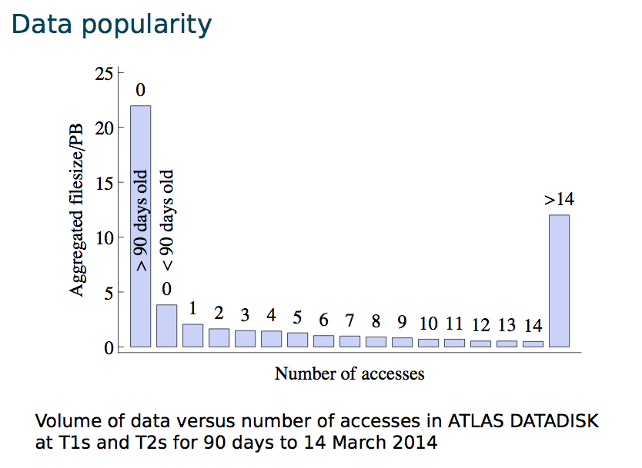
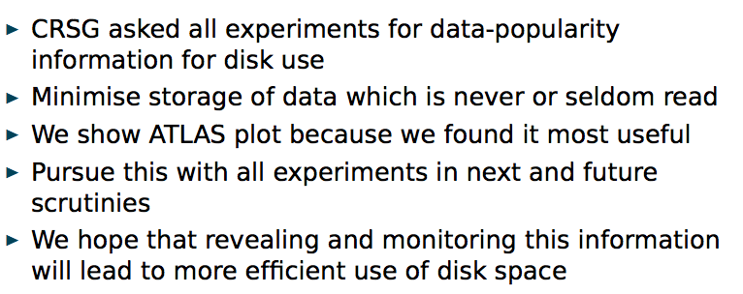

Slide 8
Scrutiny of 2015 requests

Slide 9
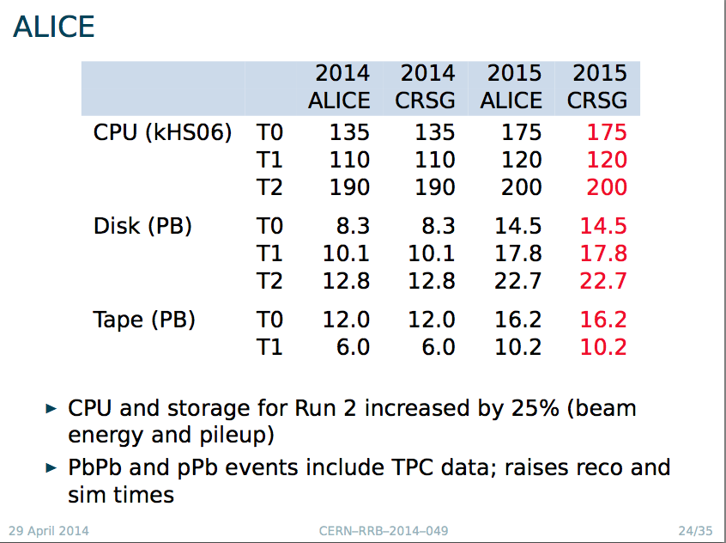

Slide 10
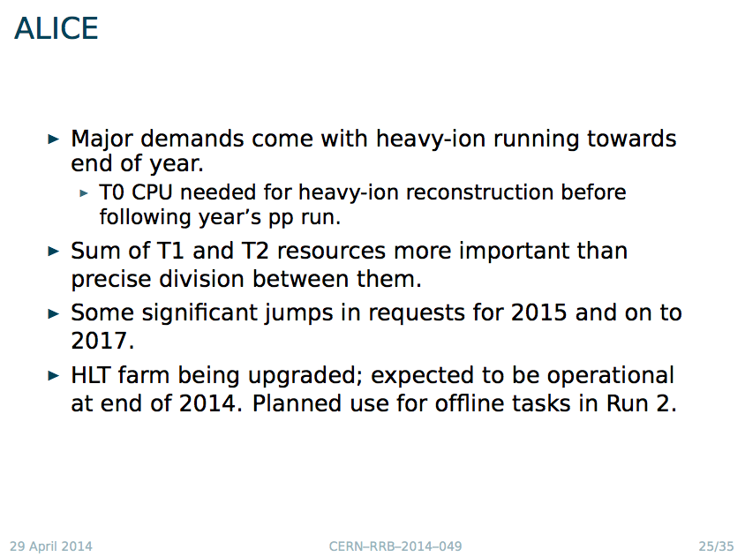

Slide 11
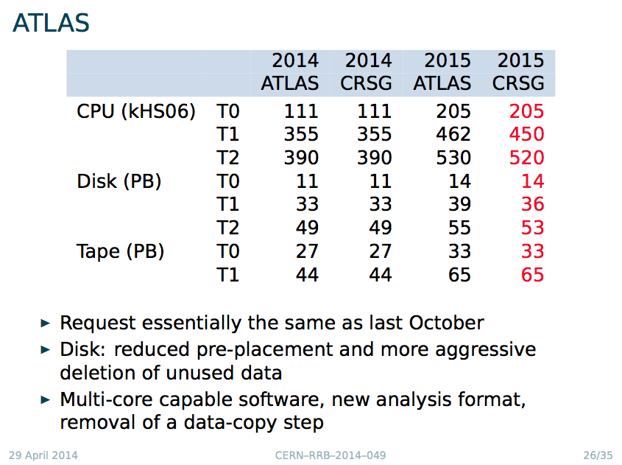

Slide 12
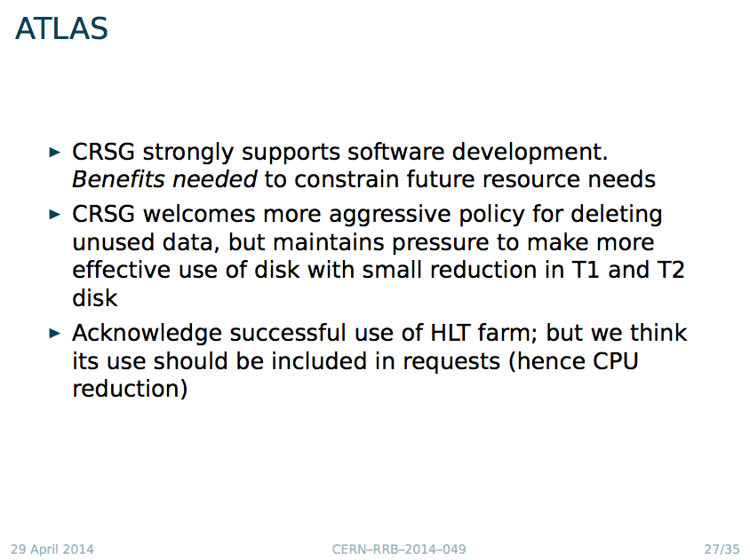

Slide 13
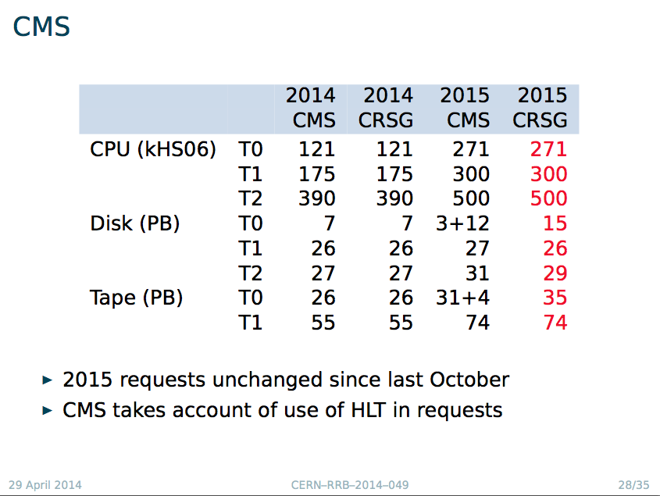

Slide 14
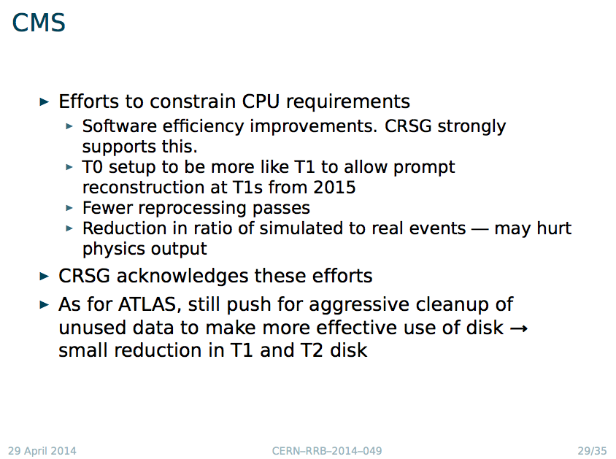

Slide 15
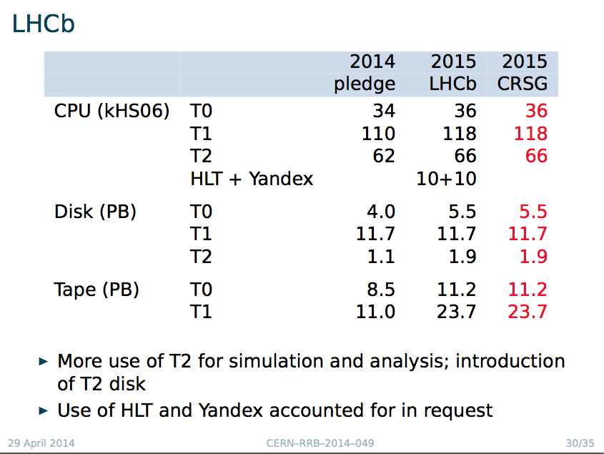

Slide 16
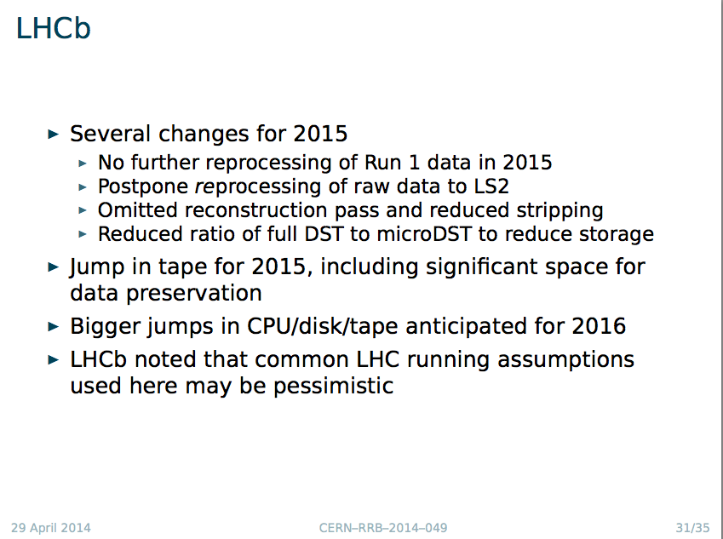
This led to a question about the assumptions for 2015 runnning in general:
Main driver is livetime
What about delayed improvements (e.g in triggers)
Conclusion was that current assumptions for 2015 are conservative – all factors conspire to make need for resources larger

Slide 17
C-RSG comments
Run 2 requests made with assumption of flat budgets
Data preservation: distinguish ability to read/analyse old data from requirements for open/public access (both tech + effort)
  Former should be included in cost of computing
  Latter is additional cost?
C-RSG acknowledges use of HLT farms in LS1 and plans to use in Run 2.
  C-RSG does not consider this to be opportunistic
  Under control of experiment
  Adjusted request where this had not been done by the experiment

Slide 18
C-RSG comments – 2
Improving software efficiency is essential to constrain growth in requests.
  (Some of) The resulting gains are already assumed.
  C-RSG strongly supports and recommends that sufficient effort is funded
Effectiveness of disk use only partly captured by occupancy
  C-RSG welcomes experiments’ efforts to purge obsolete/unused data, and thanks them for popularity information
Good networking has been exploited to reduce disk use (fewer pre-placed copies) and move processing between tiers.
  Danger that poorly networked sites will be underused and possible cost implications of providing network capacity

Slide 19
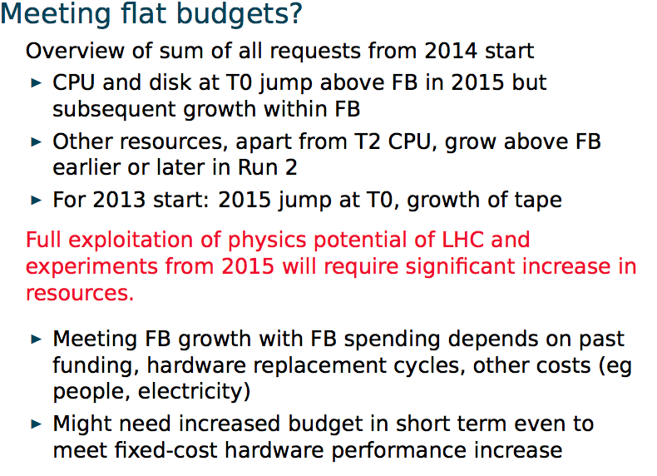
Flat budgets? (C-RSG view)

Slide 20
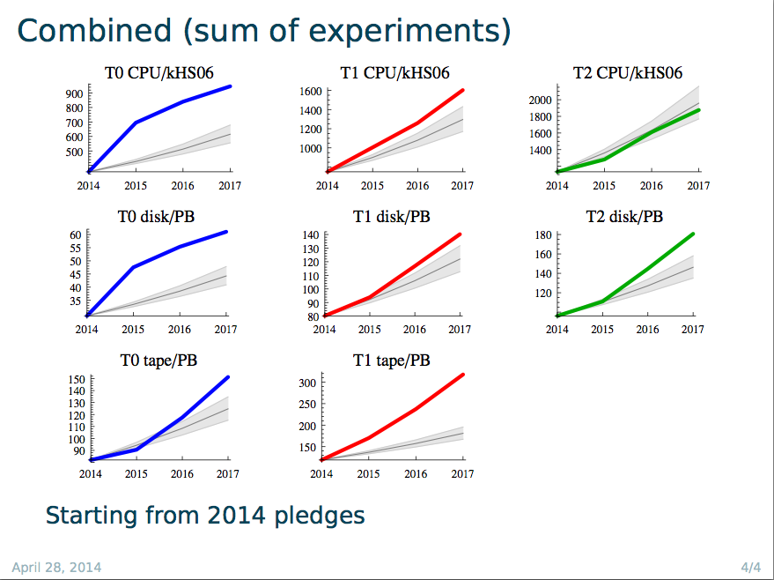

Slide 21
Budgets and pledges
“Flat budget” scenario was guidance of the RRB in April 2013, reinforced in October
Reflected in the computing requirements growth of the computing model updates (2015-17)
  BUT: this is very gross average – we do not know the details of every site, funding agency
    Growth figures based on understanding of market, experience at CERN and other large sites
  Actual ability to grow strongly depends on history
    Replacement cycle, past growth, local purchase costs and rules, etc
Thus it is clear that the real potential growth even with flat budgets is not simple to model without feedback from sites/countries/funding agencies

Slide 22
Budgets and pledges
Feedback is via the pledge process
  Not sure what other mechanism is feasible
Problems:
  Pledges are given “just in time” (actually at the last minute)
  Pledges only given in October for following year
    For some FA’s even this is a guess and actual budgets only known later
We really need a multi-year “estimated pledge” to match the 3-year resource outlook
  Only with this can we model/adjust the planning
  If some analysis has to be delayed now, can it ever be caught up?
How can this be achieved / approached / estimated?

Slide 23
HEP Software Collaboration
Summary of the workshop held at CERN on April 3-4 2014

Slide 24
HEP SW: Context
Experiment requests for more resources (people, hardware) to develop and run software for next years physics;
Prospect that lack of computing resources (or performance) will limit the physics which can be accomplished in next years;
Potential for a small amount of additional resources from new initiatives, from different funding sources and collaboration with other fields;
Large effort required to maintain existing diverse suite of experiment and common software, while developing improvements.
  Constraints of people resources drive needs for consolidation between components from different projects, and for reduction of diversity in software used for common purposes.

Slide 25
HEP SW: Goals
Goals of the initiative are to:
  better meet the rapidly growing needs for simulation, reconstruction and analysis of current and future HEP experiments,
  further promote the maintenance and development of common software projects and components for use in current and future HEP experiments,
  enable the emergence of new projects that aim to adapt to new technologies, improve the performance, provide innovative capabilities or reduce the maintenance effort
  enable potential new collaborators to become involved
  identify priorities and roadmaps
  promote collaboration with other scientific and software domains.

Slide 26
HEP SW: Model
Many comments suggested the need for a loosely coupled model of collaboration. The model of the Apache Foundation was suggested: it is an umbrella organisation for open-source projects that endorses projects and has incubators for new projects.
Agreed aim is to create a Foundation, which endorses projects that are widely adopted and has an incubator function for new ideas which show promise for future widespread use.
  In the HEP context, a Foundation could provide resources for life-cycle tasks such as testing etc.
Some important characteristics of the Foundation :
  A key task is to foster collaboration;
  developers publish their software under the umbrella of the ‘foundation’; in return their software will become more visible, be integrated with the rest, made more portable, have better quality etc
  it organizes reviews of its projects, to identify areas for improvement and to ensure the confidence of the user community and the funding agencies.
  a process for the oversight of the Foundation's governance can be established by the whole community;

Slide 27
HEP SW: Next Steps
First target is a (set of) short white paper / document describing the key characteristics of a HEP Software Foundation. The proposed length is up to 5 pages.
  Goals
  Scope and duration
  Development model
  Policies: IPR, planning, reviews, …
  Governance model
  …
It was agreed to call for drafts to be prepared by groups of interested persons, within a deadline of ~ four weeks ( i.e. May 12th. ) The goal is a consensus draft, to be used as a basis for the creation of the Foundation, that can be discussed at a second workshop some time in the Fall 2014.

