Slide 1

ALICE report
LHCC Referees meeting
Predrag Buncic

Slide 2
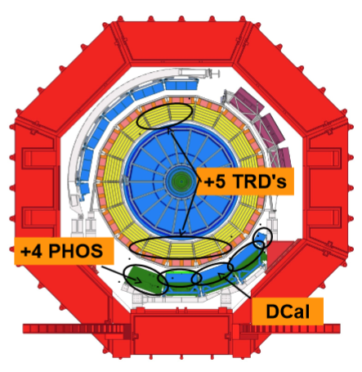
ALICE @ RUN 2
Target - integrated luminosity of 1nb⁻¹ of Pb-Pb collisions (combined RUN 1+RUN 2)
  Consistent with the ALICE approved programme
  Double event rate of TPC/TRD
New detectors installed
  DCAL, +5 TRD modules, +1 PHOS module
Increased capacity of HLT system and DAQ
  Rate up to 8GB/sec peak rate to T0
25% larger raw event size
  Higher track multiplicity with increased beam energy and event pileup
Major demand on resources towards the end of 2015 (Pb-Pb data taking)

Slide 3
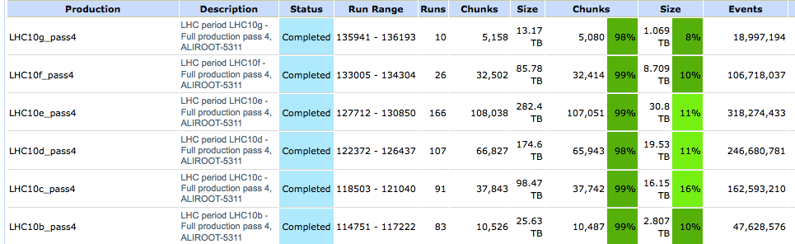
Reprocessing under way
Work on software consolidation for Run2 is completed
  Using TRD in track fit to improve high p_{T} track resolution, TPC dEdx improvements, ITS-TPC-TRD alignment, reduced memory usage
  Validation in progress
Period LHC10 pass 4 is completed
  Very good job completion rate
  Goal is to process all Run 1 data with the same software

Slide 4
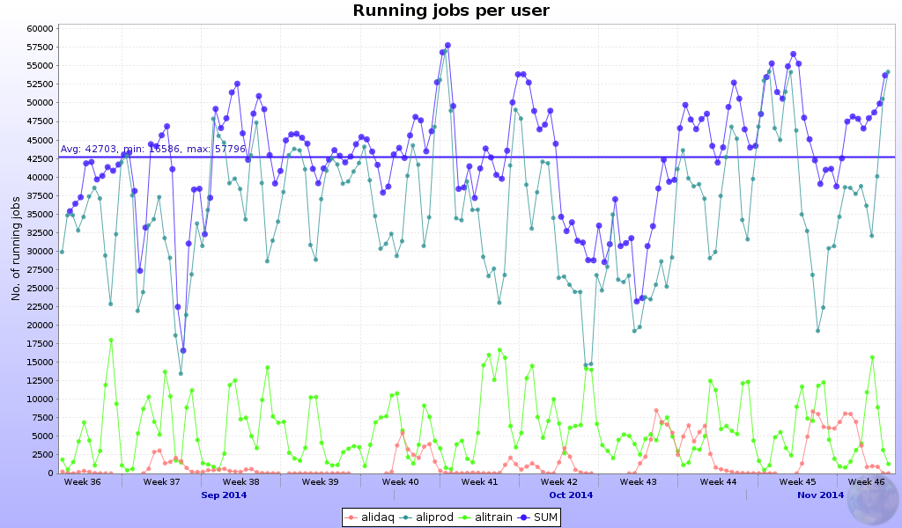
Production status
Very good period, reaching all time highs in terms of running jobs (67k)
Very short of list of MC production ready to run
Steady analysis train and reconstruction activity

Slide 5
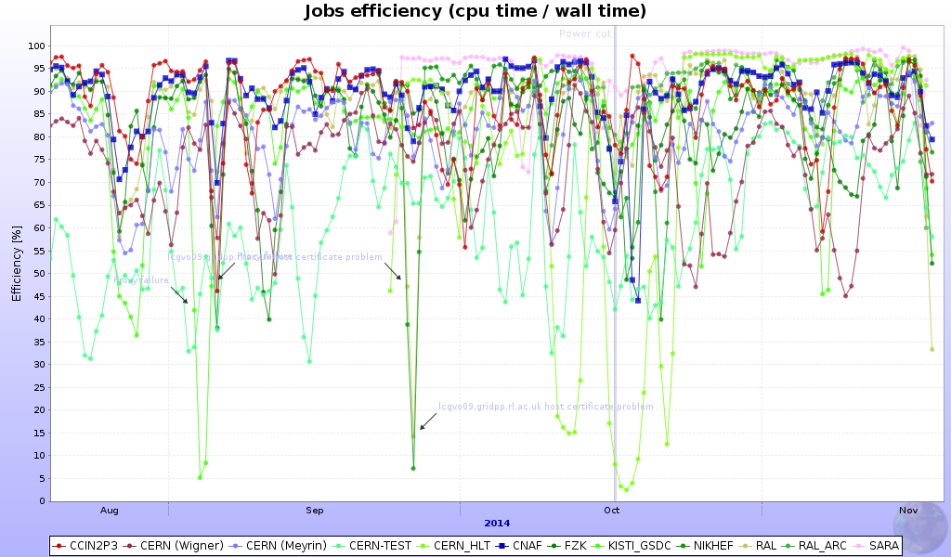
CPU Efficiency (T1s)
Average CPU/wall time efficiency in past 3 months remains over 82%

Slide 6
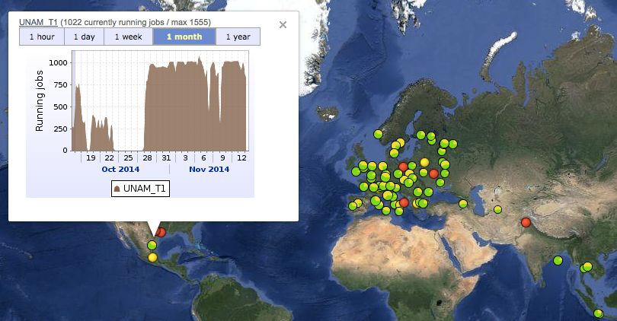
ALICE Grid keeps growing
This month UNAM (Mexico) signed WLCG MoU as T2

Slide 7
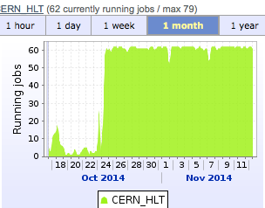
Use of HLT farm for Offline processing
ALICE HLT is relatively small compared to other experiments
  Additional 3% CPU resources
  OpenStack on top of HLT farm at P2
    Side by side operation with HLT
    HLT has priority, VMs are suspended if needed
  Using CernVM, CernVM Online and CVMFS to configure virtual cluster running Condor
  Dedicated VOBOX acts as a gateway between HLT and public network
Similar approach successfully used to create on-demand release validation cluster on CERN Agile Infrastructure

Slide 8
Simulation with Geant4
Two prong approach
  Physics Validation with AliRoot
    Geant4 interfaced via Virtual Monte Carlo (VMC)
  Multi Threading Performance tests with thread safe VMC application
    Based on standard geant4_vmc example
    Use reduced set of AliRoot features allowing for realistic performance tests:
      full AliRoot geometry imported from file
      realistic magnetic field
      realistic event generator
      Basic TPC response (hit) generation and I/O
All tests and validation based on Geant4 v10

Slide 9
Simulation status
Physics Validation
  Main problem TRD response
  Too high mean energy loss leads to unrealistic cluster per tracklet distribution
  testing now simple rescaling
Multi Threading
  Testing suite implemented and running
  performance tests ongoing
  Collaborating with ATLAS to explore contributed resources (i.e. spare CPU cycles on supercomputers)

Slide 10
AliceO2 Framework
https://github.com/AliceO2Group/AliceO2
Re-use the existing building and testing infrastructure in FairRoot
Use the transport layer and Dynamic Deployment Service from AlFa
ITS simulation is implemented in AliceO2
More detectors will follow
Panda
ROOT
. . . . . . .
Cbm
ROOT
AliceO2
FairRoot
AlFa
Libraries and tools

Slide 11
O2 TDR Schedule
  November ’13: Table of Contents, Editorial Committee (EC) membership
  December ‘13: List of contributions from the CWGs
  Feb ‘14 List of all plots, tables and text skeleton
  Apr ’14: Draft 0 of the text for review inside CWGs
  May ’14: Draft 1 for review inside EC
  4th July ‘14: Draft 2 for review inside EC
  1st Sep ‘14: Draft 3 for review inside EC (week 22 September)
  24th -26th Sep ‘14: EC review
  Jan ‘14: Draft 4 for review inside O²
  Feb ‘14: ALICE internal review
  Mar’ 15: early: Final version for editing
  mid : Circulate TDR to the ALICE collaboration
  Apr ’15: end: Submission TDR to LHCC 29 (1 month before)
  Jun ’15 : LHCC meeting

Slide 12
Plans for the next 6 months
Data processing
  Continue RAW data reconstruction on 2011 and 2012/2013 data (p+p and p+Pb)
  Run associated MC – general and PWG specific
  The reprocessing campaign will be completed by April 2015
September 2014 onward – ALICE re-commissioning
  Test of upgraded detectors readout, Trigger, DAQ, new HLT farm
  Full data recording chain, with conditions data gathering
  November-December - cosmics trigger data taking with Offline processing

Slide 13
Summary
Steady operations in the past 3 months
Gradual software and computing infrastructure commissioning leading up to Run2
  Software tuning and tests, close the books on Run 1 data processing
  Test of upgraded detectors readout, Trigger, DAQ, new HLT farm
Resources are adequate to cover the ALICE needs
  Resources request 2015-2017 endorsed by CRSG
Preparations for the ALICE upgrade
  Ongoing work on system design and simulations, software demonstrators
  New software framework for Run 3 is taking shape
  Upgrade TDR for O2 project on track

