Slide 1
Experiment strategies

Slide 2
General
ALICE and LHCb detector upgrades during LS2
➔ Plans for changing computing strategies more advanced
CMS and ATLAS major upgrades for LS3
  Expect Run 3 data is manageable with Run 2 strategies and expected improvements
  Run 4 requires more imaginative solutions and needs R&D

Slide 3

ALICE Upgrade for Run3

Slide 4
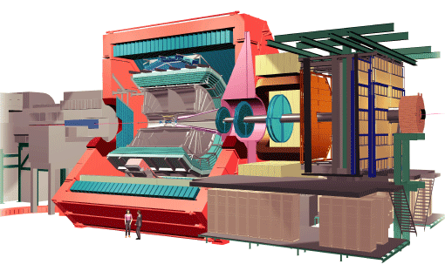
ALICE@Run3
ALICE physics program in Run3 will focus on precise measurements of heavy-flavor hadrons, low momentum quarkonia, and low mass dileptons.
50 kHz (23 MB/event)
O2
Facility@P2
Increased LHC luminosity will result in interaction rates of 50 kHz for Pb-Pb and 200 kHz for p-p and p-Pb collisions.
Several detectors (including TPC) will have continuous readout to address pileup and avoid trigger-generated dead-time.
Online/Offline (O2) Facility at P2 will be tasked with reducing recorded data volume by doing the online reconstruction.
50 kHz (1.5 MB/event)
Storage
75 GB/s (peak)

Slide 5

O2 Facility@P2
Online-Offline facility (02) will provide
  DAQ functionality – detector readout, data transport and event building
  HLT functionality – data compression, clustering algorithms, tracking algorithms
  Offline functionality – calibration, full event processing and reconstruction, up to analysis objects data
Final compression factor x20 (raw data vs data on disk)
Requires the same software to operate in challenging online environment and on the Grid
  Possibly using hardware accelerators (FPGA, GPUs) and operating in distributed heterogeneous computing environment
ALFA software framework (ALICE+FAIR)
  developed in collaboration with the FAIR at GSI

Slide 6
Computing Model
O2 Facility will play the major role in raw data processing
Grid will continue to play important roles
  MC simulation, end-user and organized data analysis, raw data reconstruction (reduced)
  Custodial storage for a fraction of RAW data
Expecting that Grid (CPU & storage) will grow with the same rate (20-25% per year)
Data management and CPU needs for simulation will be the biggest challenges
  O2 Facility will provide a large part of raw data store
  Simulation needs speed up by using new approaches (G4, GV, fast simulation…)

Slide 7


Slide 8
Towards the LHCb Upgrade (Run 3, 2020)
We do not plan a revolution for LHCb Upgrade computing
Rather an evolution to fit in the following boundary conditions:
  Luminosity levelling at 2x10³³
    Factor 5 c.f. Run 2
  100kHz HLT output rate for full physics programme
    Factor 8-10 more than in Run 2
  Flat funding for offline computing resources
Computing milestones for the LHCb upgrade:
  TDR: 2017Q1
  Computing model: 2018Q3
Therefore only brainstorming at this stage, to devise model that keeps within boundary conditions

Slide 9
Evolution of LHCb data processing model
Run 1:
  Loose selection in HLT (no PID)
  First pass offline reconstruction
  Stripping
    selects ~50% of HLT output rate for physics analysis
  Offline calibration
  Reprocessing and Restripping
Run 2:
  Online calibration
  Deferred HLT2 (with PID)
  Single pass offline reconstruction
    Same calibration as HLT
    No reprocessing before LS2
  Stripping and Restripping
    Selects ~90% of HLT output rate for Physics analysis
Given sufficient resources in HLT farm, online reconstruction could be made ~identical to offline

Slide 10
TurboDST: brainstorming for Run 3
In Run 2, Online (HLT) reconstruction will be very similar to offline (same code, same calibration, fewer tracks)
    If it can be made identical, why then write RAW data out of HLT, rather than Reconstruction output?
In Run 2 LHCb will record 2.5 kHz of “TurboDST”
    RAW data plus result of HLT reconstruction and HLT selection
    Equivalent to a microDST (MDST) from the offline stripping
  Proof of concept: can a complete physics analysis be done based on a MDST produced in the HLT?
    i.e. no offline reconstruction
      no offline realignment, reduced opportunity for PID recalibration
    RAW data remains available as a safety net
  If successful, can we drop the RAW data?
    HLT writes out ONLY the MDST ???
Currently just ideas, but would allow a 100kHz HLT output rate without an order of magnitude more computing resources.

Slide 11


Slide 12
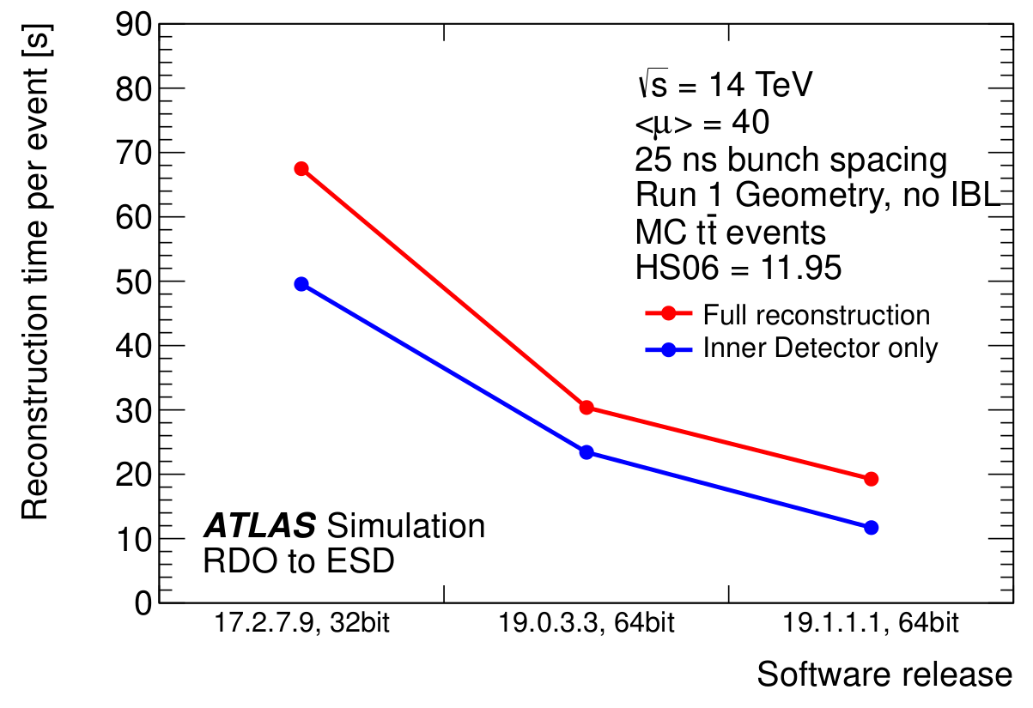
ATLAS Reconstruction
Software Speedup by factor of 3x achieved
  allows to safely operate at 1kHz EF output rate and reconstruct in timely manner at Tier0
Without compromising quality of reco output !
Speedup achieved by:
  Algorithmic improvements; cleanups; Eigen matrix library; Intel math library; switch to 64 bit; SL5→SL6, …
Runs 3 and 4:
  Must efficiently exploit the CPU architectures of 10 years from now → massive multithreading, vectors … → work starts now

Slide 13
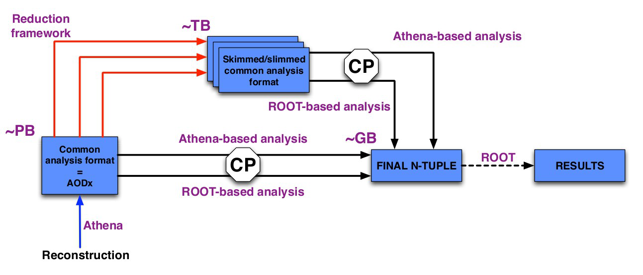
ATLAS: New Analysis Framework
One Format replaces separate Root-readable and Athena-readable formats
Common Reduction Framework and Analysis Framework for all physics groups

Slide 14
ATLAS: Distributed Computing
NEW for Run 2: Distributed Data Management System (Rucio) being commissioned
NEW for Run 2: Production System (ProdSys2 = JEDI + DEFT) being commissioned
NEW for Run 2: Distributed Data Management Strategy:
  All datasets will be assigned a Lifetime (infinite for RAW)
  Disk (versus Tape) residency will be algorithmically managed.
  Builds upon Rucio and ProdSys2 capabilities
  The ATLAS computing model [spreadsheet] has embodied similar concepts for two years.
  The new strategy will be progressively implemented in advance of Run 2
Runs 3 and 4:
  Storage is likely to be even more constrained than CPU
  Build on the New [for Run 2] Distributed Data Management Strategy
  Add dynamic, automated “store versus recompute” decisions.

Slide 15


Slide 16
Resource Needs
CMS is facing a huge increase in the scale of the expected computing needed for Run4
Phase | Pile-Up | HLT Output | Reconstruction time ratio to Run2 | AOD Size ratio to Run2 | Total Weighted Average Increase above Run2
Phase I (2019) | 50 | 1kHz | 4 | 1.4 | 3
Phase II (2024) | 140 | 5kHz | 20 | 3.7 | 65
Phase II (2024) | 200 | 7.5kHz | 45 | 5.4 | 200
The WLCG Computing Model Evolution document predicts 25% processing capacity and 20% storage increase per year
  Factor of 8 in processing and 6 in storage between now and Run4
  Even assuming a factor of 2 code improvements the deficit is 4-13 in processing and 4-6 in storage

Slide 17
Targets for improvements
It is unlikely we will get a factor of 5 more money, nor will the experiment be willing to take a factor of 5 less data
  Big improvements are needed
Roughly 40% of the CMS processing capacity is devoted to task identified as reconstruction
  Prompt reconstruction, re-reconstruction, data and simulation reco
    Looking at lower cost and lower power massively parallel systems like ARM and high performance processors like GPUs (Both can lower the average cost per processing)
~20% of the offline computing capacity is in areas identified as selection and reduction
  Analysis selection, skimming, production of reduced user formats
    Looking at dedicated data reduction solutions like event catalogs and big data tools like Map Reduce
The remaining 40% is a mix
  Lot of different activities with no single area to concentrate optimization effort
    Simulation already has a strong ongoing optimization effort
    User analysis activities developed by many people
    Smaller scale calibration and monitoring activities

Slide 18
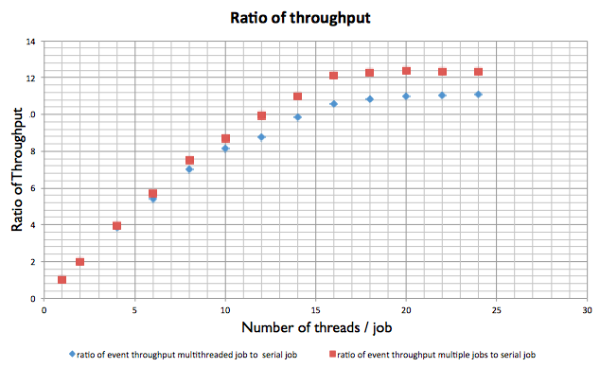
Improvements in Processing and Selection
In order to exploit new hardware investment is needed in parallelization
    CMS has already achieved >99% parallel safe code and has excellent efficiency up to 8 cores
https://indico.cern.ch/event/258092/session/7/contribution/93/material/slides/0.pdf]
CMS maintains as open as possible triggers and datasets are reduced to optimized selections for particular activities
  Nearly all the selections are serial passes through the data by users and groups
    Relies on multiple distributed copies and many reads of each event
  Techniques that reuse the selections can reduce the total processing needed

