Slide 1


Pre-Buncher Design
Mohsen Dayyani Kelisani

Slide 2
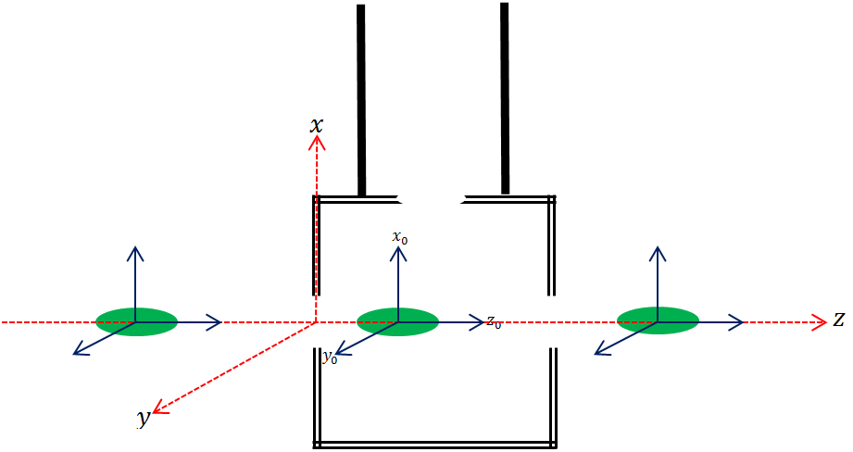
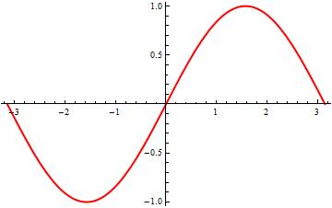




Standing Wave Cavity
$$ν_{c}=0.9995GHz$$
$$5A−140μS Puls$$
$$\left\{\begin{aligned}ν_{b}=0.5GHz \\ β=0.62 \\ h=0.57 \end{aligned}\right.$$
$$L=5cm ,V_{c}=60kV$$

Slide 3
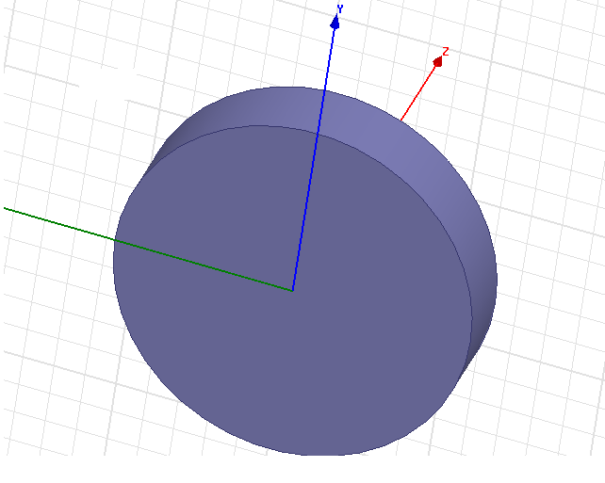
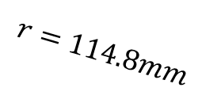
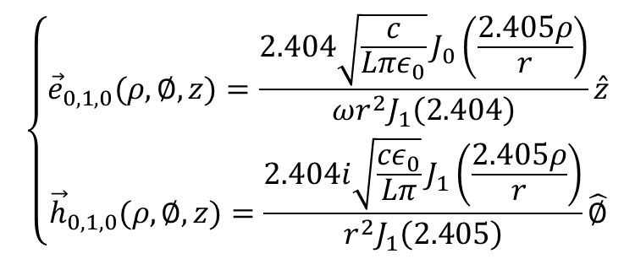
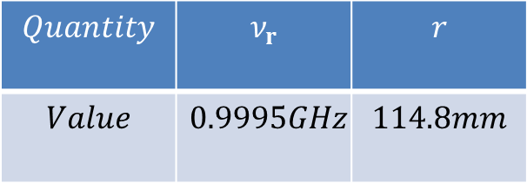
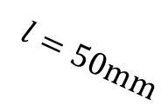
Pill Box Cavity-TM010 mode
$$\left\{\begin{aligned}{\vec{e}}_{0,1,0}(ρ,∅,z)=\frac{2.404\sqrt{\frac{c}{Lπε_{0}}}J_{0}\left(\frac{2.405ρ}{r}\right)}{ωr^{2}J_{1}\left(2.404\right)}\hat{z} \\ {\vec{h}}_{0,1,0}(ρ,∅,z)=\frac{2.404i\sqrt{\frac{cε_{0}}{Lπ}}J_{1}\left(\frac{2.405ρ}{r}\right)}{r^{2}J_{1}\left(2.405\right)}\hat{∅}\end{aligned}\right.$$
$$Quantity$$ | $$ν_{r}$$ | $$r$$
$$Value$$ | $$0.9995GHz$$ | $$114.8mm$$
$$l=50\text{mm}$$
$$r=114.8mm$$

Slide 4
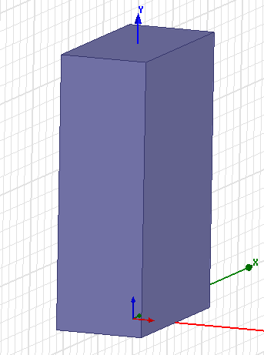
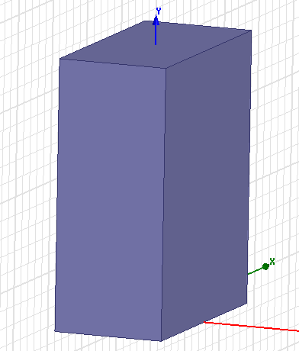
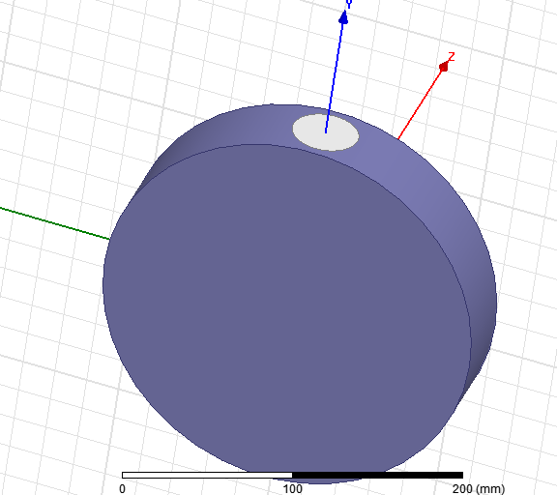
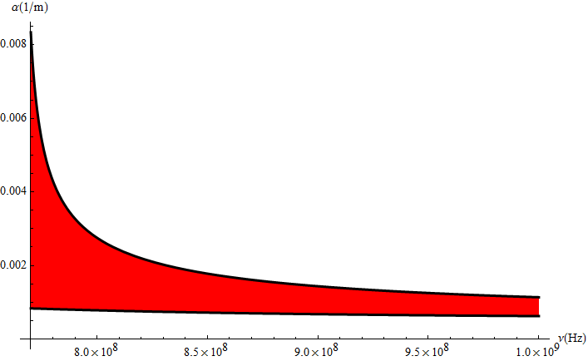
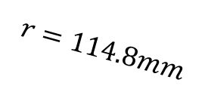




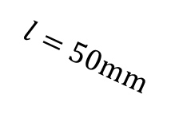
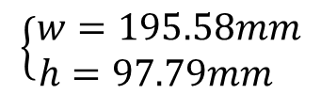
Waveguide-Cavity Connection
WR770
$$\left\{\begin{aligned}w=195.58mm \\ h=97.79mm \end{aligned}\right.$$
WR975
$$r_{a}$$
$$\left\{\begin{aligned}w=247.65mm \\ h=123.825mm\end{aligned}\right.$$
$WR770$
$$l=50\text{mm}$$
$$r=114.8mm$$
$WR975$

Slide 5
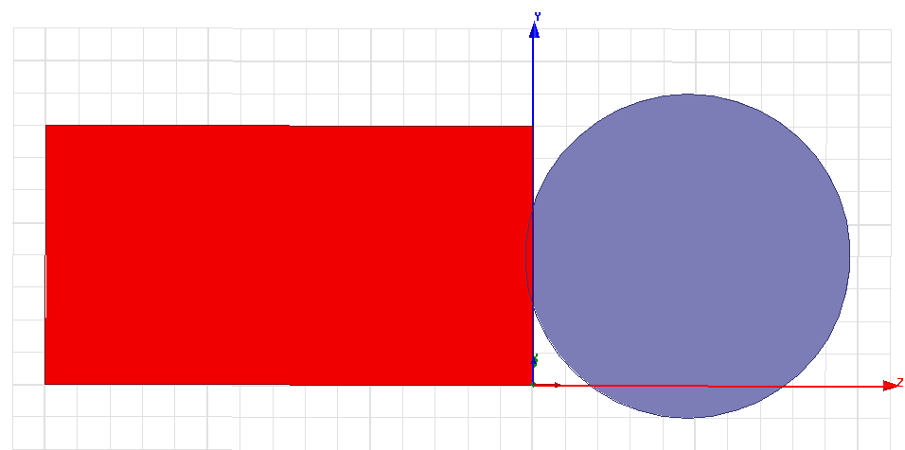

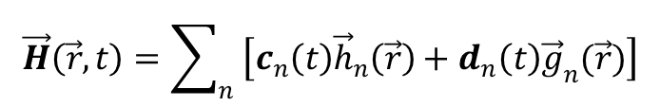

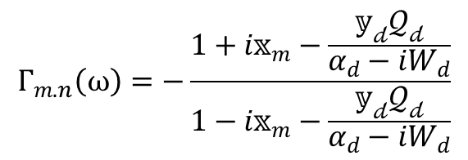
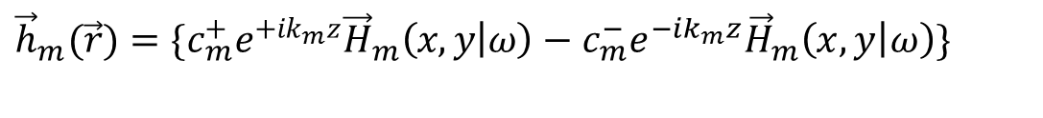
Perturbation approach
$$(1)$$
$$(2)$$
$$\vec{H}\left(\vec{r},t\right)=\sum_{n}{\left[c_{n}\left(t\right){\vec{h}}_{n}\left(\vec{r}\right)+d_{n}\left(t\right){\vec{g}}_{n}(\vec{r})\right]}$$
$${\vec{h}}_{m}(\vec{r})=\{c_{m}^{+}e^{+ik_{m}z}{\vec{H}}_{m}\left(x,y | ω\right)−c_{m}^{−}e^{−ik_{m}z}{\vec{H}}_{m}\left(x,y | ω\right)\}$$
$$Γ_{m.n}\left(ω\right)=−\frac{1+i𝕩_{m}−\frac{𝕪_{𝒹}𝒬_{𝒹}}{α_{d}−iW_{d}}}{1−i𝕩_{m}−\frac{𝕪_{𝒹}𝒬_{𝒹}}{α_{d}−iW_{d}}}$$
Perturbation

Slide 6
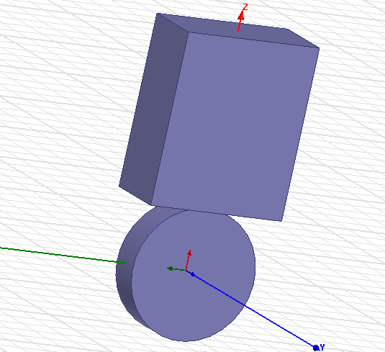
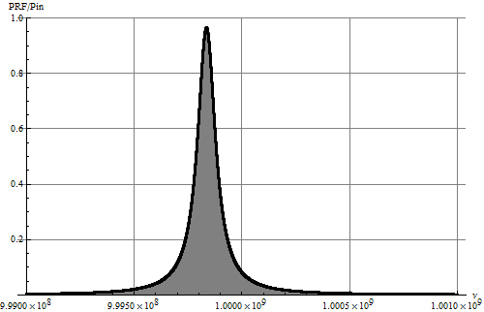

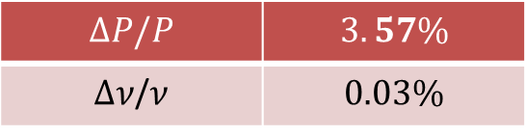
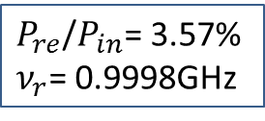

Perturbation and Simulation Comparison
$$ν_{r}$$ | $$0.9995GHz$$
$$r_{c}$$ | $$114.5mm$$
$$r_{a}$$ | $$20mm$$
$$P_{re}$$ | $$0$$
Perturbation values
$P_{re}$/$P_{in}$= 3.57%
$ν_{r}$= 0.9998GHz
$$∆P/P$$ | $$3.57\%$$
$∆ν$/$ν$ | $$0.03\%$$

Slide 7
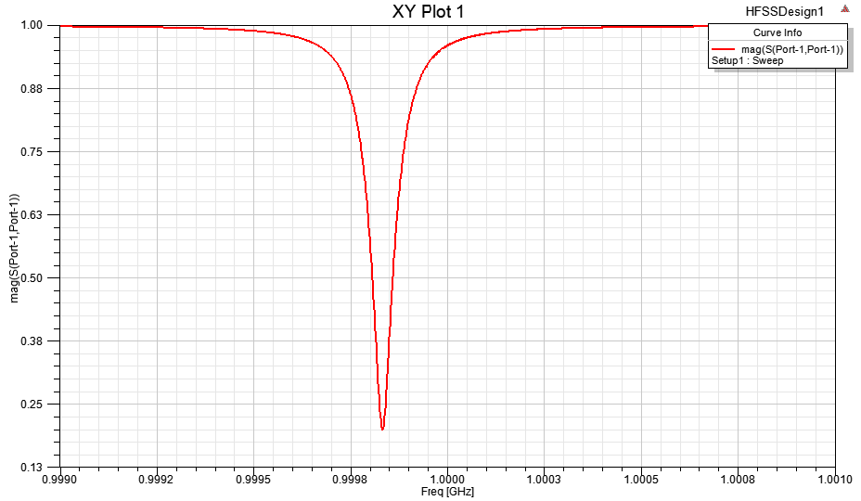
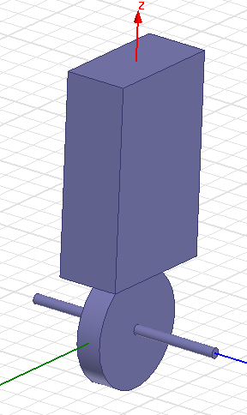

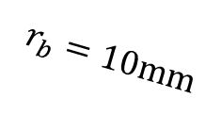
Beam Pipe Connection
0.9995GHz
$$r_{b}=10\text{mm}$$
$$r_{c}$$

Slide 8
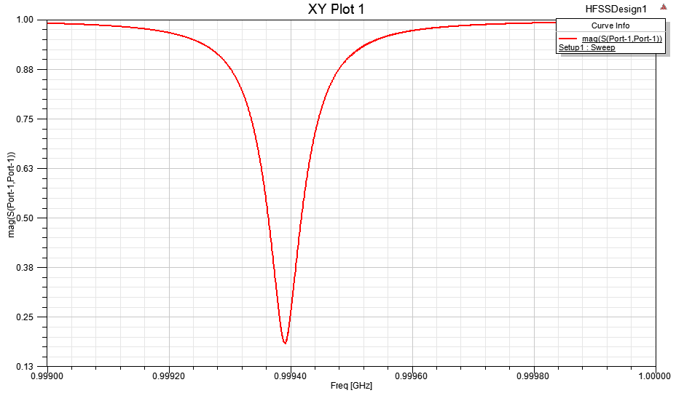
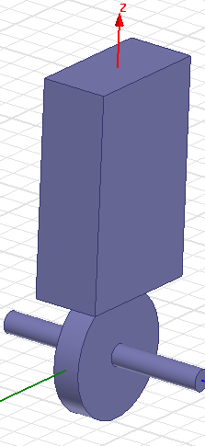

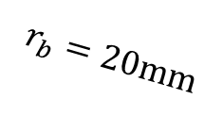
Beam Pipe Connection
0.9995GHz
$$r_{b}=20\text{mm}$$
$$r_{c}$$

Slide 9
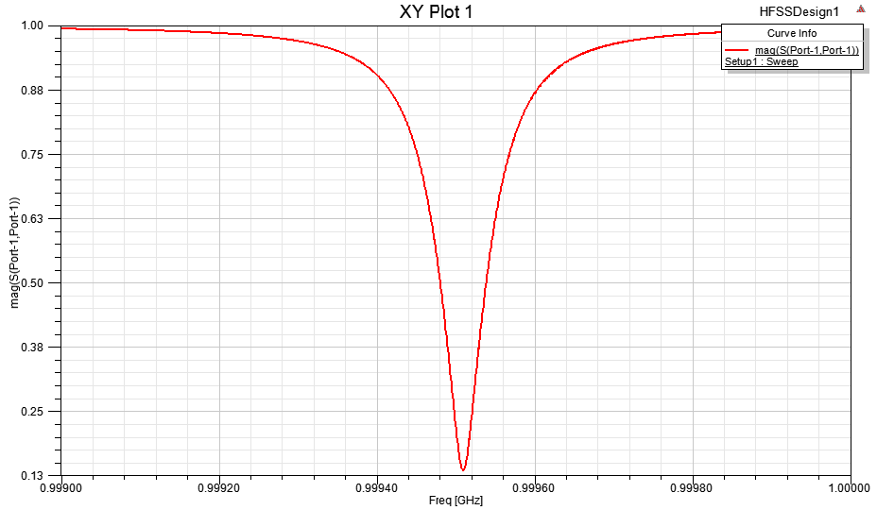
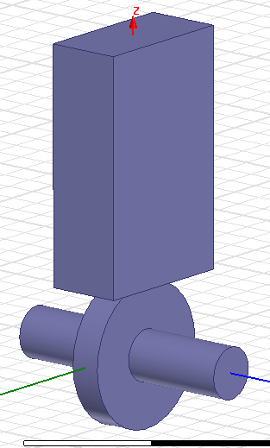


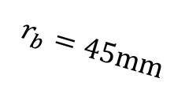


Beam Pipe Connection
$$r_{a}=20.4\text{mm}$$
$ν_{r}=0.99951$ GHz
$${P_{re}/P}_{in}=1.8 \%$$
0.9995GHz
$$r_{b}=45\text{mm}$$
$$r_{c}$$

Slide 10







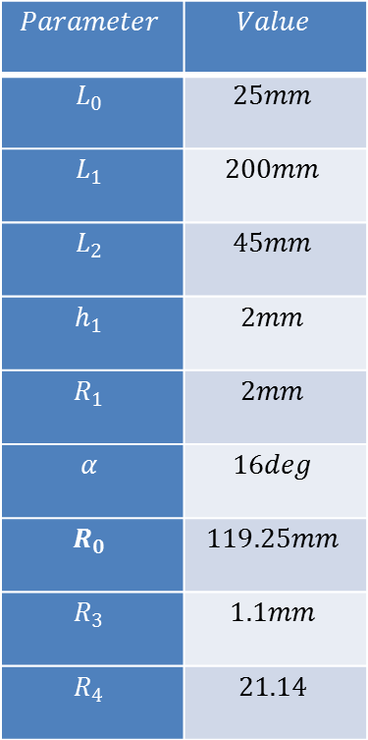











Cavity Optimization
$$Parameter$$ | $$Value$$
$$L_{0}$$ | $$25mm$$
$$L_{1}$$ | $$200mm$$
$$L_{2}$$ | $$45mm$$
$$h_{1}$$ | $$2mm$$
$$R_{1}$$ | $$2mm$$
$$α$$ | $$16deg$$
$$R_{0}$$ | $$119.25mm$$
$$R_{3}$$ | $$1.1mm$$
$$R_{4}$$ | $$21.14$$
$$R_{3}$$
$$R_{4}$$
$$L_{6}$$
$$R_{2}$$
$$h_{5}$$
$$β$$
$$R_{0}$$
$$h_{4}$$
$$h_{3}$$
$$L_{3}$$
$$R_{1}$$
$$α$$
$$L_{2}$$
$$h_{2}$$
$$L_{0}$$
$$L_{1}$$

Slide 11
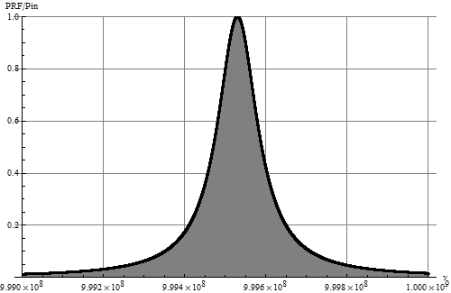
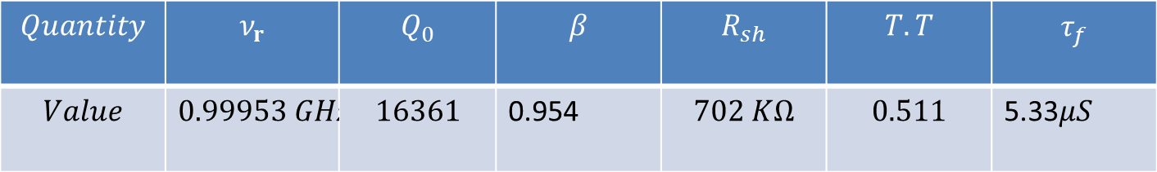



$$Quantity$$ | $$ν_{r}$$ | $$Q_{0}$$ | $$β$$ | $$R_{sh}$$ | $$T.T$$ | $$τ_{f}$$
$$Value$$ | $$0.99953 GHz$$ | $$16361$$ | 0.954 | $$702 KΩ$$ | $$0.511$$ | 5.33$μS$
$${P_{re}/P}_{in}=0.06\%$$
$$P_{g}=5.125kW$$
$$V_{c}=60kV$$
0.9995GHz

Slide 12
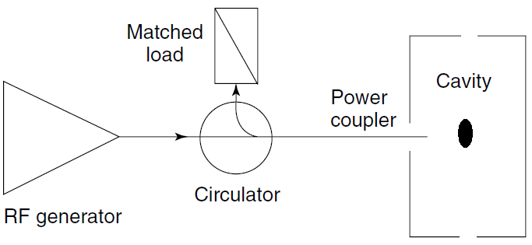
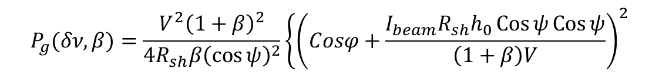
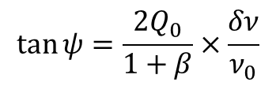
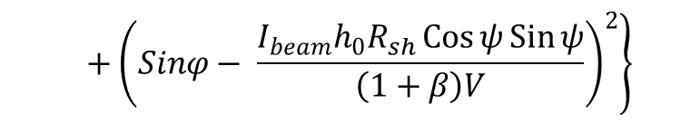
Beam Loading Effect
$$P_{g}(δν,β)=\frac{V^{2}{\left(1+β\right)}^{2}}{4R_{sh}β{\left(\cos{ψ}\right)}^{2}}{\left\{\left(Cosφ+\frac{I_{beam}R_{sh}h_{0}\operatorname{Cos}{ψ}\operatorname{Cos}{ψ}}{\left(1+β\right)V}\right)\right.}^{2}$$
$$\left. +{\left(Sinφ− \frac{I_{beam}h_{0}R_{sh}\operatorname{Cos}{ψ}\operatorname{Sin}{ψ}}{\left(1+β\right)V}\right)}^{2}\right\}$$
$$\tan{ψ}=\frac{{2Q}_{0}}{1+β}×\frac{δν}{ν_{0}}$$

Slide 13
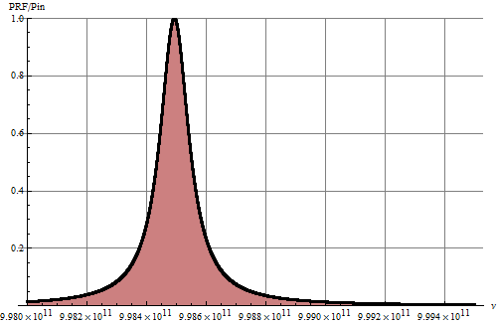

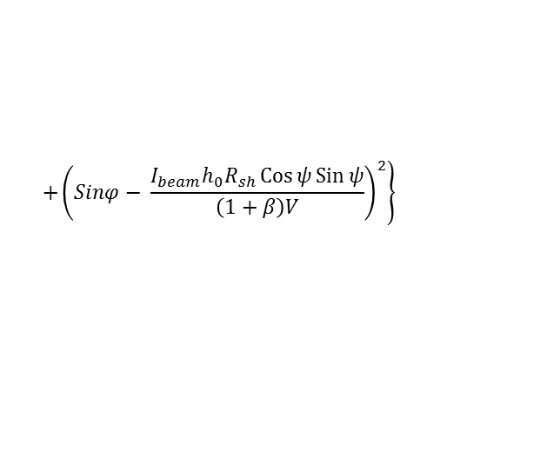
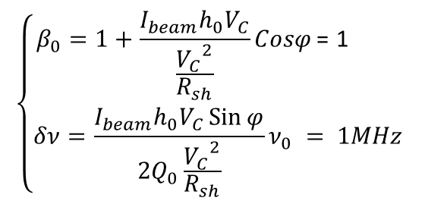
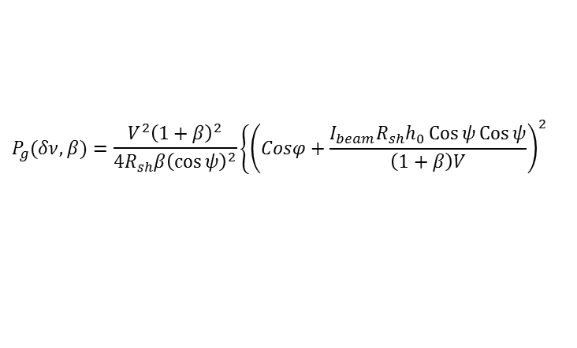


Beam Loading Compensation
$$\left\{\begin{aligned}β_{0}=1+\frac{I_{beam}h_{0}V_{C}}{\frac{{V_{C}}^{2}}{R_{sh}}}Cosφ\text{ = 1} \\ δν=\frac{I_{beam}h_{0}V_{C}\operatorname{Sin}{φ}}{2Q_{0}\frac{{V_{C}}^{2}}{R_{sh}}}ν_{0} = 1MHz \end{aligned}\right.$$
$$P_{g}(δν,β)=\frac{V^{2}{\left(1+β\right)}^{2}}{4R_{sh}β{\left(\cos{ψ}\right)}^{2}}{\left\{\left(Cosφ+\frac{I_{beam}R_{sh}h_{0}\operatorname{Cos}{ψ}\operatorname{Cos}{ψ}}{\left(1+β\right)V}\right)\right.}^{2}$$
$$\left. +{\left(Sinφ− \frac{I_{beam}h_{0}R_{sh}\operatorname{Cos}{ψ}\operatorname{Sin}{ψ}}{\left(1+β\right)V}\right)}^{2}\right\}$$
$$β=0.924$$
$$P_{g}=5.136kW$$
$$V_{c}=60kV$$
0.9985GHz
0.9995GHz

Slide 14
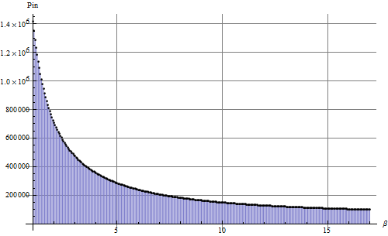
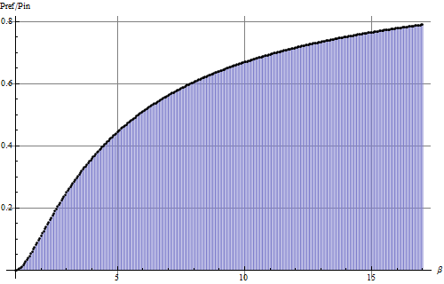



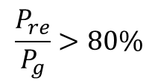

Beam Loading Compensation
Minimization Constraint: $\left|δν\right|≤0.1 × BW$
$$P_{g}<100kW$$
$$β>17$$
$$β>17$$
$$\frac{P_{re}}{P_{g}}>80\%$$

Slide 15
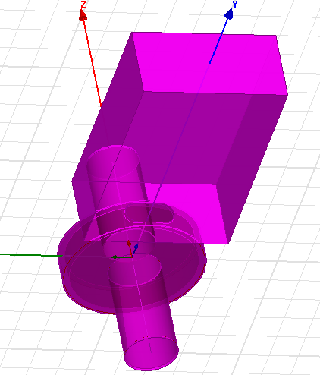
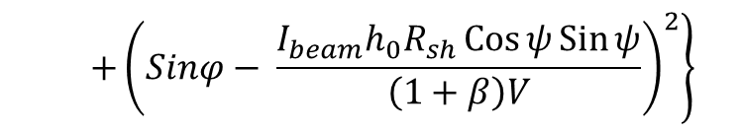
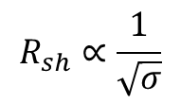



$$P_{g}(δν,β)=\frac{V^{2}{\left(1+β\right)}^{2}}{4R_{sh}β{\left(\cos{ψ}\right)}^{2}}{\left\{\left(Cosφ+\frac{I_{beam}R_{sh}h_{0}\operatorname{Cos}{ψ}\operatorname{Cos}{ψ}}{\left(1+β\right)V}\right)\right.}^{2}$$
$$\left. +{\left(Sinφ− \frac{I_{beam}h_{0}R_{sh}\operatorname{Cos}{ψ}\operatorname{Sin}{ψ}}{\left(1+β\right)V}\right)}^{2}\right\}$$
$$P_{g}(δν,β)∝\frac{1}{R_{sh}}$$
$$R_{sh}∝\frac{1}{\sqrt{σ}}$$
$$σ_{Cu} =7 ×σ_{Steel}$$
To have coupling factor bigger than 1 we should use other shape of aperture
Perturbation

Slide 16







Beam Loading Compensation
Minimization Constraint: $\left|δν\right|≤0.1 × BW$
$$β=4.4$$
$$δν=0.11MHz$$
$$P_{g}=97.323 kW$$
$$β=4.4$$
$$\frac{P_{re}}{P_{g}}=39\%$$

Slide 17








$$β=4.4$$
$$Parameter$$ | $$Value$$
$$R_{0}$$ | $$120.35mm$$
$$R_{1}$$ | $$45mm$$
$$R_{2}$$ | $$39mm$$
$$R_{3}$$ | $$84mm$$
$$δν=0.11MHz$$
$$R_{0}$$
$$R_{2}$$
$$R_{3}$$
$$R_{1}$$

Slide 18





$$Quantity$$ | $$ν_{r}$$ | $$Q_{0}$$ | $$β$$ | $$R_{sh}$$ | $$T.T$$ | $$τ_{f}$$
$$Value$$ | $$0.9994 GHz$$ | $$2371$$ | 4.675 | $$92.5 KΩ$$ | $$0.498$$ | 0$.27μS$
$$β=4.675$$
$$P_{g}=97.953kW$$
$$V_{c}=60kV$$
0.9994GHz

Slide 19


