Slide 1


CLIC Drive Beam Injector Design
Shahin Sanaye Hajari
Institute For Research in Fundamental Science (IPM), Tehran, Iran
CERN, Geneva, Switzerland

Slide 2
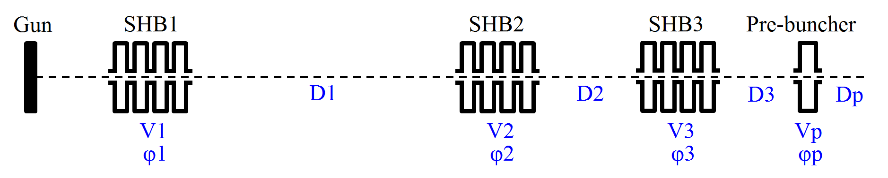
1. Sub-harmonic bunching system 1
1. Sub-harmonic bunching system and Pre-buncher
1.1 General layout
1.2 Parameters
Component | Voltage(kV) | Length(cm) | Drift space(cm)
SHB1 | 15 | 50 | 175
SHB2 | 30 | 50 | 50
SHB3 | 45 | 50 | 45
Pre-buncher | 60 | 5 | 20

Slide 3
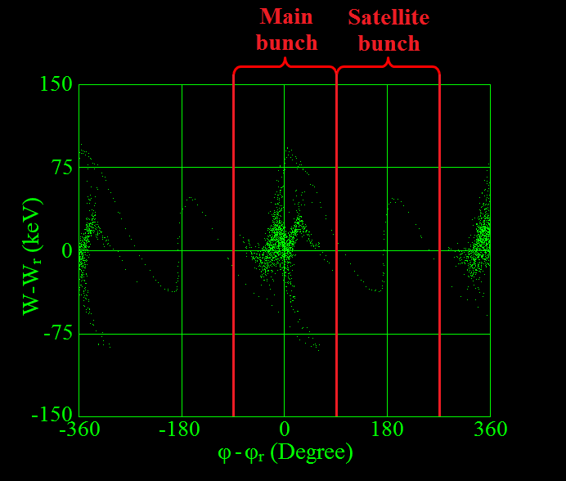
1. Sub-harmonic bunching system 2
1. Sub-harmonic bunching system and Pre-buncher
1.3 Beam parameters and the phase space
Beam current(A) | 5
Beam energy(keV) | 140
Satellite population(%) | 3.1

Slide 4
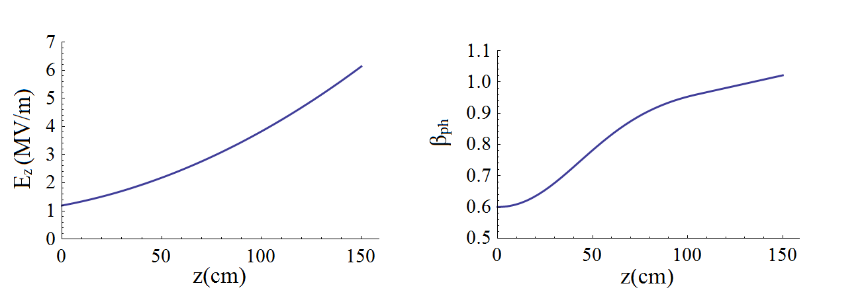

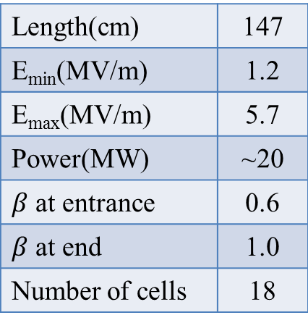
2. Travelling wave tapered buncher 3
2. Travelling wave tapered buncher
2.1 Buncher parameters
Length(cm) | 147
E_{min}(MV/m) | 1.2
E_{max}(MV/m) | 5.7
Power(MW) | ~20
$β$ at entrance | 0.6
$β$ at end | 1.0
Number of cells | 18

Slide 5
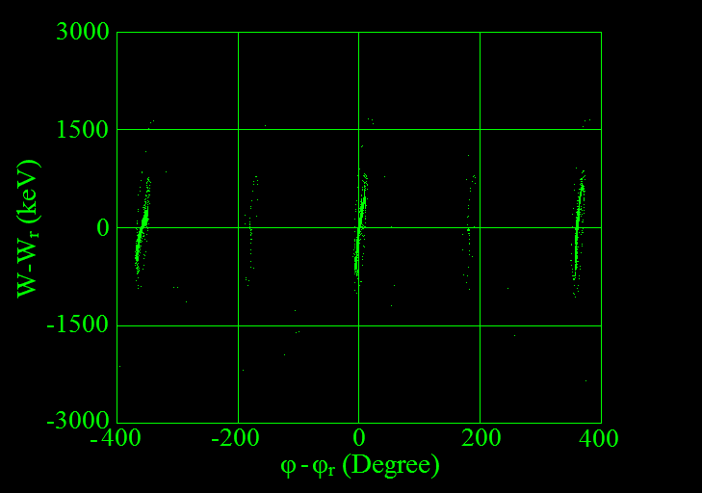
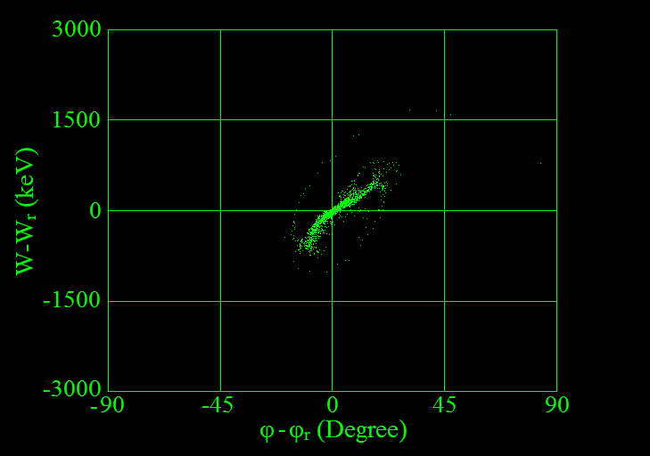
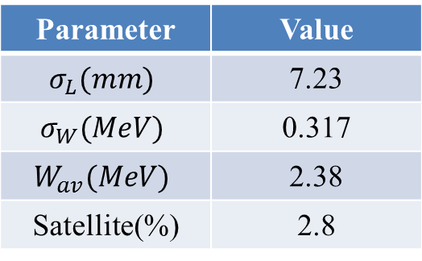
2. Travelling wave tapered buncher 4
2. Travelling wave tapered buncher
2.2 Beam parameters and the phase space
Parameter | Value
$$σ_{L}(mm)$$ | 7.23
$$σ_{W}(MeV)$$ | 0.317
$$W_{av}(MeV)$$ | 2.38
Satellite(%) | 2.8

Slide 6
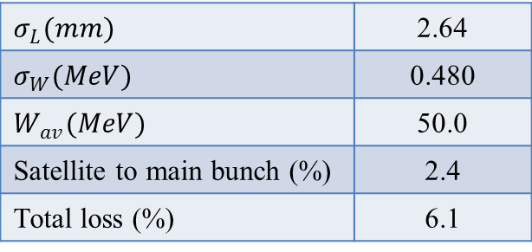
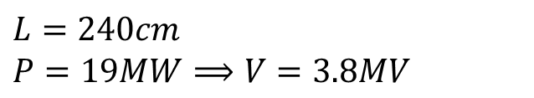
2. Travelling wave tapered buncher 5
3. Accelerating structures
3.1 Linac parameters
$$L=240cm$$
$$P=19MW⟹V=3.8MV$$
3.2 Magnetic chicane
Beam loss at chicane = 3.9%
3.3 Beam parameters at the end of injector
$$σ_{L}(mm)$$ | 2.64
$$σ_{W}(MeV)$$ | 0.480
$$W_{av}(MeV)$$ | 50.0
Satellite to main bunch (%) | 2.4
Total loss (%) | 6.1

Slide 7
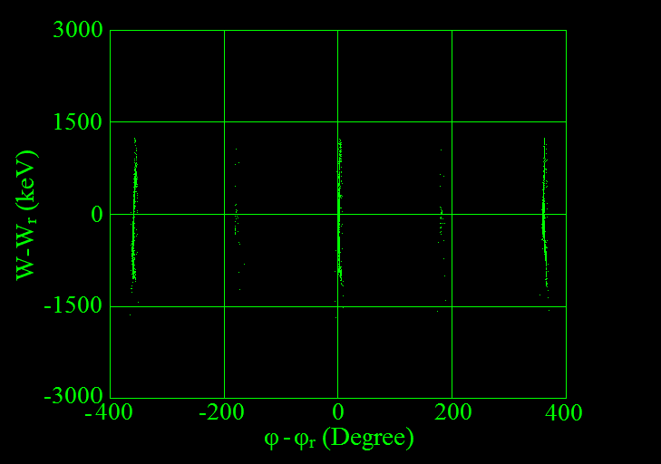
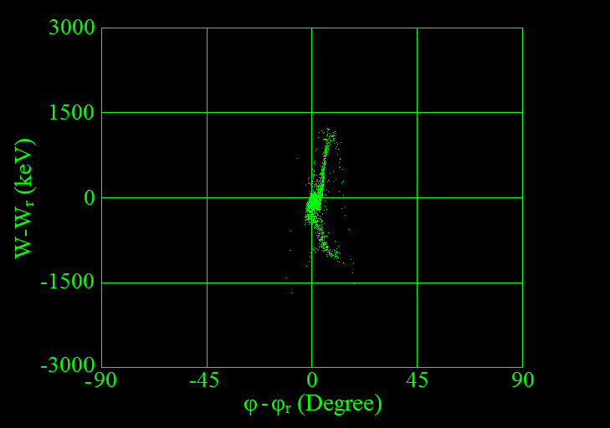
2. Travelling wave tapered buncher 6
3. Accelerating structures
3.4 The final phase space

Slide 8
Thanks for your attention

